Slide 1
BREAST DISEASES
DR. AHMED KHAN
MBBS, FCPS.
Assoc.Professor of Surgery

Slide 2
Anatomy of the Breast
Located between the subcutaneous fat and the fascia of the pectoralis major and serratus anterior muscles.
Extend to the clavicle above ,laterally to axilla and latissimus dorsi, medially to sternum and inferiorly to the top of the rectus muscle (inframamry crease).
Axillary tail blends with axillary fat.
Lymphatics: interlobular lymphatic vessels to a subareolar plexus (Sappey's plexus), 75% of the lymph drains into the axillary lymph nodes.
Medial breast drain into the internal mammary or the axillary nodes.

Slide 3
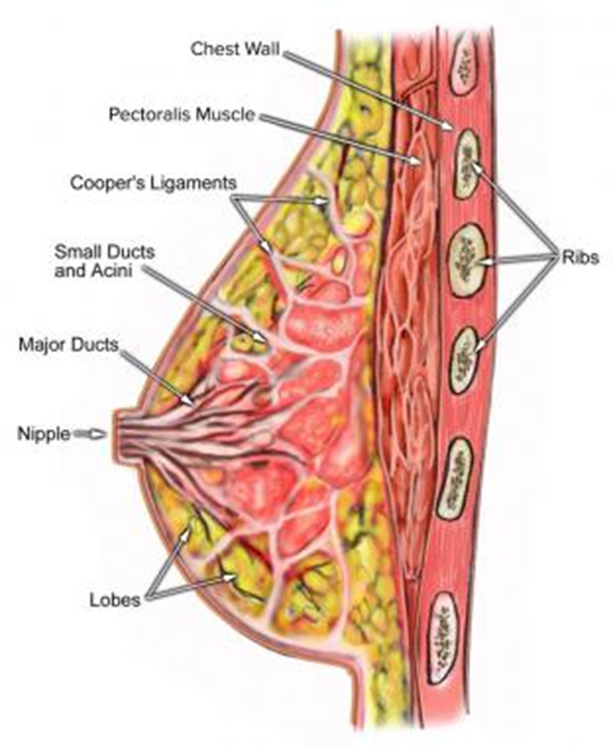
Anatomy
Made up of milk producing glands.
Arranged into units known as lobules.
Glands connected via ducts that join to form a common drainage path, terminating at the nipple.
The nipple is surrounded by a ring of pigmented tissue- areola.
Fibro-elastic and fatty tissue provide support for the rest of the structure.

Slide 4
Axillary Lymph Nodes
Level I: Lateral to the pectoralis minor muscle. Usually involved first.
Level II: Posterior to the pectoralis minor muscle.
Level III: Medial to the pectoralis minor muscle.
Rotter's nodes: Between the pectoralis major and the minor muscles.

Slide 5
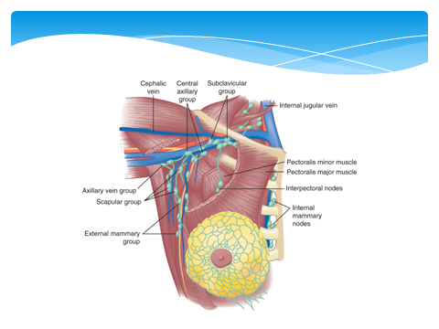

Slide 6
Physiology
Composed of glandular tissue, fibrous supporting tissue and fat.
Functional unit: Terminal duct, lobular unit.
Secretion from lobular unit drain by 12-15 major subareolar ducts.
Rest: Terminal duct lobular unit secrete watery fluid which is reabsorbed.
Pregnancy: Lobules & ducts proliferate.
Delivery reduces circulating estrogen and increases sensitivity to prolactin.
Suckling stimulates prolactin & oxytocin- ejection of milk.
Involution starts after 30- atrophy of glandular and fibrous tissue

Slide 7
Evaluation of Patients with Breast Disease
Common complaints:
Lump ( most common)
Pain/ tenderness (Mastalgia)
Change in the breast size/ skin (redness, Peau d’orange)
Change in the nipple
Discharge from the nipple

Slide 8
Imaging for Breast Disease Mammography
A high resolution x-ray taken in 2 views- medio-lateral oblique (MLO) & cranio-caudal (CC).
Abnormalities: architectural distortion, nodularity, mass, stellate lesion, microcalcifications, skin retraction, nipple changes and duct changes.

Slide 9
- Calcifications ranging from:
- benign involutional changes to suspicious
- suspicious micro-calcifications:
- pleomorphic, clustered, linear or branching
(spiculated)
- Benign calcifications tend to be larger, more regular,
white spots or flecks

Slide 10
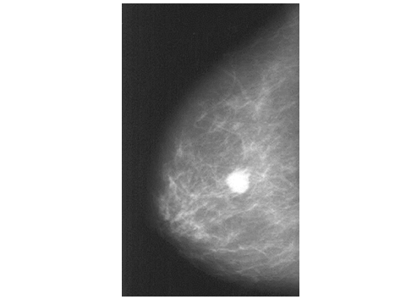

Slide 11
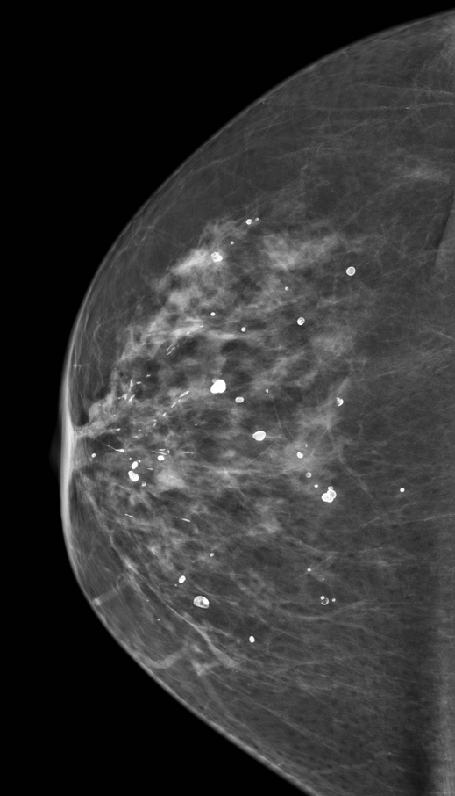
Mammogram showing: (A) Benign calcifications (B) a carcinoma.

Slide 12
BI-RADS
(Breast Imaging Reporting and Database System) scores:
0 = Needs further imaging; assessment
incomplete.
1 = Normal
2 = Benign lesion
3 = Probably benign lesion; needs 4 to 6 months follow-up
(risk of malignancy: 1% to 2%).
4 = Suspicious for breast cancer; biopsy recommended (risk of
malignancy: 25% to 50%).
5 = Highly suspicious for breast cancer; biopsy required
(75% to 99% are malignant).
6 = Known biopsy-proven malignancy.

Slide 13
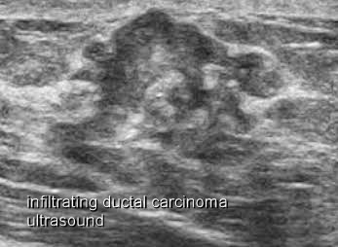
Ultrasonography & MRI
Ultrasonography
- Diff: Solid and cystic lesions.
- Benign- smooth outline.
- Malignant-
- irregular indistinct outline,
- hypoechoic due to high cellularity compared to
surrounding normal tissue.
MRI: - High sensitivity for breast cancer.
- Used for screening high risk women.
- Optimum method of imaging breast implants and
detecting implant leakage or rupture
- Recurrent diseases

Slide 14
Biopsy
FNAC: Aspirate cells for cytology.
  Fluid from cysts.
  Cannot differentiate invasive from insitu cancers.
  Helps detect metastasis in lymph nodes.
  Not popular now.
Core biopsy: Multiple cores of tissue removed by core needle from suspected lesion for study.
Open biopsy: Core biopsy inconclusive or benign lesions.

Slide 15
Core biopsy

Slide 16
Sentinel Lymph Node Biopsy
The SLN is defined as the first node in the lymphatic basin that drains the lesion.
It is the node at greatest risk of the development of metastases.
Used to identify metastatic lymph node (LN) in axilla in diagnosed breast carcinoma patients.
“Isotope with dye” is injected at tumor site and subsequently detected by scintigraphy in axillary LN.
Identified LN is examined for metastasis.
Positive SLN: Full axillary dissection done to remove LNs
Negative SLN: No axillary dissection.

Slide 17
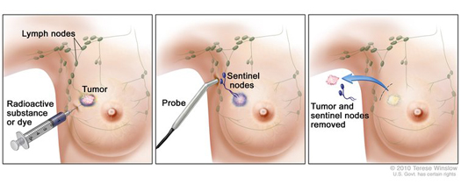

Slide 18
Frozen Section
During surgery the suspected mass or LN is submitted to laboratory to determine histological nature of the suspected tissue.
Rarely used now.

Slide 19
Diseases of the Breast

Slide 20
Benign Disorders
Breast Infection (Abcesses)
Lactational & non-lactational.
Lactational: Lactating women.
Staphylococcus aureus.
Pain, swelling & tenderness.
Milk drainage from affected segment is reduced promoting infection.
Fluocloxacillin 500mg 6 hourly for early stage.
Abscess- repeated aspiration or incision- drainage.

Slide 21
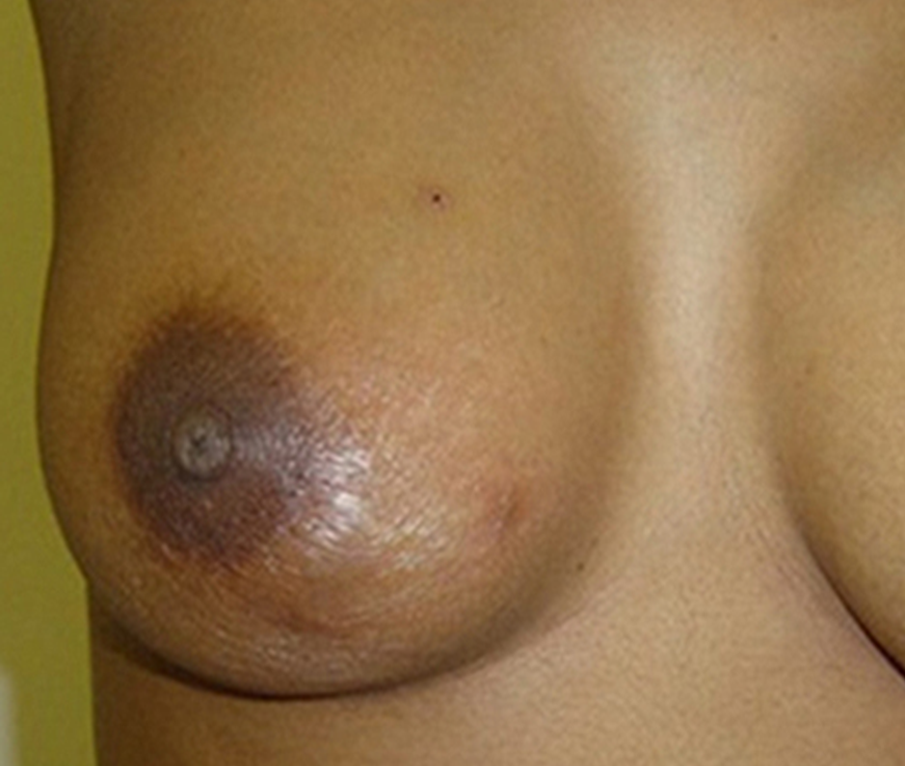

Slide 23

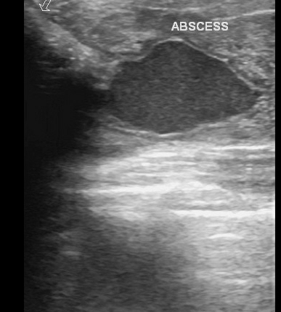
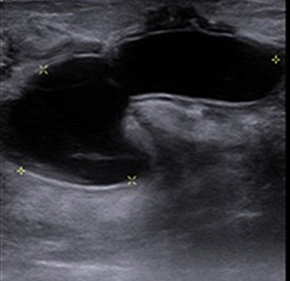

Slide 24
Non-lactational Breast Infection
Periareolar infection:
Young female, smokers(90%) with underlying periductal mastitis.
Presentation: Pain, peri-areolar swelling, tenderness and
nipple retraction(slit)
Treatment: Antibiotics- Augmentin( 375 mg 8 hr.), clarithromycin+ metronidazole.
Abscess- aspiration (small) or drainage (large)
Recurrence common. May develop duct fistula.
Surgical excision of the affected duct- in recurrent disease
Peripheral abscess:
Uncommon. Treated by antibiotics and aspiration/ drainage

Slide 25
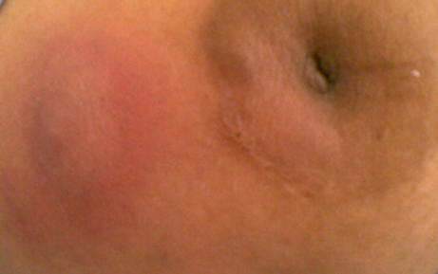
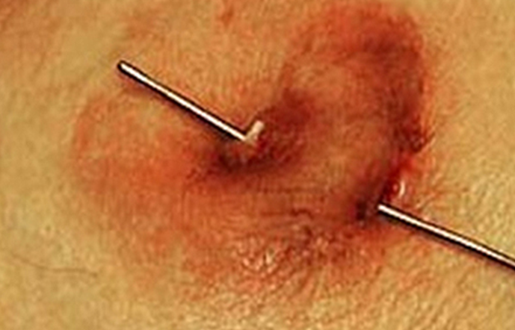

Slide 26
Benign Disorders
Fibroadenoma
15-25 years age group.
Typical features: Well-circumscribed, smooth, firm,
Freely mobile mass.
May be multiple or bilateral.
Some may increase in size. > 5cm- giant fibroadenoma.
1/3rd may regress spontaneously.
U/S- smooth outline mass.
Management: Diagnose by core biopsy.
<4cm- Reassurance and follow up.
>4cm- excision.

Slide 27
 | Hard Peri-canalicular Firoadenoma | Soft Intra-Canalicular Fibroadenoma
Incidence | MORE COMMEN | LESS COMMEN
Age | 15-30 | 30-50
Pathology | Small mass surronded by 2 cpsules: - True & false capsules | Soft large lobulated mass & may reach a large size. Capsule not well formed
Malignant Change | NEVER CHANGE | MAY SHOW SARCOMATOUS
Clinical Pictures | - Mass(2.5cm, oval, smooth, may be lobulated, attached to surrounded structure, well defined edges, freely mobile, grows slowly, single, bilateral). - No palpable L.N | - Soft with area of cystic formation, grows rapidly , huge size, (giant fibroadenoma) May occupy whole breast, mobile, not attached to surrounding structure. No axillary L.N
 | Enucleated | Small …excision Large…simple mastectomy
Cutting | By knife feel easy | There is resistance Gritty sensation
Color | Pinkish | Grayish-white
Cut surface | Bulges during cutting bec. It was imprisoned by capsule | Retract during cutting due to fibrosis
Capsular | Well encapsulated | Infiltrate the tissue around- No capsule

Slide 28
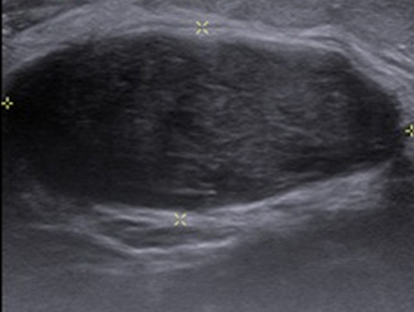

Slide 29
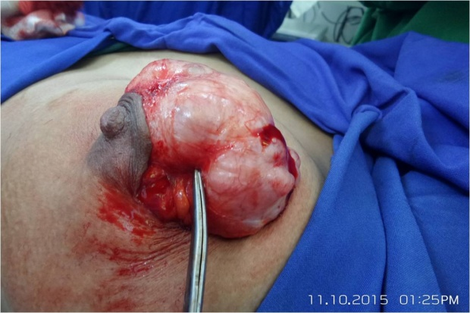
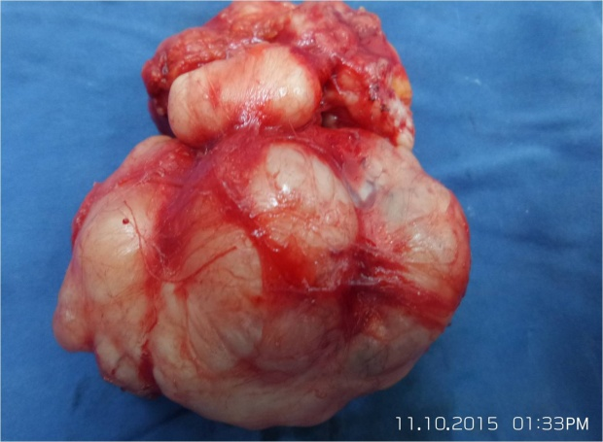
Giant fibroadenoma is an uncommon benign tumor in adolescent girls

Slide 30
Benign Disorders
Disorder of Cyclical Change
Previously known as “fibroadenosis or fibrocystic disease”.
Symptoms: Cyclical mastalgia
Signs: Focal or diffuse nodularity
Benign focal nodularity varies with cycle.
Symptomatic management:
- primrose oil (rarely used now)
- danazol (100 mg/day)
- tamoxifen (10 mg/day)
Diffuse nodularity is normal
Persistent focal nodularity- needs to exclude carcinoma by full investigation

Slide 31
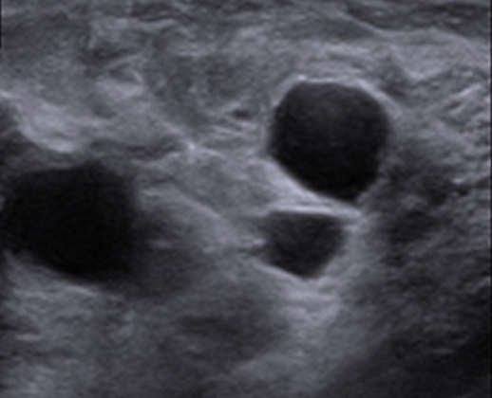

Slide 32
Benign Disorders
Cysts
Distended involuted lobules.
Age: Perimenopausal women.
Smooth, discrete lump, usually painless.
U/S confirms cyst.
Treatment: Aspiration
- If fluid is clear & no residual mass-
discharge patient.
- If fluid is hemorrhagic or cysts relapse-
excision is indicated to rule out malignancy.

Slide 33
Benign Disorders
Duct Ectasia
Major subareolar ducts dilate and shorten with age.
By the age of 70, 40% of women have dilated ducts
When symptomatic- called “duct ectasia”
Presentation: - nipple discharge (yellow, green or brown)
- nipple retraction (classically slit-like)
If discharge is troublesome- duct excision of affected duct

Slide 34
Duct ectasia showing slit-like nipple retraction.
(contrasts with breast cancer, in which the whole nipple is pulled in)

Slide 35
(Contrasts with breast cancer, in which the whole nipple is pulled in)

Slide 36
Benign Neoplasms
Duct papilloma:
- Presentation: Bloody discharge from nipple.
- Treated: by duct excision- microdochectomy.
Lipoma: Soft lobulated lesion.

Slide 37
Blood-stained nipple discharge

Slide 38
Phyllodes Tumor
Fibroepithelial tumor
Most are benign, some malignant.
Usually large, bosselated, no attachment.
Malignant may metastasize by blood
Treatment : - Wide local excision.
- Mastectomy for very large lesions.
No axillary lymph node clearance needed

Slide 39
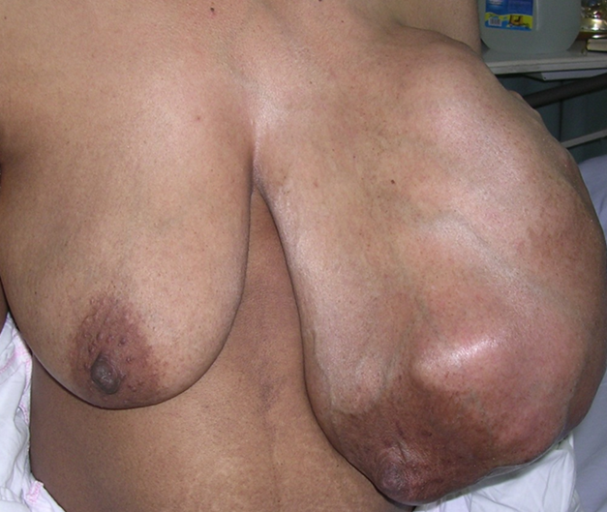

Slide 40
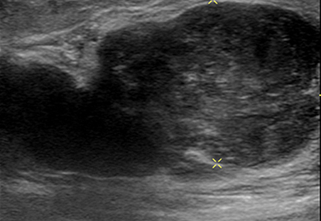

Slide 41
Breast Cancer
Most common malignancy
Most common presentation is with a breast lump or lumpiness, which is usually painless.
Any discrete lump, no matter how small or mobile, can be a cancer
Risk factors:
Age- rises with age
Early menarche and late menopause
Age at 1st pregnancy > 40
Nulliparous women
HRT (Hormone replacement therapy)
Obesity
Exposure to radiation
Diet (saturated fat)
Genetic factor (BRCA 1, BRCA 2)- 50-60 % of hereditary ca.
Previous benign disease (atypical hyperplasia)

Slide 42
Non-invasive Breast Cancer
Carcinoma arising from epithelial lining the terminal duct lobular unit.
Carcinoma in situ (non-invasive)- when malignant cells have not invaded the basement membrane.
Ductal carcinoma in situ (DCIS) - more common. 3-4% of symptomatic, 25% of screen detected cancers ( microcalcifications in mammogram).
Lobular carcinoma in situ (LCIS) - a marker of increased risk of future invasive cancer.
Ratio of DCIS to LCIS is 3:1

Slide 43
Invasive- Ductal Carcinoma
Most common (80%)
Most common type-highly variable histological pattern.
Some show special histological pattern: Tubular, cribriform, papillary, mucinous(all have better prognosis) and medullary cancers.

Slide 44
Invasive- Lobular Carcinoma
5 to 10% of invasive cancers.
30% bilateral, multicentral, multifocal.
Usually large mass at presentation.
Difficult to detect by mammogram.
Affinity to metastasize to membranous structures- pleura, periosteum and meninges.

Slide 45
Hormone & Growth Factor Receptors
ER (estrogen receptor) +ve. tumors (75%) are estrogen dependent for growth. Depriving estrogen stops its growth (Tamoxifen).
PR (progesterone receptor) +ve. are hormone dependent.
ER & PgR negative tumor (20-25%)- no benefit of hormone treatment.
HER 2(human epidermal growth factor receptor) +ve tumors (15%) are dependent on this growth factor. This can be blocked by monoclonal antibody- Trastuzumab (Herceptin) which used in treatment.
HER2 tumors have worse outlook than HER2 negative.
Triple negative (ER, PR,HER2): worse prognosis.

Slide 46
Clinical Features
Asymptomatic (screening detected).
Symptomatic:
Lump 76%- painless, ill-defined, skin attachment, peau d’orange
Pain 5%
Nipple retraction (whole nipple is pulled in)
Discharge
Skin retraction (Dimpling)
Axillary mass

Slide 47
Unusual Malignant Tumors
Paget’s disease (Nipple ulceration) - Approximately 1–2% of
patients with breast cancer present with Paget's disease.
- underlying invasive ductal carcinoma
- always affects the nipple and only involves the areola as a secondary event
Inflammatory breast carcinoma: (1%): Rapidly progressive. Characterized by pain, erythema, peau d'orange, diffusely enlarged breast due to dissemination of cancer cells through skin lymphatics.
Malignant phylloides tumor
Malignant lymphoma: Rare

Slide 48
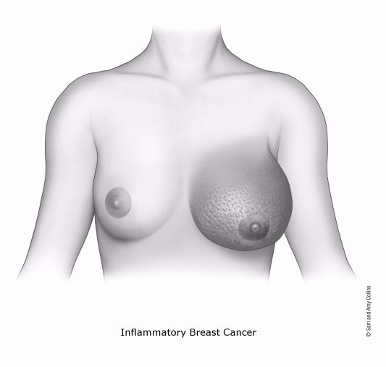

Slide 49
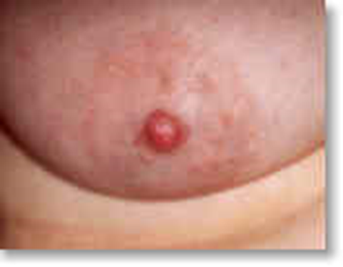
Inflammatory Carcinoma Paget’s Disease

Slide 50
Eczema nipple Paget’s Disease

Slide 51
Diagnosis (triple assessment)
I. Clinical evaluation – History & examination
II. Radiological evaluation:
U/S
Mammography
MRI
CT scan ( for staging)
III. Cytological/ histological evaluation:
FNAC
Core biopsy (U/S or Mammography guided for non-palpable mass)
Open biopsy- excision of the mass with surrounding healthy tissue.

Slide 52
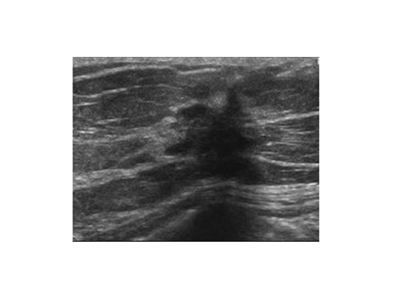
Carcinoma Breast: U/S & Mammogram

Slide 53
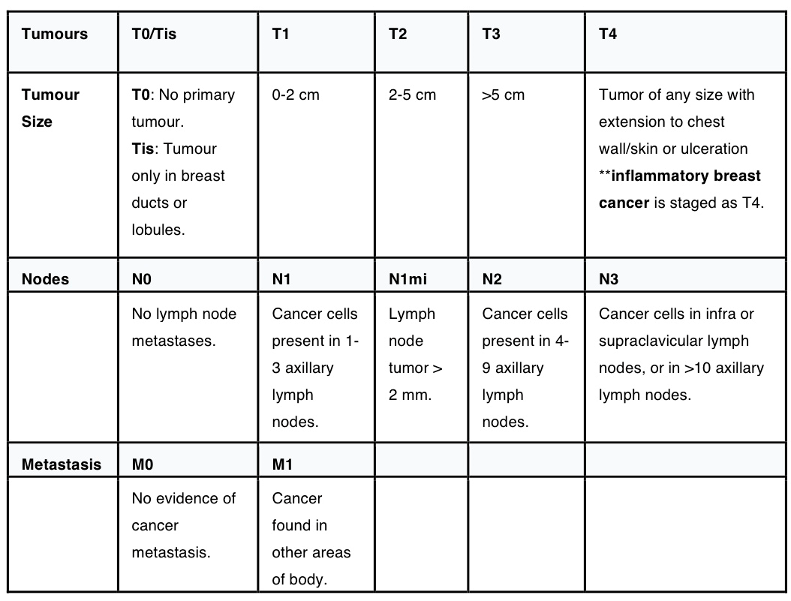

Slide 54
I. MANAGEMENT OF BREAST CANCER- DCIS
Localized disease (<4cm):- “Wide local excision” with normal healthy tissue all round the margins + Radiotherapy (except for very small lesions)
Larger (>4cm) or widespread disease:
- “mastectomy”

Slide 55
II. MANAGEMENT OF INVASIVE BREAST CANCER
Operable: T1-T3, N0,N1,M0
Local therapy(surgery) + systemic therapy.

Slide 56
MANAGEMENT OF INVASIVE BREAST CANCER
Local Therapy
Breast-conserving treatment (BCT) Wide local excision (lumpectomy) + Radiotherapy
- Suitable for tumor <4cm
-Excision of tumor with 1cm margin of normal tissue+ sentinel node biopsy± node clearance
- Postoperative radiotherapy
Modified radical mastectomy(MRM) Large tumor, widespread disease or those who choose this treatment.
- Whole breast is removed with some overlying skin (usually including the nipple),
but leaves the chest wall muscles intact with axillary surgery (SLB ± clearance)
Radiotherapy: - Given to high risk - >3 LN involvement, lymphatic/vascular invasion, grade3 tumor, >4cm tumor, tumor attached to pectoral fascia or close surgical margin <5mm

Slide 57
SYSTEMIC THERAPY
Chemotherapy, hormone therapy, immunotherapy
Adjuvant chemotherapy- when given after surgery/ radiotherapy.
For all except- tumor <1cm & grade 1
Common regimens:
- FAC (5-fluouracil,adriamycin, cyclophosphamide) 6 cycles/ 21 days.
- AC ( adriamycin, cyclophosphamide),
- FEC (5-fluouracil, epirubicin, cyclophosphamide).
Neoadjuvant chemotherapy-
when given before surgery/ radiotherapy to shrink larger
tumors.

Slide 58
Hormone Therapy
Tamoxifen (partial estrogen agonist): 20 mg / day for 5 years for pre and postmenopausal
Aromatase inhibitors (blocks conversion of androgens to estrogen): letrozole, anastrozole, exemestane
- Used in Postmenopausal women, hormone receptor +ve tumors
Oophorectomy: Women <50, ER +ve tumors, metastatic disease ( surgical or radiation)

Slide 59
Anti-HER 2 Therapy
15-20% tumor express HER2
Worse prognosis than HER2 negative tumors.
Humanized monoclonal antibody:-
- Trastuzumab (Herceptin)

Slide 60
Breast Cancer in Pregnancy
1-2% present during pregnancy
Diagnosis is often delayed
1st & 2nd trimester: Mastectomy, chemotherapy can be given (small risk to fetus), RT after delivery.
3rd trimester: Surgery or delivering baby early (32 week) followed by treatment of breast cancer.

Slide 61
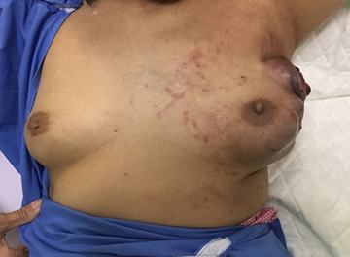
Management of Advanced & Metastatic Breast Cancer
Average survival 20-30 months
Effective symptom control with minimal side effects.
No evidence that treating metastatic disease improves survival.
Surgery only for fungating lesions.
Chemotherapy, hormone therapy, anti-HER2

Slide 62
BOOK REFERENCE
PRINCIPLES AND PRACTICE OF SURGERY
6th edition:
Edited by
O. James Garden,
Andrew W. Bradbury
John L.R. Forsythe
Rowan W. Parks
PAGE NO: 302-11

Slide 63
Thank You!

