Slide 1


Slide 2
SHOCK
DR. AHMED KHAN, M.B.B.S; F.C.P.S
Associate Prof. of General Surgery

Slide 3
Learning objectives (ILOs)
At the end of this presentation students will be able to describe:
Definition & Types of shock
Pathophysiology of different types of shock
Clinical features & management of different shock.

Slide 4
: A state of inadequate tissue perfusion of oxygen and nutrients to maintain normal tissue and cellular function.
A disparity between blood volume and vascular capacity, which can be caused by:
1. Reduction in blood volume
2. Increase in the vascular bed
3. By both the above mechanisms.
Inadequate peripheral perfusion: → to failure of tissue oxygenation → Lead to anaerobic metabolism
→ tissue acidosis & cellular
dysfunction
→ multi organ dysfunction(MOF)
& death.
Definition

Slide 5
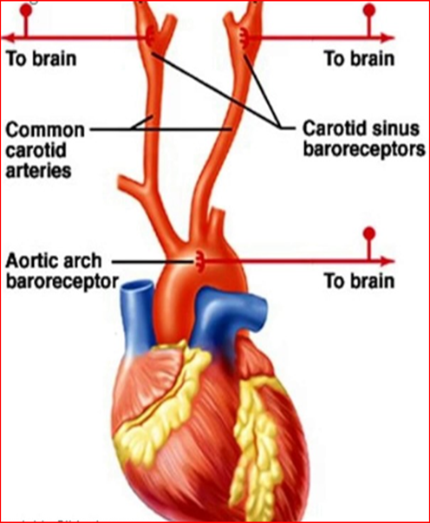
Pathogenesis:
Series of pathophysiological changes aimed at protecting the organism and preserving its vital functions as follows:
I. Sympatho-adrenal response:
The fall in blood pressure due to inadequate cardiac output is sensed by the stretch receptors located in the aortic arch and carotid sinus (Baroreceptors) with the consequent sympathoadrenal stimulation.
The Vasomotor Center activity is increased resulting in:
- an enhanced peripheral resistance to
maintain the blood pressure .
The heart rate increases to restore the cardiac output.

Slide 6
The increased “sympathetic cardiac activity” :
- increases the heart rate and
- also increases the strength of myocardial contraction.
- The arteriolar constriction is selective.
The blood flow to skin, skeletal muscle, salivary glands, intestines, liver,
and kidneys is reduced. The skin becomes cold.
Salivary secretion stops and mouth becomes dry, intestines manifest
impaired digestion and water absorption.
How ever, blood flow to essential organs like brain, heart, diaphragm
and intercostal muscles is maintained.

Slide 7
II. Neuroendocrine response :
In case of apparent hypovolemia, there will be increased secretion of ACTH, growth hormone, glucagon, ADH, catecholamines and cortisol.
ADH helps in the reabsorption of H2O from the distal renal tubules.
Activation of the renin angiotensin system
Due to decreased renal blood flow there is secretion of renin from the juxtaglomerular apparatus which leads to the formation of angiotensin, a potent vasoconstrictor which stimulates aldosterone secretion resulting in Na and H2O retention and increase of blood volume.
Glucagon stimulates gluconeogenesis and glycogenolysis thereby causing hyperglycaemia and increased osmolarity which helps in the fluid shift from the interstitium to the intravascular compartment.

Slide 8
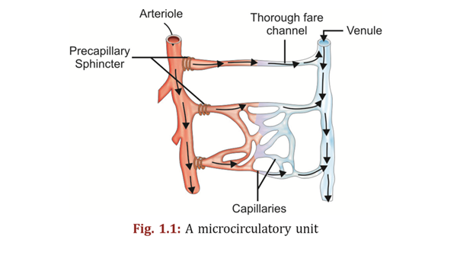
III. Microcirculatory Changes
Due to intense sympathoadrenal and neuroendocrine response following hypovolemia there will be selective diversion of blood flow through meta-arteriolar shunt or thorough channels as closure of pre-and post- capillary sphincters occur.
In the irreversible phase of shock, there is relaxation of the precapillary sphincters while postcapillary sphincters remain constricted and blood gets sequestrated in the microcirculatory unit.

Slide 9
IV. Cellular Changes:
The cellular changes are due to ischemia.
- Lack of oxygen and accumulation of waste products cause cell membrane
dysfunction and metabolic acidosis
(Hypoxia of kidney, renal function is impaired → blood levels of acids rise, like
lactate, pyruvate, phosphate & sulfate → causing metabolic acidosis)
Na and H2O enter the cell and K leaves it, which results in cellular swelling.
Mitochondrial dysfunction occurs in prolonged shock, which will cause diminished
ATP production.
There is also lysosomal disruption with resultant release of lysosomal enzymes
and intracellular autodigestion occurs.
Widespread cellular damage may lead to multiorgan dysfunction syndrome
(MODS).

Slide 10
Types of Shock
Hypovolemic
Septic
Cardiogenic
Anaphylactic
Neurogenic

Slide 11
Hypovolemic Shock
Most common type in surgical practice.
Reduction in intravascular volume.
Blood loss: Trauma, GI bleeding, ruptured aneurysm
Plasma loss: Burn
Water & electrolytes loss: Diarrhoea, vomiting
Easily correctable.

Slide 12
Classes of haemorrhagic shock
Based on estimated blood loss & patients' initial presentation (ATLS)
 | Class I | Class II | Class III | Class IV
Blood loss (ml) | Up to 750 | 750-1500 | 1500-2000 | >2000
Blood loss - % volume | Up to 15% | 15-30% | 30-40% | >40%
Pulse / min | <100 | 100-120 | 120-140 | >140
Systolic BP | Normal | Normal | Decreased | Decreased
Pulse pressure | Normal/increased | Decreased | Decreased | Decreased
Respiration rate | 14-20 | 20-30 | 30-40 | >35
Urine (ml/hr.) | >30 0.5 to 1.5 cc/kg/hour | 20-30 | 5-15 | Negligible
Mental status | Slightly anxious | Mildly anxious | Anxious, confused | Confused, lethargic
Initial fluid | Crystalloid | Crystalloid | Crystalloid & blood | Crystalloid & blood

Slide 13
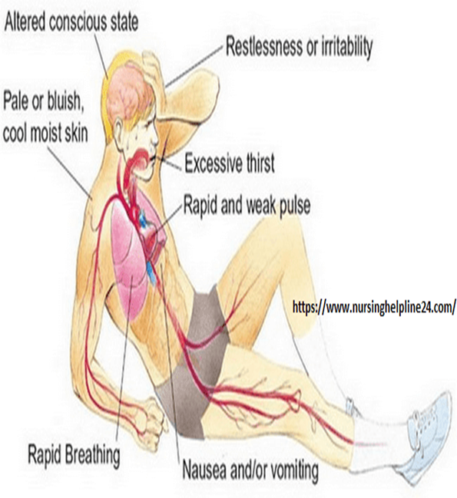
Signs and symptoms
Anxiety, restlessness, altered mental state
Distracted look in the eyes
Thirst and dry mouth
Cool, pale, clammy skin
Hypothermia
Rapid and shallow respirations
Oliguria (Urine Output<30ml/hour)
Hypotension
A rapid, weak, thready pulse

Slide 14
Treatment:
Resuscitation
a. To ensure clear airway, adequate breathing and circulation.
b. Provision of 100 percent oxygen by a face mask. Deliver oxygen at a flow of 5-6
liters per minute
Hypovolemic shock
Position: The patient is kept in “head down position”.
Arrest external bleeding
Fluid resuscitation- Two wide bore (14-16 gauge) peripheral venous access.
PRBCs: Life threatening/ continued bleeding. Vasopressor & inotropes- little role
Invasive monitoring: CVP, PAWP, acid-base status, UOP
• Fluid replacement—Crystalloid solution like Ringer lactate is ideal in situations
where Na and H2O loss is predominant and will also serve as initial treatment in
hemorrhagic shock.
Blood transfusion is advised in hemorrhagic shock and
Plasma transfusion in case of burns.
-- Colloids, e.g. Gelatin (Hemaccele), Hydroxyethyl starch (HES) and Dextran remain
longer in the circulation and draw extracellular fluid (ECF) into the circulation by
osmotic pressure.

Slide 15
Systemic inflammatory response syndrome SIRS
A clinical response to a nonspecific insult of either infectious or non infectious origin.
SIRS is defined as 2 or more of the following variables:
Fever of more than 38°C (100.4°F) or less than 36°C (96.8°F)
Heart rate of more than 90 beats per minute
Respiratory rate of more than 20 breaths per minute or arterial carbon dioxide tension (PaCO₂) of less than 32 mm Hg (N= 38-42)
Abnormal white blood cell count (>12,000/µL or < 4,000/µL or >10% immature [band] forms)

Slide 16
Bacteremia:
- It is the presence of bacteria within the
bloodstream.
Sepsis: -
- is the systemic response to infection and
- It is defined as the presence of SIRS in addition
to a documented or presumed infection
i.e., infection-induced syndrome involving 2 or
more manifestations of SIRS.
Severe sepsis meets the a forementioned criteria and is associated with organ dysfunction, hypoperfusion, or hypotension.
Multiple Organ Dysfunction Syndrome (MODS)
Progressive distant organ failure (initially uninvolved) following severe infectious or noninfectious insults (severe burn, multiple trauma, shock, acute pancreatitis)

Slide 17
Septic ShocK
Severe Sepsis induced hypotension (systolic < 90 mmHg).
Disturbance in O₂ delivery and O₂ consumption.
Gram positive (52%), Gram negative (38%) infections.
Common sites of infection: - Lung (50-70%),
- abdomen (20-25%),
- urinary tract (5-7%),
- skin.

Slide 18
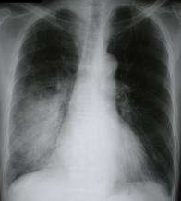
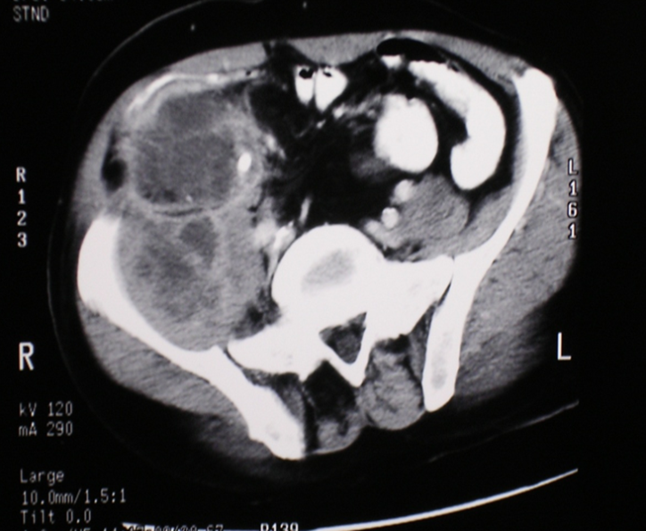
Infections most frequently led to sepsis:
- Respiratory
- Urinary tract
- Skin
- Abdominal
Risk groups:
- Immunocompromised
- > 65 years or older
- Infants under 1 year

Slide 19
Septic Shock- pathophysiology
Infection- triggers cytokines (TNF-α, IL 1-β) mediated pro-inflammatory response.
Peripheral vasodilatation due to NO release
Fall in systemic vascular resistance
Reflex tachycardia, increased cardiac output (CO)- High output state.
Clinically: warm well perfused periphery
Low diastolic BP, wide pulse pressure.

Slide 20
Septic Shock- pathophysiology
If septic state persists:
Endothelium dysfunction leads to:
Extravasation of fluid
Loss of intravascular volume
Ventricular dysfunction → impairs CO.
Peripheral perfusion falls
Clinically indistinguishable from low output state

Slide 21
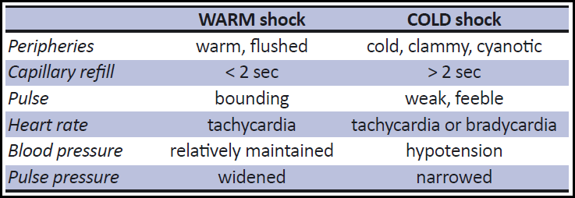
Features of warm and cold shock

Slide 22
EARLY WARM SHOCK (WARM shock)
Compensated warm phase of shock.
Prompt response to fluids and pharmacologic treatment.
Toxins increase the body temperature.
Arterial blood pressure falls but the cardiac output increases because the left ventricle has minimal resistance to pump against.
Adrenergic discharge further Increases the cardiac output. The skin remains pink, warm & well perfused (Cutaneous vasodilatation).

Slide 23
LATE COLD SHOCK (Refractory septic shock)
Late decompensated phase.
There is hypovolemia with decrease in right heart filling & decreases
cardiac output.
The knowledge of existence of a septic focus is the only factor that
differentiates septic shock from traumatic & hypovolemic shock.

Slide 24
Treatment:
• Aim of treatment is to:
a- control infection and
b- improve the hypovolemic state, caused by endotoxin induced peripheral
vasodilatation.
Blood culture should be done before antibiotic administration.
Debridement & drainage of the infection.
Antibiotics: combination of 3rd generation cephalosporin, aminoglycoside
and metronidazole should be effective against most organisms.
• Inotrope use is indicated in severely ill patients to maintain cardiac output.

Slide 25
Cardiogenic Shock
Causes: - Myocardial infarction, arrhythmias, valve dysfunction,
- massive pulmonary embolism,
- cardiac tamponade and tension pneumothorax.
A pump failure: Heart becomes unable to maintain adequate cardiac output to meet metabolic requirements.
Low output state.
Normal circulating volume.

Slide 26
Management: Cardiogenic Shock
Myocardial infarction- commonest cause.
Tension pneumothorax, traumatic cardiac tamponade- trauma.
FEATURES: Hypotension, Distended neck veins , Raised CVP.
ECG, echocardiography, CXR,ABG, CK-MB, troponin.
Maintenance of adequate oxygenation.
Judicious fluid administration to avoid fluid overload.
Thoracocentesis, pericardiocentesis in trauma.

Slide 27
The patient should have complete bed rest and be monitored in a coronary care unit.
Pain relief with Inj. Morphine or Pethidine HCl.
Pharmacologic support:
- Inotropes—Like Dopamine and Dobutamine for pump failure.
- Thrombolytic therapy: with Aspirin and Streptokinase in case of myocardial
infarction.
- Diuretics, cardiac glycosides and ACE inhibitors for patients with heart failure.
- Temporary cardiac pacing will increase cardiac output and heart rate in
bradyarrhythmias.

Slide 28
Anaphylactic Shock
It is severe systemic hypersensitivity reaction to an allergen.
Drugs (antibiotics, dextran, radiological contrasts),
food (peanuts, shellfish, dairy)
insect stings and latex.
Release of vasoactive mediators from basophil & mast cells (histamine, kinins, prostaglandins) .
Reaction mostly mediated by IgE, IgG, or complement.
Anaphylactic shock results from vasodilation, intravascular volume redistribution,capillary leak and a reduction in cardiac output
Treatment:
1. Inj. Adrenaline – 0.5 ml s.c (1 in. 10000 )
2. IV steroids and antihistamines.

Slide 29
Anaphylactic Shock
1. Stop administration of causative agent (drug/fluid)
2. Lie patient flat, feet elevated
3. Maintain airway and give 100% O2
4. Adrenaline (epinephrine):
- 0.5–1.0 mg (0.5–1.0 ml of 1:1000) IM or
- 50–100 μg (0.5–1.0 ml of 1:10 000) IV ( titrated against response)
6. Intravascular volume expansion with crystalloid or colloid
7. Second-line therapy:
- Antihistamine: Chlorphenamine 10–20 mg slow IV
- Corticosteroid: Hydrocortisone 200 mg IV

Slide 30
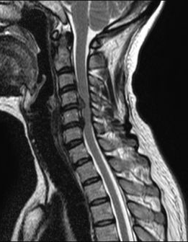
Neurogenic Shock
Injury to spinal cord (cervical, thoracic) high spinal anaesthesia.
Disruption of sympathetic efferent.
Loss of sweat gland innervation- anhydrosis.
Loss of vasomotor tone-
- profound vasodilatation,
- fall in peripheral vascular
resistance.
loss of cardiac stimulation (T1-4).
Hypotension, bradycardia, dry & warm periphery

Slide 31
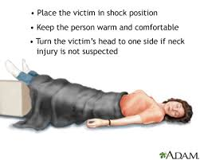
VASOVAGAL/ VASOGENIC SHOCK
( Part of neurogenic shock )
Pooling of blood due to dilatation of peripheral vascular system particularly in the limb muscles & in splanchnic bed
→ ↓Venous return to the heart leading to
→ low cardiac output & bradycardia
→ Blood flow to brain is reduced causing
cerebral hypoxia & unconsciousness.
Management: Trendelenberg position-- increases cerebral flow & consciousness is restored

Slide 32
PROGNOSIS OF SHOCK
Cardiogenic shock associated with extensive myocardial infraction : (mortality rate up to 75%)
Septic shock : (mortality rate up to 75%)
Hypovolemic, anaphylactic and neurogenic shock are readily treatable and respond well to medical therapy.

Slide 33
BOOK REFERENCE
PRINCIPLES AND PRACTICE OF SURGERY
6th edition:
Edited by
O. James Garden,
Andrew W. Bradbury
John L.R. Forsythe
Rowan W. Parks
PAGE NO: 17-26

Slide 34

THANKS

