Slide 1
Nutritional Support in Surgical Patients
Dr. Ahmed khan MBBS, FCPS
Associate Prof. of General Surgery

Slide 2
ILOs
At the end of this presentation students will be able to describe:
The pathophysiology & importance of nutritional support
Aims of nutritional support measures
Indications & complications of different forms of nutritional support.

Slide 3
Definition
Nutritional support is an adjuvant therapy used to support the surgical patients until they can sustain themselves with adequate spontaneous nutrition by mouth.

Slide 4
Severely malnourished patient with wasting of fat and muscle

Slide 5
1. Reduced Gut Barrier Function
2. Poor wound healing and collagen maturation
3. Poor immune function
4. Reduced muscle strength — Respiratory muscle –
Atelectasis and pneumonia.
5. Psychological — Apathy and depression
Consequence of malnutrition in the surgical Patient

Slide 6
GI tract may atrophy without the intraluminal nutrition,→
increased gut permeability,
a decrease in gut associated lymphoid tissue (GALT),
changes in gut flora and
reduced gut barrier function.
This may lead to →
translocation of bacteria and endotoxin into the portal and systemic circulation and →
consequent fueling of the inflammatory process with →
higher proportion of septic episodes.
leading to → multiple organ dysfunction syndromes (MODS).
Reduced Gut Barrier Function:

Slide 7
1. Patient who cannot eat, e.g.
Esophageal/gastric outlet obstruction.
Head and neck surgery or injury.
Stroke or other neurological problem.
2. Patient who cannot eat enough, i.e., hypermetabolic states.
i. Severe burns
ii. Major trauma
iii. Sepsis.
3. Patient who won’t eat
i. Patient with anorexia due to malignant disease.
ii. Depression, eating disorders.
4. Patient who should not eat
i. Inflammatory bowel disease
ii. GI fistulae
iii. Bowel obstruction
iv. Prolonged paralytic ileus
v. Radiation enteritis
vi. Intestinal failure.
Indications
Of
Nutritional support
In general, should be considered in any patient who is unable to take or resume an adequate dietary intake for more than 5 days.

Slide 8
Pre-operative nutrition is indicated in severely malnourished patients (weight loss is >20%).
Post-operative TPN is established:
- within 5–7 days for a depleted patient, and
- within 7–10 days for a normal patient.
Early Enteral nutrition is prefered to avoid bacterial translocation.
The principles of nutritional Support

Slide 9
Fluid requirements
100 ml/ kg/day – first 10 kg body wt.
50 ml / kg /day- for next 10 kg
20 ml / kg /day- for each additional kg
(Example: 70 Kg : 1000+500+1000=2500ml=2.5L)
1 ml of water / cal. / day
Adjust in patients :
- who cannot tolerate large volume
- additional fluid loss
- febrile or septic

Slide 10
Nutritional Requirements:
Water — 35 ml/kg/day
Energy — 30 kcal/kg/day
3. Na+—1 to 1.5 mmol/kg/day
4. K+ — 1 mmol/kg/day
5. Fat — 1-1.5 gm/kg/day
6. Carbohydrate — 2g/kg/day
7. Vitamins — Variable daily allowance.
8. Minerals — Zinc, magnesium, phosphate, selenium
9. Nitrogen — 0.15 – 0.2 gm/kg/day (6.25 gm protein = 1gm Nitrogen)

Slide 11
Fat
Provides 9 kcal/g and 20 to 25 percent of total kcals
• Maximum intake 2g/kg/day
• Clearance is assured by keeping triglycerides <250mg/dl.
Protein
Provides 4kcal/g and 20 to 25 percent of total kcals.
• Adult requirement is 1.5 to 2 g/kg/day
• Child requirement is > 2g/kg/day
Carbohydrate
Provides 4 kcal/g and constitutes 55 to 60 percent of total kcal provided.
• Maximum intake tolerated is 7 to 8 gm/ kg/day.
• Insulin is given for glucose >250 mg/dl.
• Intake is decreased in case of severe hyperglycaemia

Slide 12
BMI is defined as body weight in kilograms (kg) divided by height in meters squared (kg/m2)
Underweight: under 18.5 percent
Normal: 18.5 to 24.9 percent
Overweight: 25.0 to 29.9
Obese (class 1): 30.0 and 34.9
Severe obesity (class 2): 35-39.9
Morbid obesity (class 3): 40-49.9

Slide 13

Energy requirements in adults
BMI 20-25= 20-25 kcal/kg/day
BMI 26-29= 15-17 kcal/kg/day
Uncomplicated patients= 25 kcal/ kg/ day
Complicated/ stressed pts. = 30-35 kcal/kg/day

Slide 14
Parameters to Assess Nutritional Status:
1. History: Presence of weight loss and dietary history (significant Wt. loss 15-20%)
2. Physical examination includes testing of muscle power, peripheral
edema, angular stomatitis, glossitis.
Muscle power is assessed by handgrip strength and respiratory muscle function.
3. Body weight— Unintentional weight loss of greater than 10 percent of a
patient’s weight in the preceding 6 months is a good prognostic indicator
of poor clinical outcome.
4. Body Mass Index (BMI)
5. Anthropometric measurements ( human body measurements )
6. Biochemical and immunological assessment

Slide 15
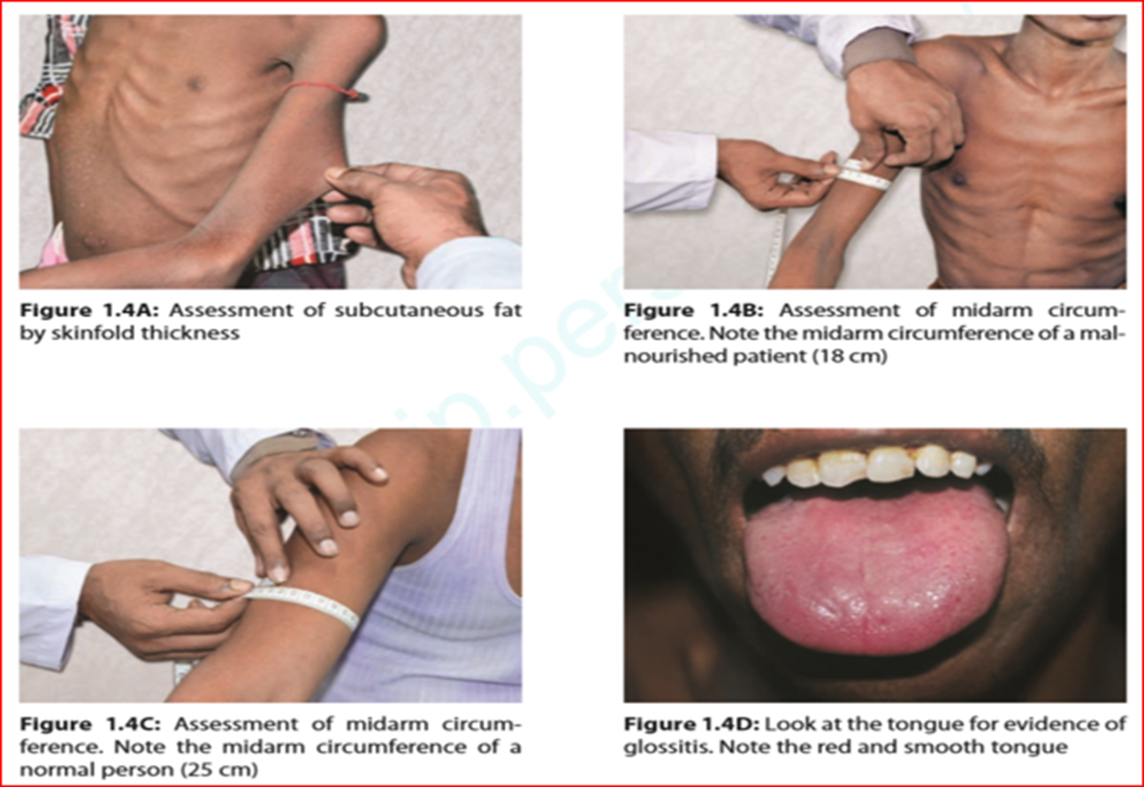
Anthropometric Measurement:
Triceps skinfold thickness (TSF)—
Subcutaneous fat accounts for about 50 percent of the body fat stores and accurately reflects the total body fat content, measured with a large skinfold caliper while the patient is standing or sitting with the right arm hanging loosely at the side, just below the midpoint between acromial and olecranon processes. If below 10th percentile or a visible loss of subcutaneous tissue on physical examination indicates fat store depletion. N=(M: 18.7+_8.5mm, F=23.6+_7.5mm)
Mid-arm muscle circumference (MAC)—
Skeletal muscle represents 60% of total body protein and in times of stress and starvation it is assessed by visual inspection and measuring mid-arm muscle circumference at the same level as the triceps skin fold thickness. If below the tenth percentile is considered clinically significant (N=> 23cm)

Slide 16
Biochemical Assessments
Serum albumin reflects the underlying illness, e.g. malignant disease, trauma, sepsis, etc. all of which result in a lowering of plasma albumin level of less than 30g/l. (3.5-5.5 gm/dL)
Other plasma proteins, e.g. transferrin, retinal binding protein, prealbumin( 16 to 30 mg/dL) have been evaluated as markers of nutritional status
Immune Assessments :
A reduced total lymphocyte count is associated with a worse prognosis.
Clinical assessment based on history and physical examination better than laboratory measurements in identifying malnourished patients.

Slide 17
SIMPLE
STARVATION
↓ energy expenditure
↓ nitrogen loss
↓ glucose use by brain*
↑ use of fat for fuel
↑ lipolysis
* RBC, WBC, renal medulla,
neurons, muscles & intestinal mucosa supply maintained
POST-SURGERY
↑ energy expenditure
↑ hormonal stimulation
↑ cellular activity
↑ metabolic rate
↑ gluconeogenesis
↑ protein breakdown
↑ nitrogen loss
↑Lipolysis

Slide 18
Postoperative Nutritional Support (Starting oral feeding)
 Introduction of solid foods depends on condition of GIT
 Oral feeding may be delayed for first 24 – 48 hours post surgery until return of bowel sounds, passage of flatus or soft abdomen
 Traditional practice has been to progress from clear liquids, to full liquids, to semi-solids
to solid foods

Slide 19
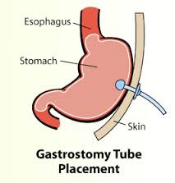
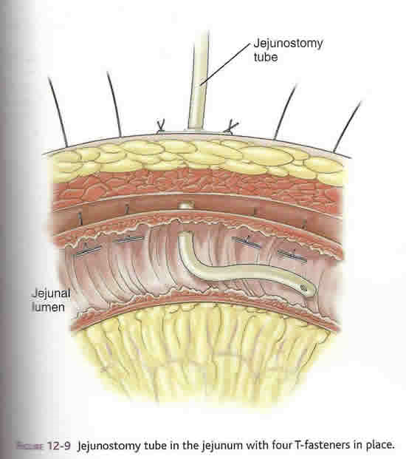
Enteral feeding
Important in maintaining gut barrier function
Intermittent bolus- suitable for stomach feeding
Continuous - suitable for duodenum/ jejunum feeding
Initiate at a slow rate, advance as tolerated
Initially dilute feeds, gradually advance to full strength
Feeding in semi-upright position (particularly for stomach feeds)
Maintain this position for 2 hours after feeds
Aspirate (stomach feeding) before next feed. >150ml- delay next feed.

Slide 20
1. Oral — Patients who can eat normally.
2. Nasogastric — Best for short-term nutritional supplementation.
3. Naso-enteric route is used if there is impaired gastric emptying or jejunal feeding is required, e.g pancreatitis.
- It can be established at laparotomy, endoscopically or
radiologically.
- There are an increasing number of well-designed
nasojejunal tubes for endoscopic placement, both single
lumen and double lumen for simultaneous gastric
drainage and Jejunal feeding.
Routes of enteral Nutrition

Slide 21
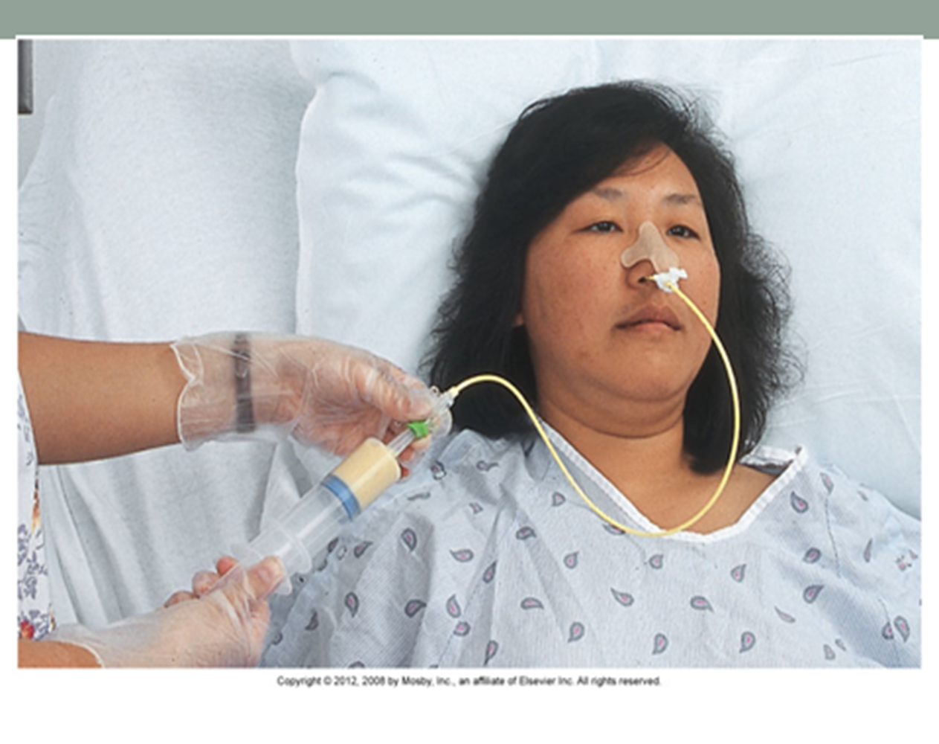
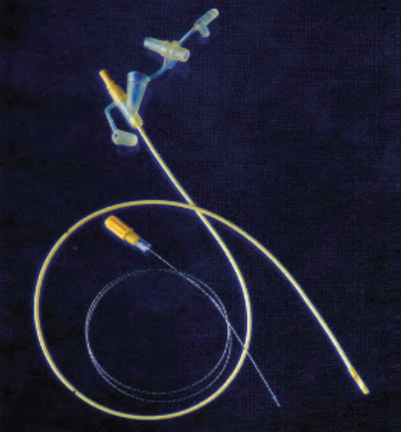
Nasogastric tube
A fine-bore feeding tube with its guidewire

Slide 22
4. Percutaneous endoscopic gastrostomy (PEG) —It is achieved by incising over the illuminated tip of the endoscope while it is in the stomach and then “railroading a feeding tube” through the gastric and abdominal puncture hole.
Indications: Mostly ‘neurological diseases’, e.g., stroke, motor neuron disease bulbar palsy & head injury etc.
Contraindication— Complete esophageal obstruction.
Complications are few (3%) but may be serious, e.g. sepsis or perforation of another viscus, e.g. colon.
5. Feeding jejunostomy—Placement of the feeding tube is done at laparotomy when oral intake is not likely for seven or more days, e.g.
a- Major upper GI resections like esophagectomy, gastrectomy,
pancreatoduodenectomy.
b- Major abdominal trauma or when having postoperative chemotherapy
or radiotherapy.

Slide 23
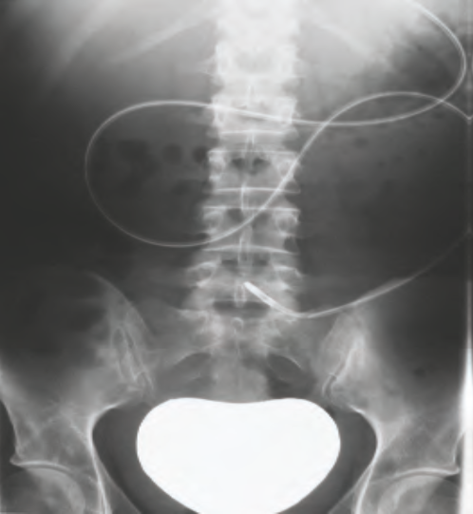
Percutaneous endoscopic gastrostomy tube
Radiograph of a tube inserted beyond the duodenojejunal flexure

Slide 24
Indications for enteral nutrition
Malnutrition with functioning gut
Post-operative feeding

Slide 25
Advantages of enteral feeding
Simplicity
Greater availability
Lower cost
Well tolerated
Maintains gut integrity
Fewer complications

Slide 26
Contraindications to enteral feeding
Intestinal obstruction
Paralytic ileus
High output entero-cutaneous fistula
Short bowel syndrome
Severe acute pancreatitis
Malabsorption

Slide 27
Complications of enteral feeding
Mechanical: tracheobronchial intubation, erosion
blockage, displacement, bowel perforation
Metabolic: Fluid/ electrolyte imbalance, hyperglycemia
Refeeding / overfeeding syndromes
Gastrointestinal: Diarrhea, vomiting, pain
Pulmonary: Aspiration
Infection: Tube site

Slide 28
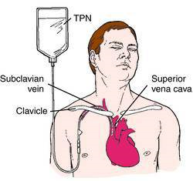
Total parenteral nutrition- TPN
Delivering predigested nutrients via hyperosmolar solution into venous system
TPN or CVN ( central venous nutrition ) : Subclavian / Internal jugular,
Catheter tip in SVC
Most commonly used
PVN ( peripheral venous nutrition ) or PPN (partial parenteral nutrition):
Solution of lower calorie, lower dextrose and higher lipid content
Suitable for 7-10 days feeding

Slide 29
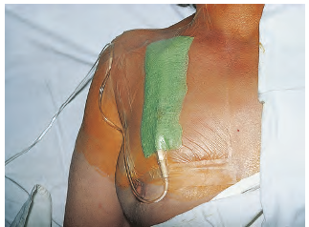
Infraclavicular subclavian line

Slide 30
PPN (Peripheral Parenteral Nutrition) :
TPN solutions have high osmolalities and can therefore,
result in thrombophlebitis if given into a peripheral vein.
In order to reduce the osmolality of PPN, the lipid content is increased as glucose-based solutions have high osmolality. lipid is immunosuppressive.
TPN or CVN (Central venous route), when chosen, the
catheter should be inserted via(access) either the
subclavian, internal or external jugular vein and is
tunneled subcutaneously to minimize the risk of infection.
Catheters used for delivering TPN should be single lumen
catheters using an electronically controlled volumetric infusion
pump.
TPN is usually given in an ‘all-in-one’ bag with a mixture
of glucose, fat and l-amino acids combined with fluid,
electrolytes, vitamins, minerals and trace elements

Slide 31
TPN - Indications
Non-functioning GIT
Short bowel syndrome
Intestinal fistula
Severe pancreatitis
Intractable vomiting/ diarrhea
Severe inflammatory bowel disease
Developmental anomalies
Multiple organ failure
Severe malnutrition ( unable to take orally )

Slide 32
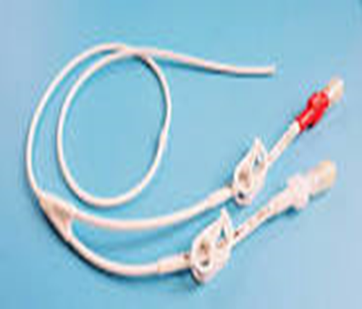
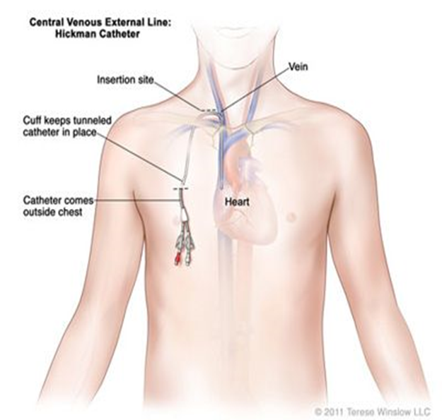
Home TPN
Long term nutritional support
Majority have malignancy
Special catheter- e.g. Hickman
Subclavian vein through subcutaneous tunnel
Support system
A Hickman catheter

Slide 33
Checks during Nutritional support
Daily – Full blood count (FBC), urea, electrolytes and blood sugar (Random).
Weekly – Liver function test, S.Albumin, trace elements.
Fortnightly – Vitamin B12, Zinc, Mn, Selenium, Copper, Iron, Transferrin.

Slide 34
Complications:
A. Related to feeding Catheter:
Catheter related sepsis –avoidance of catheter types that predispose to the development of infection, e.g. multiple lumen, non tunelled and femoral venous catheters.
Thrombotic complications include central venous and atrial thrombosis and thrombotic occlusion of the catheter.
Cardiac complications, e.g. perforation of the right atrium (when catheter is positioned in the Rt. atrium) and cardiac tamponade.
Thoracic duct injury.
Pneumothorax or hemothorax due to laceration of intrathoracic vein wall

Slide 35

Other TPN complications
Electrolyte imbalances
Acid-base imbalances
Heart failure or pulmonary oedema
Refeeding syndrome (in severely malnourished patients), which includes a rapid drop in potassium, magnesium, and phosphorus levels because of large flux of potassium and phosphate into the cells

Slide 36
To remember how to avoid the complication of refeeding syndrome when giving TPN to a severely malnourished patient
, think “Start low and go slow.”

Slide 37

A. Fluid shock
B. Hypervolemia
C. Hypovolemia
D. Refeeding syndrome
When a severely malnourished patient starts receiving TPN,
his laboratory tests show a rapid drop in potassium, magnesium, and phosphorus levels.
The findings indicate which
of the following conditions

Slide 38
BOOK REFERENCE
PRINCIPLES AND PRACTICE OF SURGERY
6th edition:
Edited by
O. James Garden,
Andrew W. Bradbury
John L.R. Forsythe
Rowan W. Parks
PAGE NO: 38-44

Slide 39
THANKS

