Slide 1
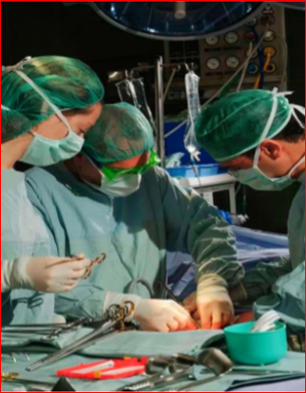
Principles of surgical oncology
DR. AHMED KHAN MBBS, FCPS
Associate Prof. of General Surgery

Slide 2
Surgical Oncologist:
“A surgical oncologist is a well-qualified surgeon who has obtained additional training and experience in the multidisciplinary approach to the prevention, diagnosis, treatment, and rehabilitation of cancer patients, and devotes a
major portion of his or her professional practice to these activities and cancer research.”
Society of Surgical Oncology Training Program Guidelines, 2004

Slide 3
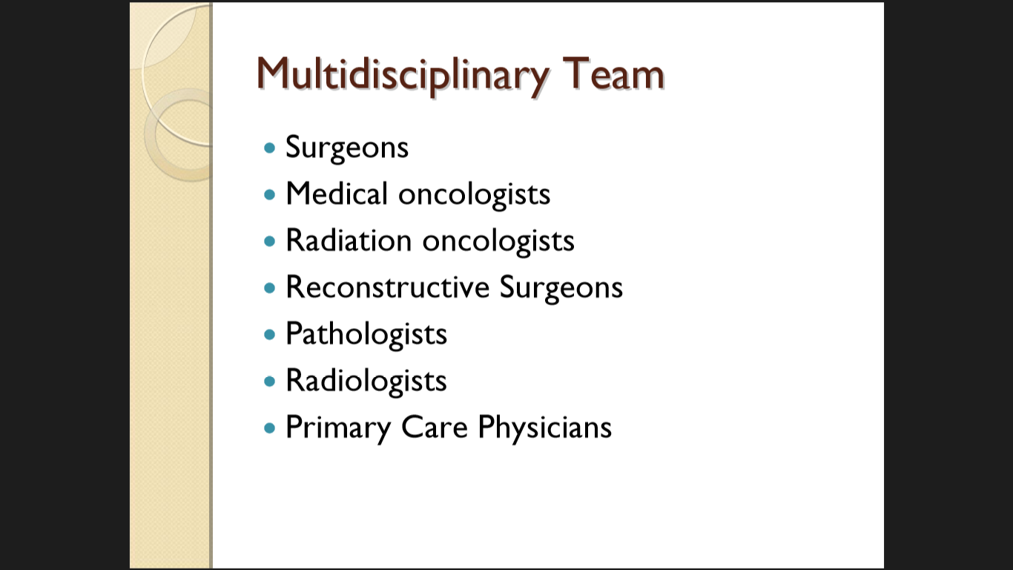

Slide 4
Surgery
Radiation
Chemotherapy
Pathology
Radiology
Nutrition
Multidisciplinary approach for management
Cancer Management

Slide 5
Nomenclature:
Epithelial cells (Endoderm, mesoderm or ectoderm) – Carcinoma
Adenocarcinoma is a malignant tumor arising from “glandular tissue”.
Connective Tissues – Sarcoma
Blood: WBC – Leukaemia, Lymphoid – Lymphoma
Germ cells – Teratoma, Seminoma, Dysgerminoma(germ cells in females)
Neuroectoderm (Different names – Melanoma)

Slide 6
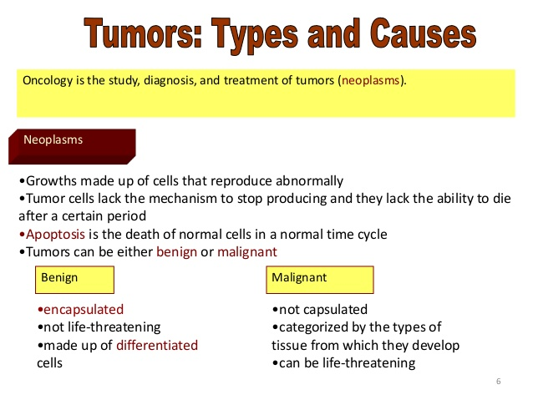

Slide 7
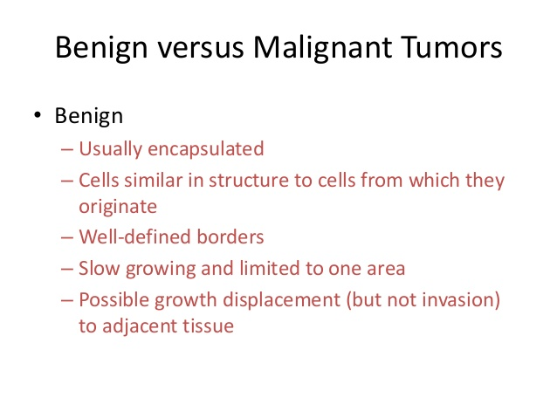

Slide 8
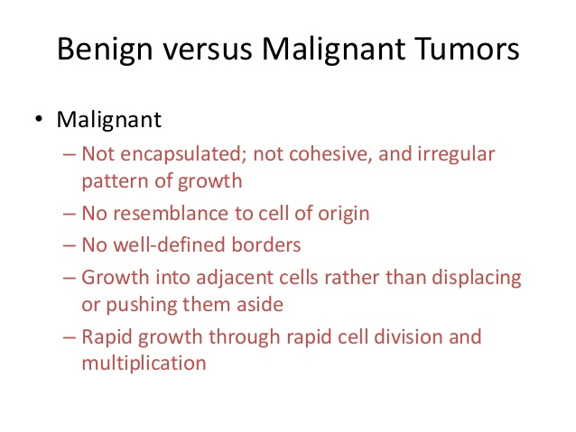

Slide 9
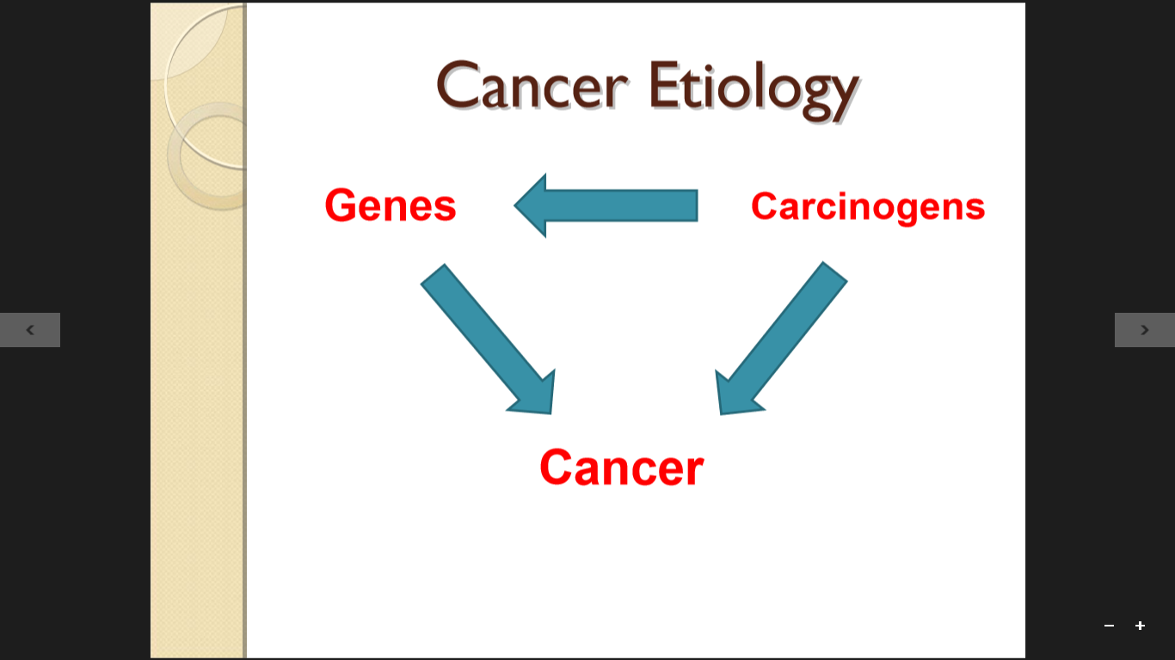

Slide 10
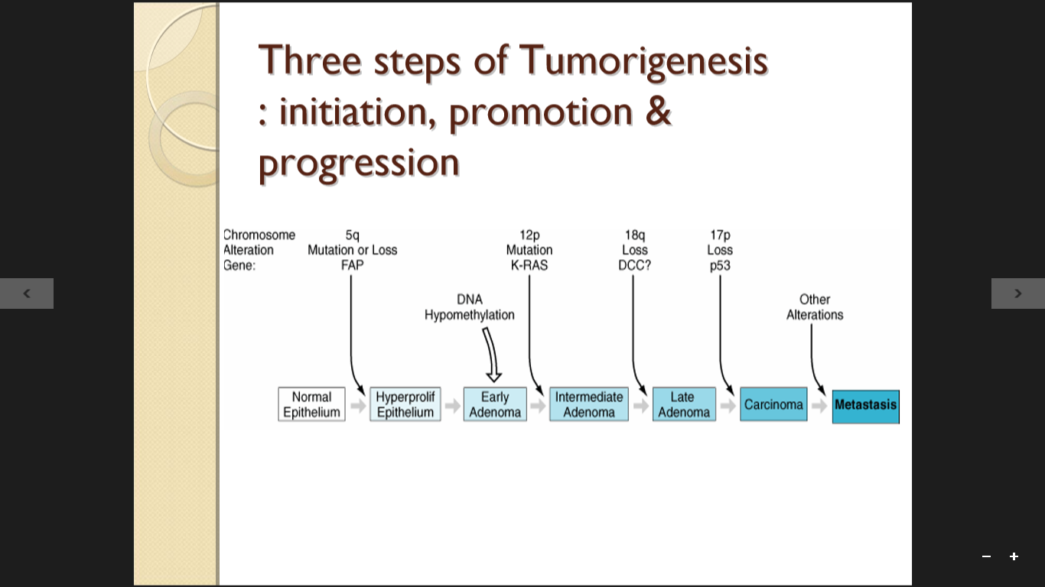

Slide 11
  The first step in this process is initiation, which requires exposure of normal cells to carcinogenic substances.
  Substances that may act as carcinogens or initiators include chemical, physical, and biologic agents
  Two major classes of genes are involved in carcinogenesis: oncogenes and tumor suppressor genes

Slide 12
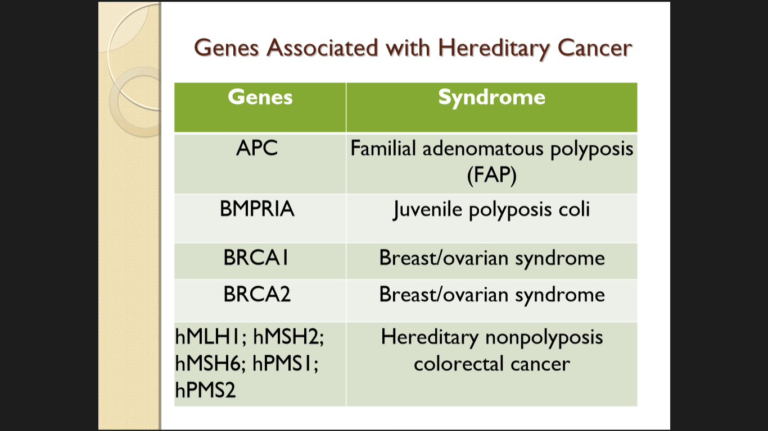

Slide 13
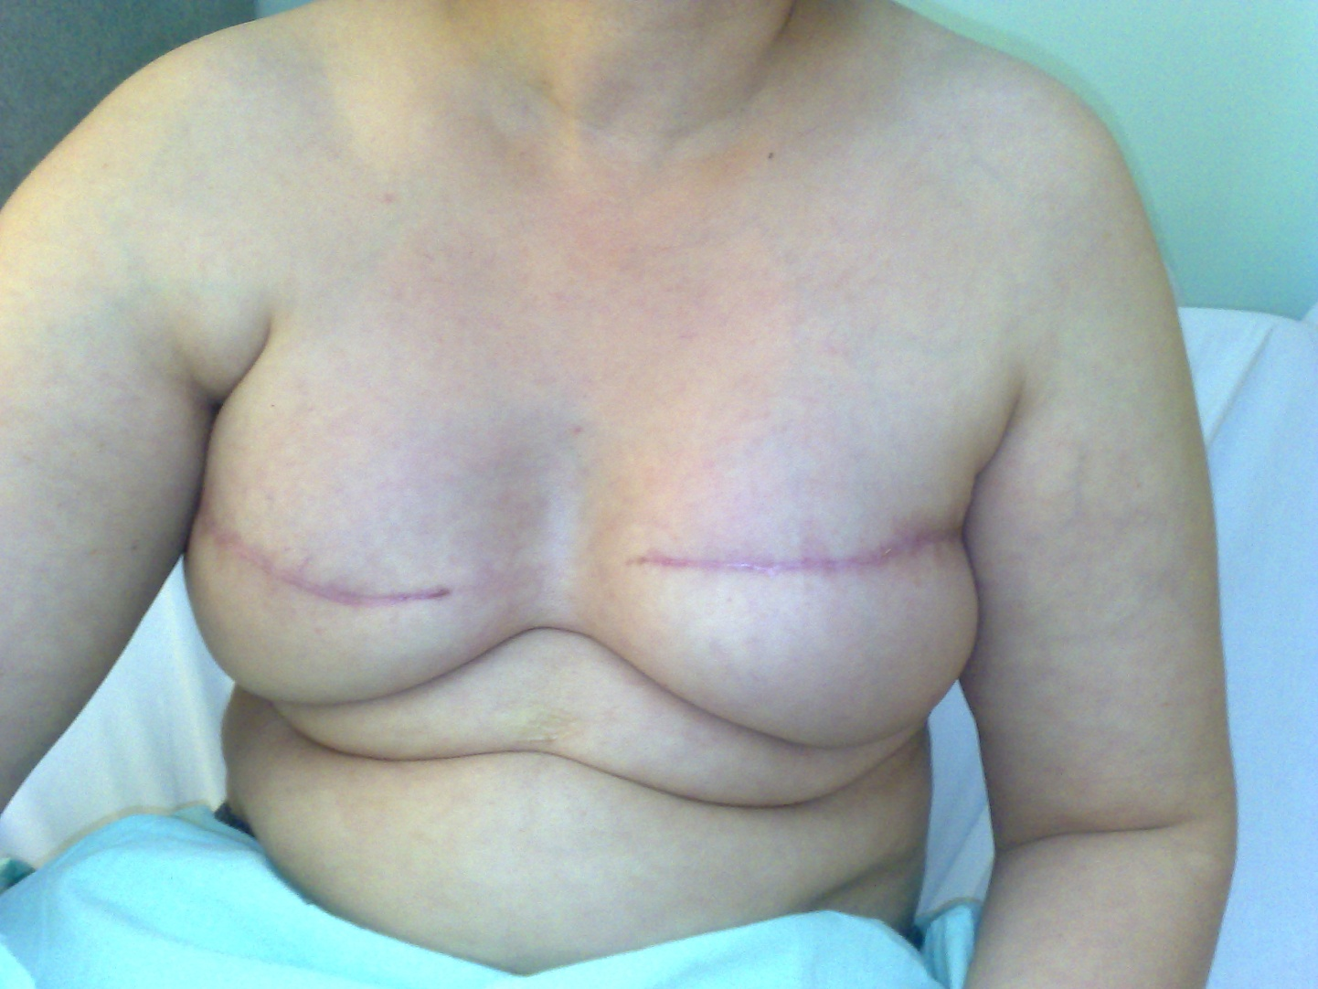

Slide 14
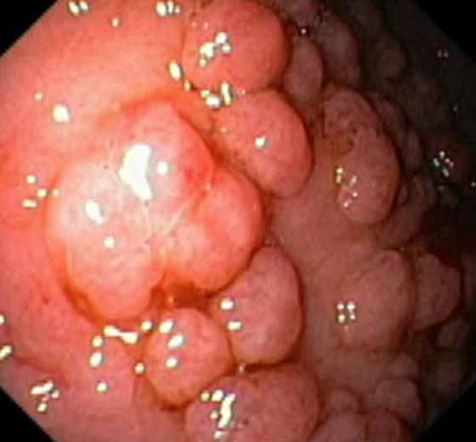
Colon in FAP

Slide 15
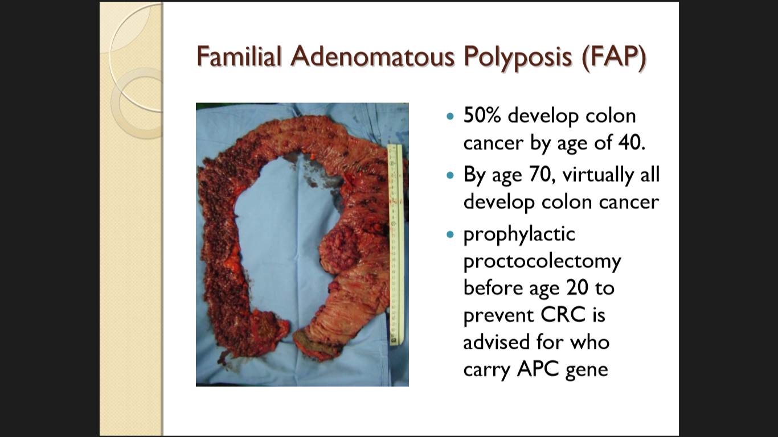

Slide 16
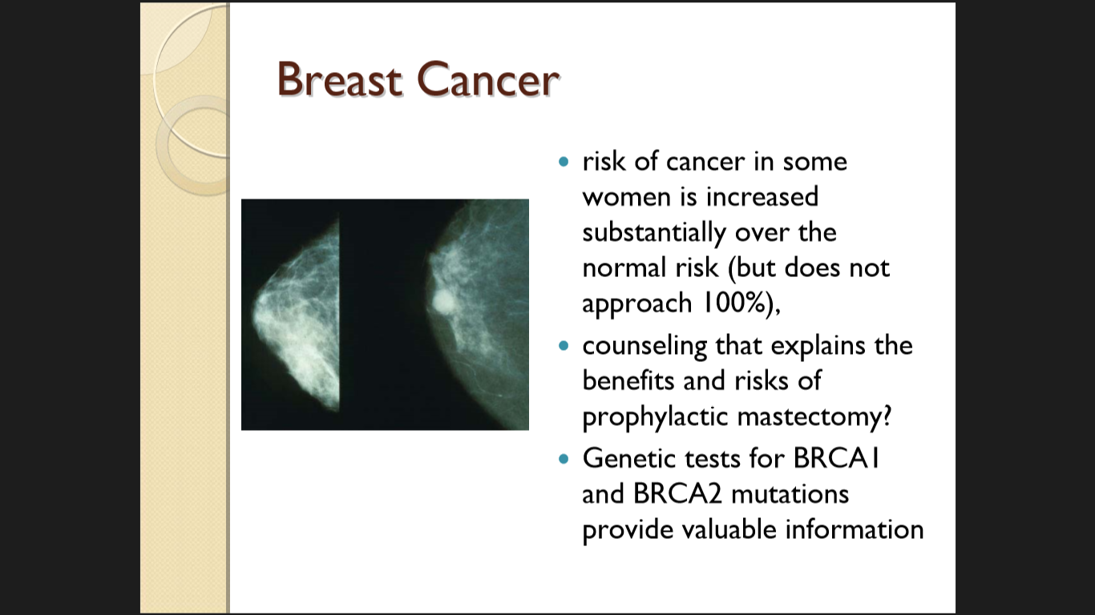

Slide 17
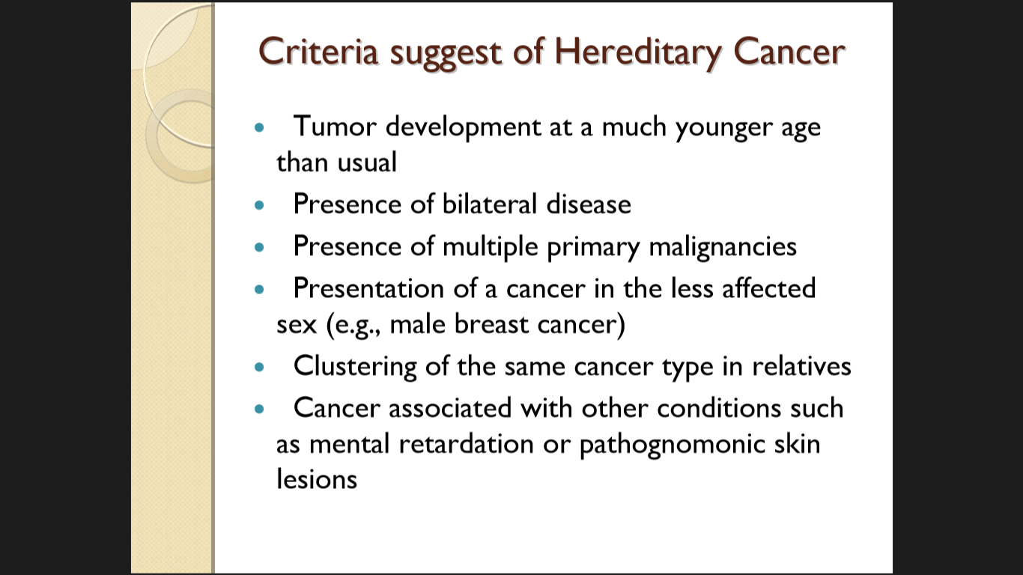

Slide 18
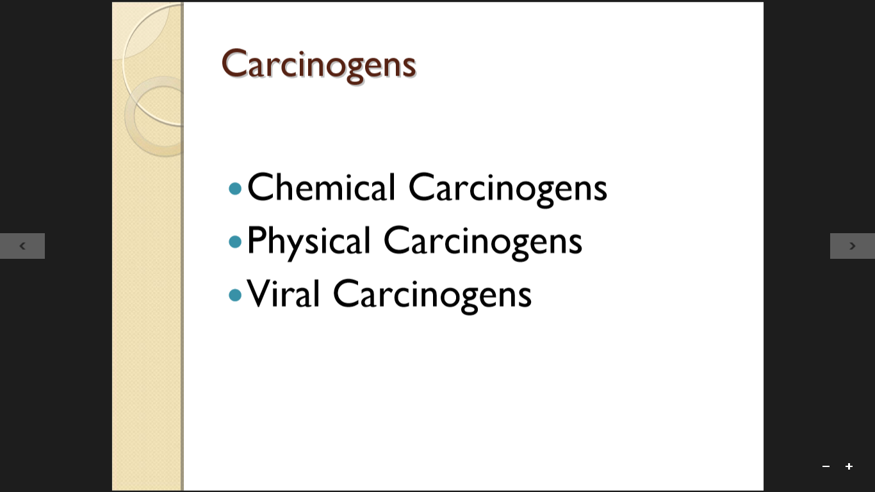

Slide 19
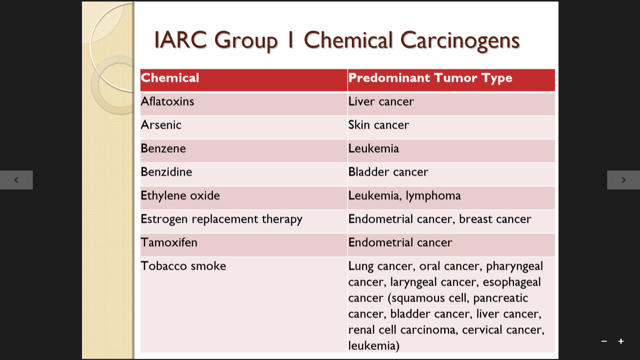

Slide 20
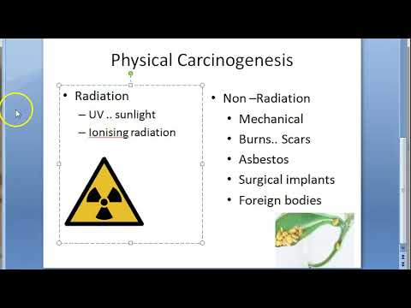

Slide 21
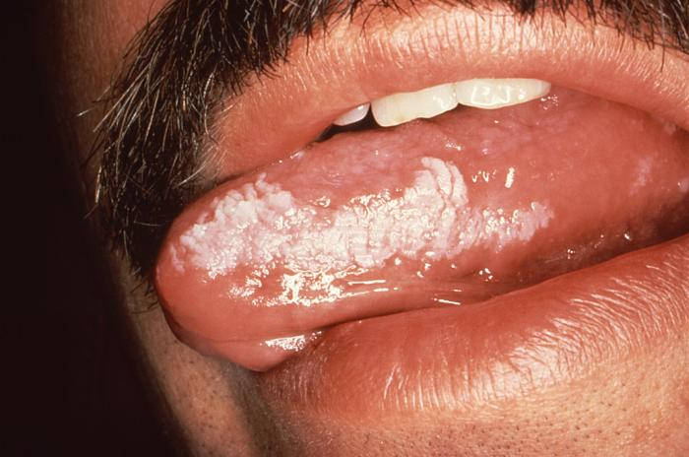
Leukoplakia of the tongue: thick white patches on the inside surfaces of mouth (precancerous)

Slide 22
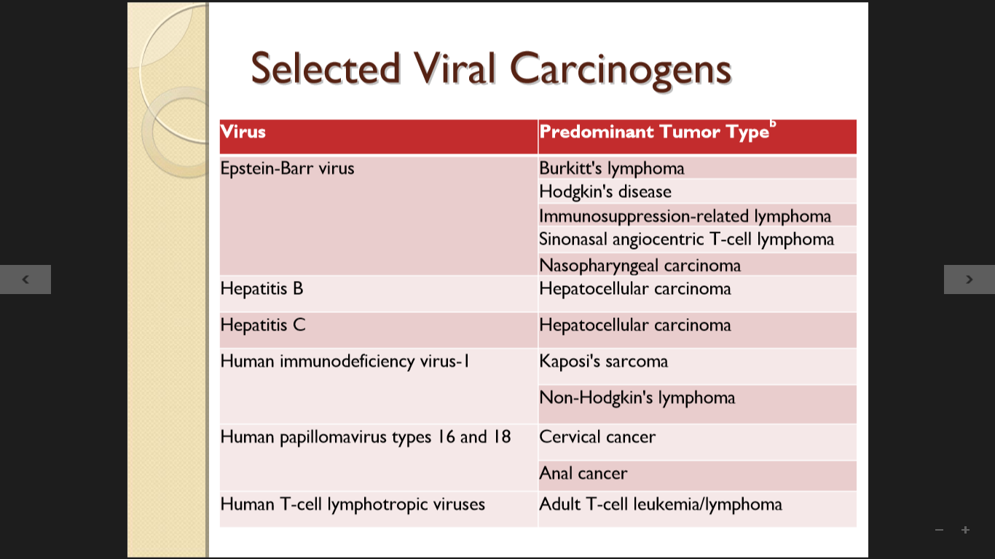

Slide 23
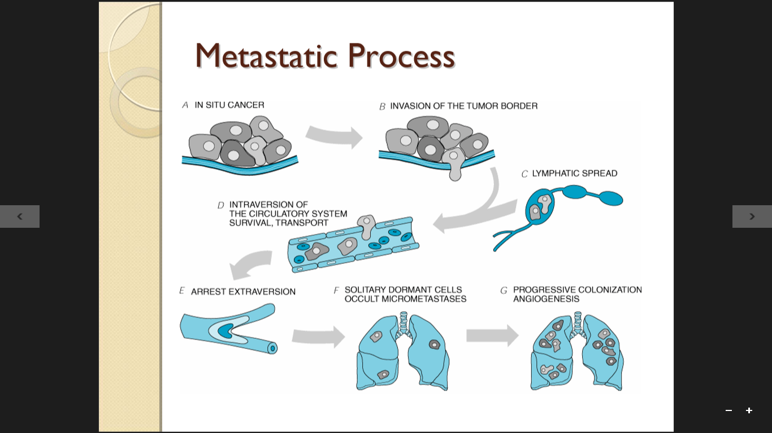

Slide 24
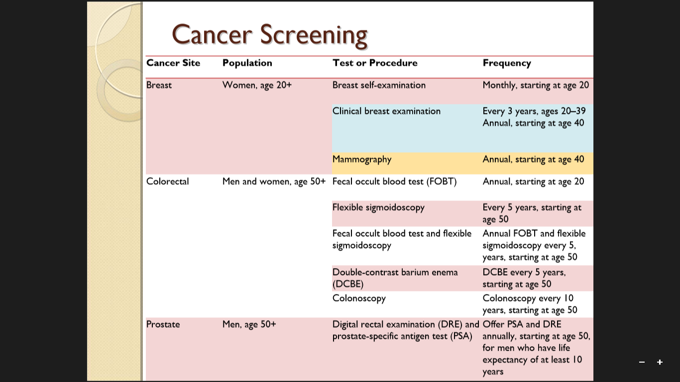

Slide 25
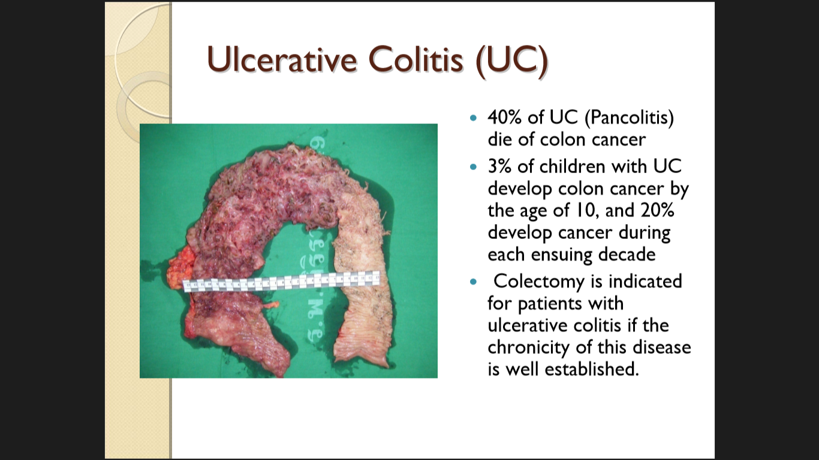

Slide 26
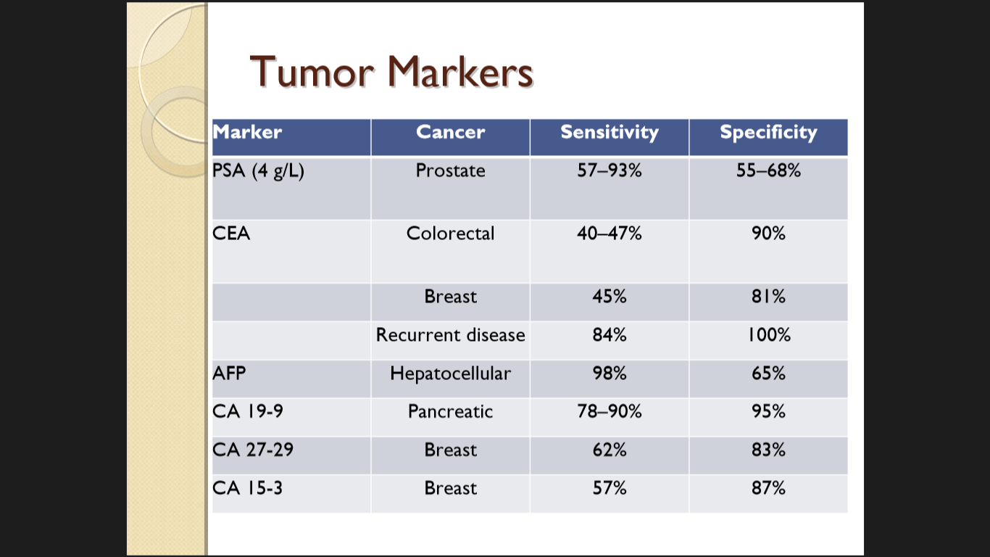

Slide 27
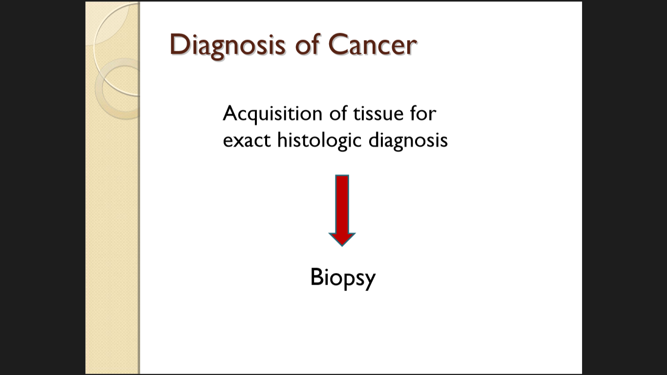

Slide 28
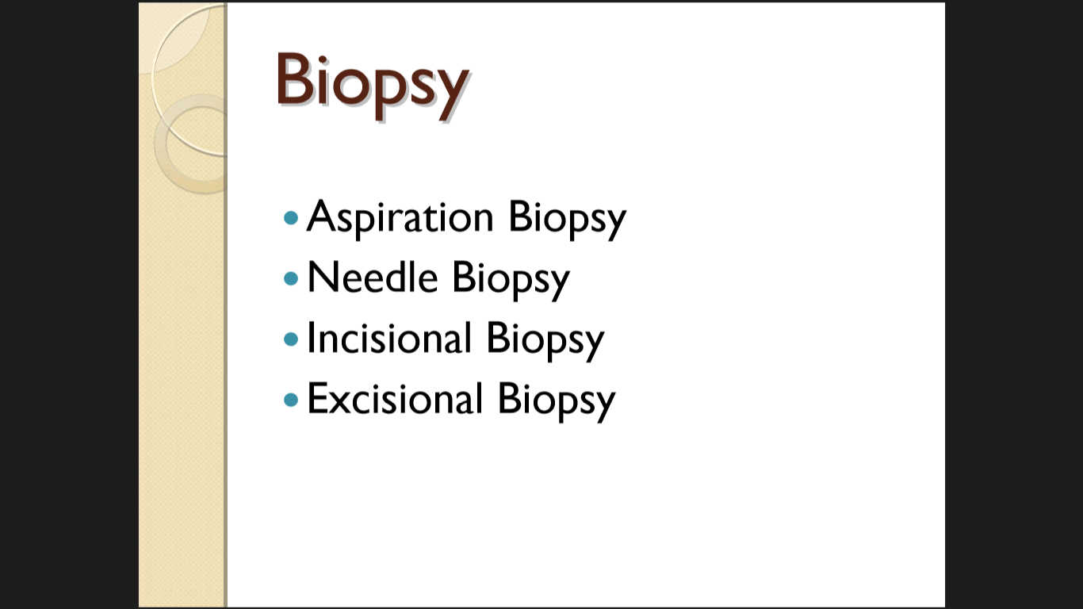
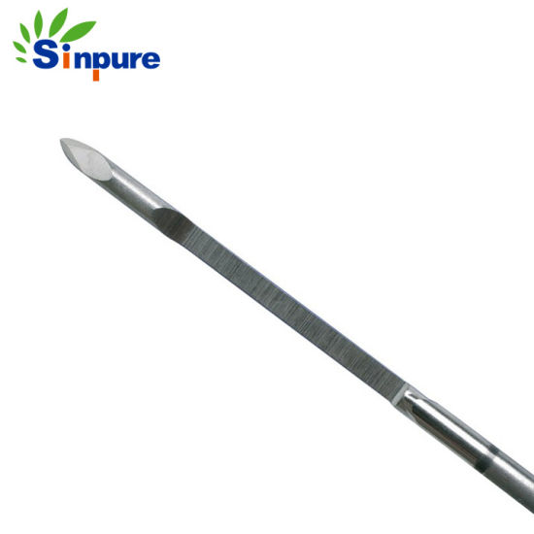
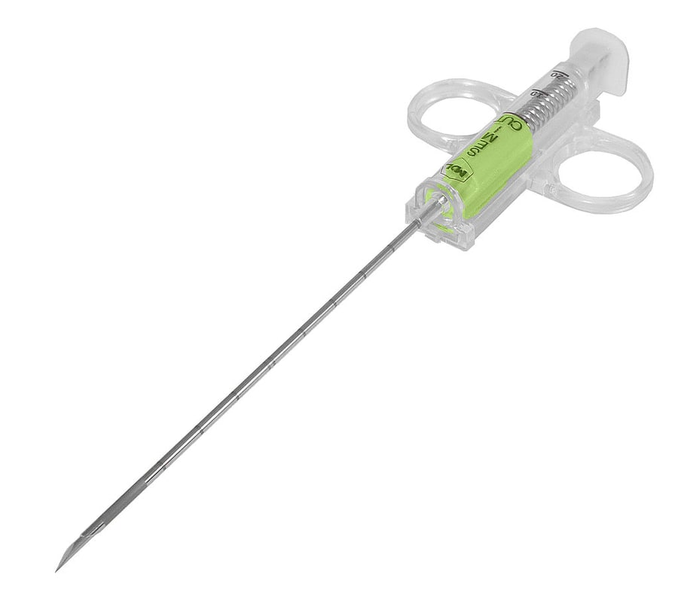

Slide 29
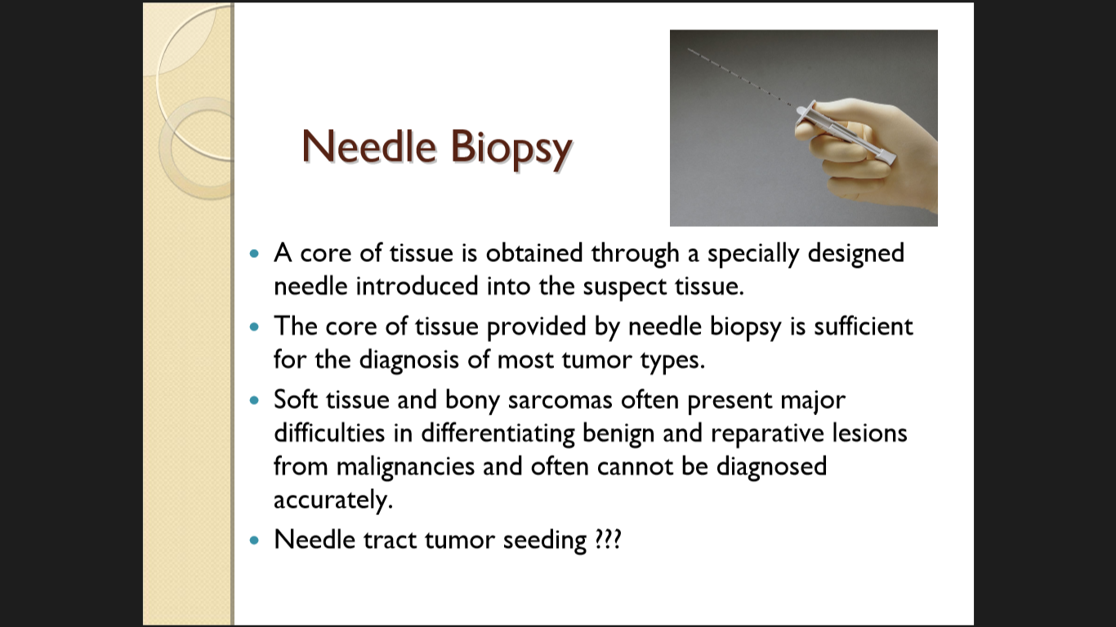

Slide 30

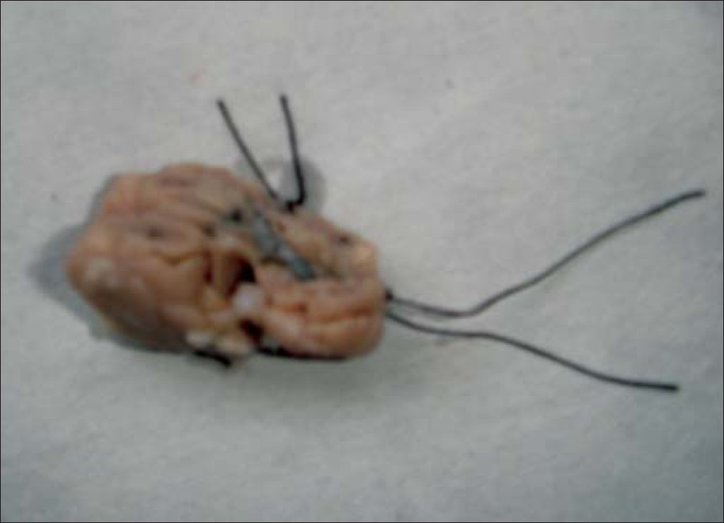
Frozen section examination:
A measure of the adequacy of the
oncological surgical operation.
The operative specimens need to be correctly orientated by the surgeon
The key issues are: whether the margins of the specimen removed are clear of tumour.
The total number of lymph nodes excised together with the number of involved lymph nodes

Slide 31

Margins of surgical excision
In general a margin of 2–5 cm is suggested.
BUT
For excision of melanomas the depth of excision is more important than the extent of surrounding skin. A margin of 2 cm usually sufﬁces in contrast to the 5cm previously practiced.
For oesophageal resection the majority of the oesophagus needs to be resected because the tumour does spread up and down in the submucosal plane.
Soft tissue sarcomas may spread along aponeurotic planes so that complete excision requires the resection of the entire muscle group and fascial compartment.
Rectal cancer occurs into perirectal tissues has led to the use of the total mesorectal excision of the rectum.
.

Slide 32
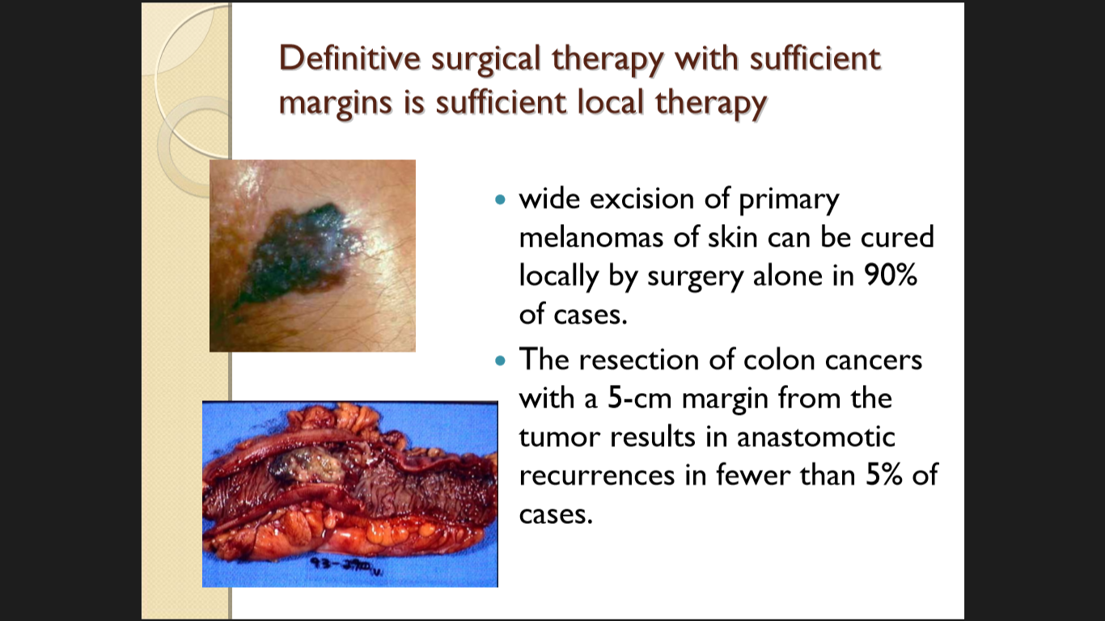

Slide 33
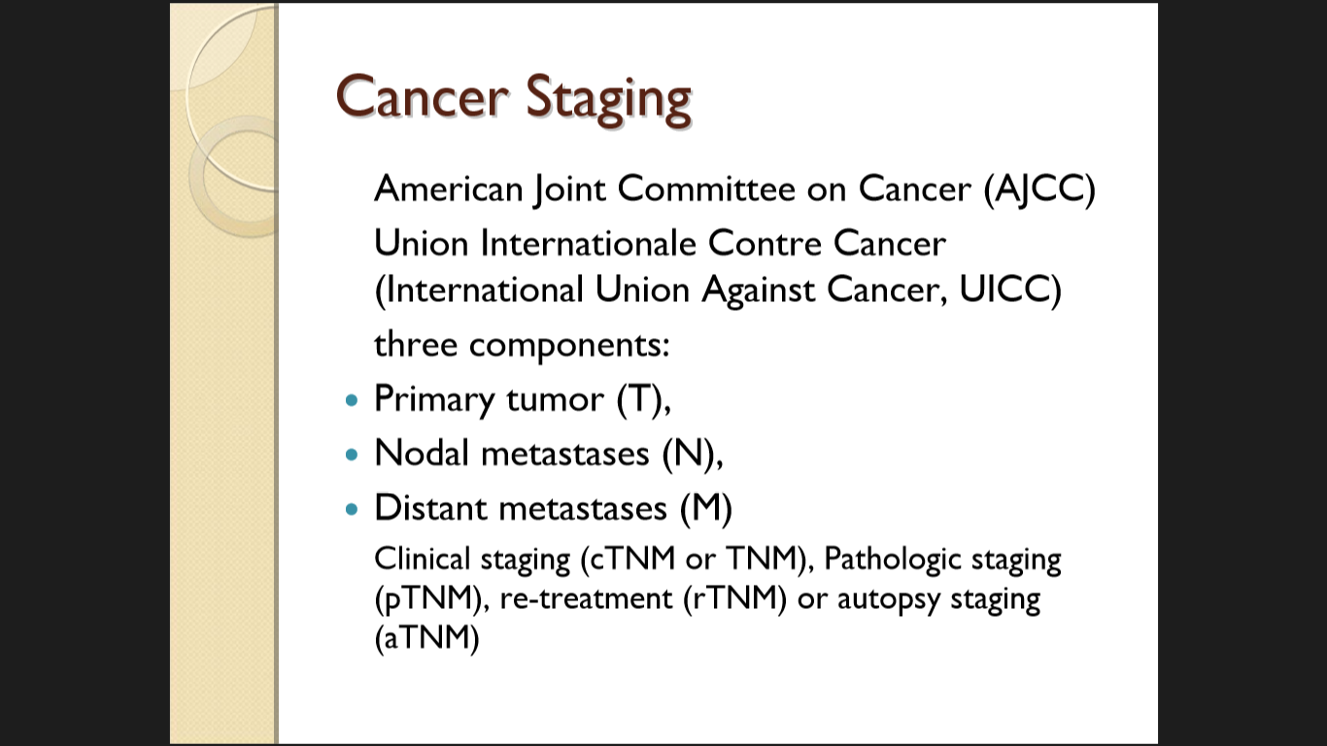

Slide 34
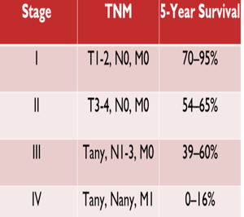
Staging: Why?
  To aid the clinician in planning treatment
  To give some indication of prognosis
  To assist in evaluating the results of treatment
  To facilitate the exchange of information between treatment centers
  To contribute to continuing investigations of human malignancies

Slide 35
Anatomic Staging
Based on three components
T | The extent of the primary tumor
N | The absence or presence and extent of regional lymph node metastasis
M | The absence or presence of distant metastasis

Slide 36
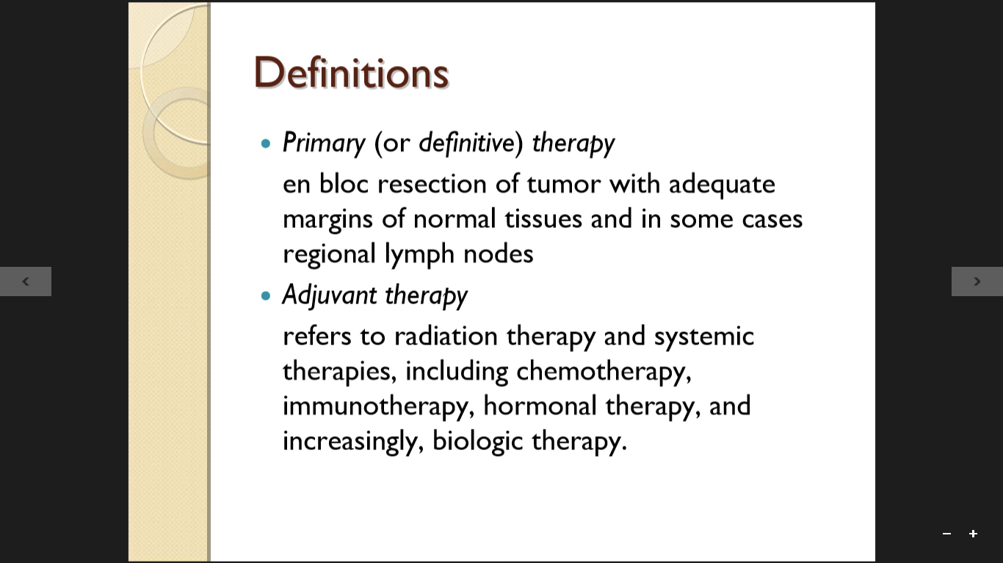

Slide 37
Radiation therapy, often combined with chemotherapy, so called chemoradiation
May be used preoperatively to reduce the bulk of a large primary tumour in order to improve successful surgical resection. (neoadjuvant therapy)
Post-operatively (adjuvant therapy).
Some cancers can be cured with chemotherapy alone.
Testicular tumours and Hodgkin’s disease are such examples.

Slide 38
Types of surgery in cancer treatment Based on outcome:
1. Curative surgery
2. Palliative surgery
3. Debulking
4. Preventive
5. Diagnostic
6. Staging
7. Supportive surgery
8. Restoration surgery
9. Oncoplastic surgery
10.Radioablaton surgery

Slide 39
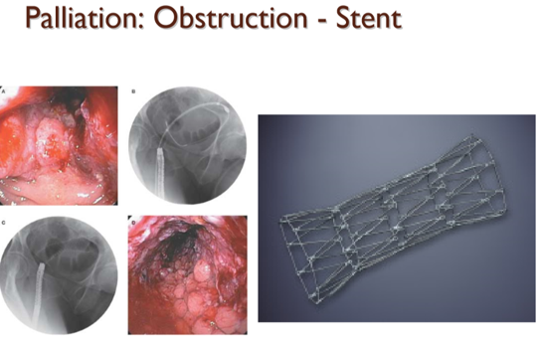
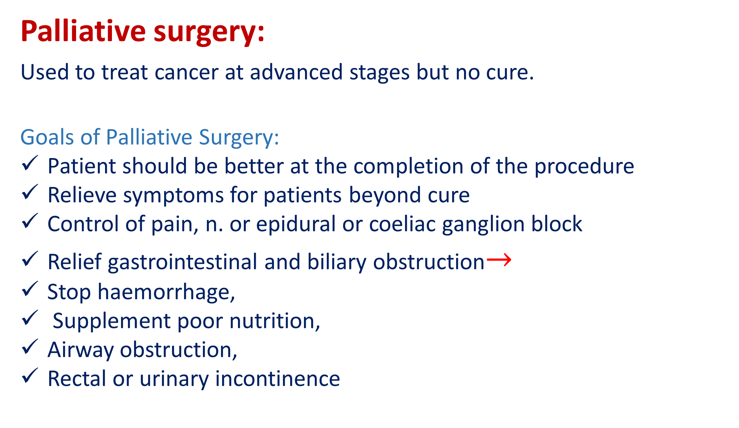
Palliative surgery:
Used to treat cancer at advanced stages but no cure.
Goals of Palliative Surgery:
Patient should be better at the completion of the procedure
Relieve symptoms for patients beyond cure
Control of pain, n. or epidural or coeliac ganglion block
Relief gastrointestinal and biliary obstruction$→$
Stop haemorrhage,
Supplement poor nutrition,
Airway obstruction,
Rectal or urinary incontinence

Slide 40
Debulking surgery :
Removes a portion of a cancerous tumor.
Used in certain situations when removing an entire tumor may cause damage to an organ or the body.
Other types of cancer treatment, such as chemotherapy and radiation, may be used after debulking surgery is performed.

Slide 41
Preventive (Prophylactic )surgery:
Is used to remove tissue that does not contain cancerous cells, but may develop into a malignant tumour.
e.g.:
– BRCA 1,2 – Mastectomy, Oophorectomy
– MEN 2 – RET - Thyroidectomy RET encodes a receptor tyrosine Oncogen
– FAP – FAP – Total Colectomy
Treating of precancerous conditions
Leukoplakia of the tongue
Circumcision for BXO☹ Blanitis Xerotica Obliterance

Slide 42
Diagnostic surgery :
Helps to determine whether cells are cancerous.
Used to remove a tissue sample for testing and evaluation (in a
laboratory by a pathologist).
The tissue samples help to:
- confirm a diagnosis,
- identify the type of cancer, or
- determine the stage of the cancer.

Slide 43
Staging surgery:
Works to uncover the extent of cancer, or the extent of the disease in
the body.
It involves removal of all visible disease, as well as removal of the
ovaries, fallopian tubes and uterus, also include removal of the
omentum, lymph nodes and other organs depending on
the surgical findings.
Laparoscopy
Laparotomy
Endoscopic mucosal resection (EMR) provides essential staging
information that guides treatment in CA oesophagus .

Slide 44
Supportive surgery:
Is similar to palliative surgery because it does not work to cure cancer.
Instead, it helps other cancer treatments work effectively.
An example of supportive surgery is the insertion of a catheter to help with intravesical chemotherapy.

Slide 45
Restorative surgery
Is sometimes used as a follow-up to curative or other surgeries to
change or restore a person’s appearance or the function of a body part.
• 1895 - 1st attempt at true breast recontruction by Czerny, who
transplanted a large lipoma from pt’s flank to mastectomy site
• 1906 - Tansini used “latissimus dorsi myocutaneous flap”
• 1963 - silicon breast implant introduced

Slide 46
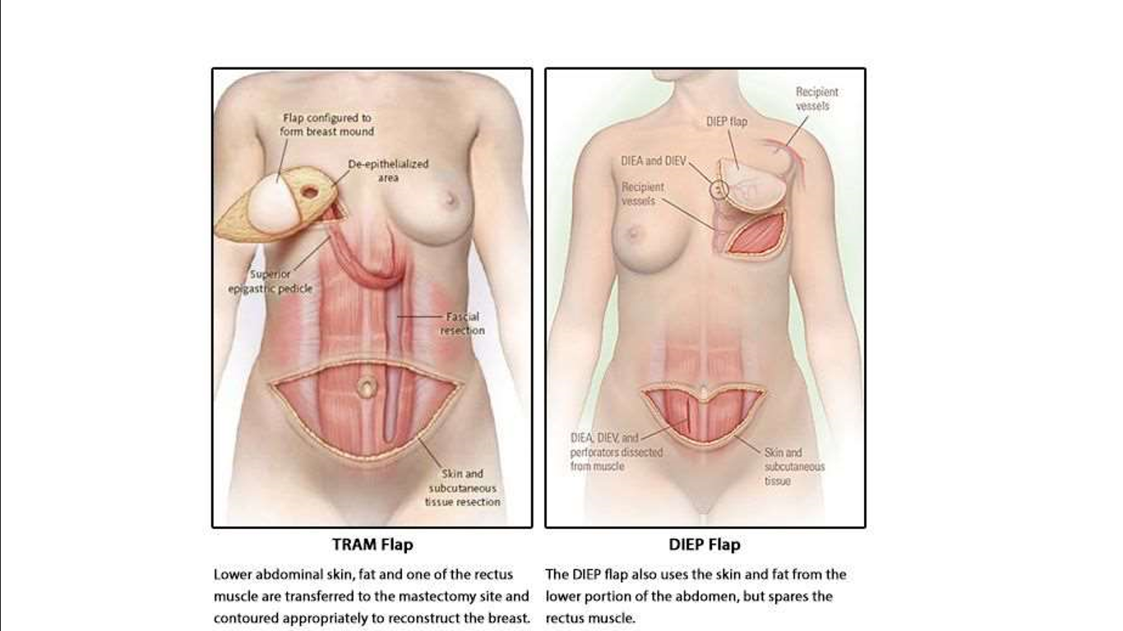
transverse rectus abdominal myocutaneous
(TRAM) flaps
Deep
Inferior
Epigastric
Artery
Perforator
Flap

Slide 47
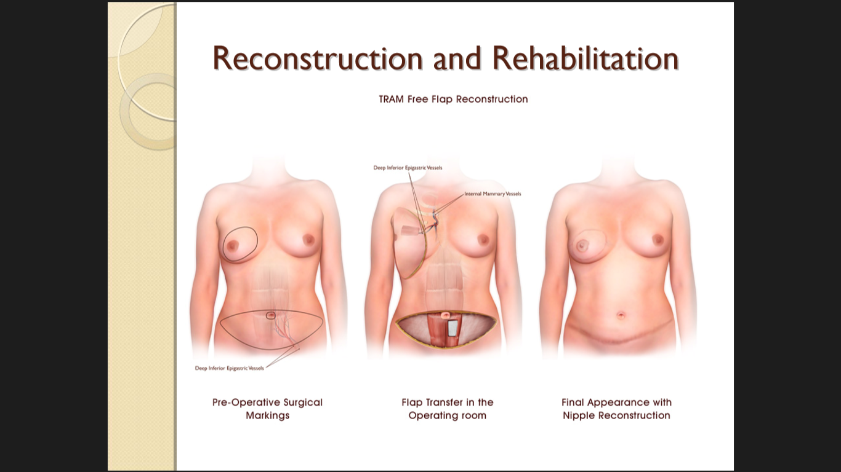

Slide 48
THANKS

