Slide 1
Abdominal wall & Hernia

Slide 2
ILOs
Anatomy: anterior abdominal wall, inguinal & femoral canal
Rectus sheath hematoma & Desmoid tumor: aetiology, clinical presentation & management
Groin & Abdominal wall hernias: aetiology, risk factors, presentation, complications & management

Slide 3
Hesselbach Triangle
Weak spot in anterior abdominal wall through which direct hernia appears.
••Medial: Outer border of rectus abdominis
••Lateral: Inferior epigastric vessels
••Below: Medial part of inguinal ligament
••Floor: Fascia transversalis
––Traversed by medial umbilical fold; (Obliterated Umbilical Artery)

Slide 4
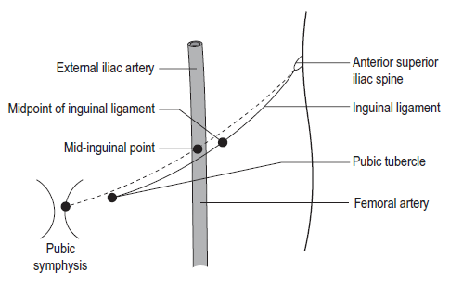
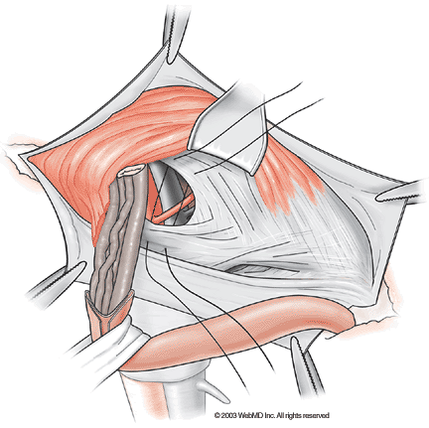
Inguinal Canal (House of Bassini)
••3.75 cm length
••Extends from deep ring to superficial ring
••Deep ring is a semioval opening in the fascia transversalis
••Superficial ring is a triangular opening in the external oblique aponeurosis

Slide 5
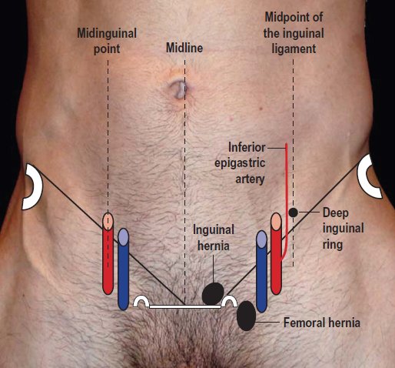
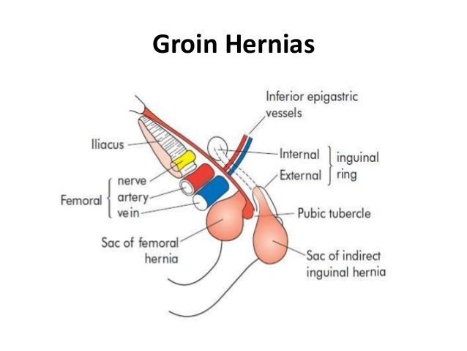
Landmarks
Deep ring: Half inch above mid point of inguinal ligament (Between anterior superior iliac spine and pubic tubercle)
(Remember here: Femoral artery is palpated at Mid inguinal point between ASIS and symphysis pubis)
Superficial ring: Just above pubic tubercle
Saphenous opening: 4 cm below and lateral to pubic tubercle

Slide 6
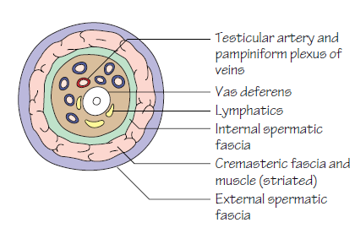
Contents of Inguinal Canal
Ilioinguinal nerve
Spermatic cord in male, round ligament in female
Contents of spermatic cord
Arteries : Testicular Artery
Artery of Vas
Artery to Cremaster
Veins : Pampiniform plexus of veins
Veins corresponding to Arteries
Lymphatics of testis
Testicular plexus of sympathetic nerves
Genital branch of genitofemoral N
Vas deferens

Slide 7
Femoral canal: 2 x 2 cm size
Medial compartment of femoral sheath
Base: Femoral ring
Bounded
Anteriorly—inguinal ligament
Posteriorly—cooper’s ligament
Medially—lacunar ligament
Laterally—femoral vein
Contents: Cloquet’s node
Lymphatics
Areolar tissue
Other names:
Inguinal ligament: Poupart’s
Lacunar ligament: Gimbernat’s
Iliopectineal ligament: Cooper’s
Saphenous opening: Fossa ovalis

Slide 8

Abdominal wall hernia
DEFINITION: Hernia is an abnormal protrusion of a part or whole of the viscus through a normal or abnormal opening through the wall of the cavity that contains it.
Risk factors:
Chronic cough, obesity,
Straining (constipation),
Repeated pregnancy,
Family history,
Ascites,
Defective collagen synthesis,
Heavy lifting,
RLQ incision.

Slide 9
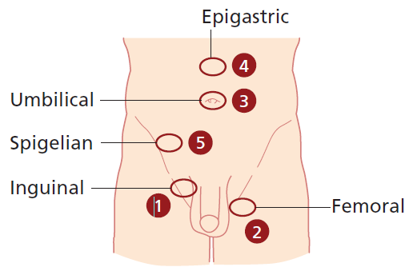
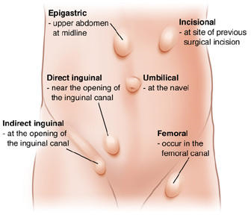
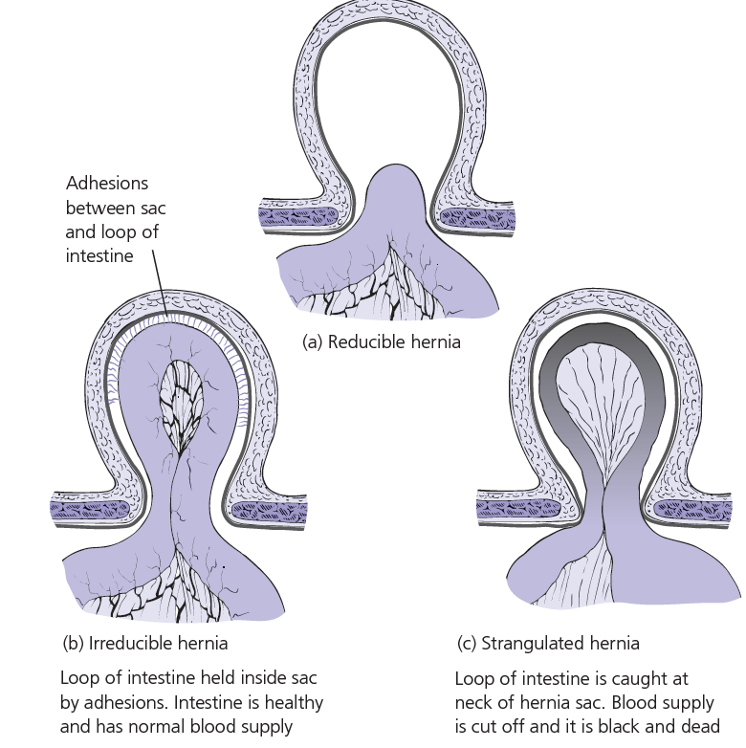
Types of Hernias
Groin hernias: Inguinal (direct/ indirect) , femoral
PUH, UH
Epigastric
Incisional
Each type can be:
Reducible
Irreducible/ incarcerated
Complicated: Obstructed & strangulated

Slide 10
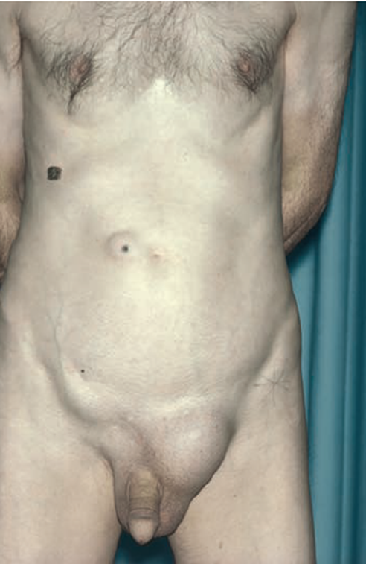
Groin Hernias
Indirect Inguinal Hernia (60%),
Direct Inguinal Hernia(25%)
Rarely obstructs/ strangulates
Appears as wide bulge
Often reduces spontaneously after cough or lying
Femoral hernia (15%)

Slide 11
DIFFERENTIAL DIAGNOSIS
Inguinal Swelling Inguinoscrotal Swelling
1. Enlarged lymph nodes 1. Encysted hydrocele of cord
2. Undescended testis 2. Varicocele
3. Lipoma 3. Lymphvarix
4. Femoral hernia 4. Diffuse lipoma of cord
5. Saphena varix 5. Inflam thickening of cord
6. Psoas abscess 6. Psoas abscess
7. Femoral aneurysm

Slide 12
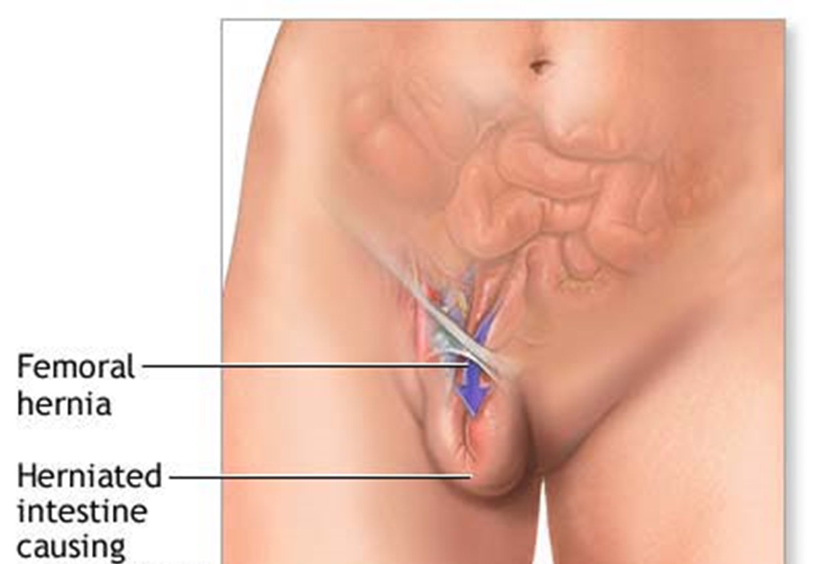
Femoral hernia
Projects through femoral ring and passes down the femoral canal (1.25 cm)
Appears, to lie in front of inguinal ligament

Slide 13
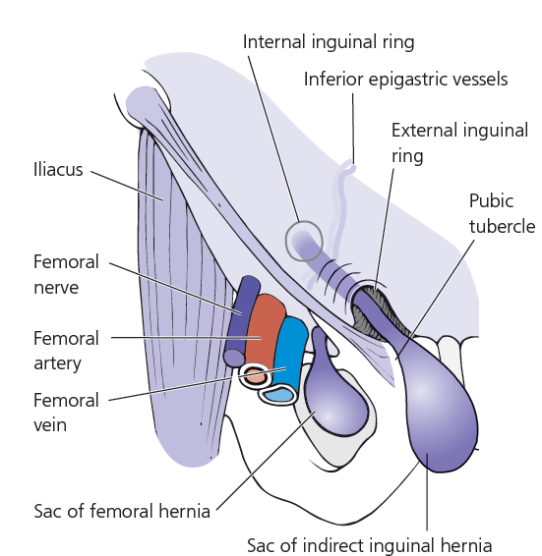
Clinical features of Femoral hernia
Groin swelling - often small
Groin pain on exercise
Often irreducible due to its curved course
Sometimes difficult to distinguish with IH
Examination: Put a finger tip over pubic tubercle (How to find it?)
IH- above & medial FH- below & lateral
Obstruction, strangulation rate high (40%)

Slide 14
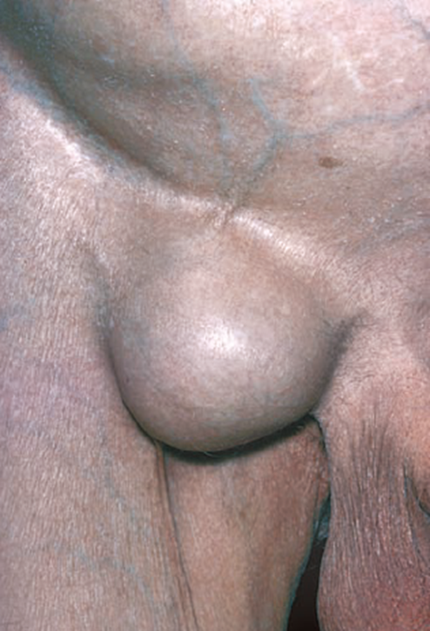
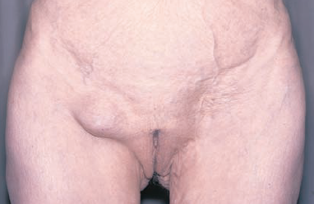

Differential diagnosis- Femoral hernia
Lymphadenopathy : Cloquet’s node
Saphenous varix- thrill on cough, disappears on lying down
Inguinal hernia
Ectopic testis
Psoas abscess
Femoral aneurysm
Soft tissue neoplasms as lipoma

Slide 15
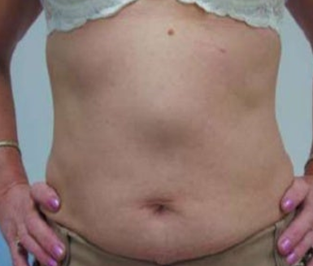
Epigastric hernia
Protrusion through a defect in linea alba, Firm midline lump.
Often contains preperitoneal fat or peritoneal sac with omentum
Open surgical repair by non-absorbable suture or mesh
Laparoscopic repair- if large

Slide 16
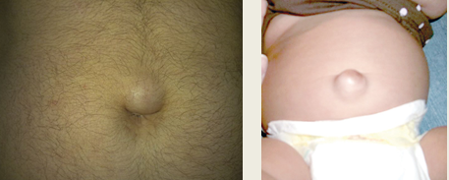
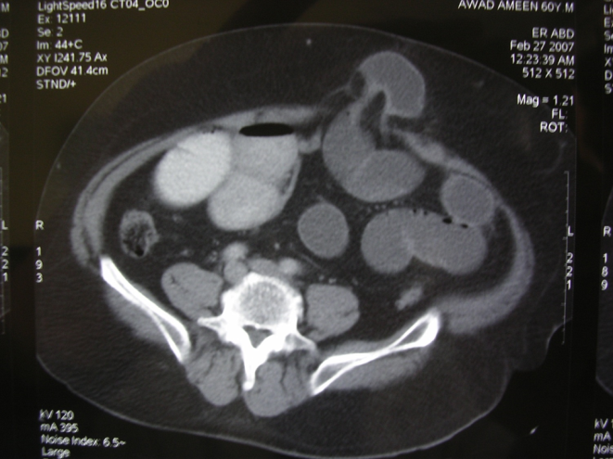
Umbilical, Para-umbilical hernia
UH: Protrusion through umbilicus. Infants when they cry. Spontaneous resolution in most by age 3. If not resolved - surgical repair
PUH: Protrusion through tissue around umbilicus.
Gradually enlarges, stretching overlying skin.
Multilocular defects , irreducible due to adhesion.
More common in female
Surgery advisable. High risk- obstruction/ strangulation

Slide 17
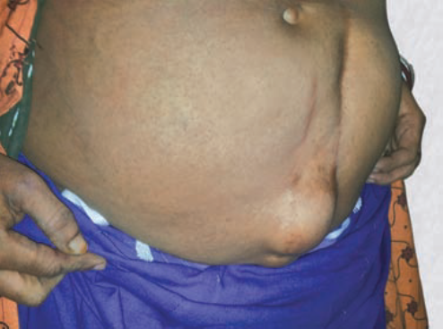
Incisional hernia
Hernia through poorly healed abdominal incisions
More common with midline vertical incisions
Predisposing factors:
1. Poor surgical technique:
Layered closure, absorbable suture, suturing under tension, drain tubes are brought out through the main wound
2. Preoperative straining factors: Chronic cough, chronic constipation and urinary obstruction.
3. Postoperative complications: Abdominal distension, cough, respiratory distress due to pneumonia or lung collapse, and postoperative wound infection.
4. General factors: Age (elderly patients), malnutrition, hypoproteinemia, jaundice, malignancy, diabetes, chronic renal failure, steroid or immunosuppressive therapy and alcoholism.

Slide 18
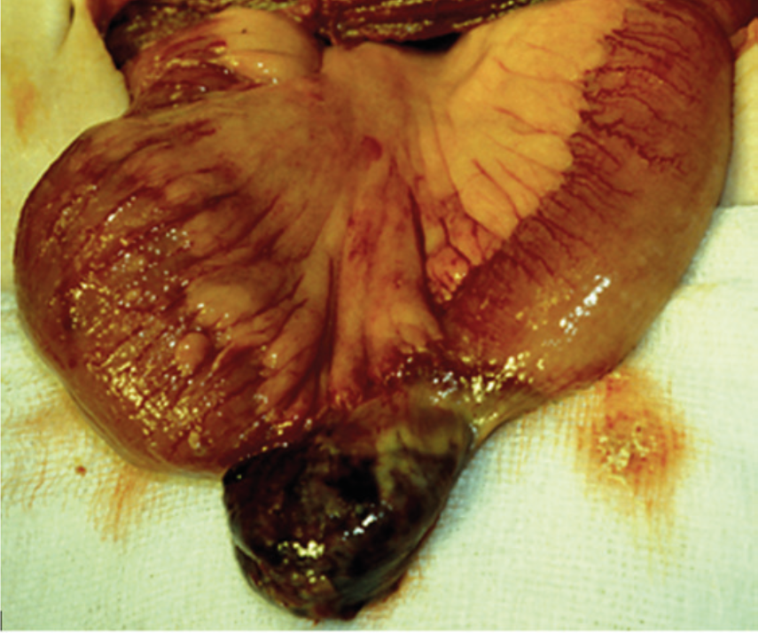
Uncommon Hernias
Richter’s hernia
Partial thickness of bowel trapped within sac leads to partial bowel obstruction with vomiting but the patient continues to pass flatus.
Sliding hernia
A peritoneal covered structure such as the colon or urinary bladder slides down extra-peritoneally with the peritoneum adjacent to it and forms the wall of the hernial sac.
Littre’s hernia:
Hernial sac containing Meckel’s diverticulum as the content is called Littre’s hernia.
Pantaloon/ Dual hernia:
A pantaloon hernia is described as having both a direct and indirect inguinal hernial sac lying
On either side of inferior epigastric vessels.
Amyand's hernia: incarcerated appendix

Slide 19
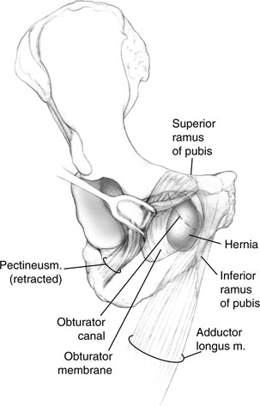
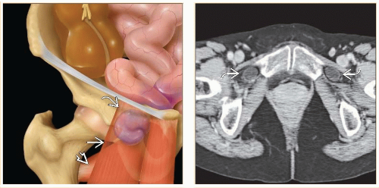
Rare external hernias
Obturator hernia: through obturator canal.
Common in female.
Diagnosis- usually at laparotomy for intestinal obstruction due to strangulated hernia.

Slide 20
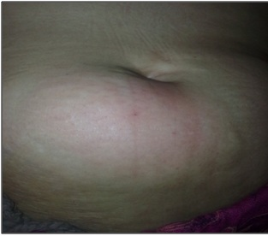
Spigelian hernia: through linea semilunaris at the lateral border of rectus abdominis. Surgical repair
Spigelian hernia in the left iliac fossa. Note the scar from a previous left inguinal hernia repair.

Slide 21
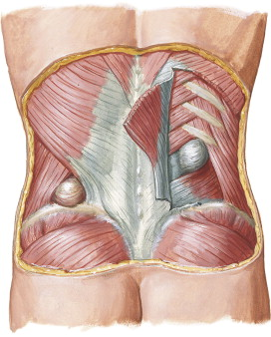

Lumber hernias
Superior lumbar triangle:
Hernia bulges below 12th rib between sacrospinalis
and posterior border of internal oblique
Inferior lumbar triangle:
Hernia bulges above iliac crest between posterior
border of ext. oblique & latissimus dorsi.
Inferior lumbar hernia, which contained caecum, appendix and small bowel.
Left superior lumbar hernia, containing extraperitoneal fat

Slide 22
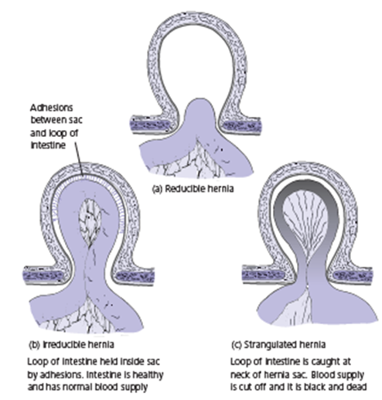
Complications of Hernia
Incarcerated: Hernia contents are irreducible due to adhesion. May obstruct or strangulate.
Obstructed: Irreducible hernia presenting with intestinal obstruction.
Strangulated: When blood supply to the contents is jeopardized in an irreducible hernia.
Skin discoloration over
a strangulated incisional hernia

Slide 23
INVESTIGATIONS
I. Routine
Hemoglobin
Bleeding time/Clotting time
Total count, differential count, ESR
Urine—albumin, sugar deposits
Blood—urea, sugar
Blood grouping/typing—for irreducible hernia/huge hernia
II. Anesthetic Purpose
X-ray chest (Chronic TB, Asthma—precipitate hernia)
ECG all leads
III. USG Abdomen and Pelvis
In old age group—to find benign prostate hyperplasia calculate post-voidal residual urine. If >100 ml it is significant
To find any mass

Slide 24
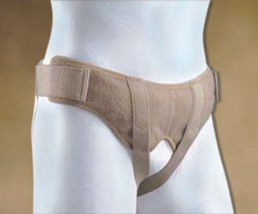
TREATMENT :
A. Treat the precipitating cause of hernia first e.g.
1. Benign prostate hypertrophy
2. Tuberculosis
3. Stop smoking
B. Conservative management is indicated only in cases of very old man with direct hernia; since there is no chance of obstruction.
C. Truss : is not curative for hernia.
It is a special belt devised to keep the hernia reduced at the deep ring or Hesselbach triangle for those who are unfit or unwilling for surgery
Hernia should be reducible to wear a truss.
Contraindicated in cases of irreducible hernia, undescended testis, associated huge hydrocele, unintelligent people.

Slide 25
SURGERIES FOR HERNIA
Indirect Hernia: Adult - Herniotomy + mesh repair
Children- Herniotomy
Direct Hernia: No sac excision, sac reduced
1. Herniotomy
1. Separation of sac from cord structures
2. Reducing the content
3. Transfixation and ligation of sac
4. Excise the redundant sac.
2. HERNIORRHAPHY
1. Herniotomy
2. Narrowing of the deep ring with 2'0 prolene (Lytle's Repair)
3. Approximation of conjoint tendon with inguinal ligament using 1' polypropylene material
3. Hernioplasty
There is already weakness of abdominal wall muscles, so no approximation can be done.

Slide 26
Hernioplasty
Open surgery: Prolene mesh repair
Laparoscopic mesh repair: Less postoperative pain, shorter hospital stay
Mesh repair complications: Seroma, infection
Laparoscopic repair: Less hernia recurrence
Polyester mesh in an epigastric hernia repair.

Slide 27
Complications of hernia surgery
Intraoperative Immediate postoperative Late complications
1. Injury to the blood vessels
(inferior epigastric and femoral) 1. Urine retention 1. Recurrence
2. Injury to bowel and bladder 2. Hematoma 2. Numbness over the local region
if the nerve was cut
3. Injury to ilioinguinal and
iliohypogastric nerves 3. Infection
4. Injury to cord structures 4. Periostitis of pubic tubercle
(as the stitch is taken from periosteum)
5. Postherniorrhaphy hydrocele
(due to obstruction of lymphatics
at deep ring when narrowed tightly)

Slide 28
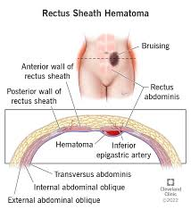
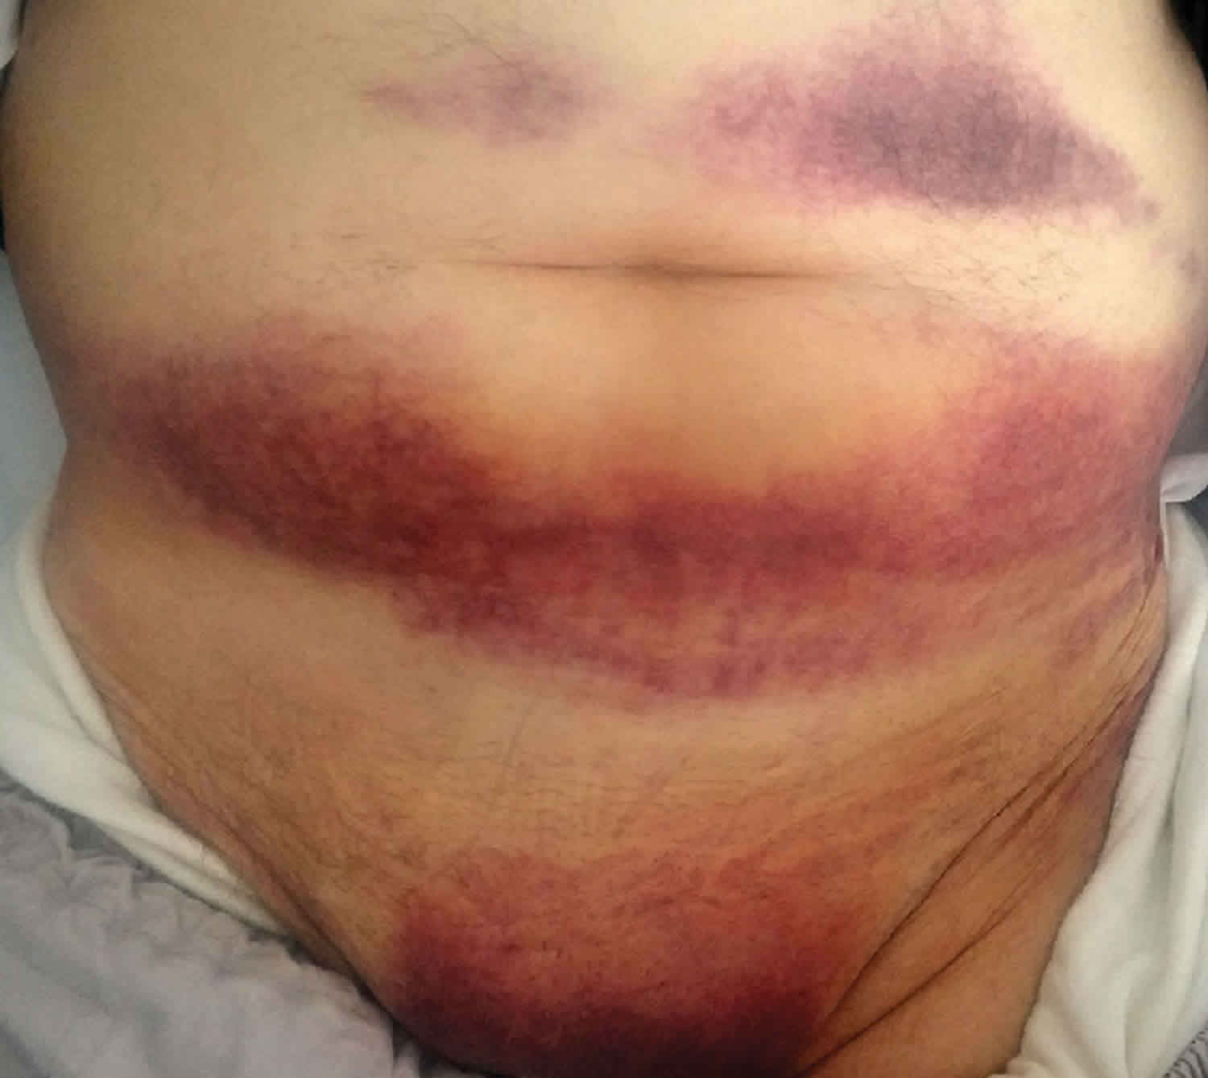
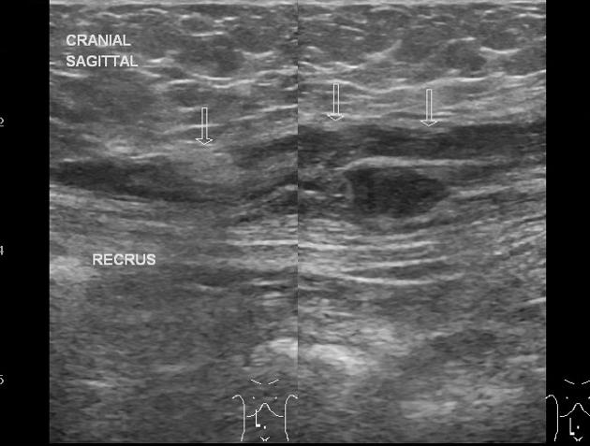
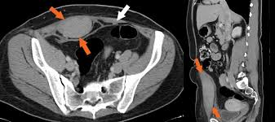
Rectus sheath haematoma
Aetiology:
Bleeding from inferior epigastric artery
Spontaneous (anticoagulation)
Traumatic (excessive physical activity)
Presentation: painful, tender swelling- LQ of the abdomen
Diagnosis-U/S.
Treatment: Spontaneous resolution/ surgical evacuation.

Slide 29
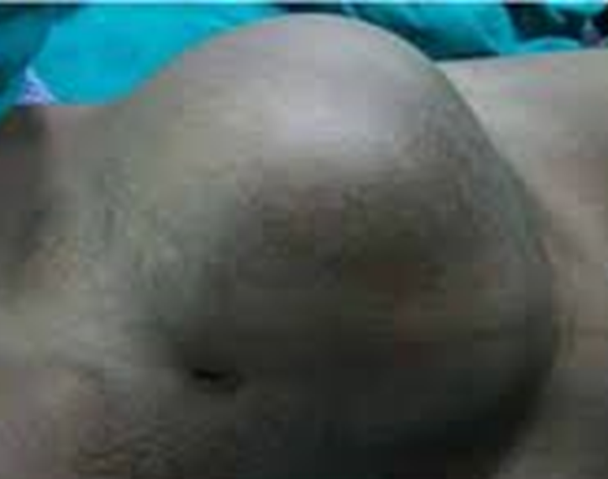
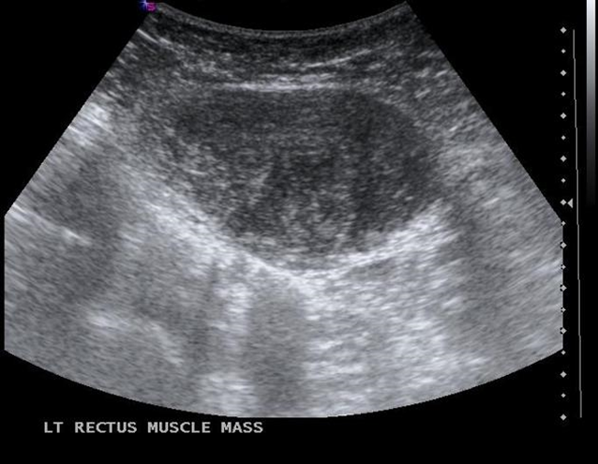
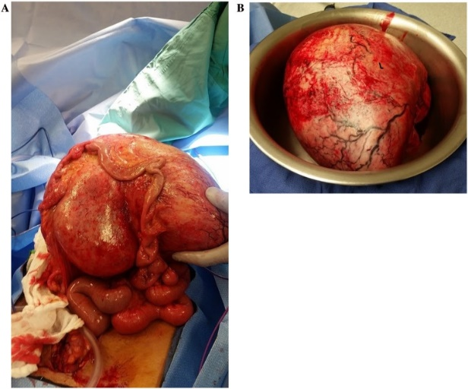
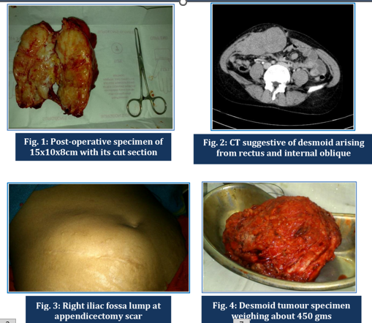
Desmoid tumour
Fibromatosis/ neoplasm: from fibroaponeurotic part of rectus abdominis.
More common in young female of child bearing age, OC use.
Other sites- extremity, intra-abdominal.
Diagnosis: CT or MRI for delineation, core needle biopsy.
Treatment: Wide local excision. Local recurrence high if margins are involved.
Recurrence: Radiotherapy, anti-oestrogen , NSAID- Sulindac Indomethacin
Chemotherapy for rapid growing recurrence

Slide 30
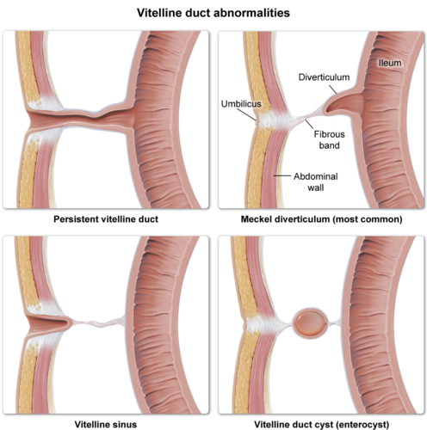
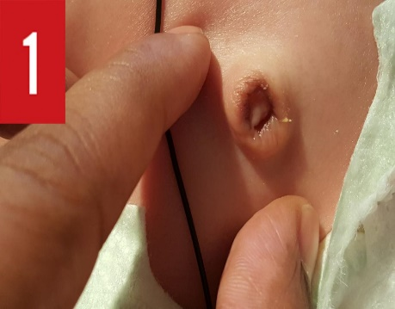
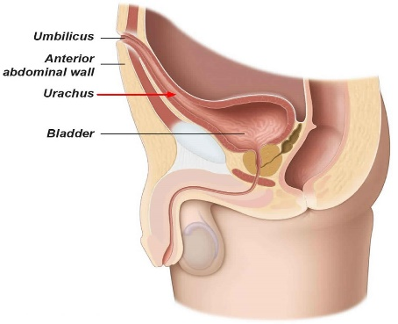
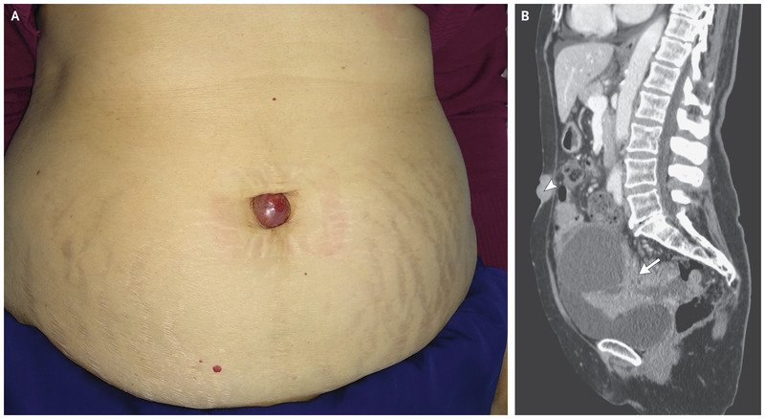
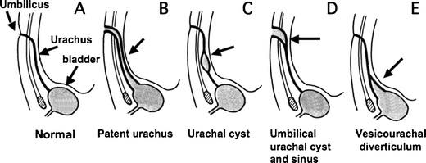
Diseases of Umbilicus
1. Persistent vitello-intestinal duct:
Persistent part- Meckel’s diverticulum.
Whole patent duct- fistula between ileum & umbilicus. Foul discharge.
Treatment: excision.
2. Persistent urachus: Cyst or urinary fistula.
3. Tumours: Primary- SCC, Melanoma
Secondary: Tumour tracking along ligamentum teres.
4. Sister Joseph’s nodule
5. Hernia: UH, PUH
Notes:
The urachus is a fibrous remnant of the allantois, a canal that drains the urinary bladder of the fetus that joins and runs within the umbilical cord.

Slide 31
Thank you!

