Slide 1

Acute Abdomen
Mohammed Al Sebayel

Slide 2
Essentials
The ‘acute abdomen’ is defined as a sudden onset of severe abdominal pain of less than 24 hours duration.
Structured approach
Initial assessment of acute surgical problem
  Does it need immediate and prompt surgical intervention,
  or urgent medical therapy.
  critically unwell, give oxygen, start suitable initial steps, and call for help early before going into detail on the history and examination.

Slide 3
Grade of Operative Surgical Urgency in Acute abdomen:
Immediate action:
  Rupture aortic aneurysm
  Bleeding ulcer (gastric or duodenal)
  Trauma.
  Rupture ectopic.
Emergency action:
  Perforations (peptic ulcer, small or large bowel perforation, diverticular disease, Inflammatory bowel disease, bowel obstruction, mesenteric ischemia
Urgent action:
  Colic……..biliary colic ……Acute cholecystitis
  Peritonism (localized peritonitis)……Appendicitis
Non urgent: biliary colic without cholecystitis and renal colic

Slide 4
Presentations Requiring Immediate /Urgent Surgery
The most serious cause of intra-abdominal bleeding is a Ruptured Abdominal Aortic Aneurysm (AAA) which requires swift referral to the vascular team and immediate surgical intervention.
Other common causes usually involve a slower rate of bleeding, but with urgent surgery still required, include Ruptured Ectopic Pregnancy, bleeding Peptic Ulcer and Trauma.
These patients will typically go into hypovolemic shock. Clinical features include tachycardia and hypotension, pale and clammy on inspection, and cool to touch with a thread pulse.

Slide 5
Indications for Urgent Operation
IHOP
Ischemia
Hemorrhage
Obstruction
Perforation

Slide 6
Perforated Viscus
Peritonitis is the inflammation of the peritoneum
Generalized peritonitis is most caused by perforation of an abdominal viscus.
The causes of perforation are broad but include:
  peptic ulceration,
  small or large bowel obstruction,
  diverticular disease,
  and inflammatory bowel disease.

Slide 7
Generalized Peritonitis
Patients with a generalized peritonitis present with some characteristic features:
Patients often lay completely still, not to move their abdomen, and look unwell
  This is especially important when compared to a renal colic, whereby patients are constantly moving and cannot get comfortable.
Tachycardia and potential hypotension
A completely rigid abdomen with percussion tenderness
Involuntary guarding – the patient involuntarily tenses their abdominal muscles when you palpate the abdomen
Reduced or absent bowel sounds, suggesting the presence of a paralytic ileu

Slide 8
Peritonitis and Peritonism….
Peritonism
Peritonism (not peritonitis) refers to the localized inflammation of the peritoneum, usually due to inflammation of a viscus that then irritates the visceral (and subsequently, parietal) peritoneum.
This leads to patients stating that their abdominal pain starts in one place (irritation of the visceral peritoneum) before localizing to another area* (irritation of the parietal peritoneum) or becoming generalize

Slide 9
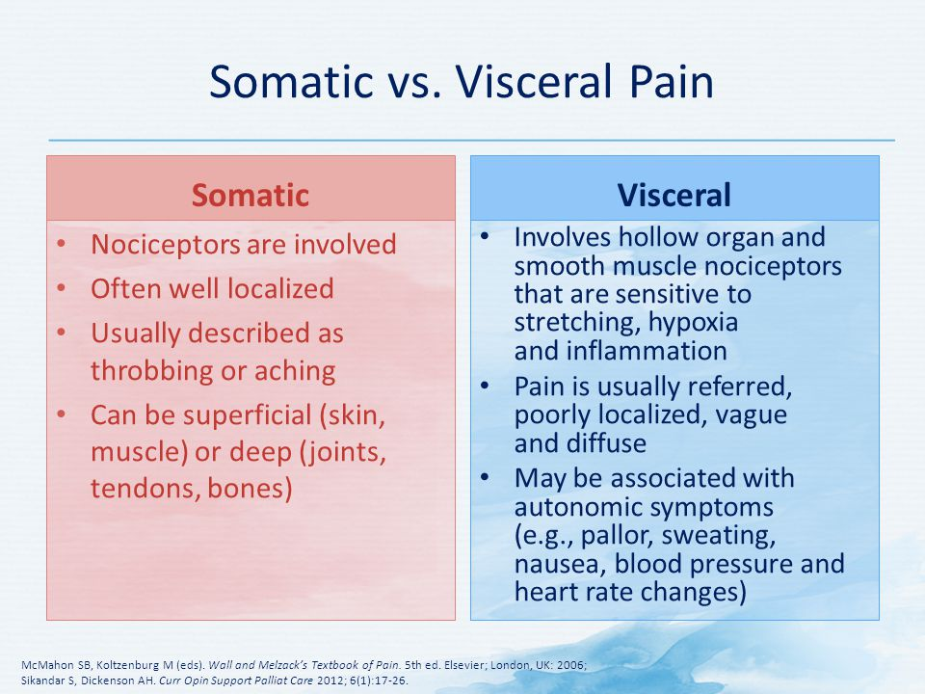

Slide 10
Presentations That Are Less Acute
Colic
Colic is an abdominal pain that crescendos to become very severe and then goes away completely. This is most typically seen in either ureteric obstruction or bowel obstruction.
Biliary ‘colic’ is not a true colic as the pain does not go away completely, instead getting periodically better and worse (colloquially termed ‘waxes and wanes’)

Slide 11
PAIN:
Site.
Onset and progression.
Character.
Referred.

Slide 12
Referred Pain:
Biliary colic: to right shoulder or scapula
Renal colic: to groin
Appendicitis: periumbilical to right lower quadrant (RLQ)
Pancreatitis: to back
Ruptured aortic aneurysm: to back or flank
• Perforated ulcer: to RLQ (right paracolic gutter)
Hip pain: to groin

Slide 13
Most Common Presentations of Surgical
Pain
Sudden onset with rigid abdomen = perforated viscus
Pain out of proportion to physical findings = ischemic bowel
Vague pain that subsequently localizes = appendicitis or other intra-abdominal process that irritates the parietal peritoneum
Waves of colicky pain = bowel obstruction

Slide 14
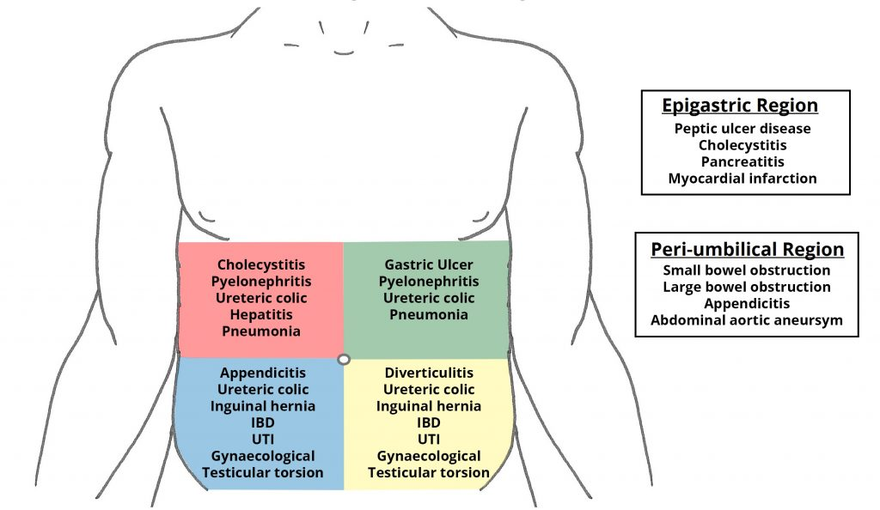

Slide 15
D/D acute abdomen by region: RUQ
Hepatobiliary: Biliary colic, Cholecystitis, Cholangitis, CBD obstruction (stone, tumor), Hepatitis, Budd-Chiari, Hepatic abscess/mass, Right subphrenic abscess.
Gastrointestinal: Pancreatitis, Presentation of gastric, duodenal, or pancreatic pathology, Hepatic flexure pathology (CRC, subcostal incisional hernia).
Genitourinary: Nephrolithiasis, Pyelonephritis, Renal: mass, ischemia, trauma.
Cardiopulmonary: RLL pneumonia, Effusion/empyema, CHF (causing hepatic congestion and R pleural effusion),MI, Pericarditis, Pleuritis
Miscellaneous: Herpes zoster, Trauma, Costochondritis

Slide 16
D/D acute abdomen by region: LUQ
Pancreatic: Pancreatitis (acute vs. chronic), Pancreatic pseudocyst, Pancreatic tumors.
Gastrointestinal: Gastritis, PUD, Splenic flexure pathology, (e.g. CRC, ischemia).
Splenic: Splenic infarct/abscess, Splenomegaly, Splenic rupture, Splenic artery aneurysm.
Cardiopulmonary (see RUQ and Epigastric).
Genitourinary (see RUQ).

Slide 17
D/D acute abdomen by region: RLQ
Gastrointestinal: Appendicitis, Crohn’s disease, Tuberculosis of the ileocecal junction, Cecal tumor, Intussusception, Mesenteric lymphadenitis (Yersinia), Cecal diverticulitis, Cecal volvulus.
Hernia: femoral, inguinal obstruction, Amyand’s (and resulting cecal distention)
Gynecological: See ‘suprapubic’
Genitourinary: See ‘suprapubic’
Extraperitoneal: Abdominal wall hematoma/abscess, Psoas abscess

Slide 18
D/D acute abdomen by region: LLQ
Gastrointestinal: Diverticulitis, Diverticulosis, Colon/sigmoid/rectal cancer, Fecal impaction, Proctitis (ulcerative colitis, infectious ; i.e. gonococcus or Chlamydia), Sigmoid volvulus
Hernia
Gynecological: See ‘suprapubic’
Genitourinary: See ‘suprapubic’
Extraperitoneal: Abdominal wall hematoma/abscess, Psoas abscess

Slide 19
D/D acute abdomen by region: Epigastric
Cardiac: Aortic dissection/ruptured, AAA, MI, Pericarditis
Gastrointestinal: Gastritis, GERD/esophagitis, PUD, Pancreatitis, Mallory-Weiss tear.

Slide 20
D/D acute abdomen by region: Suprapubic
Gastrointestinal (see RLQ/LLQ): Acute appendicitis, IBD,
Gynecological: Ectopic pregnancy, PID, Endometriosis ,Threatened/incomplete, abortion, Hydrosalpinx/salpingitis, Ovarian torsion, Hemorrhagic fibroid, Tubo-ovarian abscess, Gynecological tumors
Genitourinary, Cystitis (infectious, hemorrhagic), Hydroureter/urinary colic, Epididymitis, Testicular torsion, acute urinary retention
Extraperitoneal: Rectus sheath hematoma

Slide 21
D/D acute abdomen by region: Diffuse
Gastrointestinal: Peritonitis, Early appendicitis, perforated appendicitis, Mesenteric ischemia, Gastroenteritis/colitis, Constipation, Bowel obstruction, Pancreatitis, Inflammatory bowel disease, Irritable bowel syndrome, Ogilvie’s syndrome
Cardiovascular/Hematological: Aortic dissection/ruptured AAA, Sickle cell crisis
Genitourinary/Gynecological: Perforated ectopic pregnancy, PID, Acute urinary retention
Endocrinological: Carcinoid syndrome, Diabetic ketoacidosis, Addisonian crisis, Hypercalcemia
Others: Lead poisoning, Tertiary syphilis

Slide 22
In all patients presenting with an acute abdomen, order the following:
KEY TESTS FOR SPECIFIC DIAGNOSIS
  ALP, ALT, AST, bilirubin
  Lipase/ amylase
  Urinalysis
  β-hCG (in women of childbearing age)
  Troponins
  Lactate
KEY TESTS FOR OR PREPARATION
  CBC, electrolytes, creatinine, glucose
  INR/PTT
  CXR (if history of cardiac or pulmonary disease)
  ECG if clinically indicated by history or if >69 years and no risk factors

Slide 23
Laboratory Tests
The investigations in all cases of the acute abdomen share the same generic outline:
Urine dipstick – for signs of infection or haematuria ±MC&S. Include a pregnancy test for all women of reproductive age.
ABG – useful in bleeding or septic patients, especially for the pH, pO₂, pCO₂, and lactate for signs of tissue hypoperfusion, as well as a rapid hemoglobin.
Routine bloods – FBC, U&Es, Liver Function, CRP, amylase.
  Consider measuring serum calcium in suspected pancreatitis.
  Do not forget a group & save (G&S) if the patient is likely to need surgery soon.
Blood cultures – if considering infection as a potential diagnosis
Note: Any amylase / lipase 3x greater than the upper limit is diagnostic of pancreatitis. Any raised value lower than this may also be due to another pathology, such as perforated bowel, ectopic pregnancy, or diabetic ketoacidosis (DKA)

Slide 24
Investigation:
Imaging
In the emergency setting, every patient with abdominal pain should have an ECG to exclude myocardial infarction.
Other imaging modalities that may be initially requested include:
Ultrasound:
  Kidneys, ureters and bladder (‘KUB’) – for suspected renal tract pathology
  Biliary tree and liver – for suspected gallstone disease
  Ovaries, fallopian tubes and uterus – for suspected tubo-ovarian pathology
Radiological:
  An erect chest X-ray (eCXR) – for evidence of bowel perforation.
  CT imaging, depending on the suspected underlying diagnosis

Slide 25


Slide 26
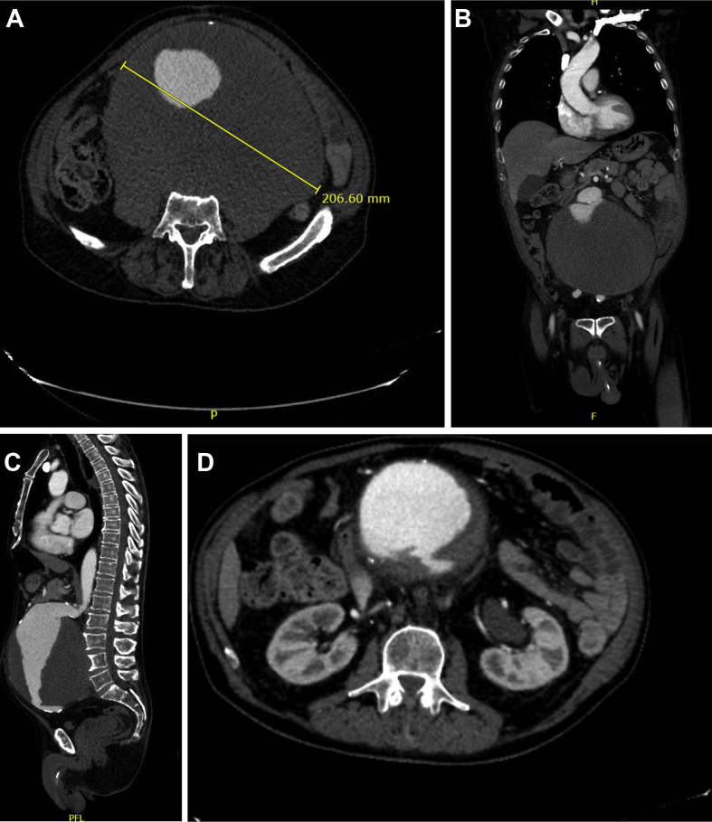

Slide 27
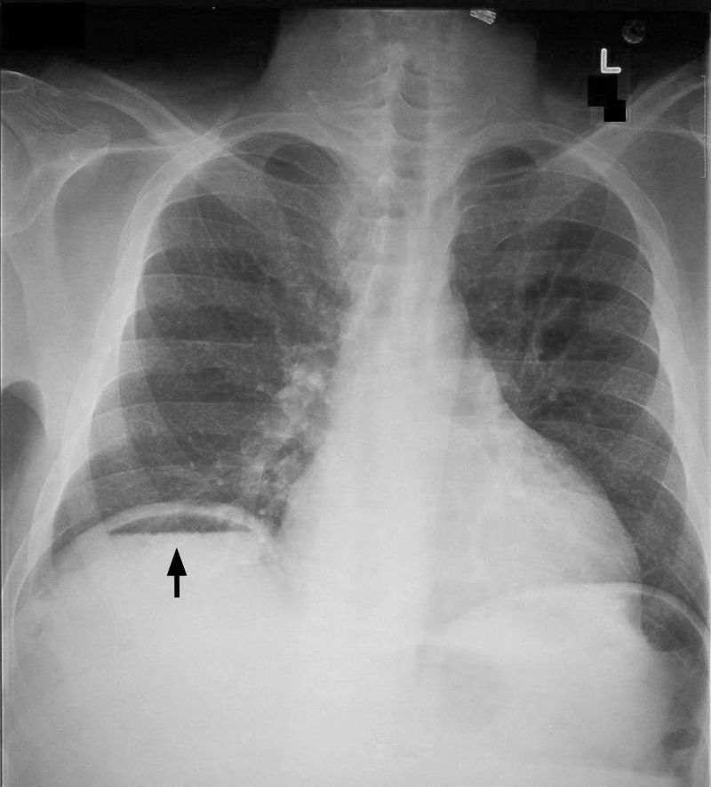

Slide 28
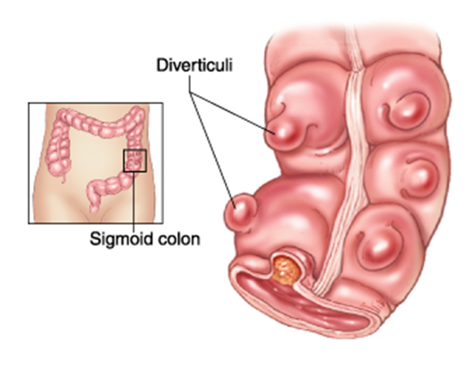

Slide 29
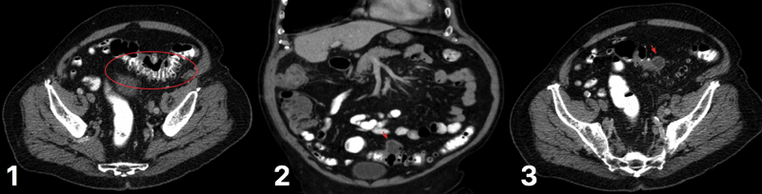
CT scan for varying degrees of diverticular disease (1) diverticulum in the sigmoid colon (2) degree of diverticulitis present (3) abscess formation, secondary to ongoing diverticulitis

Slide 30
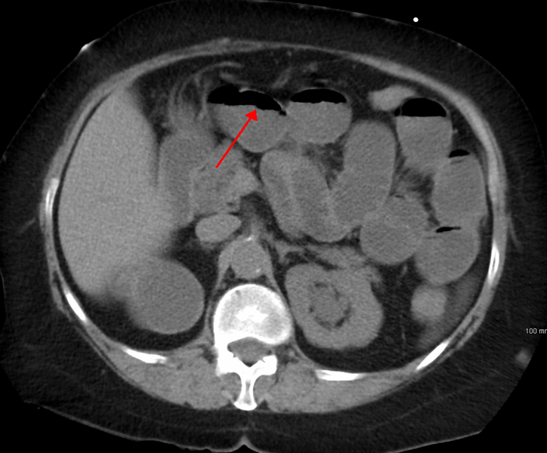
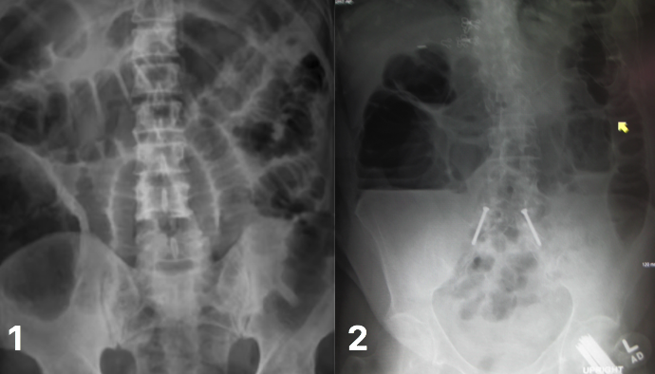
Bowel Obstruction

Slide 31
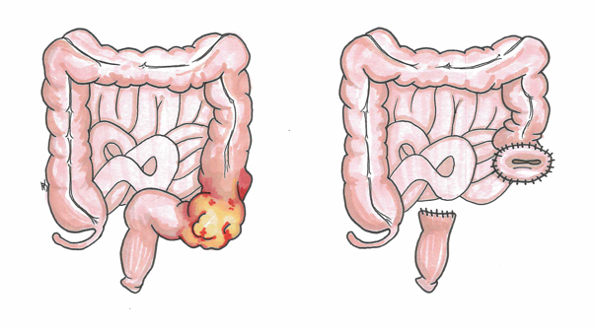

Slide 32
Acute appendicitis
The classic presentation for appendicitis is the relatively slow onset of mid-abdominal pain that eventually localizes in the right lower quadrant with associated nausea and, later, vomiting. Myocardial infarction should always be considered in this age group, and a posterior, or diaphragmatic, infarct is well recognized to cause abdominal pain, nausea, and vomiting. Acute pancreatitis can be caused by either a penetrating (posterior) duodenal ulcer or acute cholecystitis. If vomiting does not relieve the abdominal pain, pancreatitis should be considered.

Slide 33
CT abdomen Pancreatitis
Although a CT scan may eventually be useful, it will not be as helpful as the other choices at this point. It is best used at 72 hours of illness to assess the degree of pancreatic necrosis in patients with predicted severe disease. A cardiogram and troponin will help to rule in or rule out a myocardial infarction while the serum amylase and lipase will give information about pancreatitis. The gallbladder ultrasound will be important in this patient with a strong family history for cholelithiasis and cholecystitis

Slide 34
Amylase and Lipase inAcute pancreatitis:
The diagnosis of acute pancreatitis is best supported by a three-fold increase in amylase and lipase.
The lipase is considered a little more specific than amylase but situations other than pancreatitis can cause lipase elevations.
Serum amylase may be elevated for many reasons other than acute pancreatitis (eg, mumps, perforated viscus, tubo-ovarian abscess,), as can the serum lipase (eg, intestinal infarction and perforation, severe peptic ulcer disease).
The severity of pancreatitis does not correlate well with the magnitude of the elevation of the serum amylase or lipase.
Lipase and amylase levels also do not correlate with recovery or prognosis.

Slide 35
Pancreatitis: Initial Mnagement
All patients with acute pancreatitis should initially be made NPO.
If they continue to vomit, nasogastric aspiration may be indicated,. Vigorous hydration with isotonic fluids (Ringer's lactate or normal saline) is indicated to maintain blood volume, especially in the face of severe pancreatitis in which patients may sequester large amounts of fluids in the retroperitoneal space.
Use of IV antibiotics is controversial. In this patient, antibiotics are not indicated, as the severity of the disease has not been established. Immediate IV hyperalimentation is not required, especially in patients with mild pancreatitis.

Slide 36
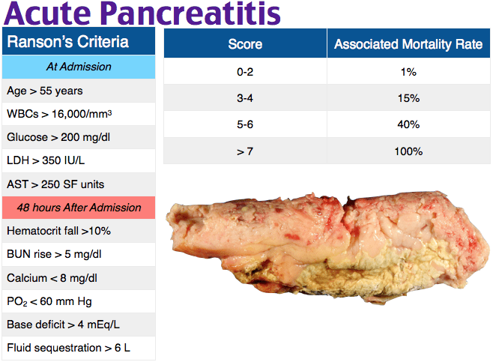

Slide 37
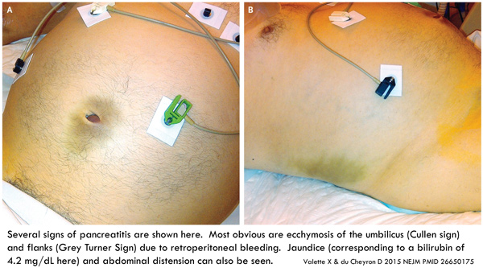
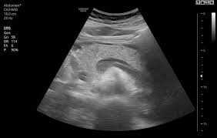
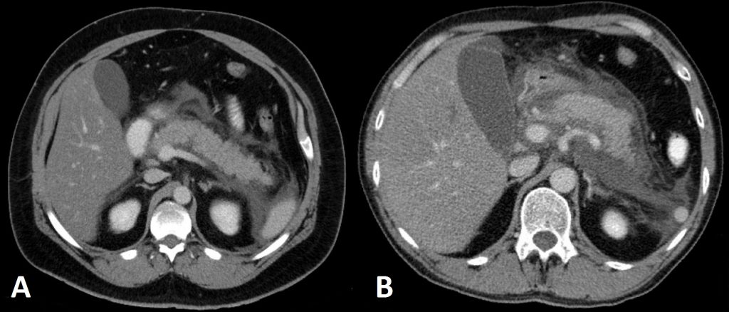
Cullen sign abd Grey Turner sign

Slide 38
The Dangerous Miss: Recognizing Acute Mesenteric Ischemia
80% of acute mesenteric ischemia cases result in mortality because of missed diagnosis. Here’s how to recognize the signs.

Slide 39
Mesenteric Ischemia
Traditionally, mesenteric ischaemia presents with a generalised abdominal pain, out of proportion to the clinical findings, although it can often be more variable or subtle than this. The patient will typically complain of a diffuse and constant pain, with associated nausea and vomiting present in around 75% of cases
On examination, the abdomen is often unremarkable* and the patient may find it difficult to localise the pain. However, remember late stage bowel ischaemia and necrosis can present as bowel perforation.
Importantly, take note of any potential embolic sources, such as AF, heart murmurs, or signs of previous valvular replacement surgery

Slide 40
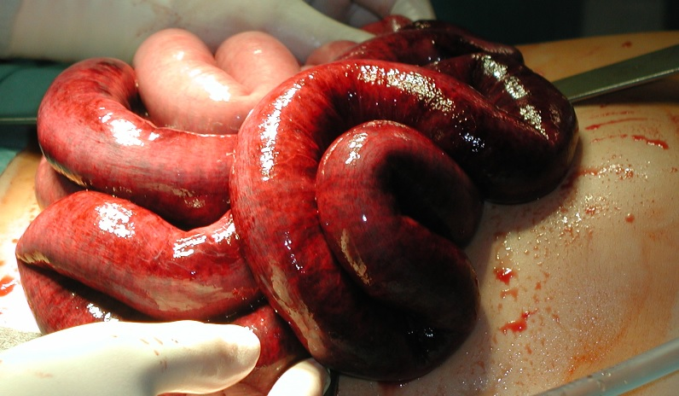

Slide 41
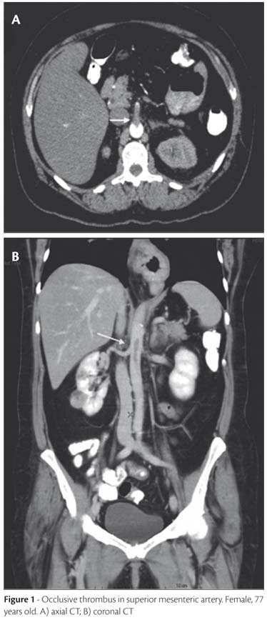
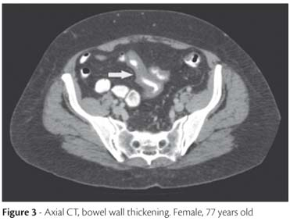

Slide 43
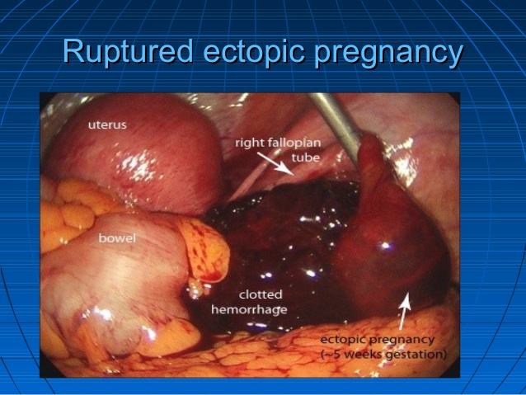
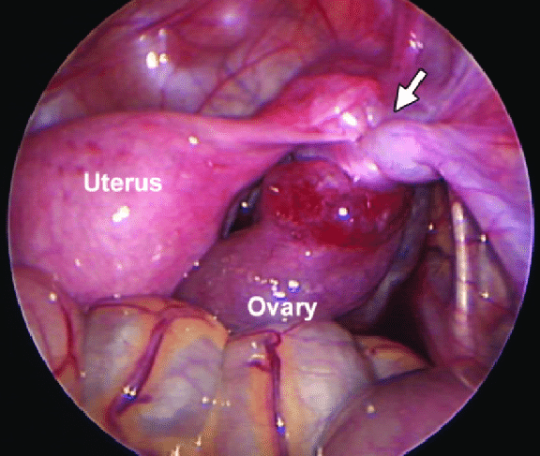
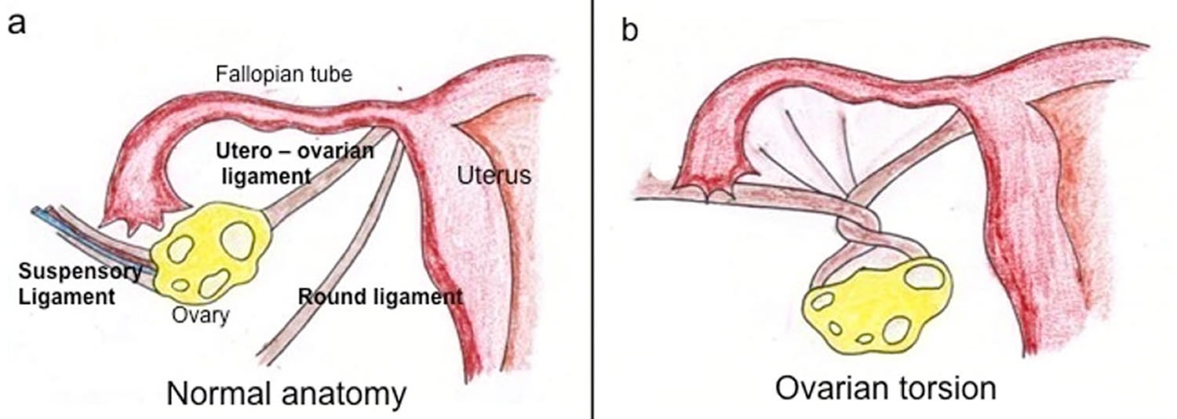

Slide 44
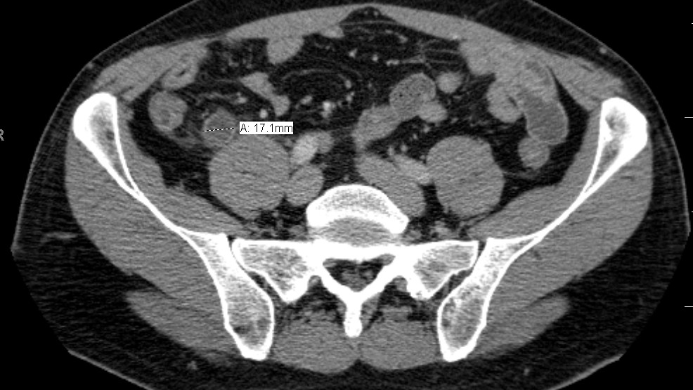
Increase diameter
appendicolith
Acute appendicitis

Slide 45
Left Iliac Fossa Pain;
Male or female ?
D/D
Diverticular diseases:
Presentation ?

Slide 46
Good Luck!

