Slide 1


Slide 2
Common Neck Swellings
Shaher Abbarah, MD, MRCSI
Assistant Professor of surgery
Associate Consultant of general surgery

Slide 3
Objectives
Introduction
Triangles of the neck, & lymph node distribution
Clinical presentations, investigation, &
management of common neck swellings
Differentiate the presenting features, use of different investigations and management of neck swellings

Slide 4
Anatomy:
The anterior triangle is situated at the front of the neck.
It is bounded:
  Superiorly
    Inferior border of the mandible (jawbone).
  Laterally
    Anterior border of the sternocleidomastoid.
  Medially
    Sagittal line down the midline of the neck
    from the chin to the manubrium .

Slide 5
The posterior triangle is situated posterior to SCM
Its boundaries are as follows:
  Anterior
    Posterior border of the SCM.
  Posterior
    Anterior border of the trapezius muscle.
  Inferior
    Middle 1/3 of the clavicle.
Notes:
Posterior triangle divided by omohyoid muscle

Slide 6
Does it move with swallowing?
This indicates it is deep to the pretracheal fascia and likely to be thyroid.
Does it move with protrusion of the tongue?
This applies to upper anterior neck lumps, and the physical sign refers to thyroglossal cysts.
Notes:
Swelling that are fixed to the trachea will move when the trachea moves. The Trachea is pulled upward during swallowing.
The hyoid bone ascend when the tongue is protruded. (So, if swelling move with tongue movement, it must be fixed to the hyoid bone)

Slide 7
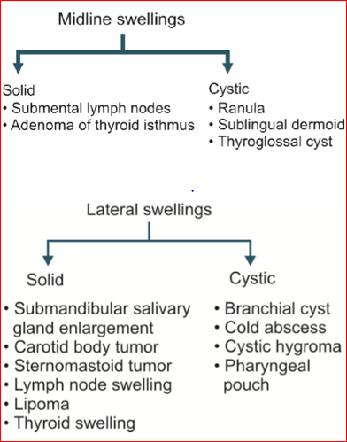
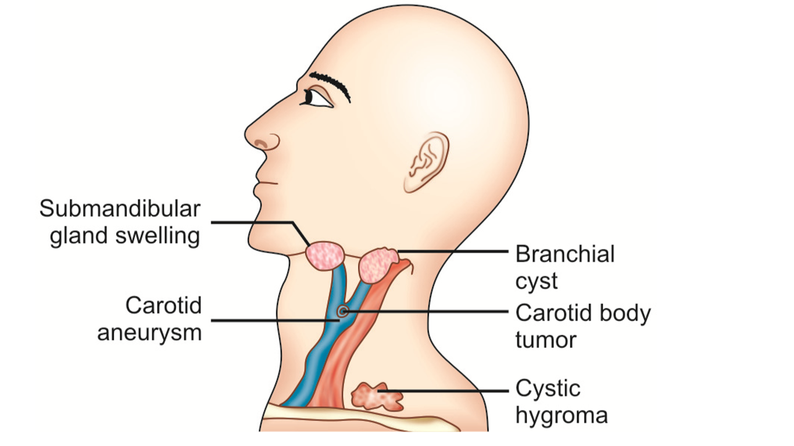
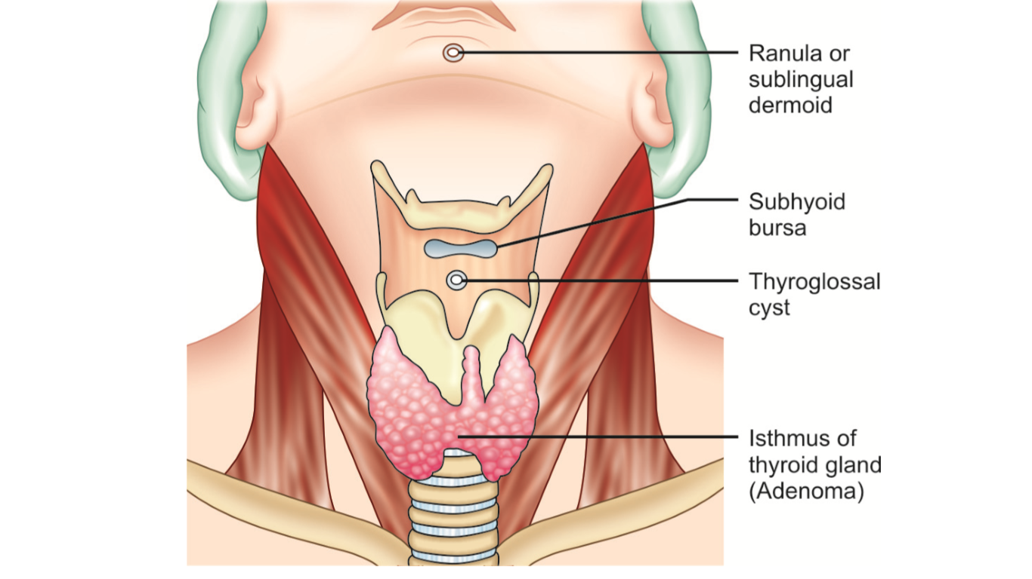
Differential diagnosis according to the site:

Slide 8
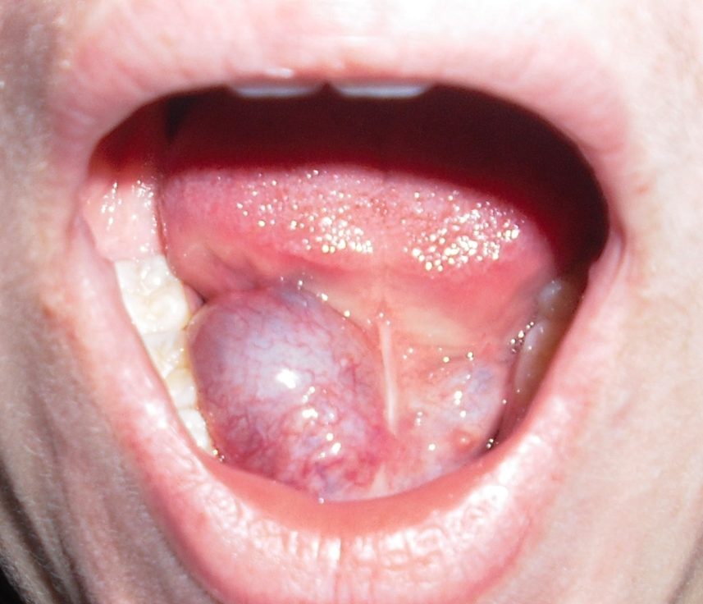
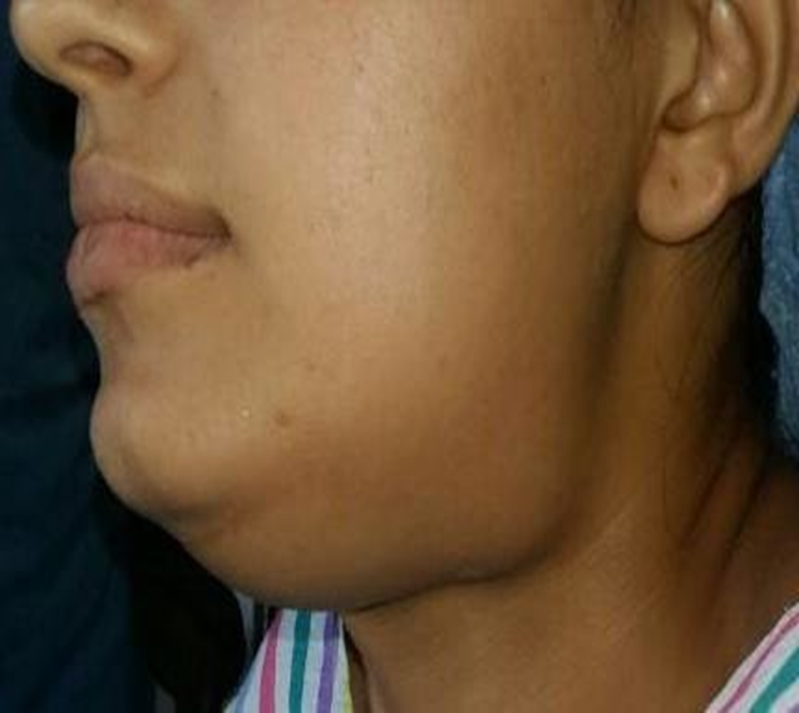
Ranula
It arises from a damaged sublingual gland .
Diagnosis: A child or young adult , Bluish in color, in the floor of the mouth, soft, fluctuant and transilluminate, noncompressible and nonreducible.
On Examination: Shape and size—1 to 5 cms in diameter, smooth surface with diffuse borders, not attached to the overlying mucosa, mylohyoid m.
Differential Diagnosis:
a. Sublingual dermoid—Transillumination ­negative
b. Hemangioma—Compressible
Plunging ranula :
So called when extends into the neck, passing beyond the floor of mouth and appears in the submandibular region
Diagnosis—by bidigital palpation (one finger in the oral cavity and the other on the neck).
The cross fluctuation will be positive.

Slide 9
Sublingual , Cervical Dermoid Cyst
It is a congenital sequestration dermoid cyst. (when face and neck formed by fusion of the facial processes, a piece of epidermis may get trapped deep in the mid-line just behind the jaw)
Cystic swelling in the floor of mouth
Transillumination– Negative.
Notes:
Dermoid cyst is a cyst that is deep to the skin and lined by skin, can be congenital or acquired
can occurs at any point in the mid-line of the trunk

Slide 10
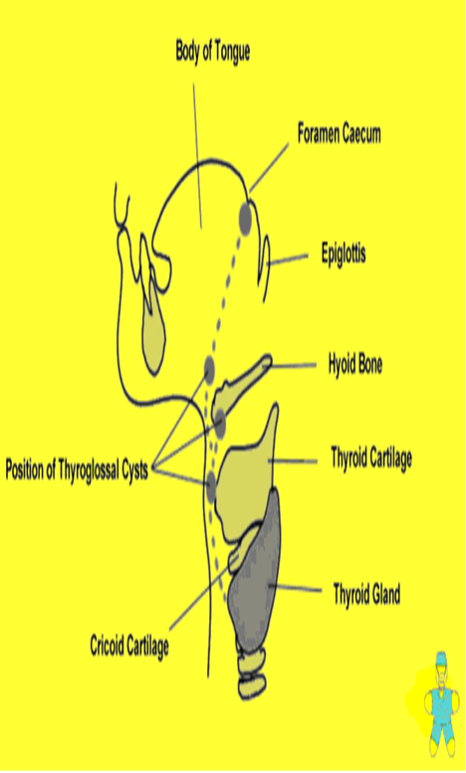
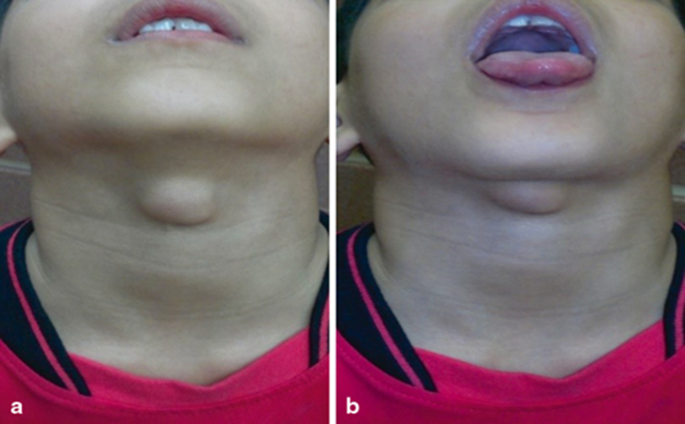
Thyroglossal cyst (tubuloembryonic Dermoid cyst)
Common Sites:
Beneath foramen cecum
In the floor of the mouth
Above the hyoid bone
Beneath the hyoid
On the thyroid cartilage
At the level of cricoid cartilage
Definition: It is the cystic swelling arising from the
remnant of the thyroglossal duct, the other name
being median thyroid diverticulum
Structures which move up with deglutition:
1. Thyroid swellings
2. Subhyoid bursitis.
3. Pretracheal and prelaryngeal lymph nodes.
4. Thyroglossal cyst.

Slide 11
Clinical Features :
Though congenital thyroglossal cyst appears around 15 to 30 yrs.
Painless, midline swelling, more common in female.
The cyst is soft, cystic, fluctuant and transillumination test is negative.
Moves with deglutition and with protrusion of tongue.
Complications:
1. Recurrent and infections
2. Abscess and fistula formation
3. Papillary carcinoma.
Treatment: Sistrunk’s Operation: Excision–Fistula with entire thyroglossal tract is excised.
Incomplete removal results in recurrence.
Notes:
Cyst contains mucoid material

Slide 12
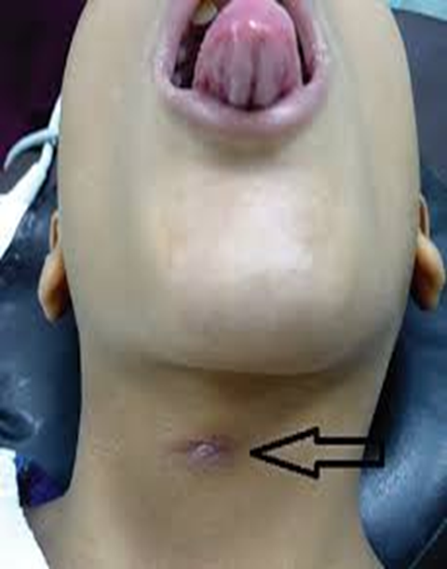
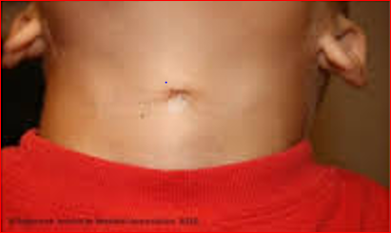
Thyroglossal Fistula:
Also called median fistula of the neck, situated below the hyoid bone.
The fistulas opening moves up on protrusion of the tongue.
Characteristic feature is the hooding of the skin above the opening, i.e. a crescentic fold of skin overlying the fistulas opening.
Treatment: Complete excision of the fistulas tract.

Slide 13
Branchial cyst
Notes:
Read about pathophysiology p.521 (principles & practice of surgery)

Slide 14
Differential Diagnosis
1. Cold abscess
2. Cervical dermoid (inframyelohyoid variety).
3. Carotid body tumor (Solid swelling).
4. Submandibular gland swelling – solid swelling, bidigitally palpable.
5. Solitary enlarged cervical lymph node.
Treatment
Excision of the cyst with entire epithelial lining otherwise recurrence will follow.

Slide 15
Cystic Hygroma
Definition: It is a collection of lymphatic sacs, contain clear colorless lymph.
Characterization: painless, posterior triangular neck mass, with +ve transillumination test
Origin: They are congenital and consist of a cluster of lymph channels that failed to connect into the normal lymphatic pathways.
Site: At the base of the neck, in the posterior triangle. It may extend up to the jaw above and down over the anterior chest wall and axilla.
Age: It appears very early and may be found at birth or within the first few years of life. Of all the congenital swellings.
Other Sites :Axilla, inguinal region, mediastinum, tongue and buccal mucosa of the cheek.

Slide 16
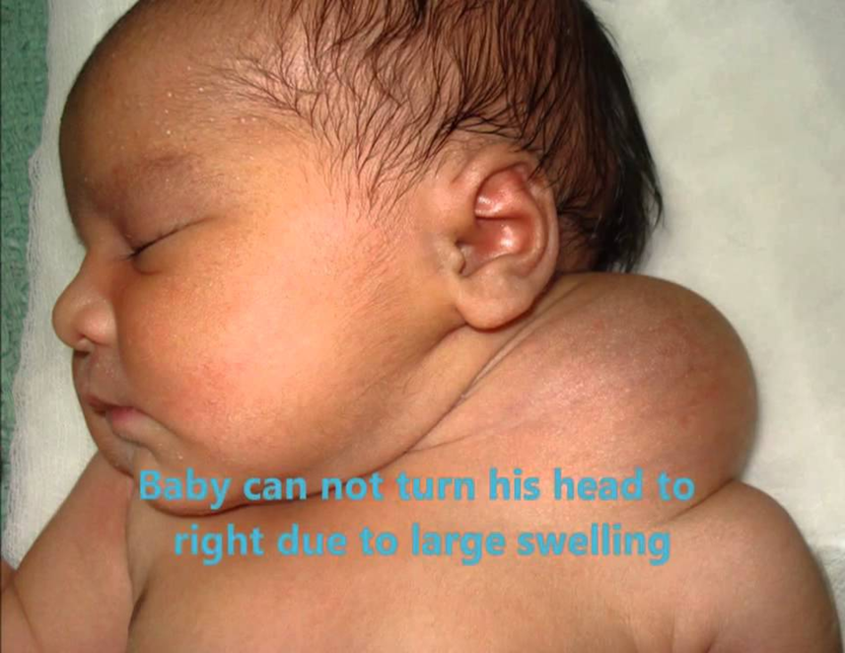
Can spontaneous recovery take place?
Yes, and when it occurs, it will take about 2 years.
Differential Diagnosis:
i. Branchial cyst
ii. Cold abscess in the neck
iii. Solitary lymph cyst—Usually it appears in the adult life and is commonly found in the supraclavicular region.
Complications:
i. Recurrent infections as the cyst is surrounded by a shell of lymphoid tissue.
ii. Sudden increase in size of the cyst may cause respiratory distress, when the treatment is aspiration of the cyst with or without tracheostomy.
Notes:
Treatment: Sclerosing agents, Surgery

Slide 17
Cold Abscess
Caseation necrosis of cervical lymph nodes.
Has no signs of inflammation.
Due to TB lymphadenitis or TB spine (cold abscess
in the posterior triangle of neck).
Pathology: Tuberculous lymphadenitis has 3 stages.
1. Stage of lymphadenitis
Lymph nodes are enlarged, nontender or slightly tender, commonly upper deep cervical nodes are involved.
They are discrete and palpable.
Age usually 20 to 30 years, i.e. young adults.
2. Stage of Peri- adenitis or Matting:
Due to involvement of capsule, the nodes move together, become firm and non­ tender.
Matting is pathognomonic of tuberculosis.
Other rare causes of matting are chronic lymphadenitis, anaplastic variety of lymphoma.

Slide 18
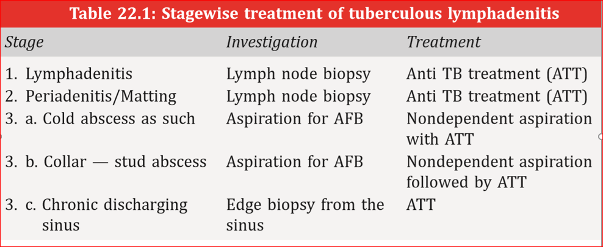
3. Stage of Cold Abscess:
It occurs due to caseation necrosis of the lymph nodes. The caseating materials liquefies and breaks through the capsules of the lymph nodes to form a ‘cold abscess’.
• In the beginning, the abscess remains deep to the deep cervical fascia. Ultimately the fascia is eroded at one point and the pus tracks into the superficial space. Now it is called collar ­stud abscess.
The superficial abscess gradually enlarges and becomes obvious on inspection.
In untreated cases, the skin at the centre undergoes necrosis and gives rise to the chronic discharging sinus.

Slide 19
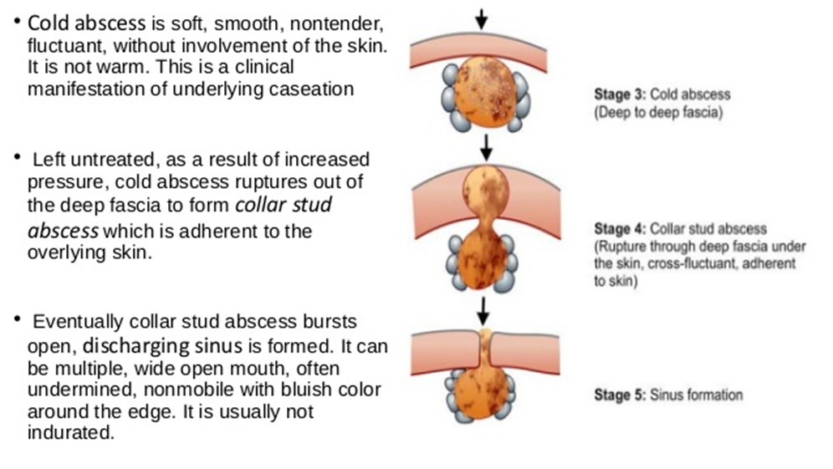
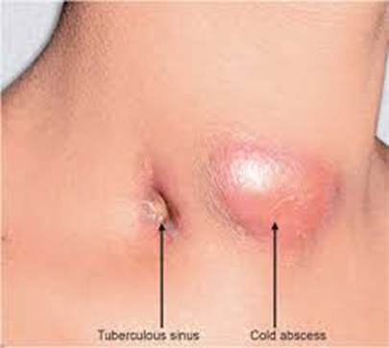

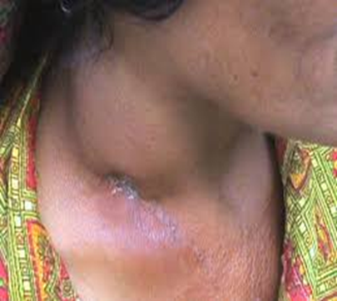

Slide 20
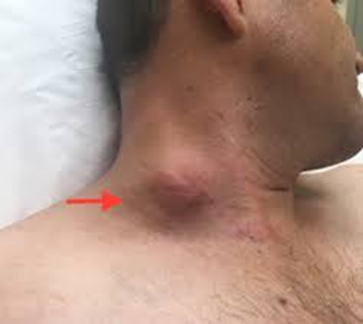
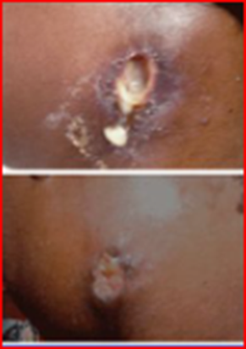
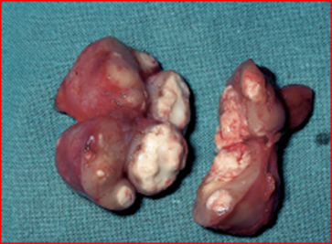
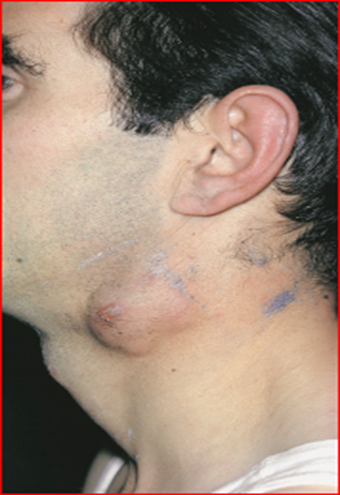
Clinical Features: Evening rise of temp., Loss of weight, Anorexia, Sweating, Lump in the neck & Tenderness in the cervical spine.
Investigations:
a. CBC (Complete Blood Count) may show low Hb%. ESR is increased in most cases.
b. Chest X­ray is usually – ve, sputum is examined for AFB (acid fast bacilli).
c. FNAC gives diagnosis in 75 percent cases.
d. Lymph node biopsy reveals central caseation surrounded by epithelioid cells with Langerhan type of giant cells.
e. If there is a cold abscess, one can aspirate the content which is cheesy, and may be +ve for AFB.
Differential Diagnosis: 1. Branchial cyst—Contains cholesterol. 2. Cystic hygroma.
Treatment:
Antitubercular treatment (ATT) for lymphatic TB (Tuberculosis)
WHO recommendation for extrapulmonary TB is as follows: The three drug regime INH, Rifampicin,
Pyrazinamide (HRZ) for two months followed by INH and Rifampicin for another four months.
Role of Surgery in TB lymphadenitis
i. Biopsy—Lymph node biopsy, edge biopsy from the edge of the sinus.
ii. Aspiration—Non dependent aspiration of cold abscess.
iii. Excision of the lymph nodes, if they persist in spite of ATT.
iv. Excision of the sinus along with the tract.

Slide 21
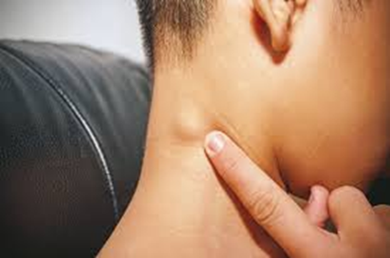
Cervical Lymphadenopathy
Causes
1. Acute:
a. Acute pyogenic lymphadenitis.
b. Acute lymphatic leukemia.
c. Acute infectious mononucleosis. (E.B. virus)
2. Chronic: A. Inflammatory a. Nonspecific—Chronic pyogenic lymph adenitis.
b. Specific—TB, syphilis, sarcoidosis.
B. Neoplastic (malignant) I. Primary: Lymphoma Hodgkin’s disease
Lymphosarcoma.
Reticulum cell sarcoma.
II. Secondary –Metastatic lymph node from a primary growth.
C. Autoimmune disorders, e.g. SLE, juvenile rheumatoid arthritis (Still’s disease).
Investigations: Blood—Complete blood count,
chest -X­ray.
FNAC and biopsy of the enlarged lymph nodes.

Slide 22
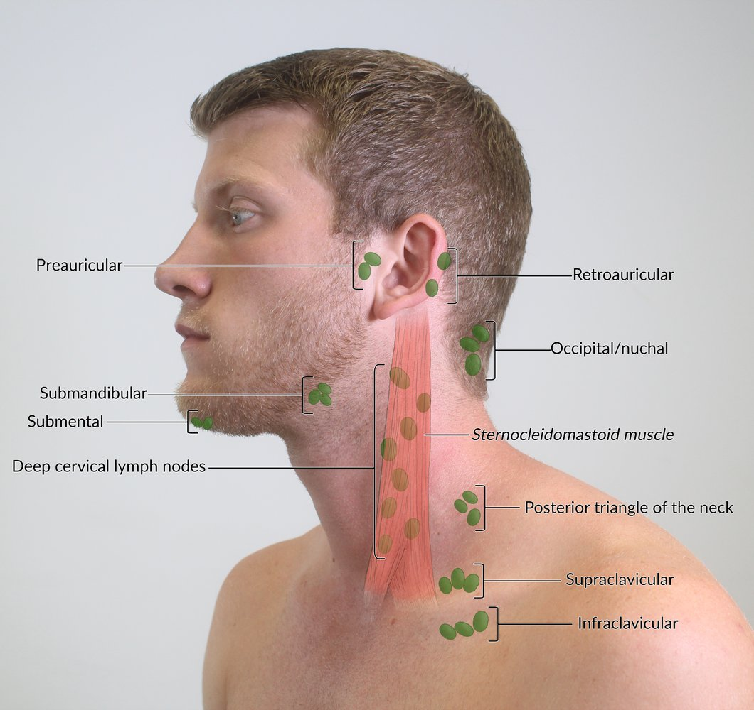
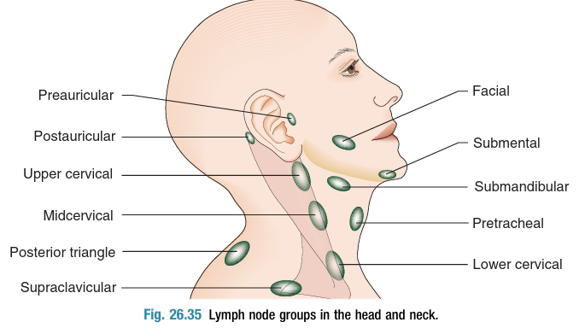
Notes:
The jugulodigastric lymph node is commonly enlarged in both inﬂammatory and malignant conditions.
Children with tonsillitis, young adults with glandular fever or Hodgkin’s disease, middle aged adults with cancers of the oral cavity and oropharynx can all present with lymphadenopathy at this site.

Slide 23
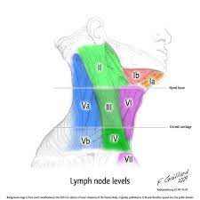
Notes:
Oncological levels of the neck lymph nodes
Level 1 divided by digastric muscle to level IA and IB

Slide 25
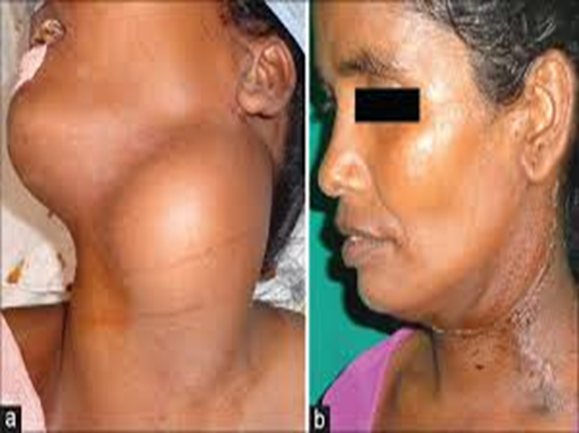
Carotid Body Tumour (Syn. Chemodectoma, Potato Tumor)
It is a slow growing tumor which arises in the carotid body at the carotid bifurcation, 2 – 10 cm, in size, well ­capsulated
A chemoreceptor organ which is stimulated by the rise in PCO2 or H+ ion concentration of arterial blood or a decline in its PO2.
Clinical Features:
Firm, homogeneous and compact tumor, like a potato.
Highest incidence is between the ages 40 and 60 years of life.
Slow growing painless swelling at the bifurcation of the common carotid artery.
Pressure on the carotid sinus from the tumor produces attacks of faintness.
Differential Diagnosis:
1. Cervical lymph node enlargement.
2. Sternomastoid tumor.
3. Branchial cyst.
4. Aneurysm of carotid artery.
Special investigation:
Arteriography—Shows the carotid bifurcation to be splayed open by the mass which rich in vascularity
Read about carotid body tumor P.527
Notes:
What is Lyre sign in CT scan?

Slide 26
Sternomastoid Tumor
During childbirth, injury to the sternomastoid muscle causes hematoma in the muscle which gets organized to form the swelling.
Clinical Features
• It is seen in infants of 3 to 4 weeks of age.
• The swelling is smooth, hard, non-tender and adherent to the muscle.
• Head points towards the muscle of same side and chin towards the opposite side producing torticollis.
Differential Diagnosis:
Lymphadenitis due to either tuberculosis or suppurative infection
Rheumatic disorder
Burns
Spasmodic.
Treatment:
Division of the lower end of the sternomastoid muscle or excision of the muscle.

Slide 27
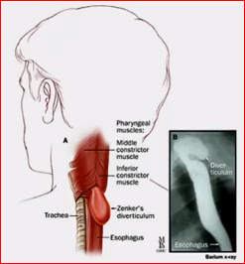
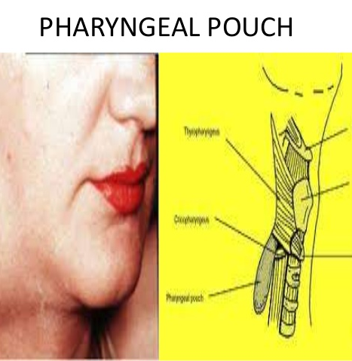
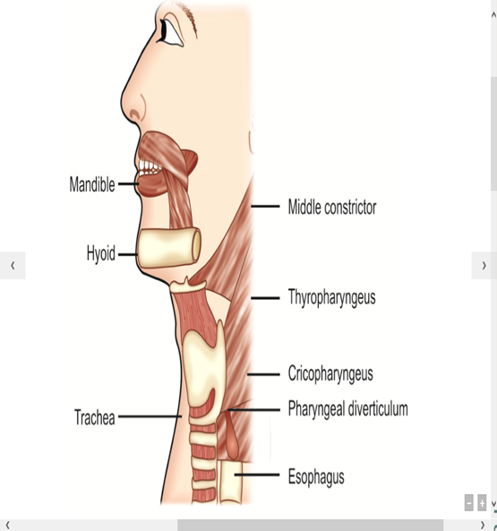

Pharyngeal Pouch- Zenker’sDiverticulum
A laterally placed swelling of the neck located behind the sternomastoid muscle below the thyroid cartilage.
It occurs as a result of protrusion or herniation of the mucosa of pharyngeal wall through the Killian’s dehiscence.
The later is a weak area of pharyngeal wall between the oblique fibres of thyropharyngeus and the sphincter like transverse fibres of cricopharyngeus part of the inferior constrictor muscle.

Slide 28
Clinical Features:
Usually a male and elderly.
Gurgling sounds in neck at the time of swallowing.
Dysphagia. , Halitosis
Regurgitation of food after turning from one side to another
leading to features of aspiration pneumonitis, lung abscess and mediastinitis.
The swelling is soft and cystic with audible gurgling.
The contents may be emptied on pressure into the pharynx and mouth.
Diagnosis:
Thin Barium Swallow – Evidence of pouch
Esophagoscopy – not indicated.
Treatment Excision of the pouch

Slide 29
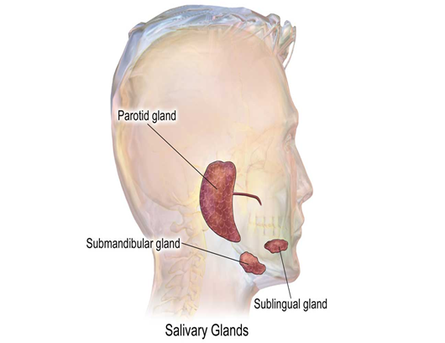

Salivary gland swellings
Viral infections (Mumps)
  Common among children.
  Usually affects parotid, occasionally submandibular
  Painful swelling, fever and headache.
  Resolves in 5-10 days.
  Treatment- symptomatic

Slide 30
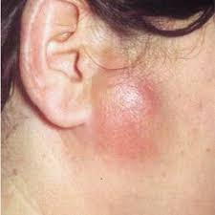
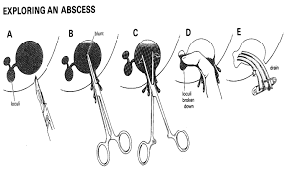
Bacterial infection:
  Common in elderly, also seen in fit and young
  Ascending infection via parotid duct
  Painful, more on eating/ drinking,
  Tender parotid swelling with fever and malaise
  Pus exuding from duct papilla
  Staph. aureus, Strep. Viridans are most common
  Treatment:
    Early cases: antibiotics, oral hygiene
    Late cases: abscess drainage, Hilton’s method

Slide 31
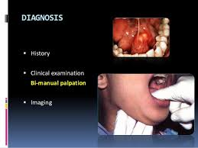
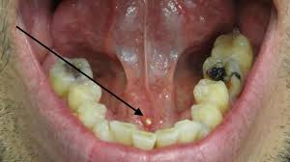
Calcular disease (Sialolithiasis):
  Painful swelling of submandibular gland during eating
  Swelling resolves/ reduces 1-2 hours after meals
  Enlarged submandibular gland on bimanual examination
  Stone in the duct- palpable in the floor of mouth
  Treatment:
    Stone in the duct- extraction by direct incision over the duct
    Stone in the gland- excision of the gland

Slide 32
Investigations (General for neck swellings) :
  CBC, Serology, Tuberculin
  Thyroid function (TSH, T3, T4, Antibody) (very important)
  CXR, U/S, CT scan, MRI, Angio.
  FNAC
  Laryngoscopy, Endoscopy (preop, to check if both vocal cords are functioning or not)
  Open biopsy

Slide 33


