Slide 1
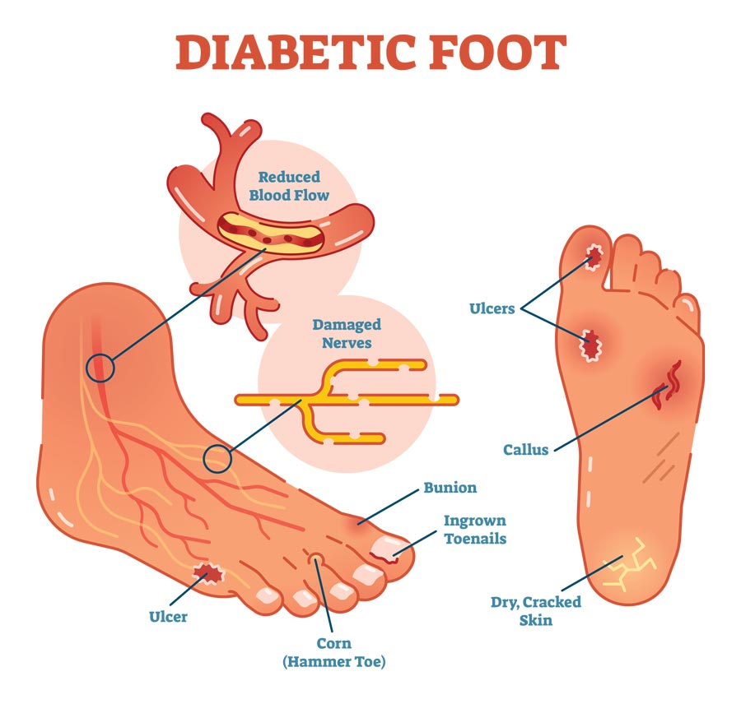
Diabetic Ulcer
Prepared by:
Dr Shaher Abbarah

Slide 2
How to Approach?
60 years old male, known case of diabetes mellitus,
presented to Emergency Department complaining of fever and Foot discharge.

Slide 3
Common triggers for ulceration
Poorly fitting footwear
Unnoticed trauma from foreign body
Burns (hot bath, hot water bottle, radiator)
Heel friction in a patient confined to bed
Nail infection
Dry skin
Self-treatment of callus with sharp instruments, or corn plasters
Callus not effectively treated

Slide 4
Duration of the current symptoms (when & How noticed)
What drew the patient attention? (discharges, bad smell, bleeding, …)
Course of the ulcer since appearance (size, shape, discharge, if healed and broken down now)
Associated Sx?(fever, sensation changes) Any other ulcers elsewhere?
Hx of previous Trauma / burn / bare foot
Any Tx had been suggested or administered?
Previous Amputation / interventions
DM controlled? (since? medication on? Following with endocrinology? Diet?)

Slide 5

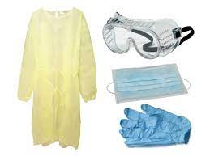
Examination:
Remember:
Wash your hand & Protective equipment (gloves, gown, face mask)
Introduce your self & identify your Patient
Assure Privacy
Chaperon / nurse presence
Explain the Procedure / what you will do
Take the Permission / consent
Check the surroundings of the patient
Position the patient & Exposure
Then, start the focus examination

Slide 6
Look:
Location
shape
Size (approximately)
Floor (Color & Content)
Discharges (pus, blood, quantity)
Edge
The floor:
- Granulation Tissue (Red Pink):
Collagen, fibroblast, capillary, Inflammatory cells and bacteria
- Eschar: (Black)
Layer of dead tissue
- Scab: (yellow)
Sloughed and dried small amount of discharges
Edge:
Flat sloping ( healing / venous)
Punched out (Syphilis / DM / Ischemic)
Undermined (pressure necrosis, carbuncle, Tuberculous)
Rolled (BCC)
Everted (SCC / Ulcerated AdenoCA)
Notes:
Sloping edge: pale/pink consistent of new healthy epithelium growing over the base of the ulcer
Also in “Look” you can comment on the surrounding of the ulcer, like: dry skin, scars, hair loss, pigmentation, …

Slide 7
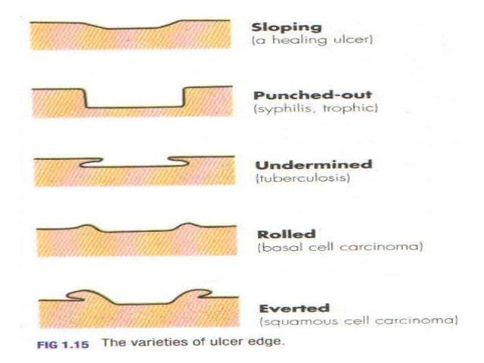
Edges:

Slide 8
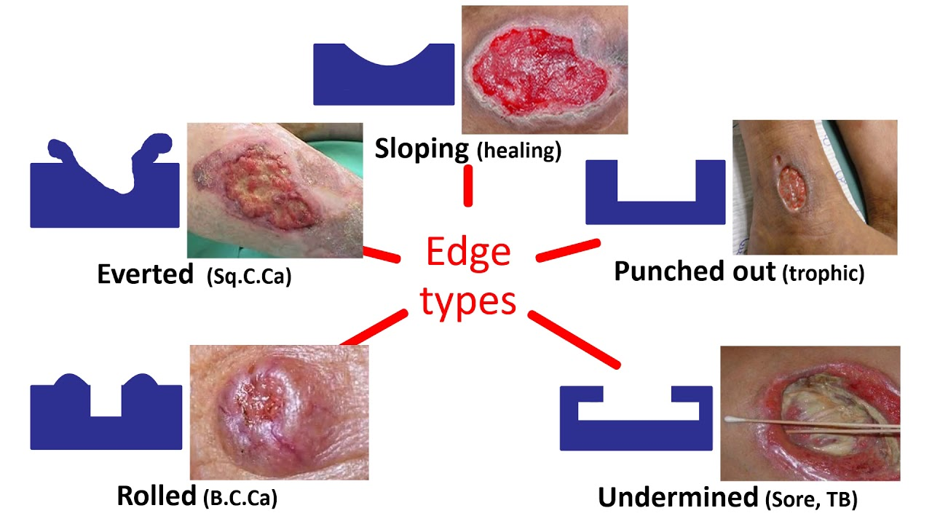
Edge:

Slide 9
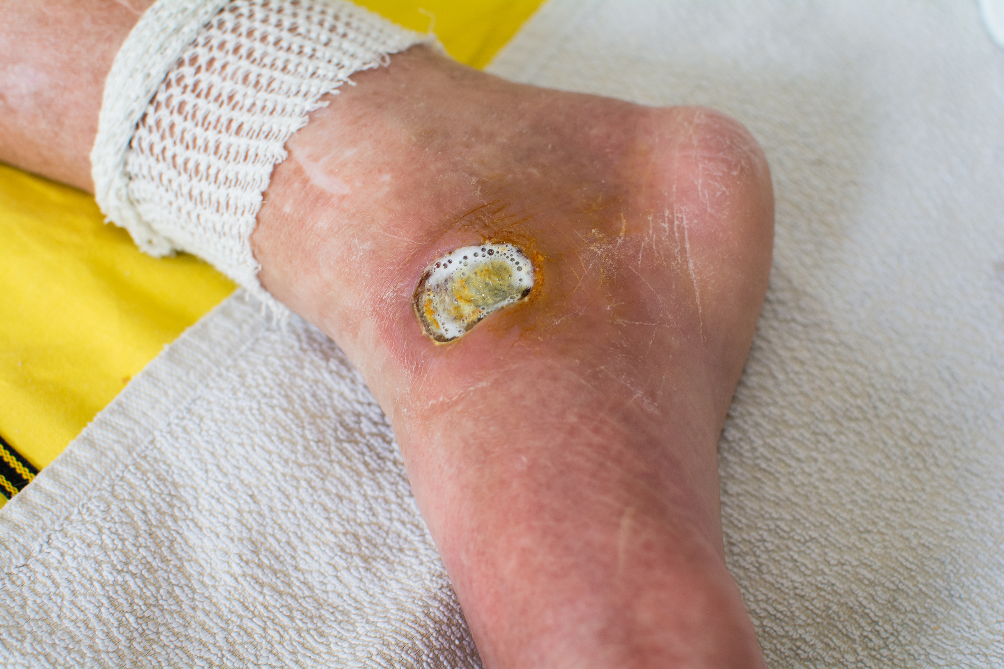

Slide 10
Feel:
Tenderness
Temperature
Base
Arterial Ulcer is painfull
Venous ulcer less painfull
Neuropathic usually not

Slide 11
Examine Surrounding Tissue:
Induration (Infection, Trauma)
Pigmentation (Venous ulcer mainly)
Scaring
Edema
Vascular Assessment
Neurosensory Assessment
Lymph nodes
Local (lymphatic / venous obstruction)
General (Liver, Cardiac, Renal, low Alb)
Light touch, pin prick, temperature, proprioception

Slide 12
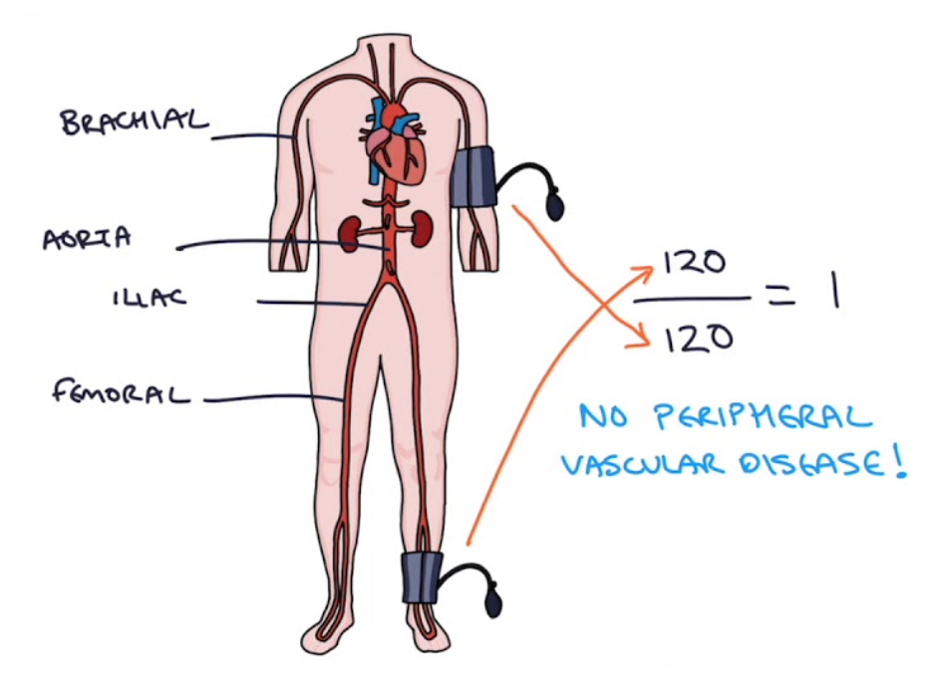
Vascular Assessment
Skin examination (Atrophy, hair loss, nail changes)
Capillary refill
Peripheral pulses (femoral, popliteal, post. tibial, dorsalis pedis)
Ankle-Brachial index ?

Slide 13
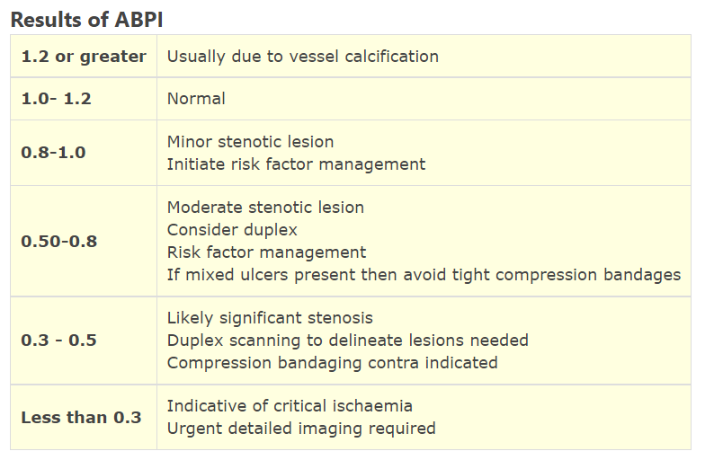

Slide 14
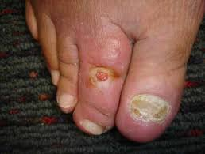
Describe

Slide 15
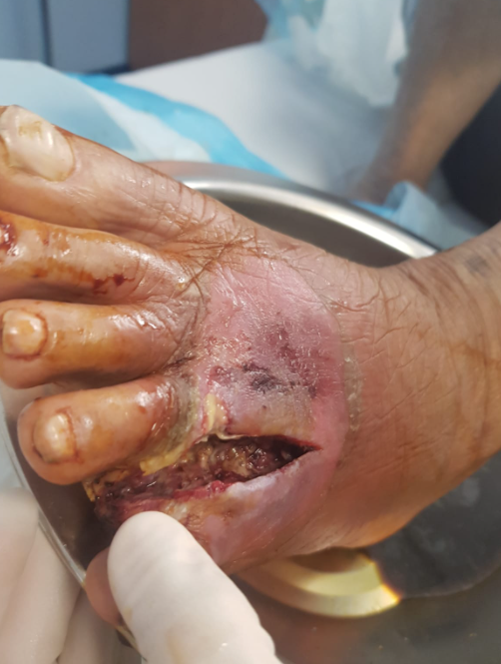
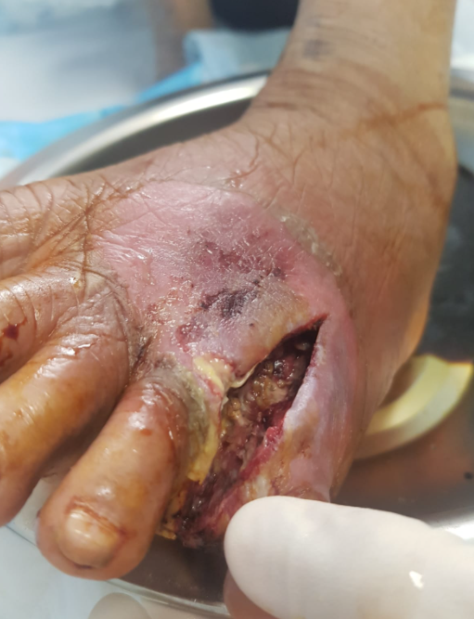

Slide 16
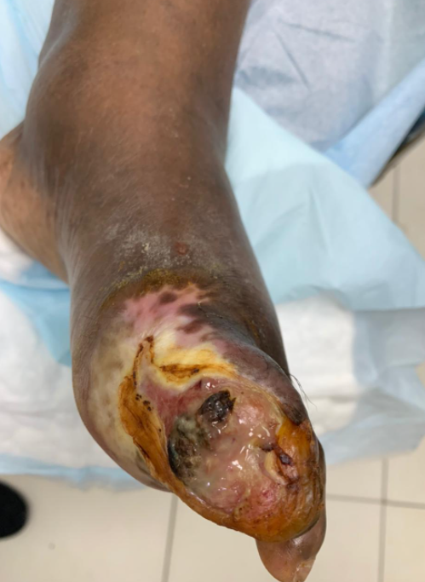

Slide 17
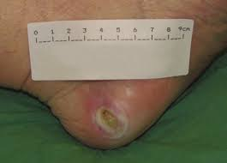

Slide 19
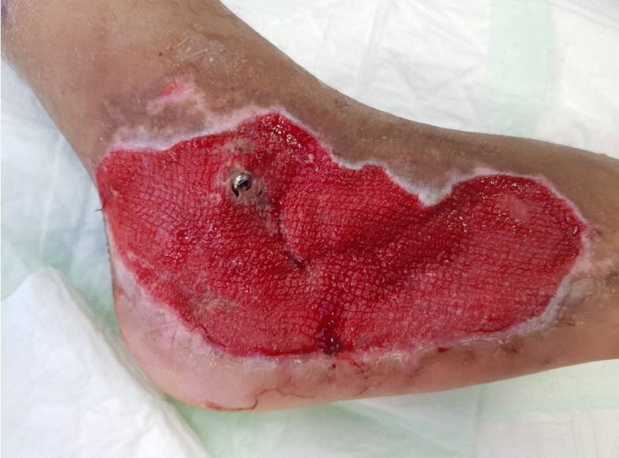

Slide 20
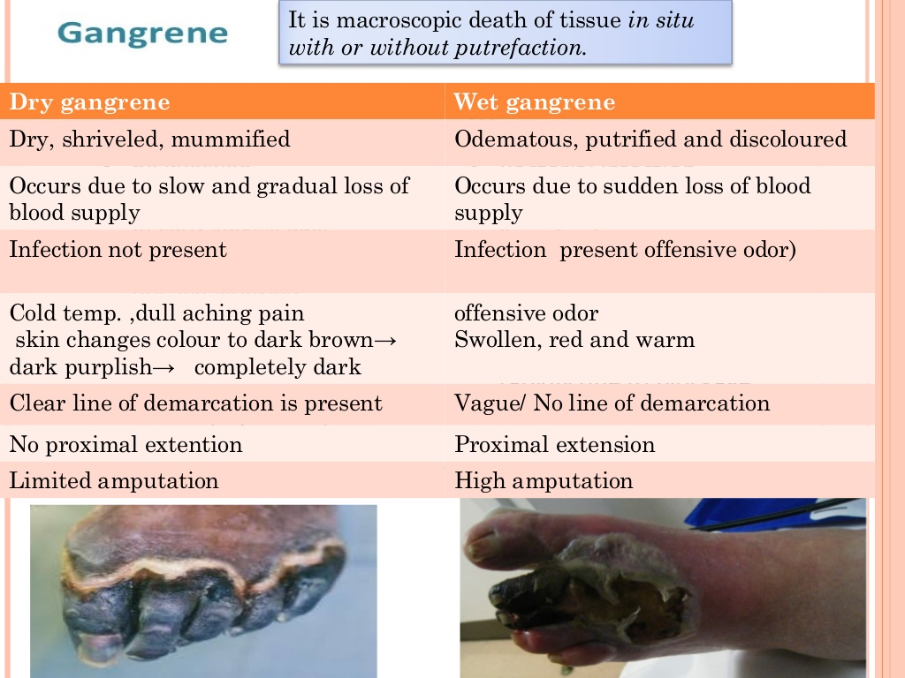

Slide 21
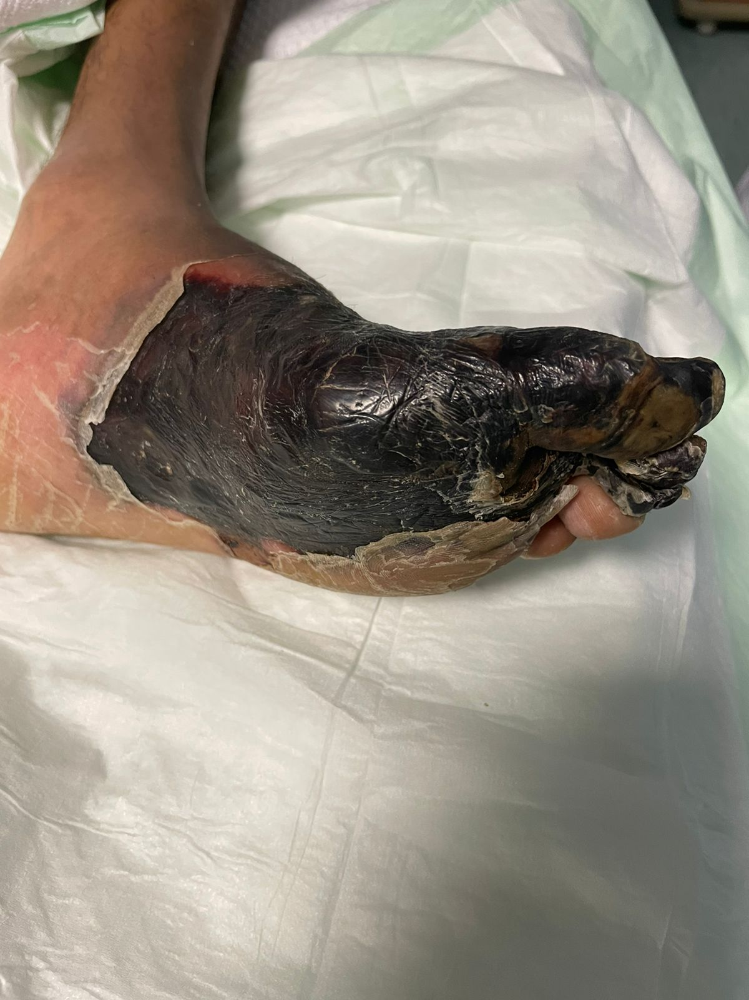

Slide 22
Investigation
Blood test (CBC, KFT, Alb, C-RP, ESR, culture)
Wound Culture
X-ray
MRI
ABI
Angiography
Read about Diabetic Foot Infection (P.58 principle & practice of Surgery)

Slide 23
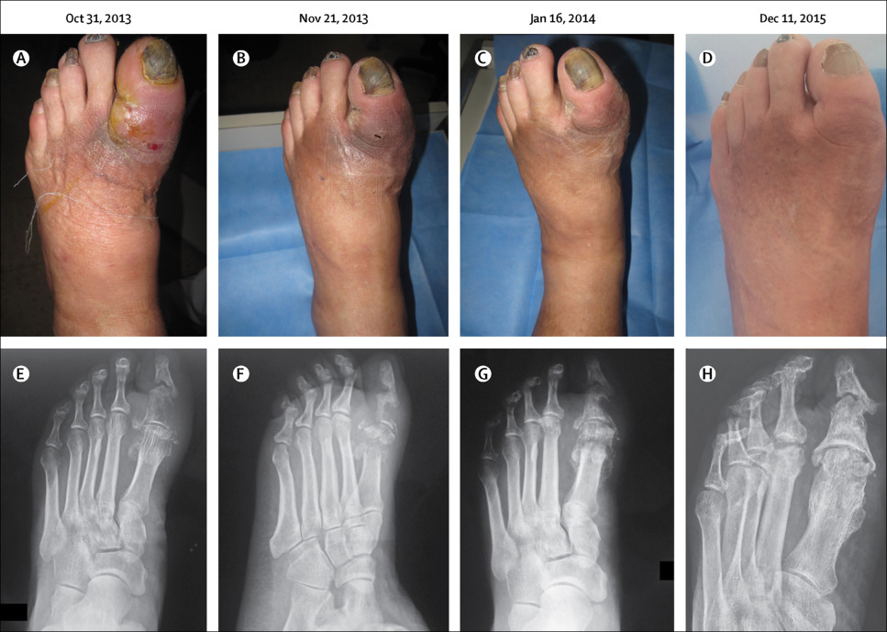
Xray findings of Osteomyelitis:
periosteal reaction / elevation
cortical irregularity / thickening
Demineralization, osteopenia

Slide 24
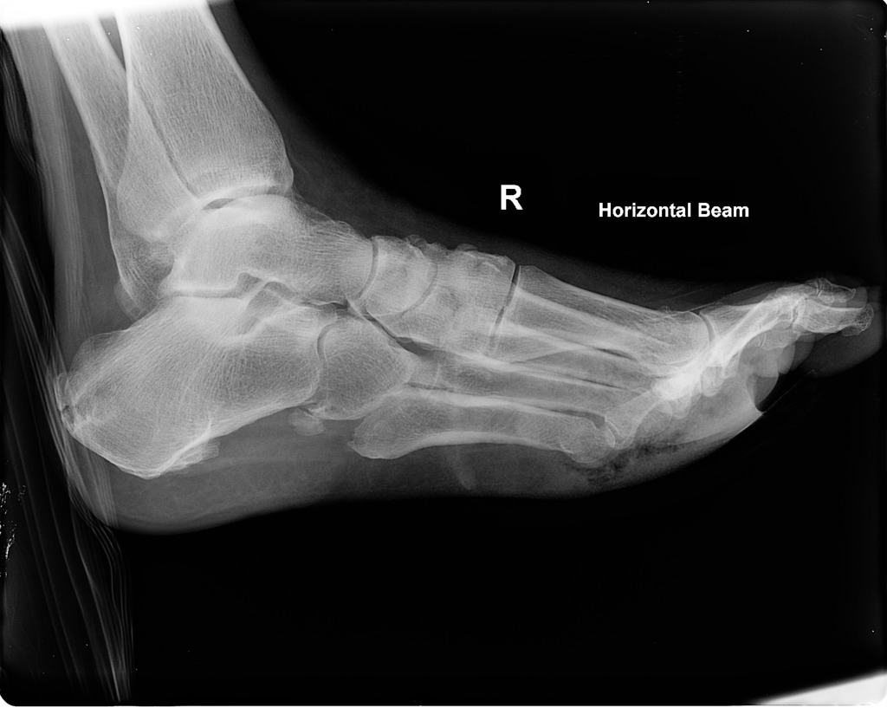
??

Slide 25
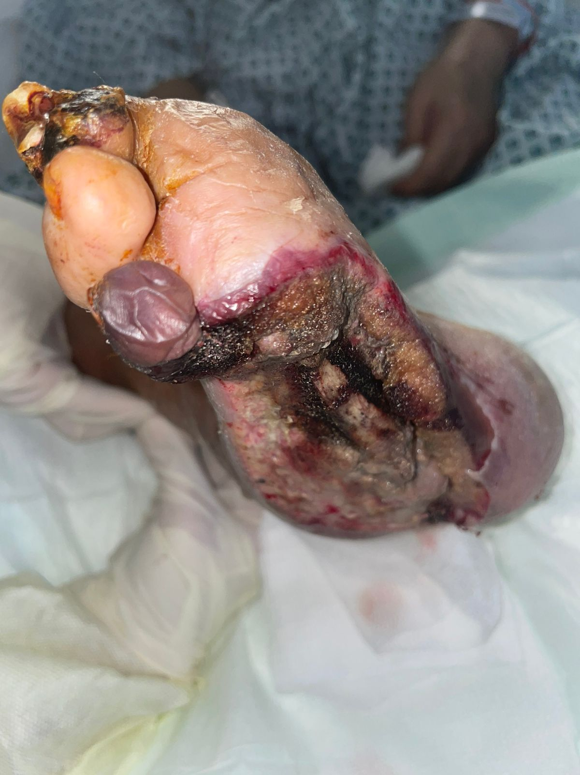

Slide 26
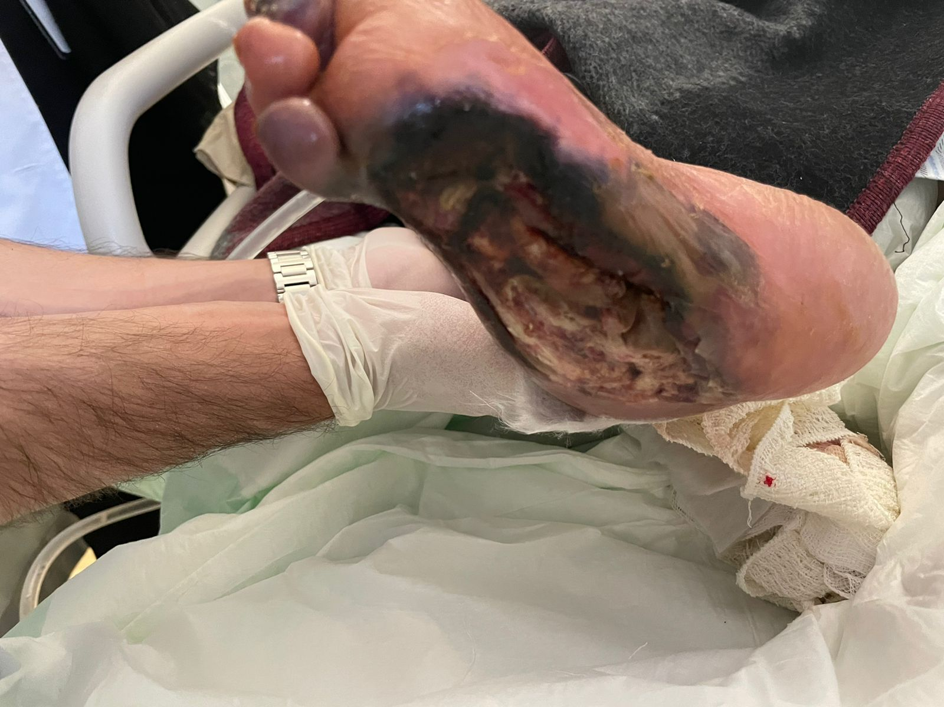

Slide 27
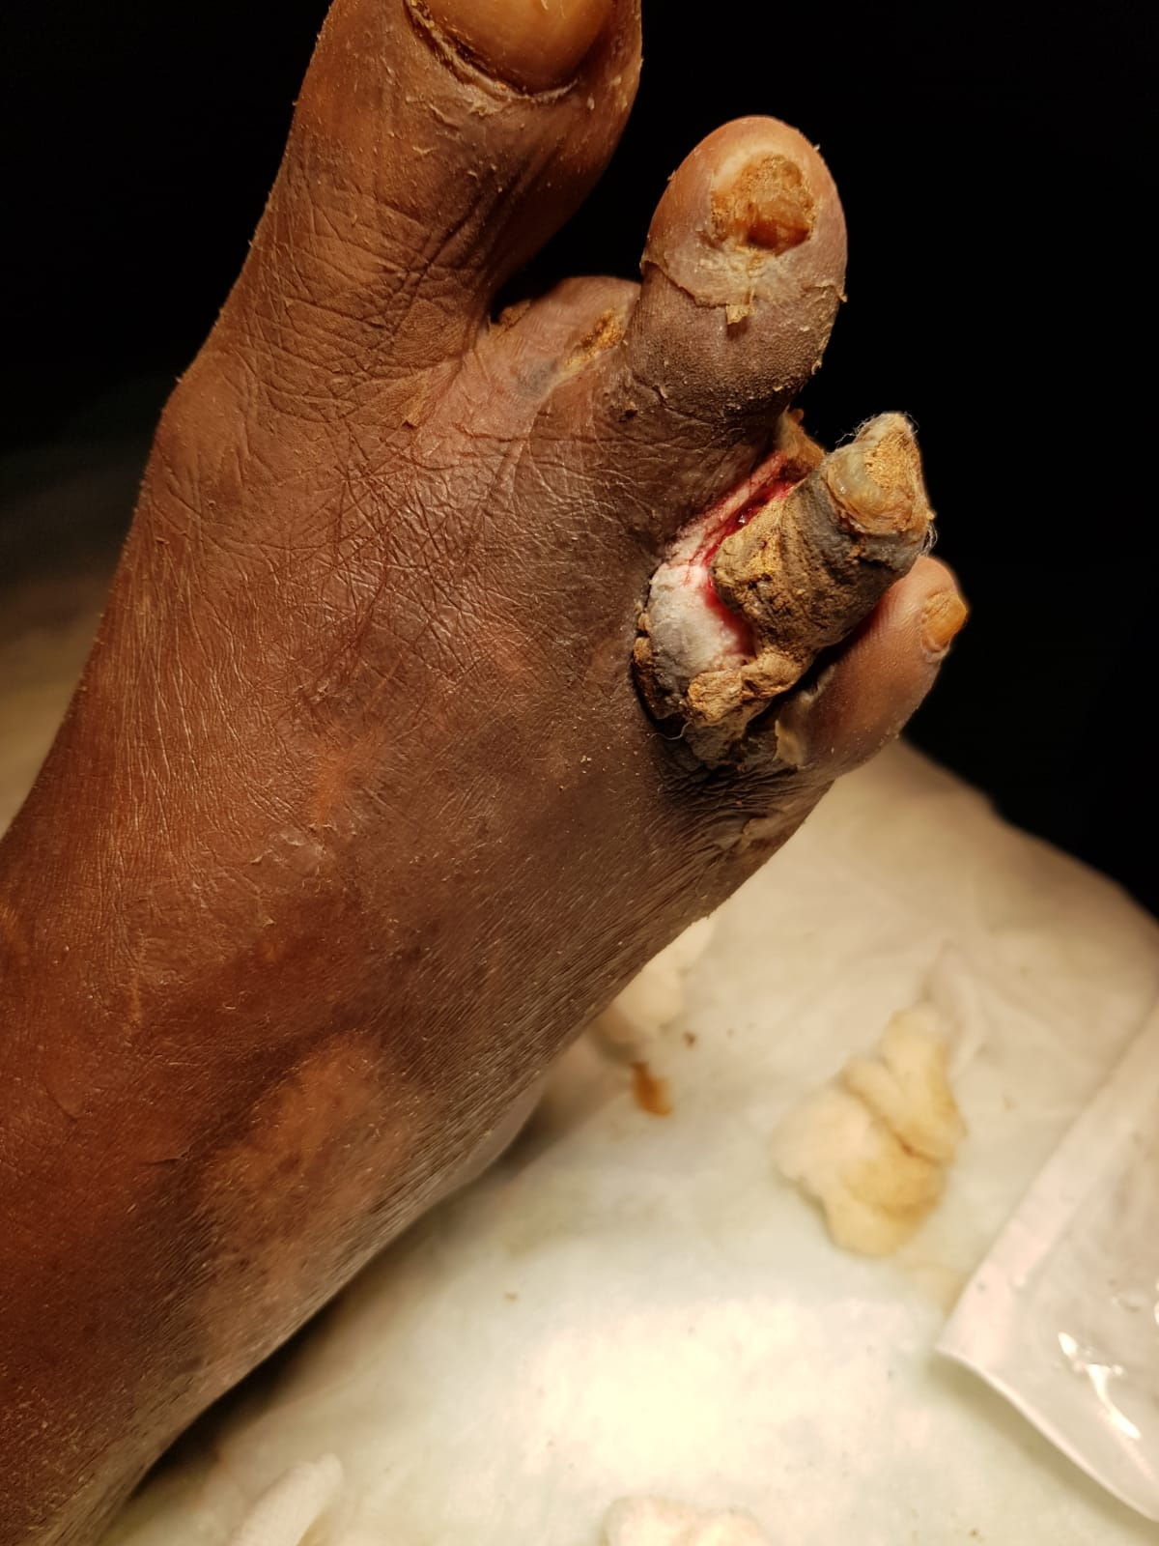
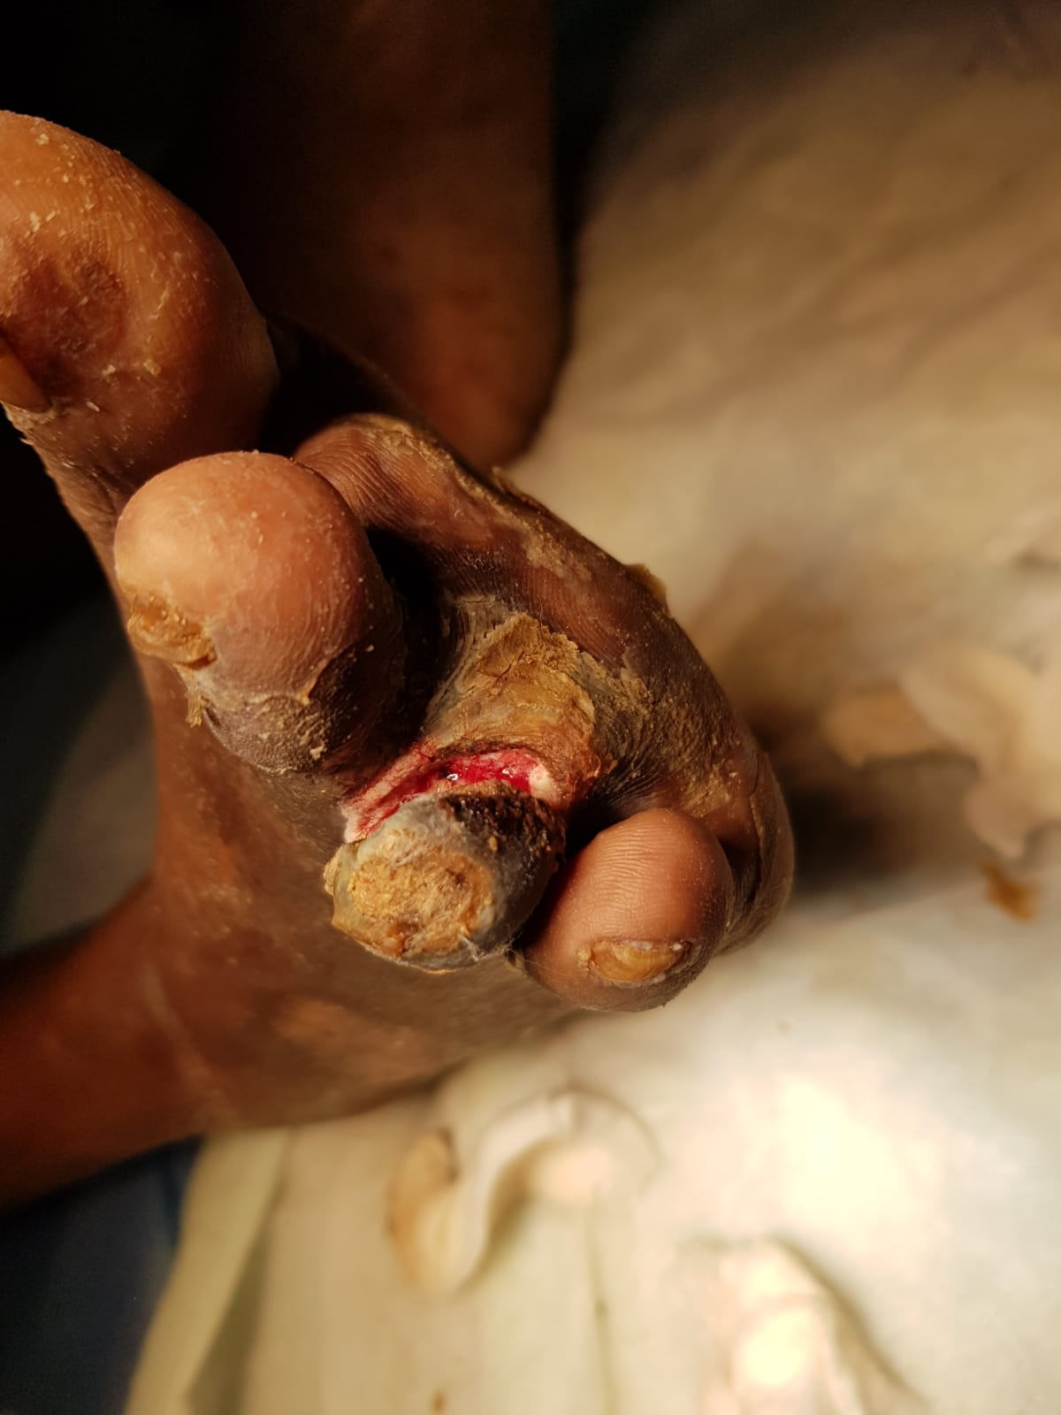

Slide 28
Management:
Local wound care:
Clean
Debride infected necrotic devitalized tissue
Wet dressing
?VAC

Slide 29
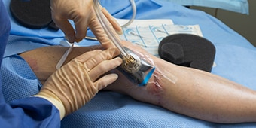
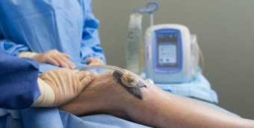

Slide 30
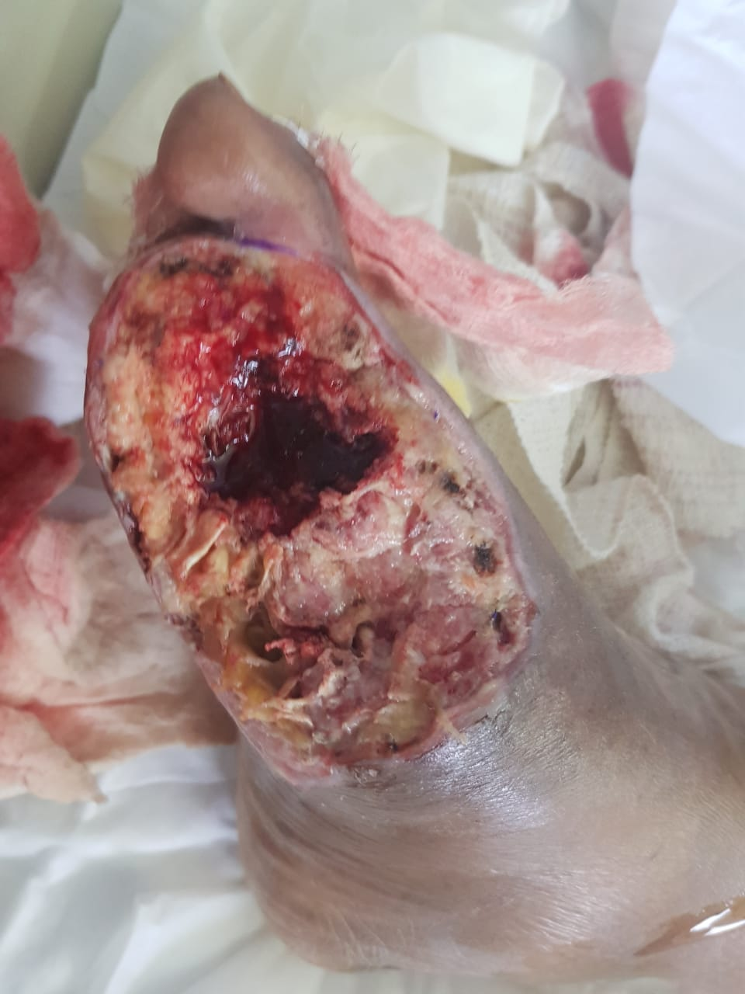
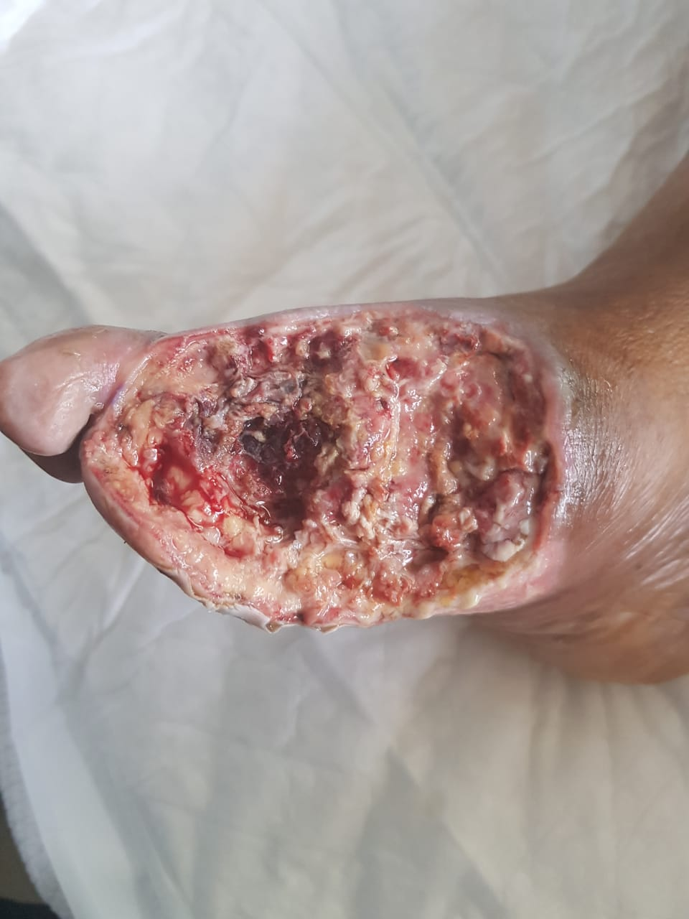

Slide 31
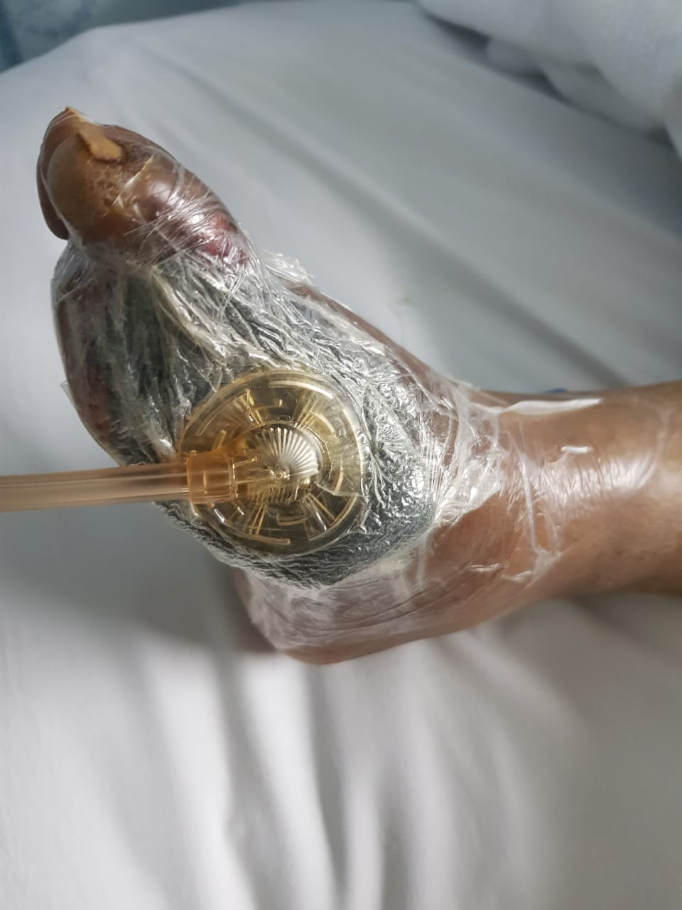

Slide 32
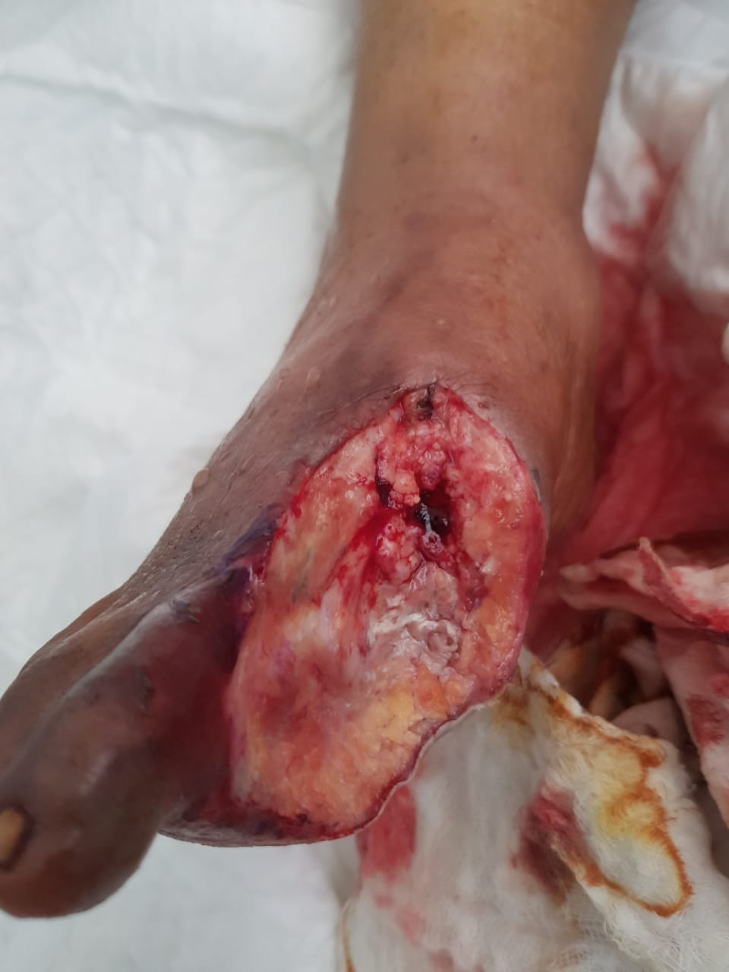
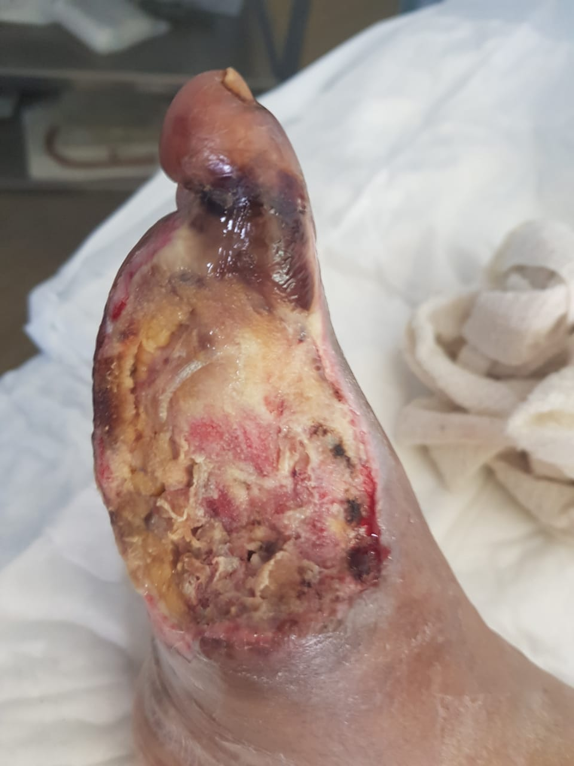

Slide 33
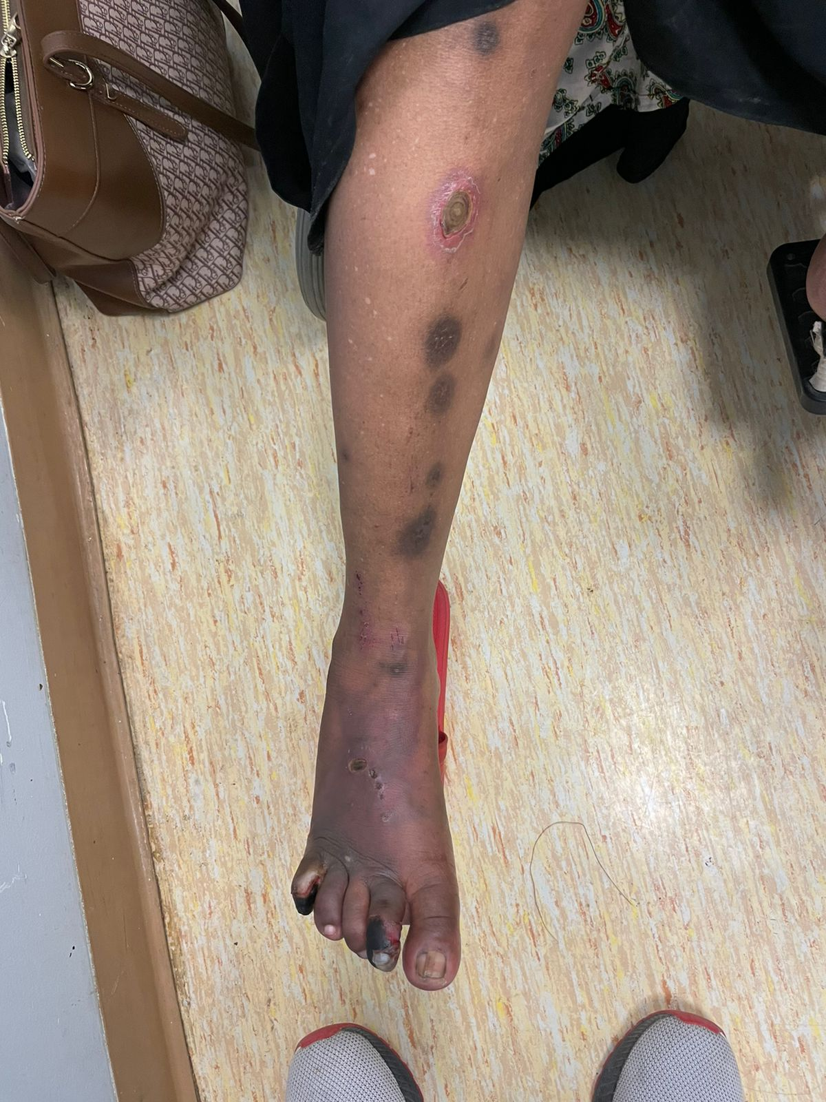

Slide 34
Diabetic Foot
All diabetes people should be examined at least annually for the presence of peripheral neuropathy, and peripheral arterial disease, two of the most important risk factors for developing foot ulcers.

Slide 35
The history of symptoms of peripheral neuropathy (a burning sensation, pins and needles in the lower extremities, shooting, sharp or stabbing pains, muscle cramps), usually neuropathic symptoms are worse during the night, at rest).
Loss of vibratory sensation and altered proprioception (affecting balance and causing numbness and tingling) and light touch reflect large‐fiber loss, whereas impairment of pain and temperature sensation occur secondary to the loss of small fibers.
Decreased or absent ankle reflexes occur early in the disease,

Slide 36
Diabetic neuropathy is also a major contributor to falls and fractures through loss of protective sensation (LOPS), proprioception, temperature discrimination, and pain, all ultimately leading to unsteadiness, recurrent minor injuries, and an increased risk of falls.
Table Neurological assessment for identification of loss of protective sensation (LOPS).
10‐g monofilament (plus at least 1 of the following 4):
Pinprick sensation
Vibration using 128‐Hz tuning fork
Vibration perception threshold (VPT)
Ankle reflexes

Slide 37
Examination of light touch (pressure perception)
Using the 10‐g monofilament. Filament, applied perpendicular to the skin surface of plantar surfaces of the big toe and the first, third and fifth metatarsal heads, bilaterally.
A normal protective sensation of pressure when the test is correct on at least two out of the four sites on each foot, and there should be at least one

Slide 38
Examination of superficial pain (pin‐prick sensation).
A disposable pin should be applied just proximal to the toenail on the dorsal surface of the hallux, with just enough pressure to deform the skin. The pin can have a sharp and a dull edge and the patient is asked to recognize if the sharp or the dull edge is touching him and at what site.
An inability to perceive the pinprick correctly over either hallux is regarded as an abnormal test result.
The pinprick should be performed starting from the toe and advancing toward the knee, on the anterior surface of both legs. Patients should not be allowed to watch during the examination.
Documentation of the level at which the sensation goes from dull to sharp is made for both sides.

Slide 39
Examination of vibration perception (using the 128‐Hz tuning fork):
This is tested on the dorsal side of the distal phalanx of the great toes, just proximal to the nail bed. It can also at the medial malleolus.
The tuning fork should be placed perpendicular to the foot at a constant pressure with the patient’s eyes closed.
The examination is repeated twice, and there should be at least one “sham” application in which the tuning fork is not vibrating.

Slide 40
Callus: high plantar pressure under the areas of callosities together with dryness of the skin. a consequence of diabetic peripheral autonomic neuropathy.

Slide 41
Charcot Foot:
Charcot neuro‐osteoarthropathy (CNO), a progressive condition of the musculoskeletal system.
Characterized by joint dislocations, pathologic fractures and debilitating deformities.
It results in a progressive destruction of bone and soft tissues at weight‐bearing joints.
It is one of the most serious complications of diabetes.
Treated by immobilization and a reduction of stress to the affected limb
Classic Charcot’s mid-foot ulcer following collapse of the foot arches.

Slide 42
Anti-biotics: (Target ?, Duration?, route)
Broad spectrum, covering G+ve, -ve & Anareobic
In case of mild infection, duration of 1-2 weeks.
In case of sever infection, duration of 2-4 weeks.
In case of Osteomylitis, duration of 4-6 weeks IV.

Slide 43
Control sugar, blood pressure, lipids
Prevention (proper shoes, instructions, … )

Slide 44
Patient education and routine foot care
• Wear comfortable, supportive footwear
• Avoid walking ‘barefoot’
• Wash the feet once a day in warm (not hot) soapy water
• If the skin is dry, use a regular emollient to reduce risk of fissuring
• Never fail to remove a foreign body from the shoe immediately after it is noticed
• Do not warm the feet using hot water bottles or by direct contact with a radiator
• Never attempt to ‘self-manage’ callosities using sharp paring instruments
• Do not apply adherent dressings such as corn plasters to the feet

Slide 45
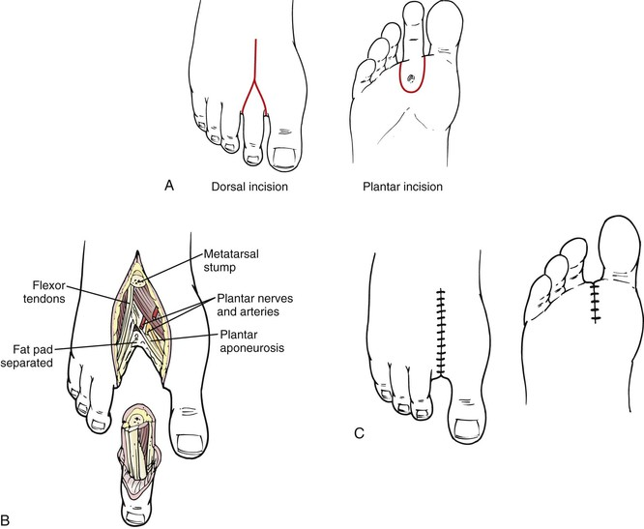
Amputations:
- Types ?
Ray amputation, which involves the excision of the toe and part of the metatarsal

Slide 46
Home message
10-25% of DM patient has risk to develop ulcers.
Main pathophysiology are peripheral neuropathy, peripheral vascular disease and immunodeficiency.
Patient education, medical management and early detection of foot problems play important roles in improving chances of limb preservation.

