Slide 1
Parathyroid glands
There are four, oval-shaped endocrine glands embedded in the posterior surface of the thyroid gland
  Two superior glands: located near the superior
  pole of the thyroid gland at the junction of cricoid
  and thyroid cartilages.
  Two inferior glands: located in the area between
  the inferior poles of the thyroid lobes and the
  superior mediastinum

Slide 2
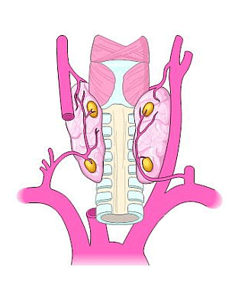
Function: secretion of PTH in response to low calcium serum levels
Effects of parathyroid hormone (PTH):
  Calcium:
    Increases blood calcium levels by directly stimulating osteoclasts to break down bone.
    Promotes calcium reabsorption by the kidneys
    Increases gastrointestinal calcium absorption by activating vitamin D
  Phosphate
    Inhibits proximal tubular reabsorption of phosphorus
Arterial supply: Inferior thyroid arteries
Venous drainage: Thyroid venous plexus
Different cells of the parathyroid glands:
  Chief cells: secretion of parathyroid hormone
  Oxyphil cells
  Adipocytes

Slide 3
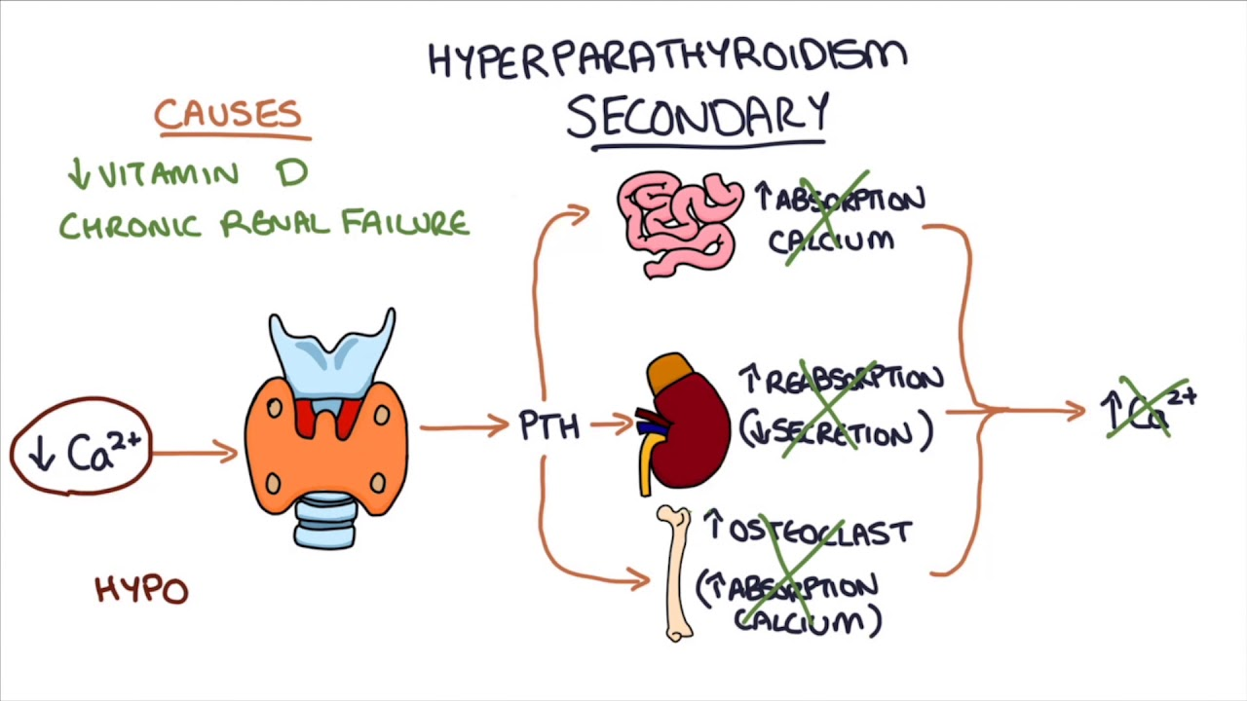
Causes:
Primary hyperparathyroidism :
is usually due to a parathyroid benign adenoma (75%) or parathyroid hyperplasia (20%). 1.0% have parathyroid carcinoma.
Secondary hyperparathyroidism:
is hyperplasia of the gland in response to hypocalcaemia (e.g. in chronic renal failure).
In tertiary hyperparathyroidism,
autonomous secretion of parathormone occurs when the secondary stimulus has been removed (e.g. after renal transplantation).
MEN syndromes
(type I (parathyroid adenoma, pancreatic islet cell tumours, pituitary adenoma) and
type II (parathyroid adenoma, medullary thyroid cancer, phaeochromocytoma)
Ectopic parathormone production (e.g. from small cell lung cancer).

Slide 4
Pathology:
Parathormone mobilizes calcium from bone,
enhances renal tubular absorption and,
with vitamin D, intestinal absorption of calcium.
The net result is hypercalcaemia.

Slide 5
Clinical features
Older women, >40 years of age.
Renal calculi or renal calcification – occurs in 20% of patients, polyuria (‘renal stones’).
Bone pain or deformity, osteitis fibrosa cystica, pathological fractures (‘painful bones’).
Muscle weakness, anorexia, intestinal atony, psychosis (‘psychic moans’).
Peptic ulceration and pancreatitis (‘abdominal groans’).

Slide 6
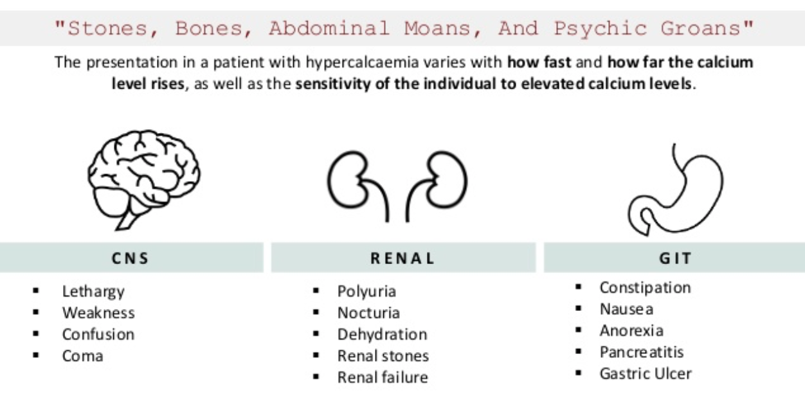
Symptoms of hypercalcemia

Slide 7
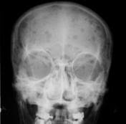
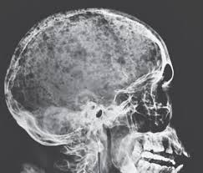
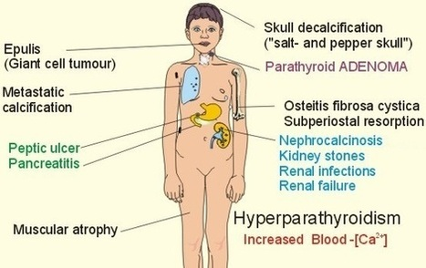
Salt-and-pepper-spots-in-skull

Slide 8
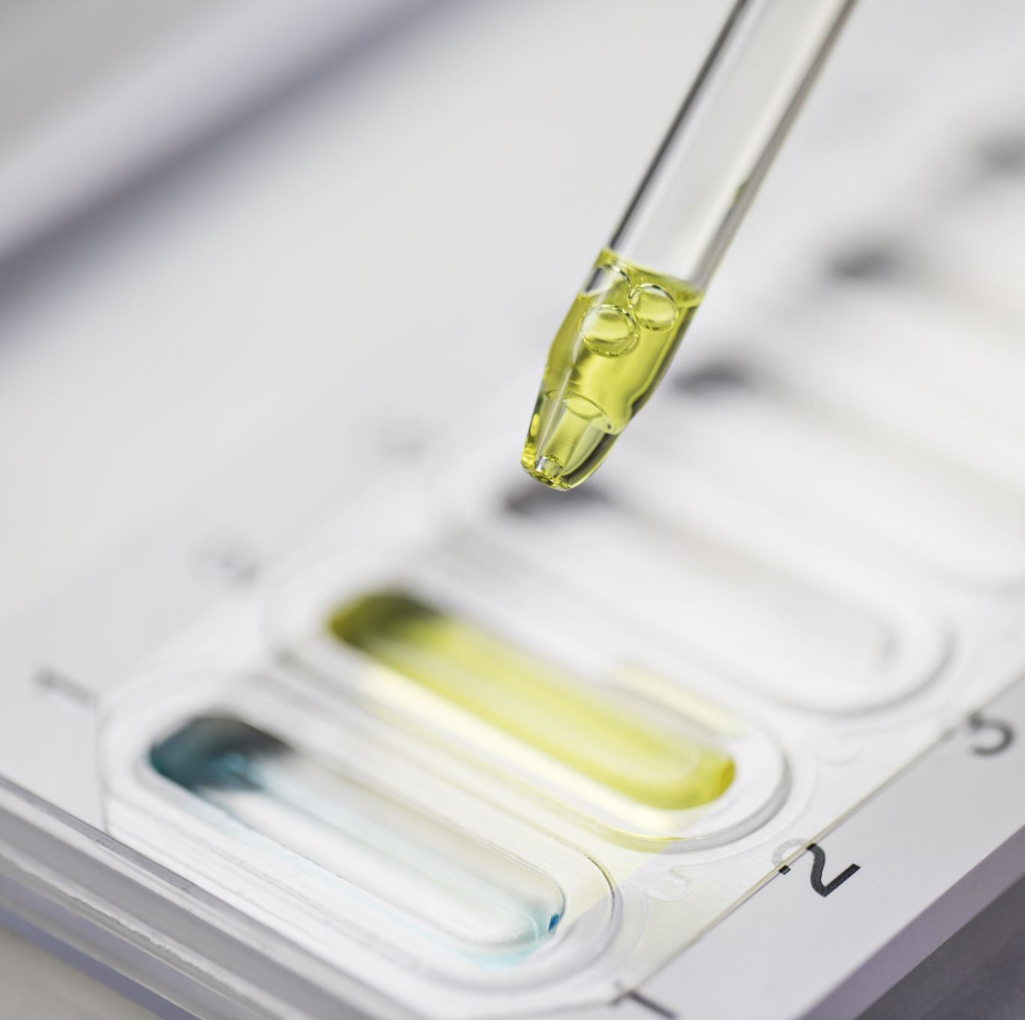
Hyperparathyroidism
Laboratory:
  High PTH
  Elevated serum Ca
  Low phosphate
  High Alkaline Phosphatase
  Low Mg
  High urinary Ca

Slide 9
Laboratory
Elevated PTH in the setting of hypercalcaemia.
Serum calcium (specimen taken on three occasions with patient fasting, at rest and without a tourniquet). Body Ca:
  99% stored in the skeleton
  1% is free
    ½ bound to proteins
    ½ is free ionized (Active)
Normal range 2.2–2.6 mmol/L. Calcium is bound to albumin and the level has to be ‘corrected’ when albumin levels are abnormal. •
May be decreased serum phosphate and elevated alkaline phosphatase

Slide 10
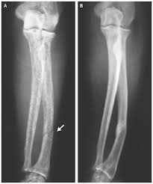
Radiology:
  DEXA : Wrist, spine, and hip
  KUB, IVP, CT (For renal stones)
  DEXA: Dual Emission X-ray Absorptiometry
Demeneralization of long bones , Pathological fracture

Slide 11
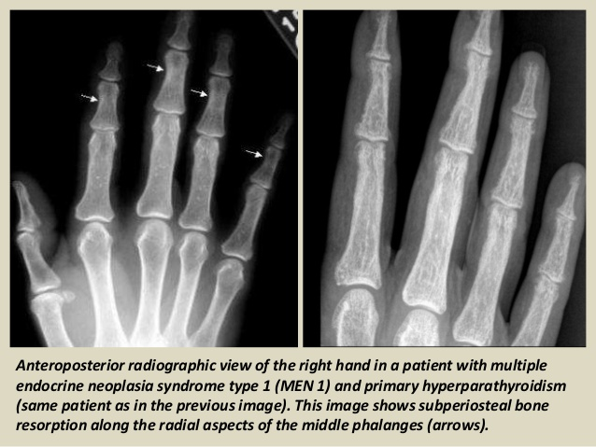
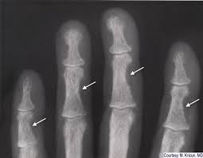

Slide 12
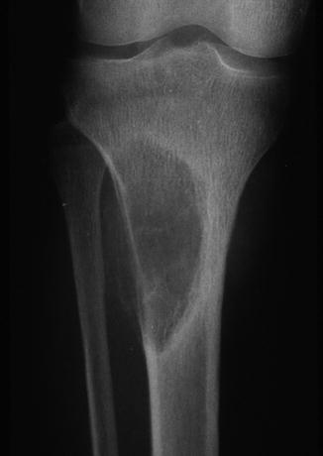
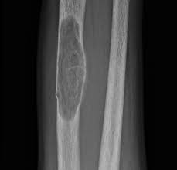
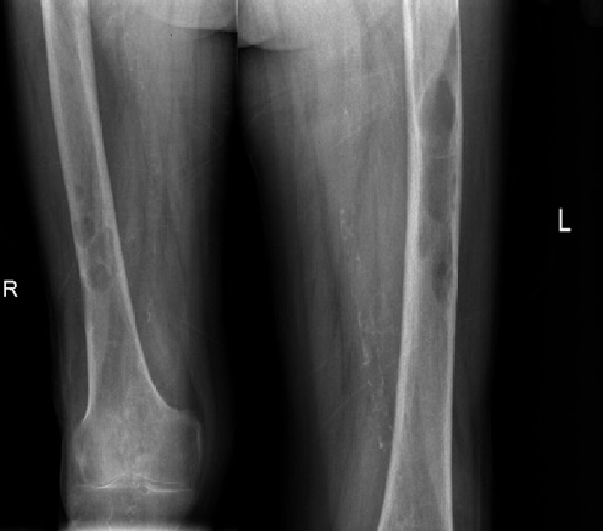
Lytic lesions caused by hyperparathyroidism are called Brown tumors. The term “Brown tumor” is a misnomer because it is not a true neoplasm.

Slide 13
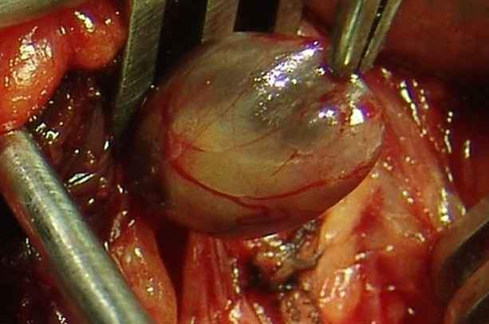
Management of Hypercalcaemia
Rehydration with intravenous saline until urine output of 100 /h.
☻Intravenous lasix is given after rehydration.
☻Serum potassium must also be replaced.
☻Biphosphonate such as disodium pamidronate.
☻Calcitonin
☻Serum parathyroid hormone concentration must be measured
urgently.
☻Urgent parathyroidectomy.

Slide 14
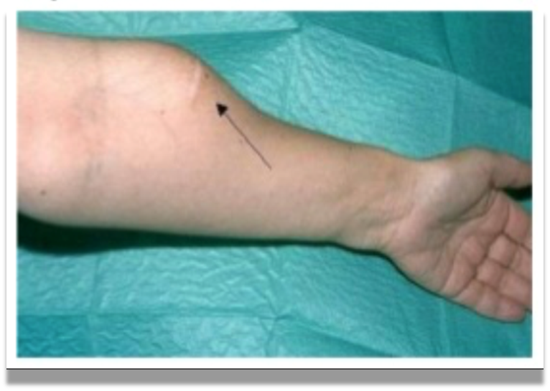
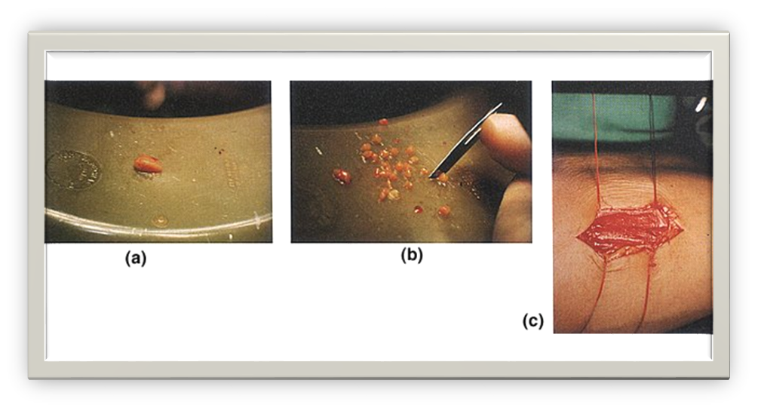
Complications of parathyroidectomy:
  Post op. bleeding
  Hematoma:
    Pre tracheal (airway obstruction)
    pre- platysmal
  Nerve injury
    1-2% permanent:
    Recurrent laryngeal (hoarseness)
    Superior laryngeal (loss of high pitched sound)
  Hypocalcemia
Notes:
During surgery how will you confirm whether the tissue is parathyroid gland? Golden yellow color ••Put it in a cup of normal saline. ••Parathyroids usually sink but fat floats. – Implant the parathyroid into the sternomastoid pocket or into the forearm

Slide 15
Hypoparathyroidism:
Is a rare condition characterized by hypocalcaemia due to reduced production of parathormone.
  Primary (Congenital)
  Secondary (Acquired)
    Iatrogenic (Surgery)
    Autoimmune:
      Adrenal insufficiency
      Hashimoto’s
      Pernicious anemia
Causes
Post-thyroid or parathyroid surgery (‘hungry bone syndrome’) or neck irradiation.
Idiopathic (often autoimmune and presents in children or young adults).
Congenital enzymatic deficiencies (numerous syndromes).
Metal overload (e.g. iron (haemochromatosis or thalassaemia), copper (Wilson’s disease), magnesium).
Pseudohypoparathyroidism (reduced sensitivity to parathormone).

Slide 16
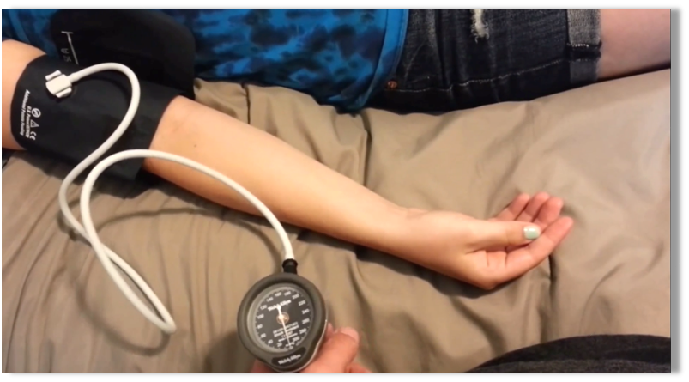
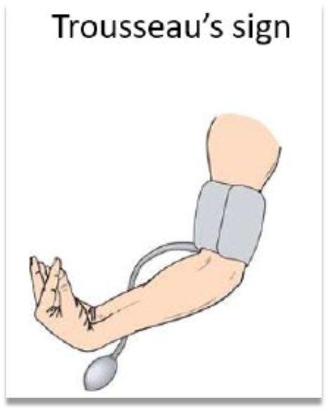
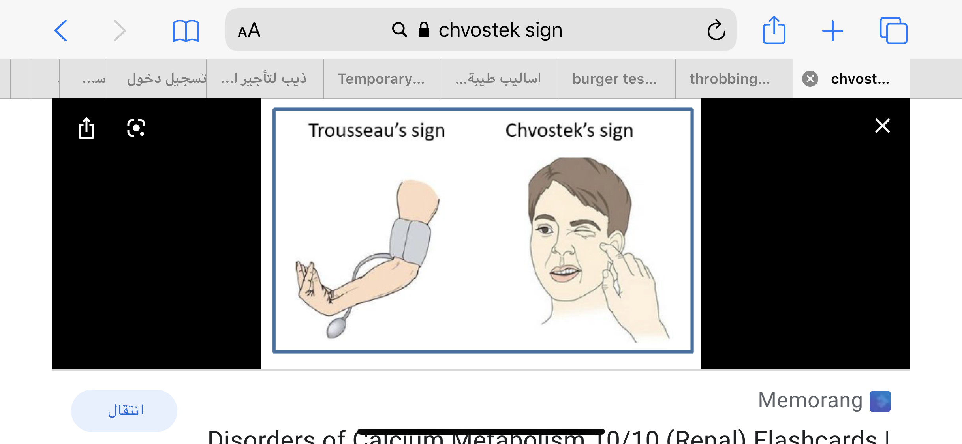
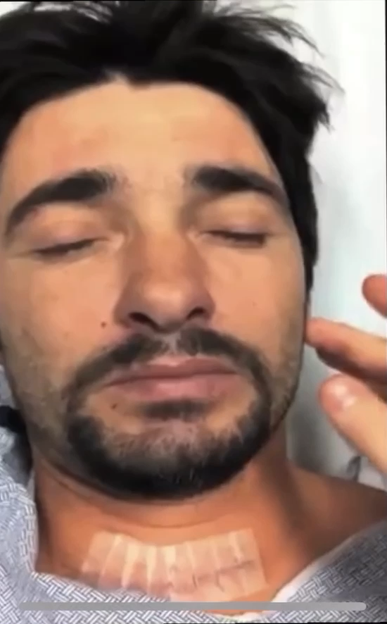
Clinical features:
1. Tetany—due to hypocalcemia; carpopedal spasm, fasciculation, and cramps Perioral paraesthesia, Periorbital, finger tips cramps
2. Laryngismus stridulus—spasm of vocal cord leading to dyspnea
Subclinical cases
1. Trousseau’s sign—flexion at Meta carpo phalangeal joint and extension at interphalangeal
joint on tying the tourniquet at upper arm and raising the blood pressure above to 20 mmHg systolic pressure
Prolonged QT interval on ECG.
2. Chvostek’s sign—on taping over the preauricular region, twitching of facial muscles

Slide 17
Hypoparathyroidism
Diagnosis:
  Blood levels of ionized Calcium and PTH are low,
Reduced serum calcium increases neuromuscular excitability.
Also measure vitamin D and magnesium.
  ECG: shows a lengthened Q–T interval
Treatment:
  Asymptomatic
    Calcium supplements PO
  Symptomatic:
    IV Calcium supplement, you have to correct magnesium as well

Slide 18
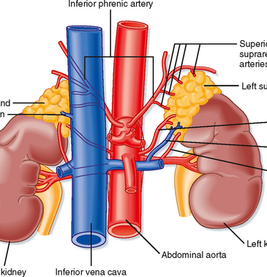
Adrenal glands
Also known as suprarenal glands
Endocrine glands that produce a variety of
hormones
Each gland has an outer cortex and
an inner medulla
The adrenal cortex is divided into 3 zones:
  Zona glomerulosa
  Zona fasciculata
  Zona reticularis

Slide 19
Mineralocorticoids:
  Zona glomerulosa
  Produces aldosterone
  Helps in the regulation of blood pressure and electrolytes balance
    Na retention
    Water retention
    K⁺ excretion
Glucocorticoids:
  Zona fasciculata
  Cortisol and cortisone
  Helps in the regulation of the metabolism and immune system suppression
  CORTISOL is responsible for control & metabolism of:
  A. CHO (carbohydrates)
      Increases glucose formation
      Increases glucose release
B. FATS:
  Control of fat metabolism
  Stimulates fatty acid mobilization from adipose tissue
C. PROTEINS:
  Control of protein metabolism
  Stimulates protein synthesis in liver & protein breakdown in tissues
D. Others:
  Inflammatory and allergic response
  Immune system therefore increases the risk of infection

Slide 20
Adrenocorticotropic hormone ACTH
Produced in anterior pituitary gland
Individual biorhythms
  Highest in early morning
  Gradually decrease on the rest of the day
Stress- Increases cortisol production
ANDROGENS:
  Zona reticularis
  Produces androgens that are converted to fully functional sex hormones in the gonads and other target organs
  Hormones which increases male characteristics via release of testosterone

Slide 21
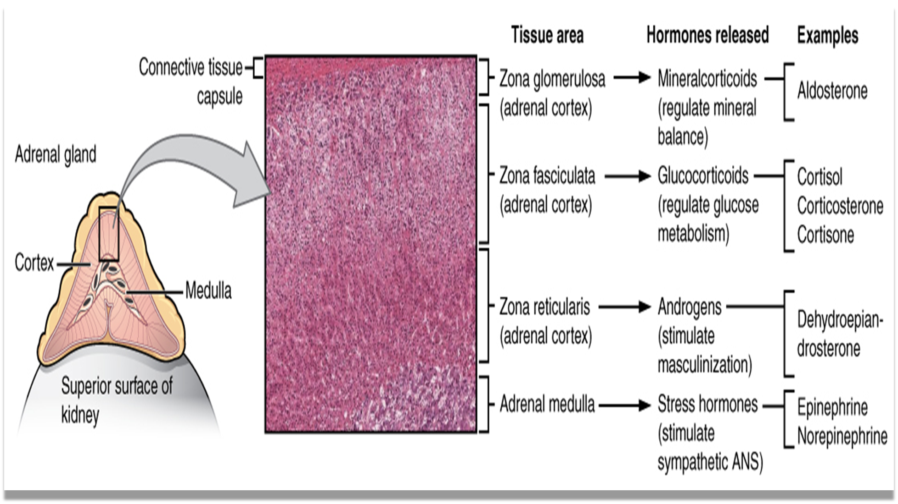
Adrenal medulla: It produces catecholamines(Epinephrine, and Norepinephrine)
Catecholamines produce a rapid response throughout the bod in stress situations.

Slide 22
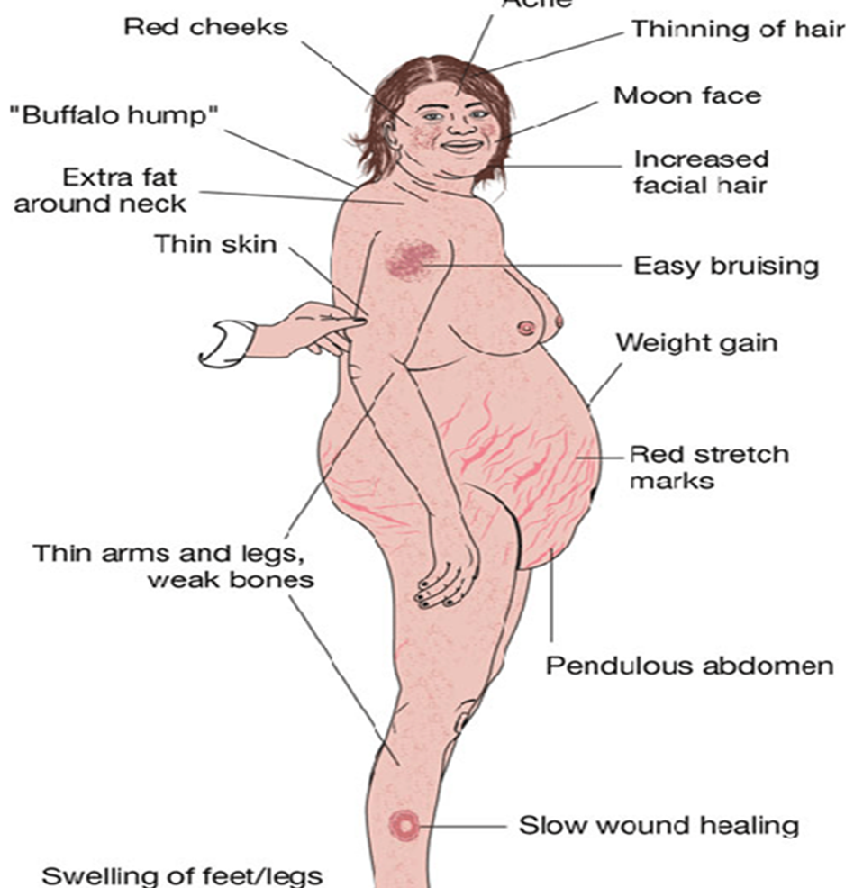
Disorders of the adrenal glands
Cushing’s disease
Cushing Syndrome ----------------------------→
Hyperaldosteronism “Conn’s Syndrome”
Addison's disease
Pheochromocytoma

Slide 23
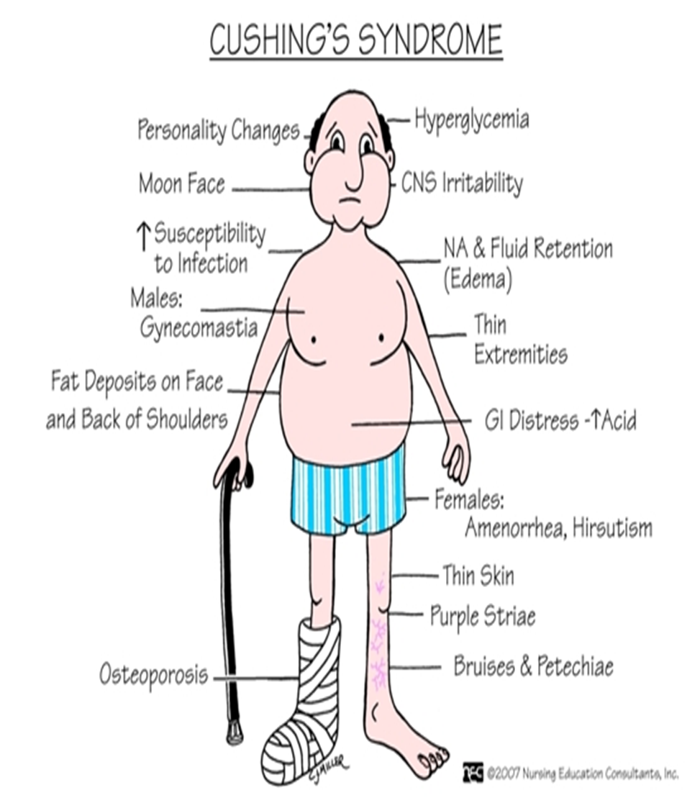
Cushing’s syndrome
Secretion of cortisol from adrenal cortex
4 times more frequent in females
Usually occurs at 35-50 years of age
Causes:
  Endogenous
    Adrenal tumor
    Tumor of the anterior pituitary gland (Cushing’s disease)
      Hyperplasia (NAH)
    Ectopic ACTH
      Secreting tumor (e.g. lung, pancreas)
  Exogenous
    Excessive cortisone intake

Slide 24
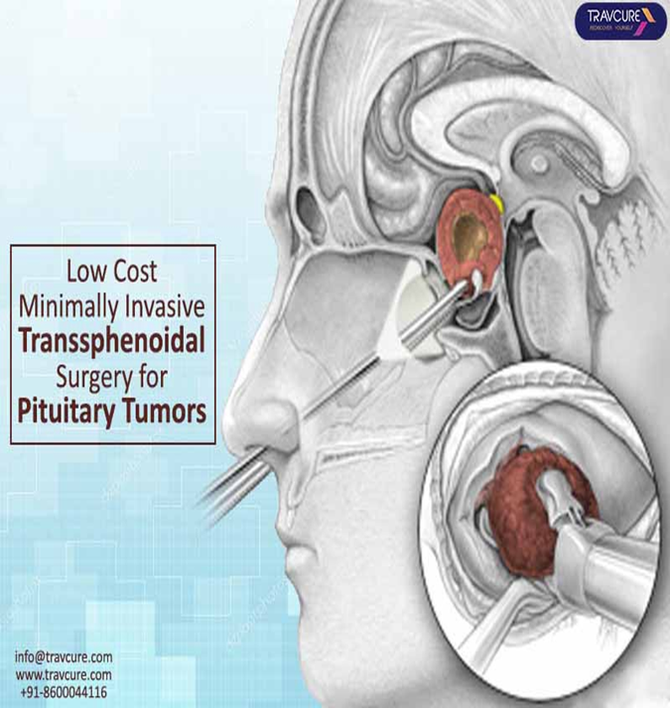
DIAGNOSIS:
  High Serum cortisol levels
  URINARY LEVELS OF STEROID METABOLITES
    17-OHCS (hydroxycorticosteroid) (High)
    17-KS (ketosteroid) (High)
Hematology:
  WBCs (Decreased)
  Lymphocytes (Increased)
  Eosinophils (Decreased
TREATMENT:
  Primary:
    Adrenalectomy (unilateral or bilateral)
      if bilateral, need hormone replacement for life
  Secondary
    Trans-sphenoidal removal of pituitary tumor
  Ectopic:
  Try to remove source of ACTH secretion
  Radiation to tumors
  Palliative drugs:
    MITOTANE (destroys tissue in adrenal cortex)

Slide 25
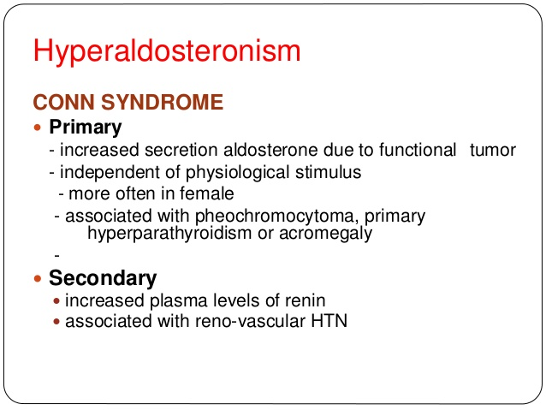

Slide 26
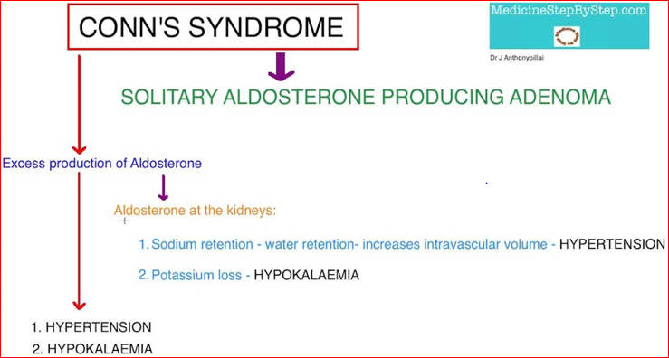
“Conn’s Syndrome”
Too much aldosterone secretion
Usually caused by adrenal tumor
SYMPTOMS & SIGNS:
  High Na and water retention
  HTN
  Low K⁺
  Usually no edema
Diagnosis:
  High urinary K⁺
  High plasma aldosterone level with low plasma renin
  EKG changes
  CT scan
Treatment:
  Control BP
    Using Aldactone which is aldosterone antagonist.
  Correct hypokalemia/hypernatremia
    K⁺ supplements+ low Na diet
  Partial or total adrenalectomy

Slide 27
The lack of LL oedema in Conn’s Syndrome results from spontaneous natriuresis and diuresis (called the "aldosterone escape") that occurs in patients with primary aldosteronism and that appears to be mediated by atrial natriuretic peptide (ANP)
Nephrogenic diabetes insipidus, caused by reversible hypokalemic tubular damage and renal tubule antidiuretic hormone resistance due to the hypokalemia, can cause nocturia, polyuria, and polydipsia in Conn’s Syndrome
Which hormone is primarily responsible for regulating blood pressure and electrolyte balance?
Cortisol
Aldosterone
Epinephrine
Insulin
Aldosterone. It helps regulate sodium and potassium levels in the blood, which in turn affects blood volume and pressure.

Slide 28
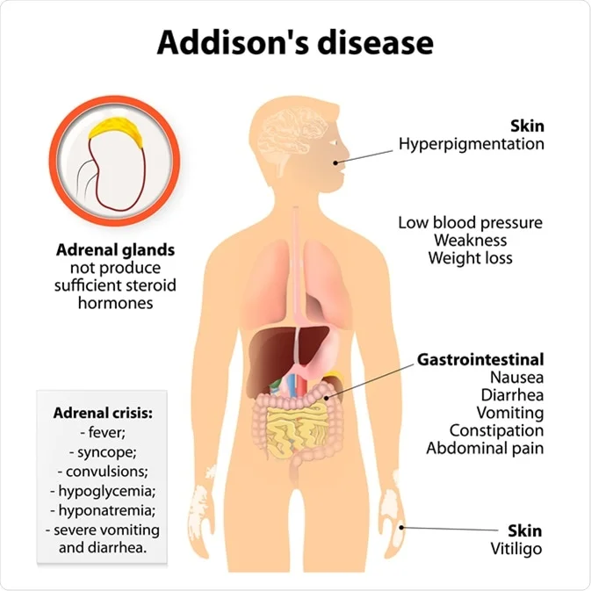
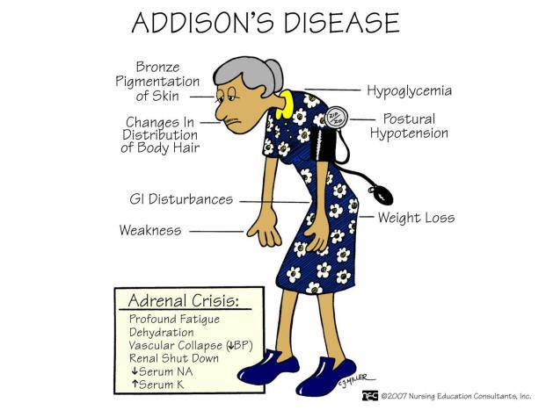
Addison’s disease
Hypofunction of adrenal cortex, leads to low levels of
  Glucocorticoids
  Mineralocorticoids (aldosterone)
  Androgens
Which test is used to diagnose adrenal insufficiency?
a) Blood glucose test
b) Thyroid function test
c) ACTH stimulation test
d) Lipid profile test

Slide 29
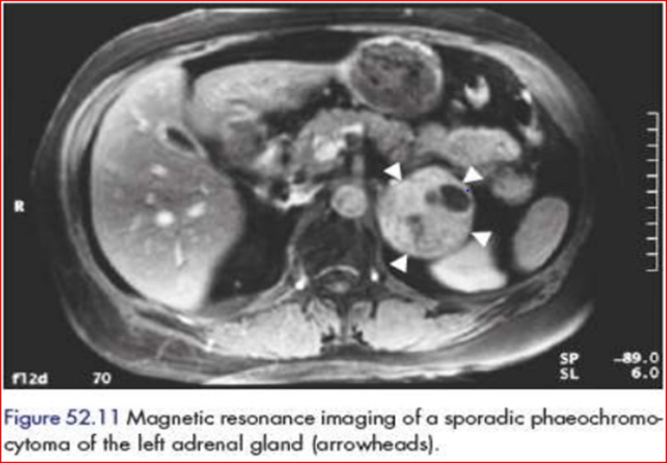
Pheochromocytoma:
Rare, catecholamine-secreting tumor
10% is malignant
SYMPTOMS & SIGNS:
Classically, it manifests with the classic triad: Headaches, Palpitations, Diaphoresis
Severe hypertension/ related complications:
Cardiovascular complications such as myocardial infarction and arrhythmias
Sudden death may occur in patients with undiagnosed tumors who undergo other surgeries or biopsy.
Precipitate hypertensive encephalopathy & cerebral haemorrhage.
Panic attacks
The following may also occur :Tremor, Nausea, Weakness, Anxiety, sense of doom, Epigastric pain, Constipation

Slide 30
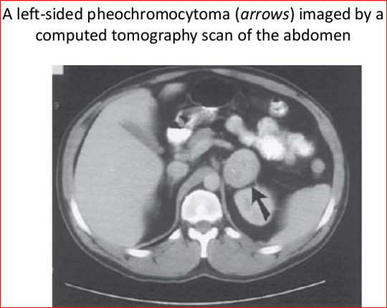
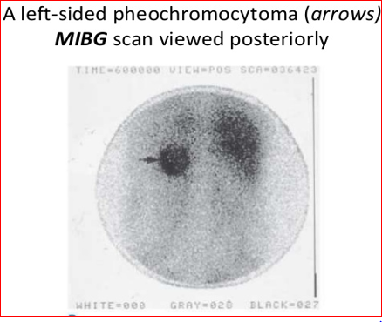
Diagnosis:
  24 hour (urine-VMA
  Plasma metanephrine metabolite of Epinephrine)
  CT/MRI to locate tumor/ (MIBG scan)
Intervention:
  Alpha blocking agents
    Prazosin (Minipress) to decrease BP
  Beta blocking agents
    Inderal to control heart rate
  Sedatives
  Surgical resection of the tumor is the treatment
  of choice and usually cures the hypertension
An MIBG scan iodine-123 meta-iodobenzylguanidine
is commonly used for detection of neuroendocrine tumours, such as neuroblastoma and phaeochromocytoma.
It can also aid in the detection of carcinoid and medullary thyroid carcinoma

Slide 31

THANKS
Notes:
N

