Slide 1


Slide 2
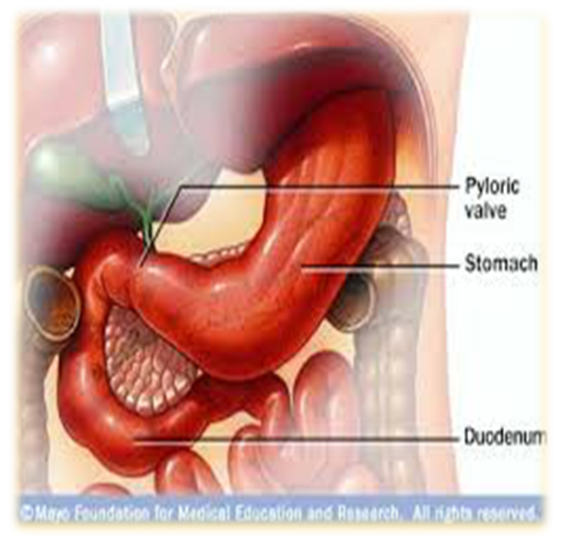
Gastroduodenal Diseases
Omar Alaidaroos MSc, MD
Associate Prof. of General Surgery

Slide 3
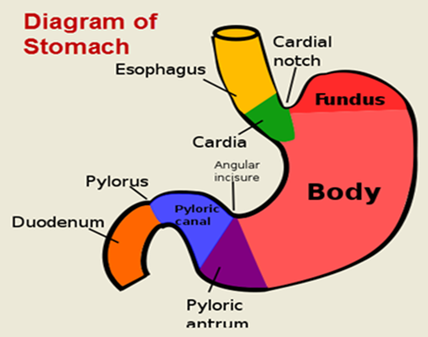
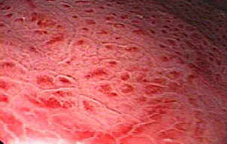
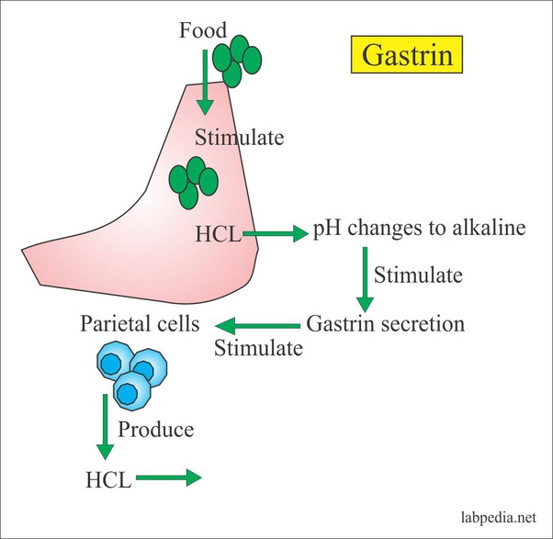
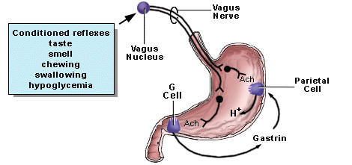
Gastritis
Irritation of gastric mucosa,
causes episodes of discomfort (usually after eating),
sometimes associated with nausea and/or vomiting
Acute vs chronic

Slide 4
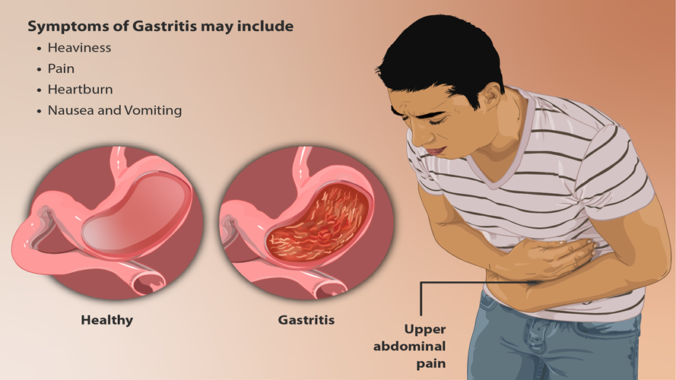
Acute Gastritis
Causes
    Medications: aspirin or other NSAIDs (non-steroidal anti-inflammatory drugs), poisons (including strong alcohol)
    Infections: bacterium helicobacter pylori.
Usually, the inflammation settles quickly when the irritant is removed.
Symptoms:
  Upper abdominal pain (Epigastric)or discomfort
  Nausea and vomiting
  Bloating
  Loss of appetite
  Weight loss
  Pernicious anemia

Slide 5

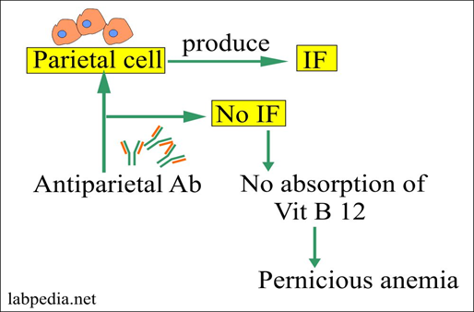
Chronic Gastritis
Types:
Type A or autoimmune gastritis.
Type B or antral gastritis.
Rarer forms, e.g., eosinophilic gastritis, granulomatous gastritis.
Type A Gastritis :
It is characterized by the presence of antibody to parietal cells.
The antrum is spared, and gastrin secretion is frequently elevated.
It is this form that may progress to pernicious anemia.
It is common in the elderly people and may be associated with other organ specific autoimmunity, e.g., Hashimoto’s thyroiditis.
The gastritis itself is usually asymptomatic, but there is a fourfold increase in the risk of gastric cancer.

Slide 6
2. Type B Gastritis Helicobacter pylori, Antral gastritis :
A symptomatic and do not require any treatment but patients with dyspepsia may benefit from H. pylori eradication.
3. Granulomatous Gastritis:
It is associated with tuberculous infection, sarcoid or Crohn’s disease characterized by antral and duodenal involvement with mucosal inflammation and ulceration that may lead to gastric outlet obstruction.
4. Eosinophilic gastritis:
It is a rare condition in which eosinophils infiltrate the distal stomach and the proximal small bowel, resulting in enlargement of antral folds, ←Prednisone

Slide 7
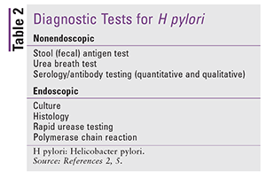
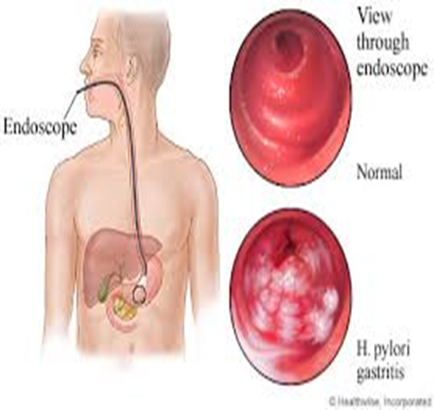
Gastritis
Diagnosis:
  History, & examination
  Labs: CBC, H-pylori
  Radiology: AXR- USS- CT scan
  OGD, and biopsy
Treatment:
  Underlying cause (Medications- Vitamin def. - lifestyle)
  Medications: To reduce gastric acid
    H2 antagonists (Zantac©)
    Proton pump inhibitor (Nexium©)
  Anti-emetic medications may be needed
  Treatment of H. Pylori

Slide 8
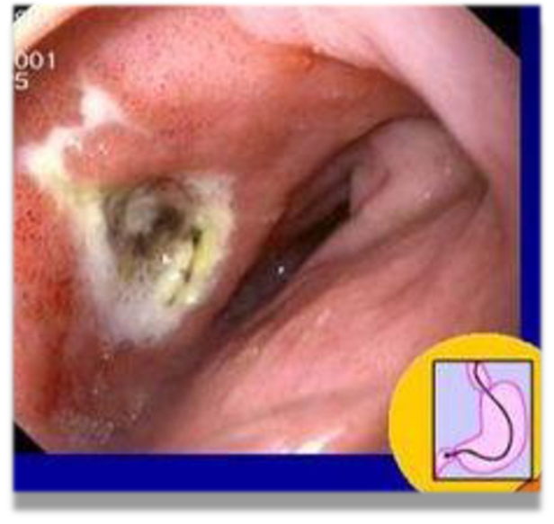
Peptic ulcer:
Peptic ulcers are found approximately four times as often in the duodenum than in the stomach
Duodenal ulcers are more common in men
Gastric ulcers equally affect men and women
Ulcers are found at all ages
More common with increasing age
Whilst acid attack is a marked feature of duodenal ulcer (DU),
impaired mucosal resistance appears to be more important for gastric ulcer.
DUODENAL ULCER: Risk Factors:
Cigarette smoking, stress, NSAIDs, corticosteroids and infection with H. Pylori
NSAIDs—Deplete endogenous mucosal prostaglandins making the mucosa more susceptible to ulceration.
Smoking—Increases acid secretion, impairs ulcer healing, accelerates gastric emptying and decreases pancreatic bicarbonate secretion.
H. pylori—Over 90 percent patients with a duodenal ulcer have this organism

Slide 9
Clinical Features: DU
1. Epigastric pain—Most frequent symptom, appears in empty stomach and relieved by taking food.
2. Appetite is good.
3. Malignancy almost never occurs.
4. Vomiting not so common.
5. Periodicity comes and goes in a 4 to 6 months cycle.
6. Duration of attack—A month or two.

Slide 10
Diagnosis :
Endoscopy—This has replaced Ba–meal examination as the mainstay of diagnosis.
In addition to confirming the presence of peptic ulceration, endoscopy allows esophageal disease to be excluded, may reveal unsuspected pathology and allows gastric ulcers to be biopsied to exclude malignancy.
2. USG—This is advisable to exclude gallstones as cholelithiasis and peptic ulceration often coexist and share common symptoms.
Differential Diagnosis
1. Chronic gastric ulcer.
2. Chronic cholecystitis.
3. Chronic amebiasis and worm infestation.
4. Chronic pancreatitis.
5. Chronic appendicitis.
6. Intestinal tuberculosis.

Slide 11
Treatment:
Medical Measures
1. Cessation of smoking and intake of NSAIDs, steroids, etc.
2. A period of bed rest and a change to less stressful life style and small frequent meals without spices (i.e. No hurry, curry and warry).
3. Drug therapy:
a. Antacid (liquid)—1, 2 and 3 hours after meal.
b. H2 Blocker—Famotidine 40mg/day.
c. Proton pump inhibitor—e.g. omeprazale 20mg/day.
d. Cytoprotective agent, e.g. sucralfate, colloidal bismuth, etc.

Slide 12
Peptic ulcer perforation
‘Boardlike rigidity’ of diffuse peritonitis However, in the elderly and the critically ill presentation can be atypical.
Subdiaphragmatic free gas on a plain erect chest X-ray is diagnostic.
The availability of Helicobacter pylori eradication regimens and potent proton-pump inhibitors alleviate patients' ulcer diathesis without the need for a definitive acid-reducing procedure.
A simple omental patch repair and thorough peritoneal toileting to be done during the emergency operation. The only exception is giant duodenal perforations (>2 cm), not be amenable to a simple patch repair
Erect chest radiograph showing right subphrenic free
gas shadow associated with a perforated peptic ulcer.
A small perforation at the juxtapyloric area
Pedicle omental patch (Graham) repair on the perforation site secured with absorbable sutures

Slide 13
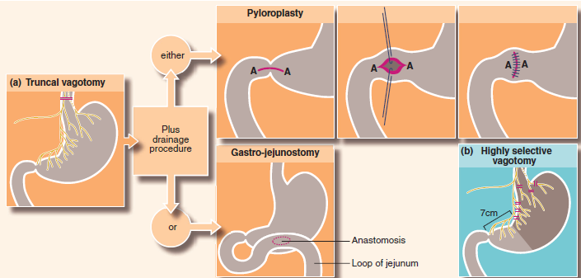
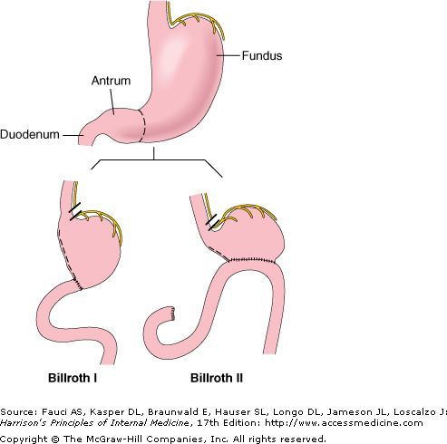
Surgical Treatment:
Indications:
1. Failure of medical treatment, i.e. failure of the ulcer to heal or recurrence, after rigid medical treatment (6 months for duodenal ulcer and 3 to 4 weeks for gastric ulcer).
2. Appearance of complications, e.g. pyloric stenosis, repeated hemorrhage.
3. Ulcer of > 5 years standing.
4. Very large ulcers (> 5 cm size).
Type of operation:
1. Truncal vagotomy with a drainage procedure (TV + D)
e.g. pyloroplasty or gastrojejunostomy.
2. Truncal vagotomy and antrectomy, bowel continuity
is maintained by Billroth I or Billroth II anastomosis.
Billroth II gastrectomy has higher mortality and morbidity.
3. Highly selective vagotomy (HSV) without any drainage procedure.

Slide 14
GASTRIC ULCER
Risk Factors :
Tobacco, alcohol and H. pylori infection.
10 percent of people taking NSAIDs, suffer from acute gastric ulcer.
Gastric ulcer frequently develops in degenerate and aged gastric mucosa.
Site Gastric ulcer is most frequently seen near the incisura, a constant notch in the lower part of lesser curvature.
Age/Sex Gastric ulcers occur most commonly in elderly women with the highest incidence between 55 and 60 years of age.

Slide 15
Clinical Features:
Pain occurs soon (15–30 min) after eating, which is the precipitating factor unlike duodenal ulcer.
Relieving factor—vomiting.
There may be loss of weight and hematemesis is more common than melena.
Diagnosis by endoscopy and biopsy.
A good clinical rule is to suspect initially that every gastric ulcer is malignant.
Treatment:
Medical treatment is effective and is the first line of approach for most patients. Surgery is usually reserved for cases where medical treatment fails or if there are complications such as bleeding, perforation, or obstruction.
Combined gastric ulcer + Duodenal ulcer, treatment of choice is partial gastrectomy that includes the entire antrum and the ulcer plus truncal vagotomy of both vagus nerves.
2. For gastric ulcer–Treatment is only partial gastrectomy (Billroth-1) that includes the entire antrum and the ulcer without vagotomy.
Billroth-I is preferred to Billroth-II operation if the duodenum is not badly deformed.

Slide 16
Complications of gastric ulcer:
Complications are same as in case of chronic duodenal ulcer. But bleeding occurs more commonly and perforation less frequently than duodenal ulcers.
  An unusual complication of perforation is a gastrocolic fistula, when ulcers on the greater curvature penetrate the colon. Here surgical intervention is necessary.
  Delayed healing, are more common in smokers than in non-smokers.
  Obstruction
  Weight loss

Slide 17
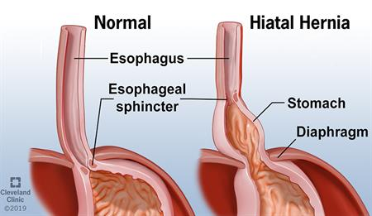
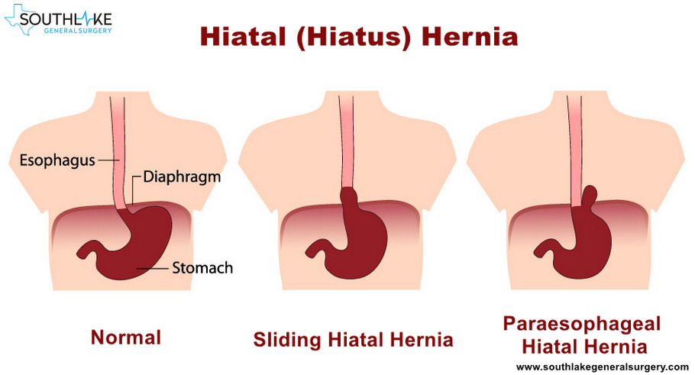
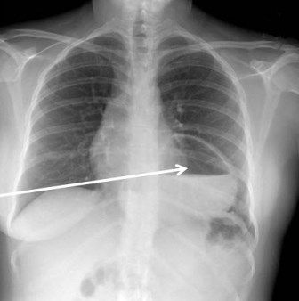
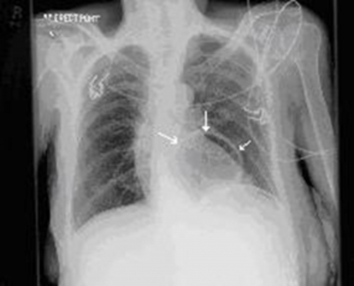

Slide 18
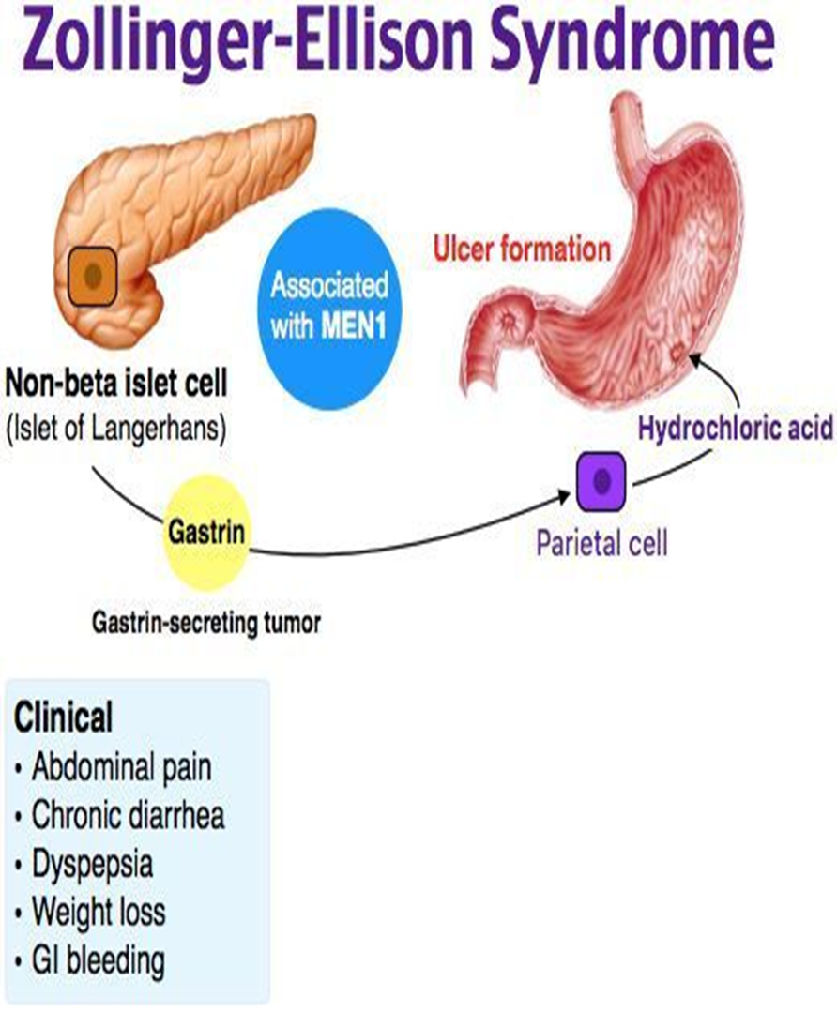
ZOLLINGER–ELLISON SYNDROME : (Gastrinoma)
A rare disorder caused by a non–beta islet cell, gastrin-secreting tumor of the pancreas that stimulates the acid-secreting cells of the stomach to maximal activity, with consequent gastrointestinal mucosal ulceration
characterized by the triad of severe peptic ulceration, gastric acid hypersecretion and a non – beta cell islet tumor of the pancreas (Gastrinoma).
It is most common between 30 and 50 years of age.
Pathology:
The gastrinoma produces enormous amounts of the hormone gastrin, due to which
the parietal cell mass increases 3 – 6 folds and secrete to their maximal capacity.
The pancreatic lipase is inactivated and bile acids get precipitated, which results in
diarrhea and steatorrhoea.
An increase in the acidity of the stomach contents, which can lead to a decrease
in the pH of the small intestine. This acidic environment can inactivate pancreatic
lipase, leading to malabsorption of fats and other nutrients.
In 90 percent cases gastrinoma is situated in the pancreatic head. The size varies
between 1 mm to 20 cm.
Approximately half to two–thirds of the cases are malignant.
Multiple endocrine neoplasia (MEN), Type I is associated in 20 – 60 percent of patients.
with hyperparathyroidism and pituitary adenomas.

Slide 19
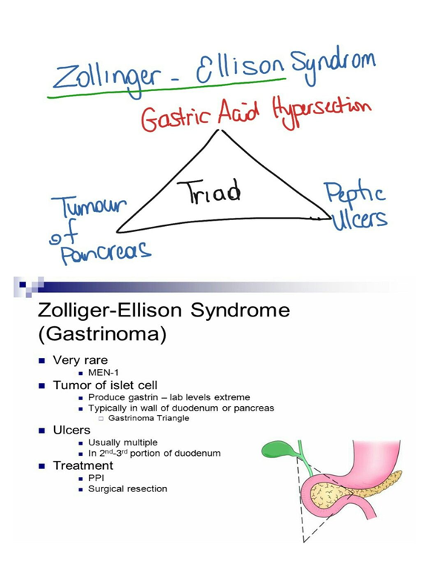
Diagnosis:
This is done by the demonstration of hypergastrinemia and concurrent gastric hyperacidity.
The tumor localization may be performed by endoscopic ultrasound.
It is seen that 80 – 90 percent of gastrinomas would be found within the gastrinoma triangle.
Treatment:
  The goals of treatment:
    Medical control of gastric acid hypersecretion
    Surgical resection of the tumor
Surgical resection of the tumor is undertaken.
Omeprazole is given in the dose of 60 to 80 mg/day
Total gastrectomy is advised only, if medical therapy fails.

Slide 20
Gastric Neoplasia
Benign
  Gastric Polyps
  Ectopic Pancreas
Malignant
  Adenocarcinoma 90-95%
  Lymphoma 1-5%
  Gastrointestinal stromal tumors 2%

Slide 21
Benign Gastric Neoplasia
Gastric polyps:
  Incidental finding on endoscopy
  Commonest symptom is bleeding
  Multiple 2- to 3-mm sessile lesions in the body and fundus
  Most cases are sporadic
  53% of patients with familial adenomatous polyposis or Gardner's syndrome.
  Fundic gland polyps constitute
    47% of all gastric polyps
    No malignant potential.
  Types:
    Hyperplastic
    Adenomatous

Slide 22
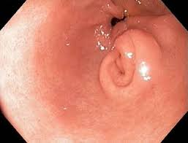
Benign Gastric Neoplasia
Ectopic pancreas:
  It is implanted in the bowel wall and carried to its final location and lacking any anatomic or vascular connection with the main pancreas.
  Most patients are asymptomatic,
  Symptoms are similar to those of PUD.
  Abdominal pain (45%), epigastric discomfort (12%), nausea and vomiting (10%), and bleeding (8%).

Slide 23
Malignant Gastric Neoplasia
Gastric Adenocarcenoma:
  95% of all malignant gastric neoplasms
  Twice as common in men as it is in women,.
  Increases with age, peaking in the seventh decade.
  More at gastric cardia

Slide 24
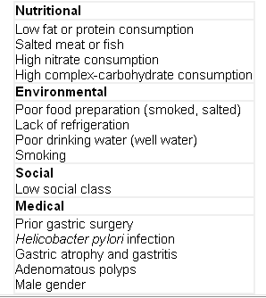
Malignant Gastric Neoplasia
Gastric Adenocarcenoma:
  Risk factors:
    Nutritional
    Environmental
    Social
    Medical

Slide 25
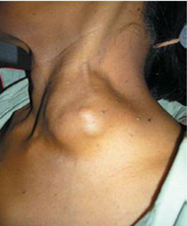
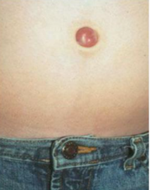
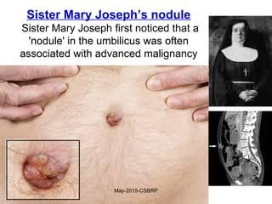
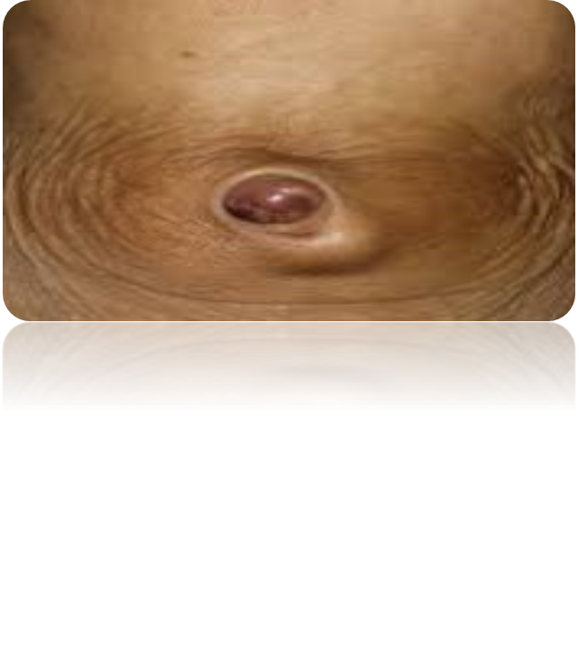
Malignant Gastric Neoplasia
Gastric Adenocarcenoma:
  Significant GI bleeding is rare
    15% of patients may develop hematemesis,
    40% of patients are anemic.
  Physical signs develop late & associated with locally advanced or metastatic disease.
  Palpable abdominal mass,
  Palpable supraclavicular (Virchow’s)
  Periumbilical (Sister Mary Joseph's) lymph node,
  Peritoneal metastasis palpable by PR (Blummer's shelf),
  Palpable ovarian mass (Krukenberg's tumor).

Slide 26
Malignant Gastric Neoplasia
Gastric lymphoma:
  The stomach is the most common site of lymphomas in the GI system.
  15% of gastric malignancies , most commonly occur in the gastric antrum
  2% of all lymphomas.
  Patients often present with vague symptoms, namely epigastric pain, early satiety, and fatigue.
  More than half of patients present with anemia.
  Massive bleeding is uncommon.
  Older patients, more common in men.
  The most common type is diffuse large B-cell lymphoma (55%), Immunodeficiencies and H. pylori infection are risk factors for its development

Slide 27
  Burkitt's lymphomas of the stomach :
    Associated with Epstein-Barr virus infections.
    Very aggressive and tends to affect a younger population
    Most commonly found in the cardia
Diagnosis of gastric lymphoma:
  Endoscopy: Nonspecific gastritis or gastric ulcerations, with mass lesions being unusual.
  CT of the chest and abdomen to detect lymphadenopathy
  Endoscopic ultrasound
    Depth of gastric wall invasion,
    Identify patients at risk for perforation
Treatment of Gastric lymphoma:
  Many patients are now being treated with chemoradiation therapy alone.

Slide 28
Malignant Gastric Neoplasia
Gastrointestinal stromal tumors GIST
  Initially thought to arise from smooth muscle cell, thus classified as leiomyomas or leiomyosarcomas.
  Arise from mesenchymal components
  2% of all gastric malignancies.
  Most frequently located in the stomach (60%-70%).
  Mean age of 60 years at diagnosis.

Slide 29
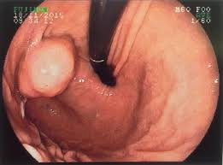
  Malignancy is also associated with tumors greater than 5 cm in size, cellular atypia, necrosis, or local invasion.
  The most common presentations of gastric GISTs are GI bleeding, pain or dyspepsia.
  Diagnosis:
    Endoscopy may be the first diagnostic test
    Endoscopic biopsy is diagnostic in about half of cases.
    CT
  The goal of surgery is a margin-negative resection

Slide 30
THANKS

