Slide 1



Fluids, electrolytes, & Acid base disorders
Shaher Abbarah, MD, MRCSI
Assistant Professor of surgery
Associate Consultant of general surgery

Slide 2
Objectives
Introduction
Body fluids compartments
Third space
Functions of body fluids
Fluids and electrolytes composition
Fluids managements
Acid base balance

Slide 3
1. Which of the following statements regarding total body water is False?
A. In males, approximately 60% of total body weight is water
B. The percentage of total body weight that is water is higher in males than in females
C. The percentage of total body water decreases with age
D. The majority of body water is contained within the interstitial fluid compartment
Notes:
D

Slide 4
Introduction
Total body water (TBW):
50-70 % total body weight
Change with age, gender, & body size
Higher in males, less in elderly
Dec with age as muscle mass
Notes:
About 60%

Slide 5
Introduction
Reasons of larger requirement of body fluids in infants, and children:
  Immature kidney: inability to concentrate
  Larger surface area per unit of body weight
  Greater metabolic activity
4 : 2 : 1
Notes:
Amount required by babies: (approximate)
at birth: about 75 mL/kg,
First weeks age: 150 mL/kg.
After the first month of life, use: 4:2:1
Adults (70kg) about 35ml/kg

Slide 6
Introduction
Body fluid compartments:
  Intracellular fluid (ICF)
  Extracellular fluid (ECF):
    Interstitial
    Intravascular
      Plasma ( 50 ml/kg body wt.)
      Blood ( 70ml/kg body wt)
Notes:
Intracellular 40%, Extracellular 20%
Interstitial: 15%
Intravascular: 5%

Slide 7
Introduction
Third space:
  Abnormal transfer of extracellular body fluid from functional body fluid compartments to a non-functional compartments, either to body spaces, or in between cells.
  No contribution to equilibrium
  Unavailable as a reserve fluid
  Unable to transport nutrients
  Common locations:
    Tissue spaces (Edema)
    Abdomen (Ascites)
    Pleura (Effusion)
    Pericardium (Effusion)
Notes:
Fluid accumulation in the interstitial space contributes to oedema
Excess fluid moves from this space into the lymphatics (only up to a point)
Edema is largely dependent on the net balance of hydrostatic and oncotic pressures inside the capillary and in the interstitium

Slide 8
Introduction
Third space:
  Increased capillary permeability allows fluids, electrolytes, & proteins to leak from the vessels
  Causes:
    Injury or inflammation
    Massive trauma
    Crush injury
    Burns
    Sepsis
    Cancer
    Bowel obstruction

Slide 9
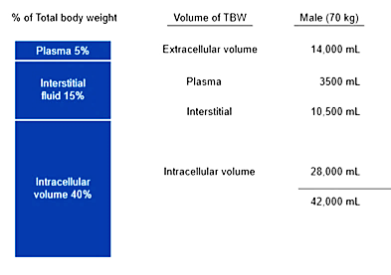
Introduction

Slide 10
Introduction
Functions of body fluid:
  Medium for transport
  Cellular metabolism
  Solvent for electrolyte and other constituents
  Helps maintain body temperature
  Helps digestion and elimination
  Acts as lubricant

Slide 11
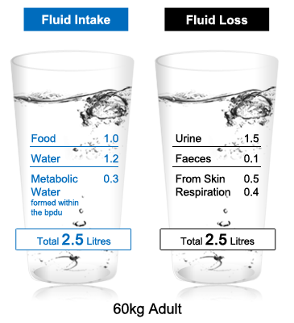
Body fluid turnover
Minimum UOP in adult 30cc/hr (0.5 cc/kg/h)
Notes:
Fluid gain = Fluid loss
Oxidative metabolism of protein & fat produce- 400-500 ml/ day
Pyrexia increases water loss from the skin by approximately 200 mL/day for each 1°C rise in temperature

Slide 12
GI secretion composition

Slide 13
The metabolic derangement most commonly seen in patients with perfuse vomiting:
A. Hypochloremic , hypokalemic metabolic Alk
B. Hypochloremic , hypokalemic metabolic Acid
C. Hypochloremic, hyperkalemic metabolic Alk
D. Hypochloremic, hyperkalemic metabolic Acid
Notes:
A

Slide 14
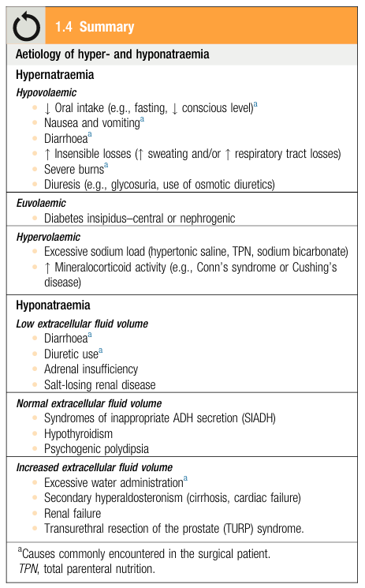
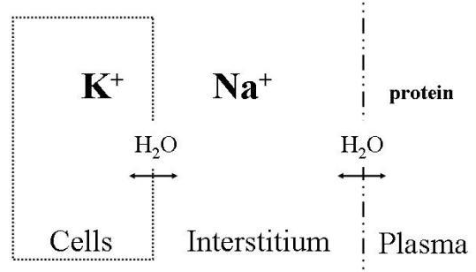
Electrolytes composition
Sodium (Na⁺):
  Major determinant of body tonicity
  Primary extracellular cation
  Clinical manifestations are predominantly
  Neurologic.
  In hyponatremia it is first necessary to
  measure the serum osmolality to evaluate
  the tonicity imbalance.
  In hypernatremia patients are categorized on the
  basis of their extracellular fluid volume status.
  Avoid rapid correction of hyper/hyponatremia
  Because …
Notes:
Intra-cellular Cations: “K” “Mg”, Anions: “Po” “protein”
Extra-cellular Cation “Na” , Anions: “Cl” “Hco”

Slide 15
Potassium (K⁺):
  Major intracellular cation
  97% located in intracellular
  Compartment
  Read more about hyper/hypokalemia (P.15 in “Principle & Practice of Surgery”)
  Tx of Hyperkalemia

Slide 16
Fluids,& electrolytes management
Before administering intravenous fluids the following should be considered:
  Fluid deficiency
  Fluid compartments requiring replacement
  Electrolyte imbalance
Notes:
Read about “Assessing losses in the surgical patient”
P. 11-12

Slide 17
Fluids,& electrolytes management
Types of fluids: Isotonic, hypotonic, hypertonic
IVF bolus :
  Given in a rapid manner,
  Isotonic fluids should used, to increase intravascular
  No Dextrose: to avoid hyperglycemia
IVF maintenance
Crystalloids vs colloids
Notes:
Major determinants of osmotic activity in plasma are Na⁺, glucose & urea
Normal serum osmolarity 285 mOsm/L
Isotonic crystalloids are appropriate for correcting EFC losses

Slide 18
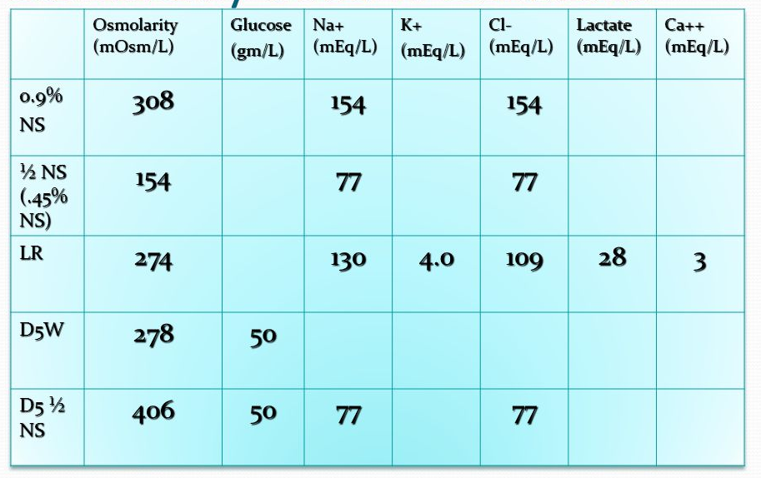
Fluids,& electrolytes management
Dextrose added to IV fluid to inhibit muscle catabolism
IVF bolus : IVF given in a rapid manner, isotonic fluids should used , to increase intravascular volume
Notes:
Hypertonic saline solutions have an osmolality greater than ECF and induce a shift of fluid from the IFC to the EFC
Potential indications include:
-treatment of cerebral oedema
-raised intracranial pressure
-hyponatraemic seizures

Slide 19
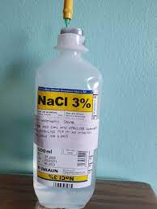
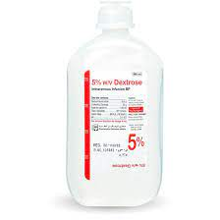
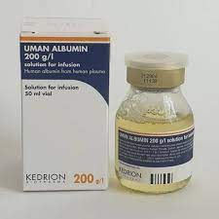
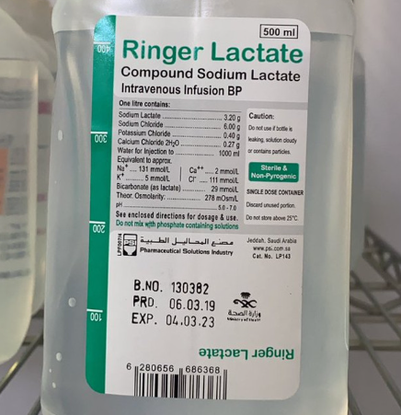
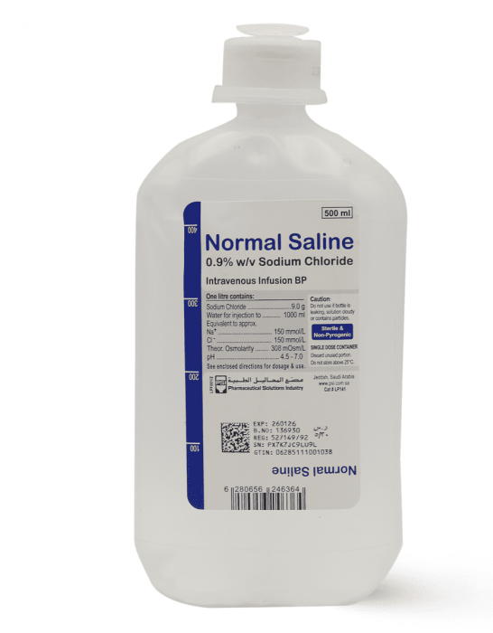
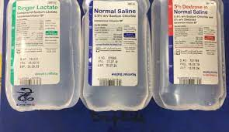

Slide 20
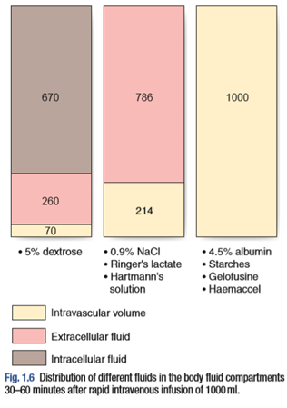

Slide 21
Fluids,& electrolytes management
Notes:
Colloids: Albumin , Dextran, Gelatin, HydroxyEthyl Starch
Side effects:
-Coagulopathy
-pruritus
-anaphylaxis
-Starch associated w/: Renal Failure, and mortality

Slide 22
Excessive administration of normal saline for fluid resuscitation can lead to what metabolic derangement?
A. Metabolic Alk
B. Metabolic Acid
C. Respiratory Alk
D. Respiratory Acid
Notes:
B
Hyperchloremic metabolic acidosis

Slide 23
Aggressive fluid resuscitation with dextran (hetastarch) can result in:
  A/ Bleeding
  B/ Metabolic Acidosis
  C/ Seizures
  D/ renal failure
Notes:
A

Slide 24
Fluids,& electrolytes management
Medical conditions predispose to fluid and electrolytes abnormalities:
  Congestive heart failure
  Renal failure
  Cirrhosis
  GI loss
  Fistula/ stoma formation

Slide 25
Acid base balance
Most enzymatic reactions occur in a narrow PH range
3 primary systems to buffer PH
  Buffer system (Principally bicarbonate):
    Carbonate-Carbonate system in RBC
    Intracellular protein, phosphate, Hg, and minerals
    Henderson-Hasselbach equation
  Respiratory system
    Eliminates CO2
  Renal system
    Excretion of acid
    Reclamation of filtered bicarbonate
Notes:
Respiratory system is most Rapid (in minutes) ,, Then: Buffers (in hours) ,, Then: Renal (in days)
Henderson-Hasselbach: to determine the pH of a buffer by measuring the concentration of Acid and conjugated base.
The Henderson-Hasselbalch equation allows for the calculation of pH from HCO3- and PCO2:
pH = 6.1 + log([HCO3-]/[0.03 × pCO2])
6.1 = pKa of carbonic acid
0.03 = solubility constant of PCO2

Slide 26
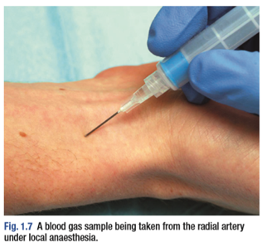
Acid base balance

Slide 27
Acid base balance

Slide 28
Acid base balance
Compensatory mechanism:

Slide 29
Blood pH abnormalities
  Acidemia: abnormally low blood pH (pH < 7.35)
  Alkalemia: abnormally high blood pH (pH > 7.45)
Blood CO2:
  The normal range for arterial blood is 36–44 mm Hg.
Blood HCO3:
  The normal range is 23 – 28 mmol/L

Slide 30
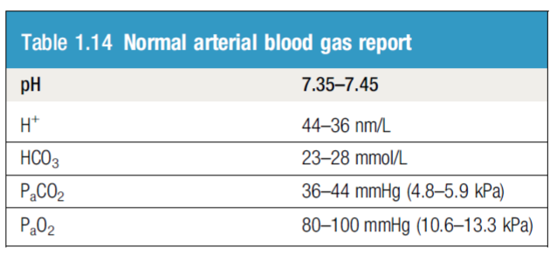
Patient newly diagnosed with Acute Kidney injury, Uremia
ABG showing:
PH 7.26
CO2 24
HCO3 18
Metabolic Acidosis

Slide 31
Metabolic Acidosis
increase in plasma hydrogen ions in conjunction with a decrease in bicarbonate concentration.
Anion gap = Concentration of measured cations - Concentration of measured anions
High Anion Gap Acidosis
Normal Anion Gap Acidosis
Read more about the Etiology of high / normal anion gap in metabolic acidosis “AMBOSS”
Notes:
Anion Gap: (Na + K) – (HCO3 + Cl)

Slide 32
ICU patient, intubated on Mechanical Ventilation.
Post OP, on NGT
ABG showing:
PH 7.50
CO2 55
HCO3 35
Metabolic Alkalosis
Notes:
Metabolic Alkalosis commonly associated with hypokalemia and hypochloremia.

Slide 33
ICU patient, intubated on Mechanical Ventilation. low RR
ABG showing:
PH 7.25
CO2 70
HCO3 35
Respiratory Acidosis
Notes:
Causes:
postoperative in hypoventilated patient
excessive opiate administration
In context of pulmonary complication (ex. Pneumonia)

Slide 34
ICU patient, intubated on Mechanical Ventilation.
Post OP, with high RR
ABG showing:
PH 7.50
CO2 24
HCO3 18
Respiratory Alkalosis
Notes:
Caused by excessive excretion of Co2 .. (Hyperventilation)

Slide 35
Quiz:
https://next.amboss.com/us/questions/SHrvypiYd/1
https://next.amboss.com/us/questions/SHrvypiYd/2
https://next.amboss.com/us/questions/SHrvypiYd/3
https://next.amboss.com/us/questions/SHrvypiYd/4

Slide 36
Thanks

