Slide 1
Haemostasis, & blood transfusion
Moneer Almadani MD, FACS, F.MAS
Assistant Professor
Consultant surgeon upper GI, obesity, & gastric oncology

Slide 2
Objectives
Introduction
Coagulation pathway
Blood disorders
Surgical haemorrhage
Blood transfusion
  Indication
  Complications
Massive blood transfusion

Slide 3
Introduction
Haemostasis is a complex process that prevents or terminates blood loss from a disrupted intravascular space
Stages:
  Primary haemostasis:
    1) Vasoconstriction
    2) Platelet plug formation
  Secondary haemostasis:
    3) Blood clotting -coagulation- (fibrin formation)
    4) Fibrinolysis

Slide 4
Introduction

Slide 5
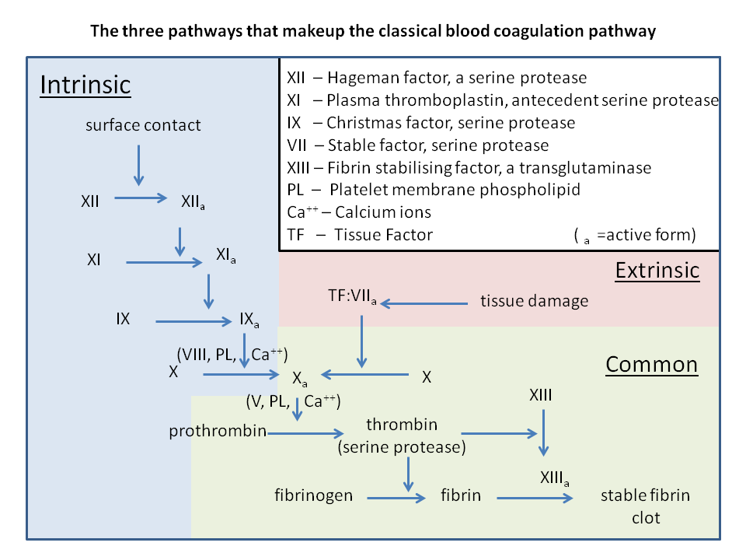
Coagulation pathway
(III)

Slide 6
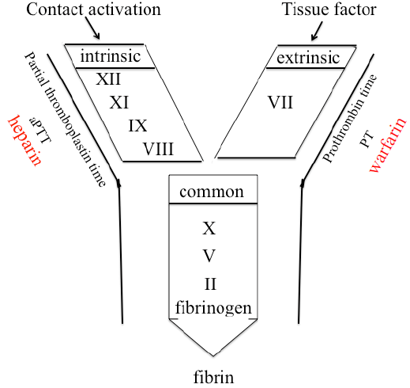
Coagulation pathway
- PT is reported with the international normalized ratio (INR).

Slide 7
Coagulation pathway

Slide 8
Coagulation pathway

Slide 9
Blood disorders

Slide 10
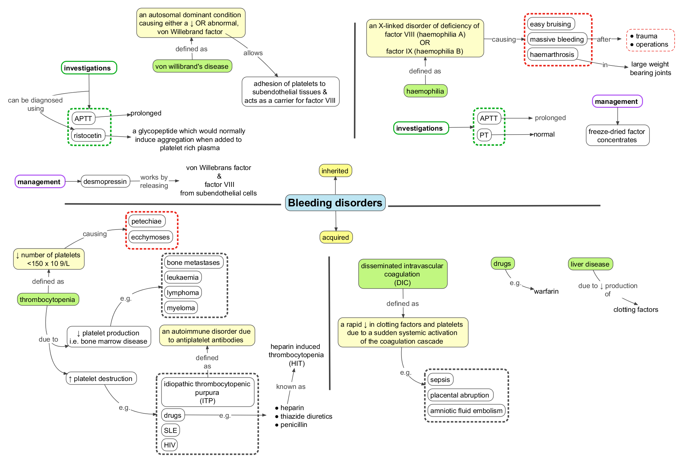

Slide 11
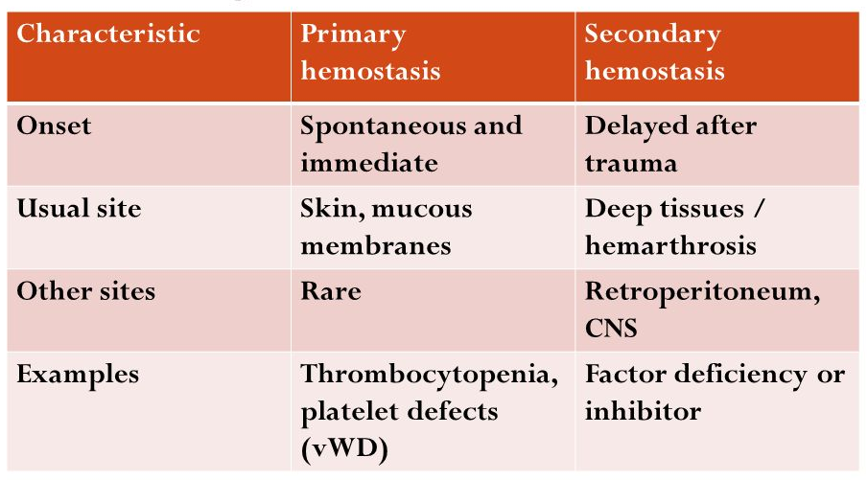
Bleeding disorders

Slide 12
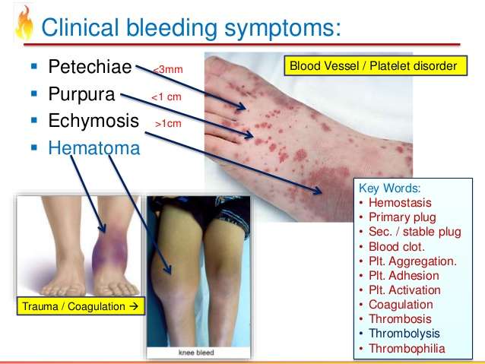
Bleeding disorders

Slide 13
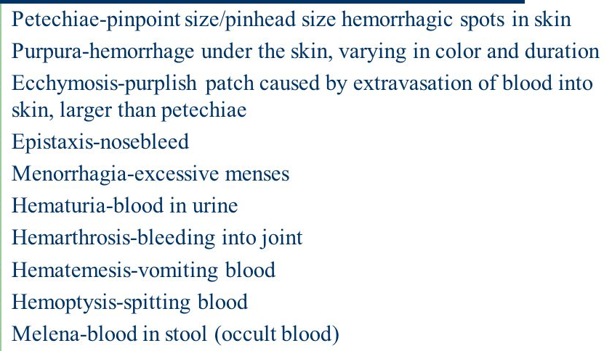
Bleeding disorders
-
-
-
-
-
-
-
-
-
-
-

Slide 14
Surgical haemorrhage
Primary:
  At the time of injury or surgery
Intermediate/ Reactionary:
  Within 24 h of injury or surgery
  Postop high BP, sneezing, coughing
Secondary:
  48-72 h after injury or surgery
  Infection/ Sepsis

Slide 15
Blood transfusion
1 unit of PRBC has 300 ml, raise Hb around 1 gm
PRBC could be stored up to 6 weeks
Type and screen Vs type and cross match
Thrombocytopenia
Platelets dysfunction and aspirin
PLT should be at least 50, 000 before surgery,
less than 20,000 associated with bleeding

Slide 16
Blood transfusion
Fresh frozen plasma FFP:
  Replaces clotting factors
  No RBC, No PLT
Cryoprecipitate:
  Replaces fibrinogen
  VWF
  Some clotting factors

Slide 17
Indications of blood transfusion
Studies have shown an association between anemia and increased mortality,
It is not clear that correction of anemia will improve mortality
Clear risk of postoperative death when the Hg fell below 7 g/dL

Slide 18
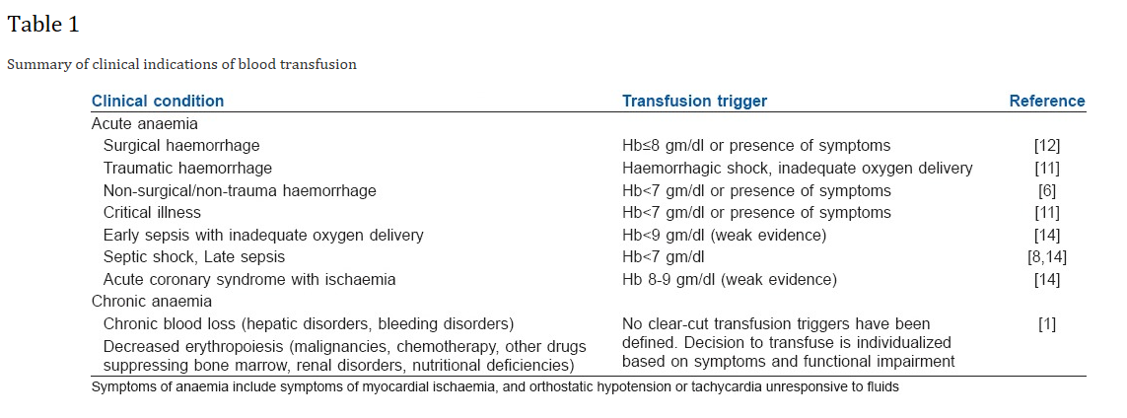
Indications of blood transfusion
Indian J Anaesth. 2014 Sep-Oct; 58(5): 538–542.

Slide 19
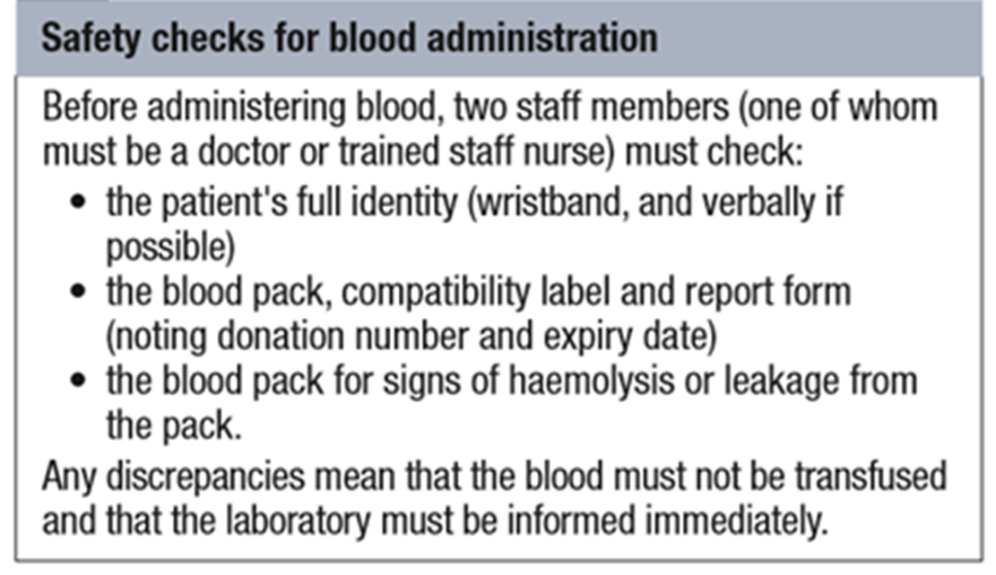
Steps prior to blood transfusion

Slide 20
Complications of blood Tx
Acute: fever due to WBC of donor
Urticaria: recipient's preformed-antibodies
Hyperkalemia from potassium released from RBCs during blood bank storage
Late: hemolytic reaction: Immune sensitization (Rh D antigen)

Slide 21
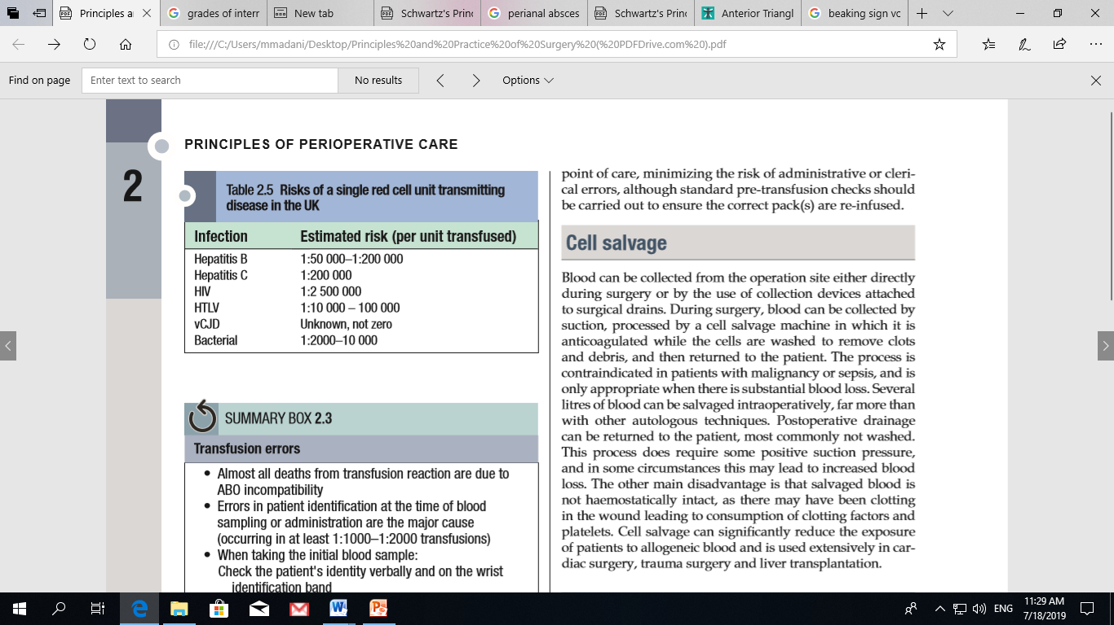
Risks of infection in blood Tx

Slide 22
Complications of blood Tx
Symptoms of transfusion reaction:
  Fever
  Chills
  Nausea
  Low BP
  Lumber pain
  Chest pain
  Abnormal bleeding
What to do?

Slide 23
Massive Blood Transfusion MBT
Different definitions
Replacement of 10 units of PRBC in 24 hours,
3 units over one hour are more sensitive
Replacement of 50% of total blood
volume (TBV) within 3 h
Hemostatic and metabolic complications

Slide 24
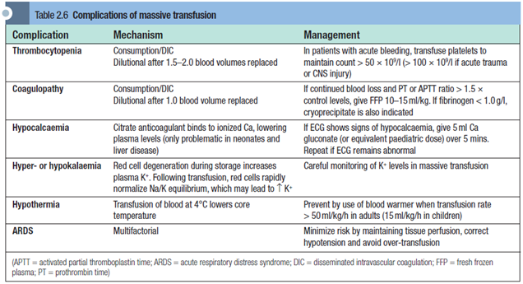
Complications of MBT

Slide 25
References
Principles and Practice of Surgery
  Pg 27-37

Slide 26
Thanks

