Slide 1
History & Examination of Hernias
Omar Alaidaroos MSc, MD
Associate Prof. of General Surgery

Slide 2
ILOs
Demonstrate ability to perform:
Proper history taking.
Physical examination correctly .

Slide 3
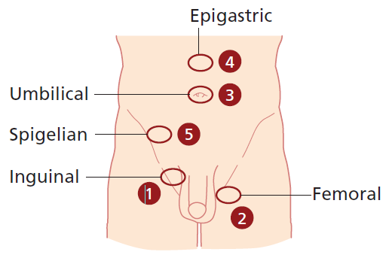
HISTORY
Name:
Age: Young Age—indirect
Old Age—direct
Sex: Most common hernia in females—indirect inguinal hernia
Most common hernia in males—indirect
Femoral hernia most common among—females
Direct hernia never occurs in females and children
Occupation: Most common in strenous labor
Presenting Complaints
I. About the hernia
II. Due to hernia (Complications)
III. Precipitating factors

Slide 4
About the Hernia
Duration, When first noticed?
2. Onset: Suddenly/gradually, How noticed?
3. Site of start: From groin to scrotum (hernia)
From scrotum to groin (hydrocele and varicocele)
4. Does it disappear completely, does it become smaller/ larger?
5. Aggravating factors:
On straining
On standing
On coughing
6. Relieving factors:
By lying down
Manually by himself
7. Associated with pain: Usually painless, Any other lump/ swelling
Pain in inguinal hernia is usually in the region of the umbilicus due to drag in the root of mesentery as bowel enters the sac

Slide 5
Complications
1. Irreducibility:
i. Crowding of the contents
ii. Adhesion between sac and contents
History of potential complications:
Abdominal pain
Vomiting
Irreducibility/ painful lump
2. Obstruction:
Four cardinal features
3. Strangulation:
(Obstruction + irreducibility + Arrest of blood supply)
i. Colicky abdominal pain if continues and becomes gangrenous pain disappears
ii. Sudden increase in size of hernia; becomes tense and tender.

Slide 6
Presenting Complaints
I. About the hernia
II. Due to hernia (Complications)
III. Precipitating factors
III. History of Precipitating Factors
1. Chronic bronchitis/asthma/TB
2. Difficulty in micturition
3. Difficulty in defecation
4. Weight lifting

Slide 7
Past History
••History of diabetes mellitus/Hypertension/Ischemic heart disease/Bronchial asthma/Tuberculosis
••History of previous surgery
History of appendicectomy: Ilioinguinal or iliohypogastric nerve if damaged by grid iron incision or during keeping the drain; Direct Hernia Occurs
If ilioinguinal nerve is cut in the inguinal canal, direct hernia never occurs Because the nerve supplies the abdominal muscles before entering the canal
Family History
History of connective tissue disorders in family.
Personal History
History of Smoking: Smoking leads to chronic bronchitis
Collagen deficiency occurs in smokers.
Para-umbilical associated with right inguinal hernia
consistent with a generalised collagen disorder

Slide 8
Examination
Introduce yourself
Explain & seek permission
Exposure
Start examination- patient in supine position
Groin swellings- also examine patient in standing
Always examine both groins

Slide 9
General Examination
Abdomen
Mass abdomen
Malgaigne’s bulgings
Ascites
Malgaigne’s bulging:
Oval, longitudinal, bilateral bulging produced on straining,
in inguinal region or above it; and are parallel to medial half of inguinal ligament
Present in direct hernia
Indicates poor muscle tone
Signifies hernioplasty is the treatment

Slide 10
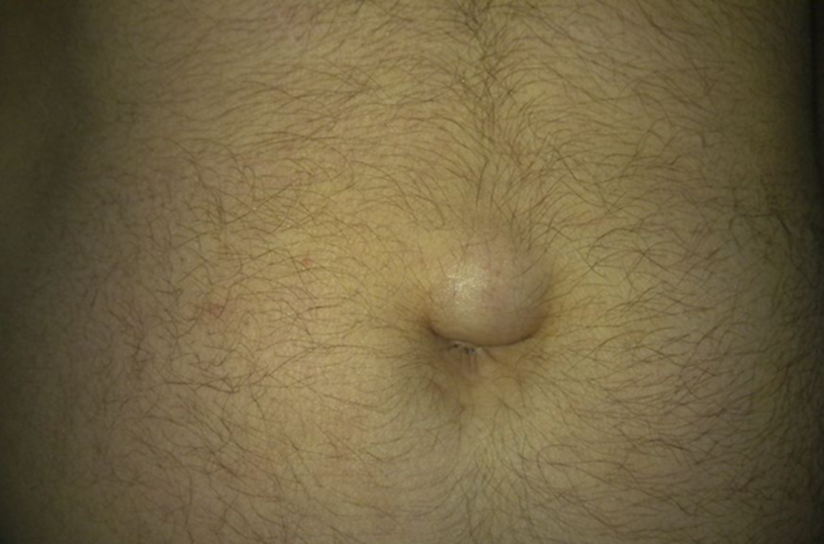
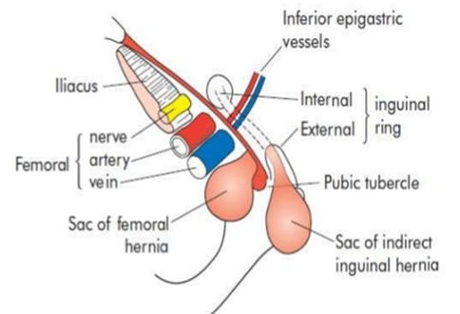
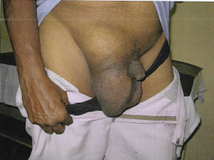
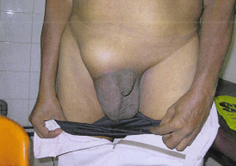


LOCAL EXAMINATION
Inspection: patient in standing position
Groin swellings- - Does it extend down to scrotum?--Inguinoscrotal
  - Is testis separate from swelling?
  Site: Femoral—below and lateral to pubic tubercle
  Inguinal—above and medial to pubic tubercle

Slide 11
2. Size
3. Shape: Pyriform—indirect
Hemispherical—direct
Retort—femoral
4. Extent
5. Surface
6. Skin over the swelling
7. Visible peristalsis
8. Cough impulse
9. Draining lymph nodes
10. Penis
11. Urethral meatus
12. Opposite scrotum

Slide 12
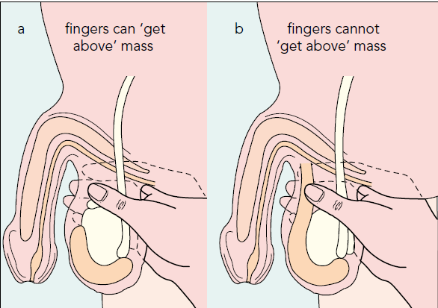

Palpation
1. Temperature
2. Tenderness
3. Site
4. Size
5. Shape
6. Extent
7. Surface
8. Skin over
9. Get above the swelling:(hernia vs scrotal swelling)
Is testis separate from swelling?
Get above the swelling is a classical feature of hydrocele
10. Cough impulse

Slide 13
11. Consistency: Soft elastic—intestine
Doughy granular—omentum
12. Reducibility:
a. Intestine: Last part is easy to reduce; Initial part is difficult to reduce;
gets reduced with gurgling sound.
b. Omentum: First part easy to reduce, last part is difficult because
omentum adheres to fundus of sac.
13. Direction of reduction of hernia
Direct hernia—directly backwards
Indirect—goes upwards, backwards and laterally

Slide 14
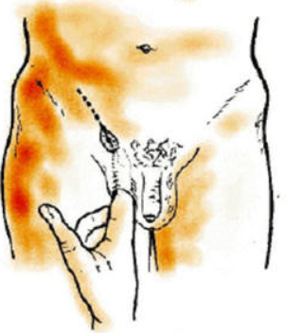
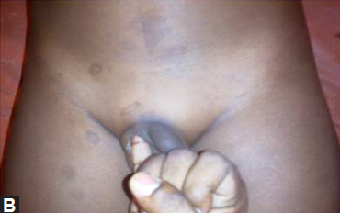
14. Ring invagination test
Only test in hernia; done in lying position.
Prerequisite:
––Swelling should be reducible
––Lax of skin should be there for invaginating (so this test could not be done in females)
Procedure
1. Reduce the swelling.
2. For right side, invaginate with right little finger into the superficial ring.
3. Rotate the little finger medially so that the pulp faces medially.
4. Note the direction of entry and site of impulse.
Look for:
•• Strength of superficial ring: Normal ring admits only the tip
•• Site of impulse:
Pulp—direct
Tip—indirect

Slide 15
15. Deep ring occlusion test: ( only after complete reduction of hernia)
After reducing the contents, patient in standing position, occlude the deep ring with thumb. Ask the patient to cough.
If swelling appears - Direct
Does not appear – Indirect
Fallacy of deep ring occlusion test (When will you get the swelling even though it is an indirect hernia by deep ring occlusion test?)
A. Pantaloon hernia
B. Wide deep ring (Occlude in such cases with index and middle finger together)

Slide 16
Percussion
••Enterocele: Resonant
••Omentum: Dull
Auscultation
Peristaltic sounds occasionally heard.
Others
1. Testis: ‘Traction Test’ to find whether the inguinal swelling is an Encysted Hydrocele of Cord.
2. Epididymis.
3. Penis:
––Phimosis
––Penile strictures
––Pinhole meatus
4. Regional nodes.
5. Opposite groin.
Per-rectal Examination
To Rule out:
1. Benign Prostate hypertrophy—micturition difficulty
2. Malignant obstruction
3. Chronic fissure—constipation

Slide 17


