Slide 1
History
&
Examination of
Extremities

Slide 2
Components of extremities
Skin & subcutaneous tissue ( lumps, ulcers)
Arteries
Veins
Lymphatics
Nerves
Musculo-skeletal system

Slide 3
Five “P” of Acute Ischemia
Pain
Pallor
Pulseless
Paresthesia
Paralysis

Slide 4
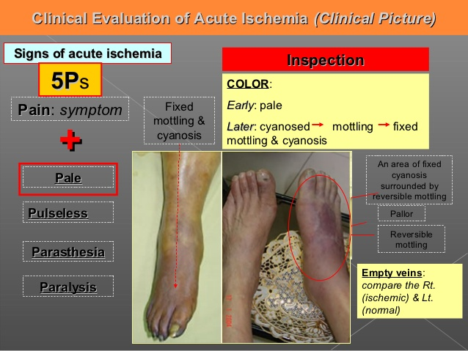

Slide 5
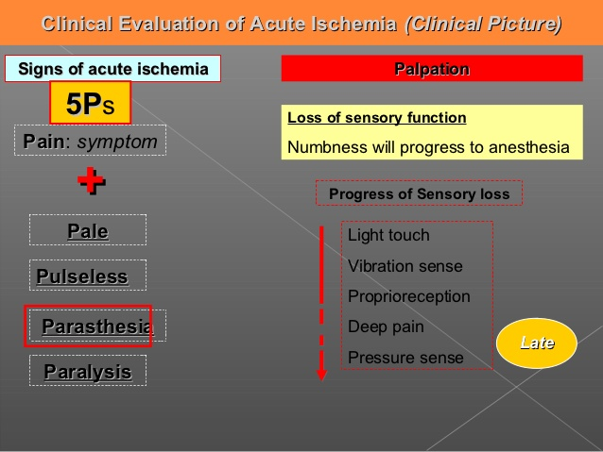

Slide 6
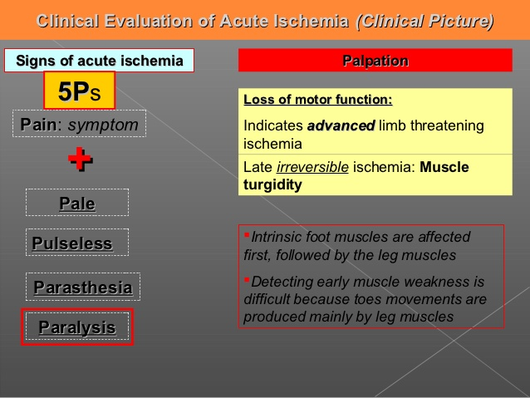

Slide 7
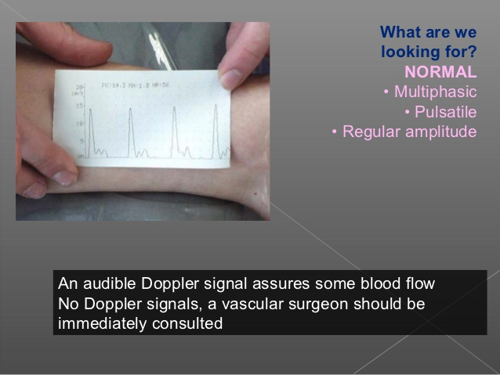
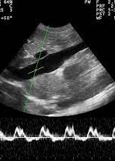
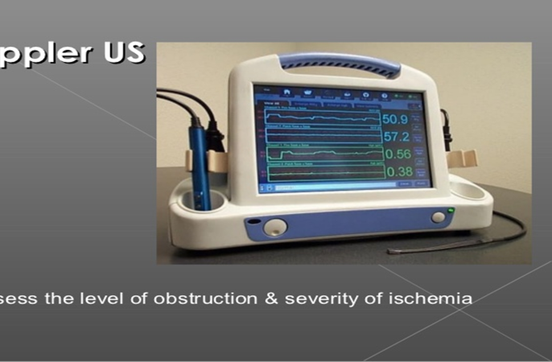
Notes:
Doppler Vs Dopplux

Slide 8
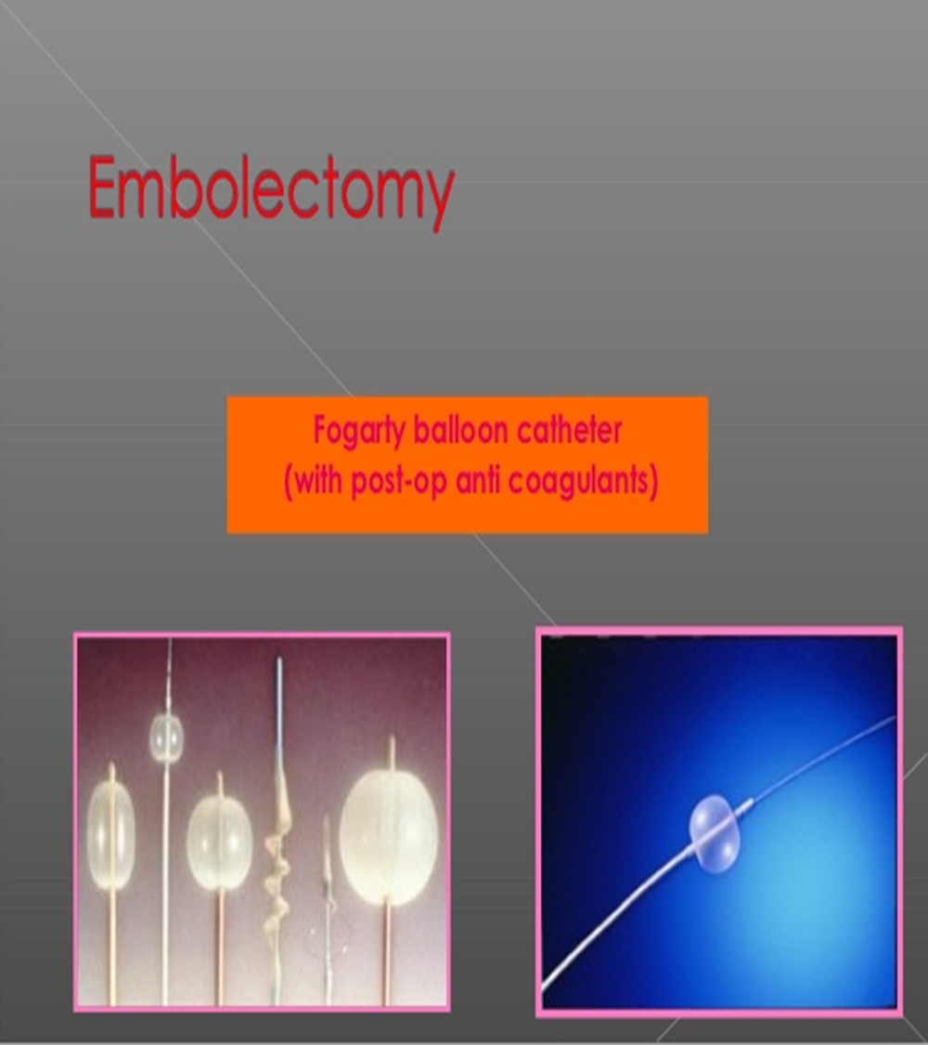
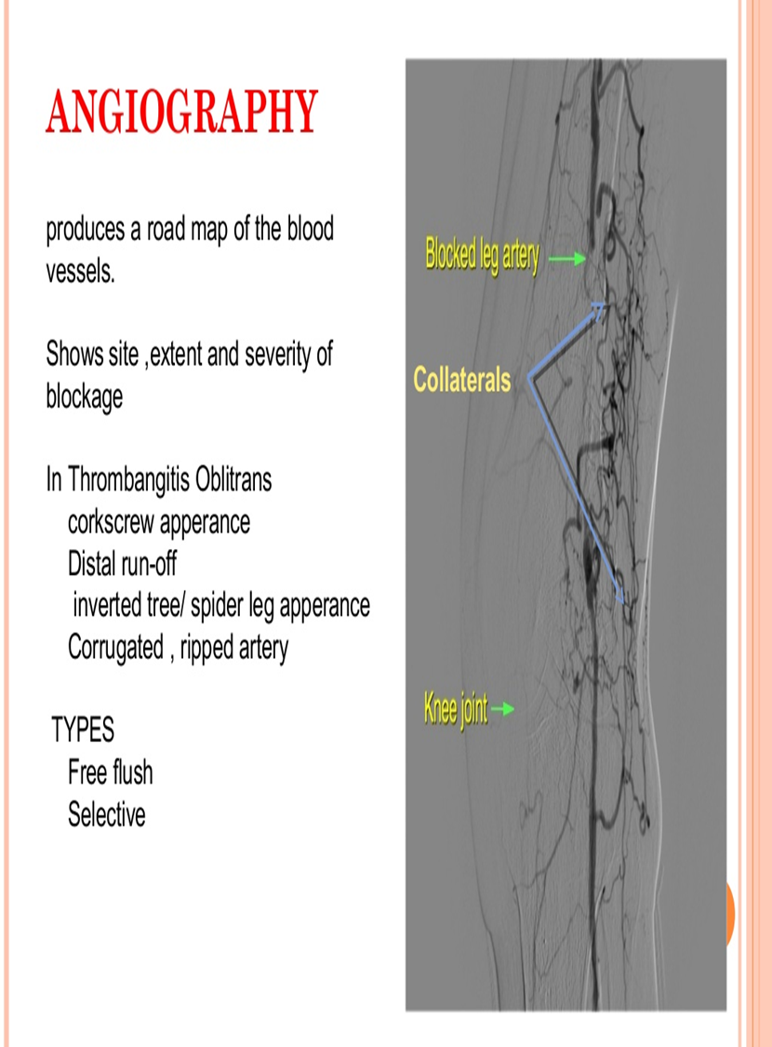
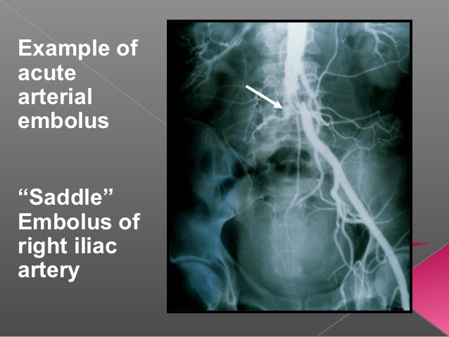
Notes:
Distal run off

Slide 9
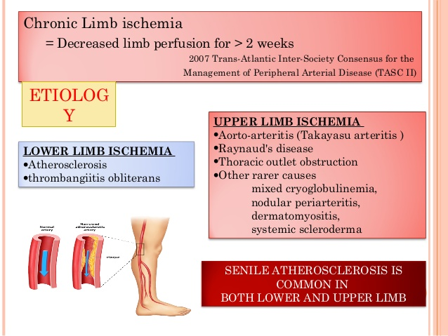

Slide 10
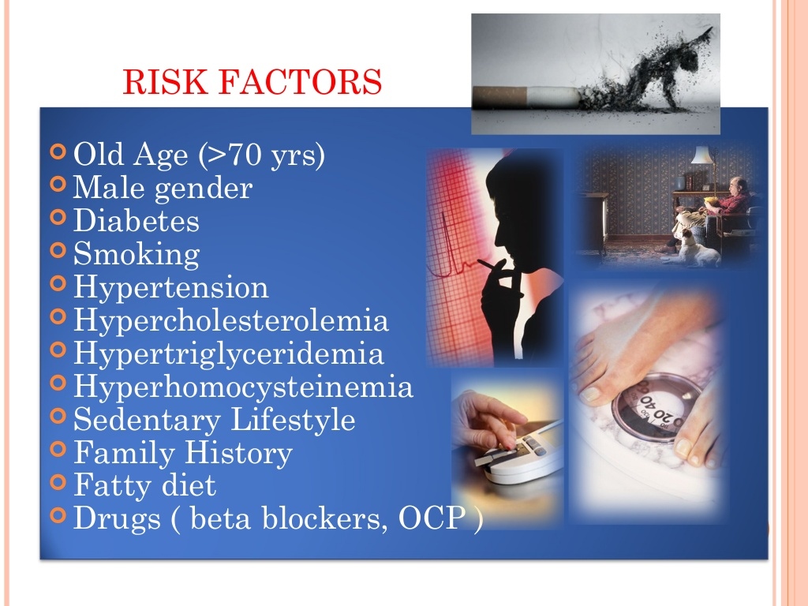

Slide 11
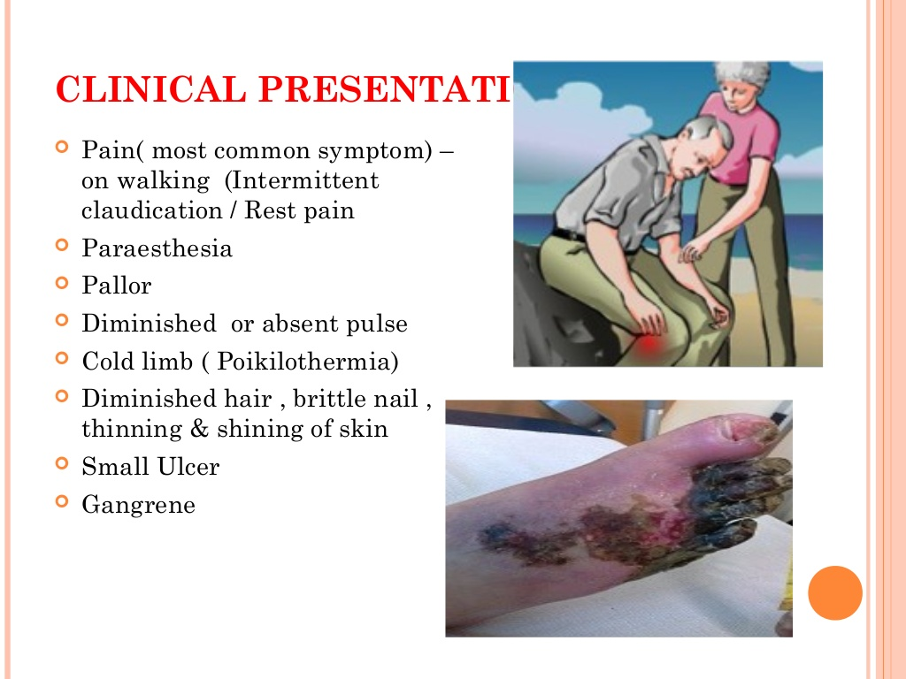
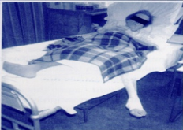
Notes:
Manifestation of chronic ischemia

Slide 12
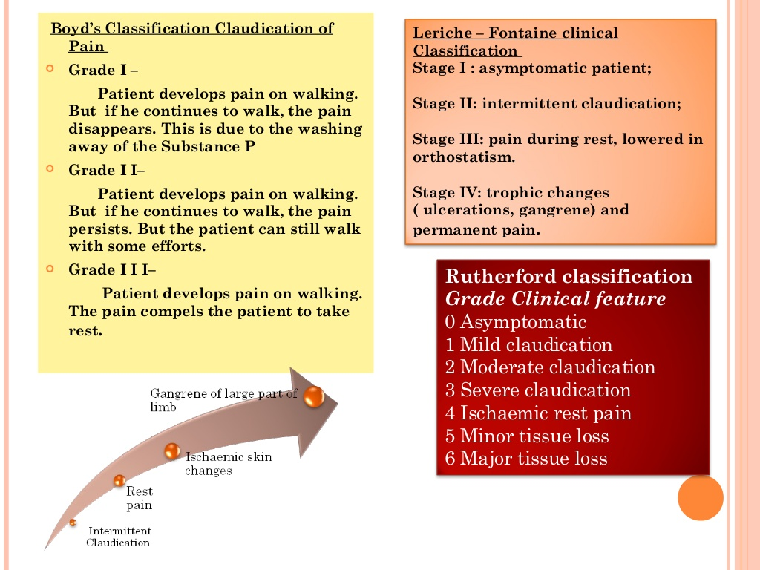
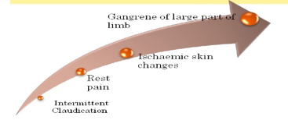
Notes:
Sequence of Symptoms

Slide 13
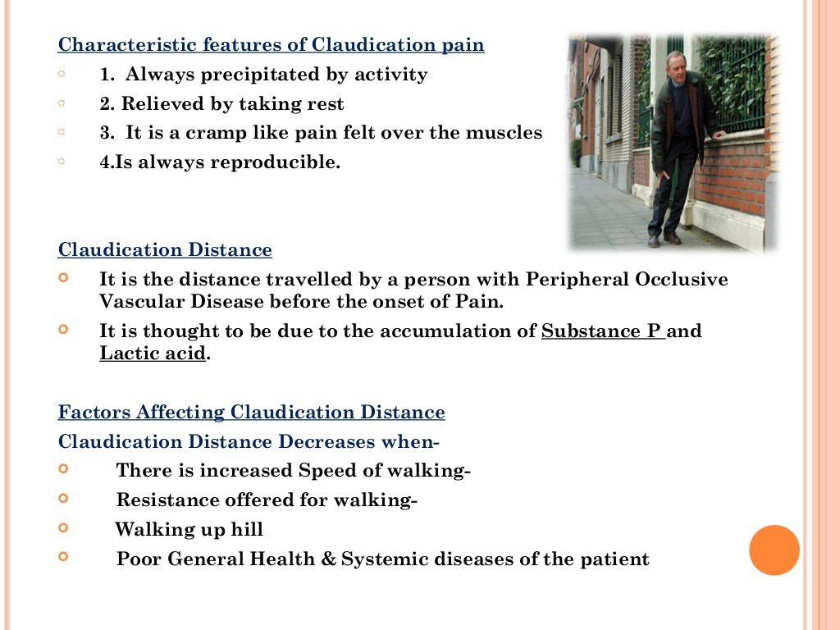
a

Slide 14
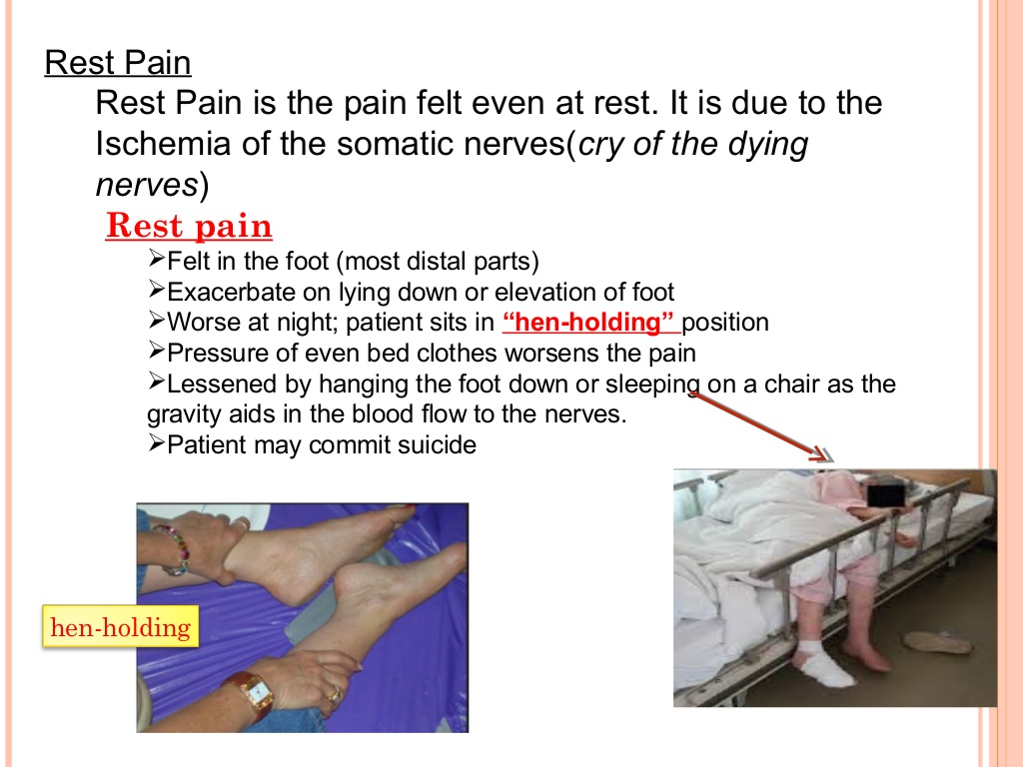

Slide 15
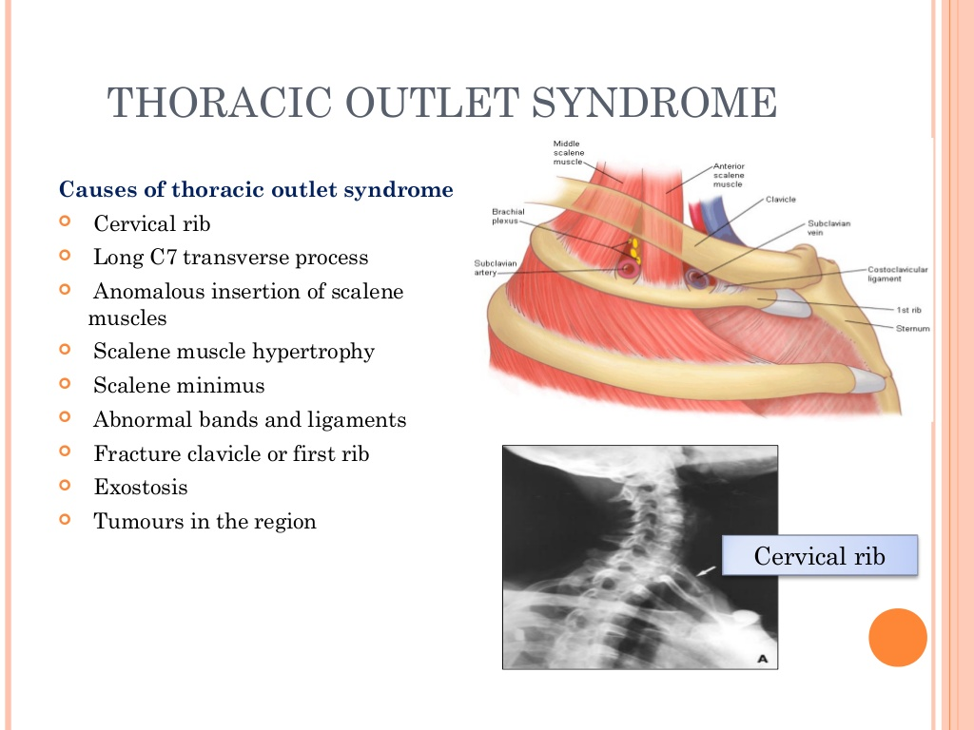

Slide 16
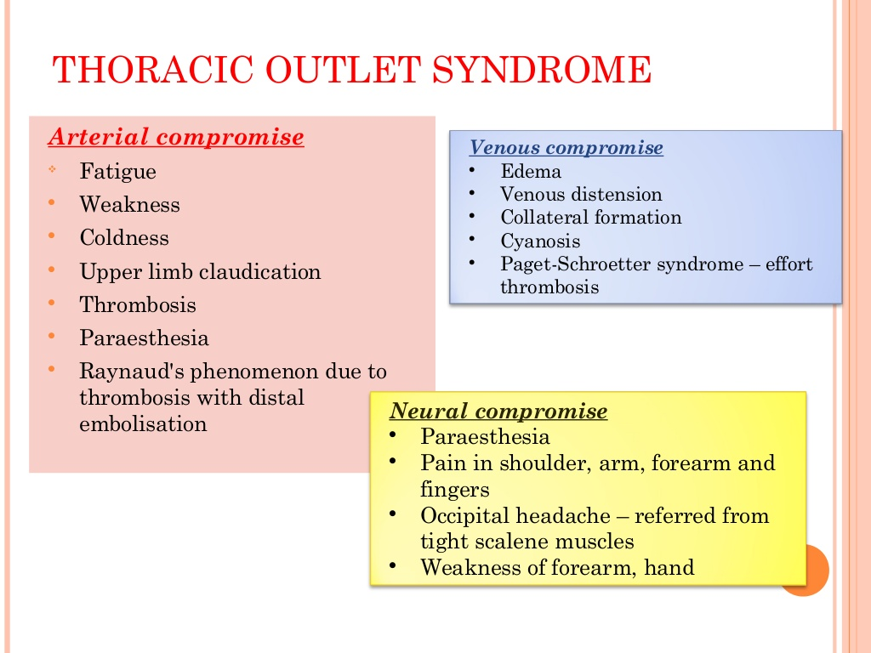

Slide 17
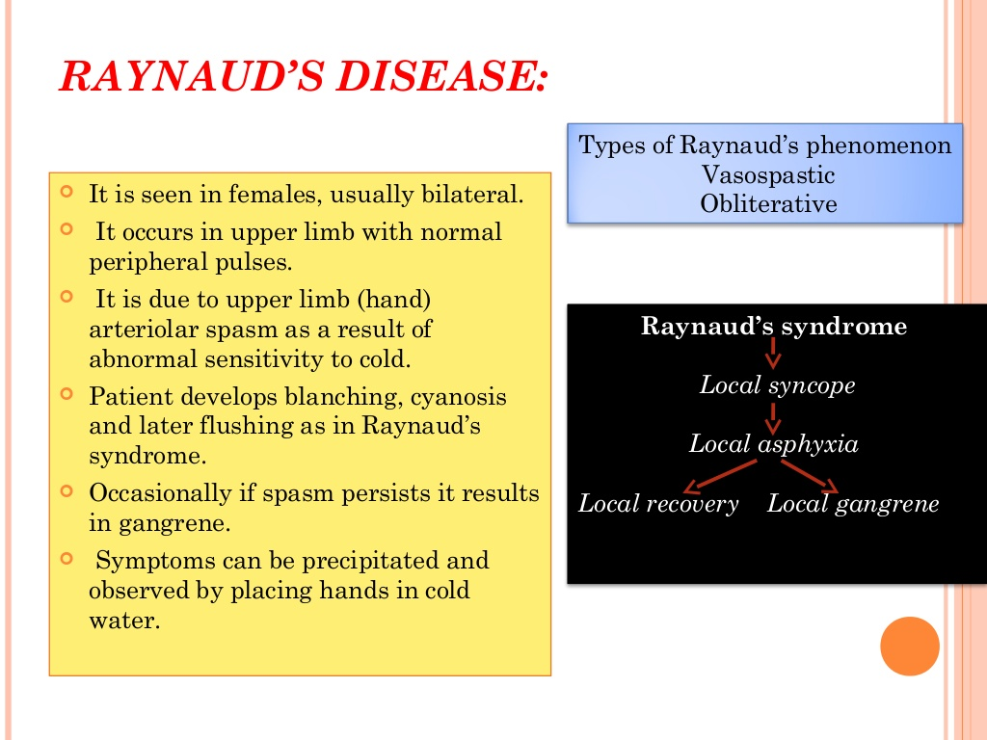

Slide 18
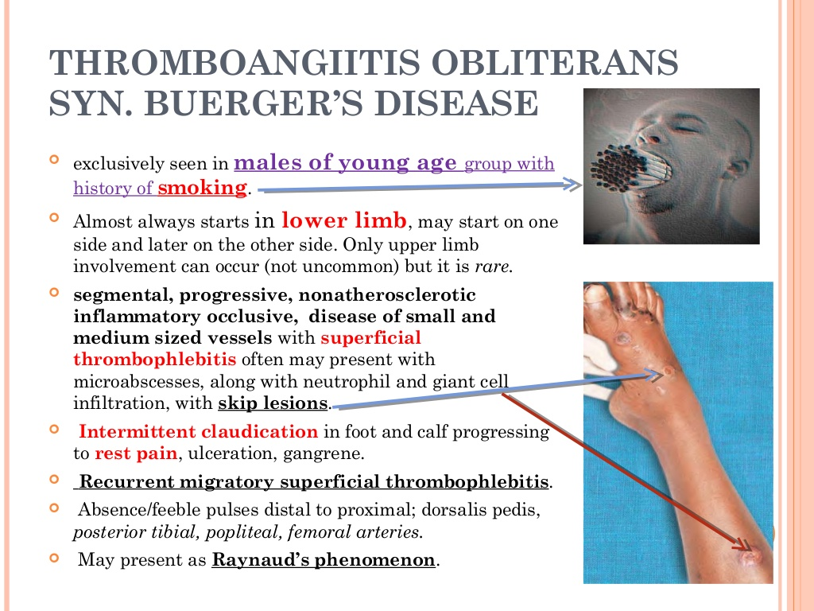

Slide 19
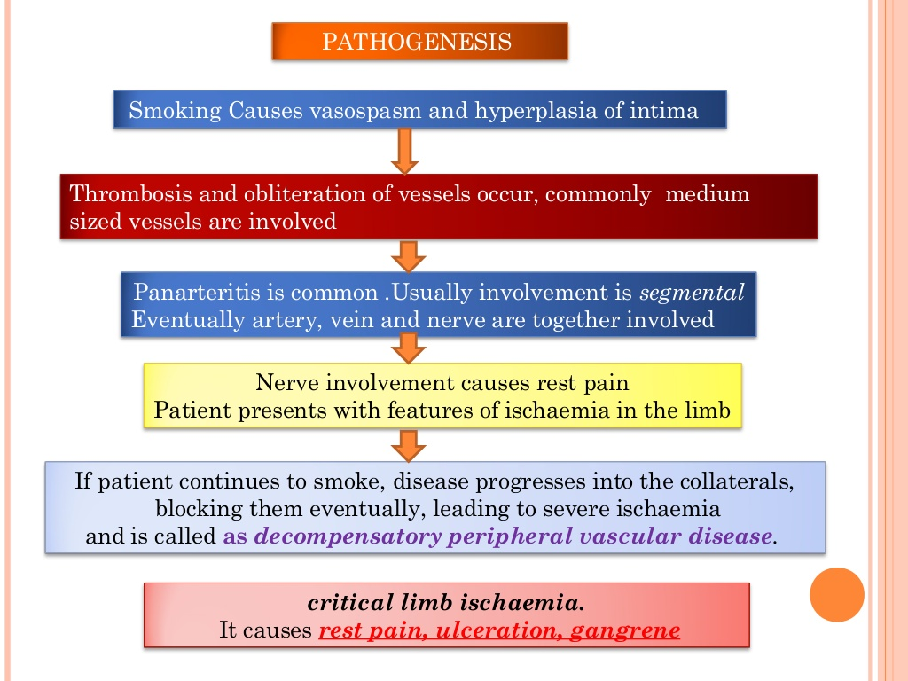

Slide 20
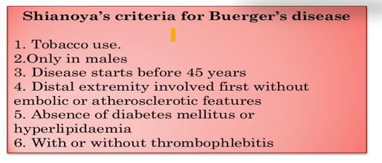

Slide 21
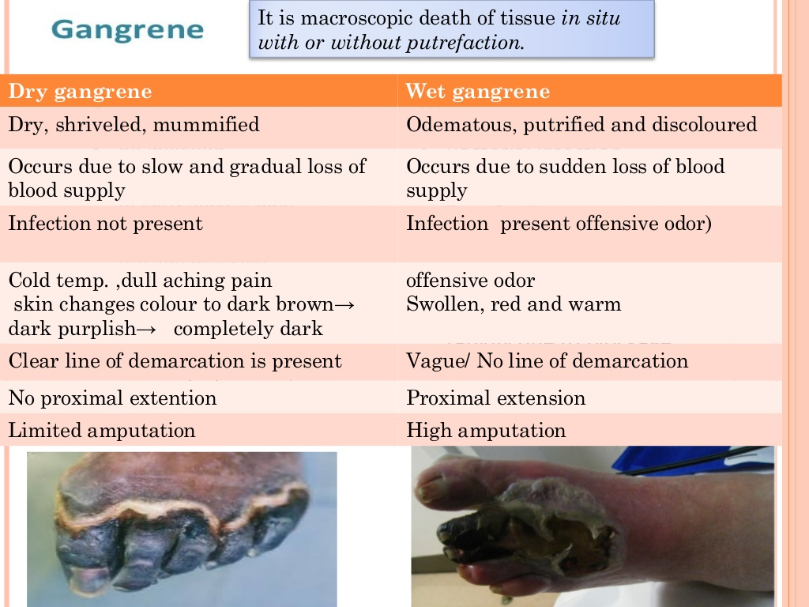
Notes:
Gangrene typically refers to necrosis with putrefaction of tissue, the tissue will characteristically appear black.
There is Two types: wet and dry types.
- In “wet type”, the process is complicated by cellular destruction by bacterial enzymes.
- In “dry type”, cellular structure is maintained. It can be progress from (dry) to (wet). Best exemplified in peripheral vascular disease where an initial patch of dry gangrene progresses to wet gangrene as a result of super-added infection.

Slide 22
Systemic inquiry
Symptoms indicating vascular disease elsewhere
Chest pain
Fainting
Weakness in limbs
Paresthesia
Blurring of vision
Other system inquiry- as in any other patient

Slide 23
Past Medical History
MI
Stroke
Diabetes
Previous episode of claudication
Dyslipidemia
Hypertension

Slide 24
Family history
Genetic predisposition:
Other family members may
be suffering from vascular disease

Slide 25
General examination
?Obese
Pulse ,
Blood pressure
Full CVS evaluation- heart, carotid, abdominal aorta, peripheral vessels

Slide 26
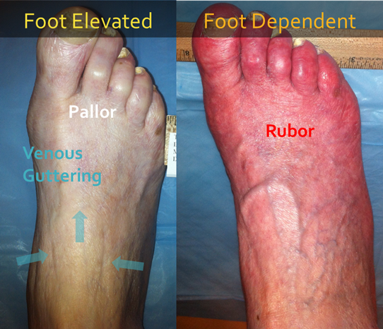
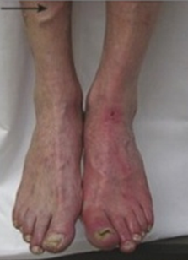
Inspection of the extremity (chronic ischemia)
Expose both limbs (lower or upper)
Skin color- shiny skin in ischemia
Thickening of nail, loss of leg hair
Discoloration ?patches of gangrene
Venous filling- empty in ischemia
(guttering of veins)
Rubor on dependency- red flushed foot
returns to normal after some time
Muscle wasting
Ulceration- tip of toes
Pulsatile mass (femoral, popliteal)

Slide 27
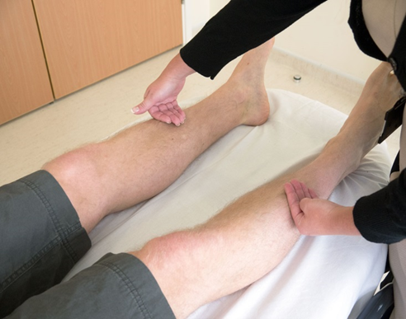
Palpation of the extremity
Temperature- colder limb in ischemia (back of your hand along both limbs)
Capillary refilling- press tip of nail for 2 secs, normal 2-4 sec.
Tenderness/ oedema
Pulses:
Carotid and abdominal aorta
(part of general examination)
Upper limb:
Lower limb:

Slide 28
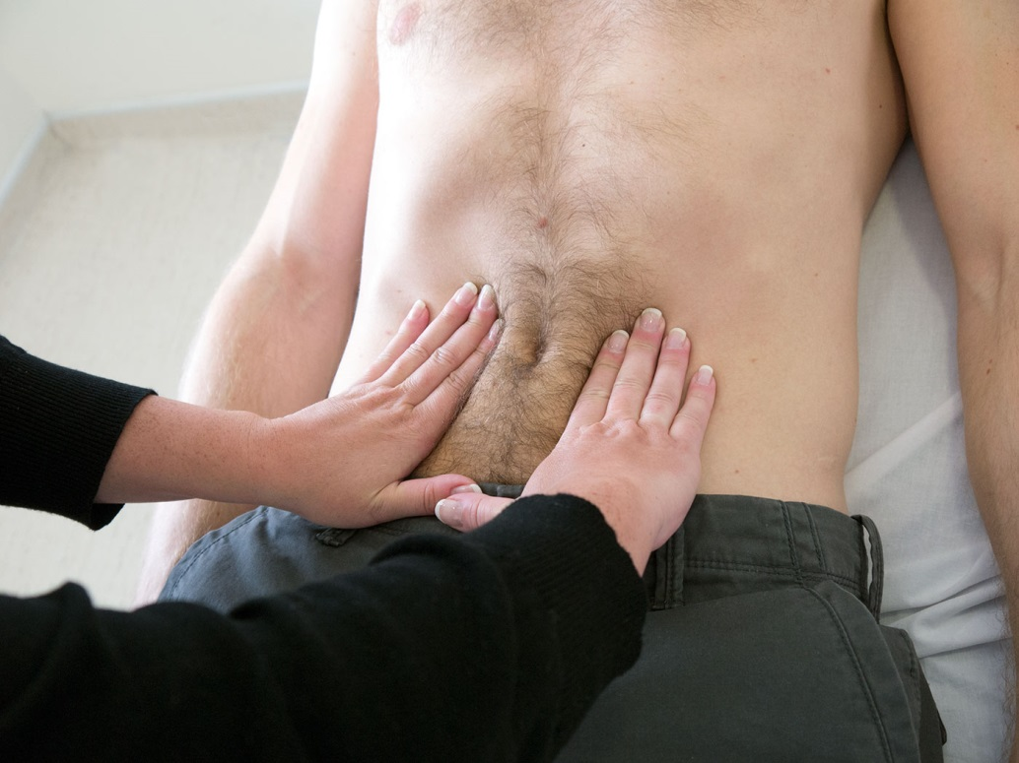
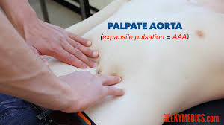
Palpation of Aorta
Supine position with the knees raised
Abdominal muscles relaxed

Slide 29
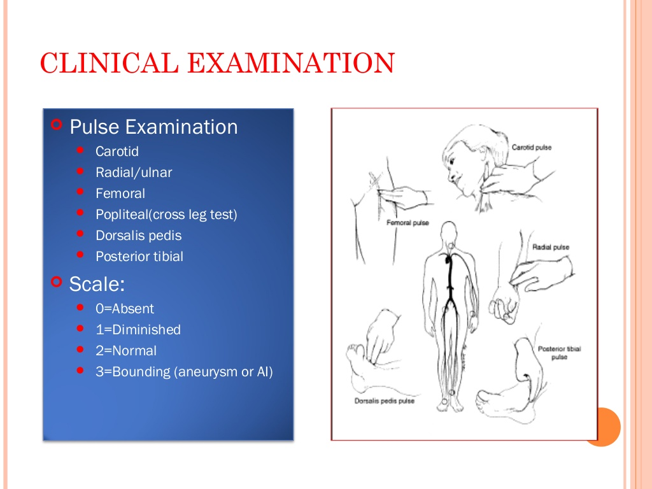
Notes:
2 is normal

Slide 30
Palpation: Upper limb pulses
Axillary: in the axilla and medial upper arm.
Brachial: antecubital fossa immediately medial to the biceps tendon.
Radial: at wrist anterior to the radius.
Ulnar: on medial side of the wrist.

Slide 31
Lower limb pulses
Femoral: At midinguinal point (midway between the anterior superior iliac spine and the top of the pubic symphysis
Midpoint of the inguinal ligament – halfway between the pubic tubercle and the anterior superior iliac spine (the two attachments of the inguinal ligament). The opening to the inguinal canal is located just above this point.
Popliteal: Knee flexed to 45 degrees. Foot flat on the examination table. Bimanual technique.
Both thumbs are placed on the tibial tuberosity anteriorly and the fingers are placed into the popliteal fossa between the two heads of the gastrocnemius muscle and compressing it against the posterior aspect of the tibia just below the knee
Posterior tibial: 2 cm posterior to the medial malleolus.
Dorsalis pedis:1 cm lateral to the extensor hallucis longus tendon or in the cleft between 1st and 2nd metatarsals (use 3 fingers)

Slide 32
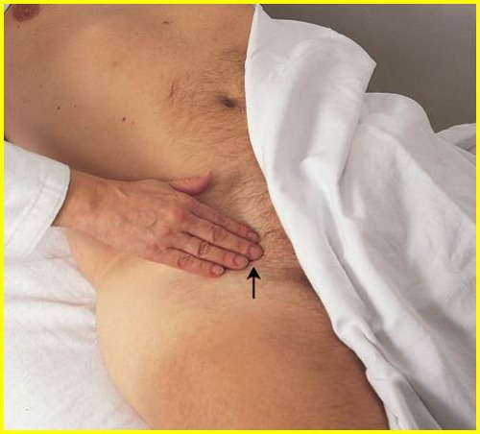
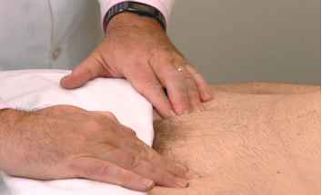

Slide 33
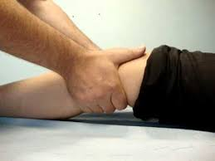
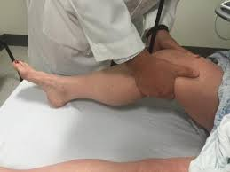
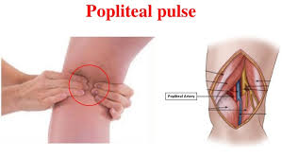
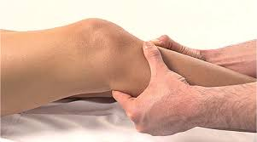

Slide 34
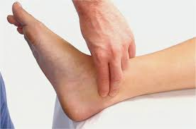

Slide 35
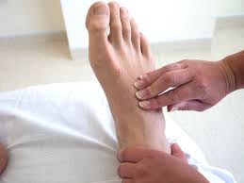

Slide 36
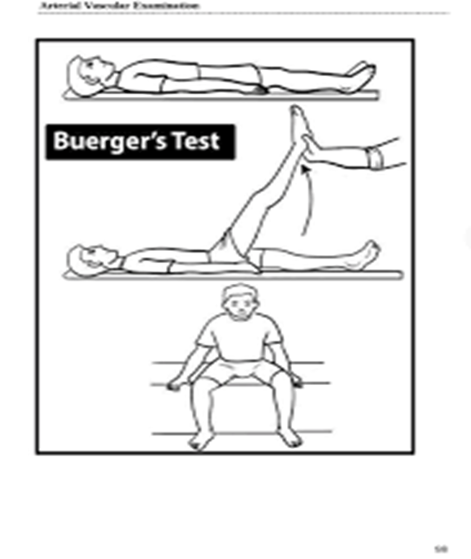
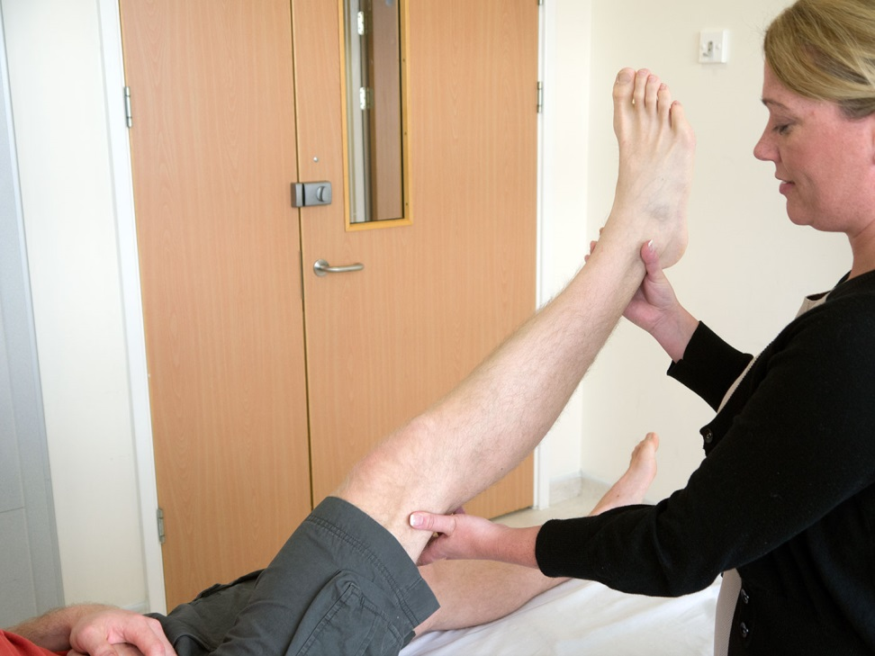
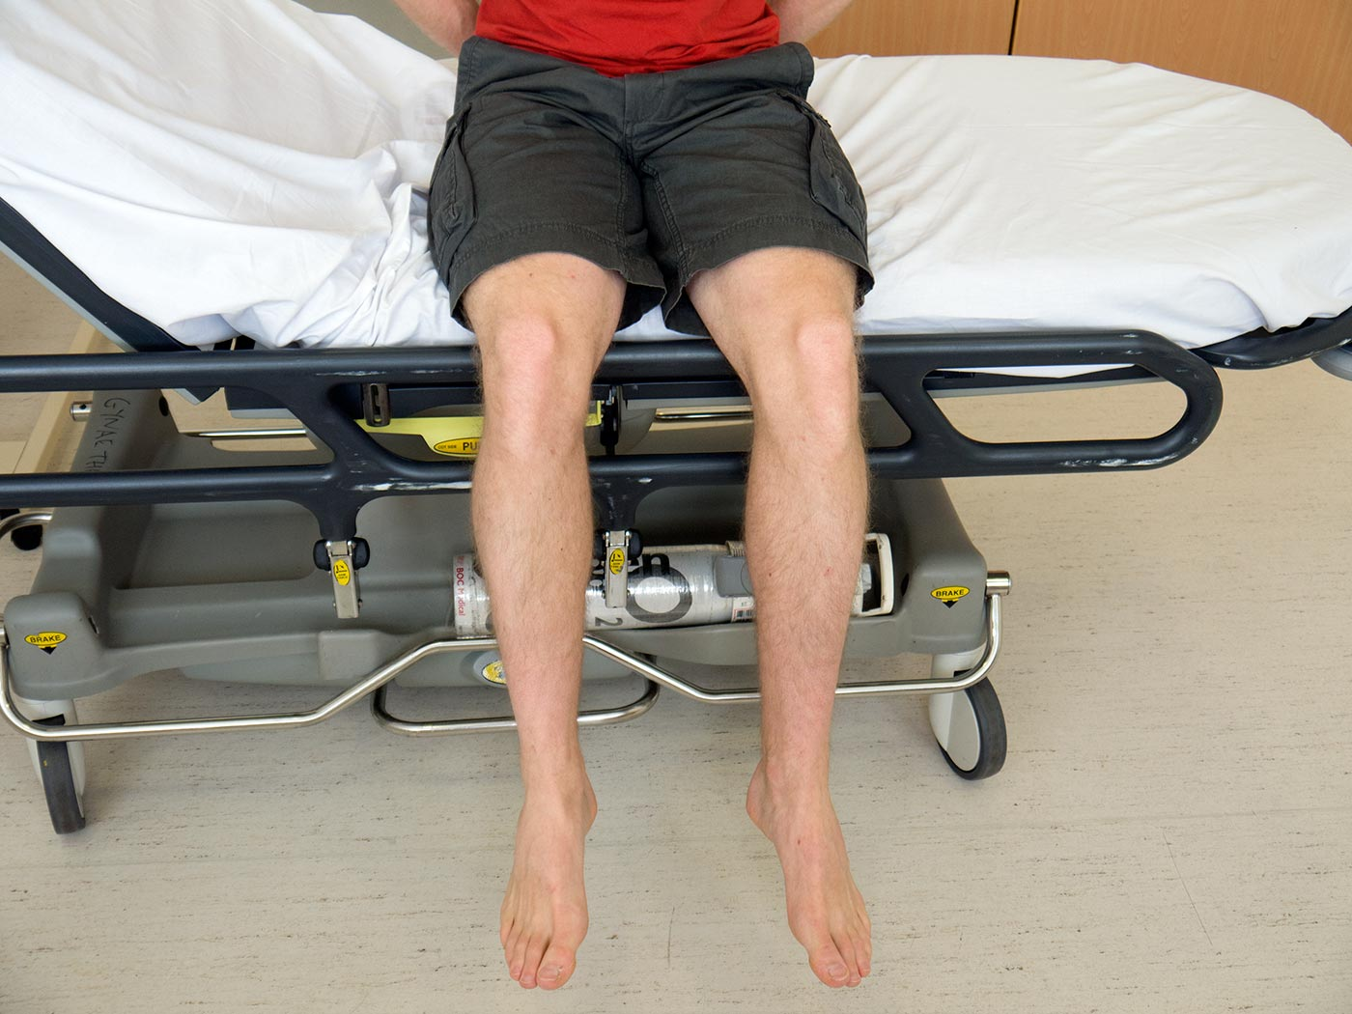
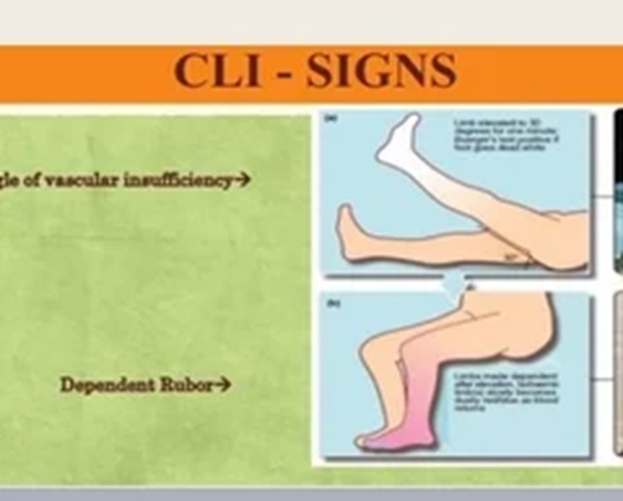
Buerger’s test: Pallor on elevation (vascular angle) < 30°= severe PAD Slowly raise the leg (stopping for few seconds at every 10 degrees) with hand under the heel and notice for skin pallor.
Rubor on dependency- red flushed foot Returns to normal after some time

Slide 37
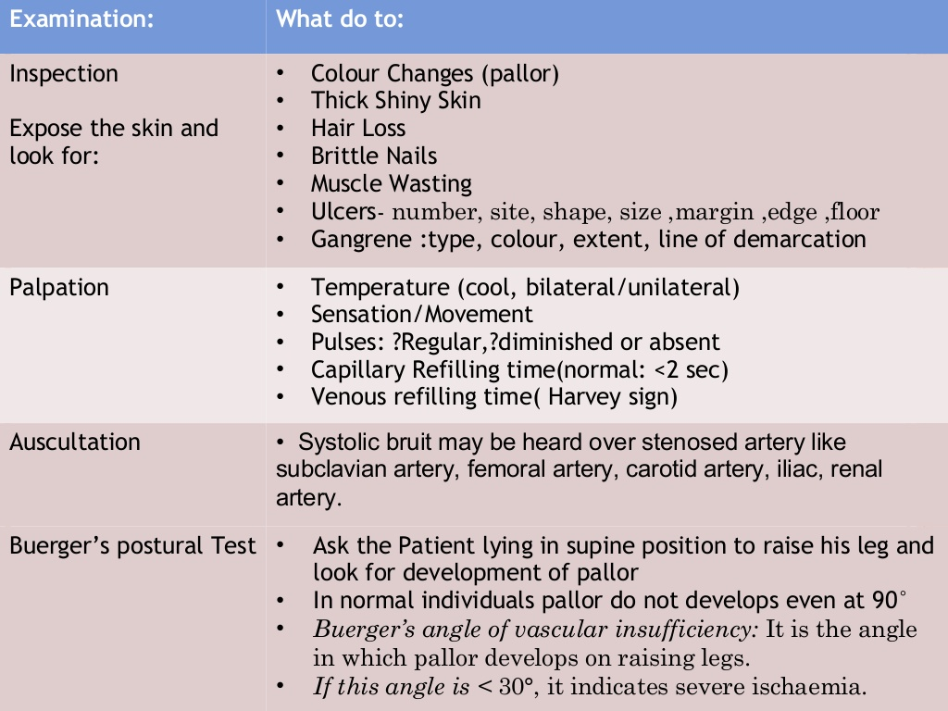
Notes:
conclusion

Slide 38
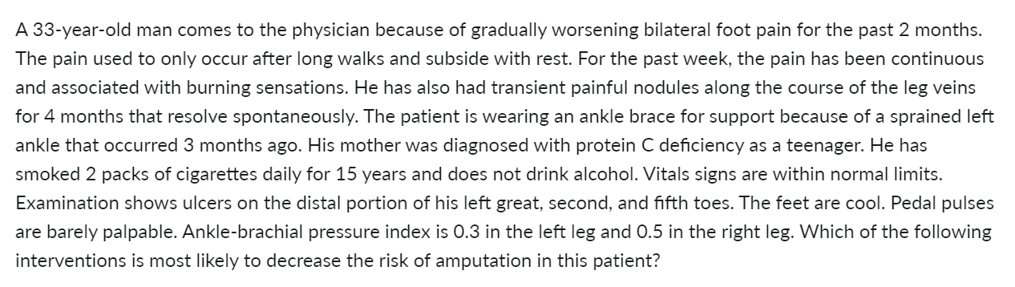
Stop smoking
Start therapeutic Heparin
Leg stocks
Avoidance of cold temperature

Slide 39
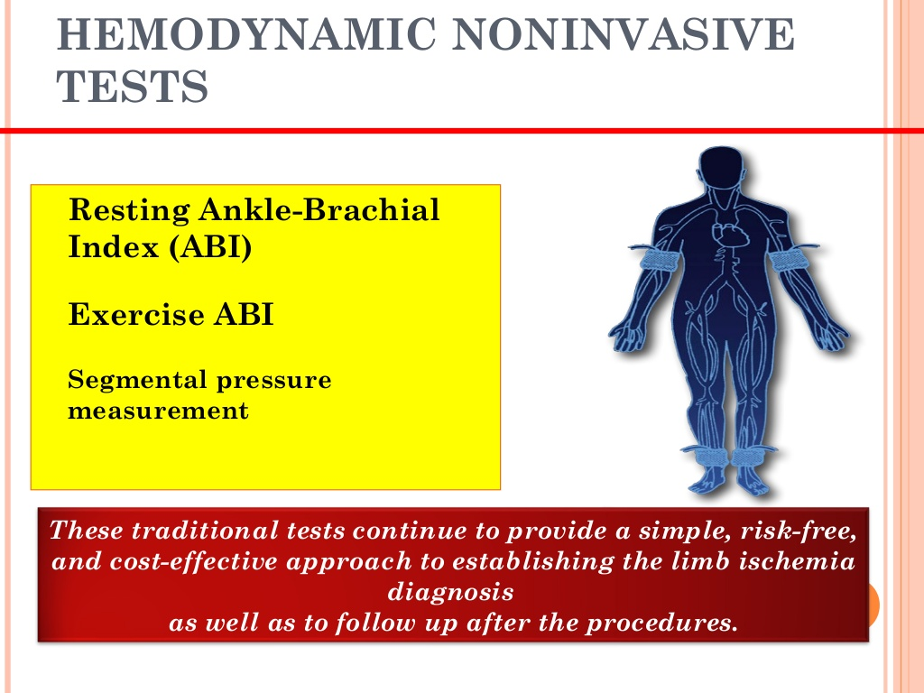
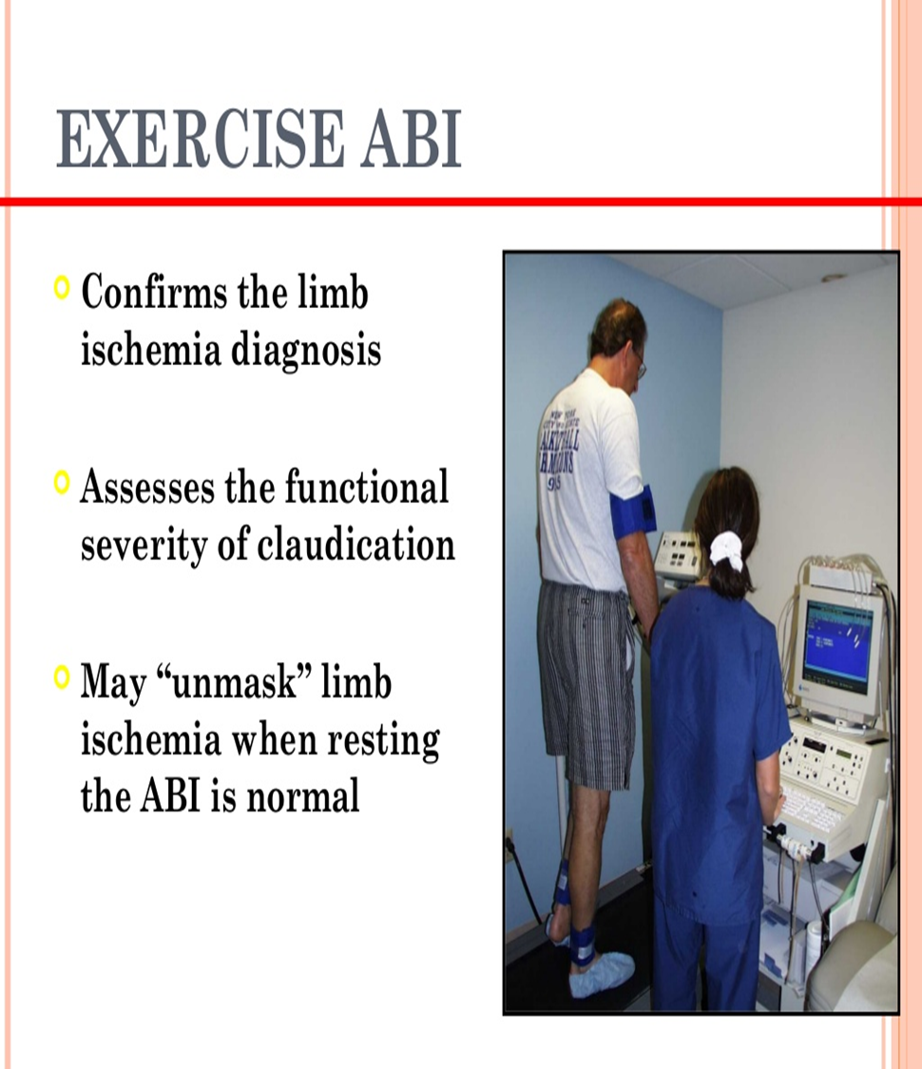

Slide 40
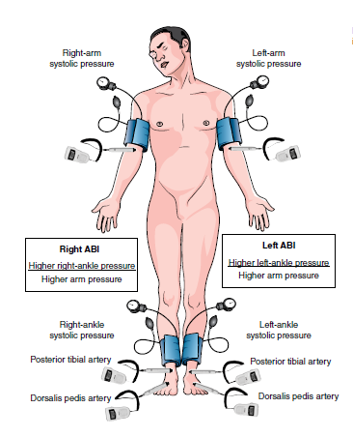
The technique of ankle–brachial pressure index measurement:
Measurement of the posterior tibialis systolic blood pressure. A blood pressure cuff is placed around the calf and the blood pressure is measured with a Doppler probe over the posterior tibialis artery.
Measurement of the brachial systolic blood pressure using a Doppler probe.

Slide 41
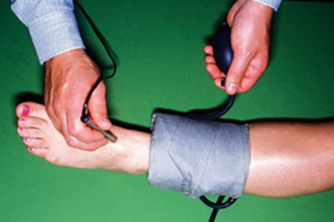
Ankle: brachial index
> 1.2 – Calcified artery -diabetes
1.19- 0.95 – Normal
O.94- 0.5 – Moderate (intermittent claudication)
< 0.5 – Severe disease (rest pain)
Ankle systolic pressure/ Brachial systolic pressure (Doppler probe)

Slide 42
Venous disease
Common presentations:
Pain in lower limbs
Prominent veins
Lower limb swelling
Skin changes
Ulcer
Upper limb pain and swelling

Slide 43
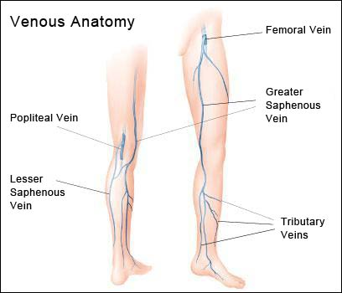
Notes:
The GSV- from the dorsal pedal venous arch and courses cephalad and enters the common femoral vein approximately 4 cm inferior and lateral to the pubic tubercle.
The LSV- originates laterally from the dorsal pedal venous arch and courses cephalad in posterior calf to join the popliteal vein

Slide 44
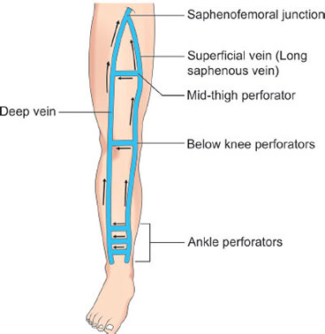
Notes:
Multiple perforator veins traverse the deep fascia to connect the superficial and deep venous systems at multiple levels

Slide 45

Common venous diseases:
Varicose veins.
Deep venous thrombosis. (DVT)
Superficial thrombophlebitis.
Venous ulcer
Chronic venous insufficiency.
Upper limb pain and swelling.

Slide 46



History
Varicose veins:
- Dull pain
- No pain during rest or early in the morning
- Exacerbated after prolonged standing

Slide 47

Clinical Features:
Pain (most common),
Ankle and calf oedema – relieved by foot elevation
Pruritus, brownish hyperpigmentation (hemosiderin deposits)
Stasis dermatitis, subcutaneous fibrosis if chronic (lipodermatosclerosis)
Ulceration: shallow, above medial malleolus, weeping (wet), painless, irregular outline
Signs of DVT/varicose veins/thrombophlebitis

Slide 48



Deep Vein Thrombosis:
- Post-operative.
- Immobility due to other illness.
- Leg pain.
- Leg swelling.
Superficial thrombophlebitis:
Inflammation & thrombosis of previously
normal superficial vein.
Pain, redness and cord like vein
Venous ulcer:
Previous DVT , Varicose Veins
Above medial malleolus (70%)

Slide 49
History of risk factors
Female
Increased age
Previous thromboembolism
Malignancy
Trauma
Obesity
Pregnancy
Post-operative state
Prolonged recumbency

Slide 50
Remaining history as any other patient
Family history of varicose veins
Use of contraceptive pills

Slide 51

Inspection
Both lower limb exposed & compare
Supine & standing (for varicose veins)
Look for varicose veins ( anterior & posterior)
Document the venous system involved
Calf or whole limb swelling (duration)
Localized swelling and skin changes in superficial thrombophlebitis in the line of superficial vein

Slide 52



Inspection
Features of chronic venous insufficiency (CVI): Oedema, leg induration, pigmentation, eczema, ulceration, skin thickness & redness- lipodermatosclerosis
Ulceration: Venous ulcers are located around medial lower 1/3rd of the leg noting size, shape, margin and floor
Ankle Flare

Slide 53



Palpation
Temperature: warm (DVT, infection)
Tense and tender calf (DVT)
Cord like structure tender in superficial thrombophlebitis
Homan’s sign- stretching calf by foot dorsiflexion causes pain
Fegans’ Method: Defect in deep fascia
Pitting edema
Skin thickening, redness
Groin LNs – cough impulse
Abdominal masses

Slide 54


Palpation
Tapping the venous column demonstrates pressure transmission to incompetent distal veins.
Coughing impulse at sapheno-femoral junction denotes incompetent valve
Schwartz or Tapping Test

Slide 55


Brodie Trendelenburg test
  Patient's leg elevated to drain venous blood.
  An elastic tourniquet applied at the sapheno-femoral junction
  The patient then stands with tourniquet in place.
  Rapid filling (<30 seconds) of the great saphenous system- perforator valve incompetent.
  No filling - perforators are competent
  Now release the tourniquet
  Filling of the great saphenous system from above- sapheno-femoral valve is also incompetent.

Slide 56


Multiple Tourniquet – Triple Test

Slide 57
Auscultation
Over large veins- murmur in arterio-venous fistula ( veins do not collapse on lying down and can feel pulsation and thrill during palpation)

Slide 58




Slide 59




Daflon tab 500 mg
Venotonic

Slide 60


Lymphatic disease
Infection: Pain, swelling of acute onset
Lymphedema: Chronic extremity swelling
Absence of renal, cardiac, abdominal and venous diseases helps in the diagnosis of lymphedema

Slide 61


Infection- lymphangitis
Inspection: Red streaks and swelling of the limb
Site of primary infection may be visible
Spreading
Palpation: Warm, tender, pitting oedema
Palpable and tender draining lymph node

Slide 62

Lymphedema
Interstitial oedema of lymphatic origin
Primary lymphedema: Congenital, due to poorly developed lymphatics
Secondary: Infective (Filariasis) or neoplastic (secondary deposits)

Slide 63


History
Age of onset:
Primary:
Congenital- from birth
Praecox- early life
Tarda- late in life
Secondary:
middle to old
Gender: F> M
Nationality: Filariasis in tropical areas
Filariasis is a parasitic disease caused by an infection with roundworms of the Filarioidea type

Slide 64


Slide 65
History
Slowly progressive swelling ( LL> UL)
Painless
Past Med Hx: malignancy, radiotherapy, recurrent infection,
Surgery: lymph node excision
Family history: primary type can be familial

Slide 66


Examination
Inspection: Unilateral swollen limb, swollen foot in lower limb , toe usually spared
Palpation: Initially pitting, later non-pitting due to fibrosis, thickened skin, hair loss, hyperkeratotic, scaly
Draining lymph nodes:
Primary lymphedema- not enlarged.
Malignancy- enlarged or excised

Slide 67
Thank you!

