Slide 1

Introduction to surgery 1
SURG 633

Slide 2
“What we Learn with Pleasure we Never Forget”
Alfred Mercier

Slide 3
Objectives
Perform & demonstrate :
  Self-learning & use of different teaching aids
  The spirit of dedication & concern
  Professional behavior with patients & their relatives
  Respect patient’s wishes, and privacy
  Importance of confidentiality of patient’s information
  Communication skills:
    Patient & their families in simple language
    Your colleagues

Slide 4
Objectives
To provide:
  A broad based theoretical knowledge of:
    Basic surgical principles.
    Common surgical diseases:
      (Epidemiology, aetiology, risk factors, pathophysiology, classification, clinical presentation, differential diagnosis, investigations, overall management, specific treatment, complications and prognosis).

Slide 5
Objectives
  Perform & demonstrate clinical skills of:
    History taking.
    Clinical examination.
    Interpretation of clinical signs.
    Recording & presenting- history & clinical examination findings.
    Symptoms & signs of common surgical diseases.
    To formulate a differential diagnoses.
    Related investigation
    Management of surgical diseases/emergency.

Slide 6
Modified Course Learning Outcomes MCLO
Objective assessments
Components:
  Knowledge
  Skills
  Competence

Slide 7
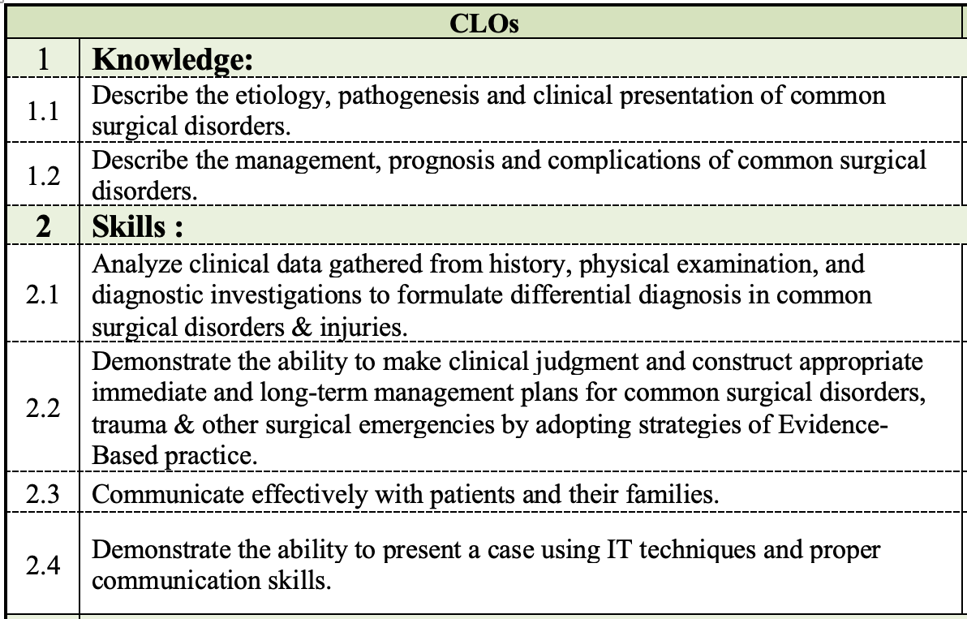

Slide 8
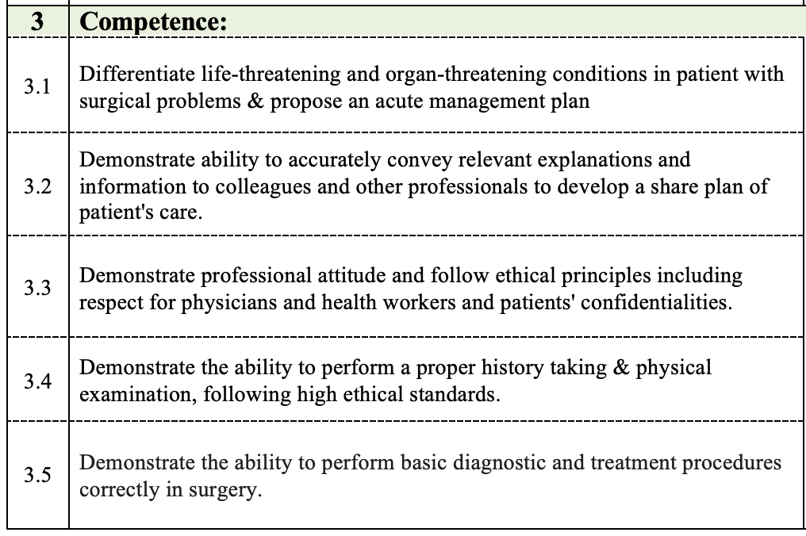

Slide 9
Course plan
Lectures/ Tutorials/ Clinical:
    Hospital posting (Monday & Tuesday)
    Lectures/ Tutorials (Wednesday &Thursdays)
    Clinical Training Day , OSCE Practice (Sundays)
Mid-Block examination:
  Case presentation & Logbook Checkup
Final written exam (Theory)
Final clinical exam

Slide 10

Course plan
Lectures:
  Number of lectures (30).
  Duration of lectures: 45 minutes.
  Lecture topics and its ILOs are listed.

Slide 11
Course plan
Lecture topics:
A. Principles of Surgery
  1. Shock
2. Nutritional support of surgical patients
3. Fluid/electrolytes disorders, acid base disorder
4. Metabolic response to injury
5. Hemostasis (coagulation defects, blood products & blood transfusion)
6. Wounds (wound healing, & management) 7. Surgical infections & antibiotics
8. Investigation of surgical patients
9. Trauma (2 lectures)
10. Preoperative assessment and management
11. Post-operative care and complications
12. Principles of surgical oncology

Slide 12
Course plan
B. General Surgery
13. Acute abdomen (2 lectures)
14. Gallbladder & biliary tract diseases
15. Diseases of stomach
16. Diseases of duodenum
17. Diseases of small bowel
18. Diseases of large bowel
19. Common neck swellings
20. Diseases of thyroid gland21. Diseases of adrenal and parathyroid
22. Liver diseases
23. Diseases of pancreas
24. Diseases of spleen
25. Diseases of the breast
26. Common ano-rectal diseases
27. Abdominal wall and hernia
28. Diseases of peritoneum and retroperitoneal space
29. Principles of surgical oncology

Slide 13
Course plan
Tutorials
  Interactive sessions
  History & clinical examination (Different systems & body regions)
  Laboratory data interpretations
  Imaging study interpretations

Slide 14
Hospital posting
    Surgical units: All weeks
    Attend: in-patient, operating room, emergency room & OPD
    Actively participate: History/examination, & differential diagnosis
    Present patient’s history, examination findings
    Participate in case discussion with in-charge clinicians/deputies
    Follow up & interpret investigation results (blood, imaging)
    Attend operations whenever allowed

Slide 15
Hospital posting
    Display professional behavior at all time
    Must abide by the hospital rules
    Strictly adhere to the confidentiality of patients & hospital
    Must follow the dress code
    Carry own pen torch and stethoscope
    Punctuality
    No cancelations
    Attendance sheets are submitted officially (am/pm)

Slide 16
Learning points at hospital posting
History & examination of different organ systems
Study of imaging investigations
Interpretation of laboratory investigations
Nasogastric tube
Wound drains
Wound care
IV lines
Observe PR exam (Perform only after permission from clinician in charge, & patient)
Observe Proctoscopy (perform only after permission from clinician in charge, & patient)
Suturing
Urinary catheterization- observe (Male & Female)
Colostomy care (if available)

Slide 17
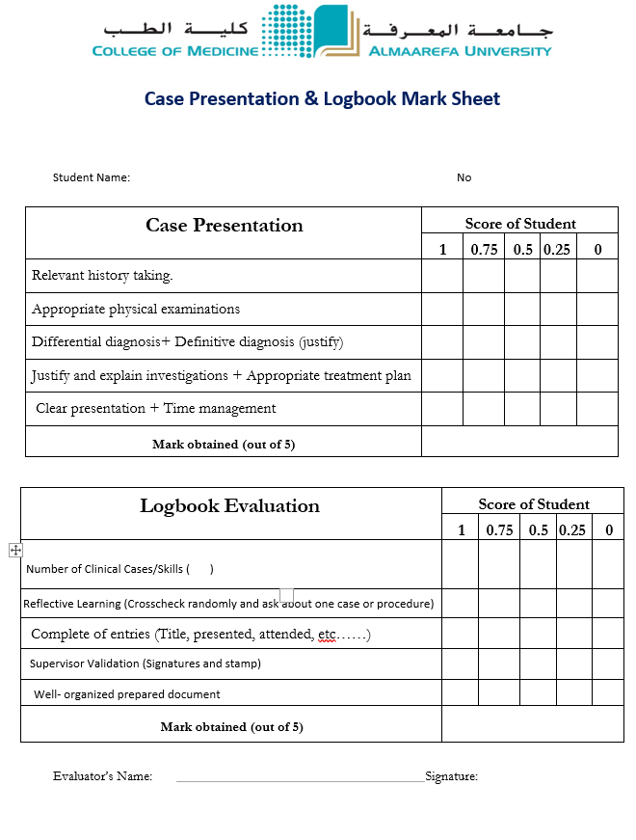

Marks distribution
Mid-Block exam:
  60 MCQs
  (15 Marks)
Case presentation: PPT(5 Marks)
logbook checkup: (5 Marks)
Final examination
  (75 Marks)

Slide 18
Final examination
1. MCQ:
  - 60 questions
  - 15 Marks
2. Slide Show:
- 5 slides
- 10 Marks (Each slide 2 marks)
3. Case scenarios:
- 2 cases
- 10 Marks (Case scenario & questions)

Slide 19
Final examination
4. OSCE: manned VS unmanned
- 5 stations ---- 10 station
- 20 Marks
- (X-ray, lab results, specimens, instruments, clinical pictures, history taking, clinical examination)
5. Clinical examination:
- 2 short cases, on patients in hospital Vs OSCE
- 20 marks

Slide 20
Topics distribution
MCQs:
  Mid-block exam:
    The first 15 lectures/ tutorials that have already been taken
  Final block exam:
    The remaining lectures & tutorials
Other examinations : All topics of the course

Slide 21
Blue print for MCQ

Slide 22
Blue print for MCQ

Slide 23
Clinical short case mark sheet

Slide 24
Important points
Professional behavior
Responsibility
Attendance, & punctuality (Hospital/ University)
Time management
  Start to prepare your assignments
  No postpone/ Keep for tomorrow
  Maximum advantages of your time
Link clinical to knowledge
Think about research project
Use your official (university) email for communication

Slide 25
Important points
Attendance, & punctuality (Hospital/ University)
25% Absence: Deprivation
Hospital : 6 times
Not necessary appears in the Portal Site
Re-examination:
Mention, Short- essay, explain, others

Slide 26


Slide 27
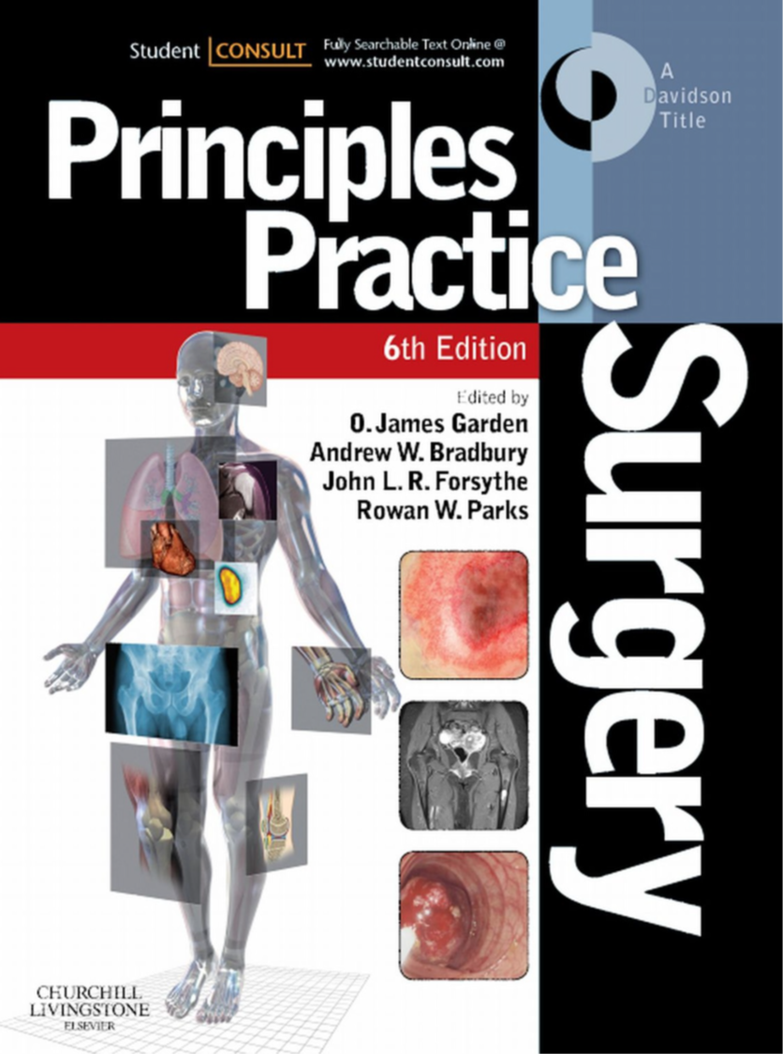
Recommended books
                1.Browse’s Introduction to The Symptoms and Signs of Surgical Disease
            2.Principles and Practice of Surgery: Editors Garden, Bradbury, Forsythe and Parks
3. Pocket Books:
              Churchill’s pocketbook- Surgery by Raftery and Delbridge
              Oxford’s Handbook of Surgery

Slide 28
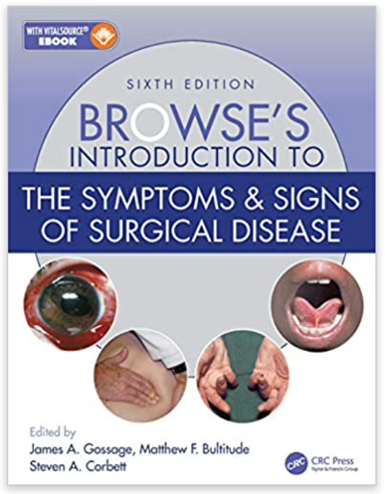
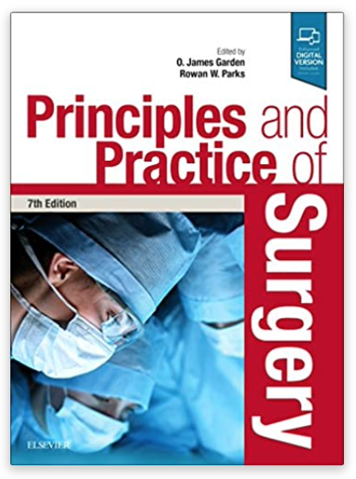
Recommended books

Slide 29
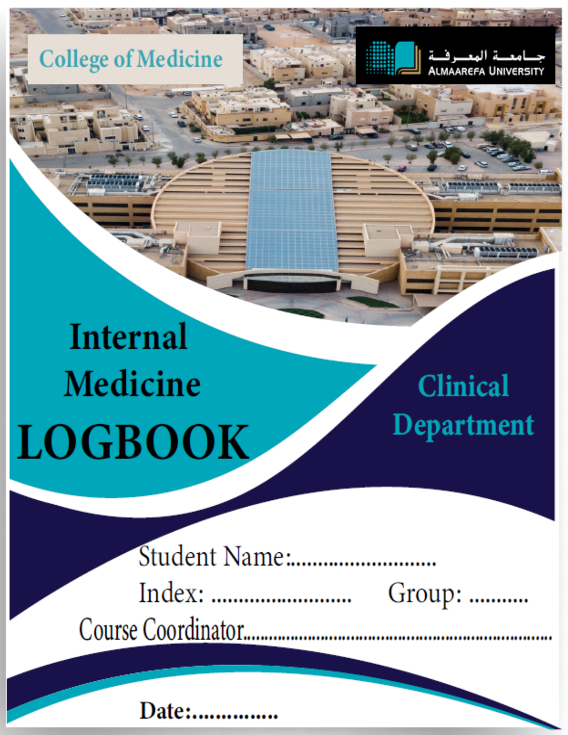

Almaarefa Logbook
Your future Portfolio

Slide 30

What is it?
It is like a book with different chapters reflecting the major clinical disciplines. As you rotate between the departments, you need to document your participation in any educational activity you have done.
Simply submit your logbook for your clinical supervisor to sign it after the end of each activity. Further feedback about your performance is possible through the forms in the logbook. You must sign it on time as it is impossible to sign in retrospectively.
This Photo by Unknown Author is licensed under CC BY-SA

Slide 31

The number of cases required?
You need to document at least 30 cases, and 15 procedures from each discipline in your logbook, throughout your entire rotation i.e. Surgery 1 and 2

Slide 32

No cases available
Don't worry!!
There is another chance in the second part of a rotation to complete your logbook.
This Photo by Unknown Author is licensed under CC BY-NC

Slide 33

Any mark for the Logbook?
A total of 10 marks is allocated for the Logbook.
Five marks for each rotation in any discipline.

Slide 34

Submission time
Before or on the day of your clinical case presentation day, the logbook will need to be submitted for marking.
If you miss the deadline, no marks will be given on the logbook!!

Slide 35


Any?

Slide 36

oaidaroos@um.edu.sa

