Slide 1

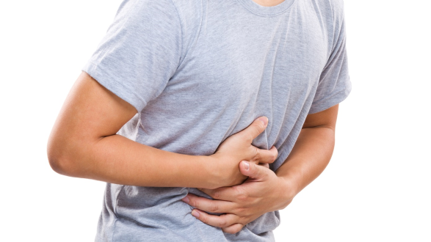
Investigation of Surgical patients
M K ALAM MS; FRCS
Professor of Surgery
College of Medicine
Al Maarefa University
Edited by Dr Shaher Abbarah

Slide 2
ILOs
Aims- Why investigate?
Spectrum of investigations.
Justify (indication) use of relevant investigations
Complications.

Slide 3
Management of a clinical problem
History
Clinical examination
Provisional/ working diagnosis/ DD
Investigations
Final diagnosis
Treatment
Notes:
What is Triple Assessment ?

Slide 4
Aims of investigation
Support clinical suspicion
Refute clinical suspicion
Assess physiological impairment- risk to surgical treatment
Detect asymptomatic disorders
Screen - carcinoma breast, carcinoma colon etc.
“Always keep in consideration- risk & cost”

Slide 5
Hematological investigations
FBC or CBC: low Hb (anemia), MCV, MCHC (normocytic, microcytic), leukocytosis (infection)
Platelet count: Thrombocytopenia ( drug- heparin, ITP, autoimmune), Thrombocytosis ( post-splenectomy)
Coagulation profile: PT, INR, APTT Disordered in: chronic liver disease, jaundice, bleeding, medications
PT assess the Extrinsic & common pathway
PTT assess the Intrinsic & common pathway
Notes:
CBC: complete blood count , FBC: Full blood count
Warfarin follow up by INR
Heparin follow up by PTT

Slide 6
Biochemical Investigations
Na: 135-146 mmol/L- ↓ -water overload, SIADH ↑- fasting, vomiting, burn, Conn’s syndrome
K: 3.5- 5.5 mmol/L- changes- vulnerable to arrhythmias ↑ met. acido, blood trans, crush injury, ↓ vom/diarrh, ileus, met alkalo, diuretics
Urea: 2.6- 6.7 mmol/L- dehydration, renal insufficiency
Creatinine: 60-120 mmol/L- marker of renal disease
Glucose: 3.9-5.6 mmol/L- diabetes
Total protein: 62-80 G/L
Albumin: 35-50G/L- nutritional assessment
Notes:
Low Albumin indicate post op morbidity and increase in complication
Pre-albumin is acute indicator of nutritional status

Slide 7
Biochemical Investigations– contd.
Bilirubin <17 mmol/L- direct/ indirect type (jaundice)
ALP: 25-120 U/L- liver, bone, placenta & intestine Indicator of bile ducts obstruction, primary biliary cirrhosis, sclerosing cholangitis
AST: 10-40 U/L- liver, cardiac muscle, skeletal muscles, kidneys, brain, pancreas
ALT: 5-30U/L- liver, skeletal muscle,
GGT - (M-10-55, F 5-35 u/L) - ↑- bile duct injury
What are liver function test?
Notes:
ALT: more specific of Liver injury
GGT: Gamma-Glutamyl Transferase,
ALP: Alkaline phosphatase
AST: Aspartate Aminotransferase (SGOT)
ALT: Alanine Transaminase (SGPT)

Slide 8
Biochemical Investigations– contd.
LDH: 49-195U/L- found in most body tissues, ↑- liver disease, heart attack, anemia, muscle trauma, bone fractures, cancers, meningitis, encephalitis, HIV
Creatinine phosphokinase (CPK/ CK)- 24-195 U/L: Found in heart, skeletal muscles, brain CPK indicative of muscular damage. CK-MB - specific of myocardial muscle damage, CK-MM- specific of skeletal muscle damage
Amylase <100 u/L mild rise- non-specific- sialadenitis, perf. PU, cholecystitis, intestinal obstruction
Lipase: 0-160 U/L – specific for pancreatic disease
Notes:
LDH: Lactate Dehydrogenase
CK: Creatinine Kinase

Slide 9
Tumour markers
PSA- Prostate
CEA- Colorectal
α- fetoprotein (AFP)- Hepatocellular
β-hCG- Testicular, gestational
CA 19-9- Colorectal, pancreas (monitor treatment)
CA 125 - Ovarian
CA 15-3 & CA 27.29- Breast (not very helpful, monitor treatment)
Notes:
CEA: carcinoembryonic antigen
CA: Cancer Antigen

Slide 10
Microbiological, serology, immunological investigations
Urine
Sputum
Stool
Hepatitis screening
Antibiotic sensitivity
Serology- antibodies against infection
Immunology- autoantibodies- TSI-thyroid stimulating immunoglobulin, Anti-thyroglobulin antibody, anti-TPO- thyroid peroxidase

Slide 11
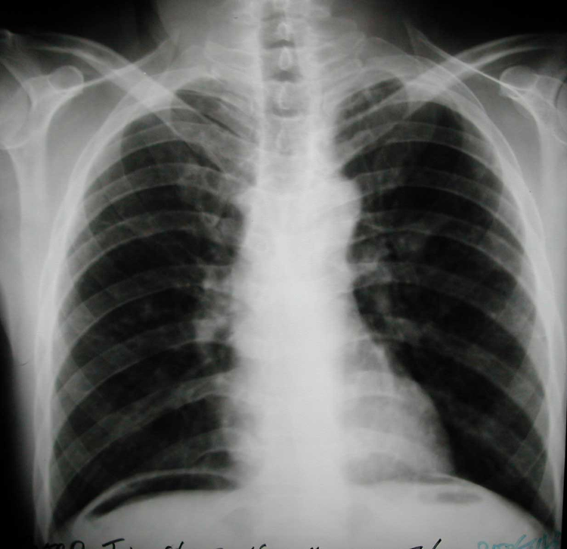
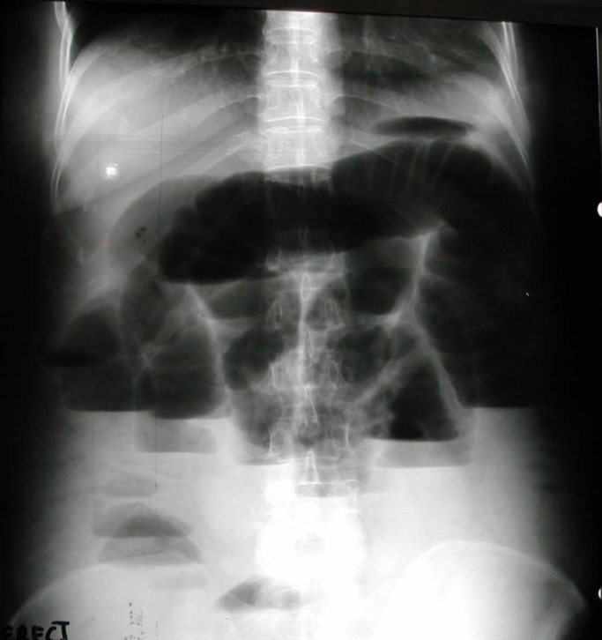
Imaging studies
Plain x-ray- CXR, AXR, tomograms
Side effects of radiation:
Induction of malignancy
Genetic mutation

Slide 12
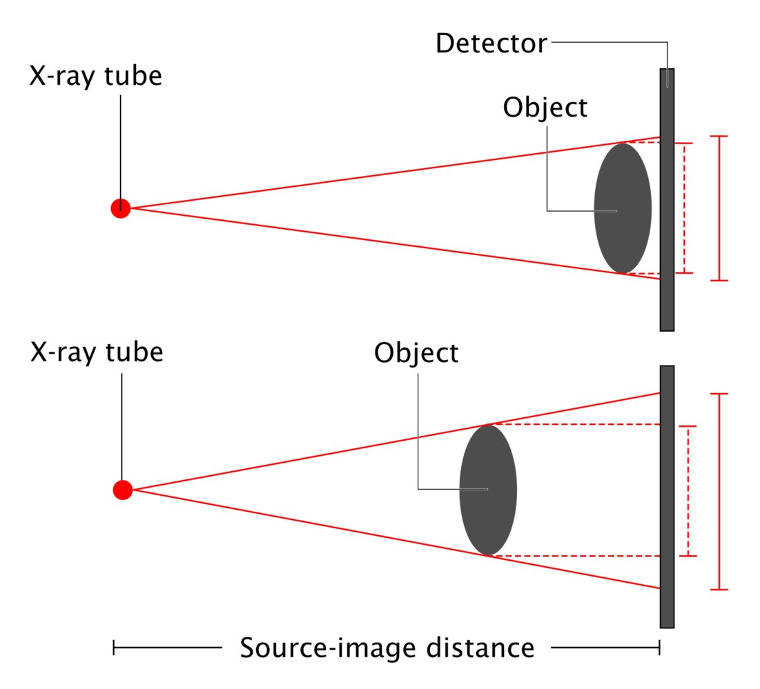
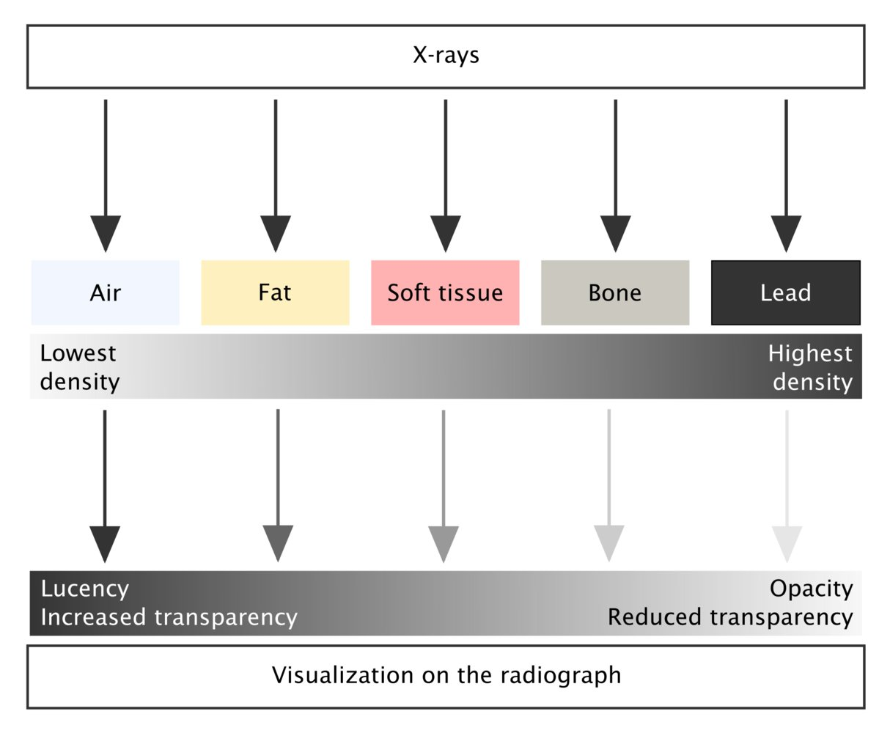

Slide 13
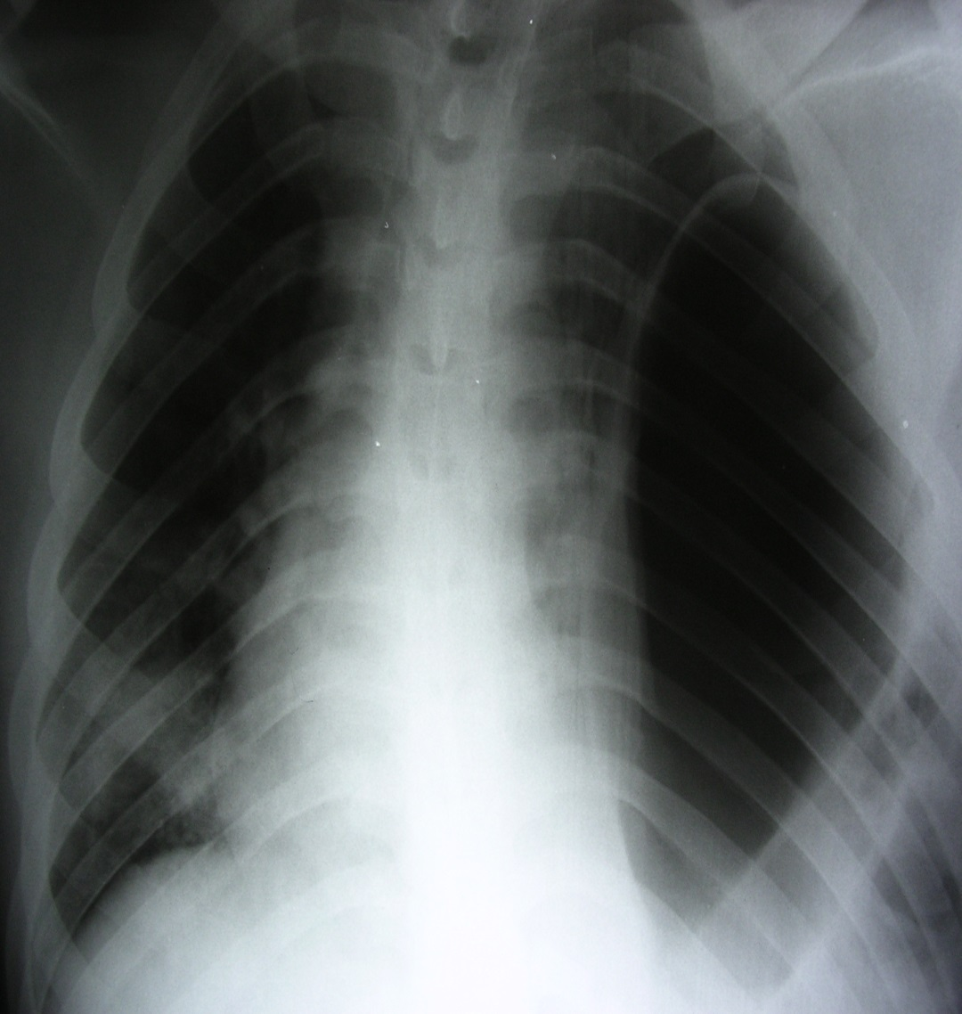
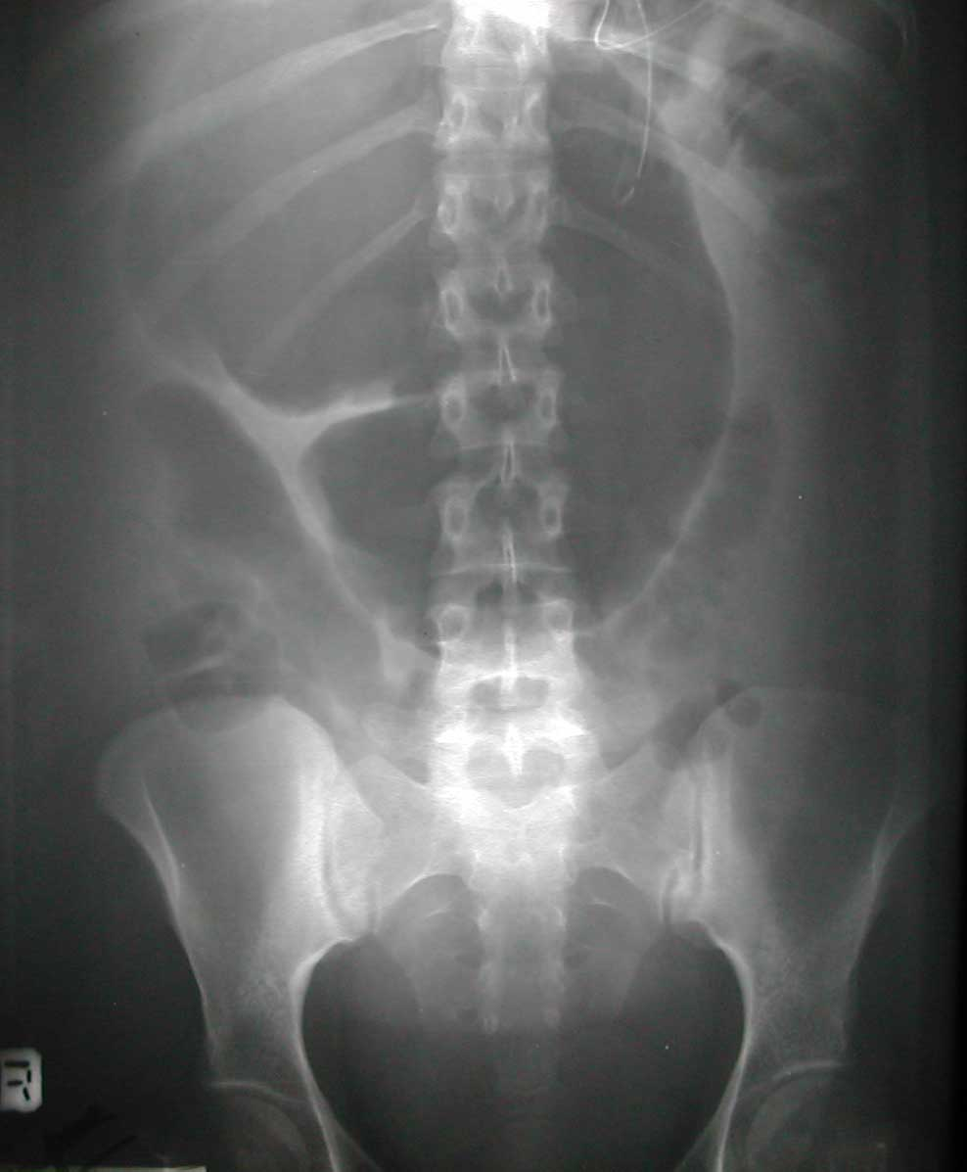

Slide 14
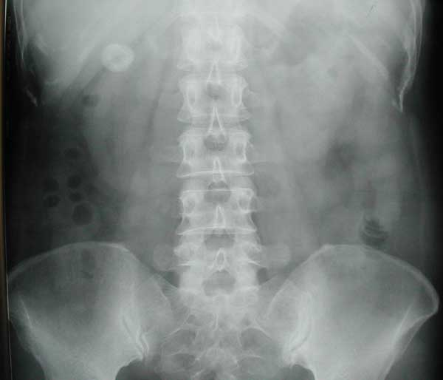
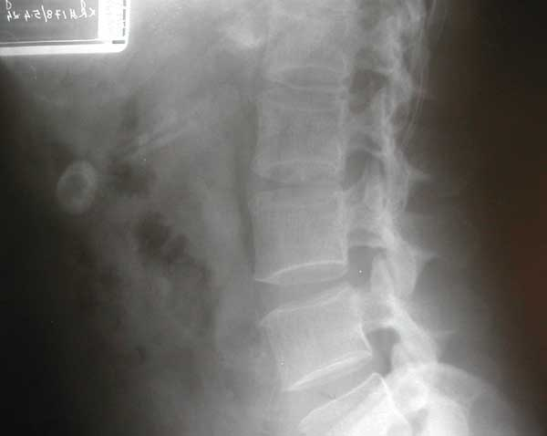
AXR (gallstone)

Slide 15
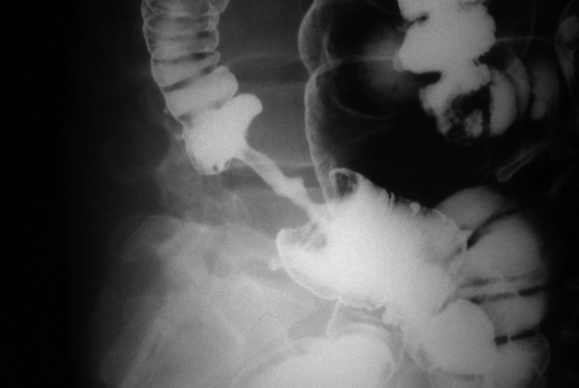
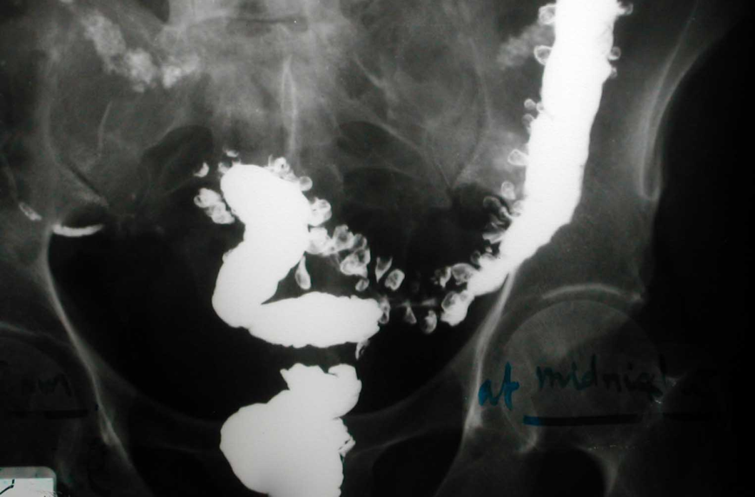
Contrast Imaging
Gastrograffin swallow, Barium meal / enema
Visualize GI tract
Single/ double contrast
Inferior to endoscopy

Slide 16
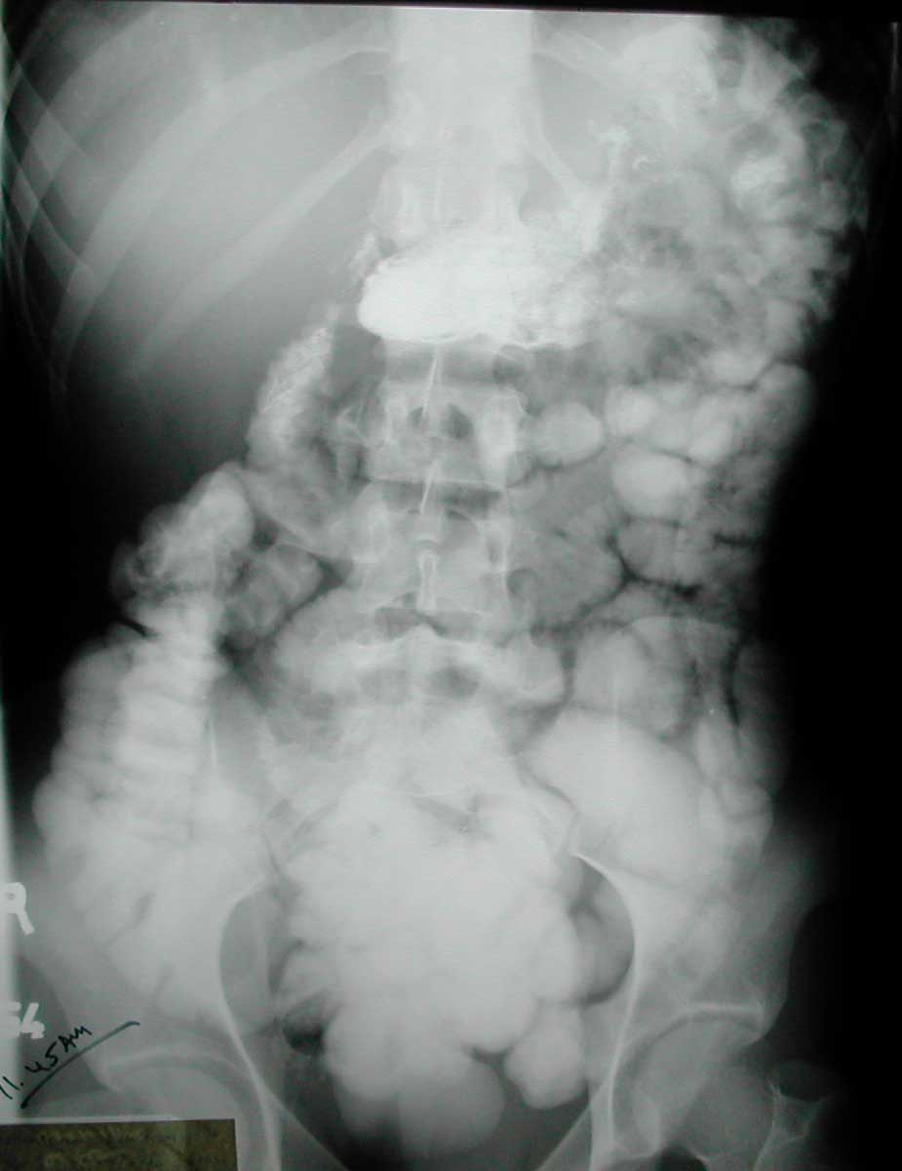
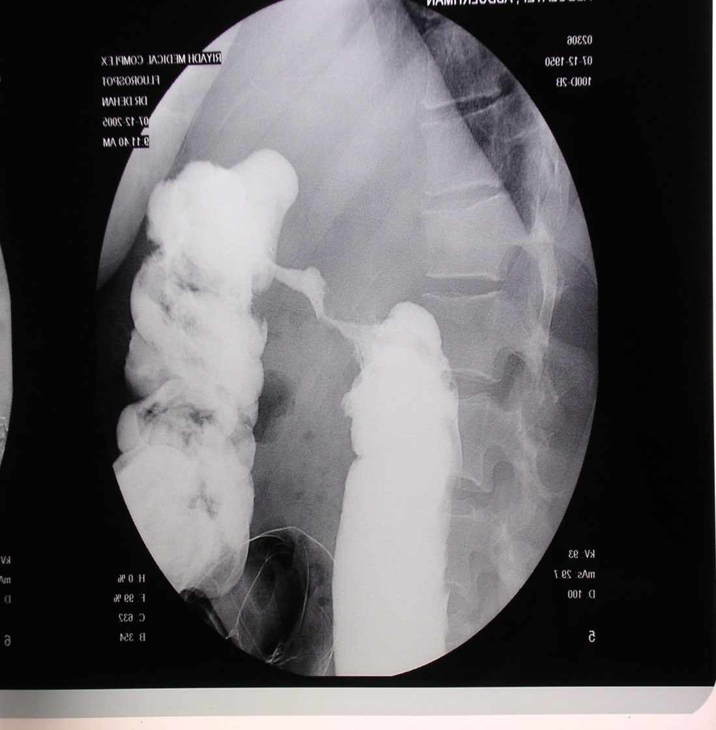
Gastrografin & Barium enema

Slide 17
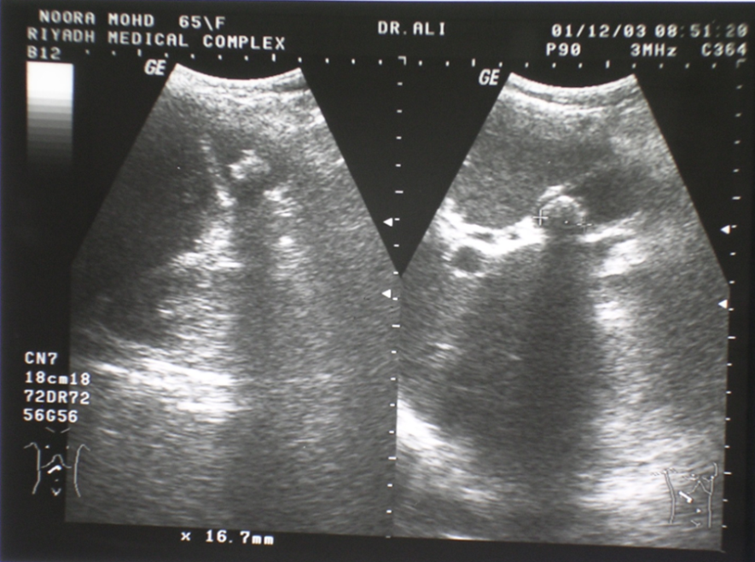
Imaging studies- Ultrasound
Safe
Low cost
Operator dependent
Investigation of first choice: biliary dis. & gynaecology.

Slide 18
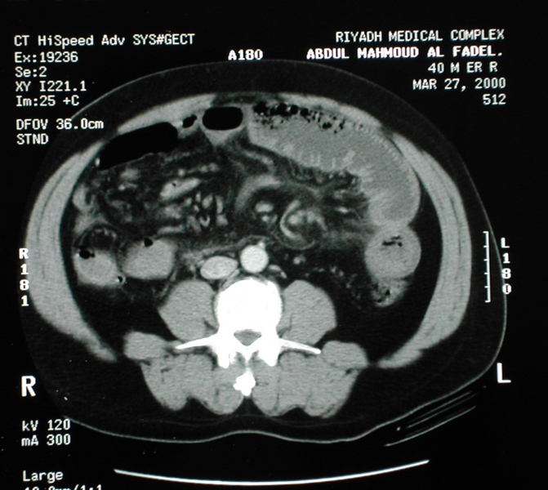
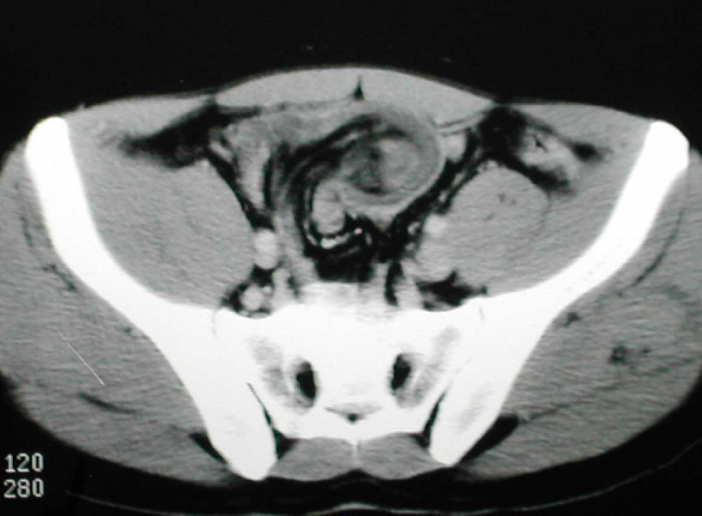
Imaging studies- CT scan
Oral, IV contrast
Used for: Abdomen, chest , brain, vascular and urinary tract.
Side effects: Anaphylactic reaction, renal injury, radiation
Intestinal ischaemia Intussusception
Notes:
What is the relation of Metformin and the IV contrast ?

Slide 19
Before CT
Wear hospital gown
Take off jewelry/metal objects
NPO ?
If IV contrast needed, Renal profile needed
Consent

Slide 20
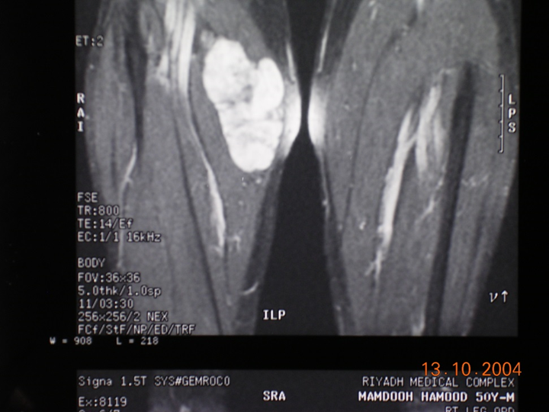
Imaging studies - MRI
Good images: Soft tissue (better than CT) Blood vessel (MRI angiogram)
No known deleterious effect
No radiation
Slow and expensive.
Contraindications
Notes:
Absolute: ferromagnetic implants
MRI use electromagnetic fields and radio waves rather than ionizing radiation
Ionizing radiation is radiation that contains enough energy to liberate electrons from atomic orbit, which ionizes them. , which can create damaging free radicals (x-ray)

Slide 21
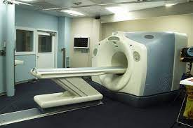
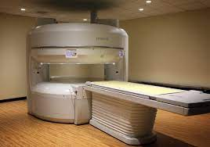

Slide 22
Imaging studies – Isotope scan
Isotope scan: More information about function than structure. I131,Tc99, I123, Ga67, Th201- incorporated into other molecule to localize target organ.
- Detected by gamma camera. - Bone metastasis, renal function, foci of infection, GI bleeding, infarction of myocardium, sentinel node detection
PET scan: Expensive.
Use: Brain physiology, tumour detection , cardiac physiology
Notes:
Technetium-99 Tagged RBC scan can detect bleeding rate of 0.1 ml/hr
PET: positron emission tomography

Slide 23
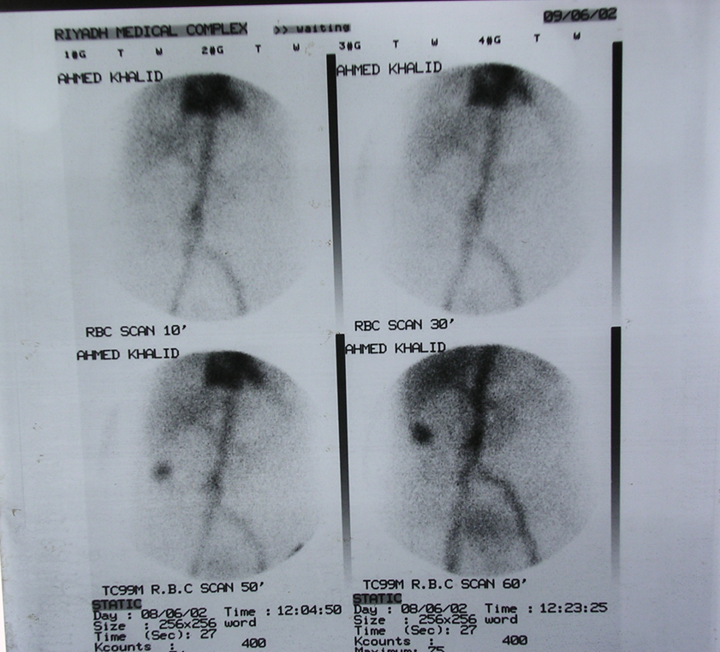
Lower GI bleeding Scan

Slide 24
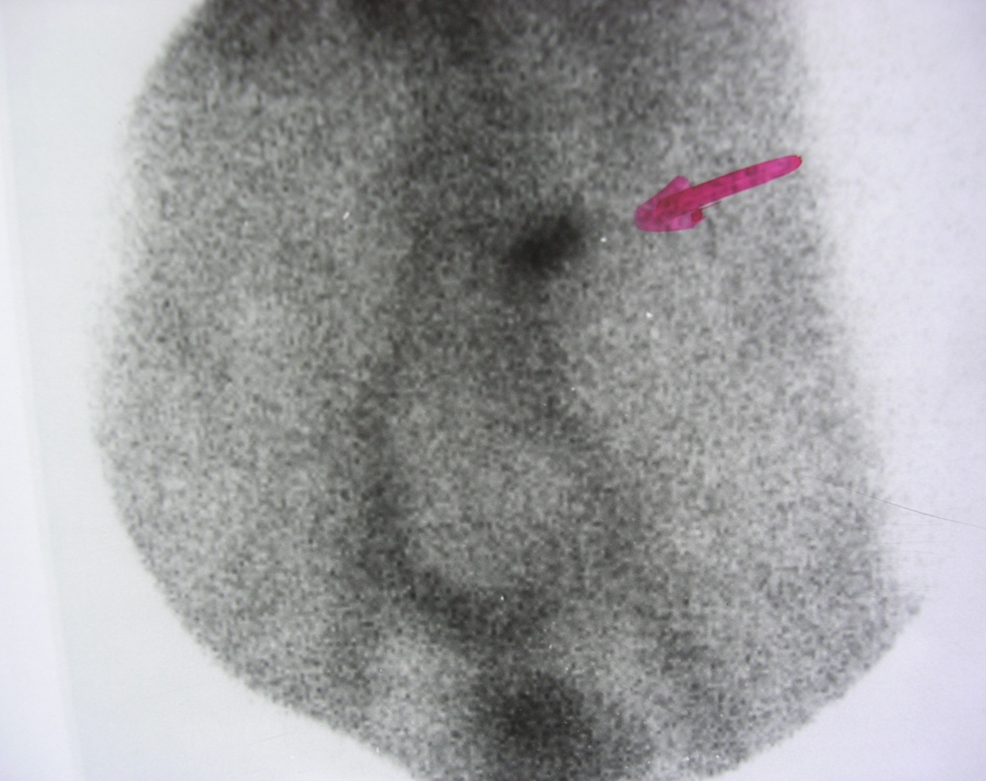
Meckel's scan

Slide 25
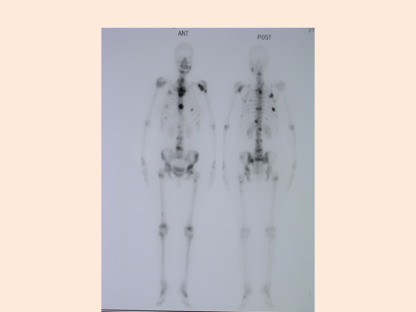
Bone scan

Slide 26
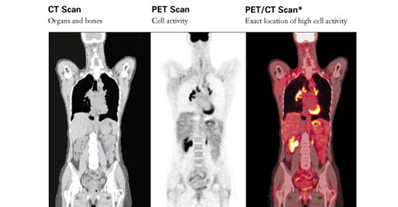
PET scan

Slide 27
Endoscopy
Precise diagnosis: GI, pancreatic, biliary, bronchus, urinary tract
Cytology/ biopsy.
Minimally invasive therapy: laparoscopy, arthroscopy, ERCP.
Disadvantages: Unpleasant, uncomfortable (sedation/ anesthesia)
Complications: Infection, perforation, aspiration, bleeding, cardiac arrhythmias, respiratory arrest

Slide 28
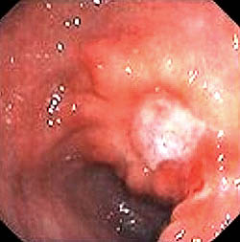
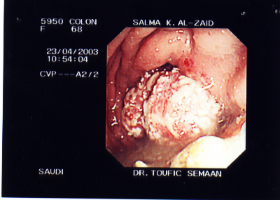
Upper GI endoscopy & Colonoscopy

Slide 29
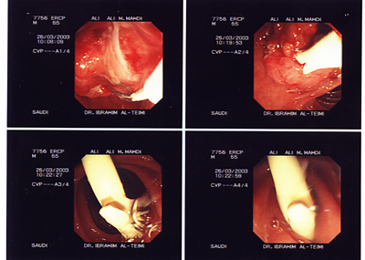
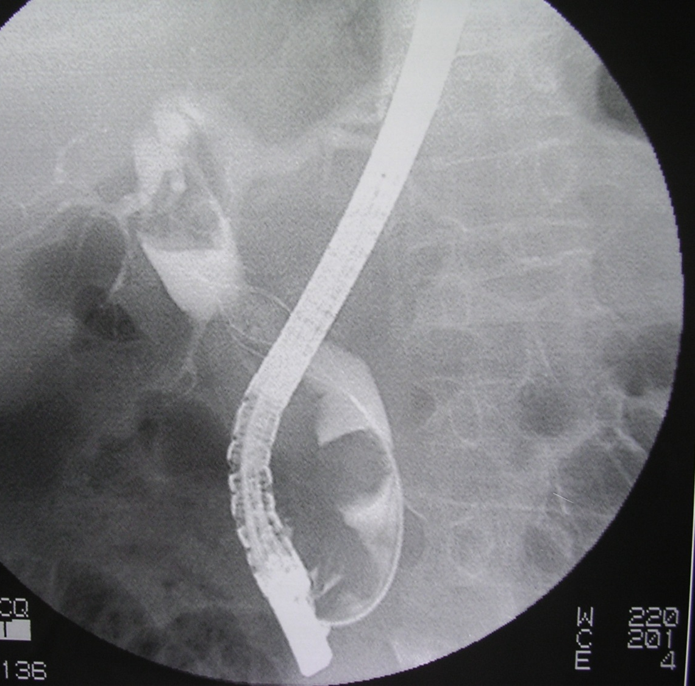
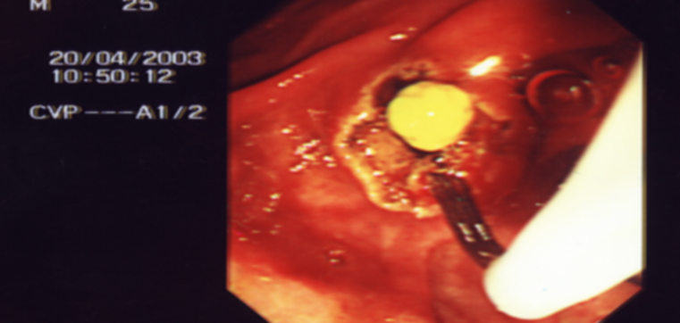
ERCP
(CBD stone extraction, Periampullary carcinoma)
Notes:
ERCP: Endoscopic retrograde cholangiopancreatography

Slide 30
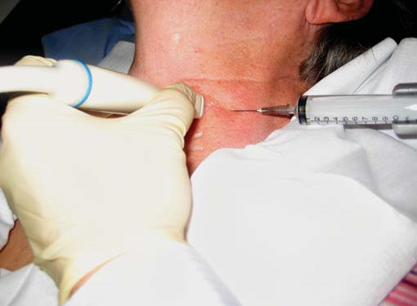
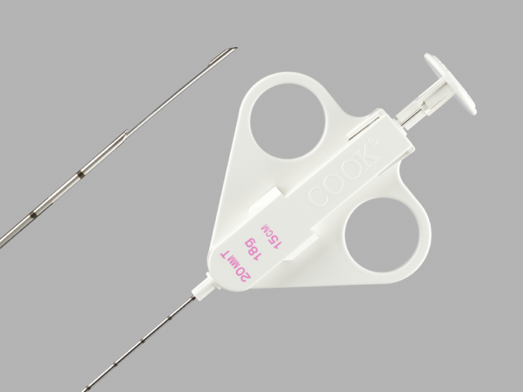
Tissue sampling
Body fluids- pleura, peritoneum, sputum , urine.
Smears, brush cytology
FNAC
Core biopsy
Open biopsy (incision/ excision)
Frozen section biopsy: Biopsy material frozen in liquid nitrogen, sliced, stained & reported in minutes
Notes:
Fine Needle Aspiration: A thin, hollow needle is used to collect a sample of cells from a mass or lesion for analysis. (Less invasive procedure). Commonly used in thyroid nodule
Core Needle Biopsy: A hollow needle is used to collect a sample of tissue for evaluation of its histopathological features. Commonly used to assess suspicious breast lesion
Open Biopsy: Incisional or Excisional

Slide 31
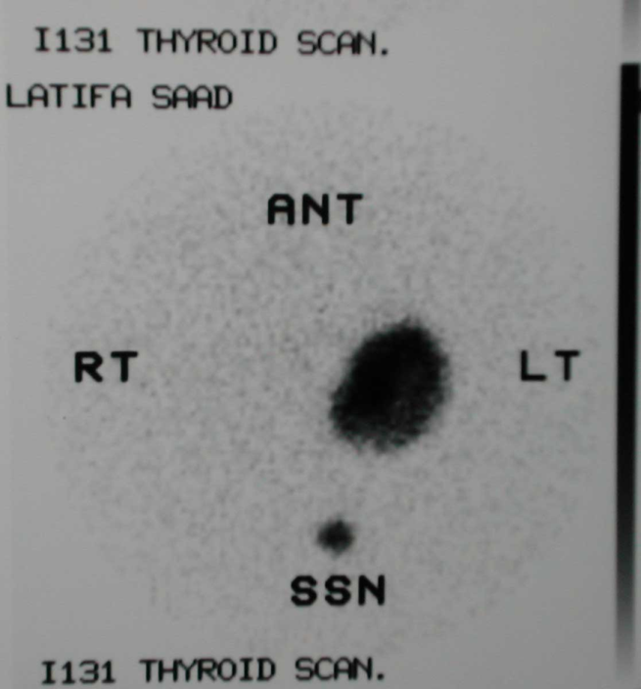
Function tests
Cardiac evaluation: ECG, Thallium scan, Echocardiography
Respiratory function: ABG (risk pCO2 > 45 mmHg) FVC & FEV1 ( risk- < 70% of predicted)
Renal function: Lab, Scintigraphic renography-
DMSA, MAG3, DTPA
Endocrine function- lab, isotope scan
Notes:
DMSA: Dimercaptosuccinic acid scintigraphy
DTPA: Diethylene-triamine-penta-acetic acid
MAG: Mercaptoacetyle triglycine

Slide 32
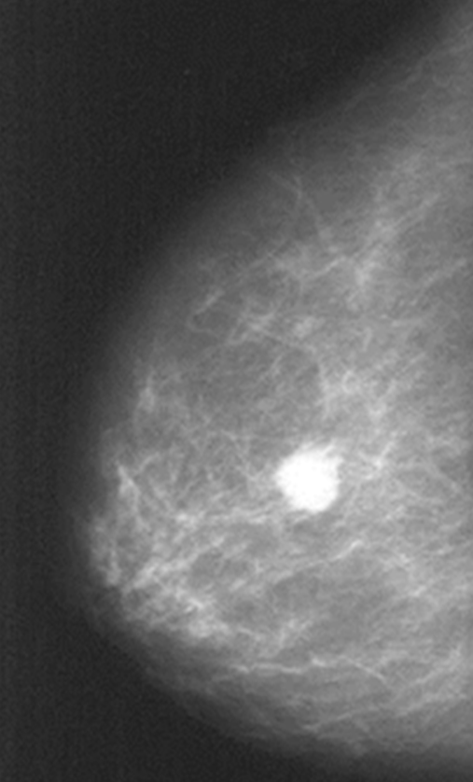
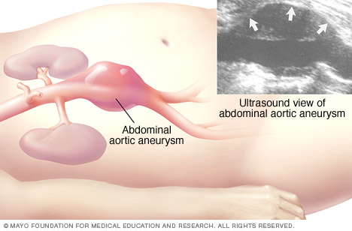
Screening
Screening for malignant disease (FOB, FIT, mammography, PSA, endoscopy)
Screening for surgical disease (one-t aneurysm AAA - ultrasonography in men ages 65 to 75 years who have ever smoked.
Notes:
FOBT: Fecal Occult Blood Test
False positive in?
“Ever smoker”: who smoke 100 cigarettes during his/her lifetime
FIT: Fecal Immunohistochemical test
Colonoscopy for colon cancer starting age at 50
Mammogram for breast cancer starting age at 40

Slide 33
Thank you!

