Slide 1
The pancreas

Slide 2
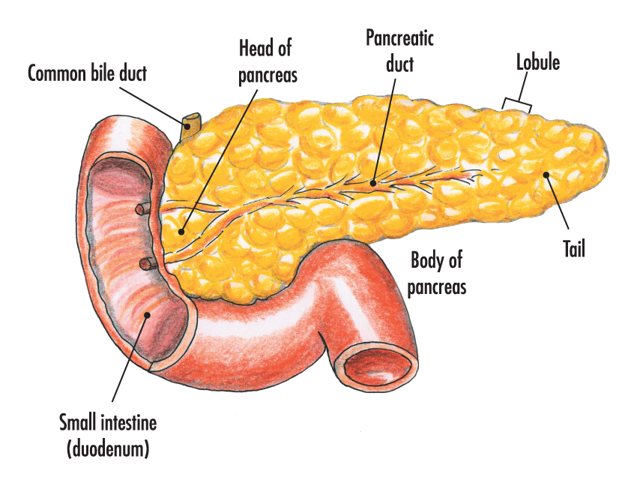
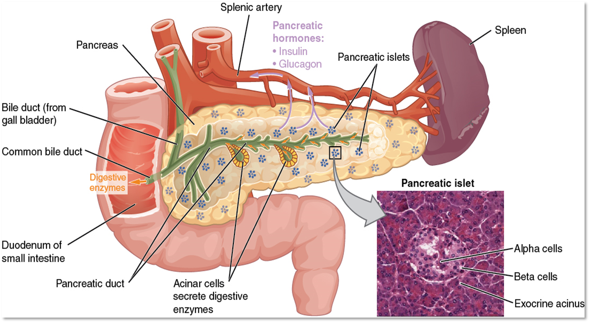
Surgical anatomy of the pancreas

Slide 3
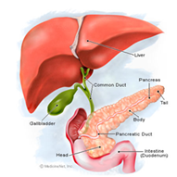
Pancreatitis

Slide 4
Etiology
1- Gallstone
2- Alcohol
3- Metabolic: Hyperlipidemia and Hypercalcemia
5- Heridetary
6- Autoimmun
7- Infection ( mumps and coxsaki B viral infection)
8- Trauma (blunt , penetrating , surgical , ERCP)
9- Pancreatic duct obstruction ( neoplasm , worms , pancreatic divism )
10- Medications ( thiazid , steroid , azathioprin)
11- Idioipathic

Slide 5
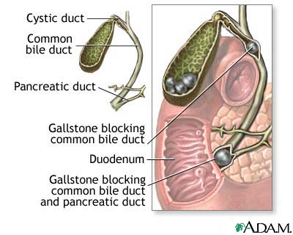
Gallstone Pancreatitis

Slide 6
Clinical Features
Symptoms :
Severe , constant , agonizing pain in the epigastrium, with radiation to the back.
Nausea , vomiting and retching are usually marked .
Signs :
1- Tenderness and guarding disproportionate to symptoms. Generalized Peritonism
2- Tachycardia , tachypnia and hypotension indicate severe pancreatitis
3- Jaundice : due to impacted stone ? co-existing cholangitis.

Slide 7
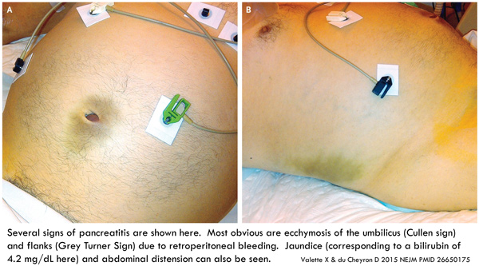
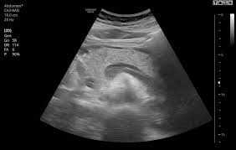
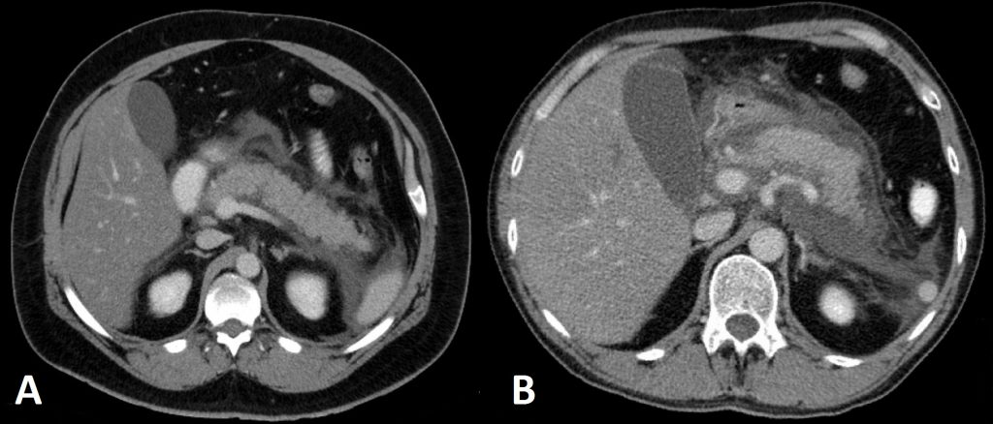
Cullen sign abd Grey Turner sign

Slide 8
Investigations
1- The key to diagnosis:
  a high index of suspicion
  measurement of the serum amylase concentration.( *3). Serum lipase is alternative and more specific.
2- Other underlying causes of hyperamylasemia:
  mesenteric vascular ischemia , bowel strangulation ,
  perforated duodenal ulcer ,
  rupture aortic aneurysm ,
  ruptured ectopic pregnancy ,
  acute cholecystitis.

Slide 9
Amylase and Lipase in Acute pancreatitis
The diagnosis of acute pancreatitis is best supported by a three-fold increase in amylase and lipase.
The lipase is considered a little more specific than amylase but situations other than pancreatitis can cause lipase elevations.
Serum amylase may be elevated for many reasons other than acute pancreatitis (eg, mumps, perforated viscus, tubo-ovarian abscess,), as can the serum lipase (eg, intestinal infarction and perforation, severe peptic ulcer disease).
The severity of pancreatitis does not correlate well with the magnitude of the elevation of the serum amylase or lipase.
Lipase and amylase levels also do not correlate with recovery or prognosis.

Slide 10
3- CBC, urea , electrolytes , liver function test , LDH , lipid profile , coagulation profile, serum calcium, C-reactive protein, blood glucose.
4- Imaging :
Chest X-ray look for pleural effusion, air under the diaphragm in cases of perforated peptic ulcer.
Ultrasound abdomen gallstone.
Abdominal computed tomography ??? diagnosis, complications of acute pancreatitis evidence of necrotizing pancreatitis.
Dx Continue…………………..

Slide 11
CT abdomen Pancreatitis
Although a CT scan may eventually be useful, it will not be as helpful as the other choices at this point. It is best used at 72 hours of illness to assess the degree of pancreatic necrosis in patients with predicted severe disease.
A cardiogram and troponin will help to rule in or rule out a myocardial infarction while the serum amylase and lipase will give information about pancreatitis.
The gallbladder ultrasound will be important in this patient with a strong family history for cholelithiasis and cholecystitis

Slide 12
Pancreatitis: Initial Management
All patients with acute pancreatitis should initially be made NPO.
If they continue to vomit, nasogastric aspiration may be indicated,. Vigorous hydration with isotonic fluids (Ringer's lactate or normal saline) is indicated to maintain blood volume, especially in the face of severe pancreatitis in which patients may sequester large amounts of fluids in the retroperitoneal space.
Use of IV antibiotics is controversial. In this patient, antibiotics are not indicated, as the severity of the disease has not been established. Immediate IV hyperalimentation is not required, especially in patients with mild pancreatitis.

Slide 13
Assessment of severity of acute pancreatitis
The aim of severity assessment is the early recognition of the patients with severe pancreatitis and to ensure that they admitted in high dependency unit or critical care unit for intensive management.

Slide 14
Ranson’s Criteria

Slide 15
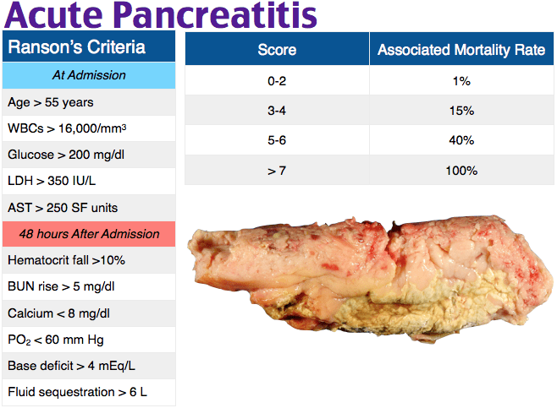

Slide 16
The criteria for point assignment is that a certain breakpoint be met at anytime during that 48 hour period, so that in some situations it can be calculated shortly after admission. It is applicable to non-gallstone pancreatitis.

Slide 17
1) For non-gallstone pancreatitis, the parameters are:
At admission:
1- Age in years > 55 years
2- White blood cell count > 16000 cells/mm³
3- Blood glucose > 10 mmol/L (> 200 mg/dL)
4- Serum AST > 250 IU/L
5- Serum LDH > 350 IU/L
Within 48 hours:
1- Serum calcium < 2.0 mmol/L (< 8.0 mg/dL)
2- Hematocrit fall > 10%
3- Oxygen (hypoxemia PaO₂ < 60 mmHg)
4- BUN increased by 1.8 or more mmol/L (5 or more mg/dL) after IV fluid hydration
5- Base deficit (negative base excess) > 4 mEq/L
6- Sequestration of fluids > 6 L

Slide 18
2) For gallstone pancreatitis, the parameters are:
At admission:
1- Age in years > 70 years
2- White blood cell count > 18000 cells/mm³
3- Blood glucose > 12.2 mmol/L (> 220 mg/dL)
4- Serum AST > 250 IU/L
5- Serum LDH > 400 IU/L
Within 48 hours:
1- Serum calcium < 2.0 mmol/L (< 8.0 mg/dL)
2- Hematocrit fall > 10%
3- Oxygen (hypoxemia PaO₂ < 60 mmHg)
4- BUN increased by 1.8 or more mmol/L (5 or more mg/dL) after IV fluid hydration
5- Base deficit (negative base excess) > 5 mEq/L
6- Sequestration of fluids > 4 L

Slide 19
Interpretation of Ranson's criteria
- If the score ≥ 3, severe pancreatitis is likely.
- If the score < 3, severe pancreatitis is unlikely
Or
- Score 0 to 2 : 2% mortality
- Score 3 to 4 : 15% mortality
- Score 5 to 6 : 40% mortality
- Score 7 to 8 : 100% mortality..

Slide 20
Alternatively, pancreatitis severity can be assessed by any of the following:
- APACHE II score ≥ 8
- Organ failure
- Substantial pancreatic necrosis (at least 30% glandular necrosis according to contrast-enhanced CT)

Slide 21
Treatment
Most of attacks of acute pancreatitis will settle with conservative treatment including :
NPO +/- NG tube
Pain relief : opiates administration
2. Fluid resuscitation : patients with severe pancreatitis require large volumes of fluid to maintain adequate urine output and blood pressure. Adequate early resuscitation in such cases is the most important consideration in early treatment .
3. Antibiotics prophylaxis: it is indicated in severe necrotizing pancreatitis and the recommended antibiotics is the imipenem or meropenem

Slide 22
4. Nutritional support : patients with severe pancreatitis who is unable to resume normal oral diets within 72 hours require nutritional support. This is best delivered by an enteral rather than parenteral route.
5. Endoscopic treatment: gallstone pancreatitis is due to the transient impaction of a stone at the papilla causing pancreatic duct obstruction. ERCP with sphincterotomy is indicated in patient with acute pancreatitis with persistent obstructive jaundice with or without cholangitis.
6. Surgical treatment: patients with gallstone related acute pancreatitis should undergo cholecystectomy ( mild pancreatitis during the index admission while severe pancreatitis interval cholecystectomy in 8 – 12 weeks after resolution of the attach of severe acute pancreatitis).
Note: Surgery is indicated in patient with infected necrotizing pancreatitis or in patient with sterile necrotizing pancreatitis who deteriorate e and develop progressive multi-organ failure.

Slide 23
Complications of acute pancreatitis
1. Infected pancreatic necrosis
It is a serious complication which can develops in acute necrotizing pancreatitis with high mortality rate. It can be diagnosed by presence of gas bubbles in CT scan at the area of pancreas or by fine needle aspiration under imaging guidance. Such patients need intensive management with antibiotics coverage and possibly surgical intervention ( surgical debridement ).

Slide 24
2. Pancreatic pseudocyst
It is a collection of pancreatic secretions and inflammatory exudate enclosed in a wall of fibrous or granulomatous tissue. It is differs from a true cyst in that collection has no epithelial lining. It form commonly in the lesser sac near the pancreas and persist for 4 weeks or more from the onset of acute pancreatitis. It need drainage if it persists more than 6 week after the attack of pancreatitis , the size > 6 cm and symptomatic

Slide 25
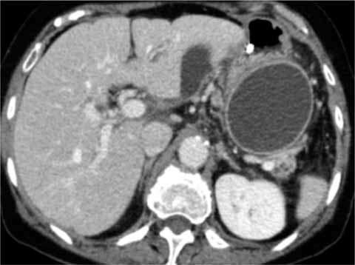
CT scan of pancreatic pseudocyst

Slide 26
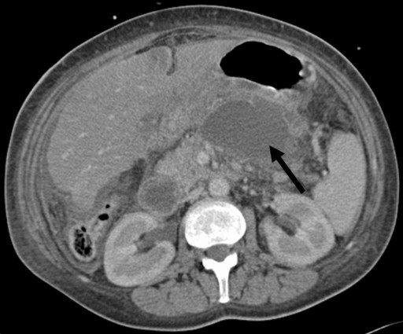
3. Pancreatic abscess
It is a circumscribed intra-abdominal collection of pus , usually in proximity to the pancreas. This is a result of infection of a pseudocyst. It need urgent drainage.
CT scan of pancreatic abscess

Slide 27
4. Gastrointestinal bleeding
Severe pancreatitis may be complicated by bleeding from gastritis , erosion or duodenal ulceration. Thrombosis of splenic vein can lead to splenomegaly , gastric fundal varices which can result in massive upper gastrointestinal bleeding ( sinistral , left sided , compartmental portal hypertension) .
5. Progressive jaundice
due to impacted stone in the papilla or compression of distal common bile duct by enlarged edematous pancreas.

Slide 28
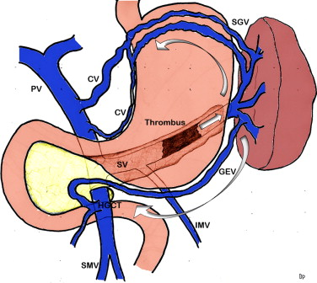
Left sided portal hypertension

Slide 29
Chronic pancreatitis
It is a chronic inflammatory condition characterized by fibrosis and destruction of exocrine pancreatic tissue.

Slide 30
Etiology
Alcohol
2. Hereditary pancreatitis
3. Idiopathic

Slide 31
Pathophysiology
The secretion of viscid pancreatic secretion may allow protein plugs to form in the duct system and these plugs subsequently calcify to form duct stones.
Impaired flow of pancreatic juice then leads to inflammation , stricture formation in duct system , and progressive replacement of gland by fibrous tissue.
Loss of acinar tissue is reflected by steatorrhea and in time loss of islet tissue may lead to diabetes mellitus.

Slide 32
Clinical features
1. Pain is the outstanding feature in most cases. It characteristically epigastric with marked radiation through to the back and is eased by leaning forward.
2. Weight loss is usual and reflects a combination of inadequate intake , poor diets and malabsorption.
3. Steatorrhea is common , the bowel motion is pale , bulky , offensive ,floating on water , and difficult to flush.
4. Diabetes mellitus develop in about one third of patients
5. Other less common manifestation of chronic pancreatitis include : transient or intermittent obstructive jaundice , duodenal obstruction , and splenic vein thrombosis ( leading to splenomegaly , hypersplenism , gastric and esophageal varices : compartmental, left sided or sinistral portal hypertension that may cause massive upper gastrointestinal bleeding)

Slide 33
Complications of chronic pancreatitis
1. Exocrine insufficiency
2. Endocrine insufficiency
3. Malignant transformation
4. Jaundice due to compression of distal CBD or tumor formation in the head of pancreas
5. Left sided ( sinistral or compartmental ) portal hypertension due to splenic vein compression or thrombosis
6. Gastric outlet obstruction due to duodenal compression

Slide 34
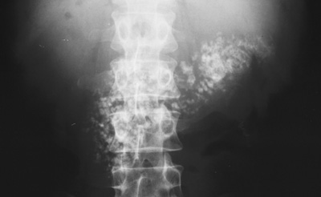
Investigation and diagnosis:
1. X-ray abdomen may show the scattered calcification in the area of pancreas.

Slide 35
2. CT scan abdomen : It may show the speckled calcifications typical of chronic pancreatitis , inflammatory changes , tumor , pancreatic duct dilatation or pseudocyst.
3. MRCP : to show the architecture of pancreatic duct , especially if surgery or endoscopic intervention is required.
4. Pancreatic endocrine function is assessed by measurement of fasting and postprandial blood glucose levels that may be supplemented by glucose tolerance test.
5. Pancreatic exocrine function can be assessed by measurement of fecal fat contents while the patient on fat controlled fat contents at 100g/day

Slide 36
Treatment
Conservative treatment
Pain relief
2. Alcohol abstinence
3. Exocrine replacement enzymes
4. Endocrine treatment with insulin or oral hypoglycemic drugs
5. Nutritional support

Slide 37
B. Endoscopic treatment
Pancreatic duct stenting is indicated sometimes when there is dominant pancreatic duct stricture or with disrupted pancreatic duct with pseudocyst or ascites formation.
C. Surgical treatment
Drainage or resective surgical intervention is indicated for :
1. intractable pain
2. Development of complications ( pseudocyst , compression of bile duct , duodenum ,portal vein or splenic vein that produce symptoms)
3. Tumor formation

Slide 38
Neoplasms of the pancreas

Slide 39
Neoplasms of endocrine pancreas
1. Insulinoma
2. Glucagonoma
3. Gastronome
4. VIPoma
Neoplasms of exocrine pancreas
Benign tumors
1. Serous cystadenoma
2. Mucinous cystadenoma
3. Intraductal papillary mucinous neoplasm (IPMN)
Malignant tumors
1. Ductal adenocarcinoma ( the commonest )
2. acinar adenocarcinoma
3. Mucinous cystadenocarcinoma
4. Intraductal papillary mucinous neoplasm
Note : periampullary tumor could originate from the head of pancreas , distal CBD ,or from the Ampullary mucosa of duodenum and commonly the patient present early with jaundice due to the early obstruction of CBD.

Slide 40
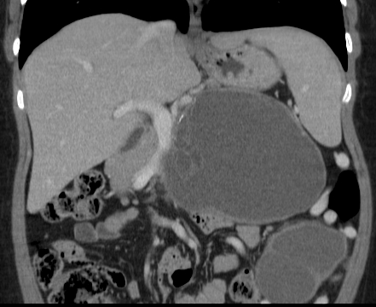
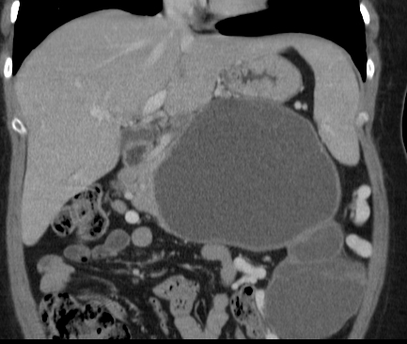
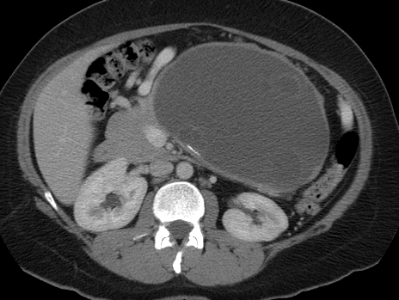
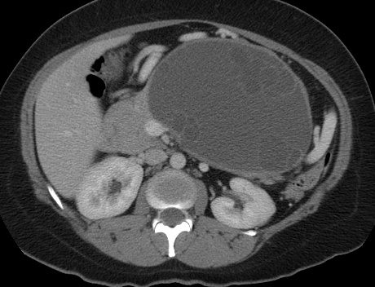
Mucinous Cystic Tumor

Slide 41
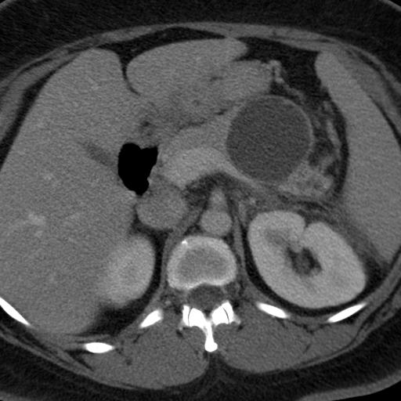
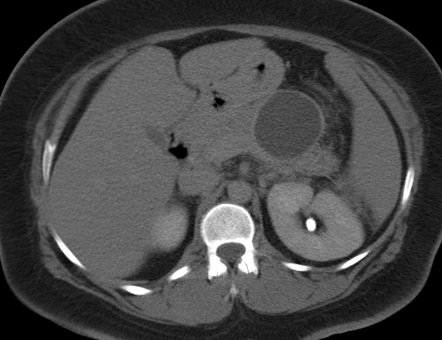
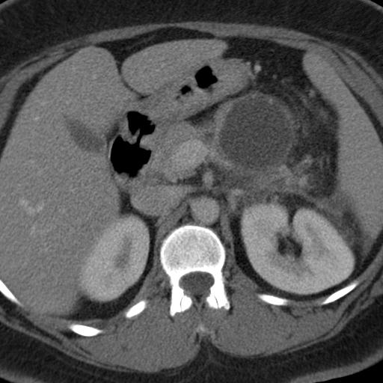
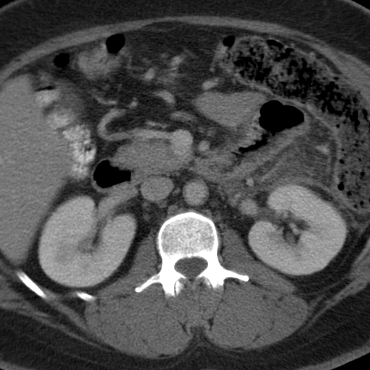
Mucinous Cystic Tumor

Slide 42
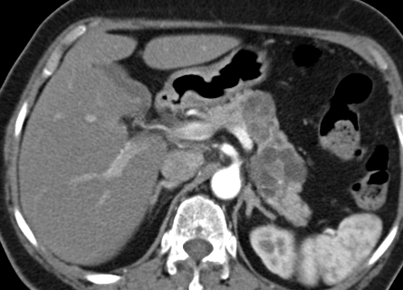
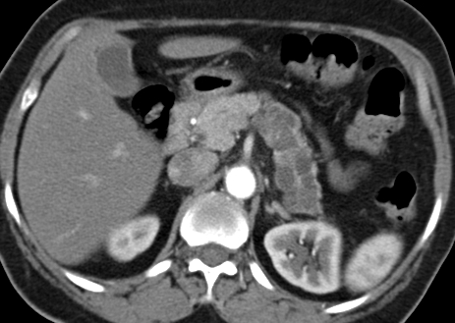
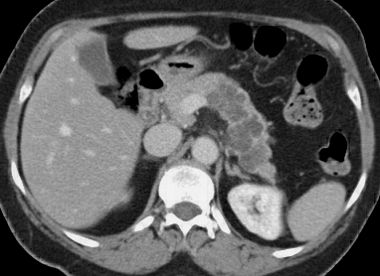
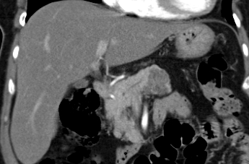
Serous Cystadenoma (Microcystic)

Slide 43

Intraductal Papillary Mucinous Neoplasms.
Older males.
Arise in the head and uncinate process of the pancreas, and they are typically connected to the ductal system of the pancreas.
IPMNs comprise lesions of the main pancreatic duct, side branches or a combination.
The prevalence of malignancy:
  lesions of the main-duct: 57–92%
  lesions of side-branch: 6–46%
Mixed features of microcystic and macrocystic lesions.
Main pancreatic duct is often dilated.
contain mucinous fluid which is sometimes extruding from the ampulla of Vater.

Slide 44
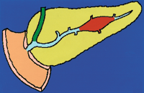

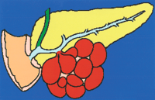
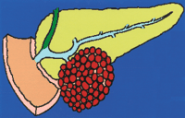
Intraductal Papillary Mucinous Tumor (IPMT)
Occurs in four forms:
    Main pancreatic duct: (1) Segmental
    (2) Diffuse.
    Branch duct: (3) Macrocystic
    (4) Microcystic.

Slide 45
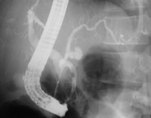
IPMT of the MPD
Segmental or diffuse.
Incidence M=F, Age: 6th decade.
Radiologic features mimic chronic pancreatitis or chronic obstructive pancreatitis.
ERCP remains the imaging modality of choice for diagnosis.

Slide 46
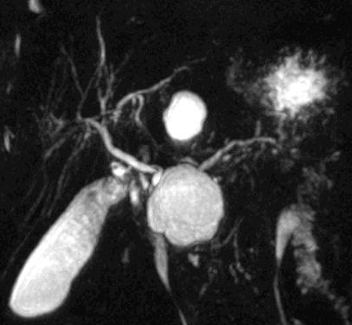
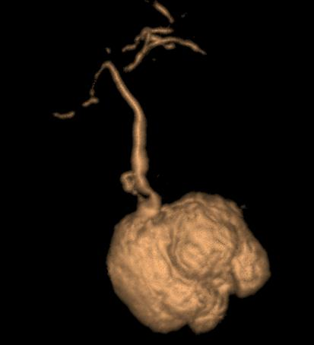
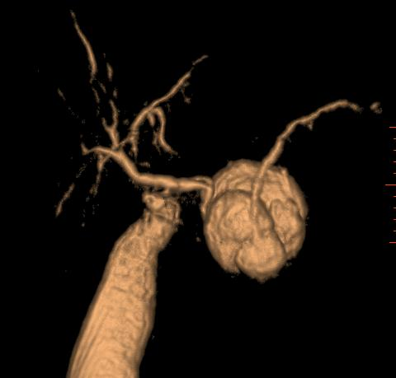
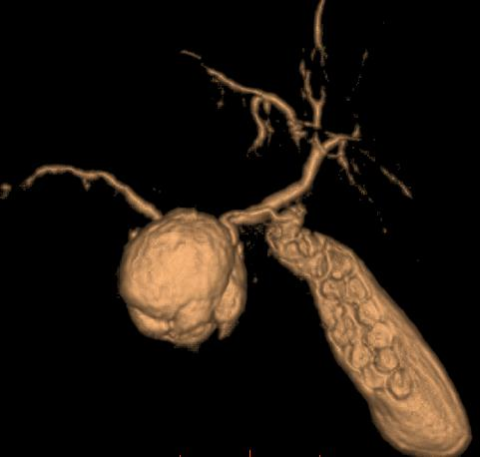

Slide 47
Management: Guidelines
The most recent guideline for the management of pancreatic cyst was published in 2007 (#).
Incidental cysts to be evaluated (MCN and IPMN premalignant).
The initial imaging test proposed is a CT scan, which may be followed by EUS-FNA in particular cases when FNA is needed for CEA level or to puncture a solid component.
Resection is recommended in all MCNs and main-duct IPMNs.
Firm recommendations for the management of branch-duct IPMNs are not provided.
Serous Cystadenomas should only be resected if symptomatic or if the diagnosis remains in doubt.
All pseudopapillary neoplasms should be considered for resection.
Interval follow up ??? No guidelines
# A. Khalid and W. Brugge, “ACG practice guidelines for the diagnosis and management of neoplastic pancreatic cysts,” American Journal of Gastroenterology, vol. 102, no. 10, pp.
2339–2349, 2007.

Slide 48
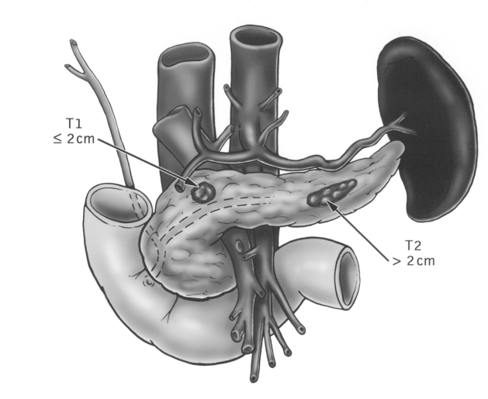
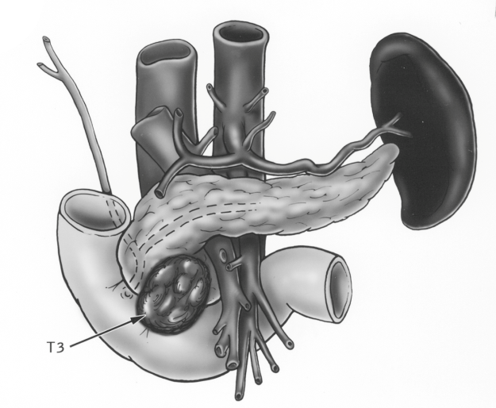
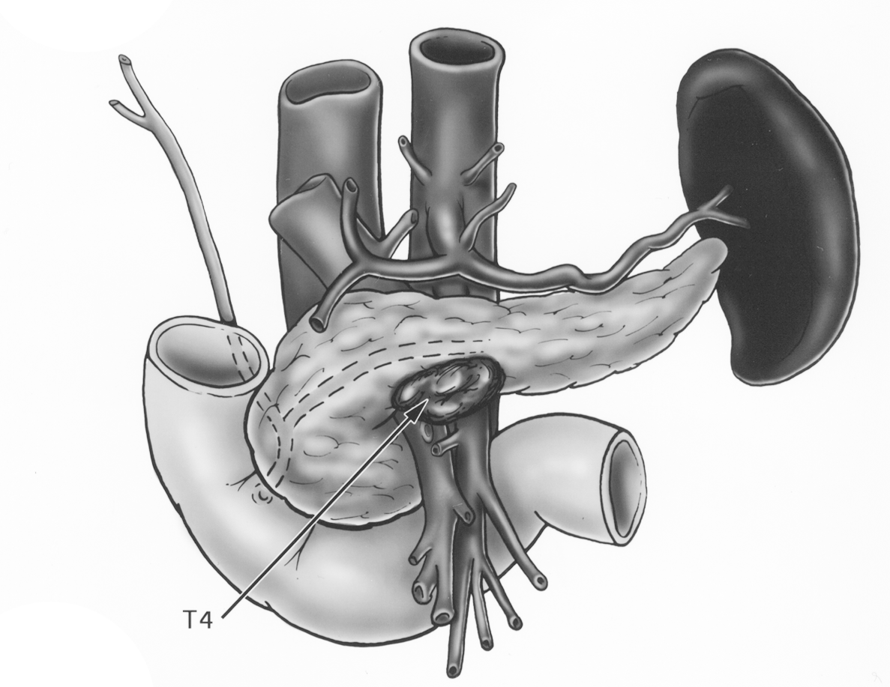
Pancreatic carcinoma
Tumor Staging according to the TNM System

Slide 49
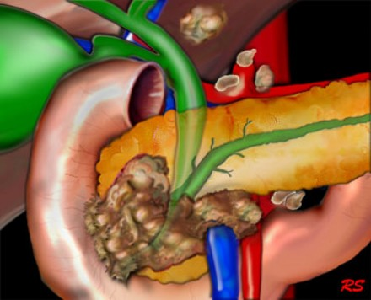
Periampullary tumor

Slide 50
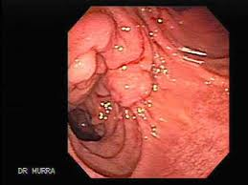
Periampullary tumor (endoscopic view )

Slide 51
Clinical features of pancreatic neoplasms
Presenting symptoms dependent on the site of the tumor within the pancreas.
1. Tumor in the head of pancreas : painless obstructive jaundice associated with weight loss is the classical presentation due to obstruction of the CBD. Obstruction of the flow of bile to the intestine will disrupt the enterohepatic circulation which results in dark urine and pale stool. Patient also may have intense itching. Gallbladder may become dilated and palpable ( Courvoisier's sign or law).
2. Tumor in the body and tail of pancreas : Biliary obstruction occur late , and symptoms are vague , with anorexia, weight loss , and with subsequent involvement of retroperitoneum , the development of back pain. New onset diabetes may predate the diagnosis. A late manifestation is a malignant-associated hypercoagulable state , resulting in intravascular clots with vasculitis , named thrombophlebitis migrans ( Trousseau's sign)

Slide 52
Investigations of pancreatic tumors
Laboratory tests : Liver function teste to confirm the cholestasis, tumor markers especially CA19-9 to help in diagnosis of malignant tumor of pancreas
Imaging
1. Ultrasound abdomen is the initial imaging which will show intra and extrahepatic biliary dilatation in jaundiced patient and will assess for gallstone.
2. CT scan and MRI can assess the site of the tumor in the pancreas and the evidence of metastases or local invasion by the tumor ( staging)
3. Upper gastrointestinal endoscopy and endoscopic ultrasound guidance can help in taking biopsy from the tumor

Slide 53
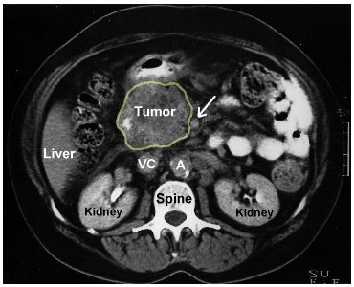
Tumor in the head of pancreas

Slide 54
Treatment
A. Curative treatment
Surgical resection currently offers the only potential for cure in pancreatic tumors. Tumors localized to the pancreatic parenchyma , or with limited involvement of peripancreatic fat or lymph nodes may be considered for resection
1. Tumor involving the head of pancreas treated by pancreaticoduodenectomy ( Whipple's procedure ) , which entails block resection of the head of pancreas , the distal half of the stomach , the duodenum , gallbladder and common bile duct.
2. Tumor involving the body or tail of pancreas removed by distal pancreatectomy and splenectomy.
3. Pruritus treatment with cholestyramine
4. Good operative risk patient may undergo triple bypass to relieve the obstructive jaundice and duodenal obstruction

Slide 55
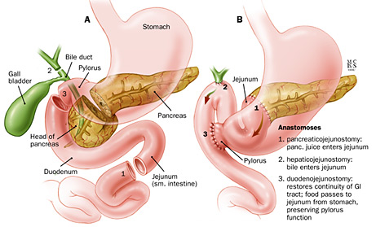
Whipple's procedure

Slide 56
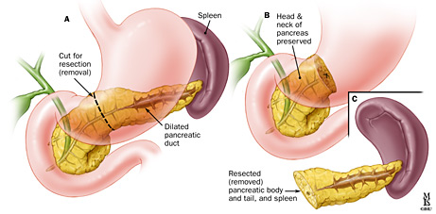
Distal pancreatectomy

Slide 57

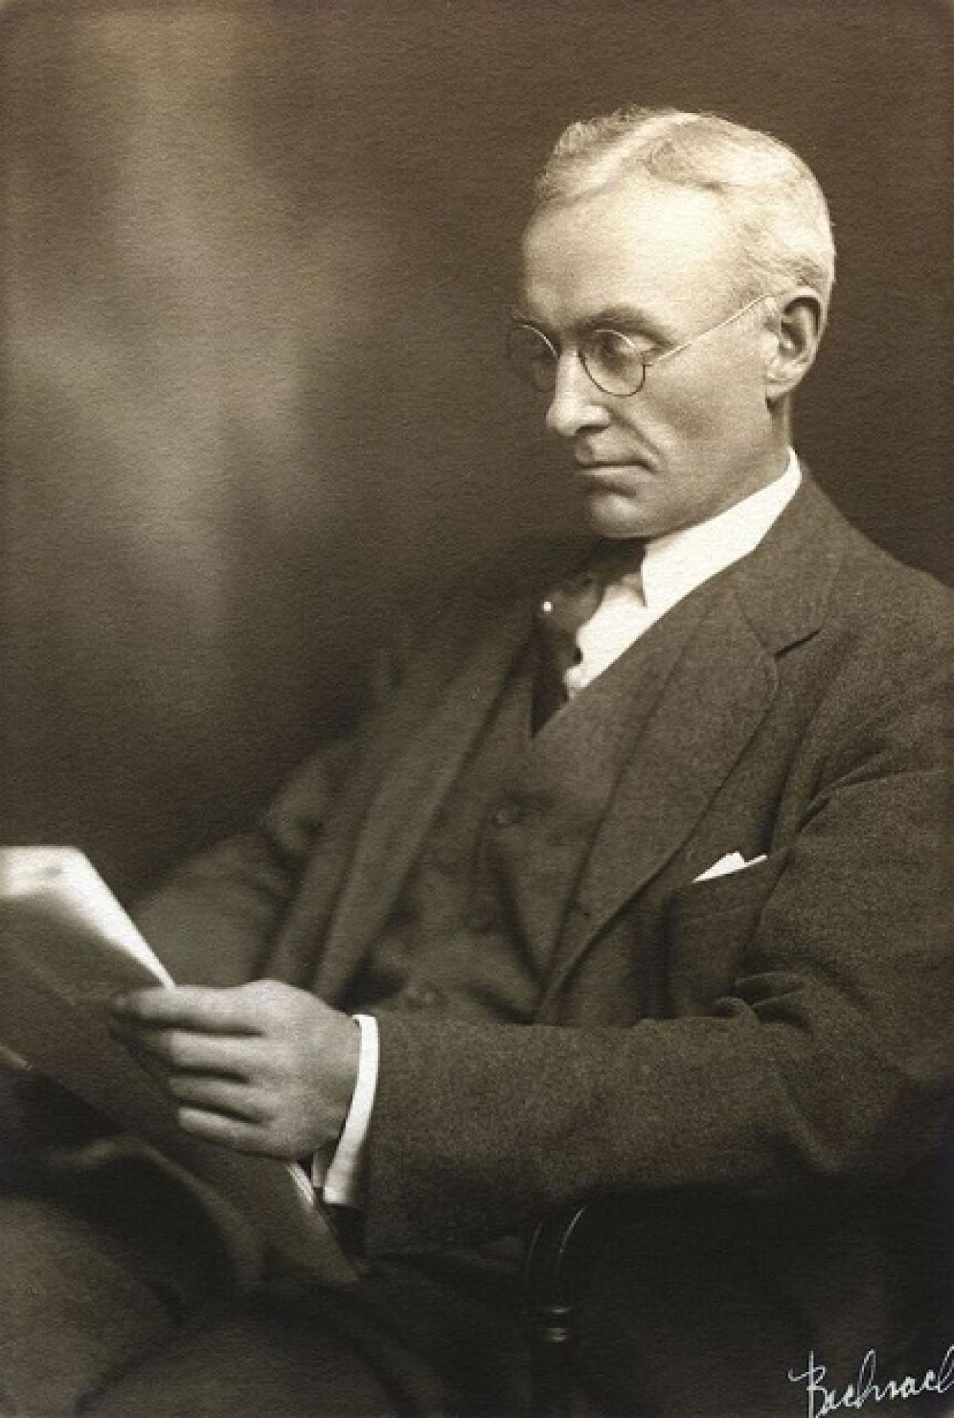
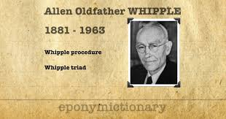

Slide 58
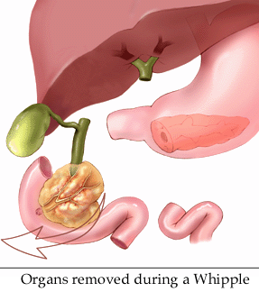
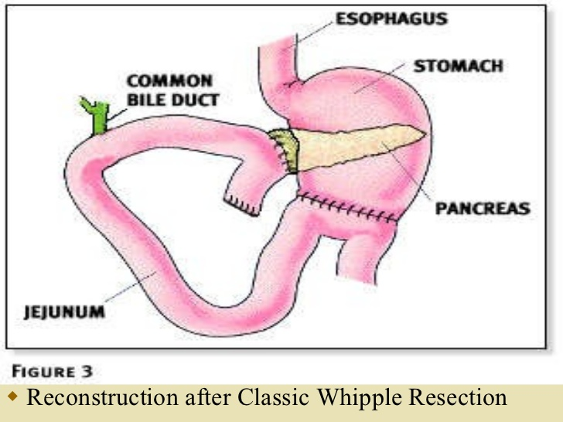

Slide 59
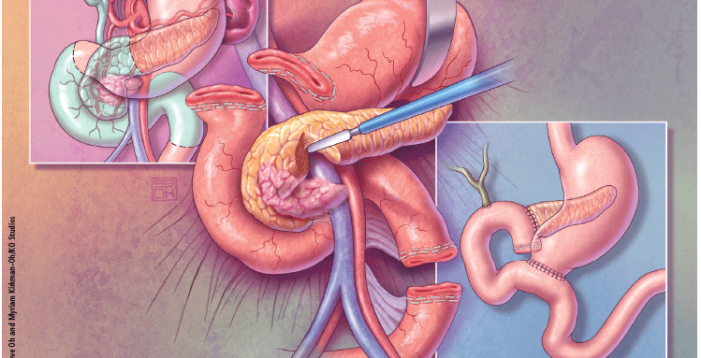

Slide 60
B. Palliative treatment
The aim is optimization of life in patient with non-resectable tumor. Such patients require histological diagnosis before starting any chemotherapy.
Obstructive jaundice : can be relieved by ERCP with biliary stenting
2. Pain relief with analgesia or splanchnic nerve block ( percutaneous , surgical or endoscopic ultrasound guidance).
3. Pruritus treatment with cholestyramine
4. Good operative risk patient may undergo triple bypass to relieve the obstructive jaundice and duodenal obstruction

Slide 61
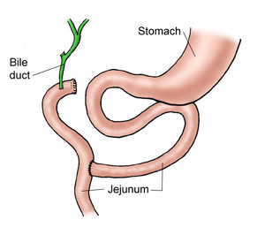
Triple bypass procedure

Slide 62
Prognosis of Ca head of Pancrease Based on people diagnosed with pancreatic cancer between 2009 and 2015.
SEER Stage 5-year Relative Survival Rate
Localized 37%
Regional 12%
Distant 3%
All SEER stages combined 9%
Neoadjuvant
Surgery
Neoadjuvant
FOLFIRINOX

Slide 63
THANK YOU

