Slide 1
Preoperative Preparation
& Postoperative Care
Omar Alaidaroos MSc, MD, FRCS
Associate Prof. of General Surgery

Slide 2
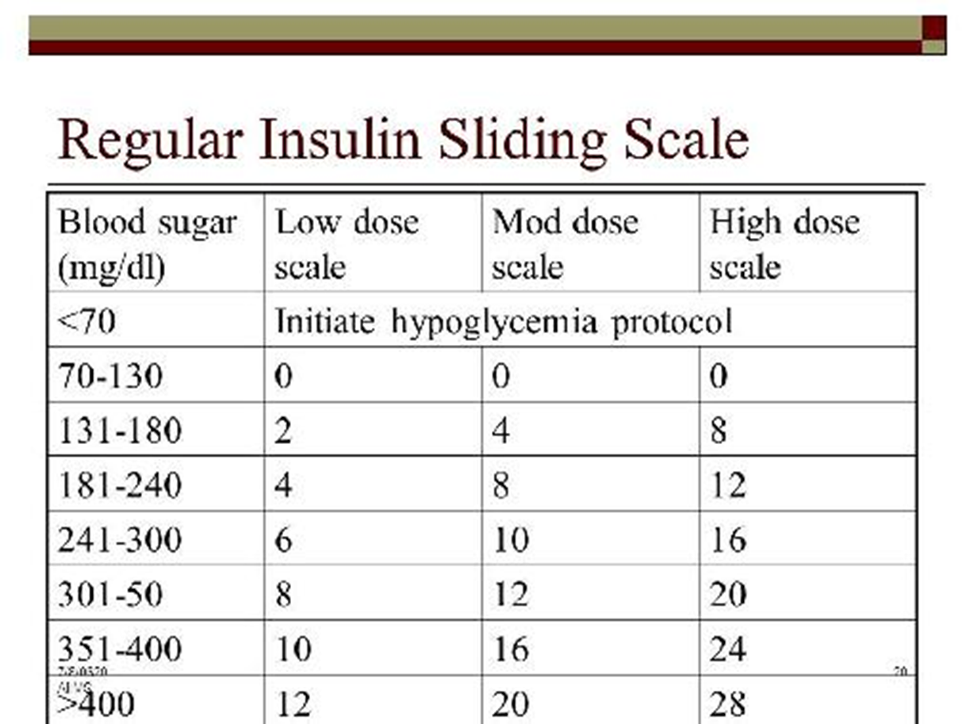
Patient History:
Explore the patient’s understanding of the need for surgery to be performed.
2. Ask about any previous surgeries and anaesthetics that the patient may have and how those procedures were tolerated
3. Ask about the patient’s family health history. Include any adverse reactions to anaesthesia, as malignant hyperthermia.
4. Ask about Co-morbidities:
A. Diabetics Patients:
Patients whose diabetes controlled by diet alone ,
nothing is needed other than preoperative
serum glucose monitoring.
Under long acting Oral Hypoglycaemic drugs
as Metformin should discontinue 2-3 days
to avoid intraoperative hypoglycaemia.
Under Insulin should receive one half or 2/3 of their
usual AM insulin dose, and then soluble insulin should be given on Sliding Scale based on finger stick monitoring.

Slide 3
B. Cardiovascular System
A. Ask about a history of dysrhythmias, chest pain, or myocardial infarction (heart attack, MI) because of the potential for re-infarction with surgery.
If had a heart attack more than 6 months, the risk of reinfarction is about 6%.
If the MI was between 3 and 6 months before a procedure, the risk increases to 15%.
If the surgery is within 3 months the risk increases to 30% with a 50% mortality!
Assess breath sounds and the lower extremities for signs of ﬂuid retention.
Listen for rales that do not clear with coughing, and for pitting oedema.
Both are a sign of symptomatic congestive heart failure, and surgery should postpone until the patient’s symptoms have been controlled.

Slide 4
C. Ask about hypertension, and if blood pressure is well controlled by medications.
Patients are generally encouraged to take their blood pressure medications on the morning of surgery with a sip of water to keep pressures under control.
Hypertension increases the risk for coronary artery disease, stroke, congestive heart failure, and renal failure.
If the hypertension is mild and controlled, the evaluation can take place up to 2 months before surgery.
If moderate, evaluation and clearance should be within 2 weeks.
If severe, surgery should be postponed with immediate evaluation and intervention.

Slide 5
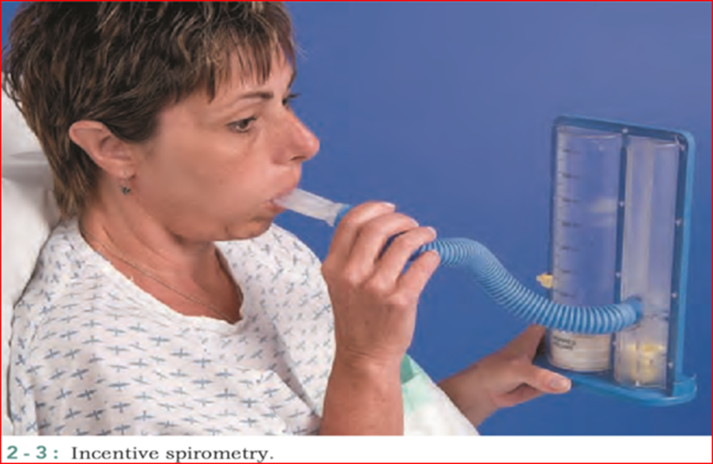
D. Respiratory diseases:
A. Ask about dyspnea both at rest and with exertion.
B. Ask about the presence of a cough, if productive a clue to an upper respiratory infection leads to cancellation of surgery.
A dry cough may be a side effect to the use of an angiotensin-converting enzyme (ACE) inhibitor medication used to treat hypertension.
C. Ask about a history of chronic obstructive pulmonary disease (COPD), and any current treatment including antibiotics, bronchodilators or nebulizer treatments, or use of home oxygen therapy.
The anaesthesia provider may give the patient a nebulizer treatment before induction.
D. Educate pt. about postoperative lung expansion manoeuvres as Incentive spirometry.

Slide 6
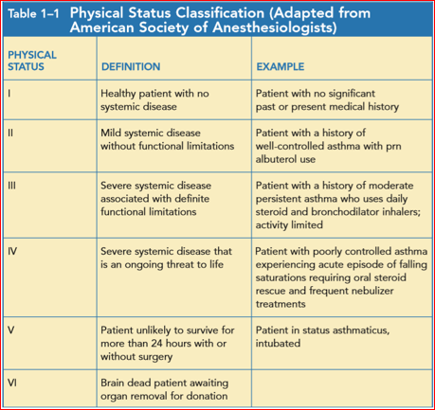
An E is added to the status number to designate an emergency operation

Slide 7
5. Ask about current medication use
A patient who takes aspirin, Coumadin, or ibuprofen is at an increased risk for bleeding.
Those who need Aspirin (antiplatelets) tightly as in mechanical heart valves , heparin can be given preoperatively.
Discontinue Coumadin 5 days preoperatively, start LMWH and check PT or INR on the day of surgery to make sure clotting studies are within normal limits before surgery.
The normal range for your PT results is: 11 to 13.5 seconds, INR of 0.8 to 1.1. PTT: 30 to 45 seconds.
Stop IV heparin 6 hours prior to surgery.
LMWH – should be stopped 12 h before surgery

Slide 8
Drugs to hold for at least 2 weeks preoperatively
Aspirin
MAO inhibitors (for Parkinson’s disease)
Oral central alpha agonists (e.g., methyldopa)
Oral contraceptive pills
Antirheumatic agents
Drugs to hold for 4–5 days preoperatively
NSAIDs, selective COX-2 inhibitors
Antiplatelets: Dipyridamole ( Persantine® ) .
Anticoagulants (e.g., warfarin,

Slide 9
Drugs to give on the morning of surgery: should be taken with a small sip of water only
Most cardiac meds (antiarrhythmics, digoxin, nitrates, beta-blockers)
calcium channel blockers
Pulmonary medications (e.g., inhalers, nebulizers)
Endocrine medications ( thyroid meds and corticosteroids)
Most GI medications (e.g., H2 blockers, PPIs)
Seizure medications (to avoid withdrawal)
Eye drops
Narcotics
Immunosuppressives

Slide 10
6. Ask about medication allergies and intolerances.
On the day of surgery, make sure that a red allergy identiﬁcation band is applied to the patient’s wrist. Ask about nondrug allergies, too.
6. Ask about illicit drug use, abuse, and addiction in the same way you asked about current medication use.
Once you explain to patients that there are drug interactions between these drugs and anaesthetic agents, patients will usually respond honestly.

Slide 11
7. Ask about tobacco use. Smokers also have a higher incidence of reactive airway disease, which may result in laryngospasm on induction.
Encourage patients to stop smoking a minimum of 8 weeks before surgery.
Cessation for 2 weeks will improve the level of carbon monoxide but secretion still a problem
8. Ask about the possibility of pregnancy, speciﬁcally to determine the date of the patient’s last menstrual period.
This is needed to prevent unnecessary exposure of the foetus to anaesthetic agents, particularly during the ﬁrst trimester of pregnancy.
Menstruation is not a contraindication; the operation need not be postponed.

Slide 12
Preoperative Preparation of the Surgical Patient in Ward
Review the patient's history and physical examination, and write a preoperative note assessing the patient's overall condition and operative risk.
2. Preoperative laboratory evaluation: Electrolytes, BUN, creatinine, INR/PTT, CBC, platelet count, UA, ABG, pulmonary function test. Chest x-ray (>35 yrs old), EKG (if older then 35 yrs old or if cardiovascular disease).
3. Type and cross for an appropriate number of units of blood.
4. Frequency of vital signs; input and output recording; neurological or vascular checks. Notify physician if blood pressure <90/60, >160/110; pulse >110; pulse <60; temperature >101.5; urine output <35 cc/h for >2 hours; respiratory rate >30.

Slide 13
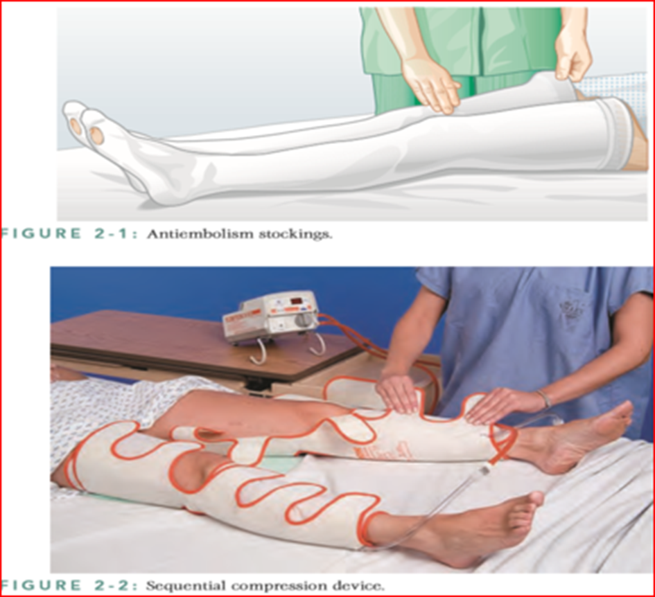
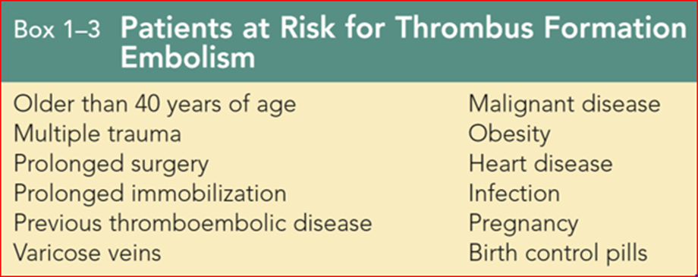
5. Skin preparation:
Patient to shower and scrub the operative site with germicidal soap (Hibiclens) on the night before surgery.
On the day of surgery, If hair must be removed, it should be clipped in the operating room.
6. Prophylactic antibiotics if indicated.
7. Preoperative incentive spirometry on the evening prior to surgery may be indicated for patients with pulmonary disease.
8. Thromboembolic prophylaxis should be provided for selected, high-risk patients

Slide 14
9. Bowel preparation Bowel preparation
Is required for upper or lower GI tract procedures.
Mechanical Prep:
Day 1: Clear liquid diet, laxative (milk of magnesia 30 cc or magnesium citrate 250 cc), tap water or Fleet enemas until clear.
Day 2: Clear liquid diet, NPO, laxative.
Day 3: Operation.
Oral Antibiotic Prep:
One day prior to surgery, after mechanical or whole gut lavage, give neomycin 1 gm and erythromycin 250 mg at 1 p.m., 2 p.m., 11 p.m.

Slide 15
10. Removal of cosmetics, contact lenses, dentures, etc.
11. Diet: NPO after midnight.
9. IV and monitoring lines: At least one 18-gauge IV for initiation of anaesthesia.
IV Orders: D5 1/2 NS at 100 cc/hour.
Oxygen: 6 L/min by nasal canula.

Slide 16
Ingested material Minimum fasting period (hr)
Clear liquids 2
Breast milk 4
Infant formula 6
Nonhuman milk 6
Light meal (toast and clear liquids) 6
Fasting Recommendation

Slide 17
BEDTIME PREANESTHETIC MEDICATION: Preoperative sedation can be given as ordered by anaesthesiologist.
SPECIAL ORDERS
- BLOOD TRANSFUTION
- VENOUS ACCESS HEMODYNAMIC MONITORING
- NG TUBE
- BLADDER CATHETER
- PREOPERATIVE HYDRATION

Slide 18
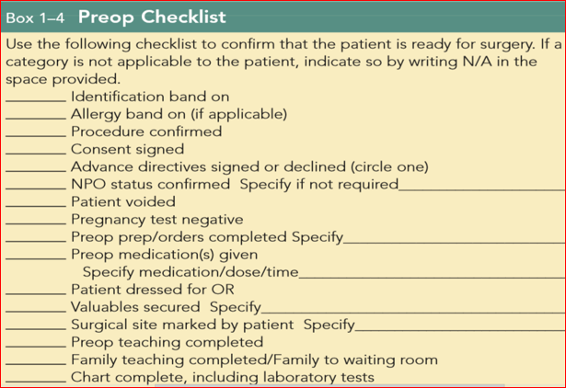

Slide 19
Postoperative Orders
Transfer: From recovery room to surgical ward when stable.
Vital Signs: q4h, I&O q4h x 24h.
Activity: Bed rest; ambulate in 6-8 hours if appropriate. Incentive spirometer q1h while awake.
Diet: NPO x 8h, then sips of water. Advance from clear liquids to regular diet as tolerated.
IV Fluids: IV D5 LR or D5 1/2 NS at 125 cc/h (KCL, 20 mEq/L if indicated).
Medications:

Slide 20
Postoperative day number 1
A. Assess the patient’s level of pain, lungs, cardiac status, flatulence, and bowel movement. Examine for distension, tenderness, bowel sounds; wound drainage, bleeding from incision.
B. Discontinue IV infusion when taking adequate PO fluids. Discontinue Foley catheter, and use in-and out catheterization for urinary retention.
C. Ambulate as tolerated; incentive spirometer.
D. Consider prophylaxis for deep vein thrombosis

Slide 21
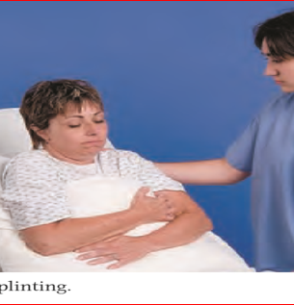
For patients with limited mobility Encourage:
Incentive spirometry promote deep breathing, increase lung volume.
B. Coughing to clear mucus from the airway.
C. Promote deep breathing by teaching the patient to “splint” the chest and abdomen with a pillow when coughing or forcibly exhaling, by squeeze the pillow tightly against the abdomen or chest as a means of decreasing pain.
A ﬁnal step in the prevention of atelectasis and pneumonia is progressive and early ambulation.

Slide 22
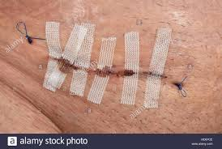
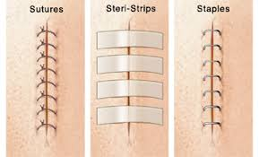
Postoperative day number 2
If passing gas or if bowel movement, advance to regular diet unless bowel resection.
Laxatives: Dulcolax or Glycerin suppository prn or Fleet enema prn or milk of magnesia, 30 cc PO prn constipation.
Postoperative day number 3-7
A. Check pathology report.
B. Remove staples and place steri-strips.
C. Consider discharge home on appropriate medications; follow up in 1-2 weeks for removal of sutures.
D. Write discharge orders (including prescriptions)

Slide 23
GENERAL COMPLICATIONS:
1 IMPAIRED CONCIOUSNESS
2 POSTOPERATIVE PYREXIA
First 48hrs
  Atelectasis
  Transfusion rxn
  Pre-existing infection
3-7 days: infections
UTI, wound infection, pneumonia, anastomotic leakage
7 days onwards
  Infections
  Abscess formation
  DVT/PE

Slide 24
GASTROINTESTINAL COMPLICATION:
POSTOPERATIVE ILEUS
PROLONG ILEUS AND INTESTINAL OBSTRUCTION
GASTRIC DILATATION
POSTOPERATIVE FECAL IMPACTION
POSTOPERATIVE DIARRHEA
POSTOPERATION PAROTITIS: Acute bacterial suppurative parotitis is caused most commonly by Staphylococcus aureus and mixed oral aerobes and/or anaerobes. It often occurs in the setting of debilitation, dehydration, and poor oral hygiene, particularly among elderly postoperative patients.

Slide 25
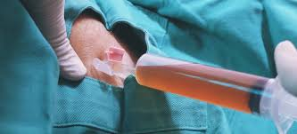
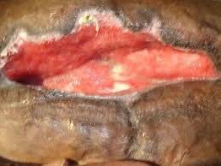
URINARY COMPLICATIONS:
POSTOPERATIVE URINARY RETENSION
URINARY TRACT INFECTION
WOUND COMPLICATIONS:
HEMATOMA
SEROMA
WOUND DEHISCENCE
WOUND INFECTION

Slide 26
Risk factors in wound dehiscence
General
● Malnourishment
● Diabetes
● Obesity
● Renal failure
● Jaundice
● Sepsis
● Cancer
● Treatment with steroids
● Emergency surgery
Local
● Inadequate or poor closure of wound or closure of a wound under tension
● Poor local wound healing, e.g. because of infection, haematoma or seroma
● Increased intra-abdominal pressure, e.g. in postoperative patients with chronic obstructive
airway disease, during excessive coughing

Slide 27
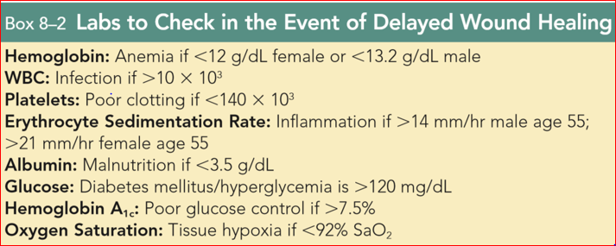

Slide 28
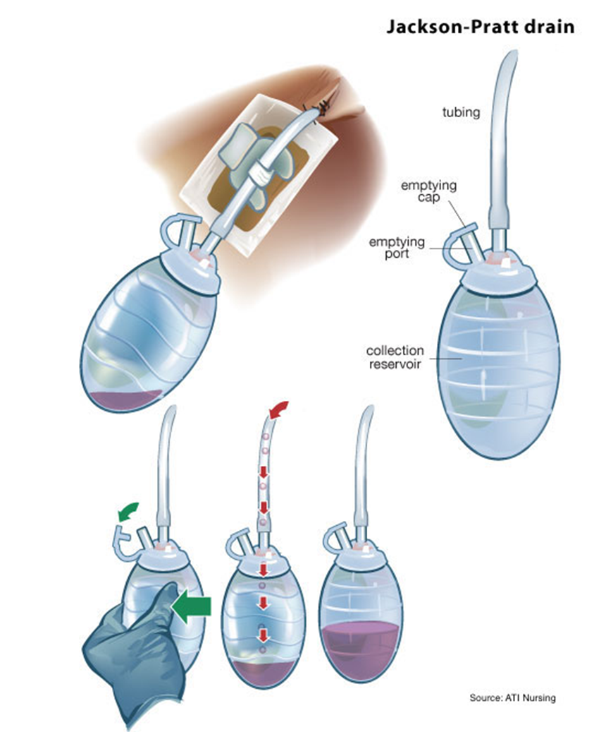
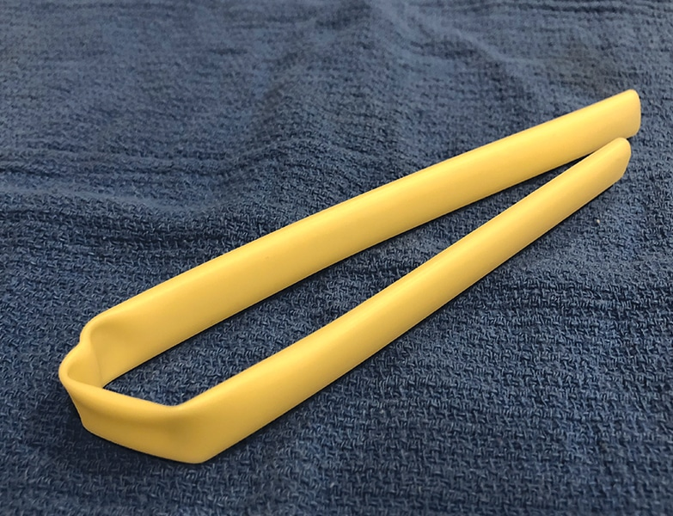
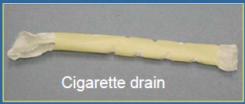
SURGICAL DRAINS
Passive drain
gauze drain
Penrose drain
Cigarette drain
Active drain
Sump drain
Jackson Pratt drain
Radivac drain

Slide 29
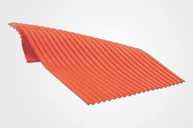
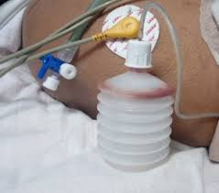
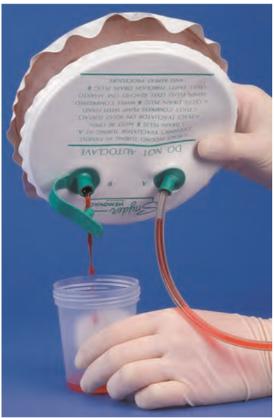

Corrugated Rubber Drain
Closed Suction Drain

Slide 30


THANKS

