Slide 1


Slide 2
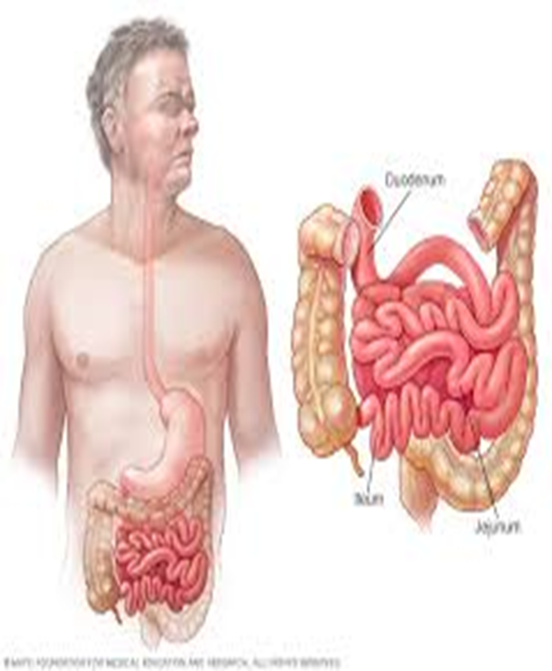
Surgical Diseases of Small Bowel
Omar Alaidaroos MSc, MD
Associate Prof. of General Surgery

Slide 3
Objectives
Introduction
Bowel obstruction
Paralytic Ileus
Meckel’s diverticulum
Mesenteric ischemia
Crohn’s disease
Small bowel tumors
Benign
Malignant

Slide 4
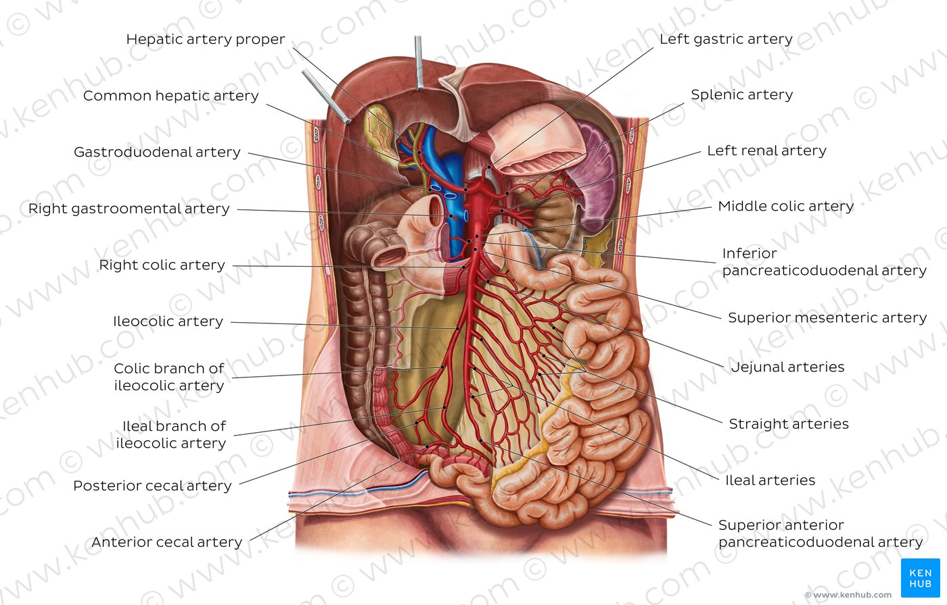
Anatomy
Small bowel extends from the pylorus to the ileocaecal junction.
2.75 -10.49 m long, & 2.5–3 cm in diameter.
The surface area of its mucosa is 30 square meter
It receives blood supply from the coeliac trunk, & superior mesenteric artery

Slide 5
3 distinct regions – the duodenum, jejunum, & ileum.
Ileocecal sphincter – Transition between small and large intestine

Slide 6
Duodenum:
  Shortest part (20-25 cm) in length, & preparation for absorption begins.
  Shaped like a "C". It surrounds the head of the pancreas.
  It has 4 parts
  Receives bile through CBD, and pancreatic juice through
  the pancreatic duct, controlled by the sphincter of Odd
  It has Bruner’s glands, which empty into the intestinal glands, secrete an alkaline fluid composed of mucin, which exerts a physiologic anti-acid function by coating the duodenal epithelium, therefore protecting it from the acid chyme of the stomach.

Slide 7
Jejunum :
  Is the midsection of the small bowel, connecting the duodenum to the ileum.
  It is about 2.5 m long
  Contains the plicae circulares, & villi that increase its surface area.
  The suspensory muscle of the duodenum
  marks the division between the duodenum
  and the jejunum.

Slide 8
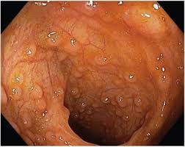
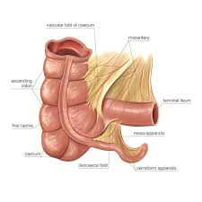
Ileum:
  It is about 3 m long and contains villi like the jejunum.
  It has Peyer's patches (Aggregated lymphoid nodules)
  It joins to the cecum of the large bowel at the ileocecal junction

Slide 9
Function:
Chemical digestion
Absorption of nutrients, & minerals from food, using small finger-like protrusions called villi.
(sugars, amino acids, and fatty acids)
Absorbed in Duodenum → Fe, Ca++, B2, B6.
Absorbed in Jejunum → B1 & B9.
Absorbed in TI → B12, bile salts, Vits ADEK

Slide 10
Diseases of small bowel
Bowel obstruction
Mechanical vs. adynamic
Acute vs. chronic
Open V s Closed
Partial vs. complete

Slide 11
Intestinal Obstruction
Dynamic: where peristalsis is working against a mechanical obstruction.
Adynamic: mechanical element is absent
- Peristalsis my be absent(paralytic ileus)
-May be present in non propulsive form. (mesenteric vascular occlusion or pseudo-obstruction)

Slide 12
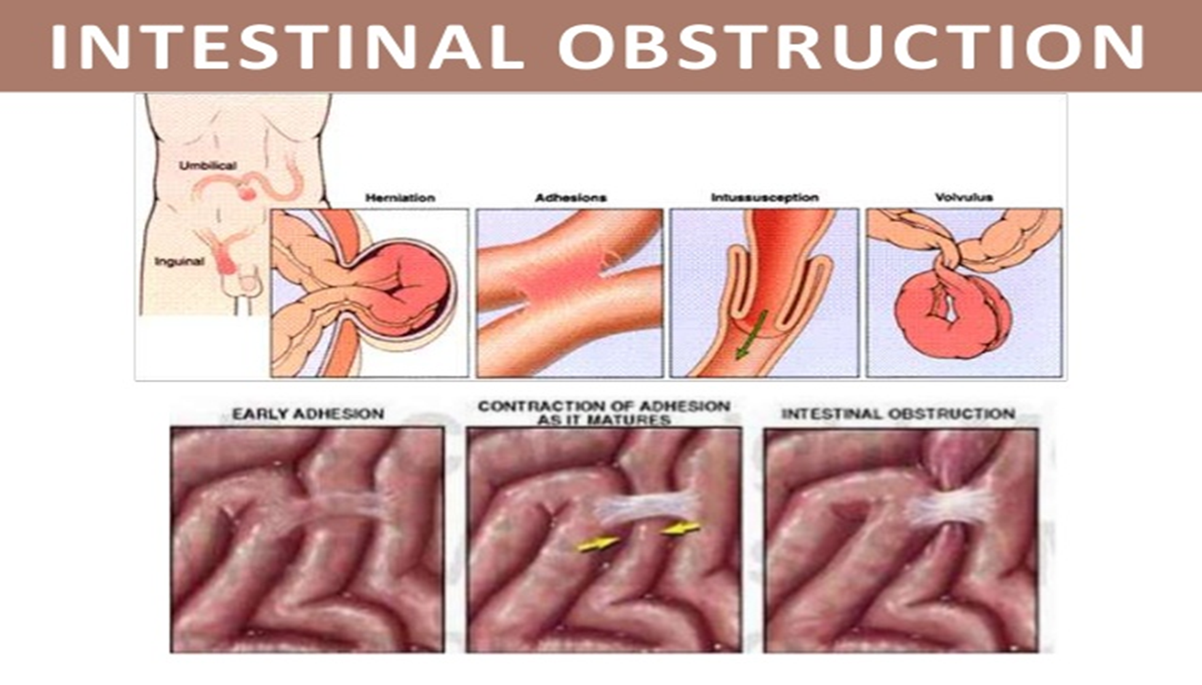
Mechanical Obstruction
1.Intraluminal: impacted faeces, foreign bodies, gallstones, Bezoars.
2.Intramural: tumors, inflammatory strictures,
3.Extramural: adhesion, hernias, volvulus, intussusception, tumors

Slide 13
Acute obstruction:-
Usually in small bowel
Obstruction with severe colicky central abdominal pain, distension, early vomitting and constipation.
Chronic obstruction: -
Usually in large bowel
Lower abdominal colic & obstipation followed by distension.
Acute on chronic:
Short history of distension & vomiting against background of pain & constipation.
Subacute obstruction : incomplete obstruction.

Slide 14
Simple: Blockage without interfering with vascular supply
Strangulation:
Significant impairment of blood supply
Most commonly associated with hernia, volvulus, intussusception, mesentric infarction, adhesions/ Bands
Surgical emergency
Closed loop obstruction: Bowel is obstructed at both the proximal and distal end.
Band adhesion causing a closed-loop obstruction.

Slide 15
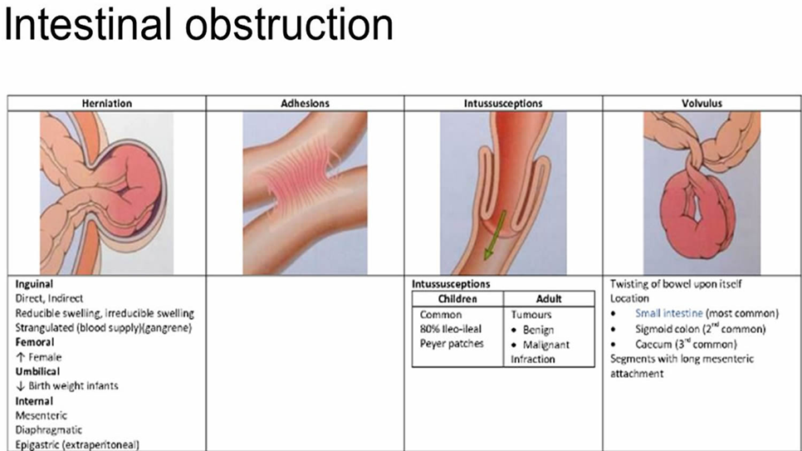
Causes of
Adhesions- 40%
Tumors -15%
Inflammatory- 15%
Obstructed hernia-12%
Intraluminal-10%
Miscellaneous -8%

Slide 16
Pathophysiology
Proximal to obstruction
Increased fluid secretion → abdominal distention
Accumulation of gas → abdominal distention
Increased intraluminal pressure
Vomiting
Dehydration
Dilatation of bowel
Reflex contraction of smooth muscle → colicky pain
Increased peristalsis to overcome obstruction → increased bowel sounds
If obstruction not overcome → bowel atony
Decreased reabsorption with time and flaccidity to prevent vascular damage from high pressure
Distal to obstruction: nothing is passed & bowel collapse → constipation

Slide 17
Colicky abdominal pain
Vomiting
Abdominal distension – increases as the condition progresses
Absolute constipation (Obstipation): absence of flatus and stool
Proximal small-bowel obstruction:
  less distention and more rapid onset of vomiting.
  Bilious vomiting
Distal small bowel obstruction:
  central abdominal distention
  vomiting (feaculent) is a late feature (because the bowel takes time to fill)
In strangulation:
severe constant abdominal pain
fever
tachycardia
tenderness with rigidity/rebound
tenderness.
shock

Slide 18
General examination
Early stage:
  Normal vitals
  Hyperactive bowel sounds
Late stage:
Vital signs
Signs of dehydration –tachycardia, hypotension
dry mucus membrane, decreased skin turgor, decreased urine output
Inspection
distension, scars, peristalsis, masses, hernial orifices
Dilated loops of bowel may be palpable
Palpation
tenderness, masses, rigidity
Percussion
tympanitic abdomen
Auscultation
high pitched bowel sound associated with peristalsis and cramp pain
or silent abdomen
*Examine rectum for mass, blood, feces or it may be empty in case of complete obstruction

Slide 19
Investigations
Full blood count (WBC, Hb, Hct), High WBC (neutrophilia with strangulation)
Electrolytes ( Hypovolemic hypochloremic hypokalemic alkalosis)
Hyper kalemia, hyperamylasemia & raised LDH may be associated with stangulation.
BUN, & creatinine levels: If increased, may indicate decreased volume state (e.g, dehydration).
Abdominal X-ray, at least 2 images (Supine & Erect)
Small bowel follow-through
CT abdomen with contrast (Triple)
Scopes (OGD/Colonoscopy)

Slide 20
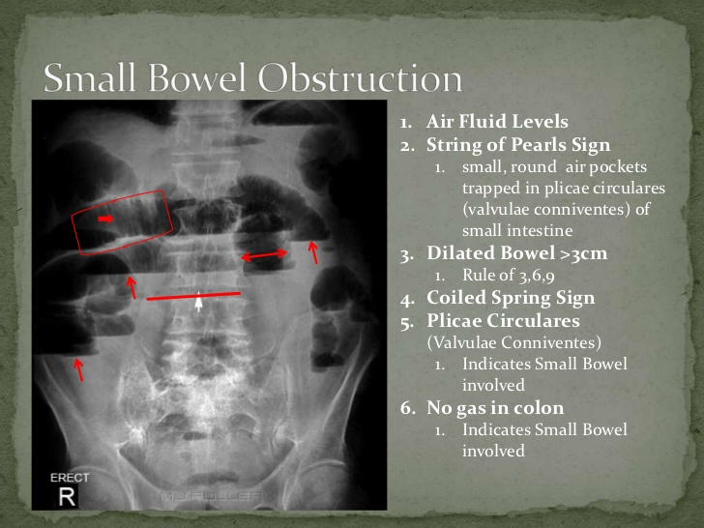
Notes:
The 3-6-9 rule is describing the normal bowel calibre:
small bowel: <3 cm
large bowel: <6 cm
appendix: <6 mm
caecum: <9 cm

Slide 21
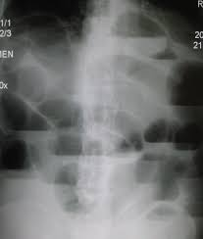
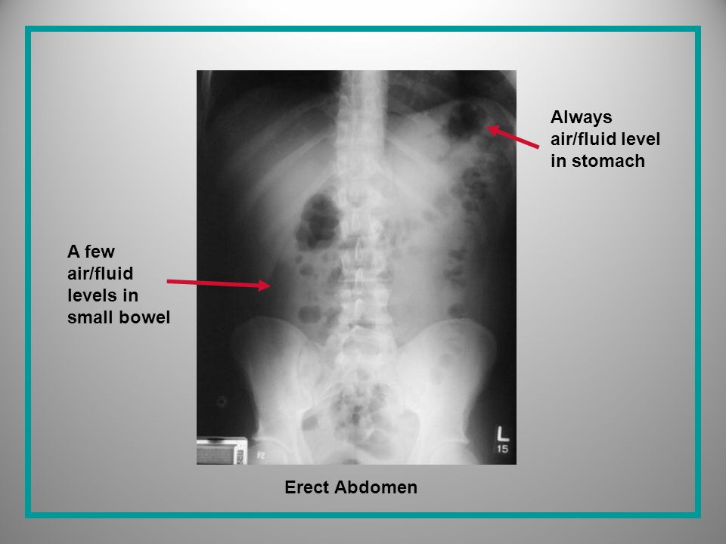

Slide 22
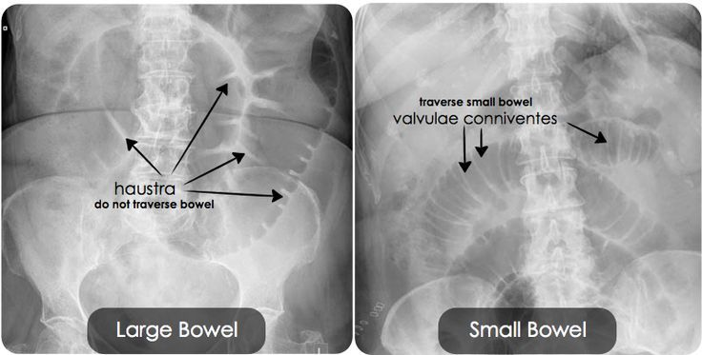

Slide 23
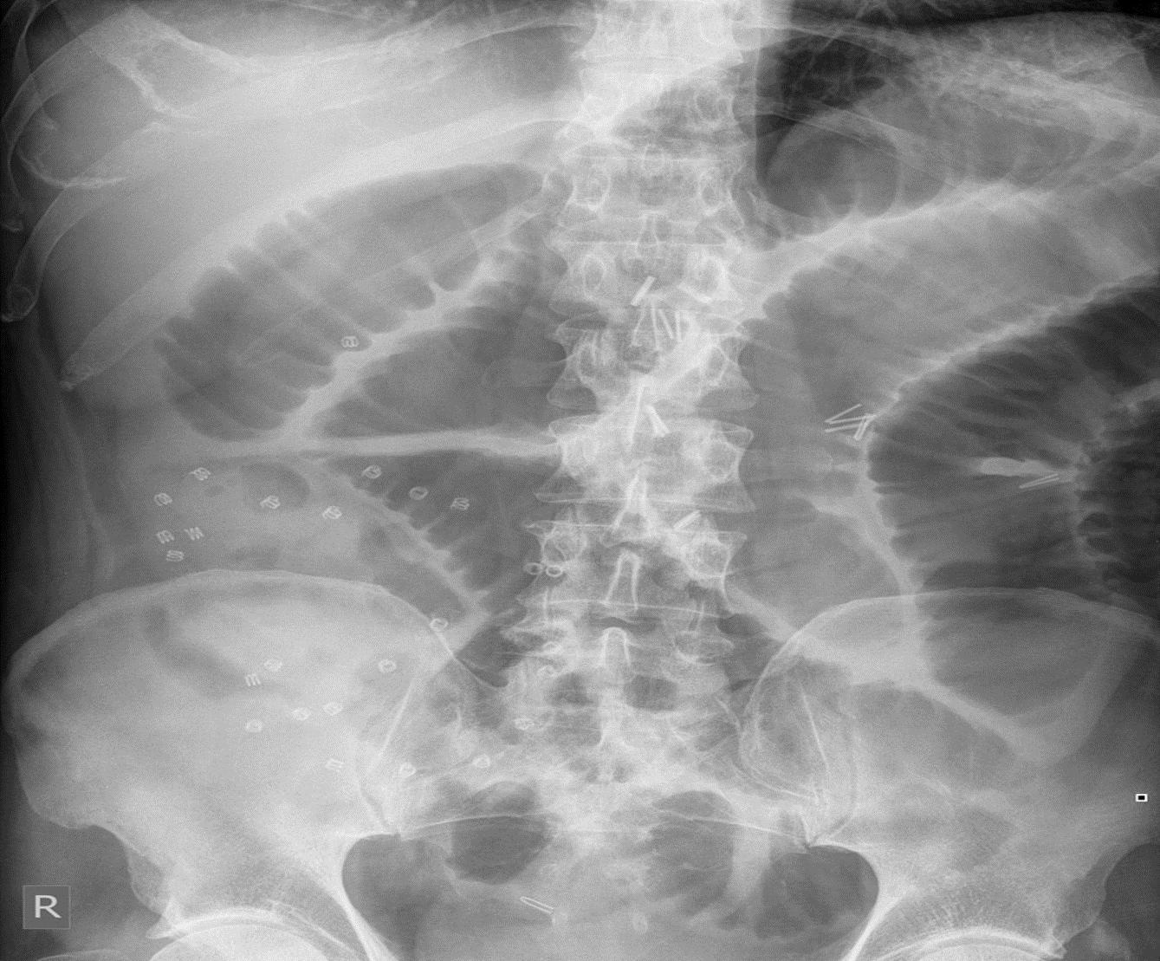
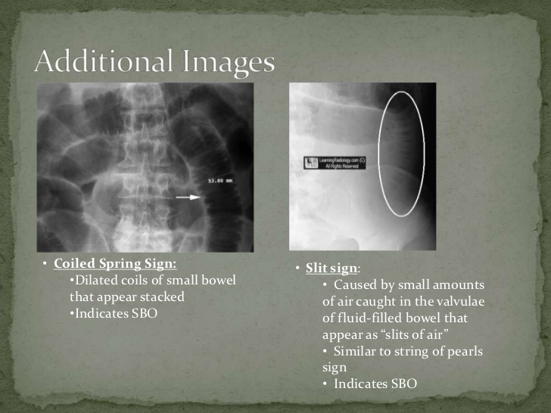

Slide 24
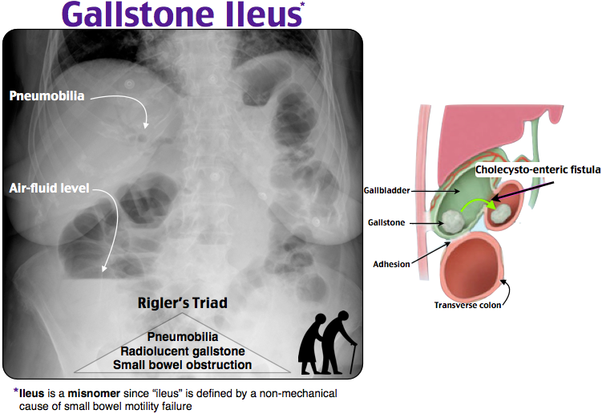

Slide 25
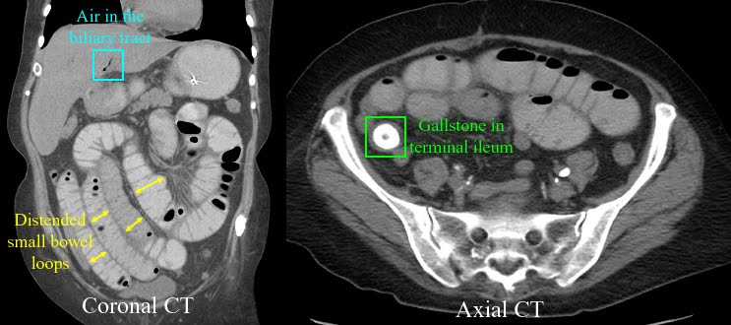
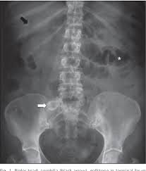
Rigler triad in gallstone ileus

Slide 26
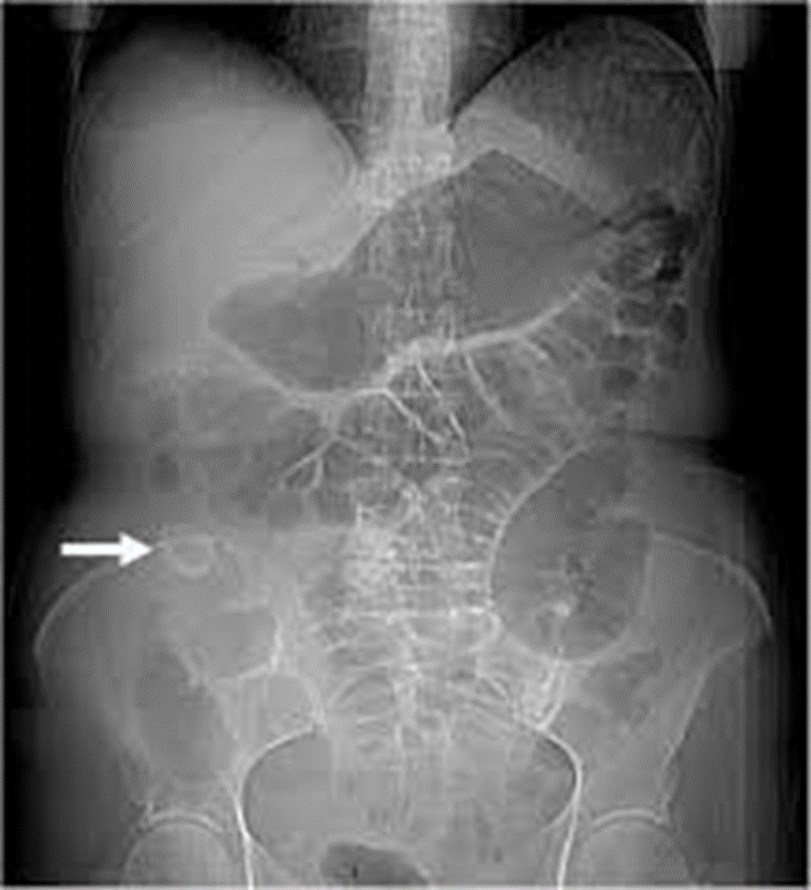
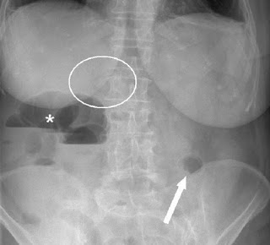
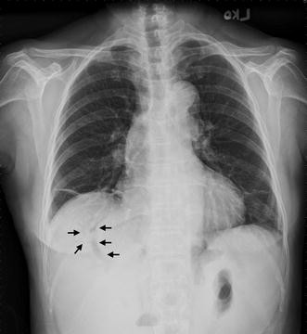
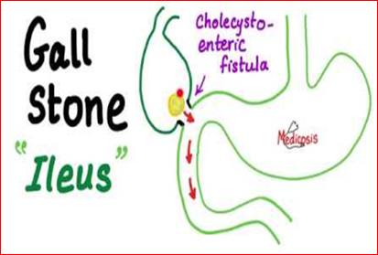

Slide 27
Management
Starts ABC
Supportive measures:
  Nil By Mouth
  Intake- output charts
  IV lines, and rehydration (IV crystalloid with K⁺)
  Foley's catheter
  NG Tube to aspirate content for ‘decompression’
  TED stockings, DVT prophylaxis
  Antibiotics
  Antiemetics
  Analgesia
  Might needs ICU
  Obstruction due to adhesion rarely need surgery

Slide 28
Indication for surgery:
- Virgin abdomen. (No previous surgery)
- failure of conservative management
- tender, irreducible hernia
- strangulation, peritonitis
Surgery:
Assess bowel viability
Treat the cause
- Adhesions…. Adhesiolysis
- Mass…… Resection
- Hernia…… Repair
- Etc.

Slide 29
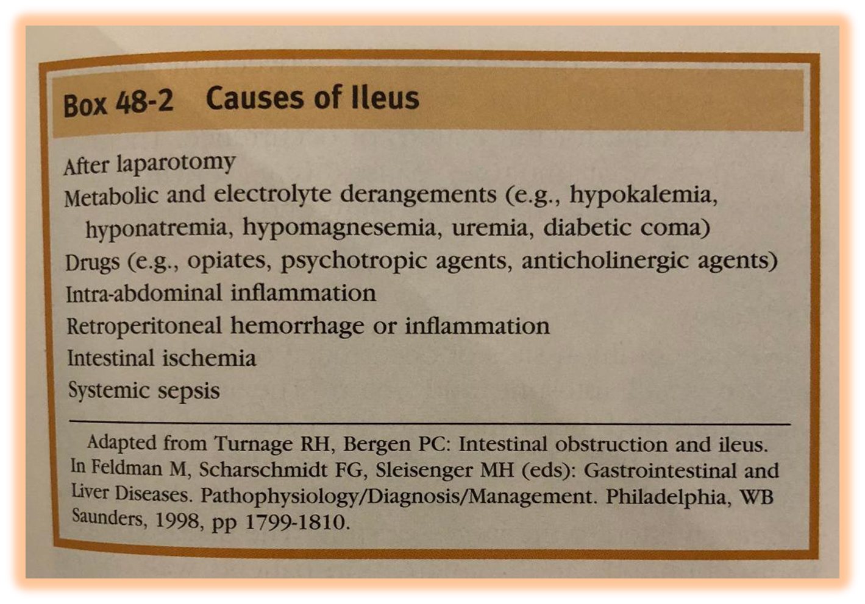
Paralytic Ileus
This is a ‘disordered neuromuscular transmission’ within the myenteric plexus
Normally, the different parts of the bowel take different amounts of time to start working properly again (e.g., peristalsis and digestion):
  Stomach: up to 24 hours
  Small bowel <24 hours
  Large bowel 24-48 hours
  Longer than this can indicate ileus
Usually treated conservatively
Towards causes, optimize patient condition
Distinguishing mechanical small bowel obstruction
and paralytic ileus may be difficult:
  Both show distended bowel on x-ray
  Both can present with constipation
  Bowel sounds are absent in ileus

Slide 30
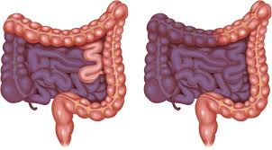
Mesenteric ischemia
Arterial or Venous
Acute or Chronic
Symptoms:
  Non-specific
  Severe abdominal pain out of proportion to the degree of abd. tenderness
  Diarrhoea (watery, bloody)
  Acute: Sudden abdominal pain, passage of altered blood, shock.
  Chronic: Abdominal angina, “food-fear”, weight loss or diarrhoea.
Signs:
  Abdominal tenderness
  Guarding
  Rigidity
Symptoms are out of proportion to signs

Slide 31
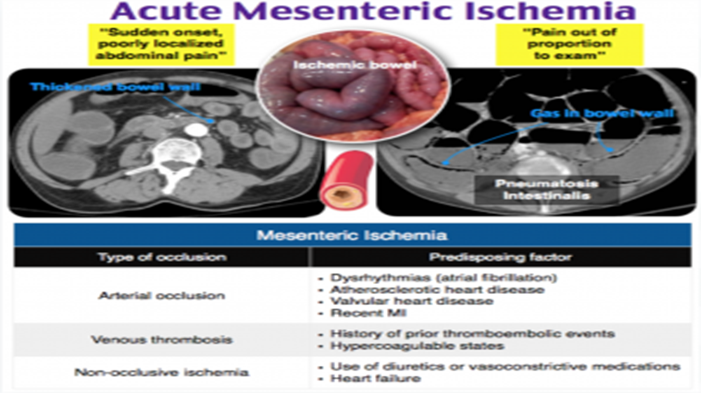
Predisposing factors:
  Thrombophilia
  Hyper-viscosity
  Gut hypo-perfusion
  Shock (hypovolemic- cardiogenic-septic)
  Cardiac arrhythmia
  Causes:
    Arterial:
      Arterial embolus : (most common-50%; heart; usually lodge distal to origin of the middle colic
      Recent MI- Atrial fib
      Polycythemia- SCD- DIC
      Arterial thrombosis
    Venous thrombosis : (5-15%) and 95% SMV
    Vasospasm (non-occlusive mesenteric ischemia – NOMI):
      usually in critically-ill pt.
      Receiving vasopressors.

Slide 32
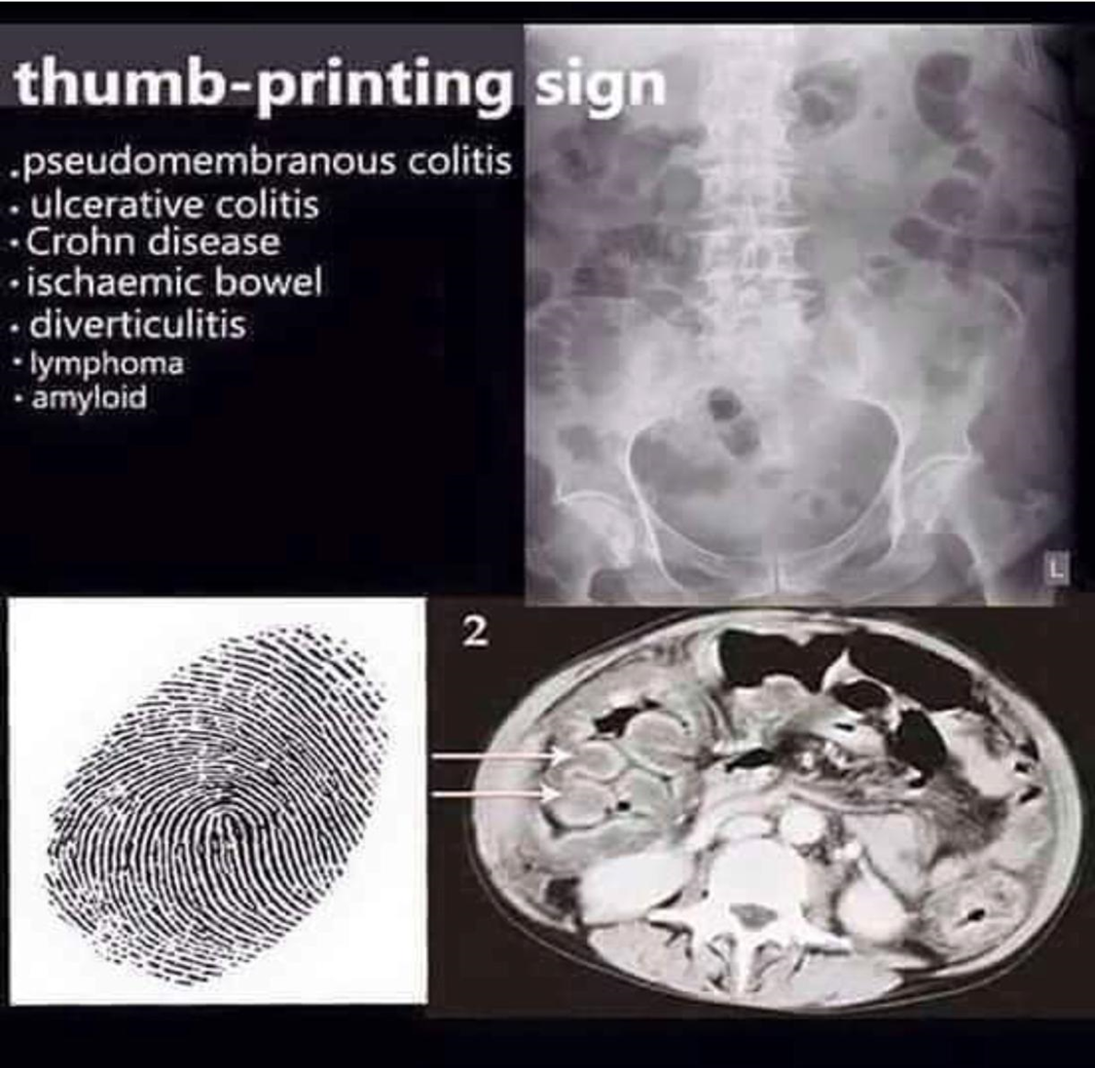
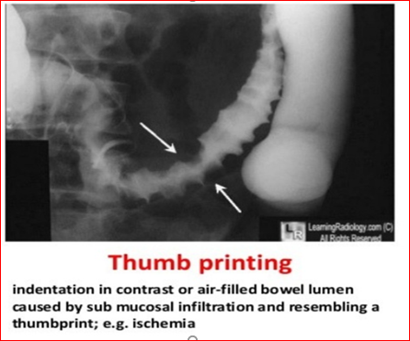
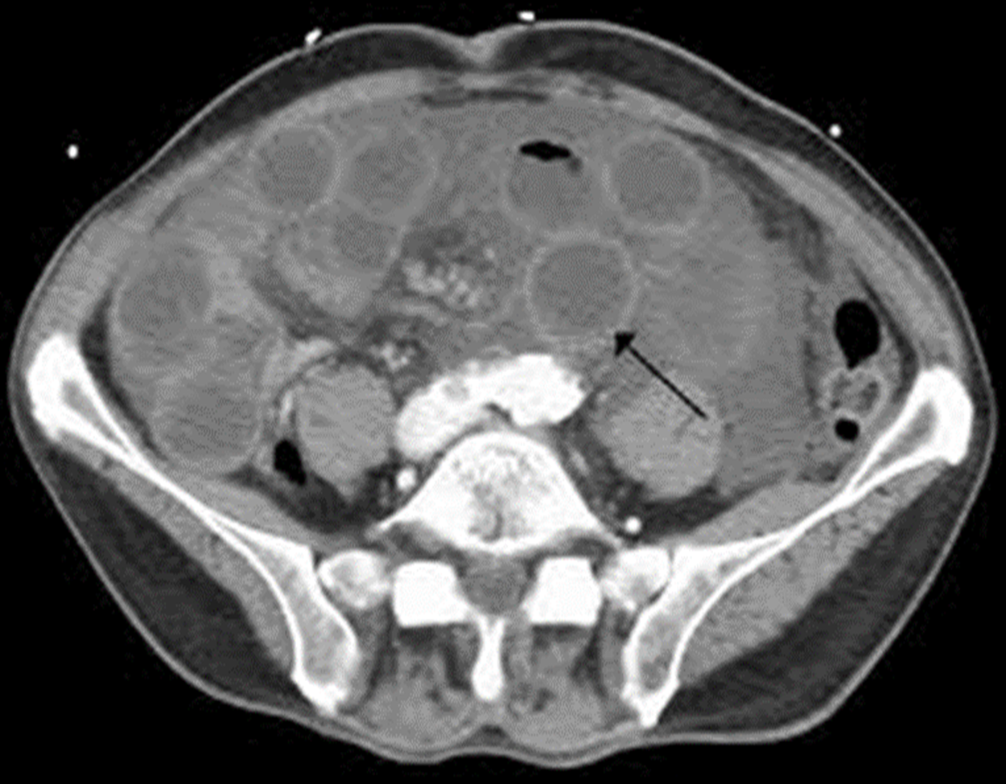
Investigations:
  Labs:
    High WBC- High lactic acid- high amylase
    ABG (metabolic acidosis)
  AXR
    Thickened, dilated gas-filled bowel
    Gas in bowel wall
  CT angiography
    Exclude other pathology
    Assess mesenteric vasculature, intestine & its mesentery
    Test of choice for acute mesenteric venous thrombosis

Slide 33
Treatment:
  Resuscitation,
  Golden hours
  Anticoagulation, & thrombolysis
  Surgical option:
    Bowel Resection,
    Embolectomy, thrombectomy
    Vascular bypass or Endarterectomy (If stable patient)
  Surgical indications:
    signs of peritonitis :
    Necrotic : segmental resection
    Questionable viability: second look

Slide 34
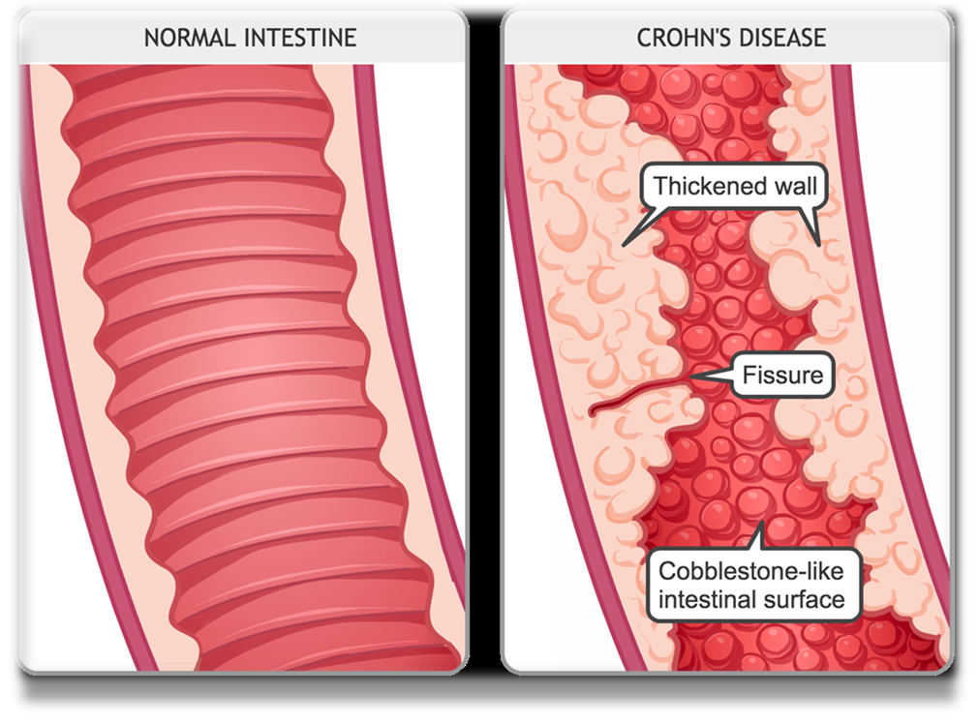
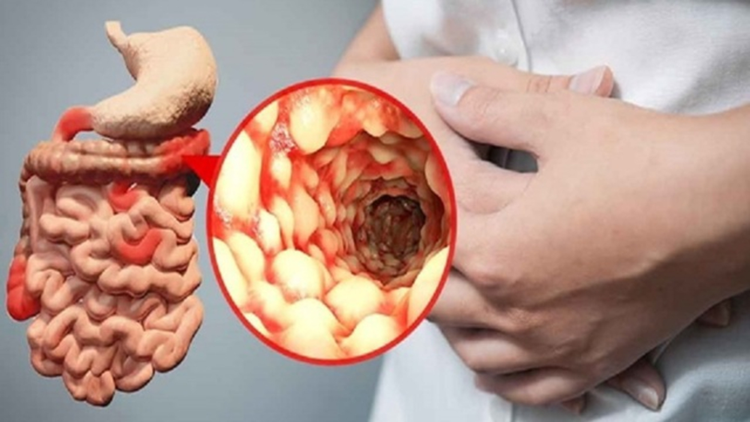
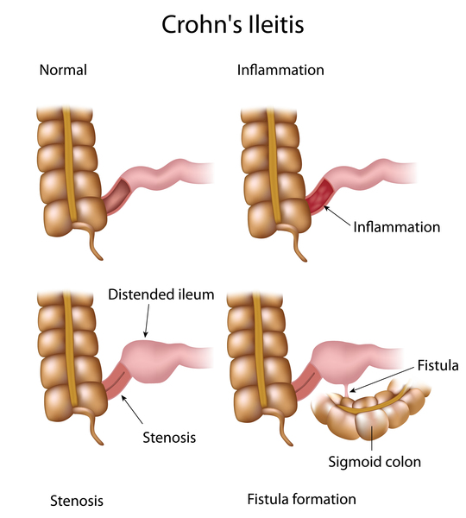
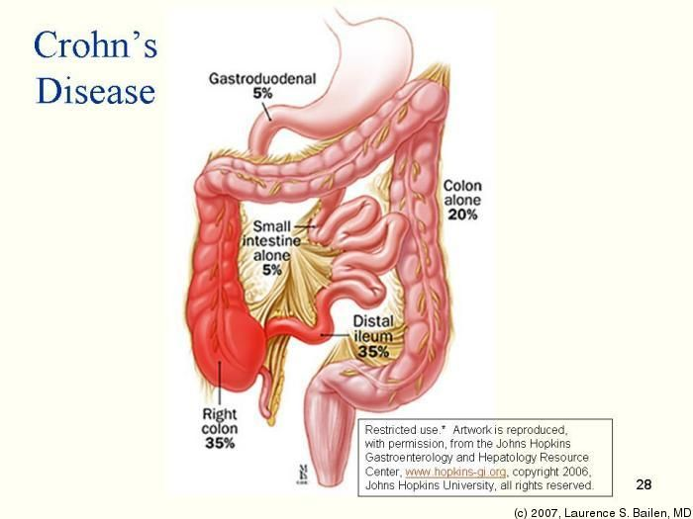
Crohn’s disease
Disease could affect any part of GIT from mouth to anus, 50% of cases both small and large bowel are involved
Causes:
  Inflammation caused by an unusual strains of mycobacteria.
  Uncertain aetiology
  Cigarette smoking is a common risk factor
  Hereditary
  Immunological
It is characterized by full thickness inflammatory process of any part of GIT from lips to anal margin.
Pathological features include full thickness inflammation, edema, fissures/ulceration, non- caseating foci of epithelioid and giant cells.

Slide 35
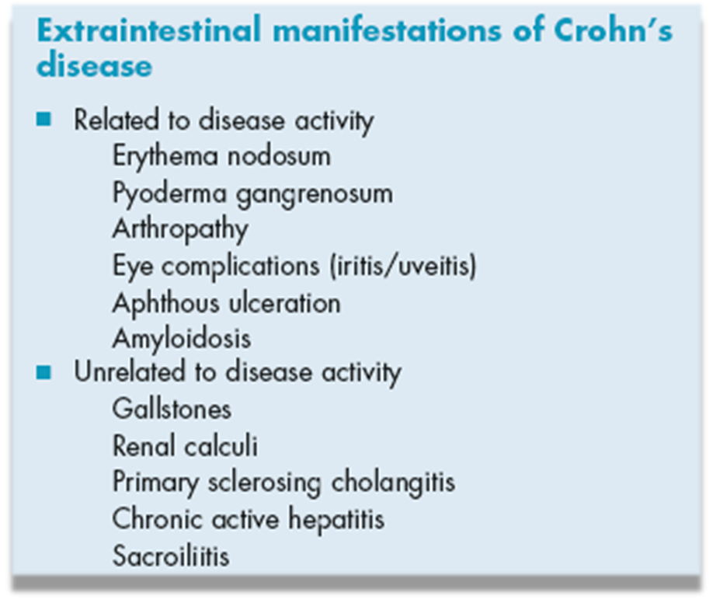
A chronic disorder with exacerbation,
remission and varied clinical presentation:
  Recurrent abdominal pain and diarrhea
  Weight loss
Symptoms of complications:
  Bowel obstruction( stricture – adhesions)
  Fistulation (to other organs)
  Anal, & perianal diseases (25%)
  Extra-intestinal
Terminal ileum with multiple
enterocolic fistulae
Note the normal mucosa on either
side of the inflammatory stricture

Slide 36
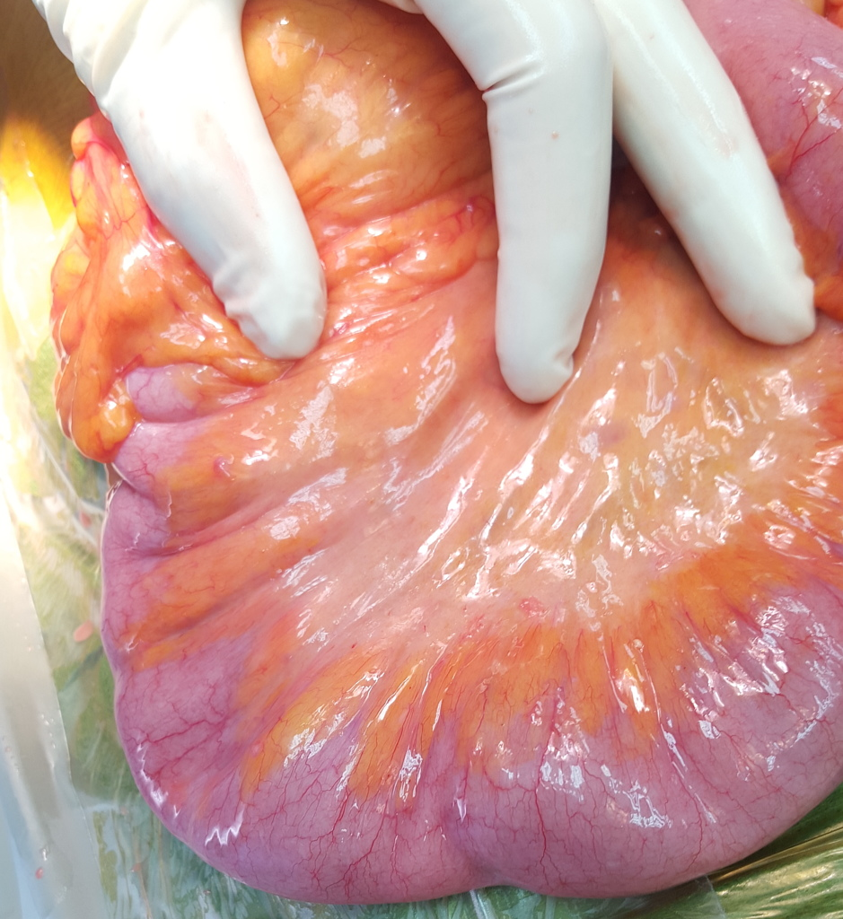
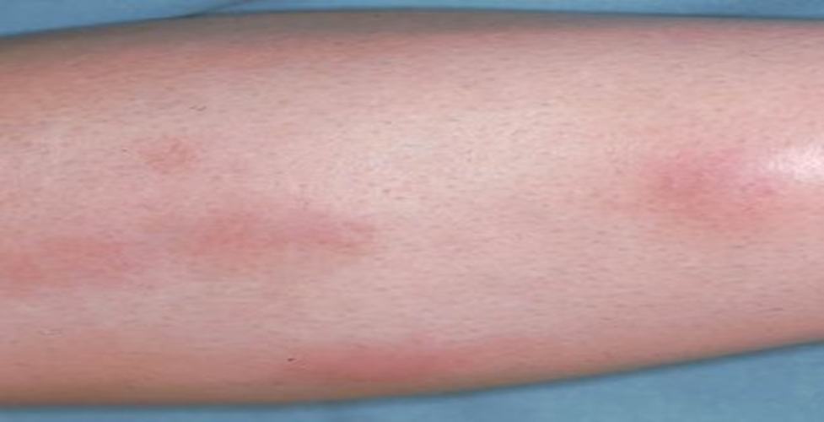
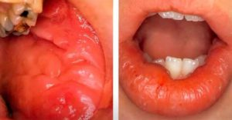
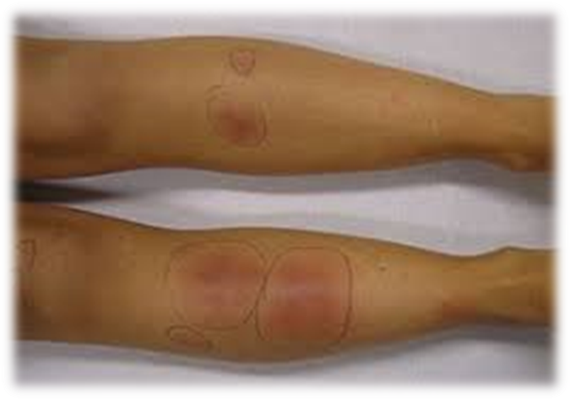
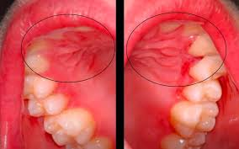
Creeping fat sign
Erythema nodosum
Aphthous Stomatitis of Oral Cavity
Thickening of the wall of the terminal ileum
with encroachment of mesenteric fat.

Slide 37
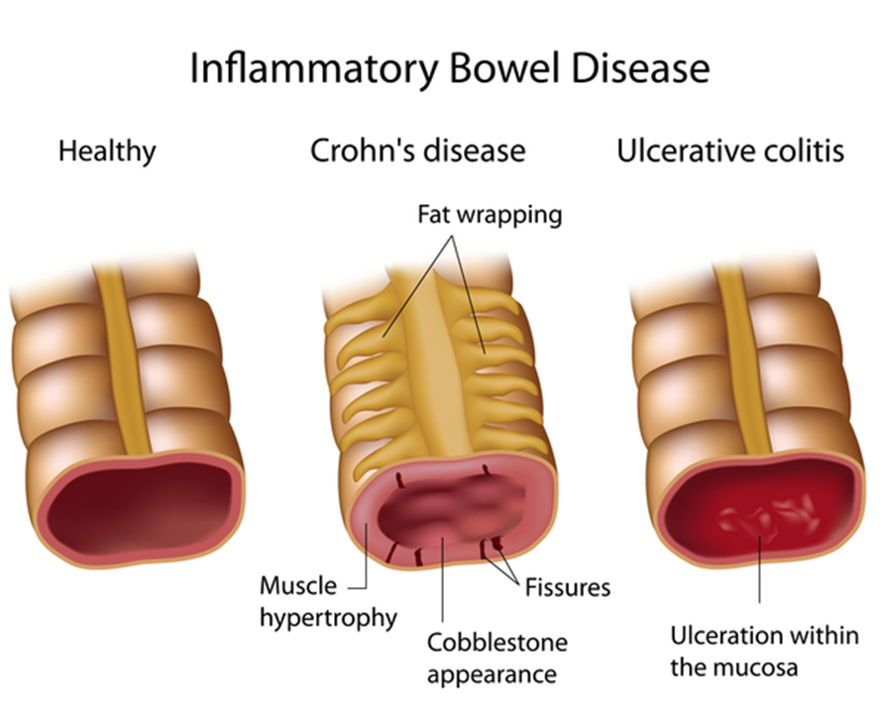
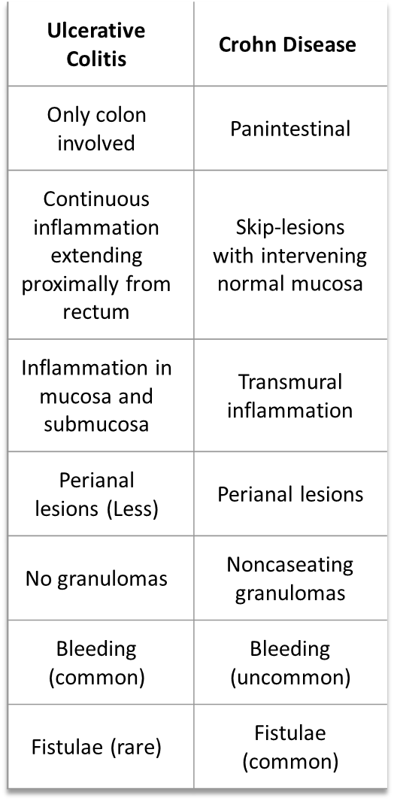
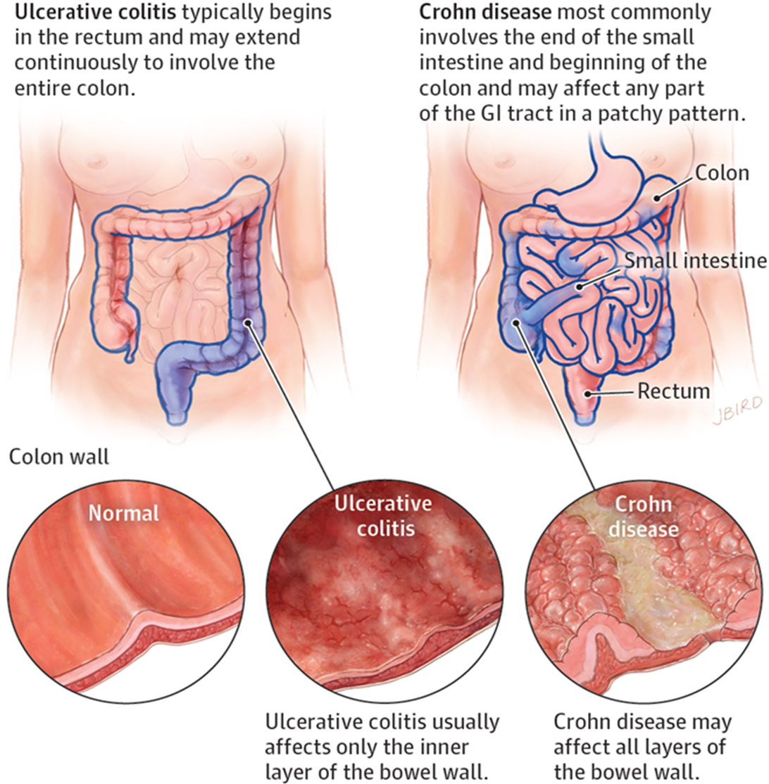

Slide 38
Investigations:
  Labs (WBS, Hb)
  Blood : Anemia, high C- reactive protein and low Vit-B12 levels
  Barium meal and follow through
  CT abdomen with oral and I/V contrast
  Colonoscopy/ with biopsy
  Capsule endoscopy/ Enteroscopy
    Management:
      Medical:
        Nutritional correction-
        Corticosteroids-
        Aminosalicylates-
        Immunosuppression (azathioprine- 6 mercaptopurine)- Monoclonal antibodies
  Surgical: Resections, strictureplasty or colectomies.
    Indications:
      Complications (perforation, fistulation, haemorrhage, abscess)
      Failure of medical therapy
      Perianal disease
      Malignancy

Slide 39
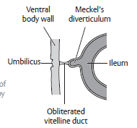
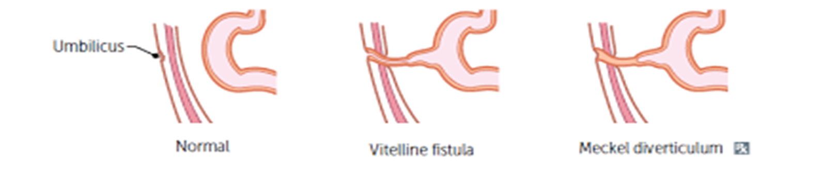
Meckel's diverticulum
Embryological remnant of Vitello-intestinal duct.
Arise from antimesentric border of ileum
Occurs in 2% population, 2 feet from ileocecal valve and 2 inches long and 2 times common in men.
Presents as :
  Persistent vitello-intestinal fistula
  Acute diverticulitis
  Perforation and peritonitis
  Intestinal obstruction
  Bleeding due to ectopic gastric mucosa.

Slide 40
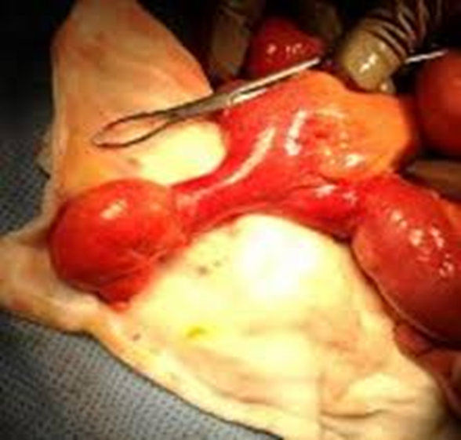
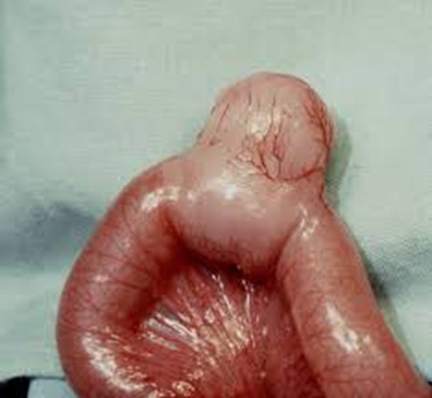
Complications:
  Bleeding: due to ileal mucosal ulceration.
  Obstruction
  Volvulus of the intestine
  Intussuception
  Stricture due to diverticulitis
Clinical manifestation:
  Asymptomatic (95%)
    50% are younger than 10y/o
  Symptomatic (5%)
    Bleeding (Most common in children)
    Intestinal obstruction most common in adult (Intussusception- twist)
    Diverticulitis mimics appendicitis

Slide 41
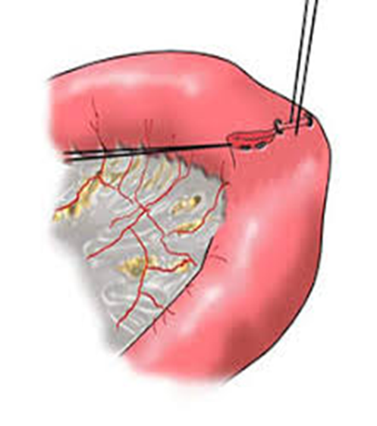
Diagnosis:
  For asymptomatic usually discovered as an incidental findings in radiographic imaging, endoscopy, or intraoperatively.
  Radionuclide scans (99m Tc-pertechnate) for ectopic gastric mucosa or in active bleeding
  Angiography to localize site of bleeding
Management:
  Observation: Asymptomatic and incidentally: left as such.
  Excision: Narrow necked, inflamed or symptomatic diverticulum is excised
Acutely inflammed
Meckel's diverticulum

Slide 42
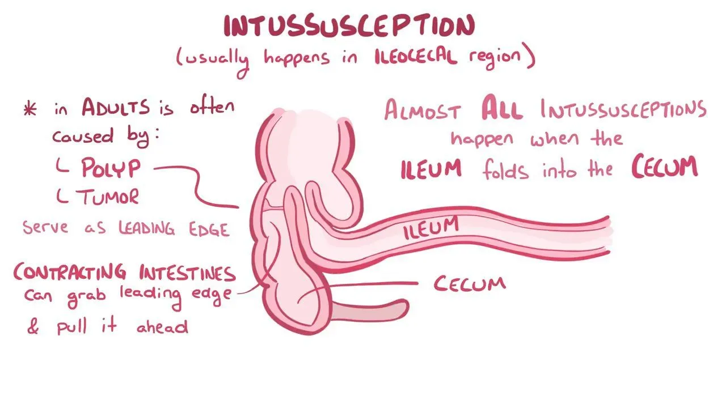
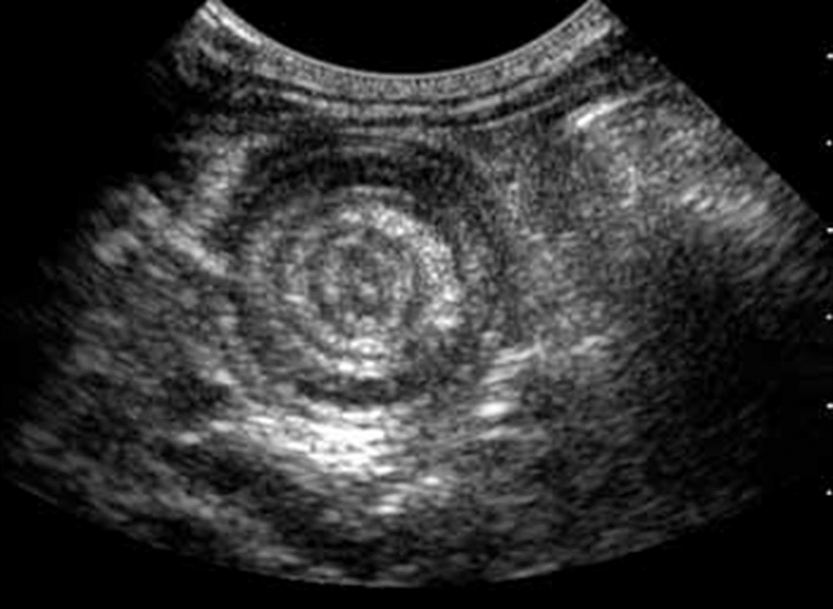
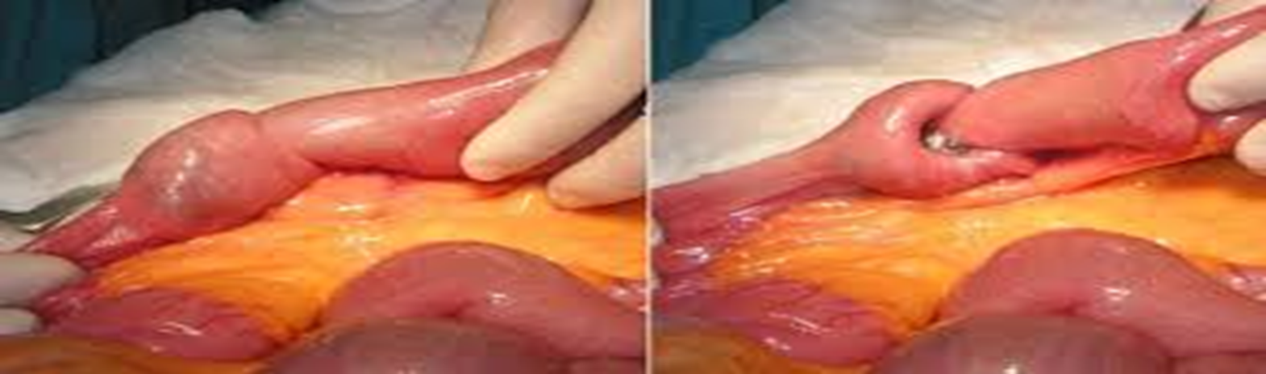
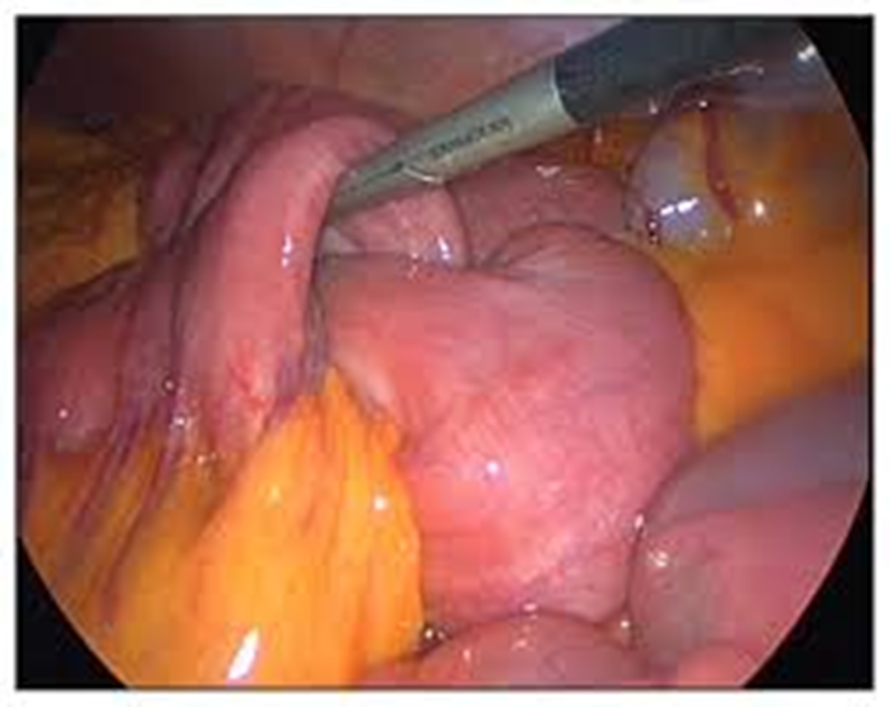
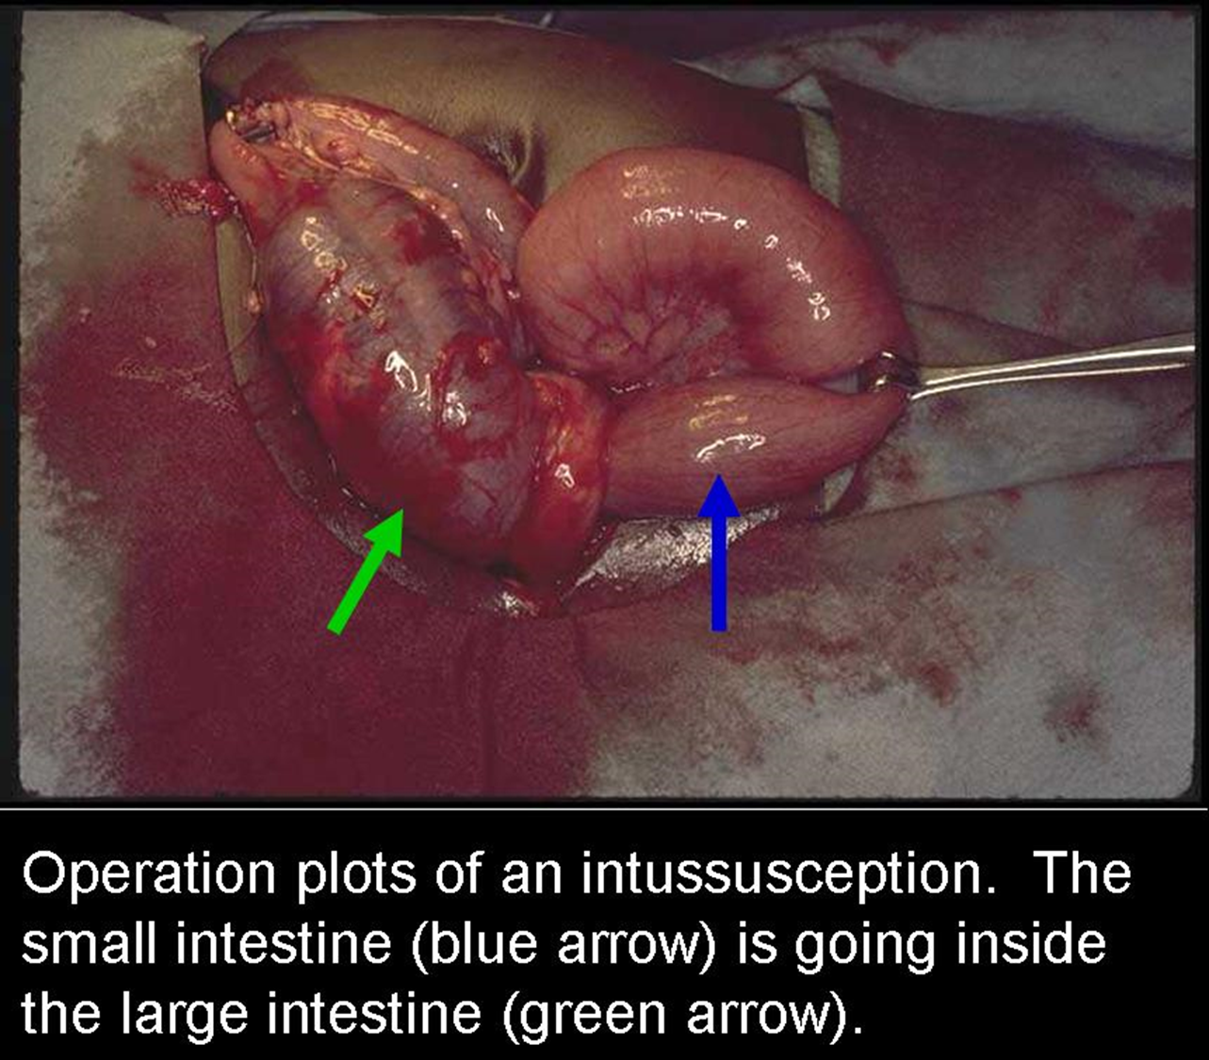

Slide 43
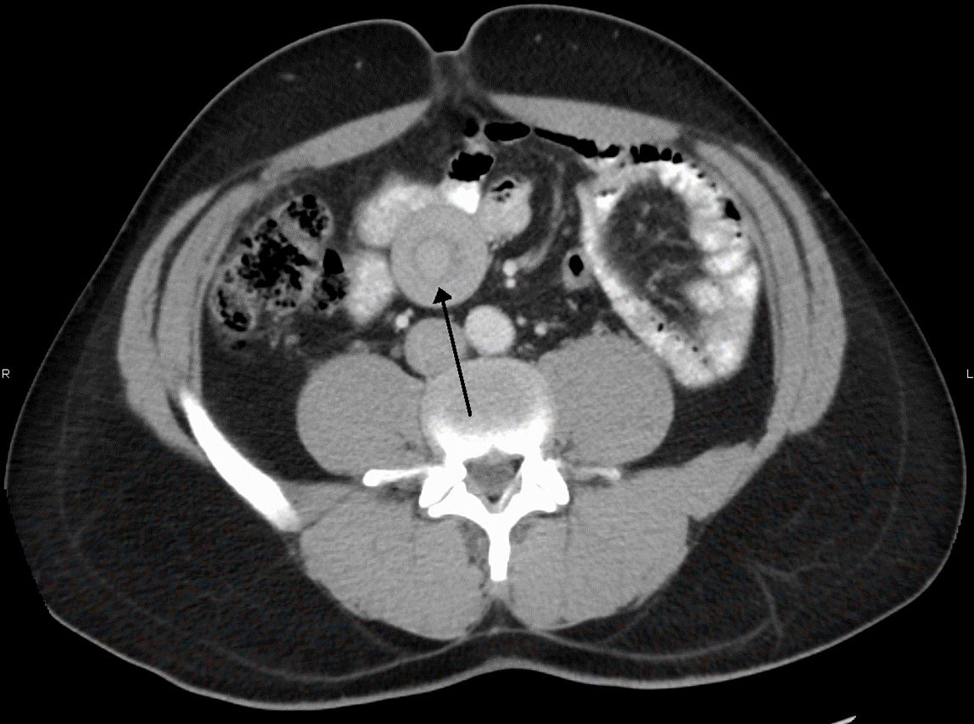
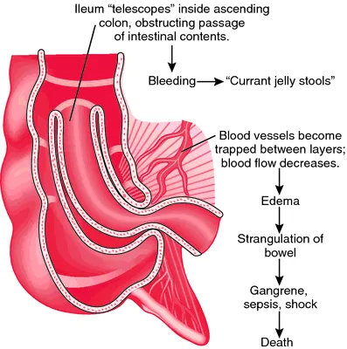


Slide 44

Small bowel neoplasm
Primary tumours of small gut are uncommon and form only 5% of the GIT neoplasms.
1% to 2% of all malignant tumors of the gastrointestinal tract
Aetiological factors include:
  Inherited Conditions: Polyposis coli, Peutz-Jegherz Syndrome, Gardner's syndrome.
  Immunocompromised states: Coeliac disease, AIDS, transplant recipients.
  Geographical Areas: Lymphomas more common in Middle East
Classification:
Benign
Adenomas
GIST
Lipomas
Neurofibromas
Malignant
Lymphomas
Adenocarcinomas
Carcinoids
Secondary tumours from lung, breast or malignant melanoma.

Slide 45
Gastrointestinal stromal tumors GIST
Account for less than 1% of GI tumors.
GISTs are usually found in:
  Stomach(50-60%) , Small intestine (20-30%), Anywhere along the GI tract
Pathologists have shifted from designations such as leiomyoma or leiomyosarcoma to the term stromal tumors (i.e., GISTs).
Benign GISTs are 3-4 times more common than malignant GISTs.
Malignant GISTs has high local recurrence and metastasis
The incidence is equal in men and in women,
Most frequently diagnosed in the fifth decade of life.
These tumors may grow intramurally and cause obstruction.
Vague, nonspecific abdominal pain or discomfort (most common)
Bleeding is the most common indication for surgery in patients with benign GIST tumors.
Surgical resection is necessary for appropriate treatment. Neoadjuvant vs adjuvant chemotherapy

Slide 46
Malignant small bowel neoplasm
Malignant neoplasms of the small bowel are among the rarest types of cancer, accounting for only 2% of all GI cancers
Adenocarcinoma, & carcinoid tumor are the most common malignant neoplasm
Adenocarcinomas are more in the proximal small bowel.
Adenocarcinoma
Common location: Duodenum and upper jejunum
Discovered late
Associated with:
  FAP
  HNPCC
Management:
  Palliative care (Bypass)
  Surgical resection

Slide 47

Carcinoid tumor
A specific type of well-differentiated NET that primarily arise from enterochromaffin cells in the gastrointestinal tract, but can also occur in the lungs
2nd most common affected site after appendix
Produce serotonin and other vasoactive substances
Carcinoid syndrome: metastasize to the liver , secreted hormones to enter the systemic circulation.
  Flushing , & diarrhea, emesis and wheezing due to bronchoconstriction
  Heart failure, heart valve lesions.
Clinical presentation: Obstruction, Bleeding, Metastasis to LN
Diagnosis:
  Symptoms of carcinoid syndrome (if liver metastasis)
  Labs:
    5-HIAA (5-hydroxyindoleacetic acid)
    Chromogranin
  CT abdomen: small bowel calcified mass
Treatment: Depends on the size of the tumor, the presence of metastasis, and the patient's overall health.
  Small Carcinoid Tumors (≤2 cm):Appendectomy: Surgical resection (standard)
  Larger Carcinoid Tumors (>2 cm) or Tumors with Risk Factors: Right Hemicolectomy
  Follow-Up and Monitoring:
  Regular Surveillance: with imaging studies and monitoring of tumor markers (like chromogranin A) is essential to detect recurrence or progression.
  Hormonal Monitoring: For patients with carcinoid syndrome, monitoring and managing hormone levels is crucial.

Slide 48


Small bowel lymphoma
Small bowel is the commonest affected GI portion
Symptoms:
  Vague
  Obstruction
  Bleeding
  Perforation
  Weight loss
Diagnosis:
  Blood : Anemia and high ESR, Tumour markers
  Radiological: CT or MRI abdomen with oral and intravenous contrast.
  Endoscopy: Upper GI endoscopy -Enteroscopy -Colonoscopy.
Treatment:
  This depends upon presentation, stage and type of the tumour.
  Chemotherapy

Slide 49
Short gut syndrome
Presence of less than 200 cm of residual small bowel in adult patients.
Insufficient intestinal absorptive capacity results in the clinical manifestations of diarrhoea, dehydration and malnutrition.
Causes:
  Crohn's disease;
  Mesenteric infarction
  Radiation enteritis
  Midgut volvulus
  Multiple fistulae
  Small-bowel tumours
Management:
  Nutritional Support including TPN.
  Antimotility agents (loperamide HCL or diphenoxylate)
  Octreotide – to reduce volume of gastrointestinal secretion
  Gut lengthening procedures
  Intestinal Transplantation

Slide 50
THANKS

