Slide 1
Management of patients with multiple trauma
Dr. Ahmed Khan
MBBS; FCPS (General Surgery)
Assoc. Prof. of surgery

Slide 2
ILO’s
At the end of this presentation students will be able to describe:
Incidence of trauma
Causes & types of trauma
Timing & mode of death in trauma & its effect on management.
Pre-hospital care & triage
Hospital care: Primary survey & initial management
Secondary survey
Pathophysiology of common injuries
Investigations during primary and secondary survey
A brief outline of management of major injuries.

Slide 3
Epidemiology
Most common cause of death (ages 1 and 44 years).
Affects a disproportionate number of young people
Burden to society- lost productivity, premature death, & disability.
A major public health issue.

Slide 4
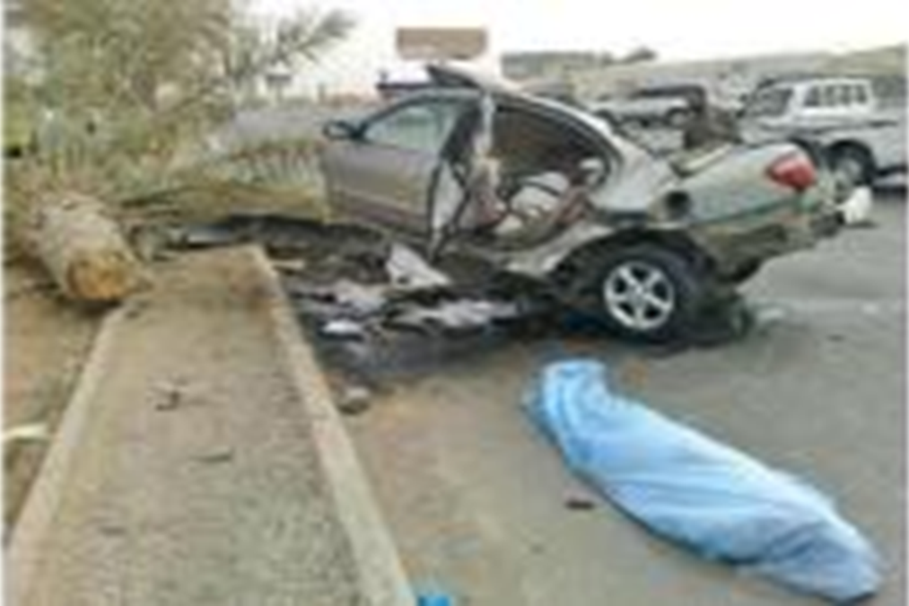
RTA

Slide 5
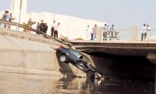
Arab News

Slide 6
Arab News
20 deaths daily on the Kingdom's roads.
Last year- 707 amputations due to RTA.
Accidents increased by 78% in the KSA recently
Affecting mostly young (18 and 22 years)
Around 30% of injured- permanently disabled.
The state spent SR21 billion treating such patients

Slide 7
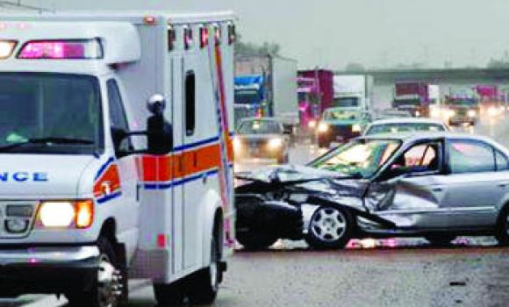
Mobile phones leading cause of road deaths

Slide 8
Types of trauma
Blunt trauma: an impact from blunt object.
Penetrating trauma: an sharp object piercing the body.
Assessment & diagnosis: blunt injuries more difficult than of penetrating injuries
Multi-trauma- injury affecting simultaneously different organ and body system

Slide 9
Causes of trauma
RTA or MVA
Pedestrian trauma
Fall from height
Assault
Firearm injuries
Knife
Industrial accidents
Natural disasters
Explosions

Slide 10
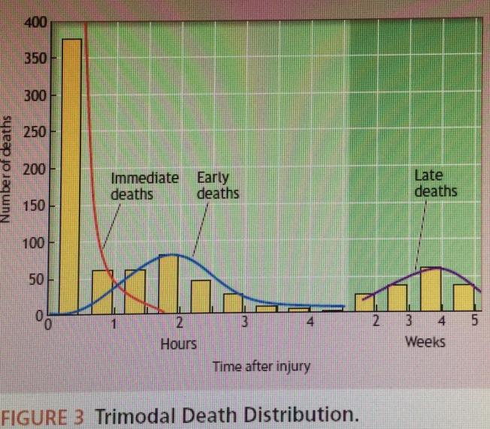
Trimodal death in trauma
Immediate: Deaths within seconds or minutes after injury. 50% deaths due to injury to the aorta, heart, brainstem, or spinal cord or by acute respiratory distress.
Early: Death within hours of injury- approx. 30% of deaths. Half die of hemorrhage, the other half due to CNS injury. Can be saved by appropriate treatment- golden hour.
Late: Deaths in days to weeks.
Infection & multi organ failure.
Care provided earlier impacts
the outcome.
ATLS manual

Slide 11
Improvement in mortality
Early deaths: - Prevention and control program
- Legislation & behavior modification
Later deaths: - Trauma centers providing better care.
- Better understanding of pathophysiology of multiple organ failure and brain injury

Slide 12
Pre-hospital care
Deliver to hospital as rapidly as possible- scoop & run
Only Critical interventions at the scene:
- Airway, hard collar, spine board,
control external bleeding.
- Infusion on way to the hospital

Slide 13
Triage (sort out)
Definition: To Prioritize victims (Multiple) based on –
-- severity of injury,
-- likelihood of survival, &
-- urgency of care.
Goals:
  Identify high-risk injured patients who would benefit from the resources available .
  Limit the excessive shifiting of non-severely injured patients so that the trauma center is not over crowded.

Slide 14
Hospital care
ATLS approach (Advanced Trauma Life Support)
Primary survey- initial assessment & management
Treat the greatest threat to life
Immediate intervention as the threat to life identified
Detailed history not essential
Re-evaluation of initial management
Secondary survey- a head to toe evaluation

Slide 15
Primary survey
A B C D E
Airway & cervical spine protection
Breathing & ventilation
Circulation with control of external bleeding
Disability (neurologic assessment)
Exposure/Environmental control- undress, prevent hypothermia

Slide 16
Primary survey- “a team approach”
Multiple providers
Simultaneous diagnosis & treatment
Reduces the time to assess & stabilize
Team is organized before patient arrival.
Leadership & unity of command-essential

Slide 17
Primary survey- “one clinician”
Do not perform subsequent steps in the primary survey until after addressing life-threatening conditions in the earlier steps.

Slide 18
Special attention!
Children - anatomic/ physiologic variations
Pregnant - anatomic/ physiologic variations, 2 patients!
Elderly- limited physiological reserves, co-morbidities, medications
Obese- intubation , ultrasound, diagnostic peritoneal lavage & CT scan are difficult. Limited cardiopulmonary reserve.

Slide 19
Airway & cervical spine
Verbal response: Salam! How are you?
Airway is compromised if:
No response- unconscious , GCS <8,
Noisy breathing
Severe facial trauma
Oropharyngeal bleeding or foreign body
Patient agitated - ?hypoxia

Slide 20
Airway & Cervical spine
Adequacy of airway- completed within seconds
Open the front of the collar for airway manipulation
Maintain manual inline stabilization of C spine by an assistant. Avoid excessive movement of C spine.
Oropharyngeal airway/ bag valve mask ventilation
O₂ supplement + pulse oximetry- every trauma patient
Rapid-sequence endotracheal intubation (ETT)
Frequent reassessment for airway compromise

Slide 21
Difficult airway
Surgical airway when oral intubation (ETT) cannot be accomplished:
  Cricothyroidotomy – Surgical placing a tube through incision in the cricothyroid membrane (CTM)
  Tracheostomy (laryngeal injury)

Slide 22
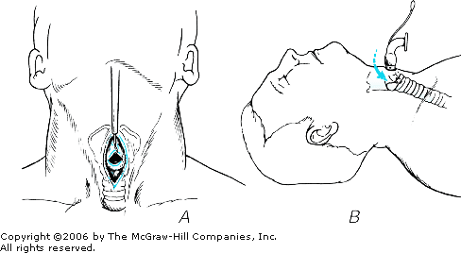

Slide 23
BREATHING
Ventilation- Is it adequate ?
Its function of the lungs, chest wall, and diaphragm.
Life threatening injuries to look for:
Tension pneumothorax.
Open pneumothorax (open chest wound).
Flail chest with underlying pulmonary contusion.
Massive hemothorax.

Slide 24
BREATHING PROBLEM !
Adequate exposure of neck and chest
Dyspnoea, tachypnoea, tachycardia
Inspection: Unilateral diminished chest expansion.
Bruising/ abrasion over the chest.
Distended neck veins.
Palpation: Trachea deviated.
Percussion: - Dull – haemothorax. - Hyper resonant – Pneumothorax.
Auscultation: diminished or absent breath sound

Slide 25
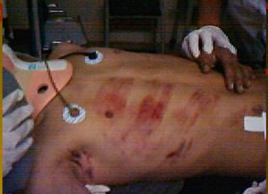

Slide 26
Tension pneumothorax (Pathophysiology)
Traumatic punctured lung wound acts as a one-way valve.
Each inhalation- additional air accumulate in pleural space.
Normal negative intrapleural pressure becomes positive.
Depressing the ipsilateral hemidiaphragm.
Pushing mediastinal structures to other side.
Compressing contralateral lung.
Heart rotated about the superior and inferior vena cava
Venous return and cardiac output decreased.
Distending the neck veins.

Slide 27
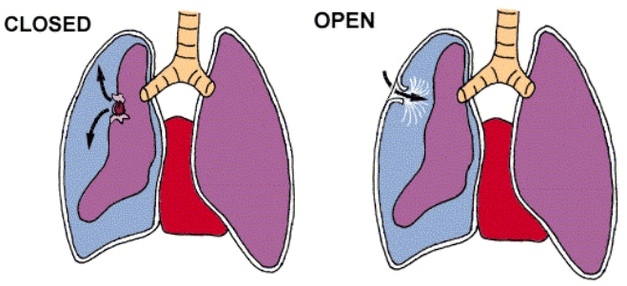
Pneumothorax

Slide 28
Tension pneumothorax:- Clinical features
Tachypnoea, tachycardia, use of accessory muscles
Asymmetrical chest wall movement
Hyper resonance on percussion
Absent or decreased breath sounds
Distended neck veins
Systemic hypotension
Subcutaneous emphysema
Tracheal deviation away from the affected side
Treatment: x-ray confirmation not required
Wide bore needle in 2nd intercostal space, mid-clavicular line
Chest tube in 5th intercostal space, anterior axillary line

Slide 29
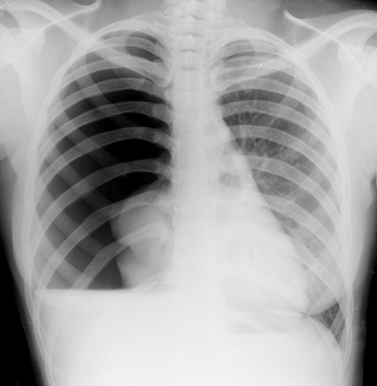

Slide 30
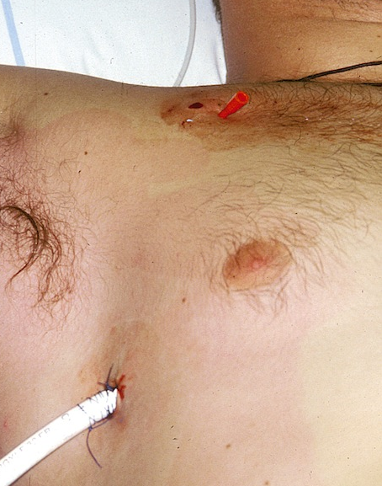
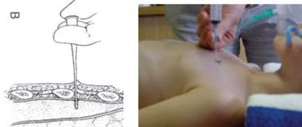
Tension pneumothorax
Needle decompression Intercostal tube

Slide 31
Open pneumothorax or sucking chest wound
Pathophysiology
Full-thickness loss of the chest wall: free communication between the pleural space and the atmosphere.
Collapse of the lung on the injured side
If the diameter of the injury is greater than the narrowest portion of the upper airway, air will preferentially move through the injury
Impairs ventilation on the contralateral side

Slide 32
Pneumothorax

Slide 33
Open pneumothorax
Management
Complete occlusion of the injury may result in converting an open pneumothorax into a tension pneumothorax.
Initial treatment: occlusive dressing, which is taped on three sides over the wound
- Dressing permits effective ventilation, while
the untaped side allows accumulated air to
escape from the pleura
Definitive treatment: wound closure and tube
thoracostomy

Slide 34
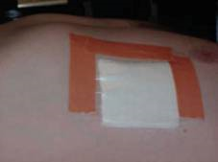
3 sided occlusive dressing

Slide 35
Flail chest with pulmonary contusion Pathophysiology
Three or more ribs fractured in at least two locations
Paradoxical movement of “free-floating segment” may occasionally compromise ventilation.
More importantly, an underlying pulmonary contusion may compromise oxygenation or ventilation
Initial chest x-ray underestimates the degree of contusion
The lesion evolve with time and fluid resuscitation

Slide 36
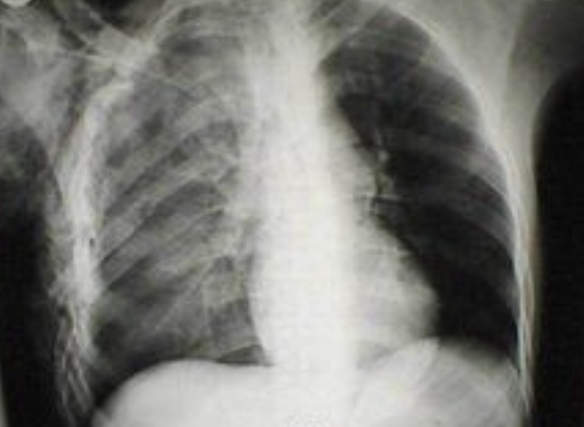

Slide 37
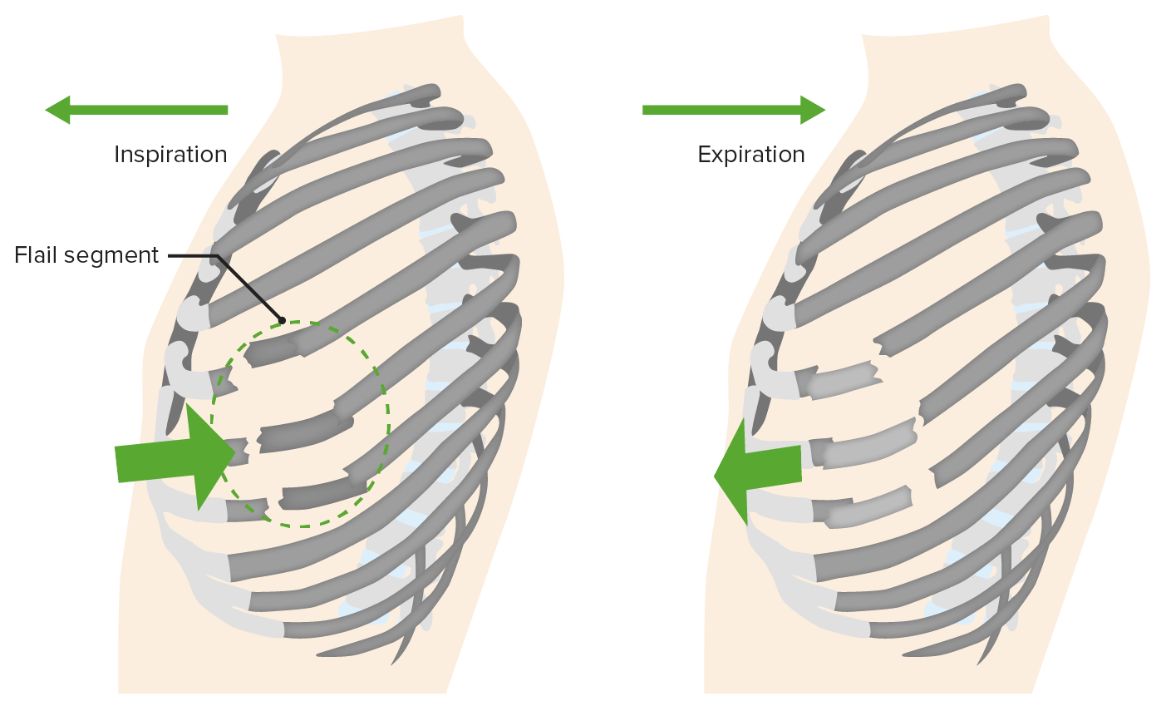

Slide 38
Flail chest with pulmonary contusion
Management
Respiratory failure may not be immediate
Frequent re-evaluation is needed.
Intubation(ETT) and mechanical ventilation is required

Slide 39
Massive hemothorax
Accumulation of >1.5L of blood
Cause: Disruption of large vessel
Flat neck vein
Dullness on percussion
No breath sound on auscultation
Shock
Management:
- Chest tube in 5th space.
- Fluid resuscitation.
- Thoracotomy if significant bleeding continues.

Slide 40
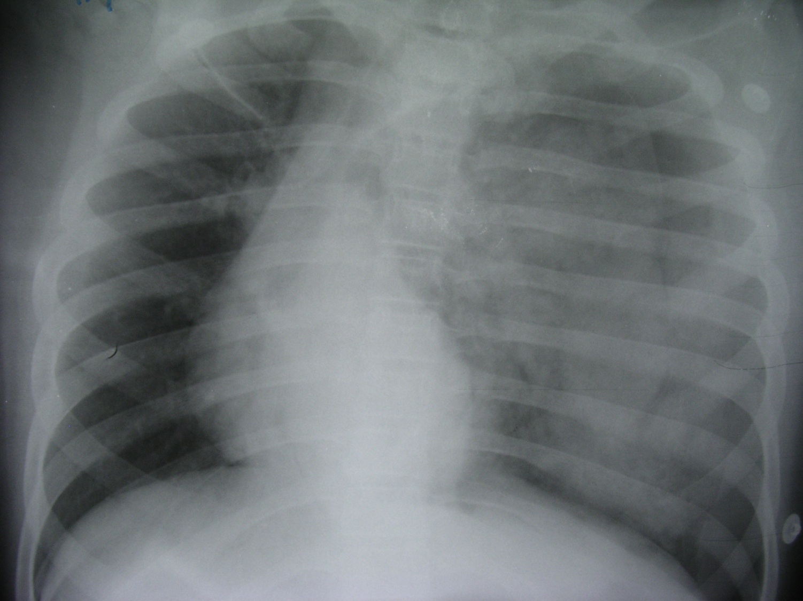

Slide 41
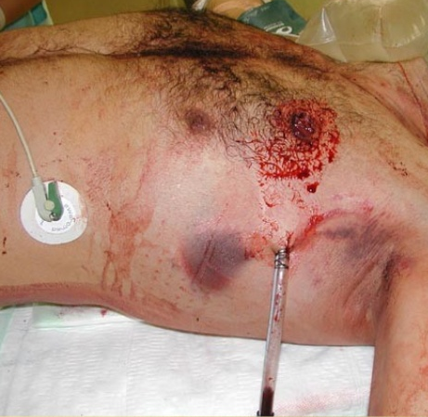

Slide 42
Circulation
Assessment of:
- cardiovascular compromise &
- control of bleeding
Shock? - Skin pallor, tachycardia, altered consciousness
Look for any:
- External bleeding source or
- Internal hemorrhage?

Slide 43
Circulation:-
Hypovolemic shock- Pathophysiology
Shock- secondary to hemorrhage in most trauma patients
Patient can be in shock before developing hypotension
Hypotension- a sign of decompensation (class III )
5 locations for major blood loss:
- Chest
- Abdomen
- Pelvis and retroperitoneum
- Multiple long bone fractures ( lower limb)
- External hemorrhage

Slide 44
Pathophysiology of blood loss
Compensatory responses occur as:
- Progressive vasoconstriction- skin pallor
- Tachycardia to preserve cardiac output.
- Increased peripheral resistance- catecholamines.
Venous return- preserved in early stage, reduced later due to reduced blood volume in venous system.
If Continued bleeding- shock develops.
Inadequate tissue perfusion, metabolic acidosis.

Slide 45
Classes of hemorrhagic shock
 | Class I | Class II | Class III | Class IV
Blood loss (ml) | Up to 750 | 750- 1500 | 1500- 2000 | > 2000
Pulse | <100 | >100 | >120 | >140
BP | Normal | Normal | Decreased | Decreased

Slide 46
Circulation
Indicators of shock in trauma patients
Tachycardia*
Agitation
Tachypnea
Sweating
Cool extremities
Weak peripheral pulse
Decreased pulse pressure
Hypotension
Oliguria

Slide 47
Causes:- Cardiogenic shock in trauma
1- Tension pneumothorax- most common cause, 2- Pericardial tamponade (penetrating trauma),.. Classical Beck’s triad 3- Myocardial contusion
Beck’s triad: hypotension, distended neck vein (raised CVP >15 cm H2O, CVP in haemorrhagic shock <5 cmH2O, n=8 to 12 mmHg) muffled heart sound
Dysrhythmias in contusion
Ultrasonography : helpful in diagnosis
Treatment: fluid resuscitation, pericardiocentesis

Slide 48
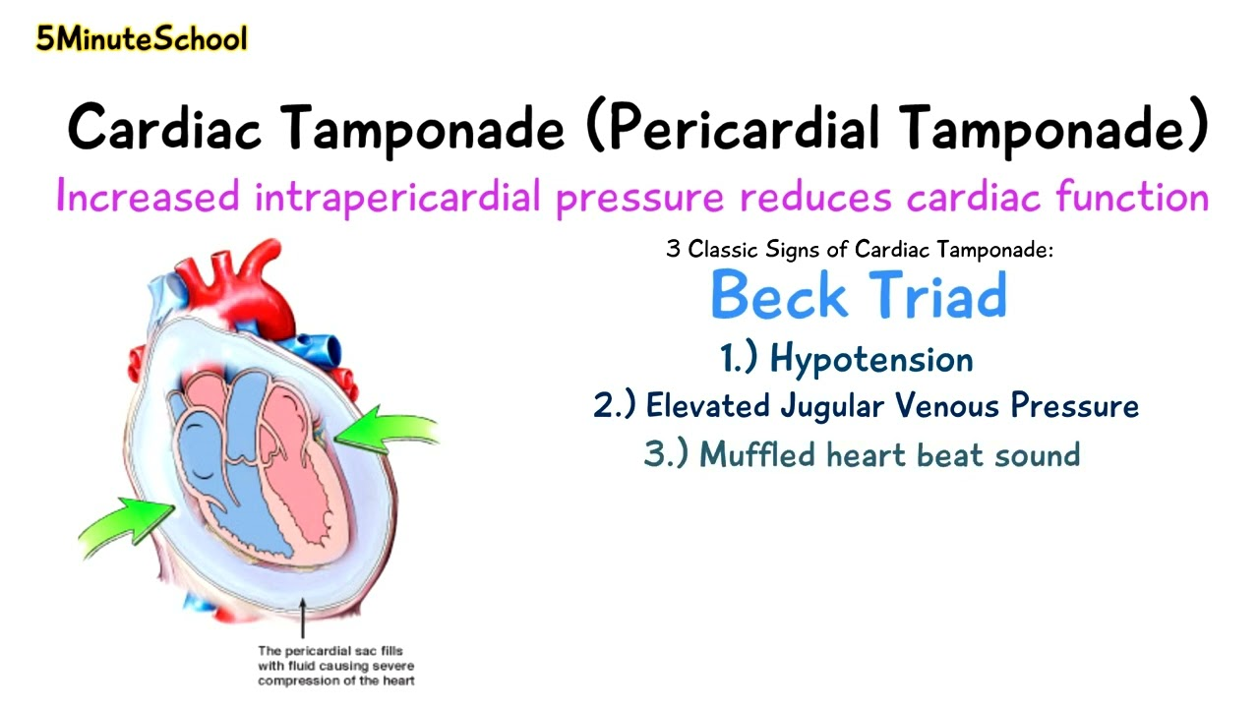

Slide 49
Circulation-Neurogenic shock
Loss of sympathetic tone due to cord injury
Hypotension, warm well perfused limbs, diminished/absent motor function
Bradycardia
Management:
- IV fluids,
- vasopressors (Norepinephrine, epinephrine, phenylephrine, dopamine, and vasopressin)
- corticosteroids

Slide 50
Circulation-Septic shock
Delayed arrival
Penetrating abdominal injuries
Early septic shock- normal circulating volume
Tachycardia
Warm skin
Systolic BP is near to normal
Wide pulse pressure

Slide 51
Treatment: Circulation-
Initial management
External haemorrhage- compression dressing ? tourniquet
IV access- two peripheral catheters (upper limb), rapid infusion
Other IV access: - Saphenous vein ‘cut down’,
- central venous line
ECG monitoring
Blood samples- typing, x-match, haematology, biochem., pregnancy test (female),
ABGs.
Initial resuscitation:
- 1-2 L of Ringer's lactate or NS (room temp.)
- Packed red blood cells (PRBC), if no response
- Foley’s catheter: urine output - 0.5 mL/kg/hour in adult

Slide 52
Circulation-…Initial management
Search for source of blood loss:
CXR, X-ray pelvis, FAST (focused abdominal sonography in trauma).
Fracture pelvis: pneumatic antishock garment or a bed sheet wrapped around the pelvis may be applied
Limb fractures- splint
Control bleeding : - Surgical interventions,
- angioembolization,
- pelvic stabilization.

Slide 53
Evaluation of fluid resuscitation
BP and pulse rate
Urine output (0.5ml/kg/hour)
Mental status and skin color/temperature
CVP
Acid/base status

Slide 54
Management decisions -
Rapid responders
Hemodynamics return to normal after resuscitation
Hemodynamics remain stable even after reducing infusion to maintenance rate.
Probably bleeding has stopped spontaneously
Obeservation: Continued evaluation for source of bleeding
May still need surgery

Slide 55
Management decisions-
Transient responders
Decompensate once fluid resuscitation is slowed down.
? Ongoing bleeding or inadequate resuscitation.
Increase fluid resuscitation.
Blood transfusion (type specific or O negative)
Surgical intervention ??

Slide 56
Management decisions-
Non-responders
Fail to respond to fluid and blood resuscitation.
Cause: - Major blood loss (>40%) &
- ongoing loss
Immediate surgical intervention
or
? Non-hemorrhagic shock (cardiogenic)
Echocardiography
CVP

Slide 57
Disability-Neurologic evaluation
Level of consciousness: Glasgow Coma Scale (GCS)
If the GCS is used in intubated and paralyzed patients, record should be made
Pupillary response can still be assessed in a paralyzed patient

Slide 58
Glasgow Coma Scale (GCS), Total = 15
Eye response | Vocal response | Motor response
Spontaneous 4 | Oriented 5 | Obeys commands 6
To voice 3 | Confused 4 | Purposeful movement to pain 5
To pain 2 | Inappropriate words 3 | Withdraw from pain 4
None 1 | Incomprehensible words 2 | Flexion to pain 3
*** | None 1 | Extension to pain 2
*** | *** | None 1

Slide 59
Head injury severity
Mild GCS ≥ 13
Moderate GCS 9- ≤ 12
Severe GCS ≤ 8

Slide 60
Exposure/ Environment control
Completely undress the patient
Perform a rapid head-to-toe examination
? Missed injuries- areas at back and perineum, not easily seen
Cover patient once assessment completed to prevent hypothermia

Slide 61
Adjuncts to Primary Survey & resuscitation
Oxygen
Pulse oximetry
BP monitoring
ECG monitoring
NG tube, urinary catheter (urine sample)
Ventilatory rate
ABG levels
X-ray- chest & pelvis (AP)
FAST, ?DPL

Slide 62
Secondary Survey
Only after completion of primary survey
- Once all life threatening injuries dealt &
- Normalization of vital signs
Secondary Survey:
AMPLE history (Allergies, Medication, Past/Pregnacy, Last meal, Events of trauma)
Examination (Head to toe)
Continuous reassessment of vital signs
Additional laboratory/ radiological tests.
Additional tubes, lines and monitoring devices
Priorities and plan definitive management of all injuries

Slide 63
Head injury
Traumatic brain injury (TBI)- is the leading cause of death in trauma patients- 50% of all traumatic deaths.
- Primary injury - the anatomic and physiologic disruption
that occurs as a direct result of trauma
- Secondary injury- extension (sequelae) of the primary injury, result
from local swelling, increased ICP, hypoperfusion,
hypoxemia, or other factors.
Aim- detection and treatment of primary injury and prevention of secondary injury

Slide 64
Head injury- management
Maintain BP >90 mmHg, PaO2 >60 mmHg (75-100mmHg)
Assess GCS and lateralizing signs- pupil and motor function
- a neurological symptom that suggests an issue with one side of the brain or body
Pupillary asymmetry >1 mm suggests intracranial injury
Larger pupil is on the side of the mass lesion
Extremity weakness- detected by testing motor power
CT scan head- accurate localization of the lesion
Epidural or subdural hematoma: Treatment: evacuation
Intracerebral hematoma & contusion
Diffuse axonal injury: maintain brain perfusion & prevent rise in ICP.

Slide 65
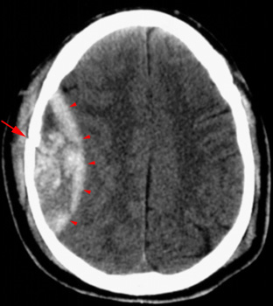
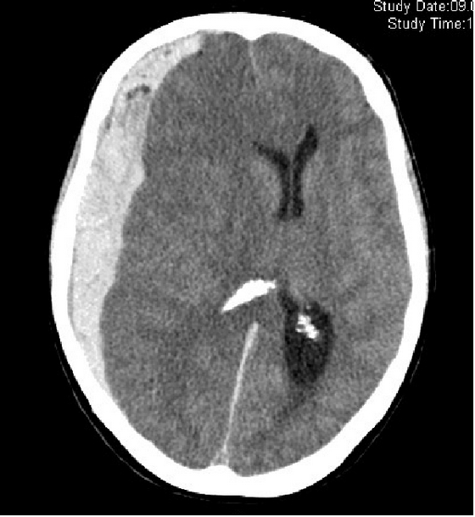
Epidural Subdural
Hematoma Hematoma

Slide 66
Spinal cord injuries
Requires Intensive hospital care, long-term rehabilitation &
life-long care.
Initial care - strict immobilization of the spine
Complete neurologic assessment
Steroid therapy must be initiated within a few hours of injury
Injuries above C3- are apneic, need intubation
between C3 and C5 – may need intubation later
Complete transection- poor prognosis
Preservation of remaining function

Slide 67
Thoracic injuries
Life-threatening : tension pneumothorax, massive hemothorax, open pneumothorax, flail chest, and cardiac tamponade
Rib fractures, sternal fracture, lung contusion,
Injuries to trachea, bronchi, heart, diaphragm, esophagus,
thoracic aorta
Diagnostic modalities: CXR, ultrasonography, chest CT, esophagography, esophagoscopy, bronchoscopy, and angiography

Slide 68
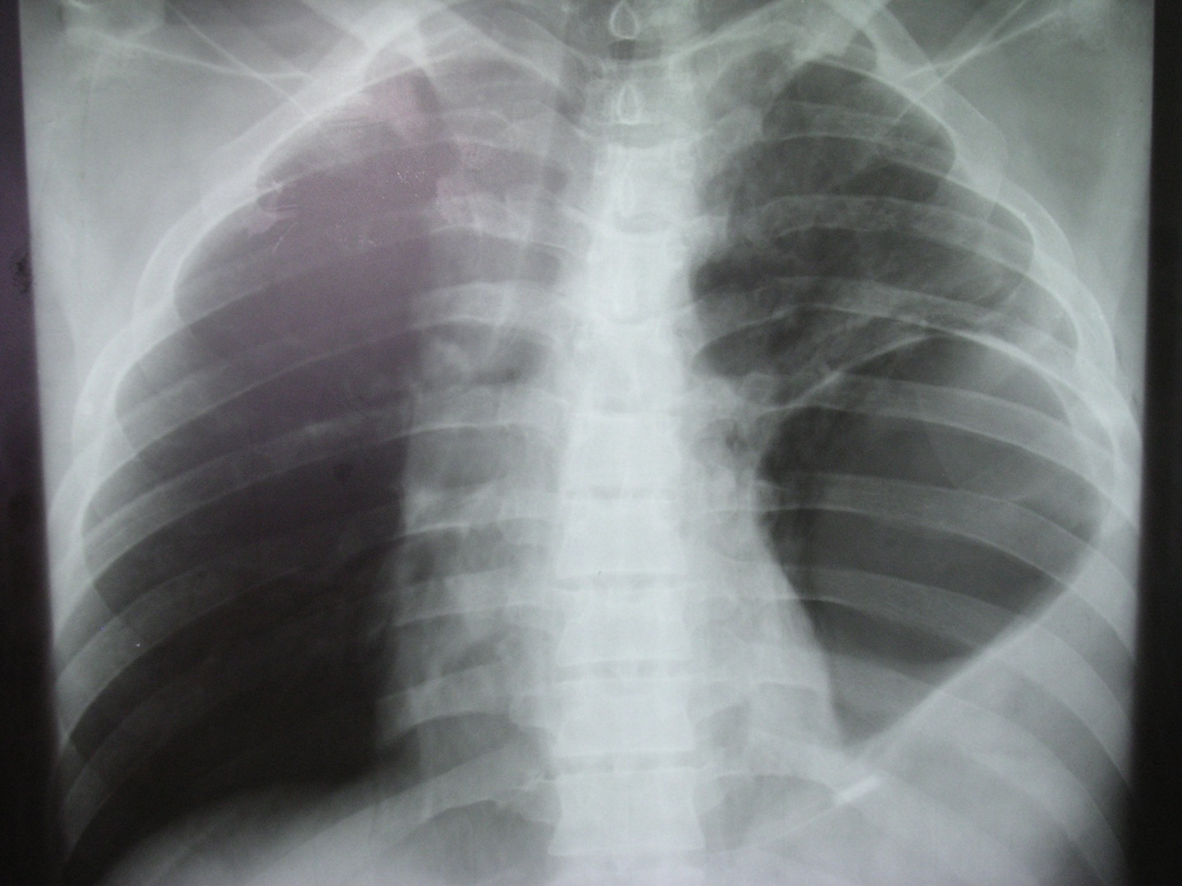

Slide 69
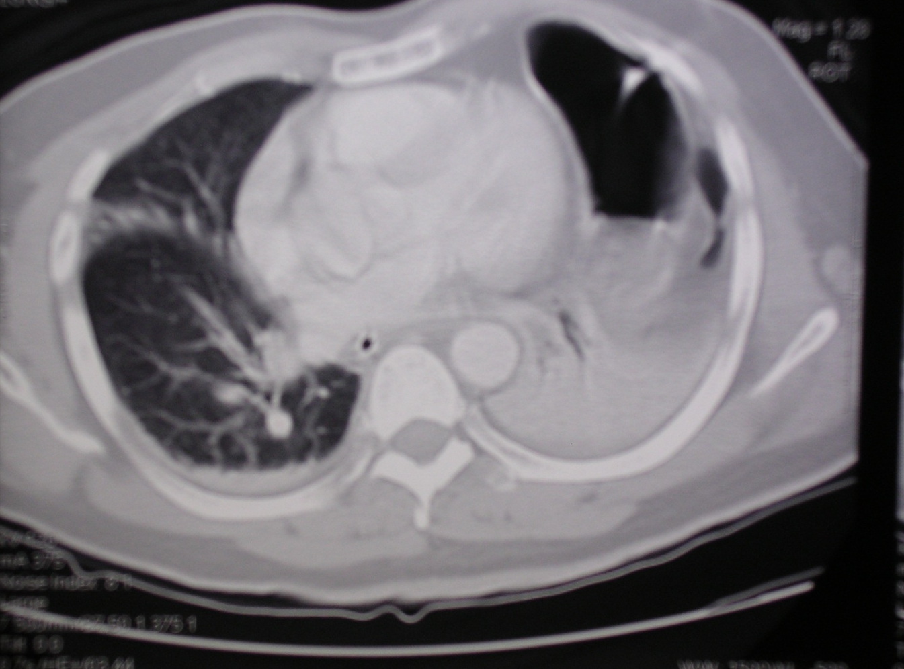

Slide 70
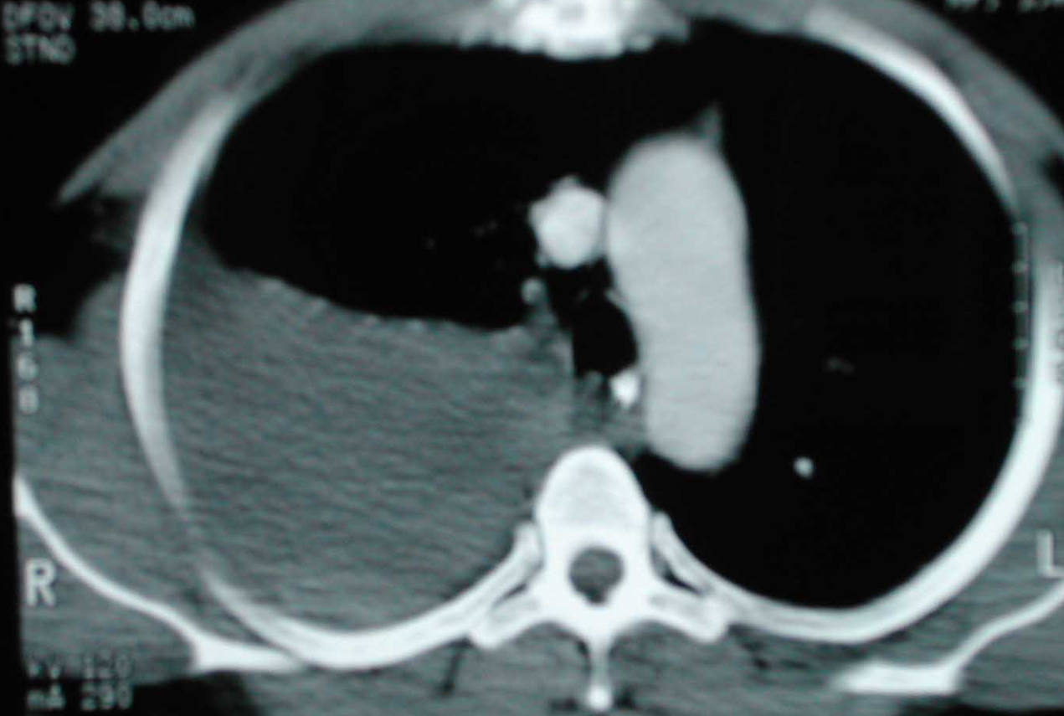

Slide 71
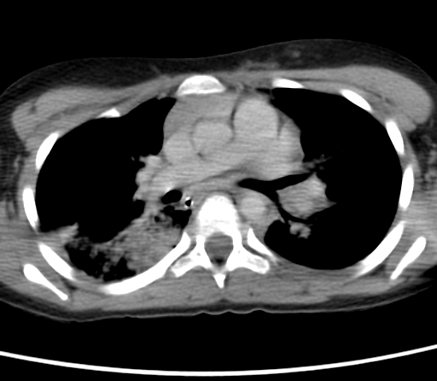

Slide 72
Abdominal injuries
25% of all trauma victims require “abdominal exploration”
-Exploratory laparotomy cause of the problem is found during the procedure, then treatment
is often done at the same time
P/Exam: inadequate to identify intra-abdominal injuries
Diagnostic modalities- CXR, FAST, DPL, CT & laparoscopy
Blunt trauma:
Hemodynamically stable- FAST , CT scan
Hemodynamically unstable- FAST

Slide 73
Diagnostic peritoneal lavage (DPL)
Insert catheter below umbilicus under LA.
- if Bloody aspirate- laparotomy.
1L NS infusion into peritoneum.
Returning fluid is bloody- positive lavage.
Rapid and safe
Do not determine origin of blood
Too sensitive
Does not evaluate retroperitoneal injury
Replaced by FAST and CT scan

Slide 74
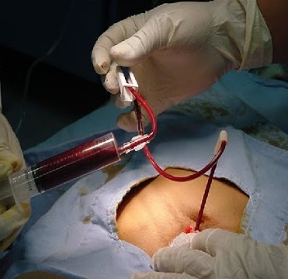
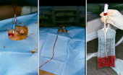
Diagnostic peritoneal lavage (DPL)

Slide 75
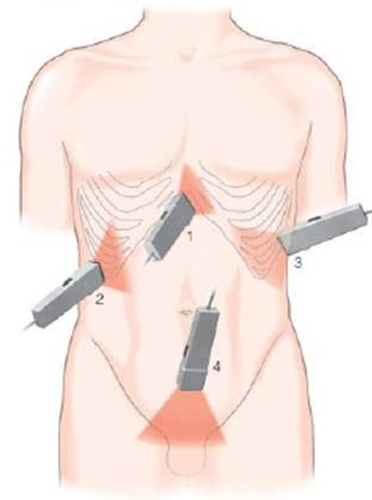
FAST- Focused abdominal sonography in trauma
Rapid & accurate.
Sensitivity up to 99%.
Detects small amount (100 ml) of blood.
Four views: 1.Pericardiac 2.Perihepatic 3. Perisplenic 4.Pelvic
Helpful in management of unstable
patients.

Slide 76
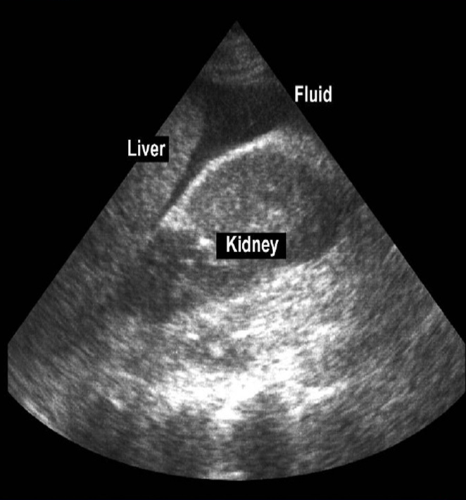
FAST

Slide 77
Penetrating Abdominal injuries
Gun shot injuries- urgent surgery
Stab (knife) injury:
A- Hemodynamically stable- wound exploration, CT scan, Surgery only if intra-abdominal injuries found
B- Hemodynamically unstable- surgery

Slide 78
Splenic injury
Most frequently injured organ in blunt trauma
History of injury to the left side of the chest, flank, or left upper part of the abdomen
Bruising, pain tenderness- lower chest and upper abdomen on left side
Diagnosis: -
- CT in hemodynamically -stable patients
- FAST or exploratory laparotomy in an unstable patients

Slide 79
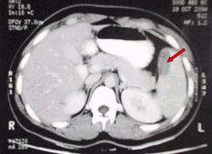
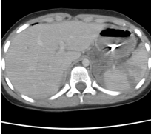
Splenic injury (CT scan)

Slide 80
Splenic injury:
I-Non-surgical management (70%)
Hemodynamically stable.
FAST, CT scan.
No other intra-abdominal injury requiring operation
ICU admission for continuous monitoring.
Serial hemoglobin.
Repeated abdominal assessment.
If hypotension develops - for surgery.

Slide 81
Splenic injury: II- Surgical management
Hemodynamically unstable
FAST: splenic injury, free fluid (hemoperitoneum)
Surgery- splenectomy
Polyvalent pneumococcal vaccine (pneumovax)

Slide 82
Liver injury- pathophysiology
Susceptible to injury due to large size(1200-1600 g)
Covered by bony thoracic cage
Injury frequency - only 2nd after spleen( personal series)
Highly vascular- only 4% of body weight but 28% of total body blood flow
Double blood supply- portal vein & hepatic artery
Draining hepatic veins- short and thin walled

Slide 83
Liver injury
Spontaneous hemostasis- 50% of small lacerations
Profuse bleeding is from deep hepatic lacerations
Mortality : 8%- 10% Morbidity : 18%-30%.
Diagnosis: Hemodynamically unstable- FAST Hemodynamically stable- FAST, CT scan
Management based on hemodynamic status

Slide 84
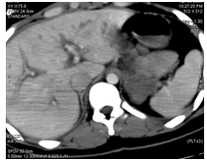
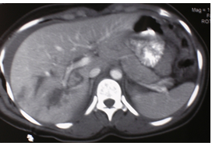
Liver injury- CT scan

Slide 85
Liver injury- Non-operative management
Hemodynamically stable patients
CT scan
If No other indications for abdominal exploration
ICU admission for close observation
Serial hemoglobin estimation
Transfusion requirements of <2 units of blood
Surgery- if become unstable

Slide 86
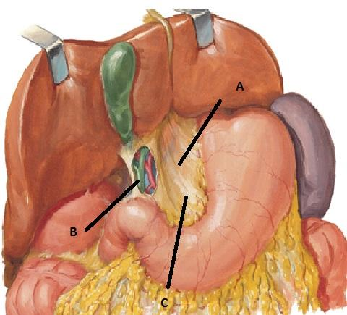
Liver injury-Surgical management
Principles of surgical management:
- control of bleeding,
- removal of devitalized tissue, and
- adequate drainage.
Bleeding vessels & biliary radicles are individually ligated.
Pringle’s maneuver:
clamping the hepatoduodenal ligament (the free border
of the lesser omentum)
Perihepatic packing- if fail to control bleeding.
Packs removed in 48 hours.

Slide 87
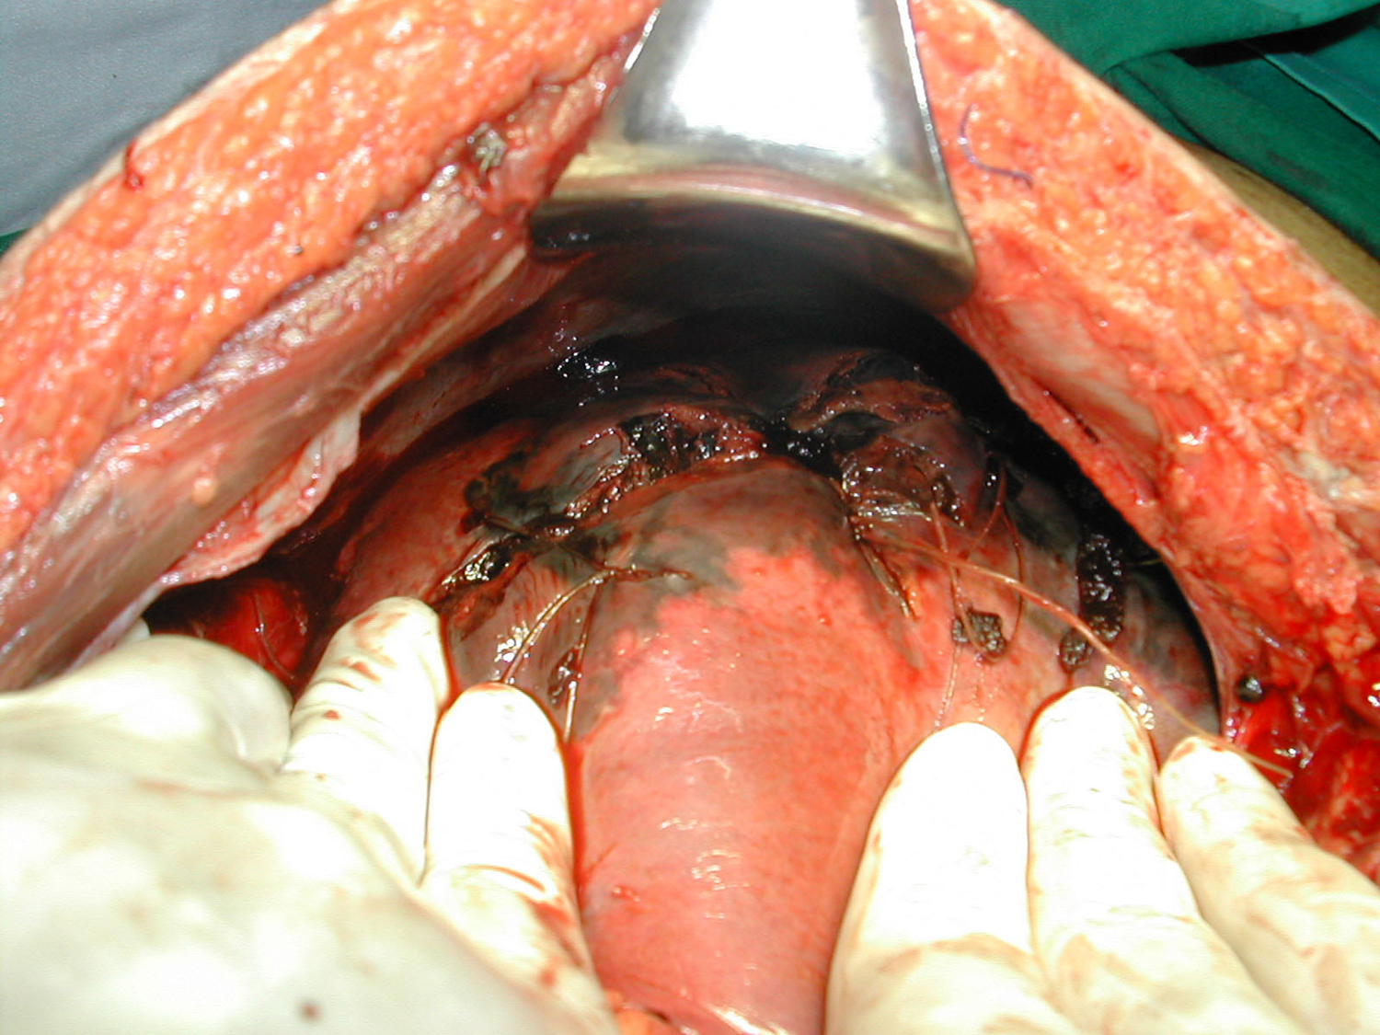

Slide 88
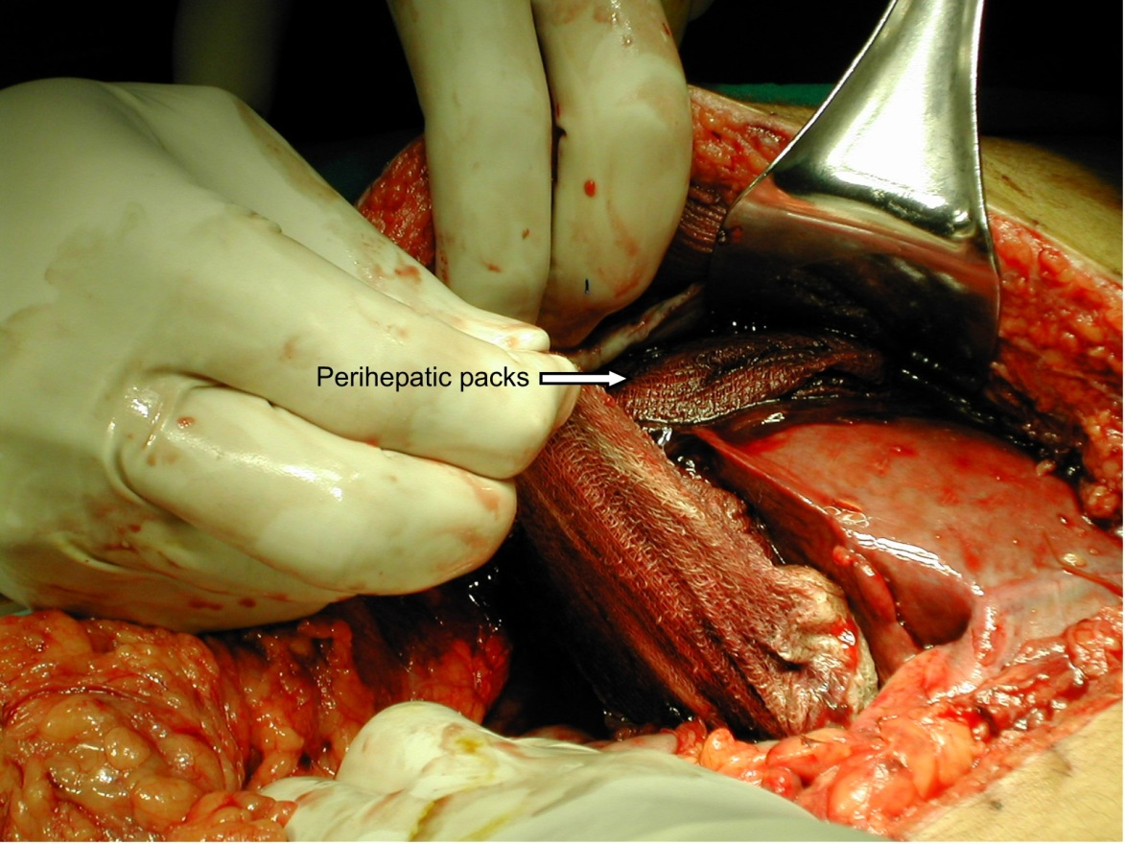

Slide 89
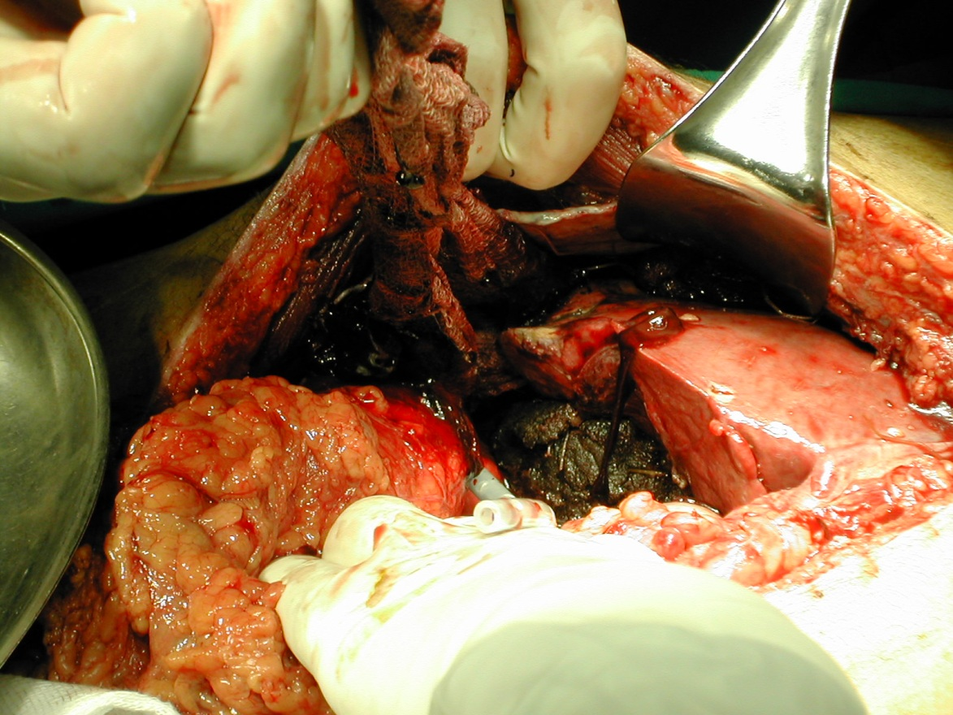

Slide 90
Pancreatic injuries
Uncommon.
Penetrating injury or direct blow.
Diagnosis: difficult
- U/S, CT scan, elevated serum amylase may help
Treatment:
- No ductal injury: simple drainage
- Ductal injury: distal resection

Slide 91
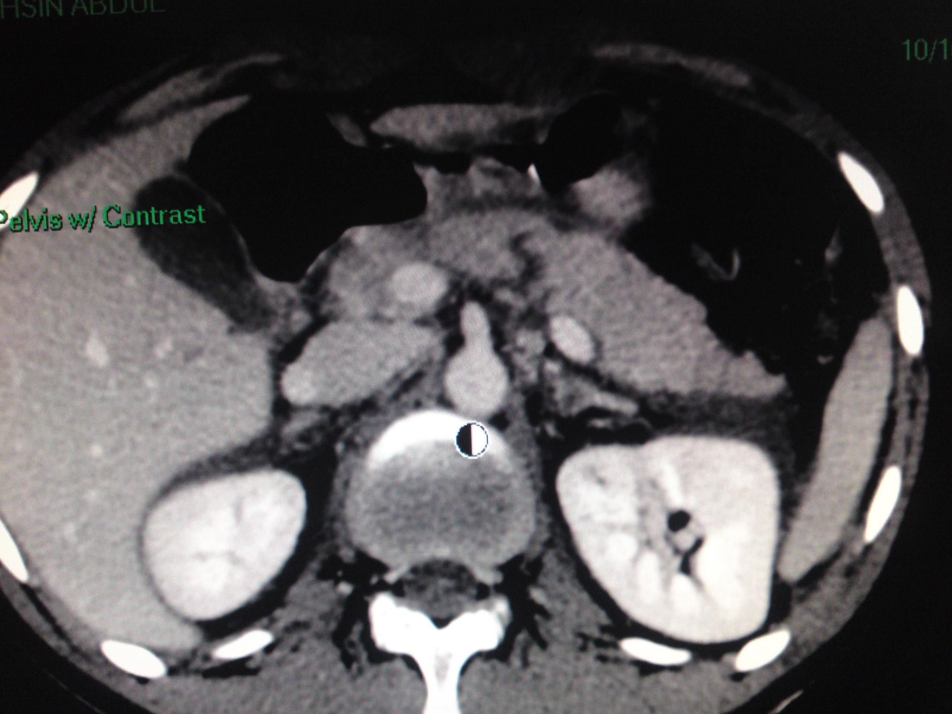

Slide 92
Bowel injuries
Mostly - in penetrating trauma.
Less common - after blunt trauma.
Features of peritonitis will be evident.
CT scan: - free air in peritoneum
- contrast leak.
Rx: - Small bowel: Suture repair
- Colon: Suture repair ± proximal colostomy

Slide 93
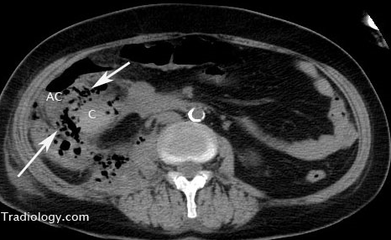
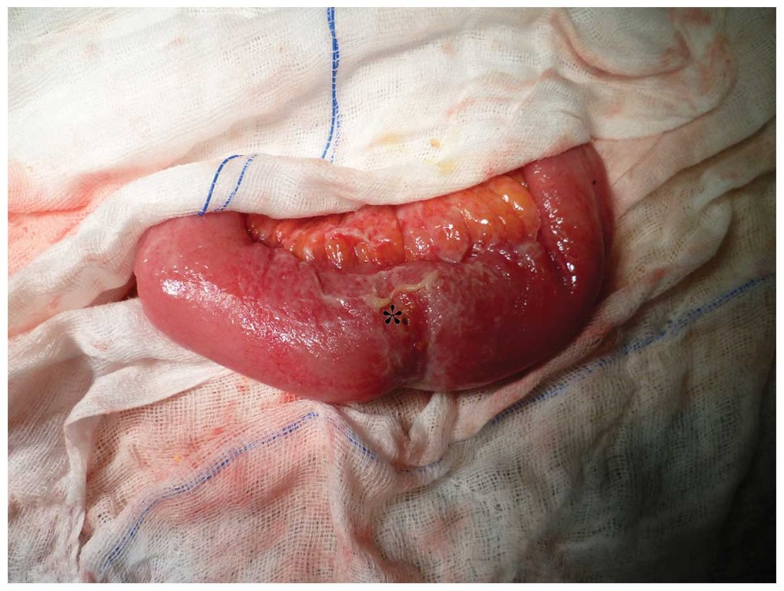
Bowel injuries
CT: contrast leak (C) & free air Intraoperative

Slide 94
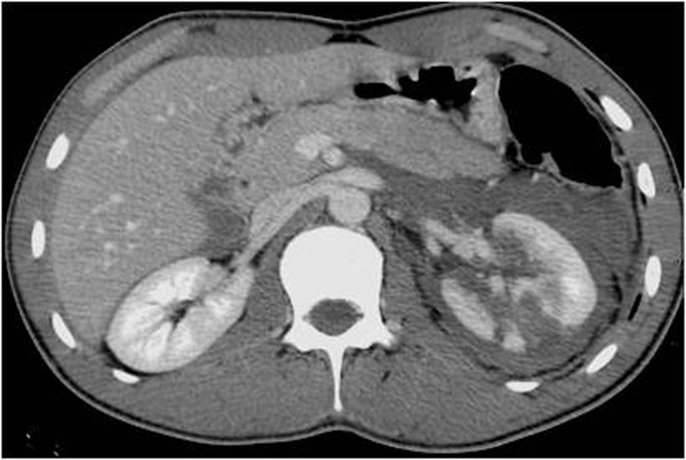
Renal injuries
Minor - renal contusion (85%)
- Conservative management
Major:
Deep medullary injuries with extravasation &Vascular injuries
- Surgical repair

Slide 95
Thank you!

