Slide 1
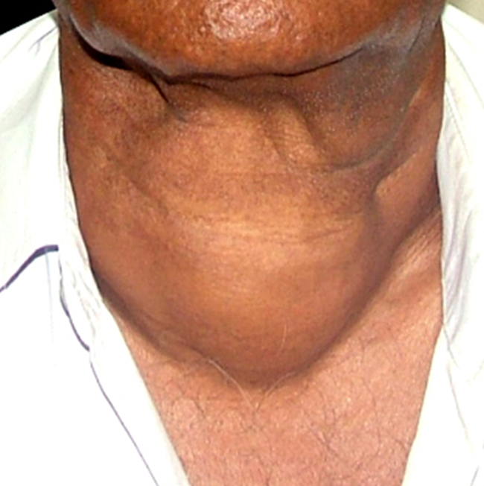
Thyroid Gland Diseases

Slide 2
CLO’s
Surgical anatomy, development & physiology
Thyroid diseases- classification, aetiology, clinical presentations, investigations & treatment
Complications of thyroid surgery

Slide 3
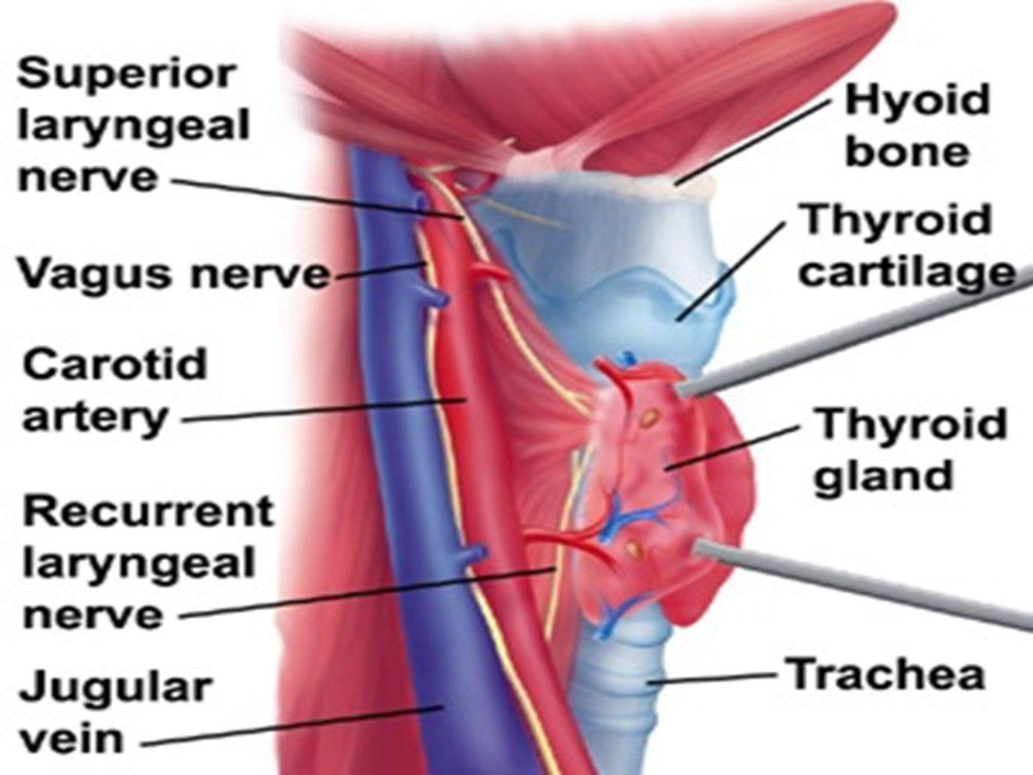
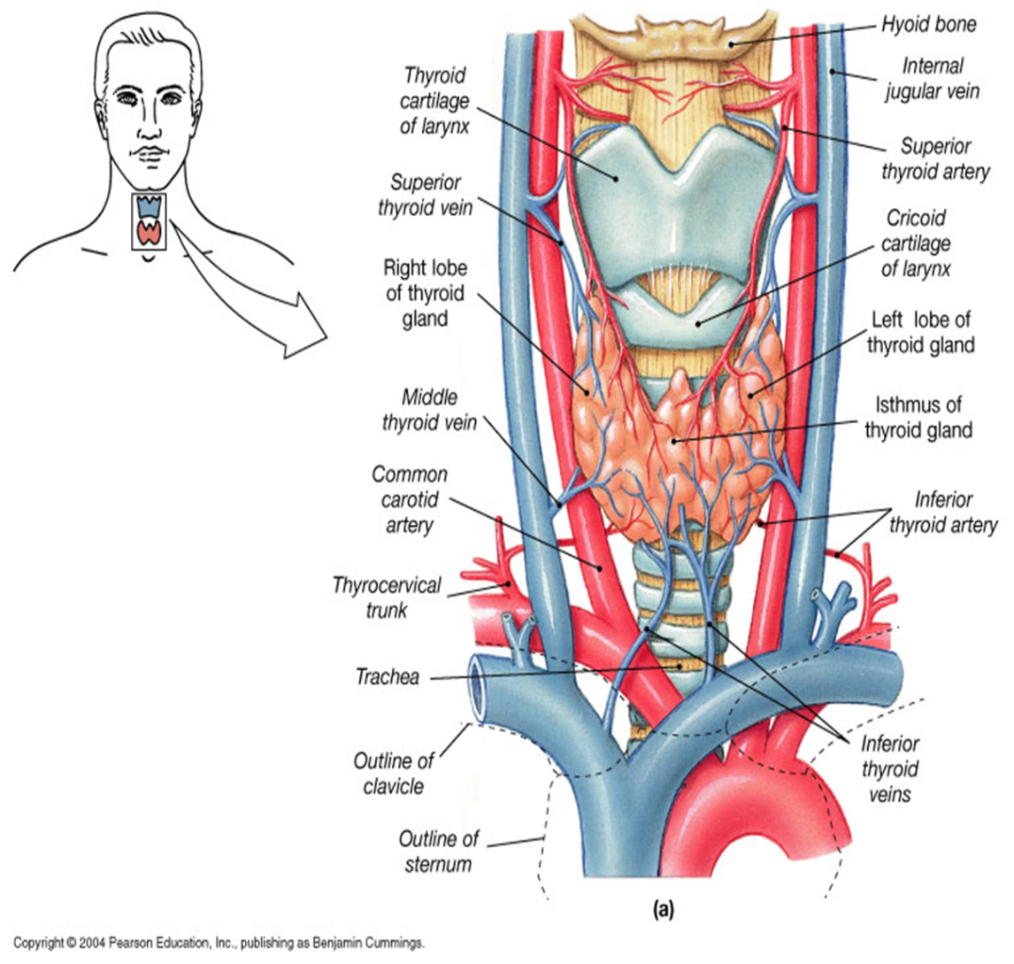

Slide 4
Classification- thyroid diseases
Congenital- Thyroglossal cyst, Lingual thyroid
Simple - Non-toxic goitre, MNG, STN, Cyst
Functional disorders- Hypothyroidism Hyperthyroidism- Grave’s disease, Toxic adenoma, Toxic MNG, Thyrotoxicosis factitia
Thyroiditis- Hashimoto’s disease, acute/ subacute thyroiditis, Riedel’s thyroiditis
Neoplasm: Benign: Follicular adenoma
Malignant: Papillary, Follicular, MTC, Anaplastic, Lymphoma, Metastatic

Slide 5
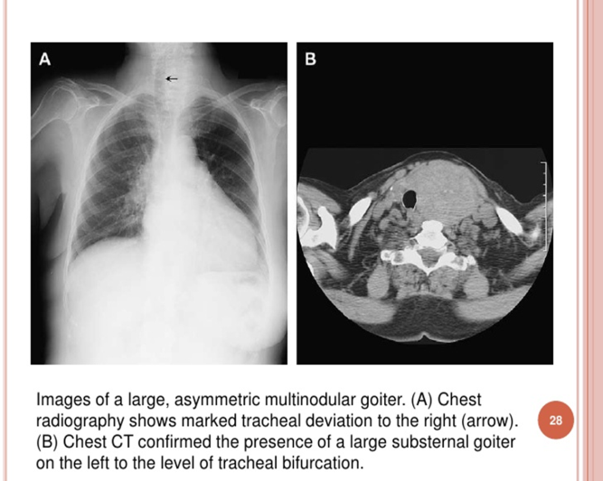
Assessment of Thyroid Diseases
FT4, T3,TSH (TSH low in hyper, high in hypo) TRH (hypothalamus) Serum Calcitonin (MTC)
Antibodies: TSI-thyroid stimulating immunoglobulin, Anti-thyroglobulin antibody, anti-TPO- thyroid peroxidase
Ultrasound
FNA: accurate, palpation/US guided- non-diagnostic /benign/ undetermined / follicular neo./ suspicion of malignancy/ malignant- Bethesda system
Radioisotope scanning (Tc99-Sodium pertechnetate)- toxic goitres
CXR, CT, MRI ( retrosternal mass, staging malignancy, local invasion)
PET scan
Laryngoscopy- vocal cord assessment

Slide 6
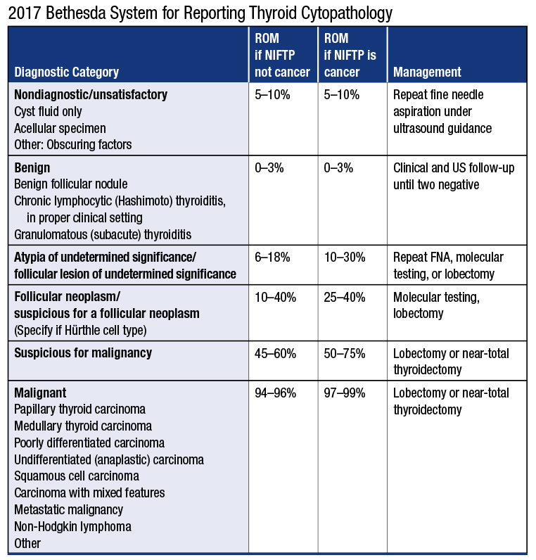

Slide 7
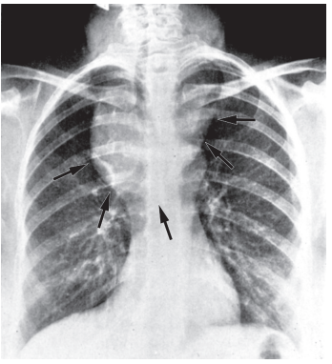
Retrosternal thyroid (arrowed) shown on a chest X-ray.

Slide 8
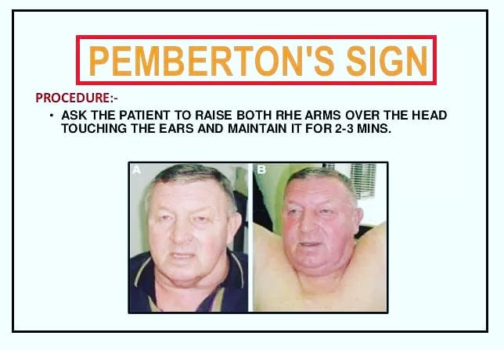
Pemberton's sign is used to evaluate venous obstruction in patients with goiters. The sign is positive when bilateral arm elevation causes facial plethora. It has been attributed to a “cork effect” resulting from the thyroid obstructing the thoracic inlet, thereby increasing pressure on the venous system.

Slide 9
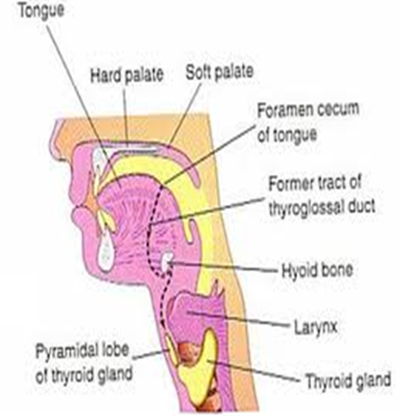
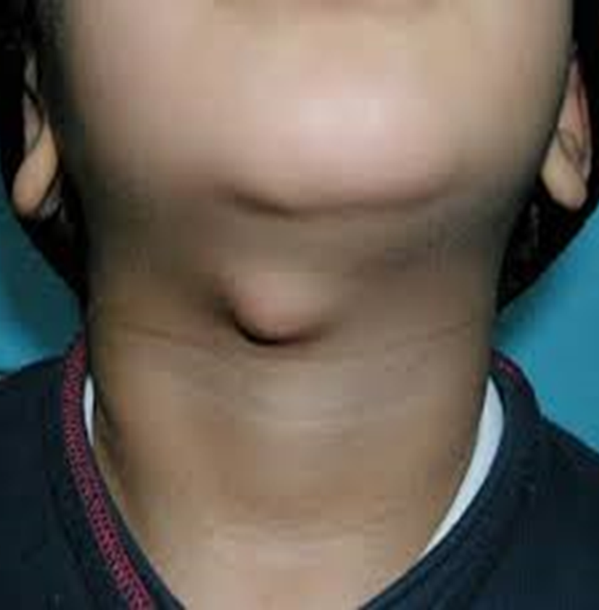
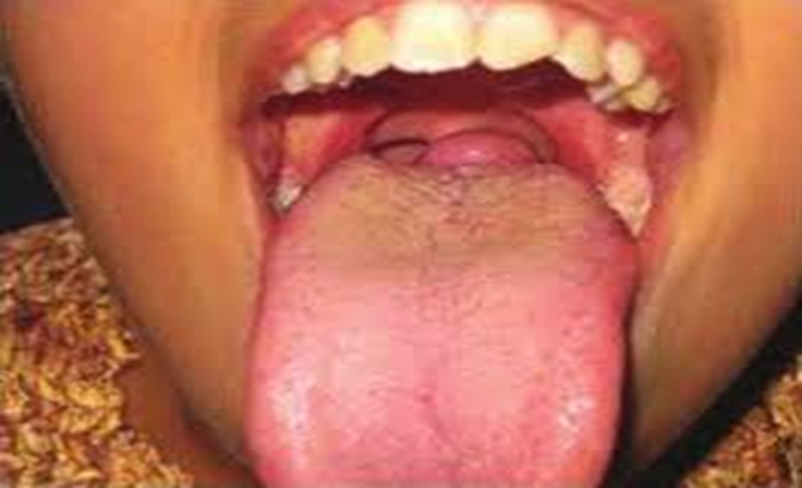
Congenital

Slide 10
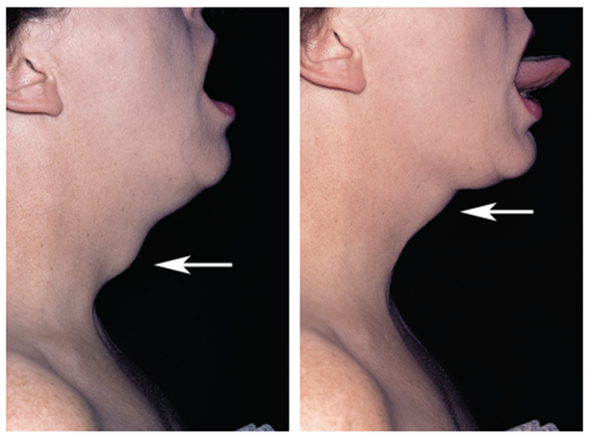

Slide 11
Hypothyroidism
Primary:
Hashimoto’s disease
Post RAI for Grave’s disease
Post thyroidectomy
Sub-acute thyroiditis
Iodine deficiency
Goitrogens use- lithium, anti-thyroid drugs
Inborn errors of thyroid hormone synthesis
Secondary:
Hypopituitarism

Slide 12
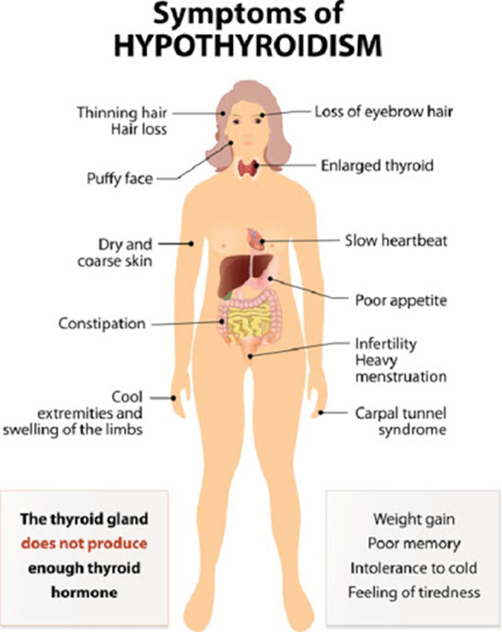
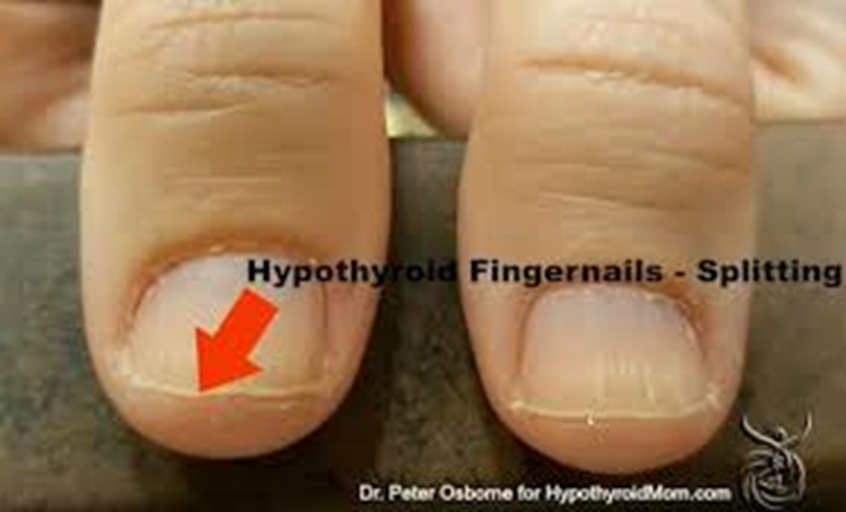
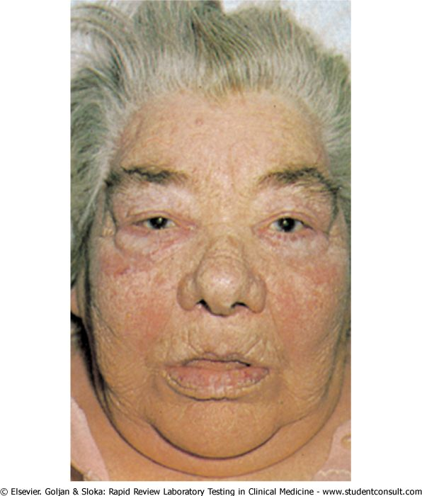
SIGNS OF HYPOTHYROIDISM
•• Obese
•• Dry inelastic skin
•• Macroglossia
•• Mask like facies
•• Loss of hair in lateral eyebrow
•• Hoarseness of voice
•• Pseudomyotonic reflex (delayed ankle jerk); also called ‘hung up’ reflex

Slide 13
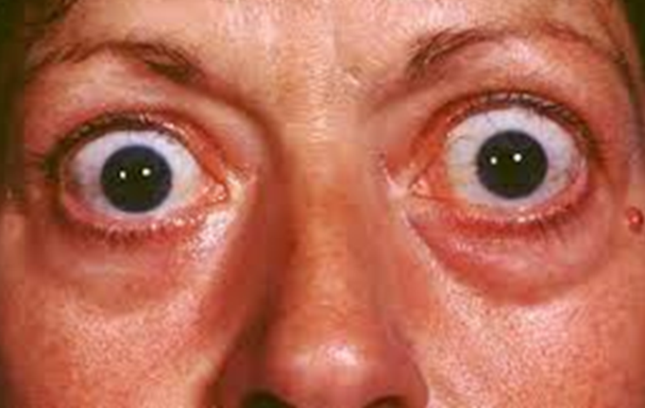
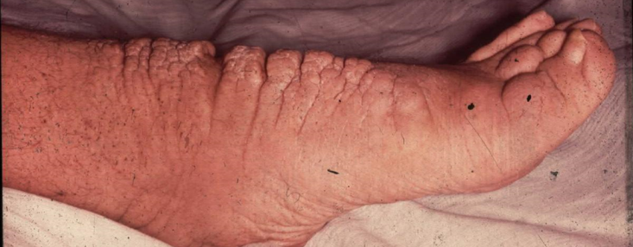
Grave’s Disease
Most common form of thyrotoxicosis (60-80 %)
Any age, common in 20-40 age group
5 times > in females
Autoimmune disease
15% relatives with same disorder
Disease consists of one or more of the following:
- Thyrotoxicosis
- Goitre (diffuse enlargement, ± bruit)
- Ophthalmopathy (exophthalmos, lid-lag, lid retraction, chemosis ophthalmoplegia)
- Dermopathy (pretibial myxedema – only 2%)

Slide 14
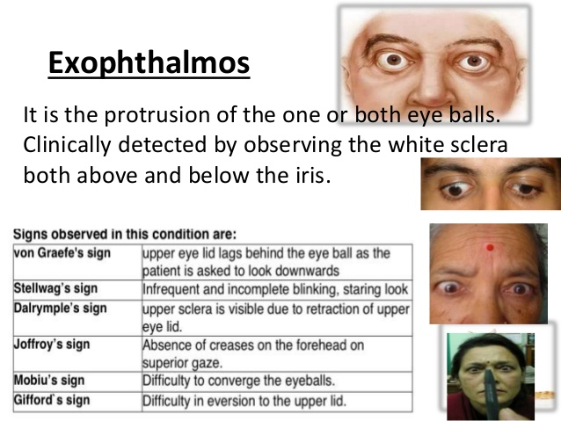

Slide 15
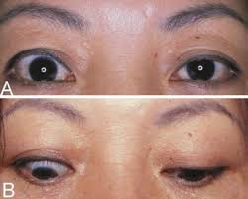
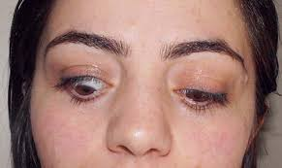

Slide 16
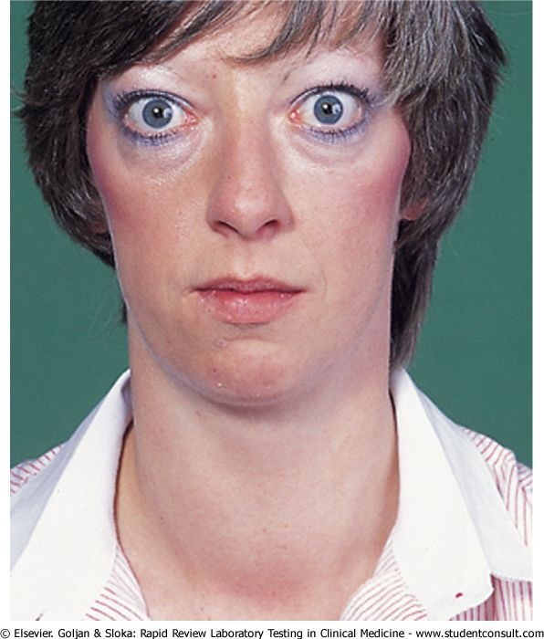
Features of thyrotoxicosis (Grave’s Disease)
Heat intolerance, excessive sweating
CVS: tachycardia, palpitation, atrial fibrillation, CHF
GI: Wt. loss, increased appetite, diarrhoea
Neuromuscular: anxiety, nervousness, tremor, proximal myopathy
Reproductive: amenorrhea, infertility

Slide 17
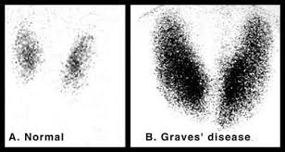
Diagnosis of Grave’s Disease
Low TSH, high FT4, &/or T3
Detection of TSH-R Ab: TSI-thyroid stimulating immunoglobulin
Isotope scan- diffuse high uptake
Ultrasound- rarely needed

Slide 18
Treatment of Grave’s Disease
Antithyroid drugs:
Blocks coupling of iodine with tyrosine
Supress synthesis of thyroxine
Carbimazole- 30-60 mg daily, divided dose-4-6 weeks
Other drugs- Propylthiouracil, β- blocker- propranolol
Skin rash, agranulocytosis,
Long term remission- only 20-30%

Slide 19
Treatment of Grave’s Disease
Radioactive iodine ablation: RAI treatment of choice for most. 1-2 dose- oral, 90% cure at 1 year
Contraindications: pregnancy, lactation, suspicion of carcinoma, low iodine (<20%) uptake
Surgery: RAI ablation contraindicated. Preoperatively- euothyroid with antithyroid medication. Total thyroidectomy- recommended

Slide 20
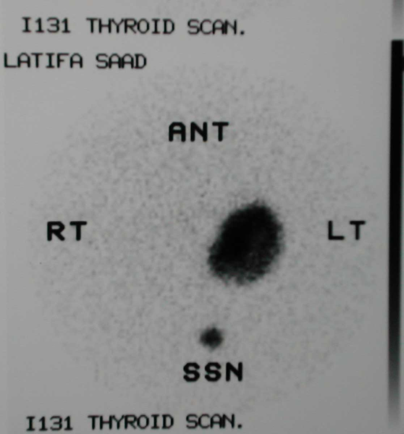
Toxic MNG (Plummer’s disease):
Secondary hyperthyroidism:
This is overactivity that develops in an already hyperplastic gland. It is a disease of the middle age and occurs in patients with a preexisting euthyroid enlarged nodular gland. i.e. Long history of MNG.
Develops from multinodular goiter. Nodules become autonomous i.e., become hyper active- independent of TSH
Cardiac symptoms more common, eye symptoms-rare
Toxic adenoma:
Single nodule, hyperactive, independent of TSH
Radioactive scan: ‘Hot’ one/ more nodule, rest suppressed
Treatment: RAI ablation
Surgery: Large MNG with obstructive symptoms Failure of RAI

Slide 21
Thyroiditis: Hashimoto’s disease
Chronic autoimmune, destructive lymphocyte infiltration
Commonest cause of hypothyroidism
Females- >10 times
90 % - circulating anti-TPO (thyroid peroxidase)
Initially euothyroid, later hypo- wt. gain, cold intolerance, constipation, dry skin, weakness
Diffuse goitre/ may be nodular
May change to lymphoma
Diagnosis: Low T4, increased TSH, anti TPO, FNA
Treatment: Thyroxine replacement Surgery- compressive symptoms, ? malignancy

Slide 22
Other types of thyroiditis
Acute suppurative thyroiditis: Staph/strep infection. Treatment: antibiotics ± drainage
Sub-acute thyroiditis (de Quervain): young female, often post-viral URTI. Thyroid/jaw/ear pain. Resolves spontaneously. NSAID- relief of symptoms
Riedel thyroiditis: Idiopathic progressive inflammation of thyroid & surrounding- replaced with dense fibrosis. Firm painless swelling, tracheal compression. Surgery difficult- to exclude malignancy, relieve compression,

Slide 23
Simple goitre
Aetiology: Endemic (iodine deficiency), goitrogenous food (cabbage), enzymatic deficiency of hormone synthesis
Gland enlarges, follicle filled with colloid, multiple nodule filled with colloid & cyst formation
Neck Swelling- no symptom multiple/solitary nodule dyspnoea, dysphagia
Investigations: Normal hormones, U/S, CT
L-thyroxine suppression therapy – 0.1-0.2 mg/day, Rarely effective
Surgery: Compression, cosmetic, ? Malignancy
Total thyroidectomy

Slide 24
Solitary Thyroid Nodule (STN)
Definition: A discrete swelling in an otherwise impalpable thyroid
3-4% of adult, F:M-4:1
Risk of malignancy 10-15%
Condition presenting as STN:
- Dominant nodule of MNG (Toxic nodule)
- Thyroid adenoma
- Cyst
- Carcinoma 10-15% (Children 50%)
- Colloid goitre (simple nodule)
- Localised type of thyroiditis

Slide 25
STN- Risk factors for carcinoma
Male > 50, children
Exposure to radiation (low dose)- Hodgkin’s, ca-breast
Rapid nodule growth
Pain, hoarseness, compressive symptoms
History of MEN 2 (HPT, phaeochromocytoma, MTC)
Family history of thyroid carcinoma
Firm, irregular, fixation, LAP (papillary carcinoma)

Slide 26
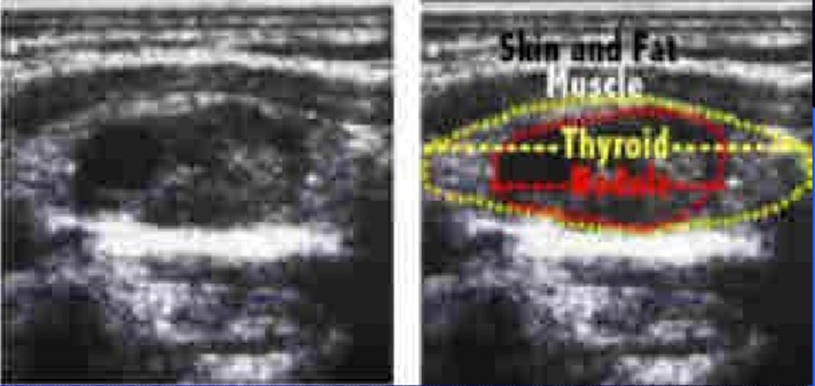
STN- Evaluation
TFT, serum calcitonin, antibodies
US: Solid/ cyst / art of MNG/ LAP
Isotope scan: differentiate toxic nodule vs toxic MNG
FNAC: colloid nodule, thyroiditis, papillary/MTC/anaplastic ca/ lymphoma. Cannot distinguish follicular adenoma vs carcinoma

Slide 27
Indication for surgery in STN
Malignant or suspicion of malignancy
Toxic adenoma
Pressure symptoms
Cosmetic

Slide 28
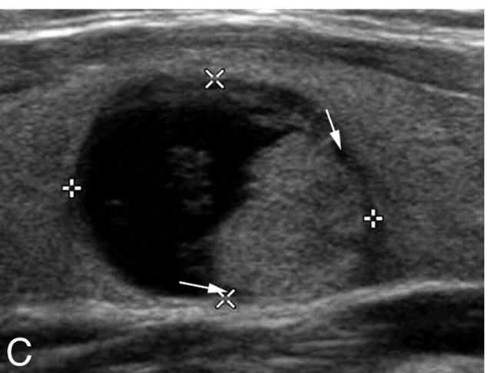
Thyroid Cysts
15-20% lesions are cysts
Solid area within cyst suggests malignancy. 25% papillary ca. undergo necrosis- appear partially cystic
Benign cyst- aspiration is curative
Indications for surgery:
-Recurrent cyst
-Malignant cytology of aspirated cyst fluid
-Haemorrhagic fluid
-Residual swelling after aspiration
-Large cyst > 4cm

Slide 29
Thyroid carcinoma
Papillary (including mixed papillary & follicular) - 75%
Follicular - 16%
Medullary - 5%
Undifferentiated (anaplastic) - 3%
Miscellaneous ( lymphoma, fibrosarcoma, squamous cell ca, teratoma, & metastatic ca)-- 1%

Slide 30
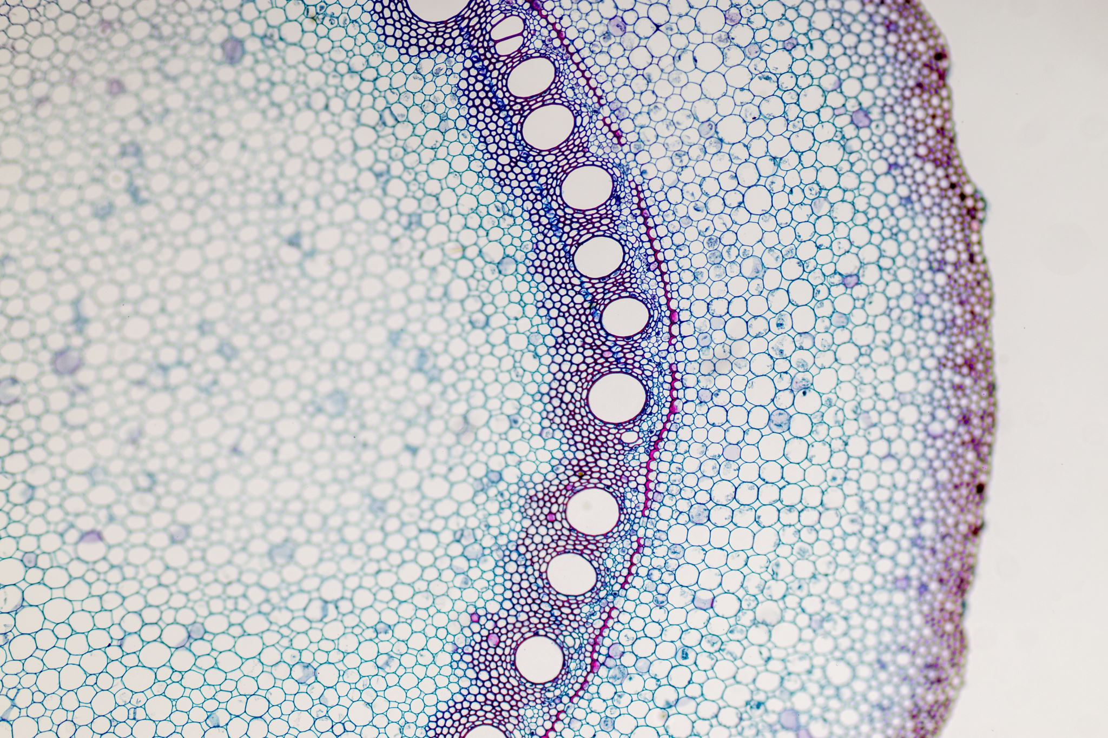
Aetiology
History of irradiation—papillary carcinoma.
2. History of longstanding multinodular goiter—follicular carcinoma.
3. Family History of—medullary carcinoma thyroid.
4. Hashimotos thyroiditis—lymphoma and papillary carcinoma.
5. Thyroglossal cyst—papillary carcinoma.

Slide 31
Papillary Carcinoma
Solitary firm nodule/ dominant nodule in MNG
Slow growth, remains confined to thyroid & LN for years
U/S- solid nodule Isotope scan- ‘cold nodule’
Enlarged LAP in - 10%
FNA diagnostic
Thyroglobulin- marker for recurrence or metastasis
Later stages- metastasis to lung
May convert to undifferentiated type

Slide 32
Follicular Carcinoma
Differs from follicular adenoma by the presence of capsular or vascular invasion (FNA cannot differentiate)
More aggressive than papillary,
Spread- mainly by blood .
Death due to local extension/ extensive metastasis of bone, lungs & viscera
Thyroglobulin- to follow the course of the disease

Slide 33
Management of Papillary & Follicular Carcinoma
Low risk group: 1. Age <45 2. Primary lesions <1cm 3. No evidence of intra/ extra-glandular spread. Treatment: Lobectomy + isthemectomy
All other high risk: Total thyroidectomy.
Modified neck dissection for lymphatic spread.
Surgery followed by RAI ablation therapy
Patient placed on L-thyroxine suppressive therapy
Regular F/U: Thyroglobulin, US, whole body scan.

Slide 34
Medullary Carcinoma (MTC)
A disease of the C cells (parafollicular cells)
MTC- 80% sporadic , the rest are familial
More aggressive than papillary or follicular ca. Less aggressive than undifferentiated thyroid cancer
Extends locally, invade lymphatics & blood vessels
Calcitonin & CEA - markers for DX and F/U
Treatment : TOTAL THYROIDECTOMY

Slide 35
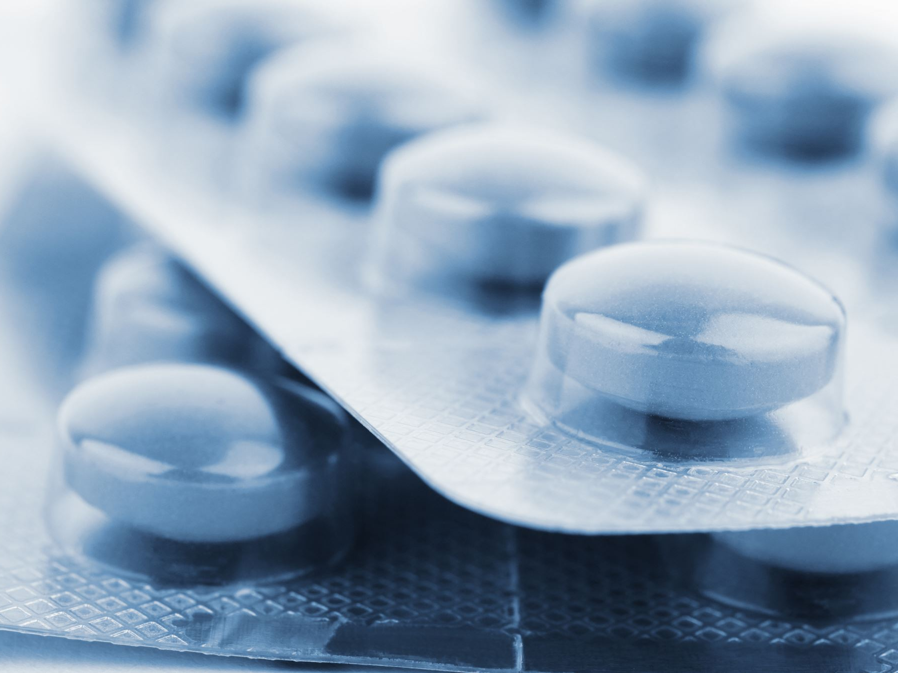
Undifferentiated (Anaplastic) Carcinoma
Older patients with a long history of goiter
The gland suddenly—over weeks or months—begins to enlarge and produce pressure symptoms, dysphagia, or vocal cord paralysis
Death from local extension- within 6-36 months
Very resistant to therapy

Slide 36
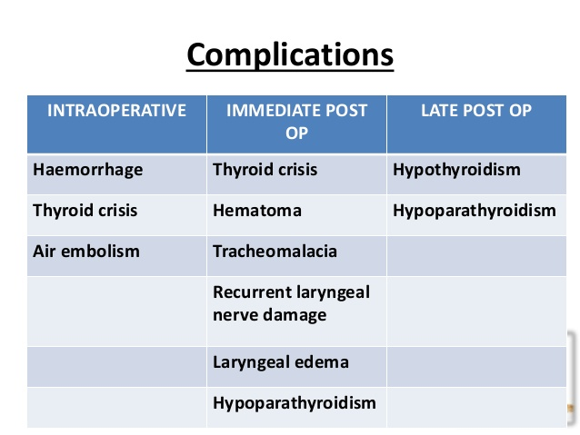

Slide 37
Complications of Thyroid Surgery
1.Tension Haematoma (1%): Usually within 6 hours of surgery. Management: immediate opening of the incision, airway control & return to OR- wound irrigation & control of bleeding
2.Recurrent laryngeal nerve injury (RLN): 1%
Transient recovers in 1-6 weeks. Unilateral- hoarseness of voice. Bilateral- compromises airway, may need tracheostomy. The nerve provides the motor supply to the vocal cords (all intrinsic muscles of the larynx except cricothyroid) and sensory supply to the mucous membrane of the larynx inferior to the vocal folds.
The external branch of superior laryngeal nerve leading to a subtle disturbance in voice and in particular singing

Slide 38
Develops typically 24-72 hrs post operatively, but may manifest as early as as 1-3 hrs after surgery.
• Laryngeal muscles are sensitive to hypocalcemia and inspiratory stridor progressing to laryngospasm, may be the first indication.
Circumoral tingling/ numbness , Chvostek’s/ Trousseau’s sign
Transient- Ca-carbonate 1 g x tds oral.
Severe: 10% Ca gluconate infusion.
Permanent: parathyroid tissue auto transplant
4. Hypocalcaemia

Slide 39
5. Tracheomalacia:
• It occurs after removal of long standing goiter, especially the thoracic inlet, that has compressed and weakened cartilaginous rings supporting the tracheal wall.
• Immediate intubation or tracheostomy should be performed.
• Later options include stenting, extrinsic tracheal support, tracheoplasty.

Slide 40
THANKS

