Slide 1
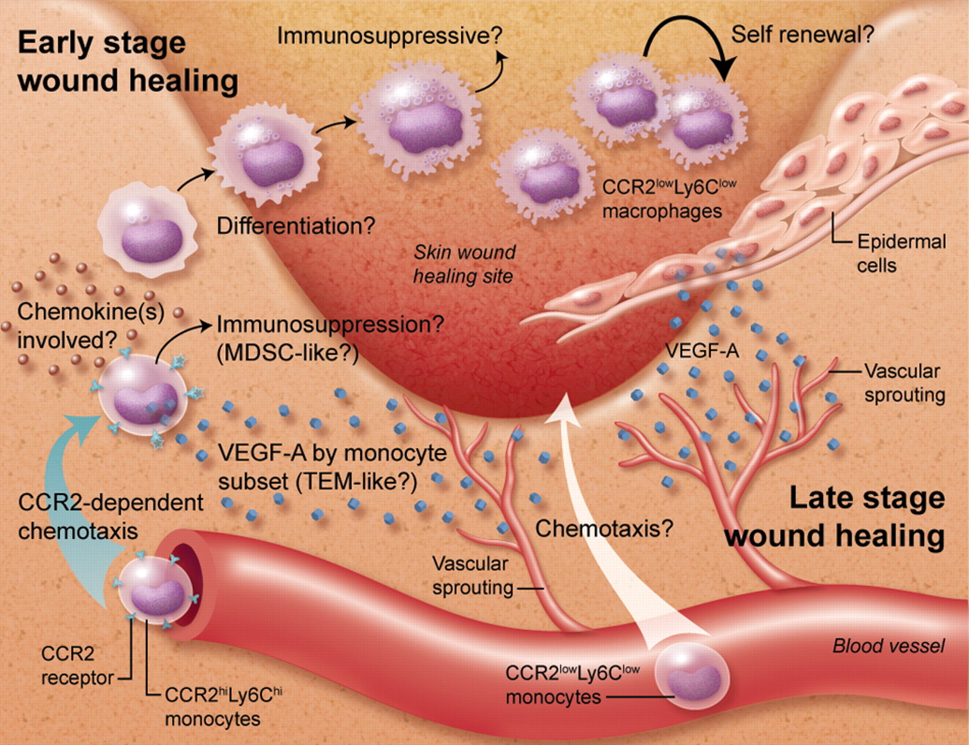
Wound healing
Moneer Almadani MD, FACS, F.MAS
Assistant Professor of surgery
Head of surgery unit
Consultant surgeon upper GI, obesity, & gastric oncology

Slide 2
Objectives
Introduction
Phases
Types
Wound closure
Factors influencing wound healing
Complications

Slide 3
Introduction
Wound is a break in the skin
Wound healing is the effort of injured tissue to restore normal function and structural integrity after injury
A complex series of events , begins at the moment of injury and could continue for months to years

Slide 4
Introduction
Healing, & tissue repair are central in surgery
Understanding the physiologic mechanism involved in process of wound healing
Create an environment where healing can proceed in an optimal fashion
Accomplished

Slide 5
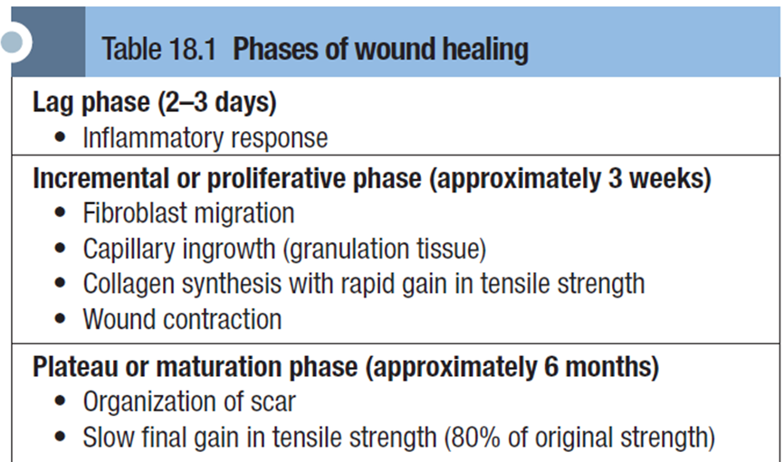
Phases of healing

Slide 6
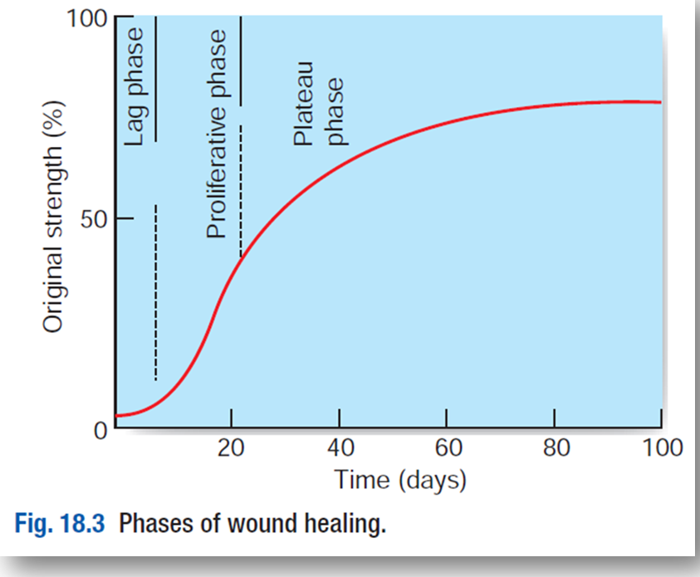
Phases of healing
Overlap in both time and activity
All wounds undergo the same basic steps of repair
Acute wounds proceed in an orderly
and timely reparative function
Chronic wounds stalled in the inflammatory
phase, and doesn't proceed to closure

Slide 7
Phases of healing
Lag phase:
  Characterized by an inflammatory response to injury, during which capillary permeability increases and a protein-rich exudate accumulates
  Inflammatory cells migrate into the area, dead tissue is removed by macrophages, and capillaries at the wound edges begin to proliferate
  Elapses before fibroblasts begin to manufacture collagen to support the wound

Slide 8
Phases of healing
Incremental phase
  (Regenerative)
  Systemic stimulus for fibroblast activity.
  Progressive collagen synthesis by fibroblasts
  Increased in collagen turnover
  Old collagen undergoes lysis and new collagen is laid down
  Increased in tensile strength

Slide 9
Phases of healing
Plateau phase:
  (Maturation)
  After 3 weeks, the gain in tensile strength levels off
  Excess collagen is removed during this final clearing-up process
  Fibroblasts and inflammatory cells declined
  Skin and fascia recover only 80% of their original tensile strength

Slide 10
Types of surgical wounds

Slide 11
Types of wound closure
  Primary (First intention)
  Wounds are sealed immediately
  Clean type
  Simple suturing, & Skin graft /flap
  Secondary (Second intention)
  No closure
  Highly contaminated wounds
  Re-epithelialization > Wound contracture
  Tertiary (Third intention)
  Delayed primary closure
  Contaminated wounds treated first, once the wound is clean then closed

Slide 12
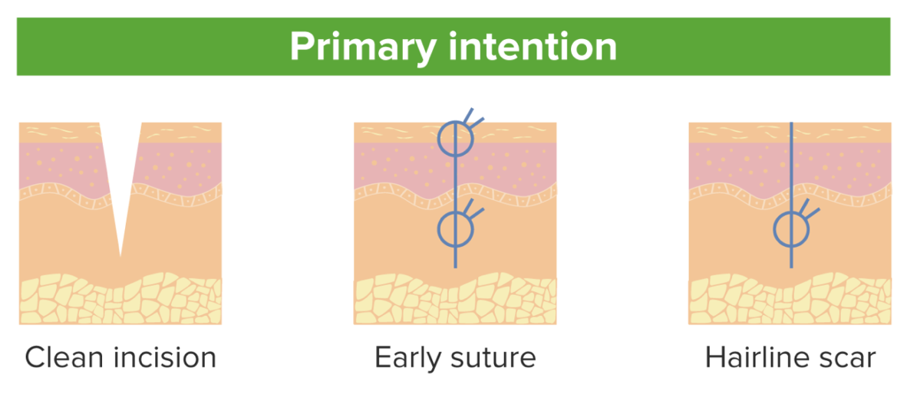
Types of wound closure

Slide 13
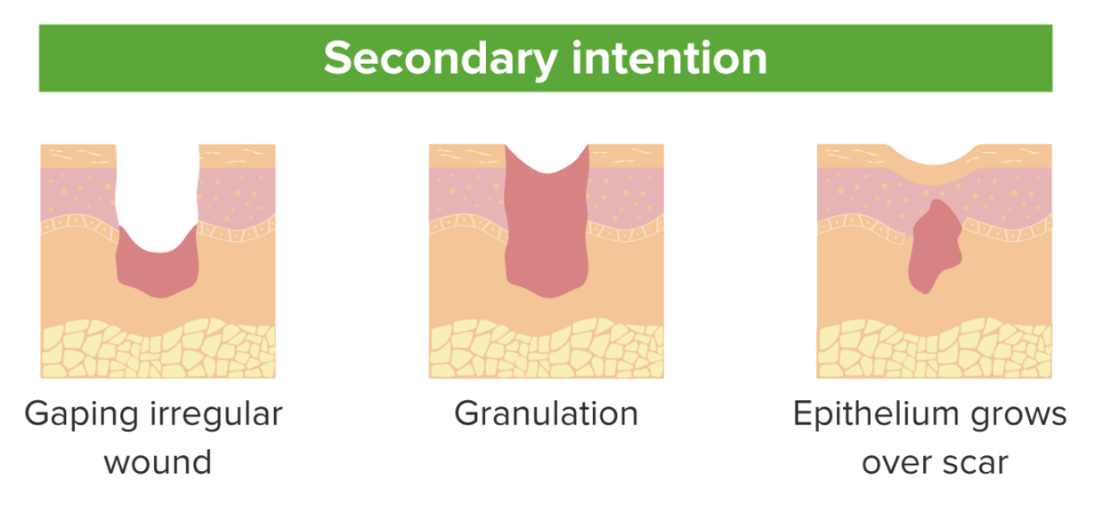
Types of wound closure

Slide 14
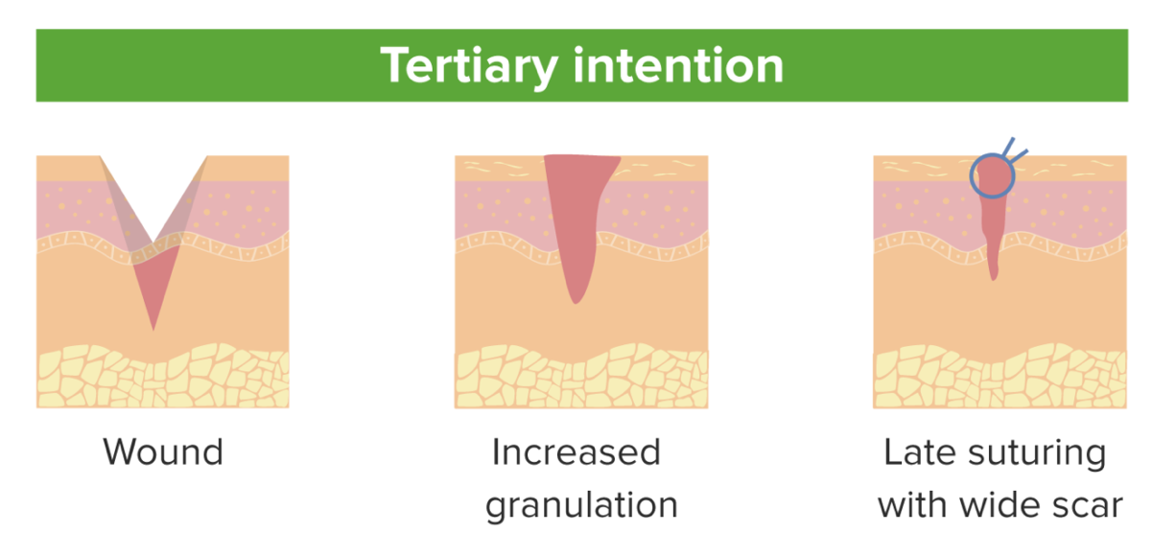
Types of wound closure

Slide 15
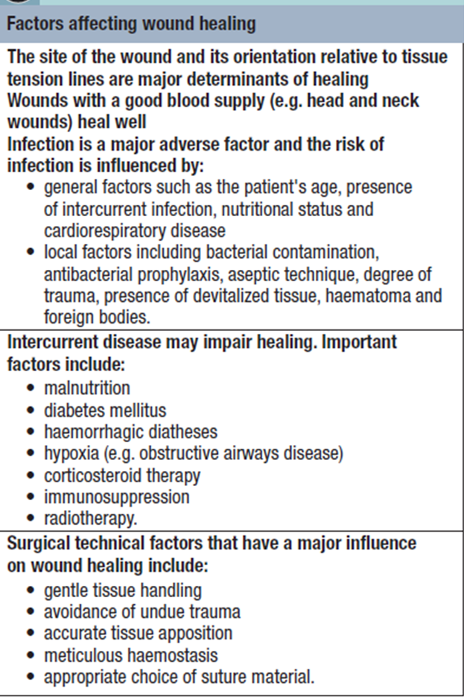
Factors affect wound healing

Slide 16
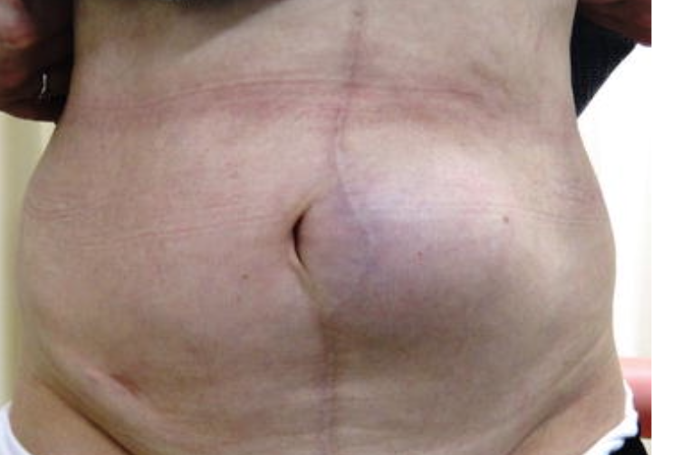
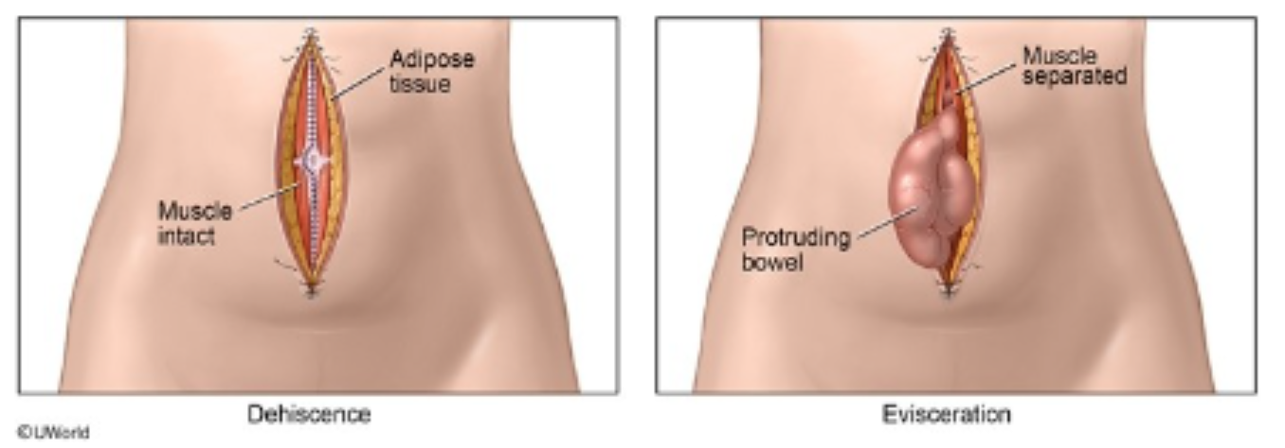
Complications of wound healing
Wound infection
Evisceration
Bleeding
Adhesions
Herniation
Sinus/Fistulation
Suture complications
Malignant changes
Excessive healing
(Hypertrophic scar- Keloid)

Slide 17
Excessive wound healing
Keloid scar Vs. Hypertrophic scar

Slide 18
Excessive wound healing
Keloid scar Vs. Hypertrophic scar

Slide 19
Excessive wound healing

Slide 20
References
Principles and Practice of Surgery
  Pg 281-286

Slide 21
Thanks

