Slide 1
The Liver

Slide 2
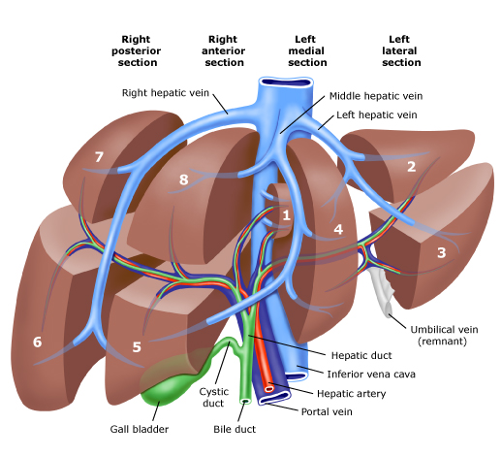
Surgical anatomy of the liver

Slide 3
Jaundice

Slide 4
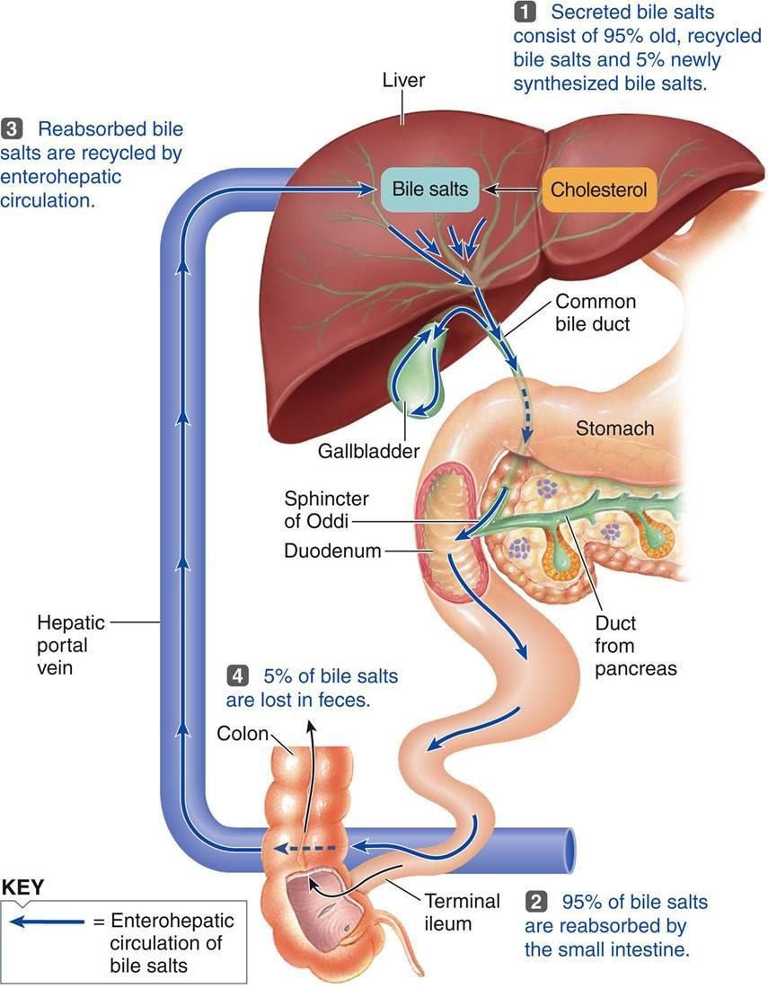

Slide 5
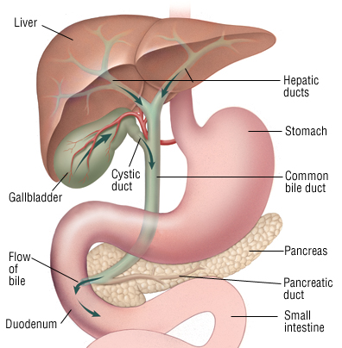
Pathogenesis jaundice is caused by an increase in the level of circulating bilirubin and becomes obvious in the skin and sclera when levels exceed 50 µmol/ l.
Bile flow

Slide 6
Causes of Jaundice
1. Pre hepatic
• transfusion reactions
• hemolysis secondary to sepsis, drugs or hematological diseases such as hereditary spherocytosis , sickle cell anemia
2. Hepatic
• hepatitis (e.g. viral hepatitis a, b, c)
• cirrhosis
• drugs

Slide 7
3. Post Hepatic (Biliary Obstruction – Surgical Jaundice)
Intraluminal - gallstones
• Intramural - benign biliary stricture
(ischemic, traumatic, primary sclerosing cholangitis)
- primary cancer (cholangiocarcinoma, Ampullary carcinoma)
• Extramural - secondary carcinoma (e.g. portal nodes)
- carcinoma on the head of pancreas
- chronic pancreatitis with pressure on distal CBD

Slide 8
Diagnosis
History and physical examination
a) Detailed history of the age , sex , occupation , social habits , drug and alcohol intake , history of drug injection or blood transfusion.
b) History of intermittent pain , fluctuating jaundice and dyspepsia suggest calculus obstruction of the common bile duct.
c) History of weight loss and progressive jaundice favors diagnosis of neoplasia.

Slide 9
d) Obstructive jaundice is likely if there is a history of passage of dark urine ,pale stools and pruritus ( owing to inability to secret bile salts into the obstructed biliary system)
e) Hepatocellular jaundice is likely if there are stigmata of chronic liver disease such as liver palms , spider naevi , testicular atrophy , and gynaecomastia
f) The abdomen must be examined for evidence of hepatomegaly , or distended gallbladder and for signs of portal hypertension such as splenomegaly , ascites and large collateral veins " caput medusa" in the abdominal wall

Slide 10
Biochemical and hematological investigations
a) Complete blood count : anemia may signify occult blood loss or hemolysis and low white cell and platelets count may indicate hypersplenism.
b) Coagulation screening : prolongation of prothrombin time may be present in both hepatocellular and obstructive jaundice and should be corrected with administration of vitamin k
c) Liver function test : in jaundice due to biliary obstruction , the circulating bilirubin is conjugated and rendered water-soluble ; it can then excreted in the urine and gives it a dark color. as bile can not pass to the gastrointestinal tract , the stool becomes pale and urobilinogen is absent from the urine. obstruction increase the formation of alkaline phosphatase from the cells of bile ducts. serum transaminase levels may raise in obstructive jaundice. however they significantly raised in hepatocellular injury.

Slide 11
Radiological investigations
if the clinical picture and biochemical investigations suggest that jaundice is obstructive , radiological technique can be used to define the site and nature of the obstruction.
a) Ultrasound : obstructive jaundice is diagnosed by biliary dilatation , especially the intrahepatic bile ducts and it can follow down the cause of biliary obstruction. ultrasound can show gallstone , common bile duct stone , space occupying lesion in the liver , liver metastases , ascites. gallstone can appear as hyper-echoic shadow with classical ' acoustic shadowing' in ultrasound.
b) Magnetic resonance imaging (MRI): magnetic resonant cholangiopancreatography (MRCP) is non-invasive tool to assess the biliary system. MRI can assess for any lesion causing biliary obstruction such as pancreatic tumor or cholangiocarcinoma.

Slide 12
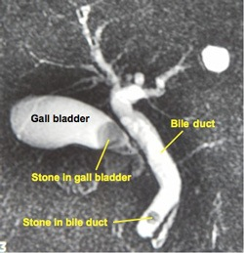
MRCP showing stone in the common bile duct and in the gallbladder

Slide 13
c) Endoscopic retrograde cholangiopancreatography (ERCP) : ERCP is an invasive diagnostic and therapeutic investigation which outline the biliary and pancreatic system by injecting contrast through a cannula inserted into the papilla of Vater by means of side viewing endoscope passed into the duodenum. it gives more detailed information than ultrasound and allows endoscopic extraction of common bile duct stones, biopsy of periampullary tumors , and relief of obstructive jaundice by stent insertion. complications of ERCP included acute pancreatitis , cholangitis , duodenal perforation and bleeding.

Slide 14
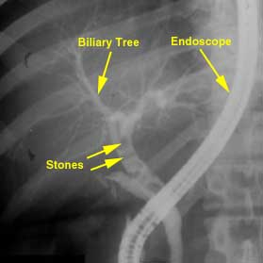
ERCP showing stone in the bile ducts

Slide 15
d) Percutaneous transhepatic cholangiography (PTC) : it is invasive investigation used to outline the proximal biliary tree in obstructive jaundice by injecting contrast through slim flexible needle passed percutaneously to the liver parenchyma and biliary system.
e) Computed tomography (CT): contrast enhanced CT scan can be used to identify and stage hepatic , bile duct and pancreatic tumors in obstructive jaundice due to these tumors.

Slide 16
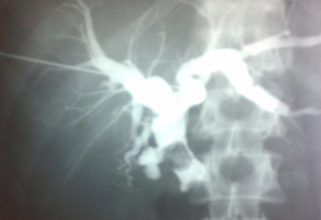
PTC showing stone in the common bile duct

Slide 17
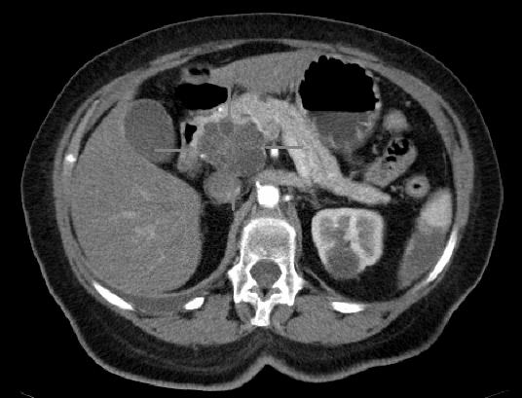
CT scan showing tumor in the head of pancreas

Slide 18
liver biopsy
Liver biopsy may be considered in patients with unexplained jaundice , in whom an obstructing lesion has been excluded radiologically.
laparoscopy
Laparoscopy under general anesthesia may be used in the evaluation of liver disease . in selected patients with malignancy of liver , biliary tree , and pancreas, it may have a role in the staging of the tumor t exclude peritoneal or liver dissemination.

Slide 19
Liver Abscesses
1) Pyogenic liver abscess
2) Amoebic liver abscess

Slide 20
Pyogenic liver abscess
Routes of infection
1. Biliary system (the commonest)
2. Portal system ( e.g. acute appendicitis)
3. Hepatic artery from any septic focus in the body (infective endocarditis)
4. Contagious organ ( e.g. empyema gallbladder)
5. Trauma (penetrating or blunt)
6. Idiopathic ( unknown source)

Slide 21
Clinical features
possible sign and symptoms:
1. Pyrexia of unknown origin
2. There is some times a history of sepsis elsewhere , particularly within the abdomen
3. Pain in the right upper quadrant
4. Swinging pyrexia , rigors , marked toxicity
5. Jaundice
6. The liver is often enlarged and tender

Slide 22
Investigations
1. blood tests: complete blood count will show leukocytosis and liver function tests are deranged
2. imaging: chest x-ray will show elevation of diaphragm and basal lung lobe collapse . ultrasound and CT scan is used to define the abscess.
3. ERCP: may be useful if biliary obstruction is thought to be responsible.

Slide 23
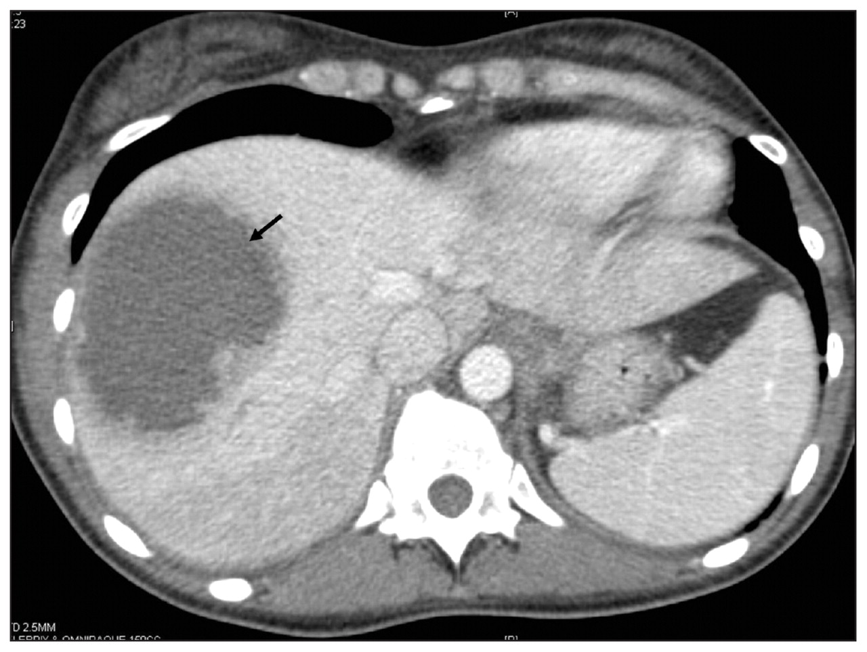
CT scan abdomen showing pyogenic abscess in the right lobe of the liver

Slide 24
Management
untreated abscess often prove fatal because of spread within the liver to multiple sites , and because of septicemia.
1. Intravenous antibiotics should be given to all patients
2. Drainage of the abscess : percutaneous drainage under ultrasound or CT scan guidance or surgical drainage if percutaneous drainage failed
3. Multiple small abscess may require prolonged treatment with antibiotics for up to 8 weeks.
4. Investigation is required to detect the source( e.g. colonoscopy , ERCP , CT scan abdomen)

Slide 25
Amoebic liver abscess

Slide 26
1) Entamoeba histolytica is a protozoal parasite that infests the large intestine. Trophozoites released by the cyst in the intestine may penetrate the mucosa to gain access to the portal venous system and so spread to the liver to cause amoebic liver abscess.
2) The abscess is large and thin-walled , is usually solitary , and in the right lobe , and contains brown sterile pus resembling “anchovy sauce “.

Slide 27
Clinical features
Symptoms
1) Right upper quadrant abdominal pain is the commonest symptom
2) Anorexia , nausea , weight loss and night sweating
Signs
1) Tender hepatomegaly
2) Jaundice (uncommon)
2) Other signs includes basal pulmonary collapse , pleural effusion.

Slide 28
Investigation
Lab tests: Leukocytosis , direct and indirect serological tests are extremely useful for diagnosis
Imaging: Ultrasound and CT scan are used to demonstrate the site and size of the abscess

Slide 29
Complications of amebic abscess
Amoebic abscess if untreated it may rupture into :
1) Peritoneal cavity causing peritonitis
2) Pleural space causing pleural effusion
3) Bronchus with anchovy sauce expectoration
4) Pericardial cavity causing cardiac tamponade and failure

Slide 30
Treatment
1) Treatment consist of administration of metronidazole 800mg 8hourly , for 7 – 10 days
2) The abscess should be aspirated under imaging guidance if no response to medical treatment within 72 hours

Slide 31
Hydatid liver disease

Slide 32
This infestation is caused in humans by one of two forms of tapeworm :
1. Echinococcus granulosus
2. Echinococcus multilocularis
Life cycle of echinococcus granulosus
1. The adult tapeworm lives in the intestine of the dogs , from which the ova passed in the stool
2. Sheep and goats serve as the intermediate host by ingesting the ova , whereas humans are accidental host.
3. Ingested ova hatch in the duodenum and the embryos pass to the liver through the portal venous system.
4. The hydatid cyst forms in the liver

Slide 33
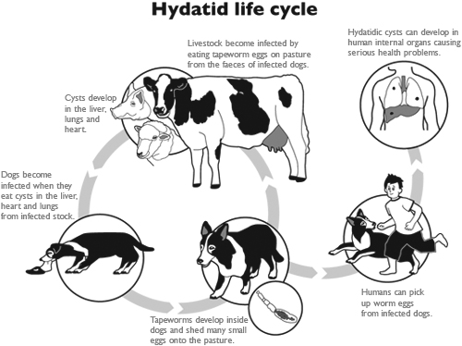

Slide 34
Clinical features
Symptoms :
1. The disease my be symptomless
2. Chronic right upper quadrant abdominal pain is the commonest presentation
signs :
Enlarged liver

Slide 35
Complications due to rupture of the cyst into :
1. biliary system which can cause obstructive jaundice
2. peritoneal cavity causing peritonitis and anaphylactic shock
3. pericardium causing cardiac tamponade
4. pleural cavity causing effusion and chest symptoms

Slide 36
Investigations
Laboratory tests : can show eosinophilia and serological tests , such as compliment
fixation test to detect the foreign protein of hydatid cyst.
Imaging : plain x-ray can show the calcification in the wall of the cyst
ultrasound and CT scan can show the site , size and daughter cyst in the liver

Slide 37
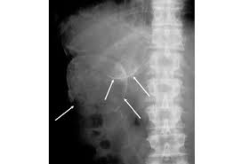
Calcification in the wall of the hydatid cyst in the right lobe of the liver

Slide 38
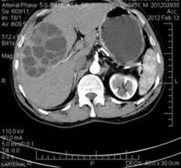
Hydatid cyst in the right lobe of the liver

Slide 39
Treatment
1. In asymptomatic patient , small calcified cyst my require no treatment
2. Patient can be treated successfully with albendazole or mebendazole but this may be prolonged
3. Surgery is the most effective treatment :
a) Deroofing and complete excision of the endocyst
b) Complete excision of the cyst ( pericystectomy )
4. Selected patients with central liver cyst may be suitable for puncture – aspiration-injection-re-aspiration (PAIR)

Slide 40
Tumors of the liver

Slide 41
Primary tumors
a) Benign 1) Adenoma
2) Focal nodular hyperplasia
3) Hemangioma
4) Hamartoma
b) Malignant
1) Hepatocellular carcinoma (hepatoma)
2) Cholangiocarcinoma
3) Angiosarcom
4) Haemangioendothelioma
5) Biliary cystadenocarcinoma
Secondary tumors ( metastasis)

Slide 42
Hepatocellular carcinoma (hepatoma)
Risk factors 1) Hepatitis b virus
2) Hepatitis c virus
3) Aflatoxin , derived from the fungus
"Aspragellus flavus“
4) Liver cirrhosis

Slide 43
Malignant Transformation
Multistep
HCC^{[2]}
Epigenetic alterations
Genetic alterations
Dysplastic nodules^{[1]}
Liver cirrhosis
Hepatitis C
Hepatitis B
Ethanol
NASH
Potential Targets
Oxidative stress and inflammation | Viral oncogenes | Carcinogens
Growth factors | Telomere shortening | Cancer stem cells
Loss of cell cycle checkpoints | Antiapoptosis | Angiogenesis
Normal liver
1. Tornillo L, et al. Lab Invest. 2002;82:547-553.
2. Verslype C, et al. AASLD 2007. Abstract 24.
Notes:
43
43
HCC, hepatocellular carcinoma; NASH, nonalcoholic steatohepatitis.
Jorge A. Marrero, MD, MS:
This slide illustrates the multistep transformation that results in the development of HCC. The process starts with a normal liver that undergoes chronic liver injury, for example, infection with hepatitis C or hepatitis B, leading to fibrosis development and, eventually, cirrhosis. The next phase is dysplasia, which in turn evolves through genetic or epigenetic alterations into HCC. This sequence has been studied in detail and more is being discovered about the exact pathways that underlie malignant transformation as time goes by.

Slide 44
Clinical features
Symptoms
1. Asymptomatic in the early stage
2. Abdominal pain
3. Sudden deterioration in the liver function due to extension of the tumor into the portal vein in patient with chronic liver disease
4. Common presenting features involve progression of existing liver disease symptoms ( abdominal pain , weight loss , abdominal distention , fever , spontaneous intraperitoneal hemorrhage )
5. Jaundice is not common unless there is advanced cirrhosis
Signs
Examination may reveal features of established liver disease and hepatomegaly

Slide 45
Investigations
Lab tests : LFT is generally deranged . α-fetoprotein (AFP) is tumor marker which elevated in some patient with HCC and can be used as screening test in high risk patients (e.g. cirrhosis)
Imaging : Ultrasound , CT scan and MRI can assess the site , size , diagnosis of the tumor and can help in planning the surgical resection. CT scan will show hypervascular tumor.

Slide 46

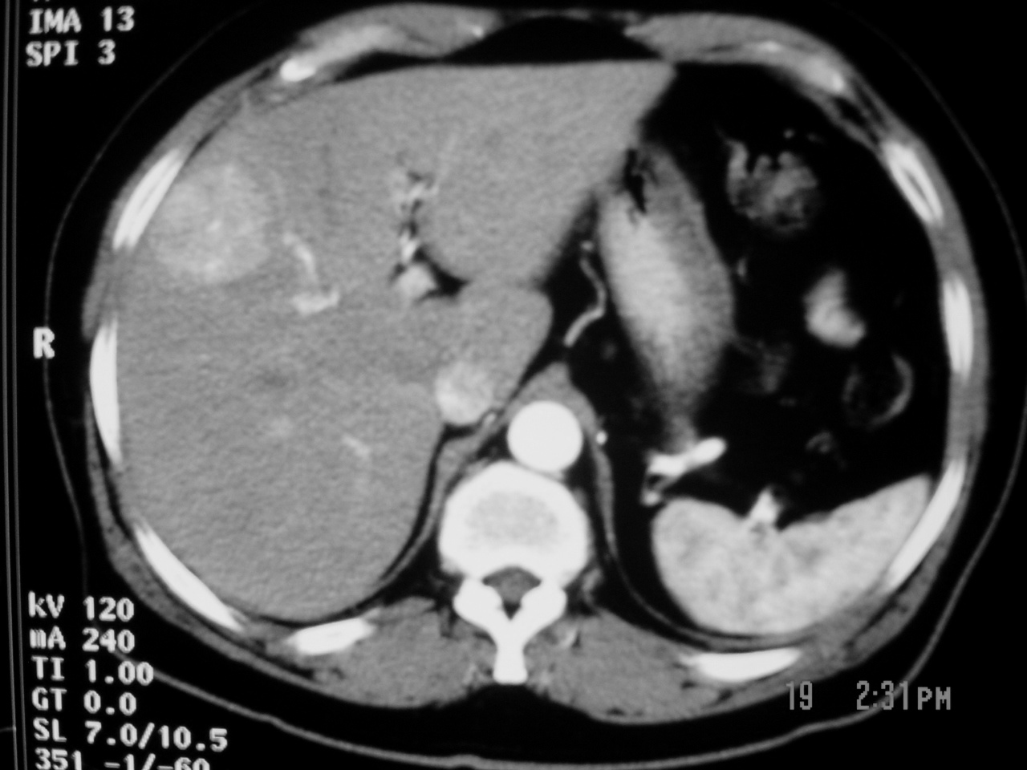
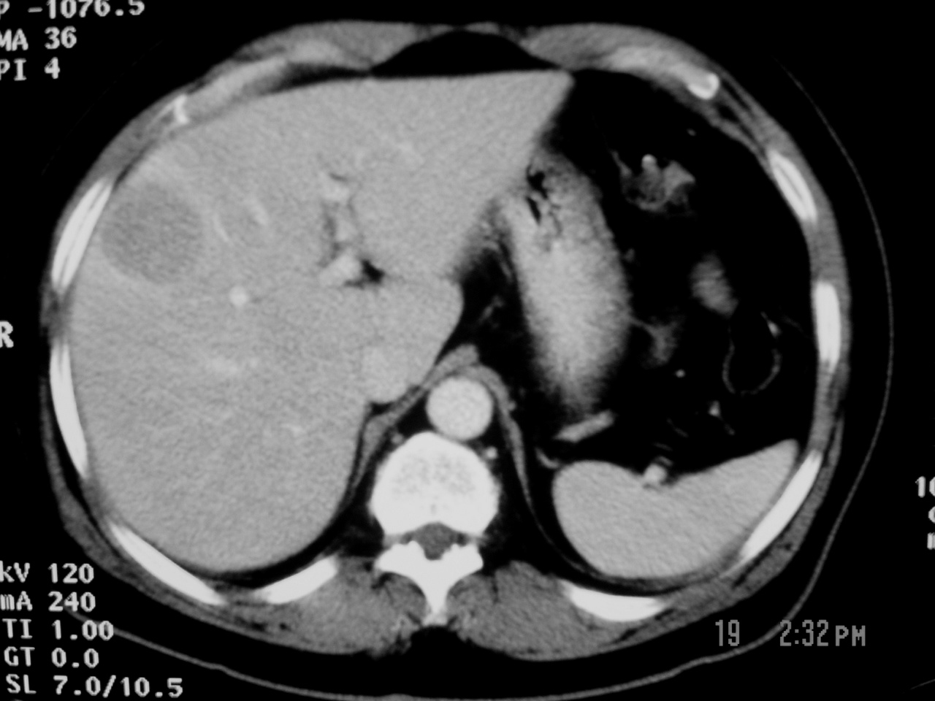
HCC
CT FINDINGS

Slide 47
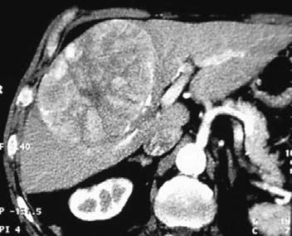
CT scan : Huge hepatocellular carcinoma in the right lobe of the liver

Slide 48
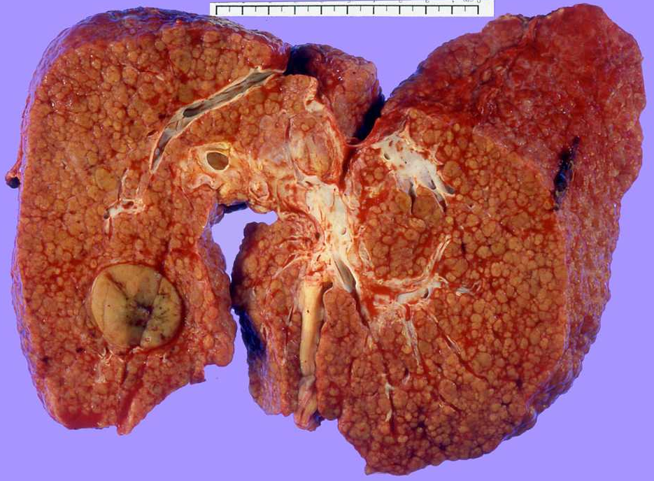
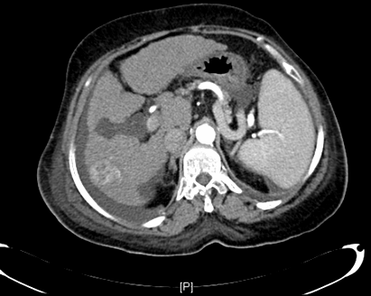
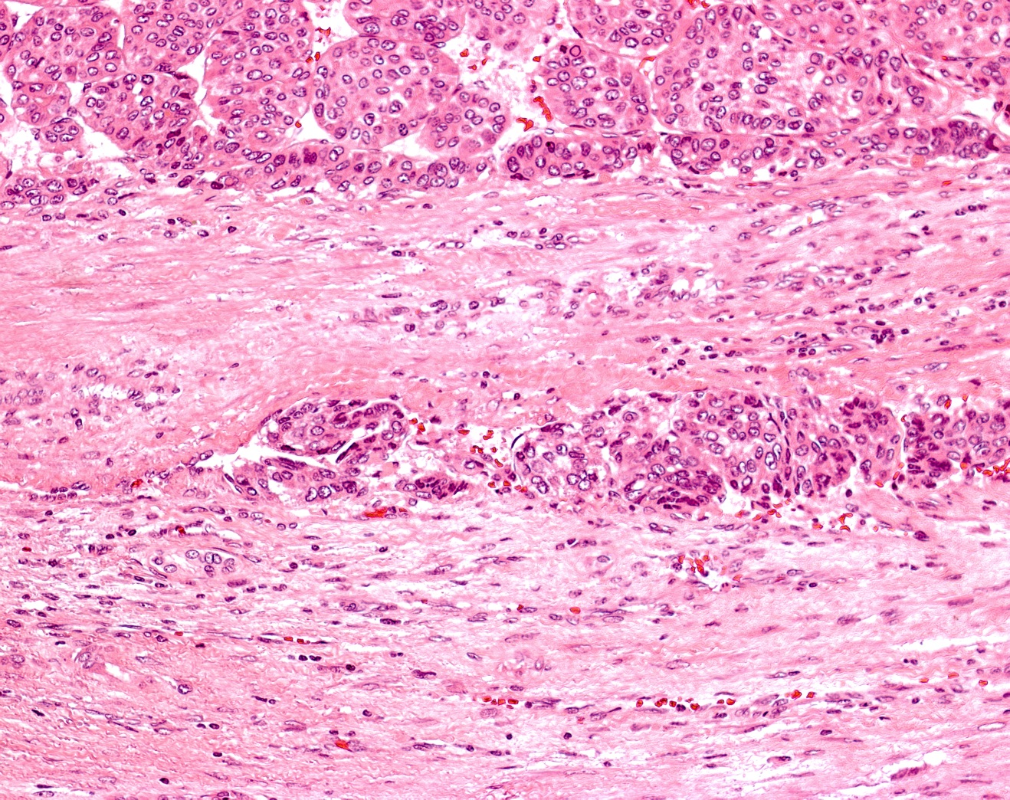
Hepatocellular Carcinoma
Liver Cirrhosis (HBV – HCV)

Slide 49
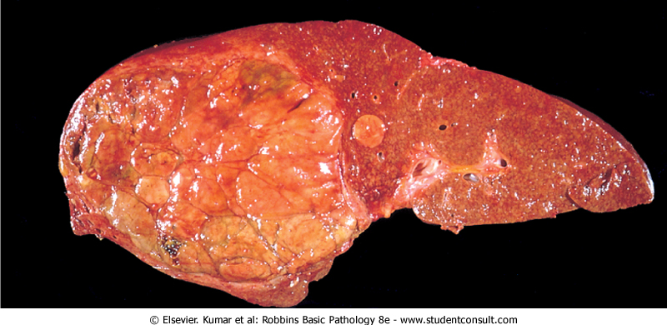
Huge hepatocellular carcinoma in the right lobe of the liver

Slide 50
HCC Staging is Multifaceted
Patient
Staging is used for prognosis and to guide treatment¹
Staging HCC¹
Most patients have underlying liver disease
Key prognostic indicators are not clearly defined
Prognostic indicators vary during the course of disease
Factors affecting staging systems^{2,3}
Tumor stage
Liver function
Health status
Impact of treatment
ECOG
PS
BCLC⁴
GRETCH⁵
Child-
Pugh
Okuda⁶
TNM
CUPI⁷
CLIP⁸
JIS⁹
Liver
Tumor

Slide 51
Liver Transplantation for HCC
“Patient Selection”
Milan’s Criteria
(Mazzaferro et al, 1994)
Single tumor ≤ 5 cm
or
≤ 3 lesions, each lesion ≤ 3 cm
No Macro-Vascular Invasion and No Extra-hepatic Spread

Slide 52
Barcelona Clinic Liver Cancer staging and treatment strategy
HCC
Stage 0
Child–Pugh A; PST 0
Stage A–C
Okuda 1–2; Child–Pugh A–B; PST 0–2
Stage D
Okuda 3; Child–Pugh C; PST >2
Very early
stage (0)
Single HCC <2cm
Carcinoma in situ
Early Stage (A)
Single HCC or
3 nodules <3cm
PST 0
Intermediate
stage (B)
Multinodular; PST 0
Advanced stage (C)
Portal invasion N1, M1,
PST 1–2
Terminal
stage (D)
Single HCC
3 nodules ≤3cm
Portal pressure/
bilirubin
Extrahepatic disease
Increased
Associated diseases
No
Yes
Normal
No
Yes
Resection
Liver transplantation
PEI/RF
Chemoembolisation
Sorafenib
Curative treatments (30%)
5-years survival: 50–70%
Randomised controlled trials (30%)
3-years survival: 20–40%
Symptomatic treatment (30%)
1-year survival: 10%
PST=Performance status
Llovet JM, et al, Lancet 2003;362:1907–17

Slide 53
Cholangiocarcinoma it is adenocarcinoma of intrahepatic biliary radicles.
Clinical features
Jaundice , pain and enlarged liver are the common presenting features.
Investigation
Can be assessed by ultrasound , CT scan and MRI
Treatment
Surgical resection is the only curative treatment when appropriate

Slide 54
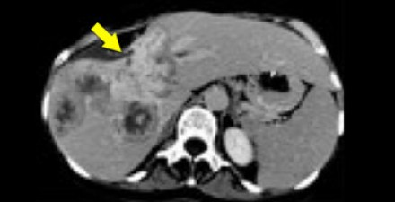
Cholangiocarcinoma in the right lobe of the liver

Slide 55
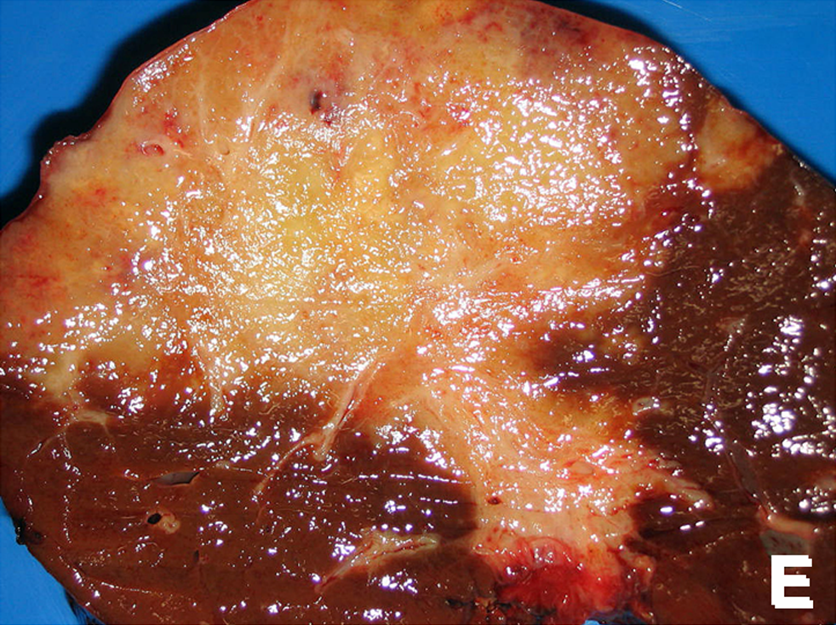
Cholangiocarcinoma in the right lobe of the liver

Slide 56
Portal hypertension

Slide 57
Portal Hypertension
Definition of portal hypertension when pressure of the portal vein exceeds 5 mm hg.
However, higher pressures (8 to 10 mm Hg) are typically required to begin stimulating the development of portosystemic collateralization.
Its causes can be classified to
  Pre-hepatic
  Hepatic
  Post-hepatic

Slide 58
Cont.
Most common cause is liver cirrhosis (hepatic).
The main issue with hypertension is the development of collaterals to systemic circulation.
No treatment to tackle this process, treatment is targeted to complication and sequalae.

Slide 59
Portal hypertension is caused by increased resistance to portal blood flow. The normal pressure of 5 – 15 cmH₂O in the portal vein is consistently exceeded.
Causes of portal hypertension
Obstruction to blood flow A. Presinusoidal extra-hepatic 1. Congenital atresia of portal vein 2. Portal vein thrombosis 3. Extrinsic compression of portal vein
B. Presinusoidal intra-hepatic ( schistosomiasis)
C. Sinusoidal ( cirrhosis)
D. Postsinusoidal ( Budd-Chiari syndrome , constrictive pericarditis)
Increased blood flow ( Arterio-venous fistula )

Slide 60
Effect of portal hypertension
1. Formation of Porto-systemic shunting at three principal sites : a) Gastro-esophageal varices that may cause severe upper gastrointestinal bleeding b) Retroperitoneal and periumbilical collaterals " Caput medusa " that may cause excessive bleeding during surgery at these sites c) Anorectal varices that may cause lower gastrointestinal bleeding
2. Splenomegaly and related hypersplenism with pancytopenia
3. Ascites that my be complicated by primary peritonitis and respiratory compromise.
4. Encephalopathy due to increase level of toxins such as ammonia in the systemic circulation

Slide 61
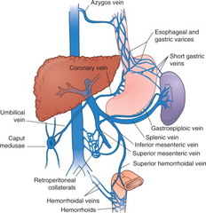
Sites of Porto-systemic anastomosis in portal hypertension

Slide 62
Clinical features
1. Patients with cirrhosis frequently develop anorexia , generalized malaise and weight loss.
2. Clinical manifestations include jaundice , spider naevi , ascites and hepatosplenomegaly.
3. Slurring of speech , a flapping tremor or dysarthria may point to encephalopathy.

Slide 63
Investigations
Laboratory tests: may show elevated bilirubin , with depressed serum albumin. Anemia may be present. The prothrombin time and other indices of clotting may be abnormal. Serology tests for hepatitis B , C may be positive as underlying cause for liver cirrhosis.
Assessment of patients with portal hypertension using Child-Turcott-Pugh system
Points scoring
3 | 2 | 1 | Criterion
marked | minimal | None | Encephalopathy
intractable | Easily controlled | none | Ascites
> 50 | 35-50 | <35 | Bilirubin(µmol/l)
< 28 | 28 -35 | > 35 | Albumin(g/l)
> 2.3 | 1.7 – 2.3 | < 1.7 | Prothrombin ratio
Grade A = 5-6 points , Grade B = 7-9 , Grade C = 10 -15

Slide 64
Child-Pugh Scoring System
 | Points
 | 1 | 2 | 3
Encephalopathy (grade) | None | 1-2 | 3-4
Ascites | None | Slight | Moderate
Albumin (g/dL) | >3.5 | 2.8-3.5 | <2.8
Prothrombin time prolonged (sec) | 1-4 | 4-6 | >6
Bilirubin (mg/dL) | 1-2 | 2-3 | >3
For primary biliary cirrhosis | 1-4 | 4-10 | >10
Class A = 5-6 points; Class B = 7-9 points; Class C = 10-15 points.
Pugh RN, et al. Br J Surg. 1973;60:646-649.

Slide 65
Treatment
1. Acute bleeding Gastroesophageal varices : Endoscopic banding or sclerotherapy injection. Uncontrolled bleeding may need surgical intervention.
2. Ascites : can be treated by restriction of water and salt intake followed by diuretics . In advanced cases may need portosystemic shunting.
3. Advanced cases of liver cirrhosis ( child C) may need liver transplant as definitive treatment for the liver cirrhosis , portal hypertension and its complications.

Slide 66
THANK YOU

