Slide 1
Nose I&II
د.محمد القبساني
استشاري جراحه الانف والاذن و الحنجره والرأس و العنق
Email: dr_of_2008@hotmail.com
Twitter :
@medoo2008

Slide 2
ANATOMY OF THE NOSE & PARANASAL SINUSES

Slide 3
ANATOMY OF SINO-NASAL TRACT
External nose
Nasal cavity
Paranasal sinuses

Slide 4
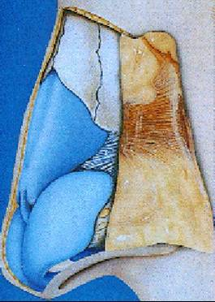
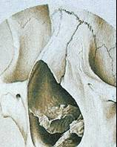
Anatomy of the External Nose

Slide 5
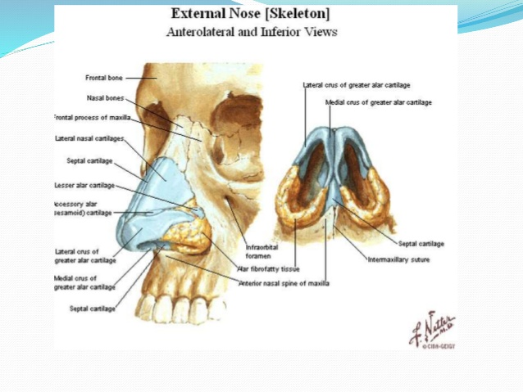

Slide 6
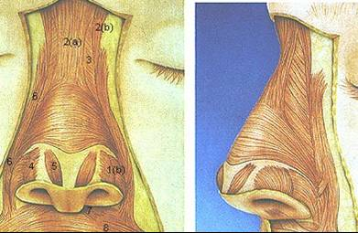
Anatomy of the External Nose

Slide 7
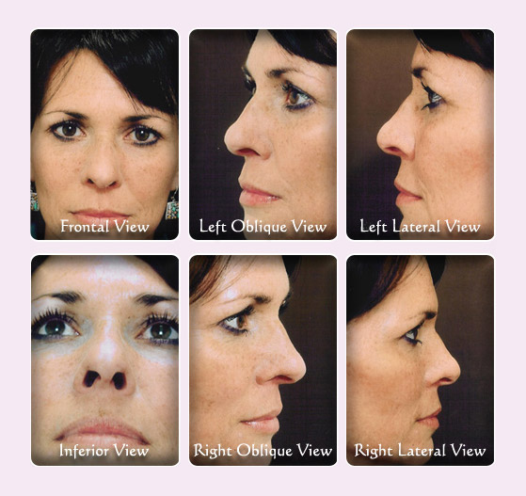
Anatomy of the External Nose

Slide 8
THE NASAL CAVITY
Nasal Vestibule
Nasal Cavity Proper

Slide 9
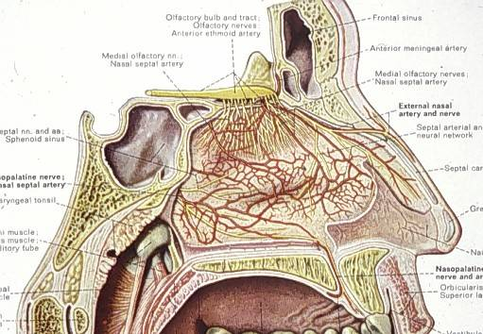
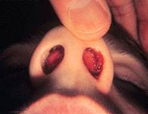
THE NASAL VESTIBULE

Slide 10
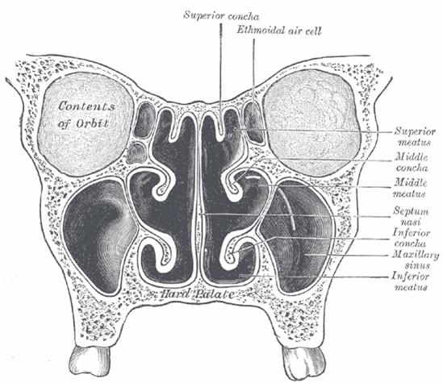
THE NASAL CAVITY
Roof
Floor
Lateral wall
Medial wall (septum)

Slide 11
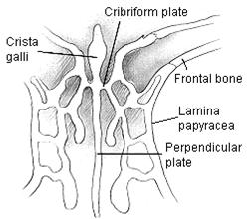
The Roof

Slide 12
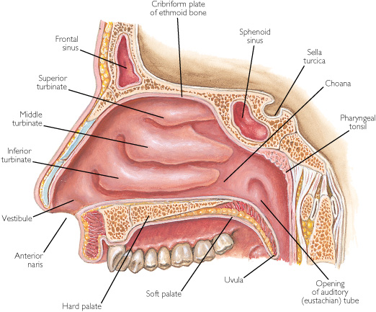
The Floor
horizontal plate of the palatine bone posteriorly and the palatine process of the maxilla anteriorly

Slide 13
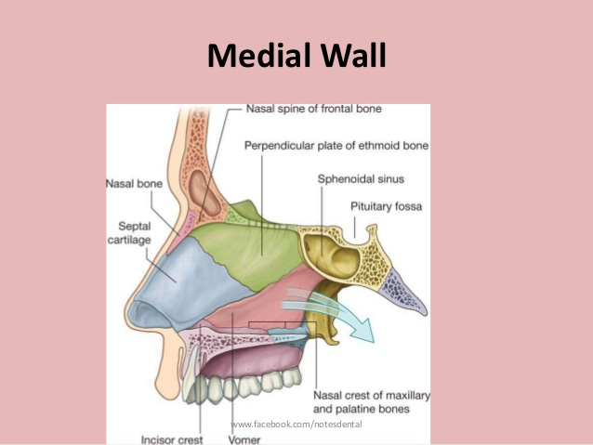
The Medial Wall (Nasal Septum)

Slide 14
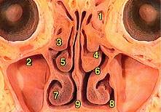
Lateral Nasal Wall

Slide 15
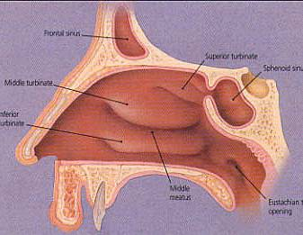
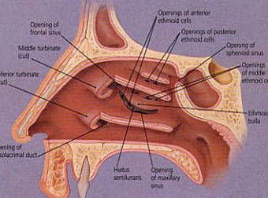
Lateral Nasal Wall

Slide 16
The Lining Mucosa
Respiratory mucosa
Olfactory mucosa

Slide 17
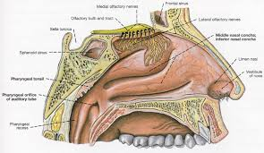

Slide 18
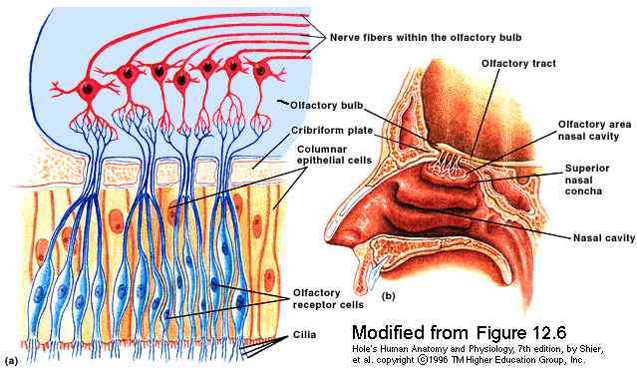
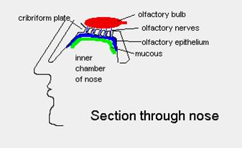
The Olfactory Mucosa

Slide 19
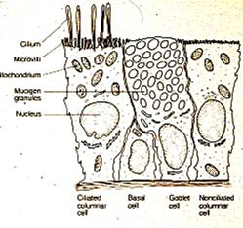
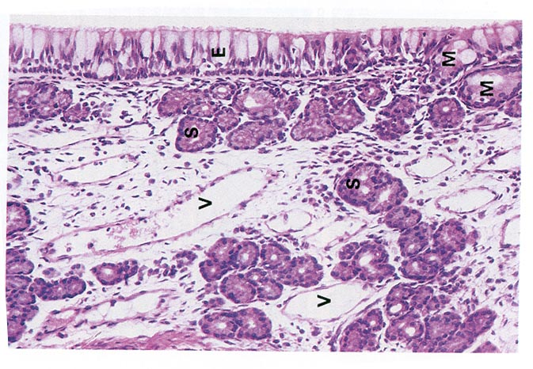
The Respiratory Mucosa

Slide 20
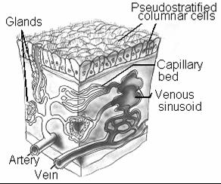
The Respiratory Mucosa

Slide 21
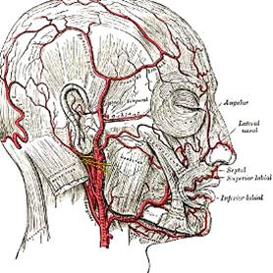
Arterial Blood Supply
External Carotid
  Maxillary
  Facial
Internal Carotid
  Ophthalmic

Slide 22
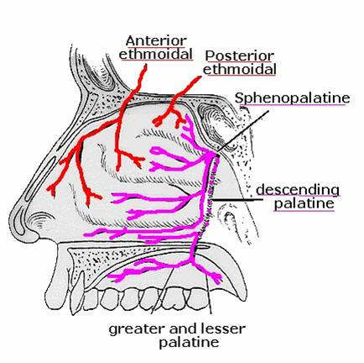
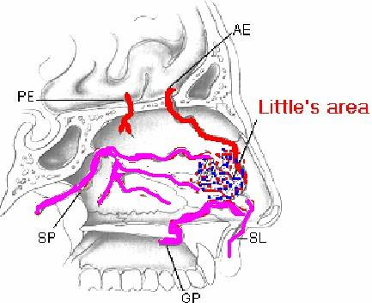
Blood Supply Of The Nasal Cavity
Lateral Wall
Nasal Septum

Slide 23
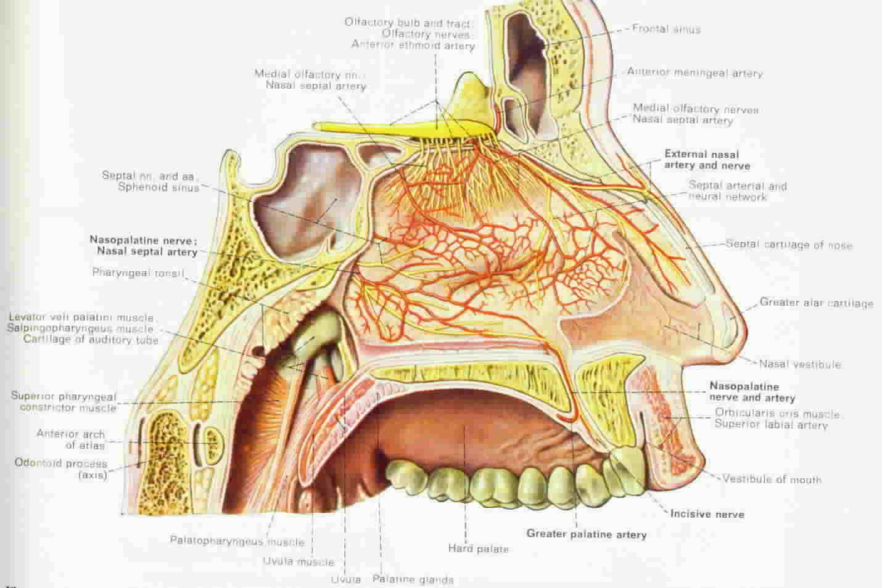

Slide 24
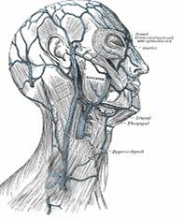
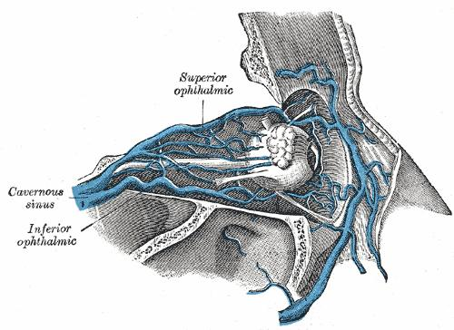
Venous Drainage
Facial vein
Internal jugular
Angular vein
Ophthalmic
Cavernous sinus

Slide 25
Lymphatic Drainage
Submandibular
Retropharyngeal
Superior deep cervical

Slide 26
Nerve Supply Of The Nasal Cavity
Olfactory
General sensory: Trigeminal nerve
Autonomic: sphenopalatine ganglion

Slide 27
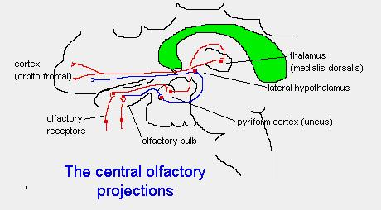
Olfactory Nerve Supply

Slide 28
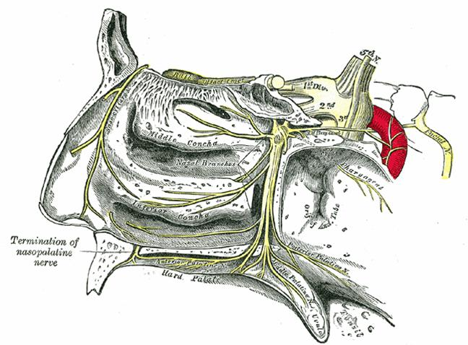
Sensory Nerve Supply
Ophthalmic and maxillary branches of the trigeminal

Slide 29
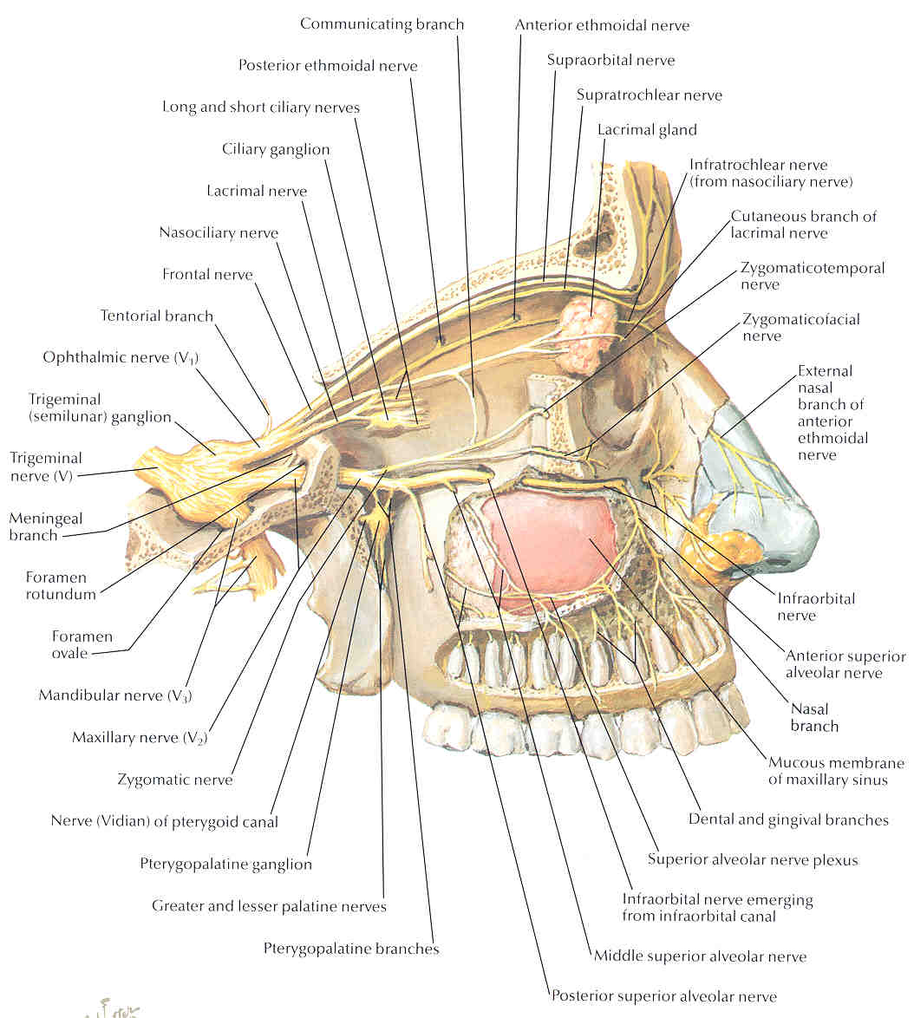
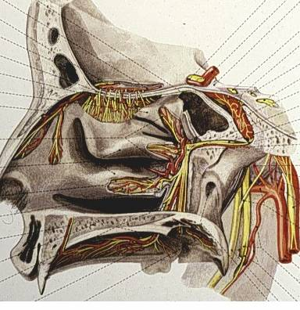
Autonomic Nerve Supply
Sphenopalatine ganglion
  Sympathetic
  Parasympathetic

Slide 30
ANATOMY OF THE PARANASAL SINUSES
Dr.Mohammed ALQabasani
Consultant
Otorhinolaryngology

Slide 31
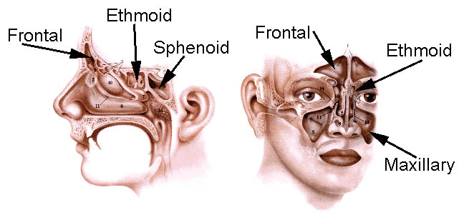

Slide 32
The Maxillary Sinus

Slide 33
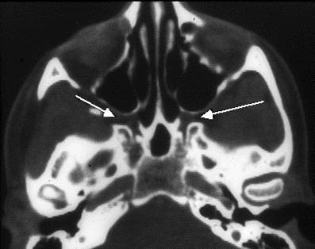
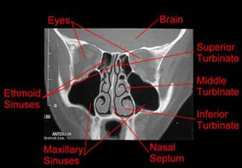
The Maxillary Sinus

Slide 34
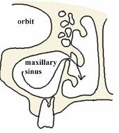
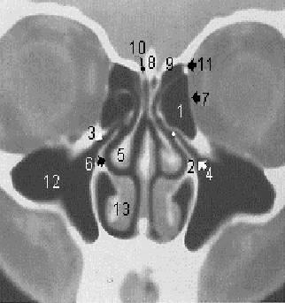
The Maxillary Sinus
Sinus ostium located in the middle meatus

Slide 35
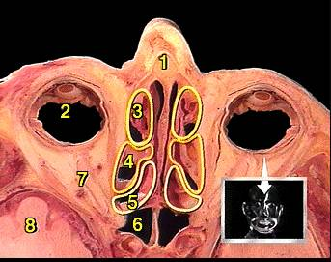
The Ethmoid Sinuses

Slide 36
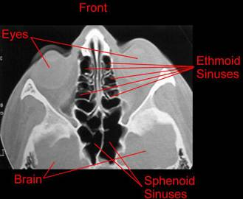
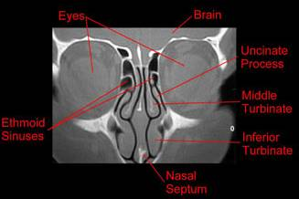
The Ethmoid Sinuses

Slide 37
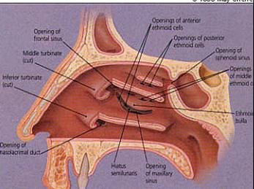
The Ethmoid sinuses
Anterior ethmoids: drain into the middle meatus
Posterior ethmoids: drain into superior meatus

Slide 38
The Frontal Sinus
Rarely present at birth; usually not visible until age 2
Great variability in size; congenitally absent in 5%

Slide 39
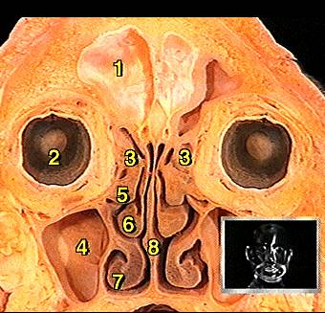
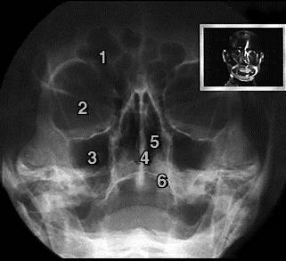
The Frontal Sinus

Slide 40
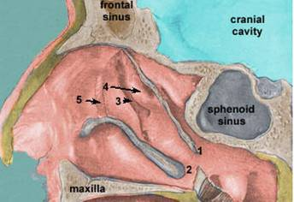
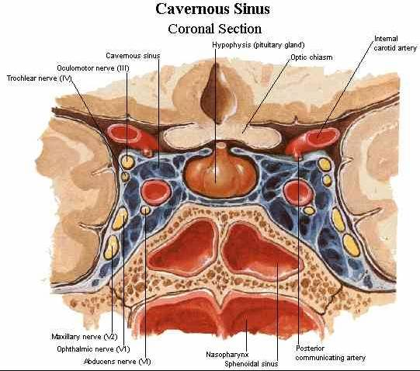
The Sphenoid Sinus

Slide 42
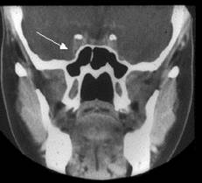
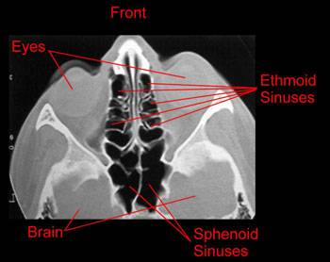
The Sphenoid Sinus

Slide 43
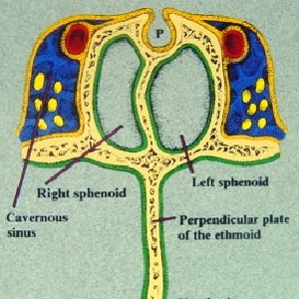
The Sphenoid Sinus

Slide 44
Lining of the Sinuses
Pseudostratified, columnar epithelium (respiratory epithelium) which is continuous with the nasal epithelium

Slide 45
Blood Supply
Branches from the internal and external carotids

Slide 46
Nerve Supply
Branches from the trigeminal

Slide 47
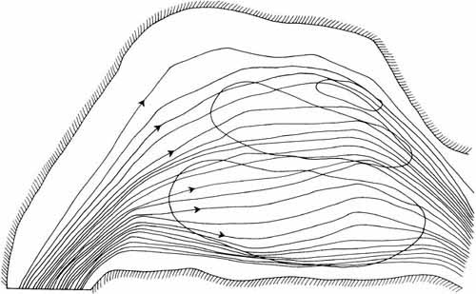
Functions Of The Nose
Respiratory channel
Warming and humidifying inspired air

Slide 48

Warming And Humidifying Inspired Air

Slide 49
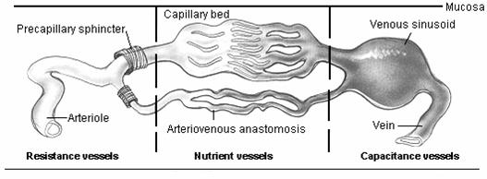

Slide 50
Functions Of The Nose
Respiratory channel
Warming and humidifying inspired air
Cleaning and filtering inspired air

Slide 51
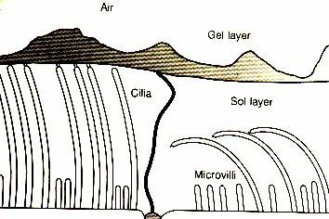
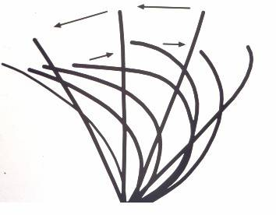
Cleaning And Filtering Inspired Air

Slide 52

Cleaning And Filtering Inspired Air

Slide 53


Cleaning And Filtering Inspired Air

Slide 54
Functions Of The Nose
Respiratory channel
Warming and humidifying inspired air
Cleaning and filtering inspired air
Olfaction

Slide 55



Olfaction

Slide 56
Investigation of Nasal Diseases
Endoscopy
Rhinometry
Measurement of olfaction
Skin allergy test
Mucociliary clearance tests
Imaging

Slide 57


Endoscopy

Slide 58

Rhinometry
Objective measurement of the nasal resistance or the flow of air in the nasal cavities

Slide 59
Measurement Of Olfaction
Identification tests
Threshold detection tests

Slide 60


Skin allergy test

Slide 61

Ultrastructure of The Cilia

Slide 62

X-Rays Nasal Bones

Slide 63
Imaging of The Paranasal Sinuses
Plain X-Rays ?????
CT scan
MRI

Slide 64


CT Paranasal Sinuses
Axial
Coronal

Slide 65





Normal Axial

Slide 66





Normal coronal

Slide 67


MRI

Slide 68

Development Of The Nose

Slide 69

Development of the nose

Slide 70

Development of the sinuses
A) at birth B) at 10-years C) at 15

Slide 71


Development of the sinuses

Slide 72
CONGENITAL ANOMALIES

Slide 73



Anterior Nares Deformity

Slide 74

Dermoid cysts

Slide 75



Meningo and encephaloceles

Slide 76
CHOANAL ATRESIA

Slide 77


THE CHOANA

Slide 78
Choanal Atresia
? Due to persistence of the primitive bucconasal membrane
Unilateral or bilateral
Bony, membranous or mixed

Slide 79


Unilateral Choanal Atresia

Slide 80


Slide 81
Unilateral Choanal Atresia
Usually diagnosed late in life
Presents by unilateral nasal obstruction and unilateral mucoid nasal discharge
Treatment is by elective surgical repair

Slide 82
Bilateral Choanal Atresia
Isolated anomaly in 60-70%
May be linked to CHARGE association

Slide 83
CHARGE ASSOCIATION
Coloboma
Heart disease
Atresia
Retarded growth
Genital hypoplasia
Ear deformity

Slide 84
Bilateral Choanal Atresia
Usually presents at birth by attacks of cyclic cyanosis and respiratory obstruction
Nasal discharge

Slide 85

Diagnosis
Clinical examination: “mirror test”
Inability to pass a catheter into the nasopharynx
Endoscopy
Radiographs

Slide 86


Slide 87
Management
Emergency
  Immediate airway support with oral airway, McGovern nipple, or intubation
Definitive surgery

Slide 88
Surgical Approaches to the Choana
Transnasal
Transpalatal
Transseptal
Lateral rhinotomy
External rhinoplasty

Slide 89
THE NASAL VESTIBULE

Slide 90
Acute Infections
Acute vestibulitis
Furunculosis

Slide 91
Acute Vestibulitis
Inflammation of the skin of the vestibule, usually due to Staphylococcus aureus

Slide 92
Causes
Habitual rubbing of the nose
Allergy
Rhinorrhea

Slide 93

Clinical Features
Pain
Irritation
Redness and swelling
Crusting

Slide 94
Treatment
Local antibiotics and corticosteroids

Slide 95

Furunculosis
Acute infection of the hair follicles with Staphylococcus aureus

Slide 96




Complications
Local abscess
Spreading cellulitis
Cavernous sinus thrombophlebitis

Slide 97
Treatment
Avoid squeezing
Local application of heat
Antibiotics

Slide 98




Other Conditions of Vestibule and External Nose
Erysipelas
Impetigo
Herpes simplex and zoster
Warts
Lupus vulgaris
Syphilis
Basal and squamous cell carcinoma

Slide 99
Diseases of the nasal septum
Deviated nasal septum
Septal hematoma and abscess
Perforated septum

Slide 100
DEVIATED NASAL SEPTUM

Slide 101
Etiology
Trauma
Maldevelopment

Slide 102


Symptoms
Nasal obstruction

Slide 103


Symptoms
Nasal obstruction
External deformity
Crusting, epistaxis

Slide 104



Examination

Slide 105


Radiology
Unnecessary in most cases

Slide 106
Treatment
No treatment
Septoplasty

Slide 107




Septoplasty

Slide 108





Complications of Septoplasty
Septal hematoma & abscess
Septal perforation
Nasal deformity
Synechia (adhesion)

Slide 109
HEMATOMA OF THE SEPTUM

Slide 110
Etiology
Direct trauma
Operative trauma
Blood dyscrasias

Slide 111


Clinical Features

Slide 112
Complications
Cartilage necrosis
Septal abscess
Permanent thickening of the septum

Slide 113
Treatment
Incision and drainage
Systemic antibiotics

Slide 114
PERFORATION OF SEPTUM

Slide 115
Etiology
Septal surgery
Other trauma
Cocaine
Chrome perforation
Syphilis, TB, Lupus, etc.
Tumors

Slide 116

Clinical features
Asymptomatic
Crusting
Epistaxis
Whistling

Slide 117
Treatment
No treatment
Nasal wash
Surgical closure

Slide 118

Turbinate Hypertrophy
Causes
  Infection
  Compensation
  Dysfunctional
  Allergies

Slide 119
REATMENT
Treat underlying cause
Surgical treatment
  SMR
  Turbinoplasty
  SMD
  Turbinectomy

Slide 121
THANK YOU
د.محمد القبساني
استشاري جراحه الانف والاذن و الحنجره والرأس و العنق
Email: dr_of_2008@hotmail.com
Twitter :
@medoo2008

