Slide 1
Up date in sinusitis
NOSE III&IV
Dr.Mohammed ALQabasani
Consultant
Otorhinolaryngology

Slide 2
Sinusitis
Infection of the sinuses

Slide 3
Rhinosinusitis
Allergic or non allergic rhinitis nearly always precedes sinusitis
Sinusitis without rhinitis is rare
Nasal discharge and congestion are prominent symptoms of sinusitis
Nasal mucosa and sinus mucosa are similar and are contiguous

Slide 4
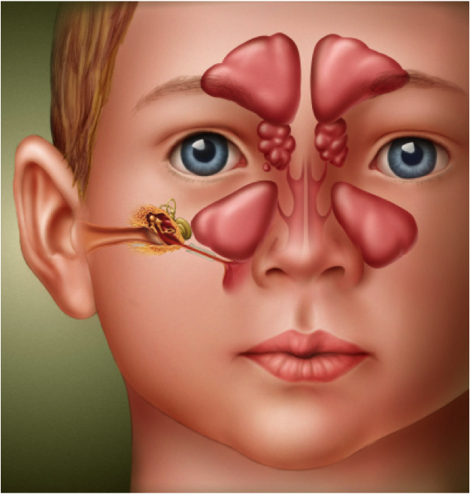
sinusitis
4 paranasal sinuses
Inflamation of one or more sinuses
  Frontal
  Maxillary
  Ethmoid
  Sphenoid

Slide 5
Development of sinuses:
Maxillary and ethmoid sinuses present at birth
Frontal sinus developed by age 5 .
Sphenoid sinus last to develop, by age of 8-10.

Slide 6
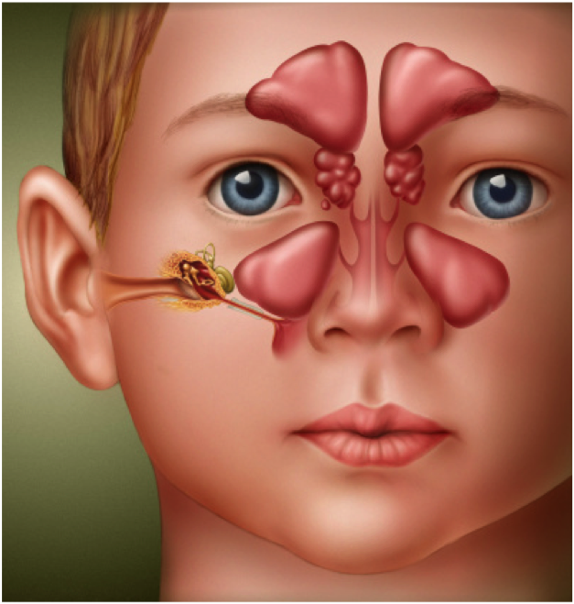
Normal sinus:
Sinus health depends on:
  Mucous secretion of normal viscosity, volume, and composition.
  normal mucociliary flow to prevent mucous stasis and subsequent infection.
  open sinus ostia to allow adequate drainage and aeration.

Slide 7
Physiologic Importance of Sinuses
Provide mucus to upper airways
  Lubrication
  Vehicle for trapping viruses, bacteria, foreign material for removal
Give characteristics to voice
Lessen skull weight
Involved with olfaction

Slide 8
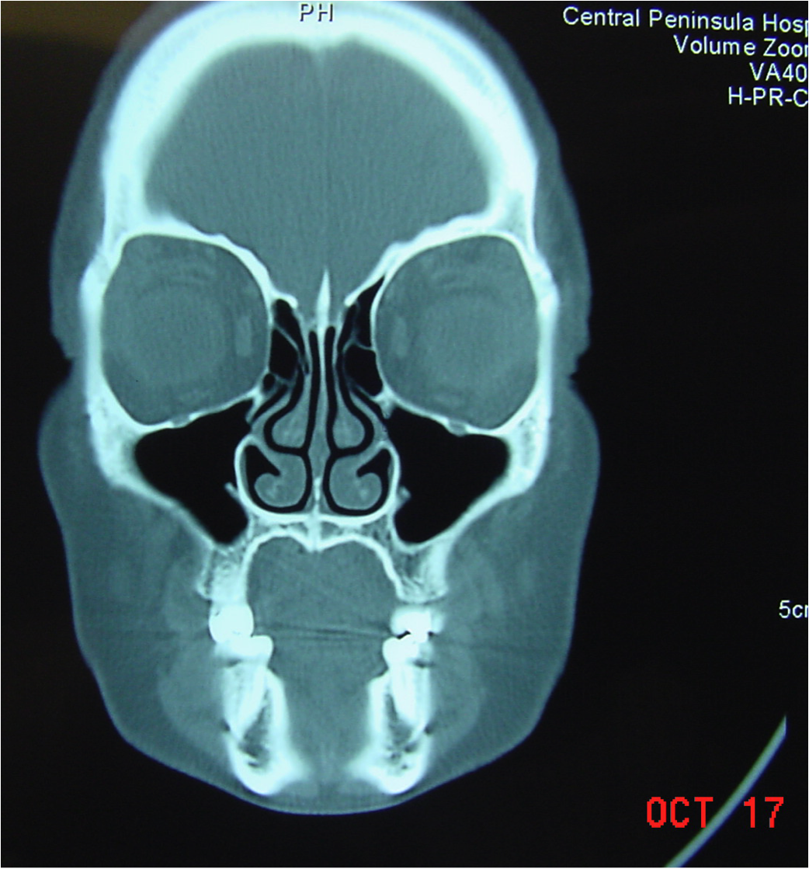
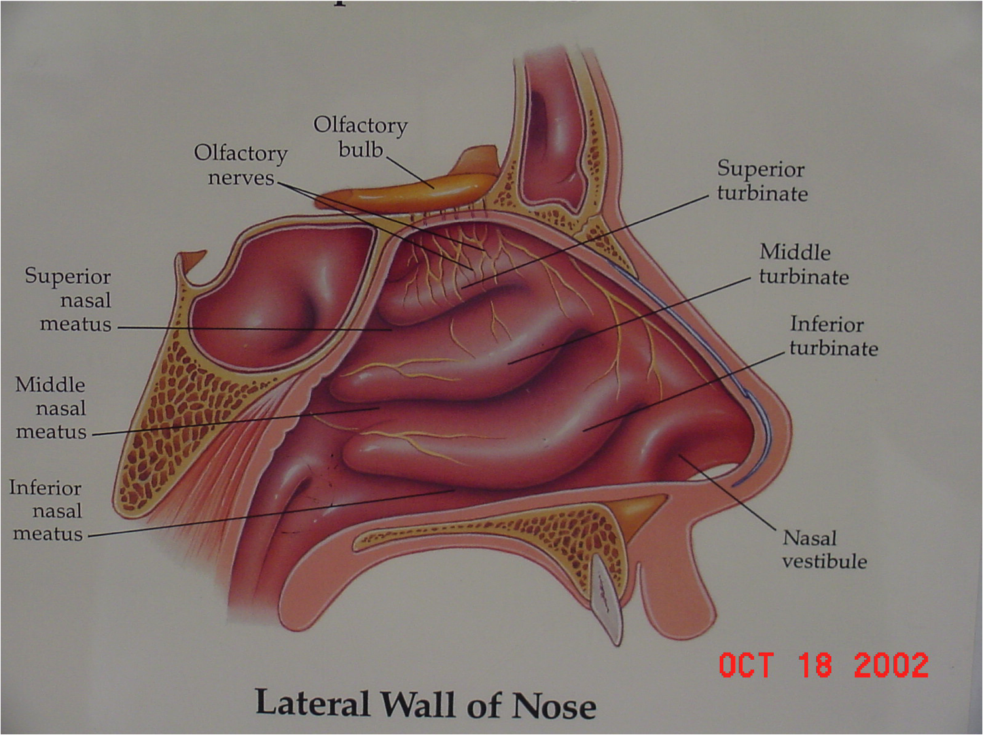
Ostiomeatal complex:
Ostiomeatal complex is that area under the middle meatus (airspace) into which the anterior ethmoid, frontal and maxillary sinuses drain
Posterior ethmoids drain into the upper meatus
Ostiomeatal complex is the functional relationship between the space and the ostia that drain into it

Slide 9
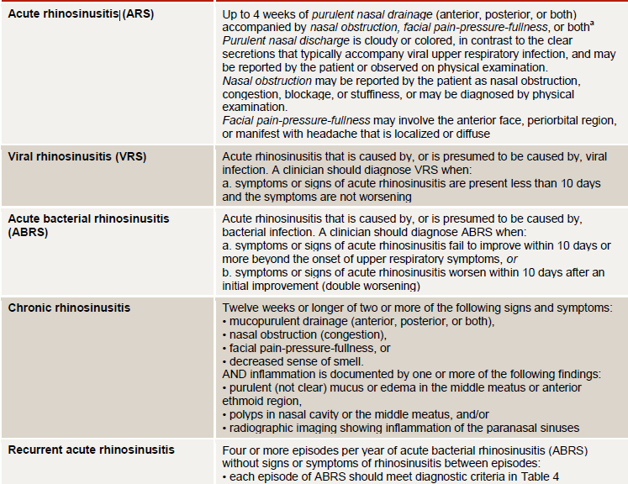
Sinusitis classification

Slide 10
Viral rhinosinusitis:
Most upper respiratory infections are viral
Short lived, last less than 10 days
Sinus mucosa as well as nasal mucosa is involved
Most will clear without antibiotics
Treatment: decongestants, nasal lavage, rest, fluids

Slide 11
sinusitis:
Acute sinusitis- infection lasting 4 weeks, symptoms resolve completely
Subacute bacterial sinusitis- infection lasting between 4 to 12 weeks, yet resolves completely
Chronic sinusitis- symptoms lasting more than 12 weeks

Slide 12
Recurrent Acute Bacterial Sinusitis:
Episodes lasting fewer than 4 weeks and separated by intervals of at least 10 days during which the patient is totally asymptomatic
4 episodes in 1 year

Slide 13
Differentiating Sinusitis from Rhinitis:
Sinusitis
Nasal congestion
Purulent rhinorrhea
Postnasal drip
Headache
Facial pain
Anosmia
Cough, fever
Rhinitis
Nasal congestion
Rhinorrhea clear
Runny nose
Itching, red eyes
Nasal crease
Seasonal symptoms

Slide 14
Common Clinical Presentations for ABS
Severe
Persistent
Symptoms
Worsening
Notes:
Session agenda
14

Slide 16
Acute bacterial rhinosinusitis if defined by at least three symptoms/signs of the five below:
• Discoloured mucus
• Severe local pain (often unilateral)
• Fever > 38ÅãC
• Raised CRP/ESR
• ‘double’ sickening

Slide 17
Why bacterial infection happen?
Obstruction of the various ostia
Impairment in ciliary function
Increased viscosity of secretions
Impaired immunity
Mucus accumulates
Decrease in oxygenation in the sinuses
Bacterial overgrowth

Slide 18
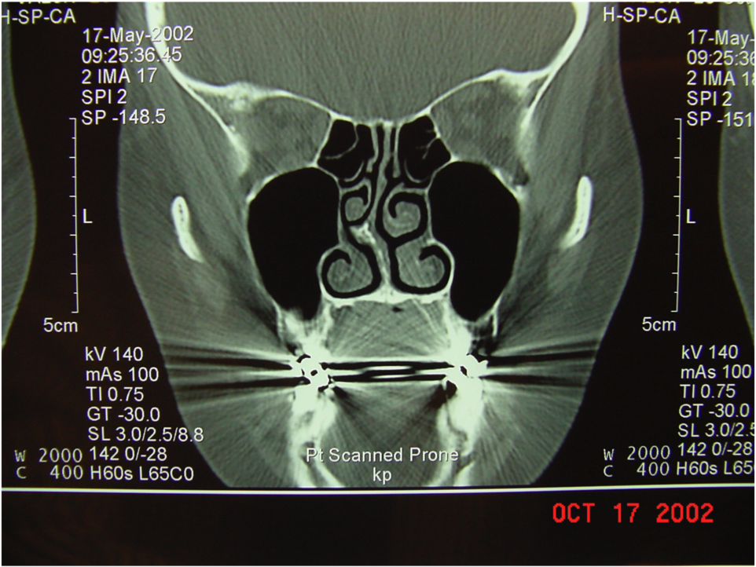
Pathogenesis of Nasal Obstruction
Viral upper respiratory infections
  Daycare centers
Allergic and nonallergic stimuli
Immunodeficiency disorders
  Immunoglobulin deficiency (IgA, IgG)
Anatomic changes
  Deviated septum, concha bullosa, polyps

Slide 19
Causes of Ciliary Dysfunction:
Immotile cilia syndrome
Prolonged exposure to cigarette smoke
Common cold viruses causing URI
Increased viscosity of mucus
Medications

Slide 20
Diseases Slowing Ciliary Function:
Allergic and nonallergic rhinitis
Rhinosinusitis
Aging rhinitis
Cystic fibrosis
Any disease causing obstruction, crusting of the mucosa

Slide 21
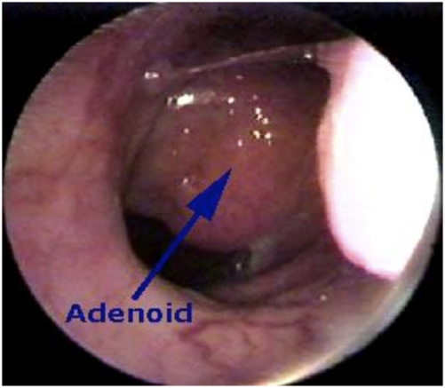
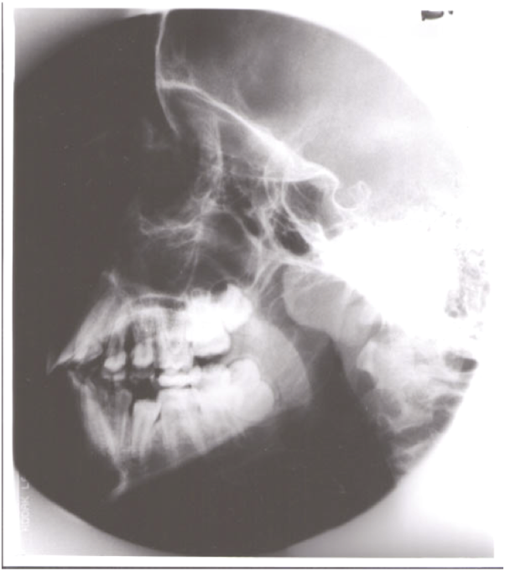
Causes of Mechanical Obstruction:
Deviated nasal septum
Concha bullosa
Foreign body
Nasal polyps
Congenital atresia
Lymphoid hyperplasia
Nasal structural changes found in Downs syndrome

Slide 22
Physical finding:
Mucopurulent nasal discharge
  Highest positive predictive value
Swelling of nasal mucosa
Mild erythema
Facial pain (unusual in children)
Periorbital swelling

Slide 23
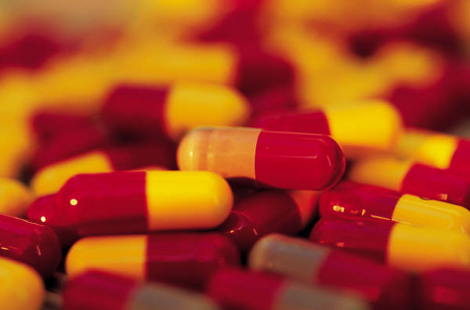
Objectives of Treatment of Acute Bacterial Sinusitis
Decrease time of recovery
Prevent chronic disease
Decrease exacerbations of asthma or other secondary diseases
Do so in a cost-effective way!

Slide 24
Suspected Microbiology of ABS, 2013
Streptococcus pneumoniae 15–20%
Haemophilus influenzae 45–50%
Moraxella catarrhalis 10–15%
Streptococcus pyogenes 5%
Notes:
Session agenda
24

Slide 25
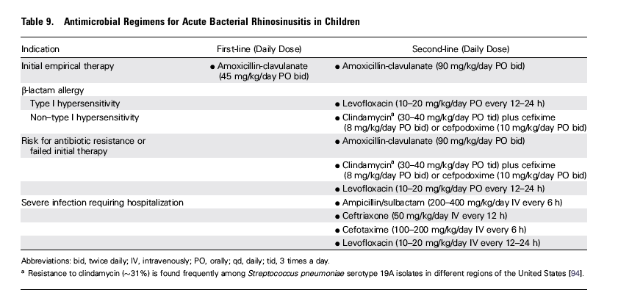
Treatment

Slide 26
Adjunctive therapy:
Saline irrigation (physiological , hypertonic saline)
Intranasal steroid
Topical ,oral decongestants,
all the above have weak recommendation

Slide 27
When initial empiric antimicrobial therapy for Acute Bacterial Sinusitis Fails…
Symptoms worse after 48-72 hours
Fail to improve after 3-5 days

Slide 28
Look for….
Resistant pathogen
Noninfectious etiology
structural abnormality
other cause for failure

Slide 29
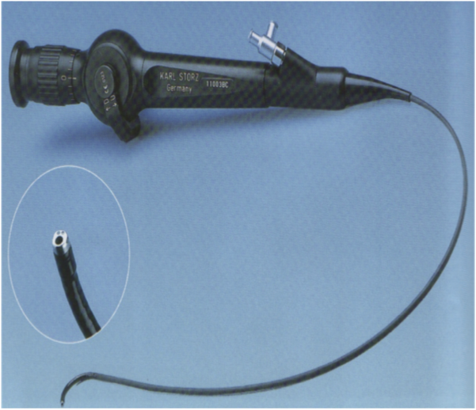
Rhinoscopy
Nasal polyps
Septal deviation
Concha bullosa
Eustachian tube dysfunction
Adenoid hyperplasia
Tumors

Slide 30
Swab culture
Direct sinus aspiration better than nasopharyngeal swab

Slide 31
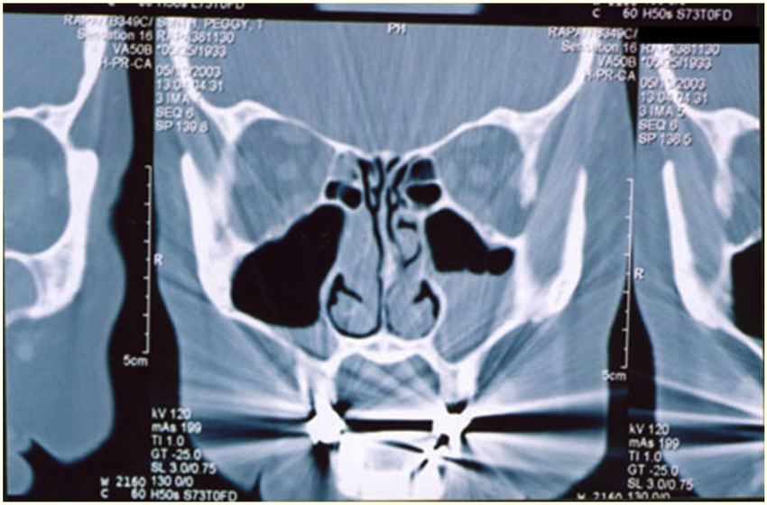
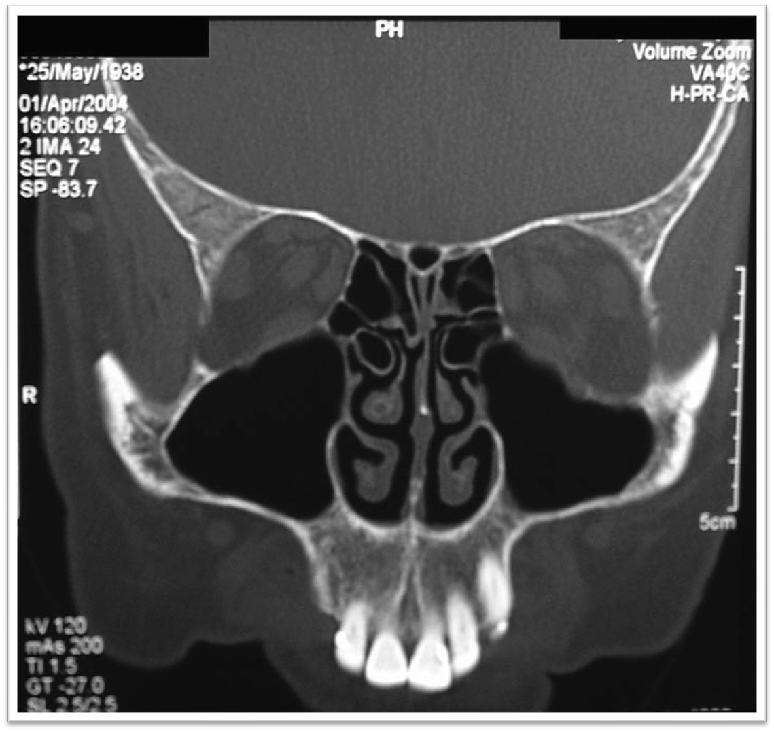
Imaging study
Structural abnormality
suppurative complications

Slide 32
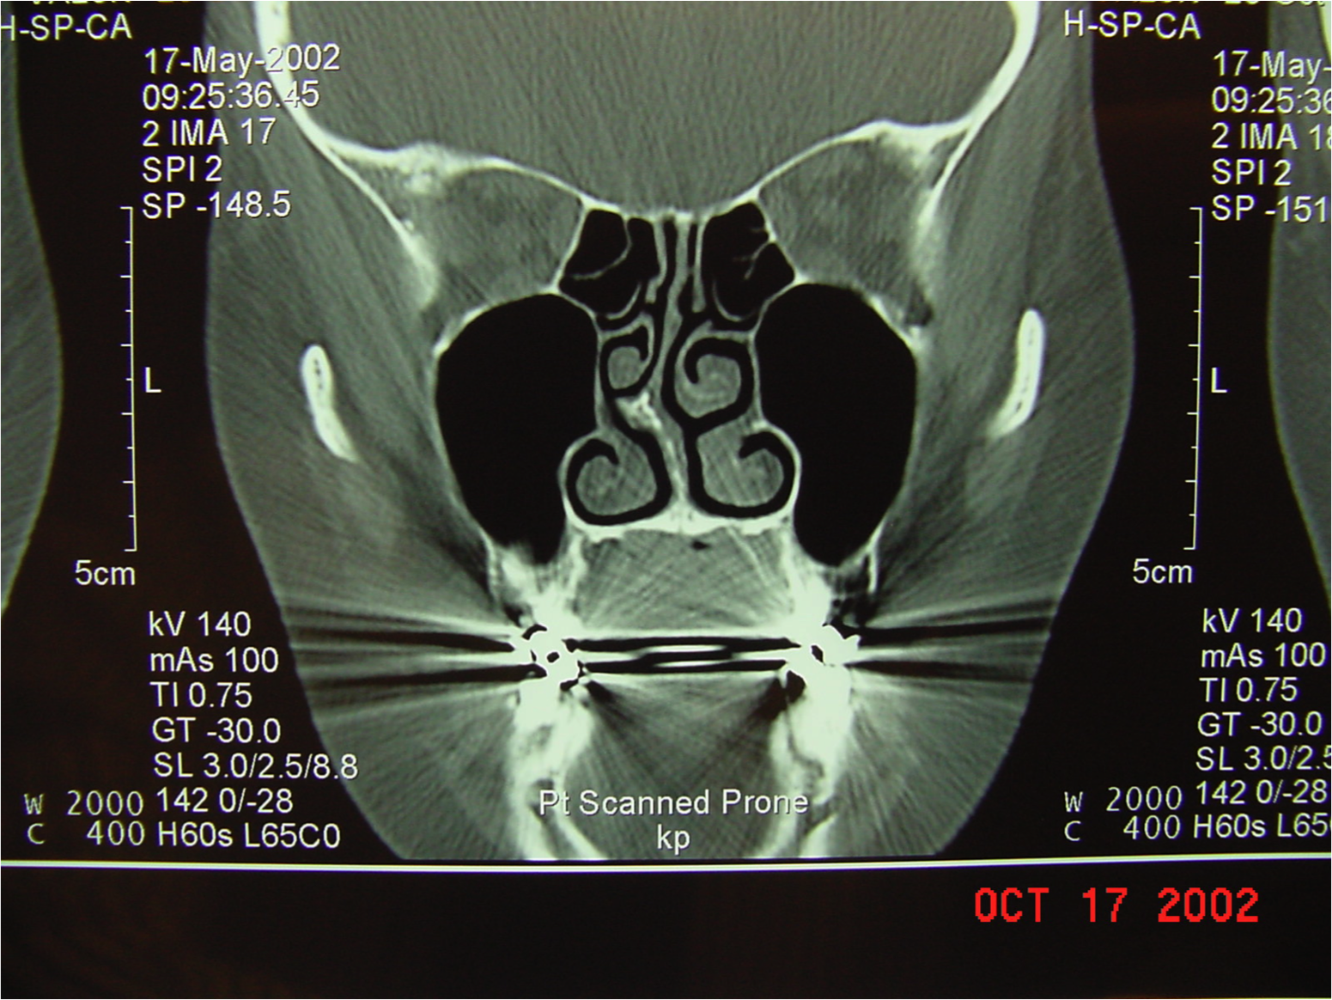

Slide 33
Clinicians should obtain a contrast-enhanced CT scan
of the paranasal sinuses and/or an MRI with contrast whenever a child is suspected of having orbital or CNS complications of ABS

Slide 34
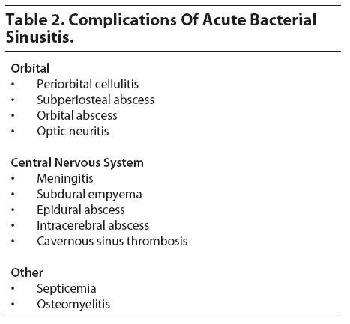

Slide 35
Suppurative complications are rare .
3.7-11% among hospitalized pediatric patients with sinusitis are primary related to orbital cellulites or intracranial infection

Slide 36
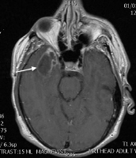
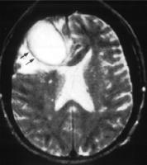
CNS
Suspected with very severe headache, photophobia, seizure, other focal neurologic findings
Subdural empyema
Epidural empyema
Venous thrombosis
Brain abscess
Meningitis

Slide 37
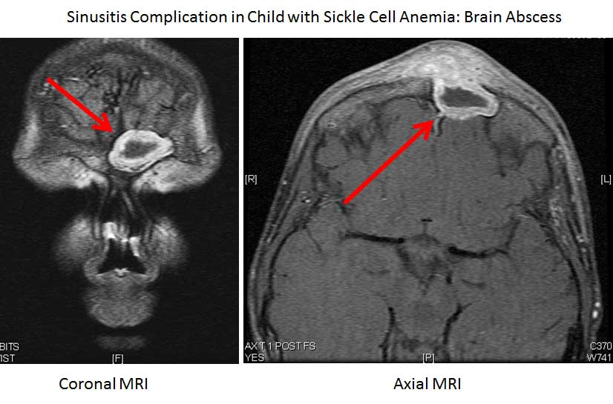

Slide 38
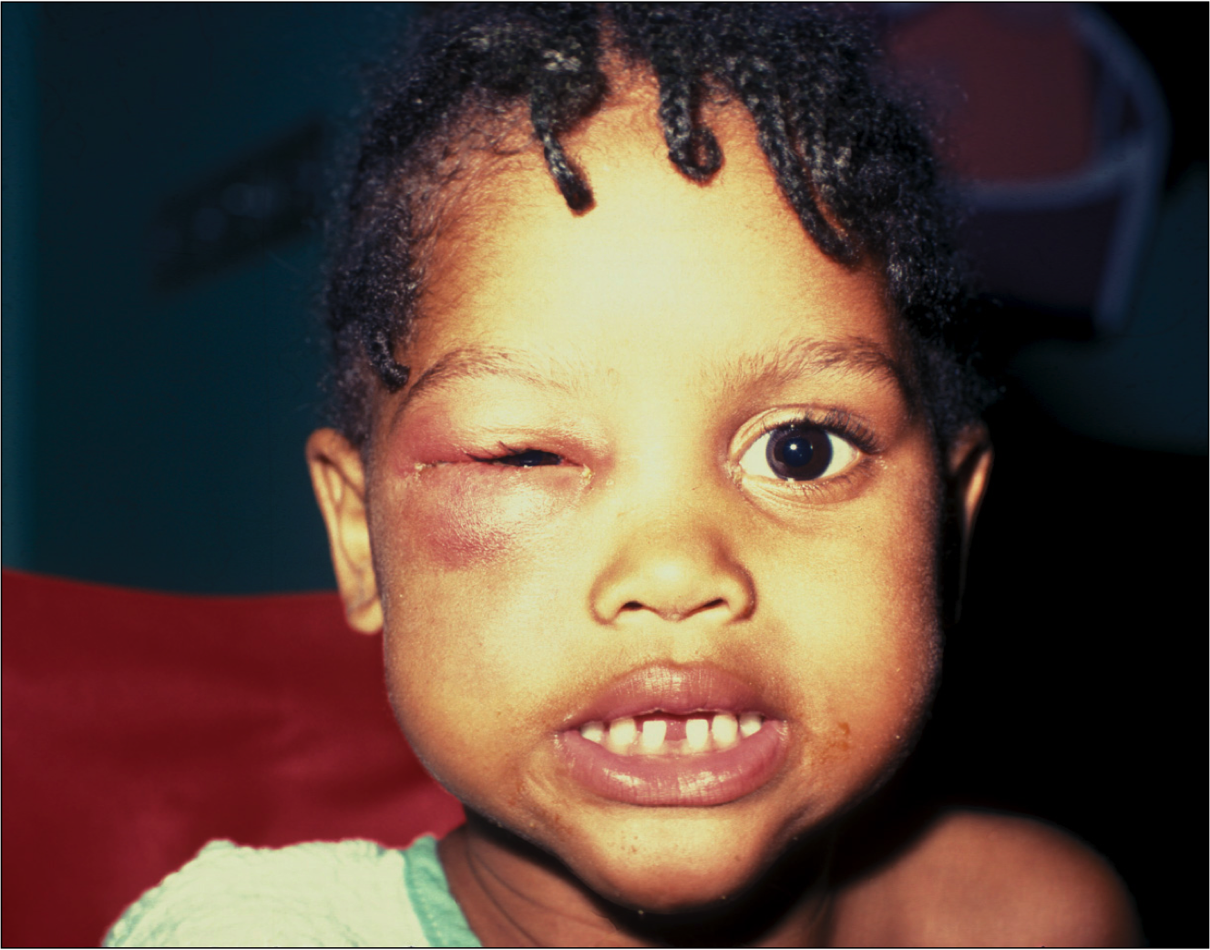
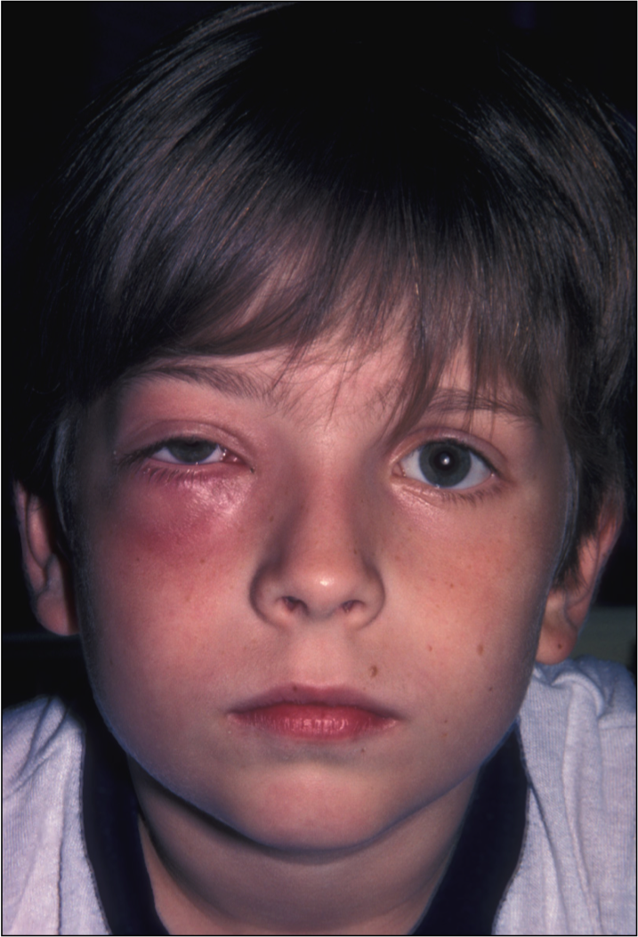
Complication of sinusitis
Proptosis – anterior and lateral displacement of globe
Impairment of extraocular movements
Loss of visual acuity
Chemosis – edema of conjunctiva

Slide 39
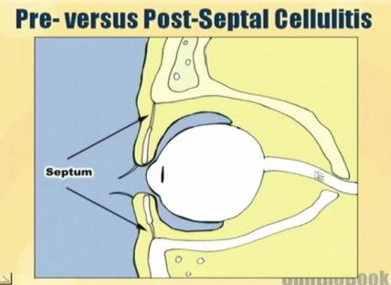
Periorbital and Orbital cellulites
The orbital septum: thin membrane that separates the superficial eyelid from the deeper eye structures.
Periorbital cellulitis,= “preseptal” cellulitis, is a bacterial infection of the eyelid and surrounding soft tissues that does not extend into the deeper orbital structures.
orbital cellulitis, =“postseptal” cellulitis, is an infection involving the fat and muscles posterior to the orbital

Slide 40
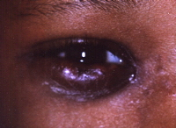
Chandler classification:
1: Preseptal cellulites
2: Orbital cellulites
3: Subperiosteal abscess
4: Intraorbital abscess
5: Cavernous sinus thrombosis

Slide 41
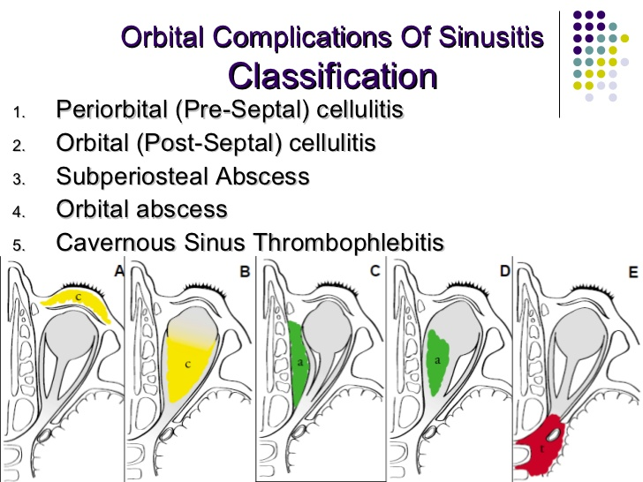

Slide 42
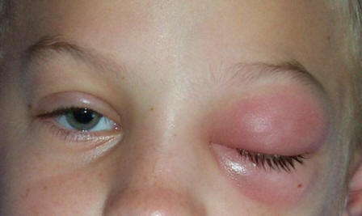
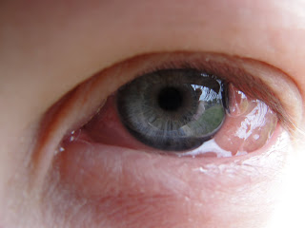

Slide 43
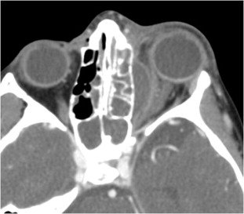

Slide 44
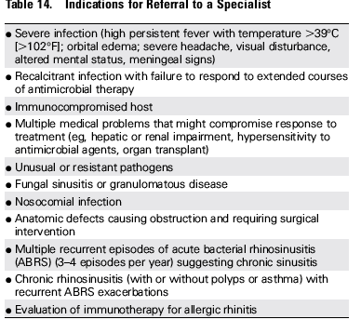

Slide 45
Indications for Hospitalization:
Acutely ill child or adult with high fever, severe head pain
Suspected sphenoid sinusitis
Anytime complications of eye, bone or intracranial structures are present

Slide 46
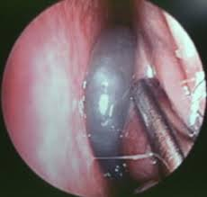
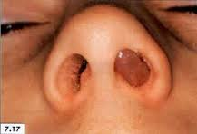
Chronic sinusitis

Slide 47
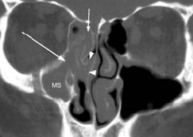

Slide 48
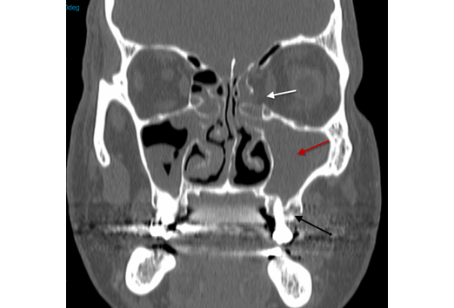

Slide 49
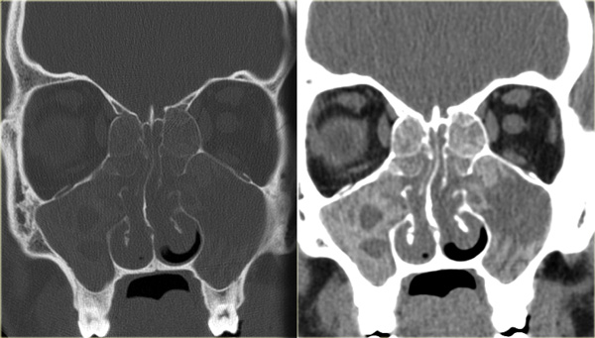
Fungal sinusitis

Slide 50
Functional endoscopic sinus surgery FESS
Medialize middle turbinate
Excise uncinate process
Anterior then posterior ethmoidectomies
Sphenoidotomy
Frontal recess dissection
Create maxillary antrostomy

Slide 51
Indications for Endoscopic Sinus Surgery
Chronic sinusitis,
Complicated sinusitis,
Recurrent acute sinusitis,
Failed medical management of acute sinusitis,
Fungal sinusitis
Obstructive nasal polyposis
Sinus mucoceles
Remove foreign bodies
Tumor excision,
Transsphenoidal hypophysectomy
Orbital decompression,
Dacryocystorhinotomy,
Orbital nerve decompression,
Grave’s ophthalmopathy
Choanal atresia repair
CSF leak repair
Control epistaxis
Septoplasty,
Turbinectomy

Slide 52
GOALS OF FESS
Complete removal of all the disease
Permanent drainage and ventilation of the affected sinuses
Postoperative access to the previously diseased areas.

Slide 53
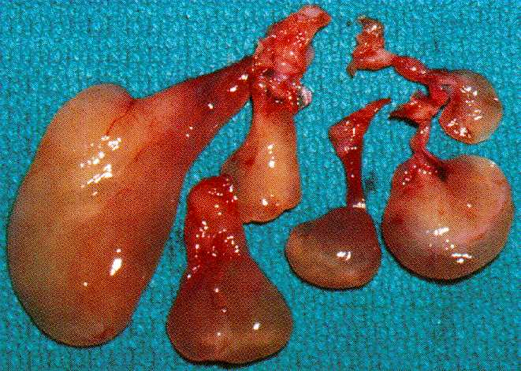

Slide 54
FESS Orbital Complications
Blindness
Indirect injury (retrobulbar Hematoma)
Direct injury to the optic nerve
Orbital Fat Penetration:
increases risk of retrobulbar hematoma
Rx: recognize orbital fat (orbital fat floats);
avoid further trauma; may complete the FESS;
avoid tight nasal packing;
Observe for vision changes, proptosis, or restricted ocular gaze

Slide 55
• Diplopia:
orbital muscle injury, most commonly from medial rectus and superior oblique muscles
• Epiphora:
injury to lacrimal duct system, avoid operating anterior to the attachment of the uncinate;
Rx: observation initially, if no resolution then dacryocystorhinostomy

Slide 56
Thank You

Slide 57
Approach to ENT patient
History of presenting illness (HPI) :f detailed HPI Focus history depends on differential diagnosis
Important +ve and important -ve (KITTENS)
Past medical history (PMH): chronic illness , hospitalization, blood transfusion
Past surgical history (PSH):
Medication history :Current Medication ,Allergy ,Over counter and herpal products .

Slide 58
Approach to ENT patient
Family history : similar disease ,anemia ,bleeding disorder
Social history :
Smoking years/pack/day other type
Alcohol amounts , frequency
Travel
Occupation
Stress ,sexual history
Systematic review :

Slide 59
Rhinology case presentation
14 years old boy presented with right side nasal bleeding ?

Slide 60
EPISTAXIS ( KITTEN)
Nasal trauma (nose picking, foreign bodies, forceful nose blowing)
Allergic, chronic or infectious rhinitis
Chemical irritants
Medications (topical)
Drying of the nasal mucosa from low humidity
Deviation of nasal septum or septal perforation
Bleeding polyp of the septum or lateral nasal wall (inverted papilloma)
Neoplasms of the nose or sinuses
Tumors of the nasopharynx especially Nasopharyngeal Angiofibroma
Vascular malformation

Slide 61
EPISTAXIS( KITTEN)
Systemic arterial hypertension
Endocrine Causes: pregnancy, pheochromocytoma
Hereditary hemorrhagic telangectasias
Anticoagulants (ASA, NSAIDS)
Hepatic disease
Blood diseases and coagulopathies such as Thrombocytopenia, ITP, Leukemia, Hemophilia

Slide 62
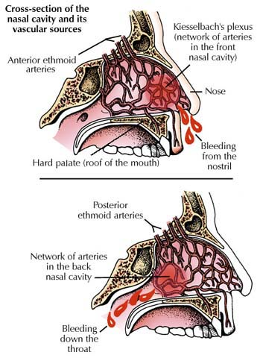

Slide 63
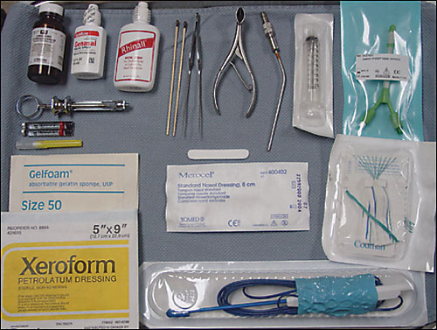

Slide 64

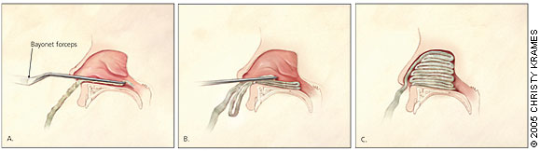
ANTERIOR PACKING

Slide 65
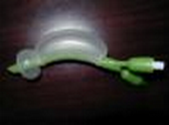
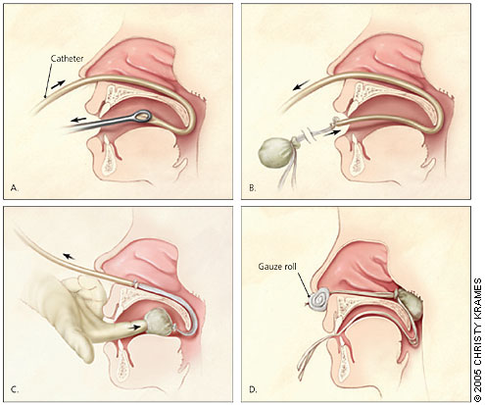
POSTERIOR PACKING

Slide 66
SURGICAL
Septoplasty
Endoscopic cauterization
Selective embolization by interventional radiologist
Transantral internal maxillary artery ligation
Anterior and posterior ethmoid artery ligation
External carotid artery ligation
Endoscopic Sphenopalatine Artery Ligation

Slide 67
Thank you
د.محمد القبساني
استشاري جراحه الانف والاذن و الحنجره والرأس و العنق
Email: dr_of_2008@hotmail.com
Twitter :
@medoo2008

