Slide 1
Air Way Obstruction I&II

Slide 2
the Upper airway extended from the nares and lip to the subglottic area
Upper airway obstruction :
Congenital
Acquired

Slide 3
Congenital upper airway obstruction
From birth to the first few weeks of life
Nasal obstruction
nasal masses
Choanal atresis and stenosis
Pyriform aperture stenosis
Pharyngeal
Craniofacial anomalies
Laryngeal
Laryngomalcia
Vocal cord paralysis
subglottic haemangioma
Subglottic stenosis
Laryngeal web
Laryngeal lymphangioma
Saccular cyst

Slide 4
Stridor
is a high-pitched wheezing sound resulting from turbulent air flow in the upper airway.
Stridor is a physical sign which is produced by narrowed or obstructed airway path
Snoring :
is low pitch sound caused by tissue vibration of the nasopharynx pharynx and soft plate due to obstruction above the larynx

Slide 5
Type of stridor
Inspiratory stridor:
supraglottic , glottic obstruction
Expiratory stridor:
trachea (lower )
Biphasic stridor:
subglottic obstruction

Slide 6
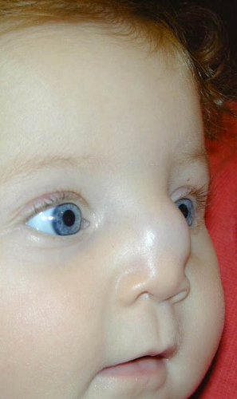
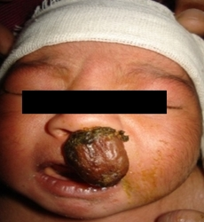
Nasal obstruction
neonates are obligatory nasal breather
in neonate Cyanosis improved with crying but worsens on feeding
Nasal masses :
Cystic ( meningoencephalocoele, )
Solid (glioma, hamartoma ,teratoma ,and lymphangioma)
Ct scan and MRI is important for diagnosis

Slide 7
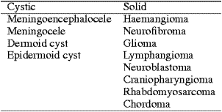
Nasal obstruction

Slide 8
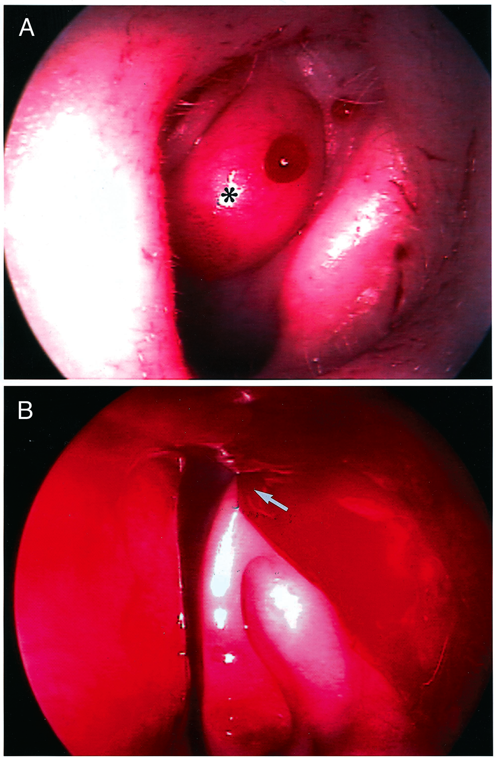
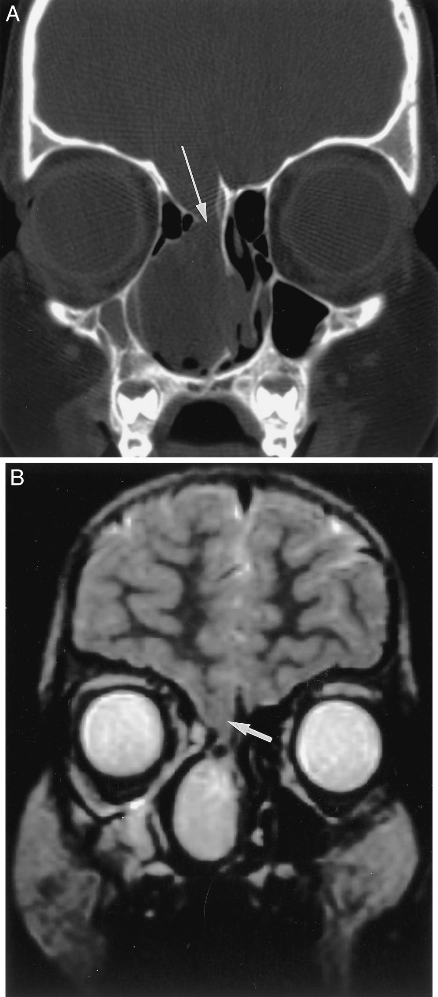

Slide 9
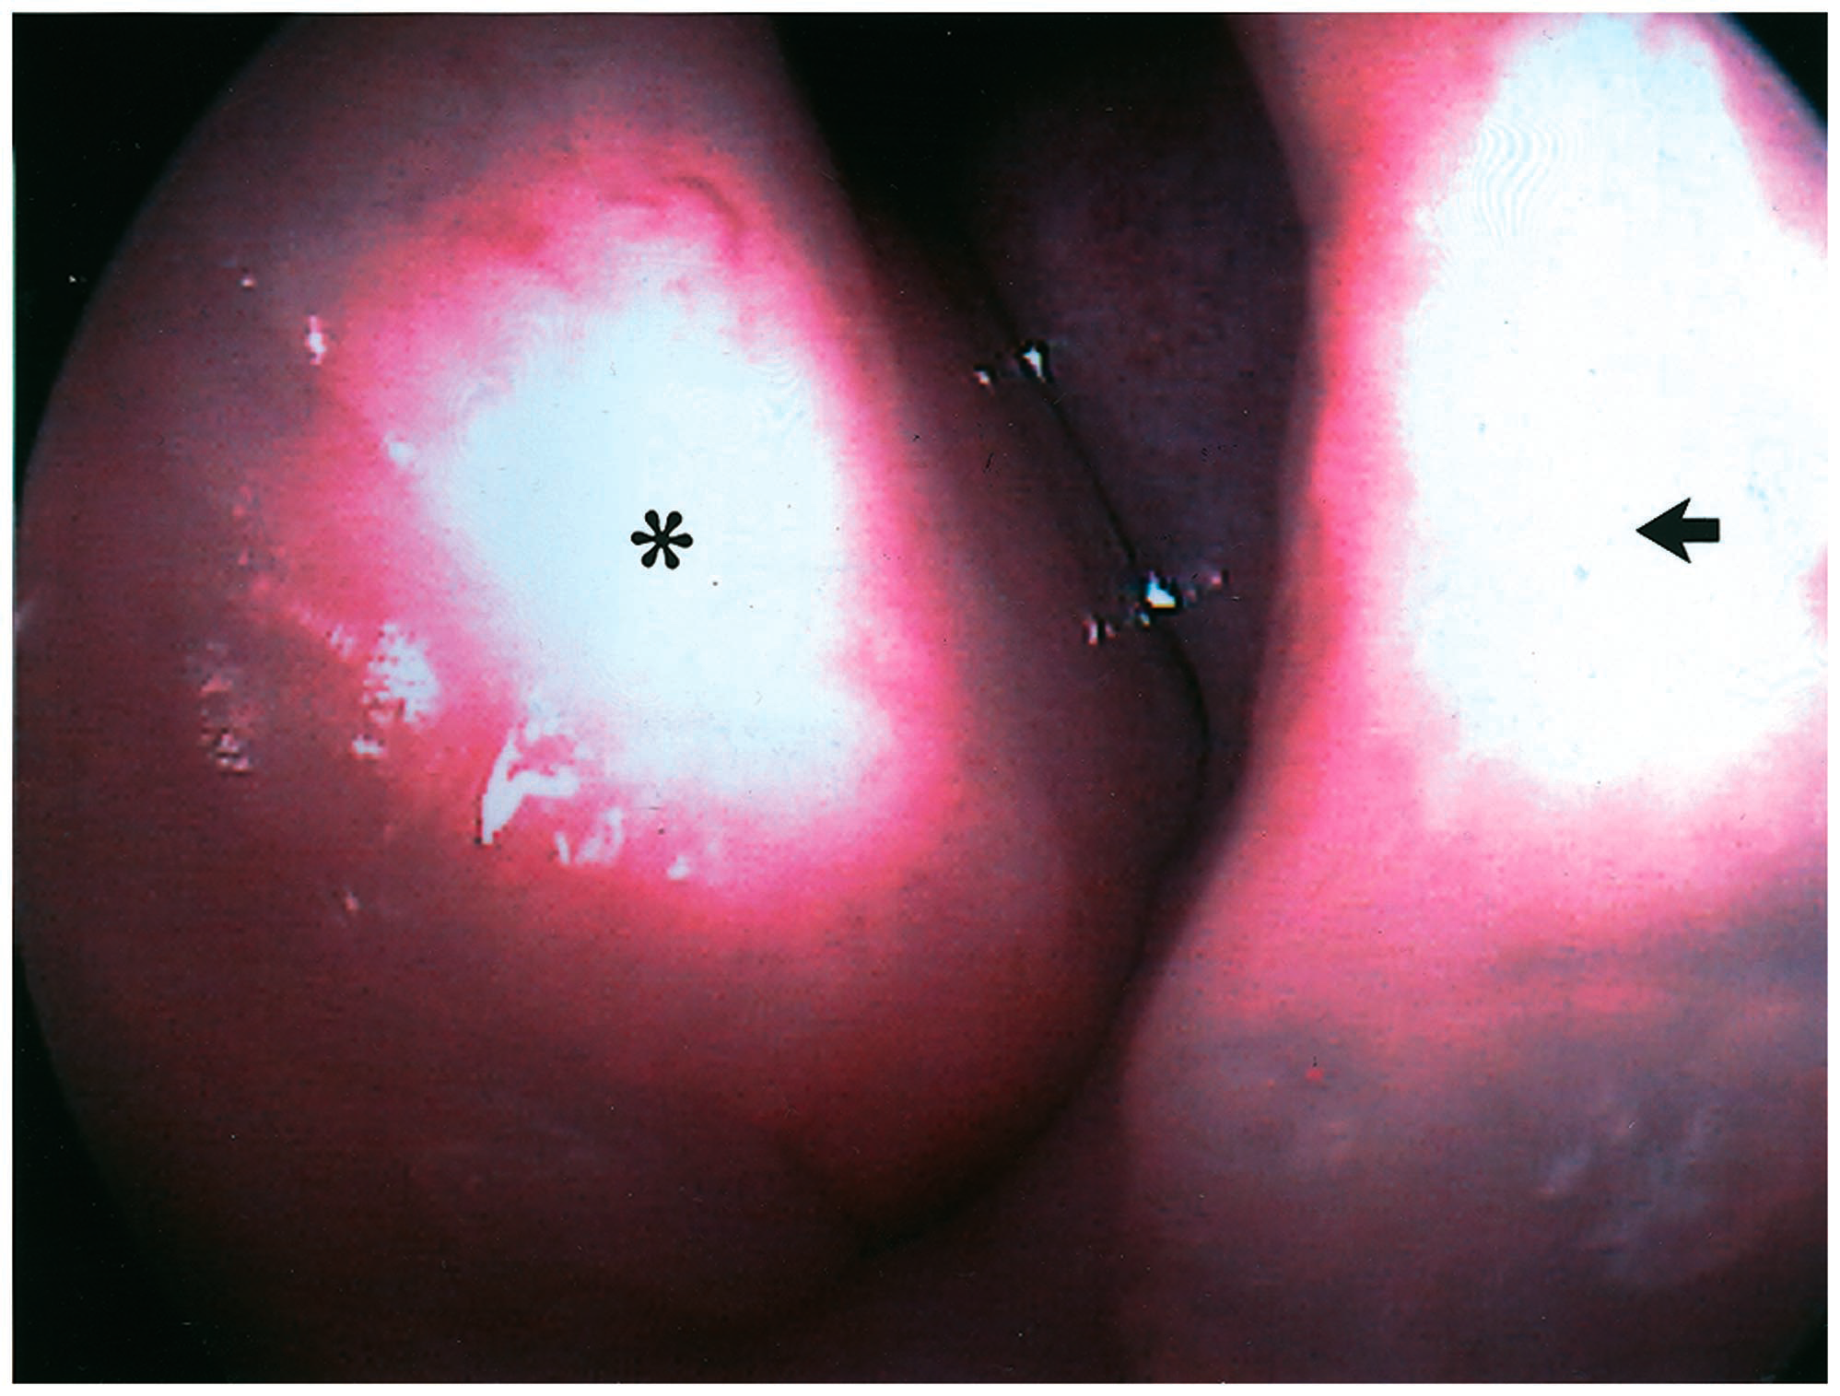

Slide 10
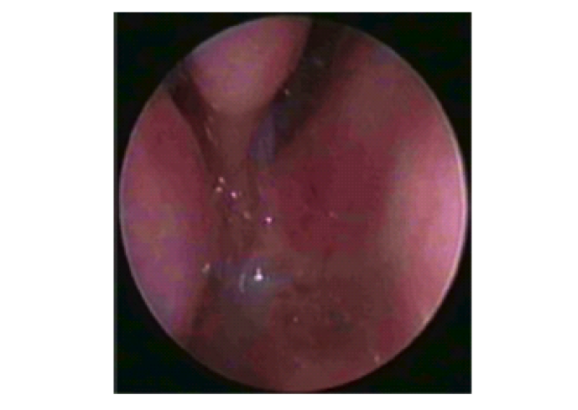
Choanal atresia
Lack of patency of posterior nasal aperture
Bilateral atresia presents soon after birth with sever respiratory distress
Unilateral atresia may undiagnosed until later in childhood (rhinorrheoa )
Types :
Membranous 10%
Bony 90 %
mixed
DX:
Cyanosis improved with crying
Inability to pass size 6 French catheter

Slide 11
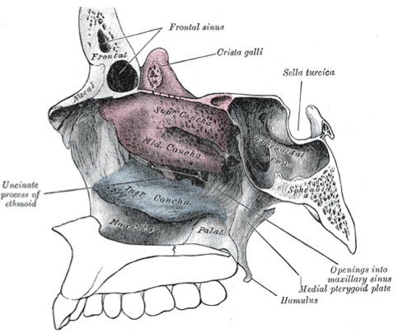
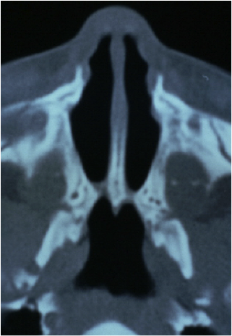

Slide 12
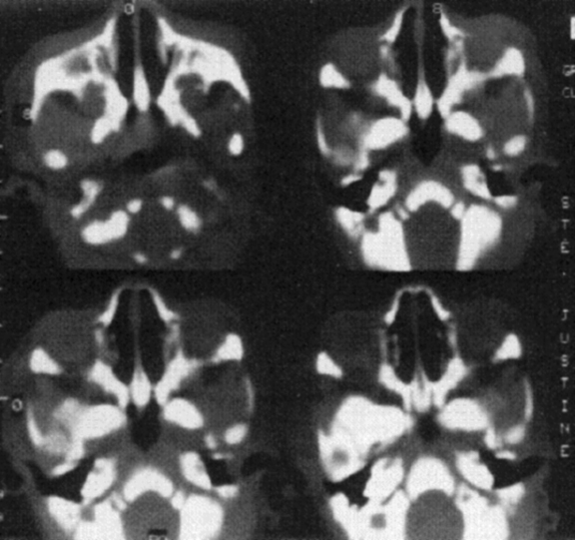
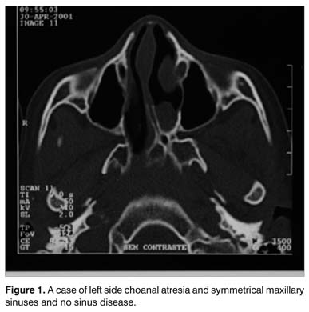

Slide 13
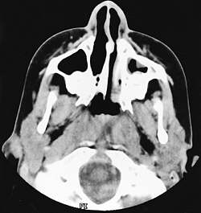
70% of choanal atrasia associated with CHARGE syndrome
C coloboma
H heart disease
A atrasia
R retarded growth
G genital hypoplasia
E ear deformity

Slide 14
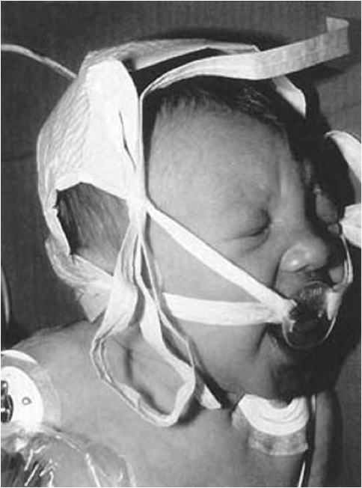
Treatment
Emergency treatment is by insertion of oral airway tube
Surgical treatment is by either transnasal or transpalatal choanal atrasia repair

Slide 15
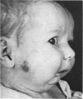
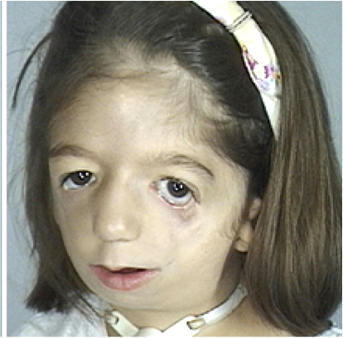
Pharyngeal obstruction
Craniofacial anomalies :
Pierre –Robin syndrome:
Glossoptosis, micrognatheia, cleft palate
Treacher- Collins syndrome:
(Mandibuolfacial dystosis)
Narrow nose high arched palate

Slide 16
Laryngeal
Laryngomalcia :
The most common cause of congenital airway obstruction
The most common cause of stridor in infancy

Slide 17
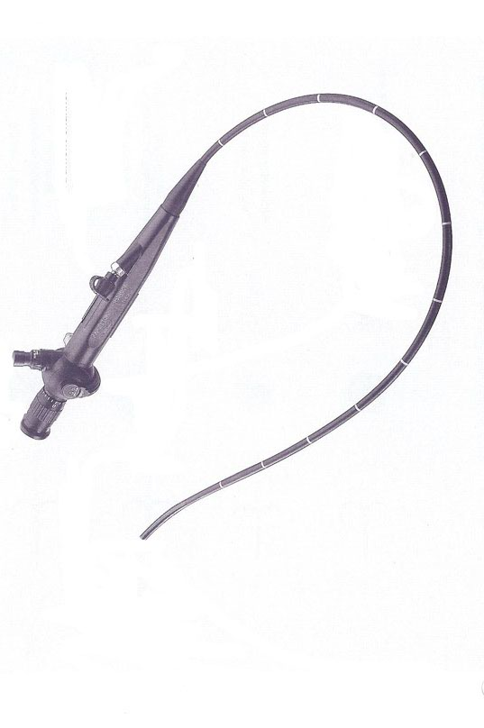
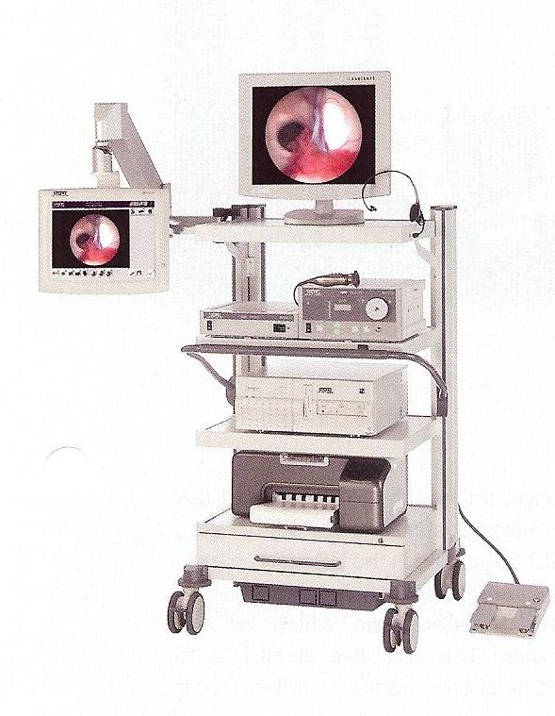
Symptoms
Stridor in the first weeks of life
Inspiratory phase
Worse with crying ,feeding ,and respiratory tract infection
Improved in prone position
DX : flexible fibrotic endoscopy

Slide 18
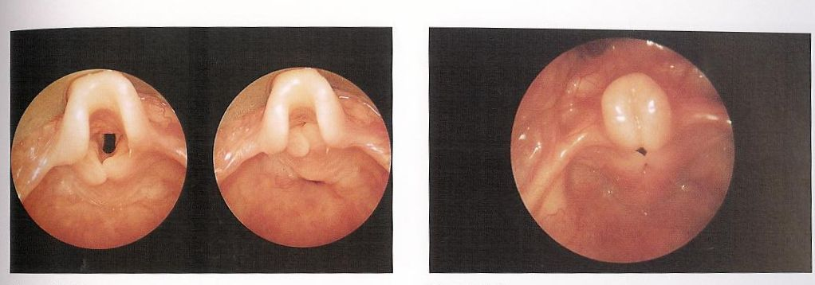
Endoscopic finding:
Tall ,omega shape epiglottis
Inward forward movement of arytenoid mucosa (sucked)
Short aryepiglottis fold
Treatment :
Mild cases :( no cyanosis not effecting the child growth )
observation
Sever cases:
supraglottoplasty ,
tracheostomy

Slide 19
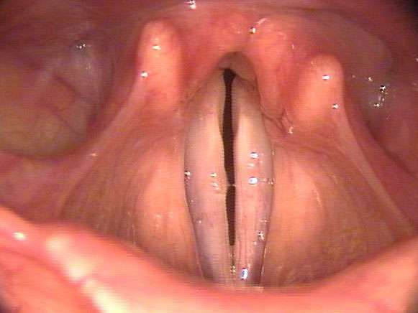
Vocal cord paralysis
Can be unilateral or bilateral ,congenital or acquired
Congenital form may associated with abnormality of the central nervous system (Arnold Chiari syndrome ) or cardiovascular anomalies
Symptoms:
high pitch inspiratory stridor
Treatment :
tracheostomy in sever cases
Spontaneous recovery occurs in half patients within a year.
surgical intervention after one year
Vocal cord lateralization,
arytoidectomy
laser cordotomy

Slide 20
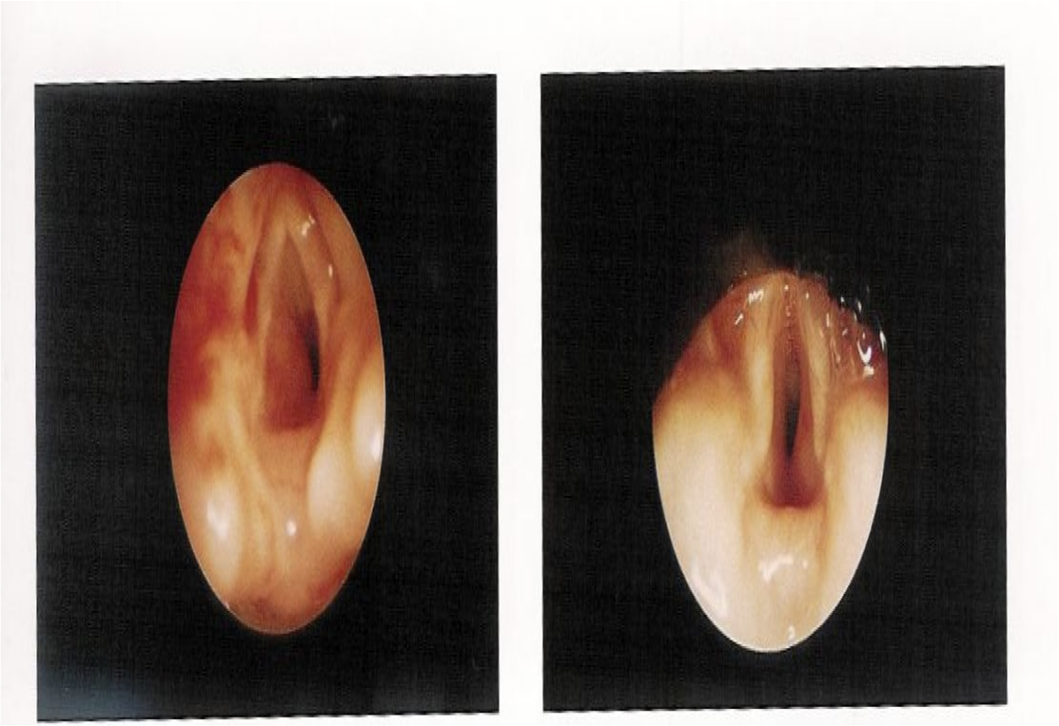
Subglottic haemangioma
Congenital vascular lesion
not present at birth but grow rapidly over the first few months of life
Symptoms:
Biphasic stridor
Tend to involute slowly after one year
50% of the patients have cutaneous haemangioma in the head and neck
Treatment :
Systemic steroid , interlesional steroid , Propranolol,
laser ablation, tracheostomy

Slide 21
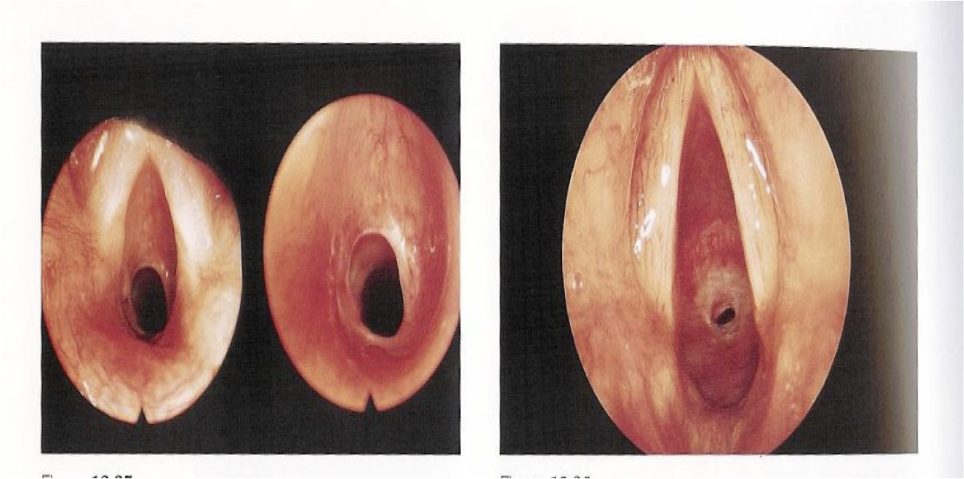
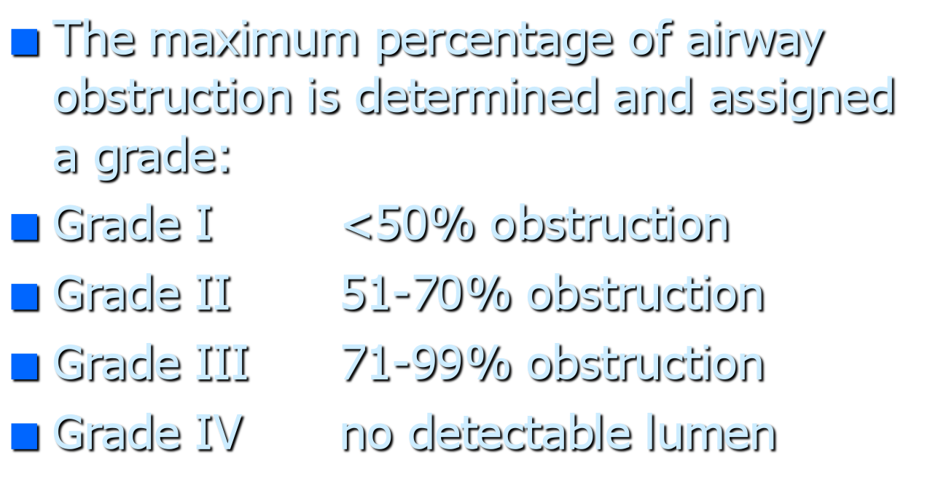
Congenital subglottic stenosis
Subglottic area is the narrowest area in the airway ,stenosis if the diameter less than 4 mm in term infant
Symptoms depend on the degree of stenosis
Biphasic stridor
Recurrent croup
Dx:
bronchoscopy,
,plain x ray, HKV x-ray

Slide 22
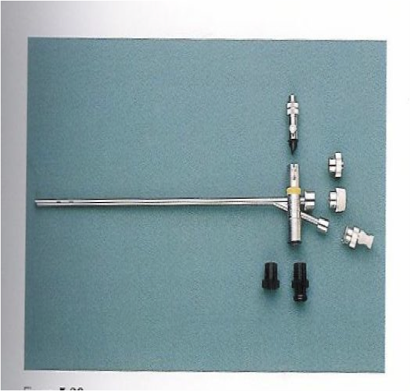
Treatment
Depend on the degree of stenosis
Tracheostomy
laser excision
Balloon dilation
Laryngotracheal reconstruction(LTR)
Criocotracheal resection(CTR)

Slide 23
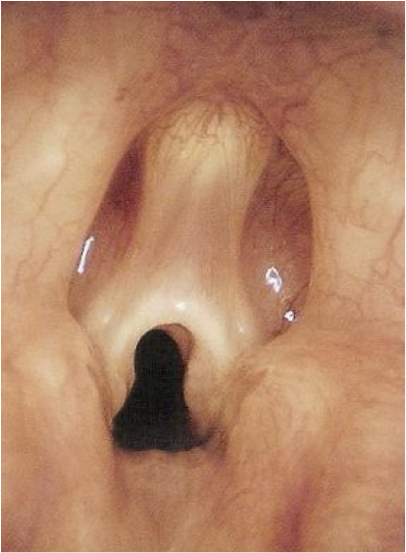
Laryngeal web
Week cry
Stridor
Treatment :
Laser excisions
Trachestomy

Slide 24
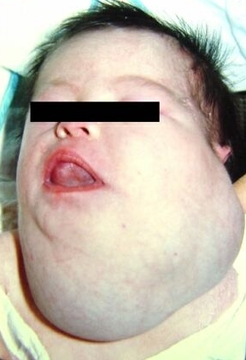

Extratracheal compression
Cystic hygroma

Slide 25
Acquired upper airway obstruction
acquired upper airway obstruction are more common than congenital type
Causes:
Infectious
Peritonsillar abscess
Retropharyngeal abscess
Epiglotitis
Croup
Bacterial tracheitis
noninfectious
FB aspiration
acquired vocal cord paralysis
Acquired subglottic stenosis
adenotonsillar enlargement
respiratory papillomatosis
malignancy
Angioedema
caustic ingestion
trauma
laryngospasm

Slide 26
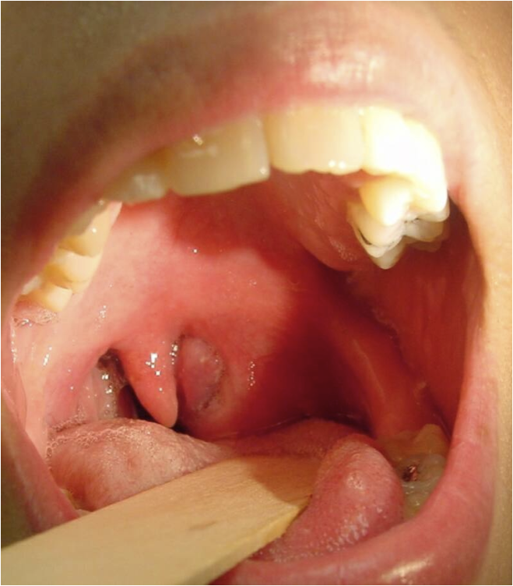
Peritonsillar abscess
common deep infection in late childhood
Symptoms : low grade fever sever sore throat ,muffled voice ,drooling, trismus

Slide 27
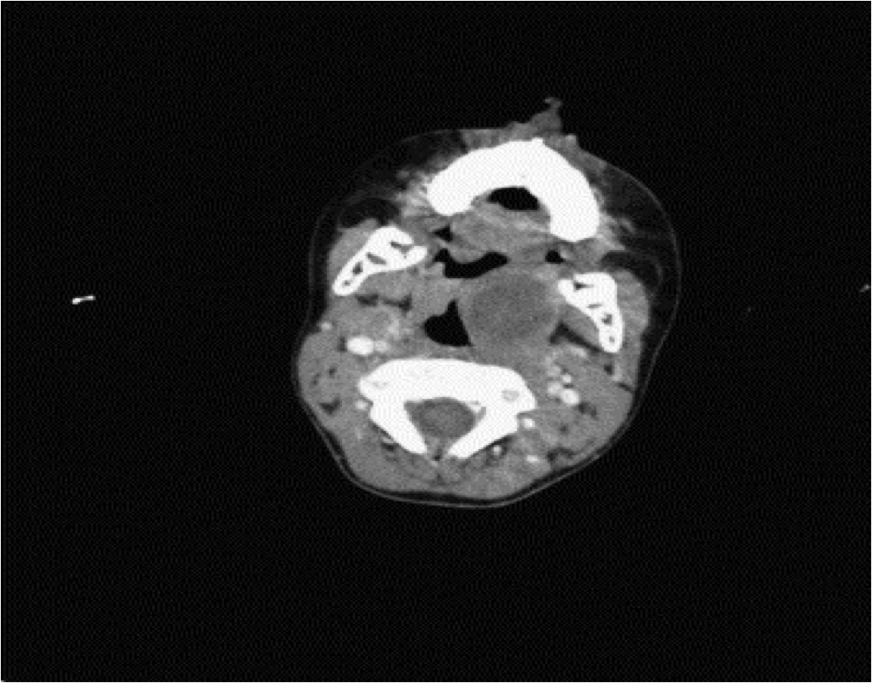
Peritonsillar abscess
Diagnosis
Clinical diagnosis
CT scan
Treatment :
aspiration
Incsion and drainge
later tonsillectomy
IV ABX

Slide 28
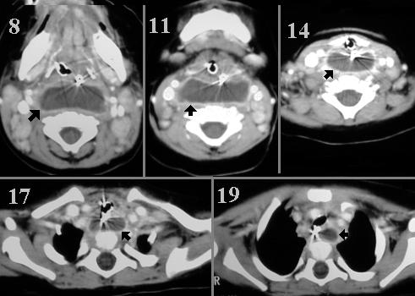
Retropharyngeal abscess
Symptoms :
fever, cervical adenopathy stridor ,torticollis, drooling
Causes :
progressive pharyngitis S.aureus ,Haemophilus , group A beta haemolytic sterptococcus , bacteroides
Treatment :
Transoral incision and drainge
IV ABX
INTUBATION
Tracheotomy

Slide 29
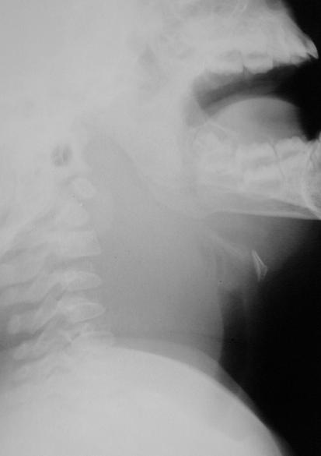
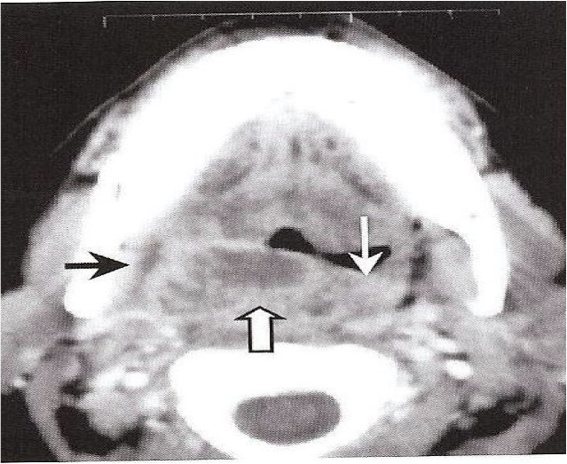

Slide 30
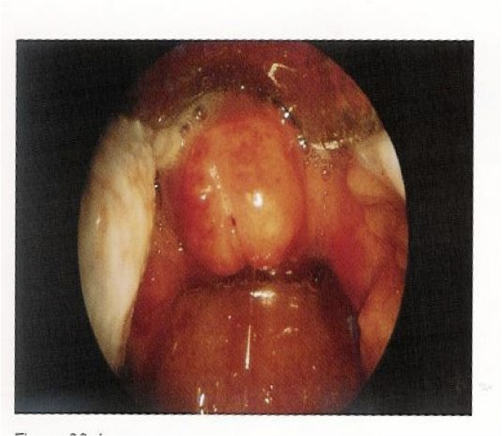
Epiglottitis
It is life threatening rapidly progressive condition
Cause :H influenzae type B
Age:2-7 years
Symptoms :
High fever dysphagia, drooling stridor toxic looking child ( sit upright with head extended )
NO EXAMINATION SHOULD BE DONE IN ER .
Intubation
tracheostomy
IV ABX
Endoscopic picture

Slide 31
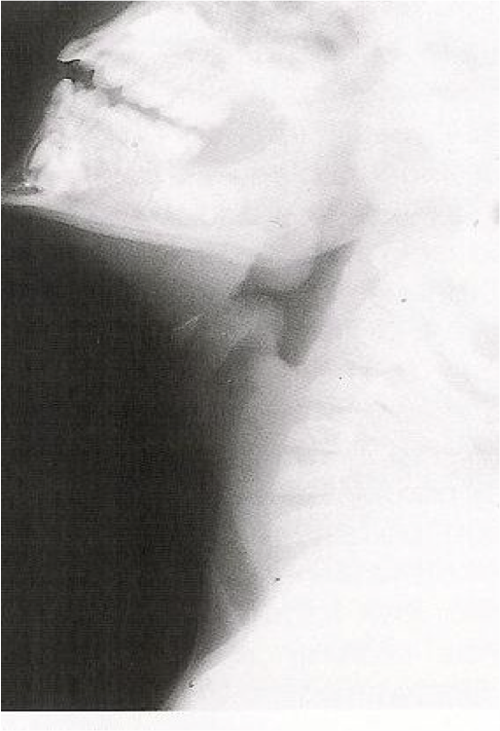
Epiglottitis
Thumb sign

Slide 32
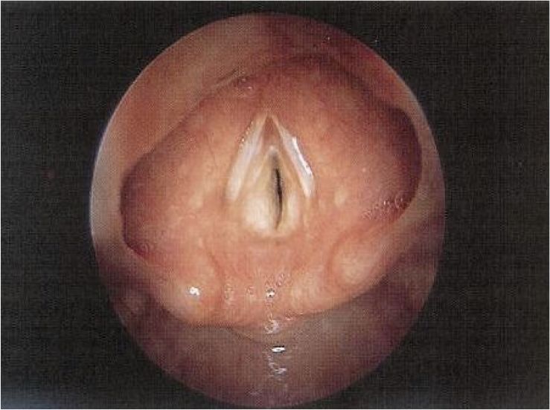
Croup
Croup (laryngotracheobronchitis )
Primary involves the subglottic
Parainfluenza 1-3
6 months-3 years
SSX:
biphasic stridor, fever , brasssy cough , hoarseness , no dysphagia
DX:
x-ray ,steeple sign
RX:
humidified oxygen,racmic epinephrine ,steroid

Slide 33

Steeple sign

Slide 34
Non infectious causes
FB aspiration
Foreign body aspiration is a common accident in children and represents an important cause of morbidity and mortality.
500 children die of FBA each year in the USA and 40% of lethal accident among children under 1 year of age were caused by FBA
Int J Pediatric Otorhinolaryngol

Slide 35

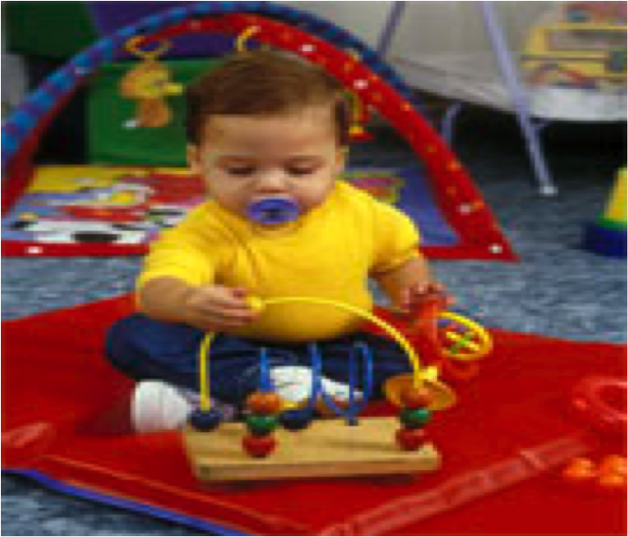

FBA is common among infants and preschool children

Slide 36
Clinical presentations
Acute episode
Period of choking ,gagging, wheezing ,hoarseness
Asymptomatic ( miss diagnosis?)
Cough , wheezing …
Complication
Pneumonia, obstructive emphysema and bronchiectasis ….

Slide 37
Medical history is the key to diagnosis FBA
Physical examination finding were abnormal in 80% of children with FBA , these were abnormal also in 40% of children without FBs .
the sensitivity and specificity of physical examination were 80.4% and 59% respectively.
Pediatr surg 2005;40:1122-1127

Slide 38
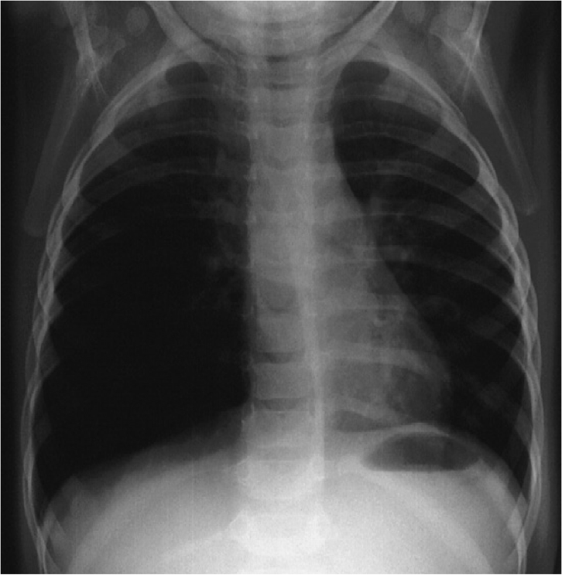
Radiological examination
Many FB are not radiopaque and small FB may cause symptoms but not radiographic changes
Plain film (inspiratory expiratory )
Air trapping,
obstructive emphysema ,mediastinal shift
Rt and LT lateral decubitus film

Slide 39
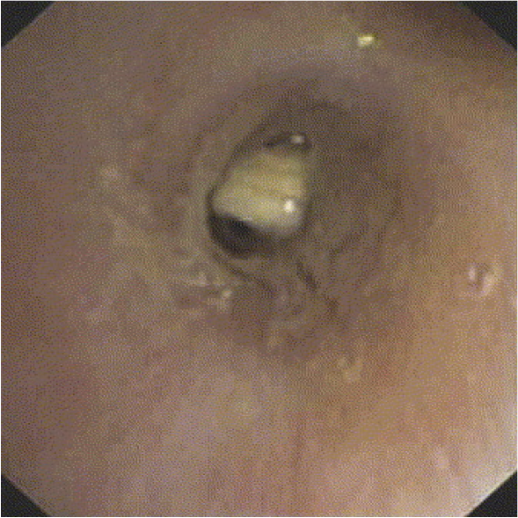
The most common objects aspirated by young children are food products (peanuts ,seeds)
Beans and seeds absorb water over time
Inert FB (Pieces of toys casuse less reaction

Slide 40
Negative imaging studies do not exclude the presence of an FB
A High degree of clinical suspicion is the most important element in the diagnostic work –up

Slide 41
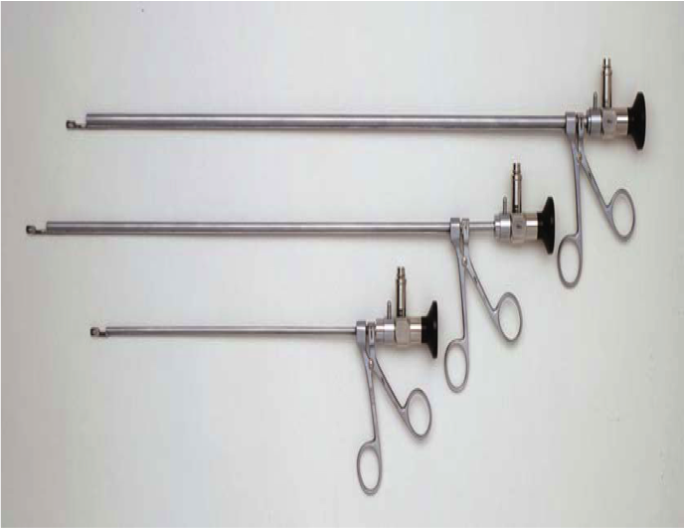
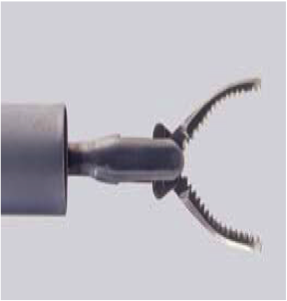
Airway foreign bodies are removed most safely under general anesthesia using the ventilating rigid bronchoscope

Slide 42
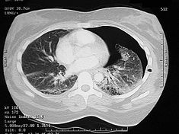
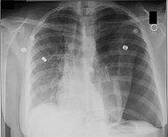

Slide 43
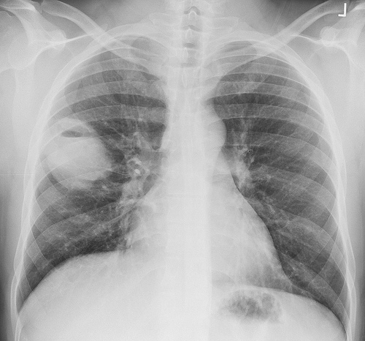

Slide 44
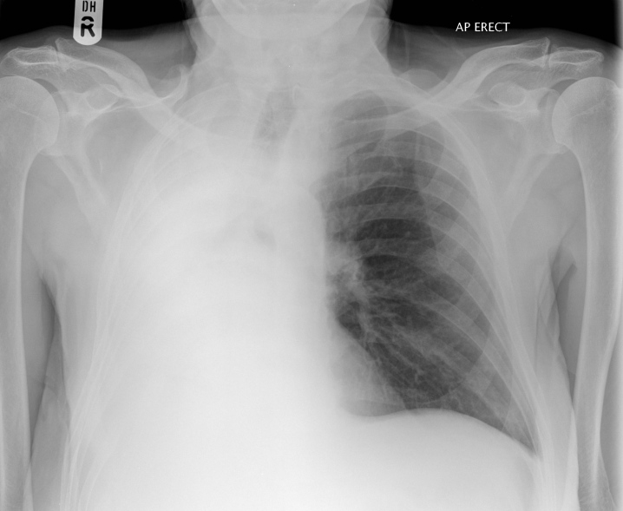

Slide 45
Acquired vocal cord paralysis
Unilateral
Bilateral
Causes :
Birth trauma
(forceps delivery)
Cardiac surgery( PDA repair)
Mediastinal or neck surgery
Tracheo-esophageal fistula repair

Slide 46
Bilateral vocal cord paralysis (abduction type)
symptoms :
Stridor
Treatment :
Need temporary tracheotomy
Vocal cord lateralization
Cordectomy
arytenoidectomy

Slide 47
Acquired subglottic stenosis

Slide 48
Risk factors:
Prolong intubation
size of the tube, material
Care of intubated patient
High pressure cuffs tube
Difficult intubations
multiple intubation
GERD
Tracheobronchial infection

Slide 49
Laryngeal ➔ granulation tissue ➔ ulceration➔ perichondratis ➔ subglottic stenosis

Slide 50
Treatment
Grade I&II
Observation
Balloon dilation
Laser excision
Grade III&IV
Trachestomy
Laryngotracheal reconstruction
Cricotracheal resection

Slide 51
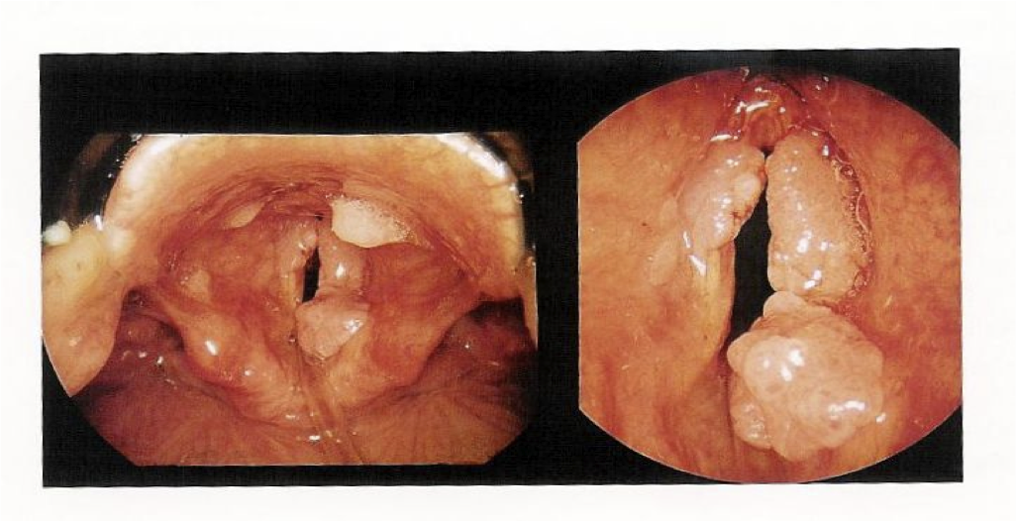
Respiratory papillomatosis
2/3 before age 15
rarely malignant change
HPV 6-11
Risks:
younger first time mother (condyloma acuminata)
Lesions:
wart like (cluster of grapes )
SSX:
Hoarseness stridor
RX;
laser excision ,microdebrider
Adjunctive therapy:
Cidofovir, acyclovir , interferon

Slide 52
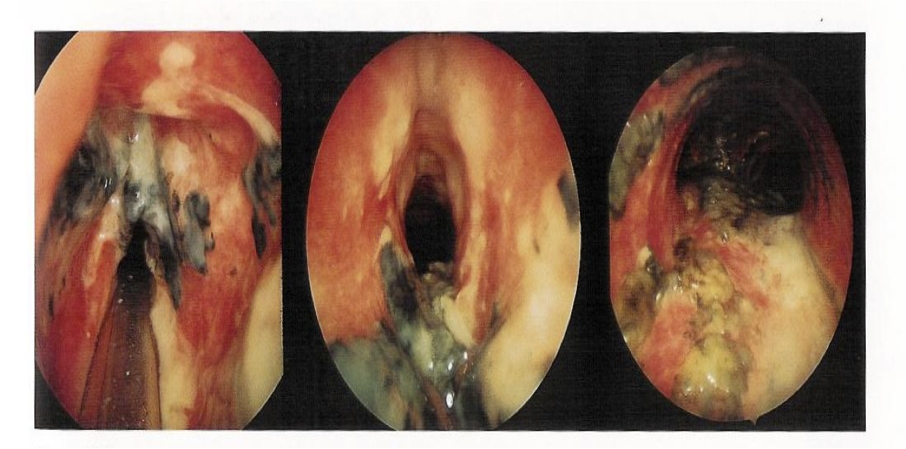
Thermal injury
Aspiration hot liquid ,caustic fluid
Treatment :
intubation
Trachestomy
IV ABX

Slide 53
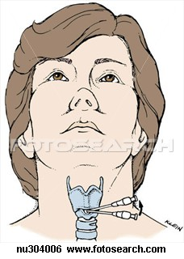
Cricothyroidectomy
a technique for obtaining an emergency airway through the cricothyroid membrane when standard airway techniques have failed.
in which a large-bore intravenous cannula is inserted directly through the membrane.
Surgical cricothyroidotomy in which a surgical hole is made in the membrane and a cuffed tube, similar to a short endotracheal tube is inserted directly.

Slide 54
Indications:
Need for an emergency airway where:
Intubation is not possible
Need to avoid neck manipulation
Severe maxillofacial trauma
Oedema of throat
Severe oropharyngeal/tracheobronchial haemorrhage
Foreign body in upper airway
Lack of equipment for endotracheal intubation
Technical failure of intubation

Slide 55
Complications:
Thyrohyoid membrane incision
Intra/postoperative bleeding
Subglottic stenosis
Dysphonia/hoarseness
Laryngeal damage
Tube misplaced in bronchus
Tracheal stenosis .
Recurrent laryngeal nerve injury
Oesophageal perforation or tracheo-oesophageal fistula.
Tracheo-brachiocephalic vein fistula
Fracture of thyroid cartilage

Slide 56
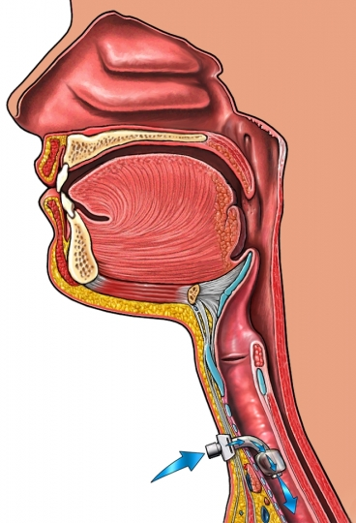
Indications for a tracheostomy
Obstruction of the upper airway
foreign body
Trauma
Infection
laryngeal tumour
facial fractures
Impaired respiratory function,
head trauma leading to unconsciousness
To assist weaning from ventilatory support in patients on intensive care
To help clear secretions in the upper airway

Slide 57
Complications
Immediate:
Haemorrhage, e.g. from thyroid isthmus
Hypoxia
Trauma to recurrent laryngeal nerve
Damage to oesophagus
Pneumothorax
Subcutaneous emphysema
Early:
Tube obstruction or displacement
Aspiration
Bleeding from tracheostomy site
Infection
Late:
Airway obstruction with aspiration
Tracheomalacia
Aspiration and pneumonia
Fistula formation, e.g. tracheo-cutaneous or tracheo-oesophageal
Damage to larynx, e.g. stenosis Tracheal stenosis

Slide 58
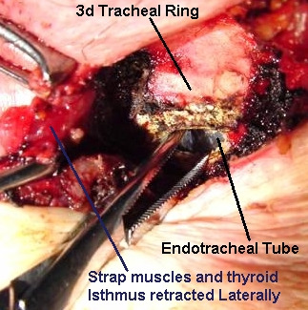
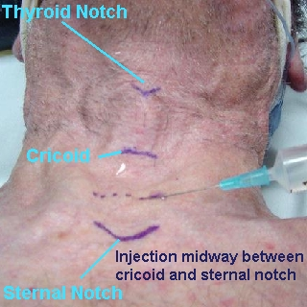

Slide 59
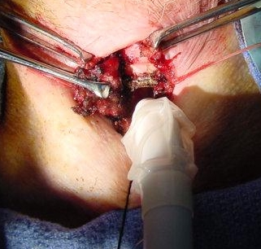
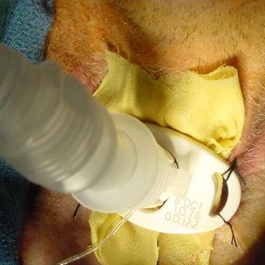

Slide 61
Clinical assessment of child with upper airway obstruction
History :
Age
Speed of onset and precipitating event
Associated symptoms (fever ,drooling. Hoarseness ..)
Feeding difficulty
Past medical history (birth trauma, intubation…)

Slide 62
Examination
Craniofacial anomalies
Cutaneous haemangiomas
Respiratory distress sign
Neck mass
Growth chart
COMPLETE ENT EXAMINATION
Flexible fibroptic examination

Slide 63
investigation
Physiological studies:
ABG
Spirometry
Imaging :
Chest Xray (FB)
HKV (subglottic stenosis)
CT scan( choanal atrasia ,retropharyngeal abscess ,tumor )
MRI (intracranial extension )
Barium swallow (vascular ring)
Endoscopy : is the tool of examination

Slide 64
Thank you

