Slide 1
Audiology
Nader Aldajani
Otologist
KFMC

Slide 2
Audiology:
The study of sound and hearing.
Audiometry: the measurement of
hearing sensitivity.

Slide 3
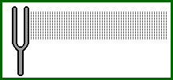
Sound:
It is a form of energy produced by a vibrating object that results in sensation of hearing.
Decibels (dB): Unit of measurement of Sound intensity.
Vibration: is the to-and-fro motion of an object ( vocal folds, diaphragm on an earphone or loudspeaker, tuning fork)

Slide 4
Frequency:
It is the number of cycles per second.
Humans: 20 Hz to 20 kHz.
Below 20 Hz, we feel a vibration rather than hear a sound.
Hertz (Hz):Unit of measurement of frequency

Slide 5
Units of Measurement:
Frequency: (Hz).
Intensity: (dB).

Slide 6
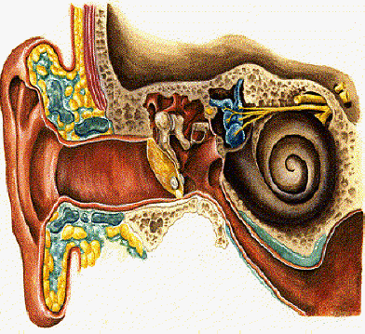
Mechanical
Senorineural

Slide 7
Audiology set:
Tympanometry.
Pure tone audiometry.
Speech audiometry.
Auditory brain stem response (ABR).
Otoacoustic emission (OAE).

Slide 8
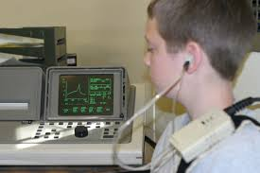
Tympanometry:
Objective test.
Used to test middle ear function.
Middle ear compliance with changing pressure in EAC.

Slide 9
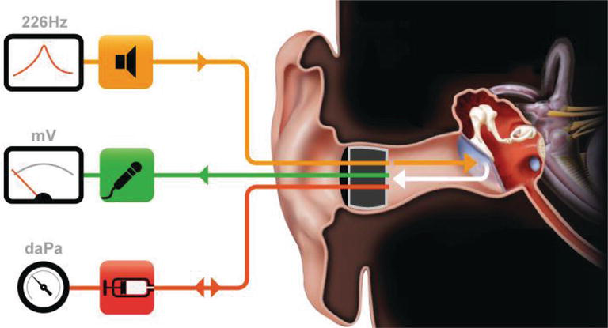
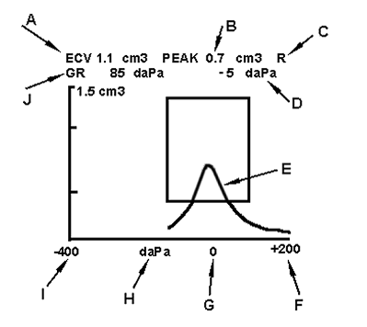
Tympanometry:

Slide 10
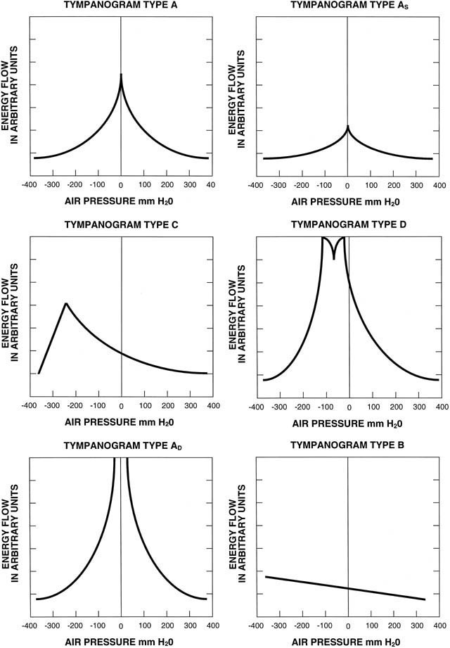
Tympanometry:
  Types of tympanogram
    Type A: inverted V near zero pressure - normal
    Type As: Reduced compliance pressure (otosclerosis).
    Type Ad: Increased compliance (ossicular discontinuity).
    Type B: is flat indicating middle ear effusion or perforation.
    Type C: with maximum compliance beyond -100 mmH2O indicating Eustachian tube function

Slide 11
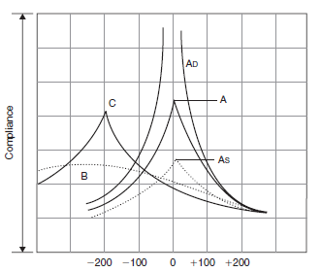

Slide 12
Ear Canal Volume:
Provides measure of volume of external ear canal.
Volumes based on age.
Type B with Volumes greater than 2.5 suggest:
  Perforation.
  Patent ventilation tube.
Type B with Volumes greater LESS 2.5 suggest:
    OME.

Slide 13
Tympanometry: how to read?
Types:
  A
  B
  C
Normal External Auditory normal volume less than 2.5 ml
Normal Middle ear compliance (o.3-1.6)..
Normal range ( -100 to +50).
Stapedial reflex
  Present or absent

Slide 14
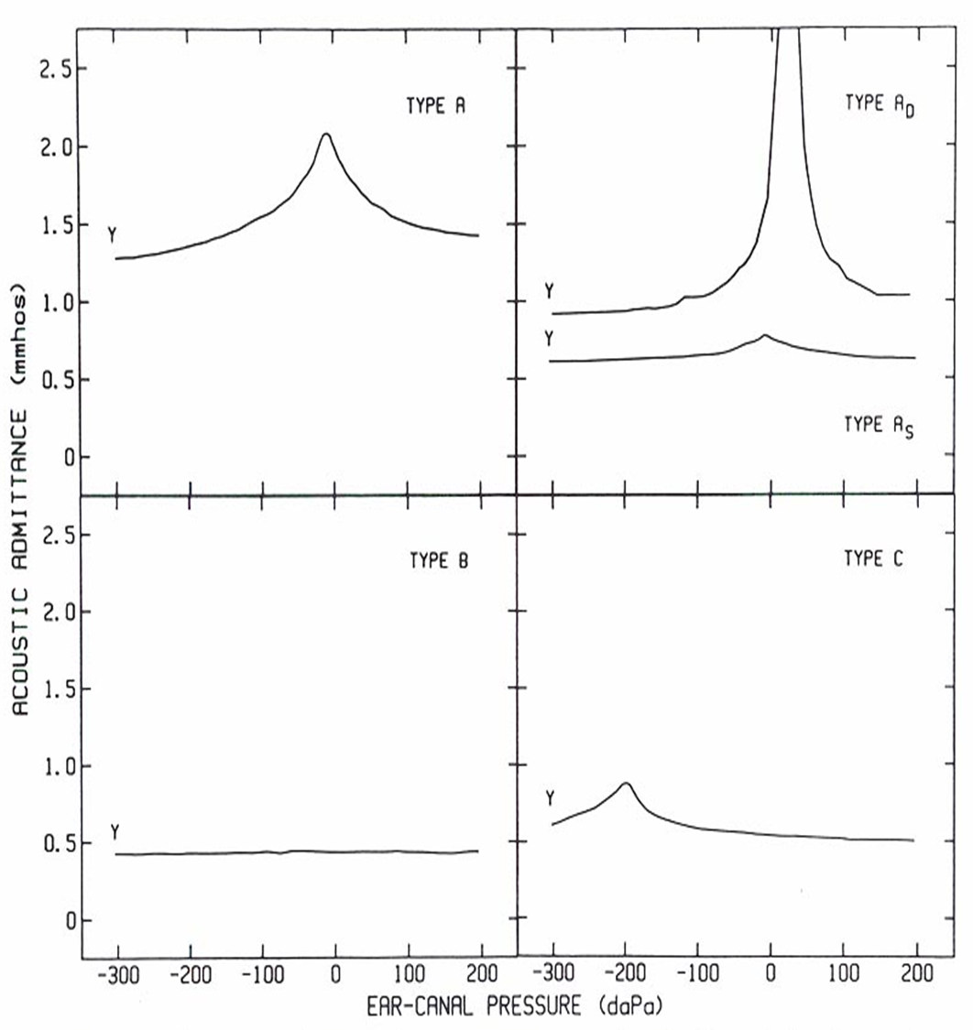
Tympanometry:

Slide 15
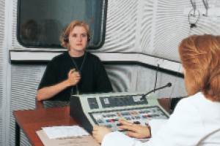
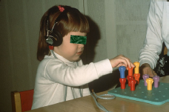
Pure tone audiometry (PTA):
In sound proof room.
With head phones /insert phones for AC and bone transducer for BC.
Buttons and dials to change frequency (Hz) and sound level (dB ).
Depends on patient response (behavioral test).
Modified in children (Play audiometry).

Slide 16
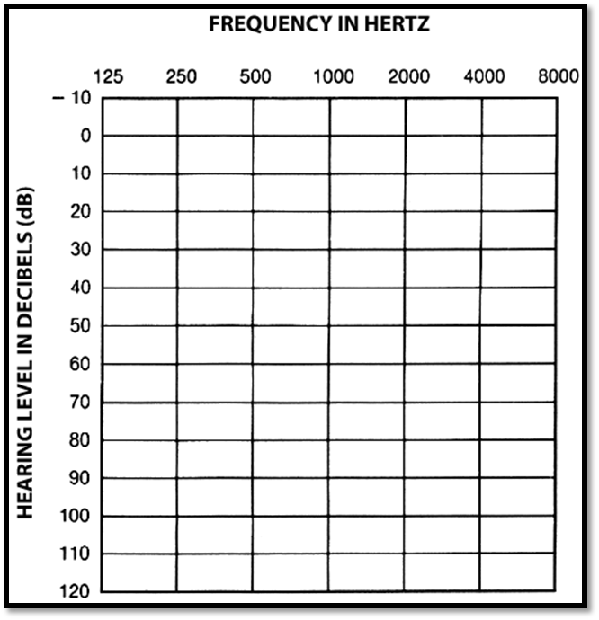

Slide 17
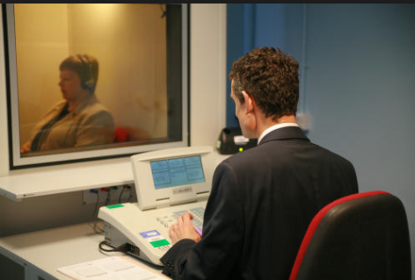
Audiometry-sound proof room

Slide 18
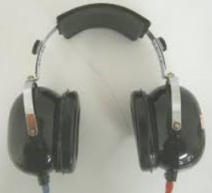
Pure tone audiometry:
Testing range of frequencies (Hz)
  0.25,0.5, 1,2,4,8 kHz
Sound intensity range: 0-110 dB
Hearing loss measured in dB vs. Hz
Masking (with noise) of non-test ear is needed when cross hearing is a possibility.

Slide 20
Audiogram- Value:
Type of hearing loss : site of the lesions
Degree of hearing loss : threshold
Configuration of hearing loss- etiology
Before and after operation- success
For hearing aid fitting-rehabilitation
For hearing screening e.g. workers in noisy environment- prevention of Hearing loss
For medico-legal purpose

Slide 21
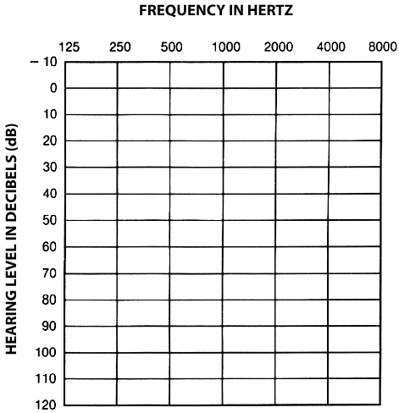
PTA: how to read
Types.
Degree.
Air conduction assesses entire system.
Bone conduction assesses cochlea.
Air-bone gap (>10)

Slide 22
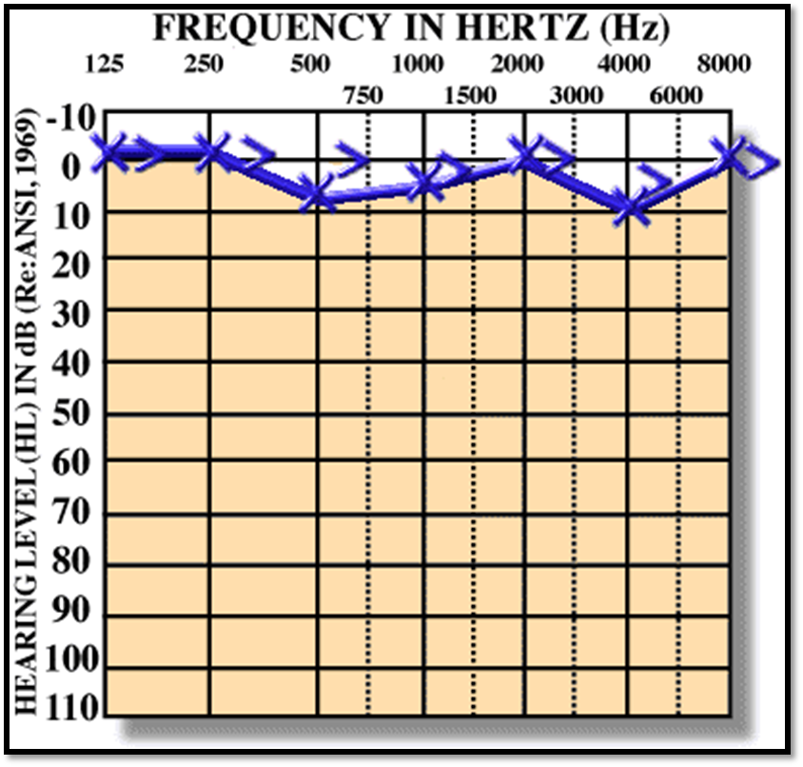
Normal Hearing:

Slide 23
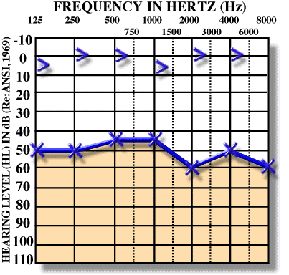
Conductive hearing loss:
  Causes are in external ear, TM or middle ear
  Air decreased
  There is Air-Bone gap.

Slide 24
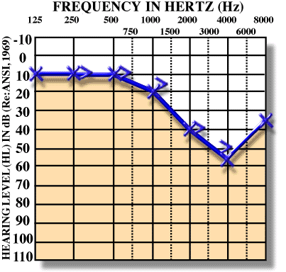
Sensorineural hearing loss:
Causes in inner ear or acoustic nerve or central.
Both Air and bone decreased
There is NO Air-Bone gap.

Slide 25
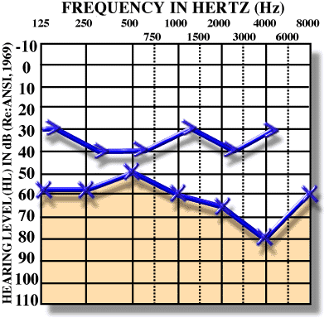
Mixed Hearing Loss
Both Air and bone decreased
There is Air-Bone gap

Slide 26
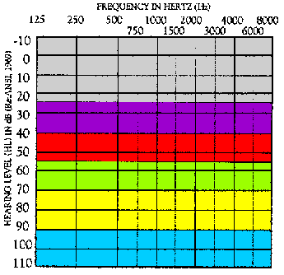
Degree of Hearing Loss
-10 – 25 dB HL = Normal range
26 – 40 dB HL = Mild hearing loss
41 – 55 dB HL = Moderate
56 – 70 dB HL = Moderately Severe
71 – 90 dB HL= Severe
Greater than 90 dB HL = Profound

Slide 27
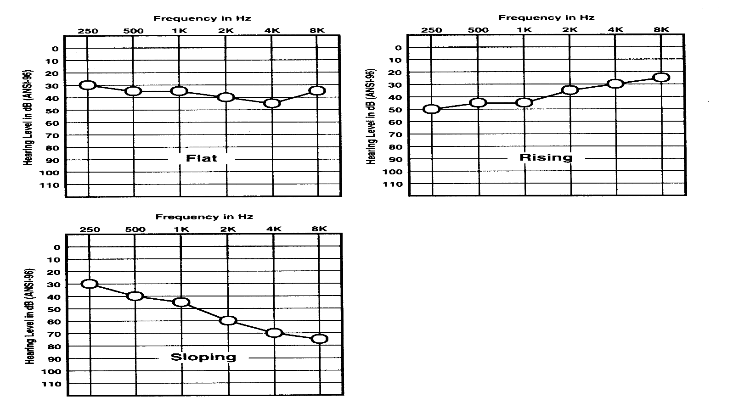
Configuration of the hearing loss:
  -Rising
  -Flat
  -Sloping

Slide 28
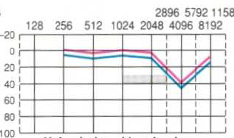
Noise induced hearing loss:
Maximum around 4kHz (notch)
May have tinnitus but may be subclinical
One side may be more than the other

Slide 29
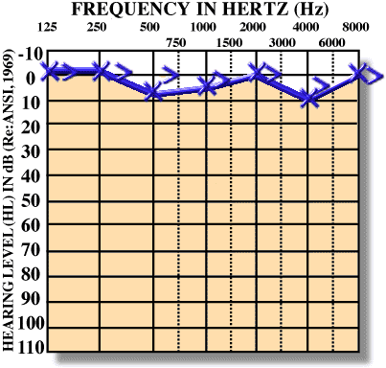
Normal
CHL
Mixed
SNHL
SNHL

Slide 30
Speech audiogram:
Speech reception threshold (SRT):
  The softest level (dB HL) at which a patient can accurately repeat spondees (two-syllable words; i.e. baseball, hotdog, birthday) 50% of the time.
Word recognition score (WRS):
  The percentage of phonetically-balanced, monosyllabic words that a patient can accurately repeat.
  Normal > 90%.

Slide 31
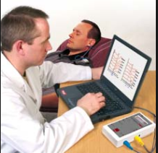
Auditory brain stem response:
Objective test for threshold hearing and
neurodiagnosis.
Technique:
  Surface electrodes
  Sound stimuli : usually clicks
Computer generates waveform
through averaging and amplification:

Slide 32
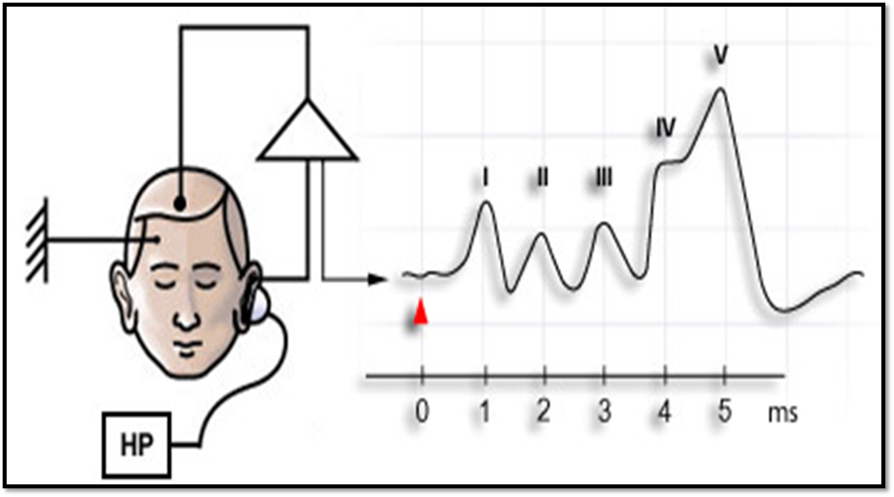
Components:
Generators of these waves (EECOLI) : E: 8th CN,C: cochlear nucleus, O: superior olivary nucleus, L: lateral laminscus. I: inferior colliculus

Slide 33
Clinical applications of ABR:
Newborn screening.
Threshold testing for difficult -to -test people:
Children
Malingerers
Neuro-diagnosis of VIII nerve/ brainstem problems.
Intra-operative monitoring.

Slide 34
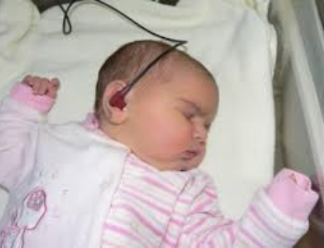
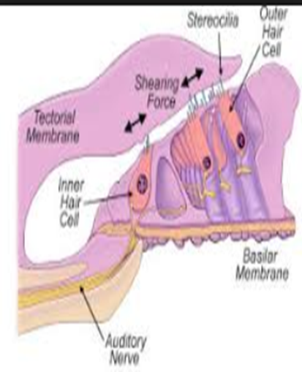
Otoacoustic emissions:
Test is objective, noninvasive, and rapid test.
Sounds that are produced by healthy ears in response to acoustic stimulation.
It is originated from that OAE are a by-product of the biomechanical motility of the outer hair cells.

Slide 35
Types of OAE’s:
Types
Spontaneous OAE’s
(SPOAE’s)
Distortion Product
OAE’s (DPOAE’s)
Transient Evoked
OAE’s (TEOAE’s)

Slide 36
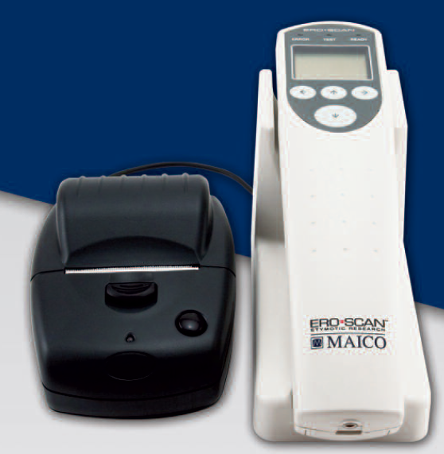
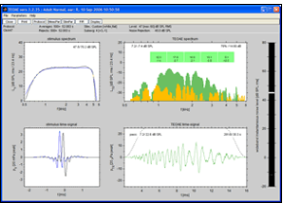
Otoacoustic emission -Equipment

Slide 37
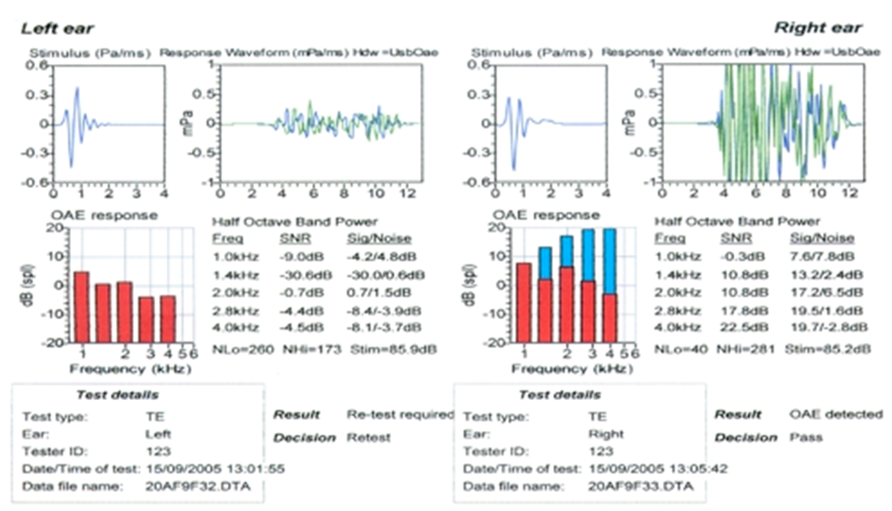

Slide 38
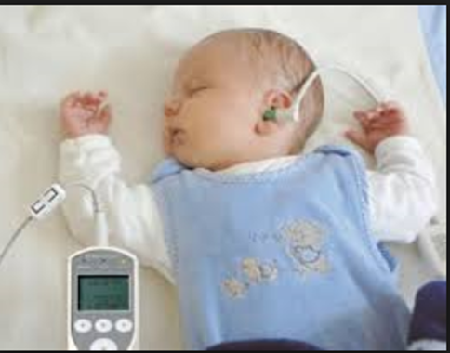
Clinical applications:
Neonatal hearing screening
Monitoring of drug ototoxicity.
Noise-induced hearing loss.
Auditory neuropathy.
Sensory vs. neural HL.

Slide 39
Hearing Tests
A.Tuning fork tests:
1. Rinne’s test
Compares air conduction (A.C.) with bone conduction (B.C)
The fork is put near auricle (A.C.) then over mastoid bone (B.C.).
Normally: A.C. is better than B.C. (Rinne positive )
In C.H.L.: B.C. is better than A.C. (Rinne negative)
In S.N.H.L.: A.C. is better than B.C. but both are less than normal. (Reduced Rinne positive)

Slide 40
2.Weber’s test:
Compares bone conduction in both ears. Put the stem of the tuning fork- on the forehead of
the patient.
Normally: The patient hears the sound centrally or equally in both ears.
In CHL : Sound is heard well in the deaf ear because the outside noise masks hearing of the
normal ear.
In SNHL :Sound is heard well in normal ear.

Slide 41
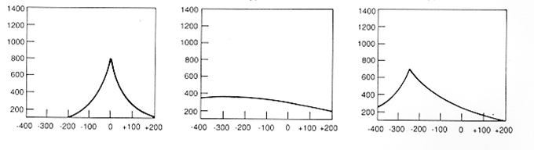
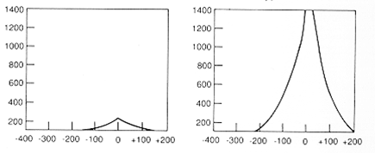

Slide 42
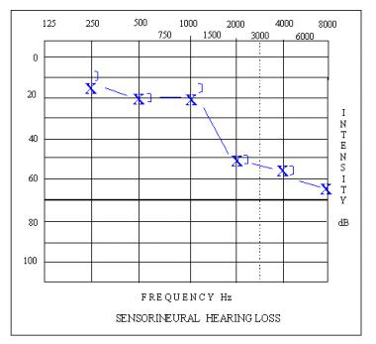

Slide 44
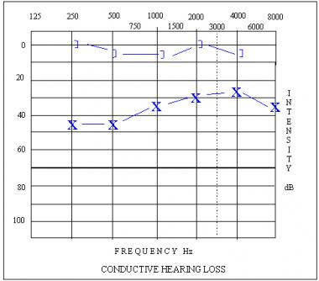

Slide 46
