Slide 1
External ear disorders
Nader ALDajani
Otologist
KFMC

Slide 2
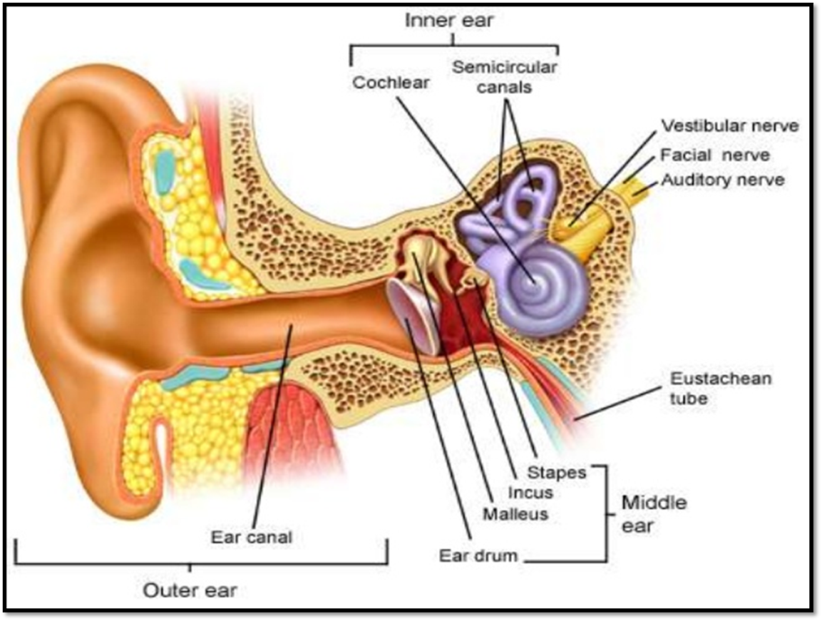
Introduction:
External ear classified into:
  Pinna.
  External auditory canal.
  Tympanic membrane.

Slide 3
External ear disorder include:
Pinna:
  Congenital:
    Anotia. Microtia, Macrotia.
    Bat ear.
    Preauricular pit or sinus.
  Traumatic:
    Haematoma of the auricle.
    Lacerations.
    Avulsion of pinna.
    Frostbite.
    Keloid of auricle.
  Inflammatory:
    Perichondritis.
    Relapsing polychondritis.
  Tumor:
External auditory canal:
  Congenital:
    Atresia.
  Traumatic:
    Lacerations.
  Inflammatory:
    Localized otitis externa (Furuncle).
    Otitis externa.
    Malignant otitis externa.
    Otomycosis.
    Herpes zoster oticus.
    Eczematous Seborrhoeic otitis externa.
  Tumor:

Slide 6
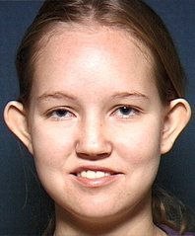
Bat ear:
Prominent ear or protruding ear.
The concha is large with poorly developed antihelix and scapha.
Corrected surgically after the age of 6 years,if cosmetic appearance so demands.

Slide 7
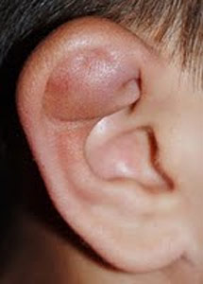
Haematoma of the auricle:
It is collection of blood between the auricular cartilage and its perichondrium.
Often it is the result of blunt trauma seen in boxers, wrestlers and rugby players.

Slide 8
Complications:
  Cauliflower ear.
  Perichondritis.
Treatment:
  Aspiration under strict aseptic precautions.
  Incision and drainage.
  Pressure dressing, packing all concavities of the auricle.
  Antibiotics.

Slide 9
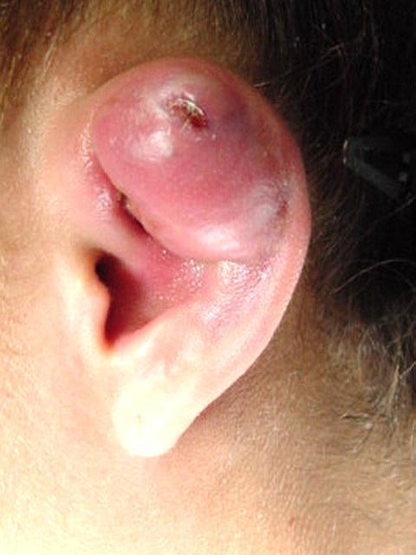
PERICPERICHONDRITIS OF THE PINNA
Usually follow trauma (hematoma auris, surgical, frostbite, burn) or otitis externa
Commonly caused by Pseudomonas
Fever, pain, redness and swelling
Treatment is by antibiotics

Slide 10
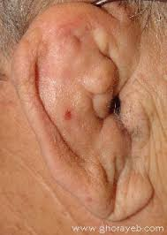

Slide 11
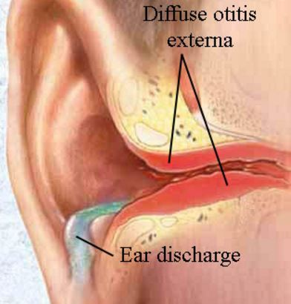
otitis externa:
Definition:
  Is inflammation of meatal skin which
  may spread to involve the pinna and epidermal layer of tympanic membrane.
RF:
  Hot and humid climate.
  Swimming.
  Trauma to meatal skin.
Pathogens:
  Pseudomonas aeruginosa.
  Proteus mirabilis.
  Staphylococci.
  Streptococci.
  other?

Slide 12
CAUSES OF OTITIS EXTERNA
INFECTIVE
REACTIVE
Bacterial
Fungal
Viral
Eczematous
Seborrheic
Staph. arues
Aspirigillus Niger
Herpes zoster
Pseudomonos
Candida Albicans
Others
Others

Slide 13
Presentations:
  Earache.
  Discharge.
  Hearing loss.
  Itching

Slide 14
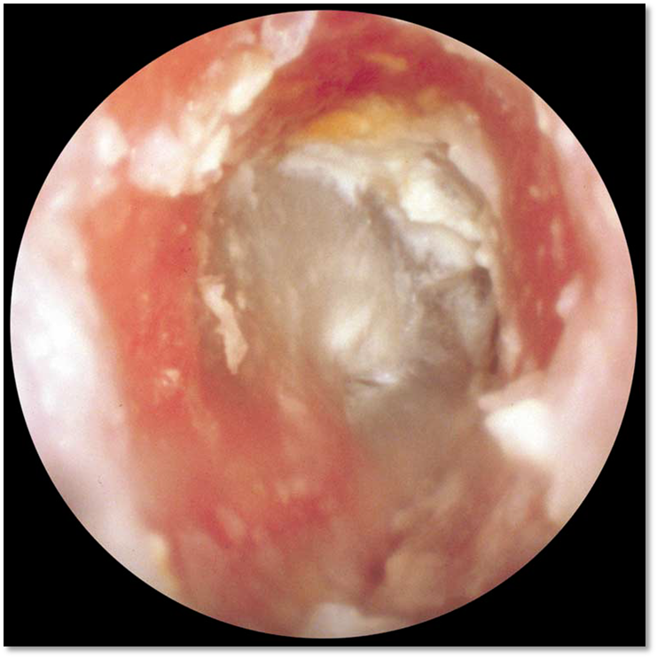
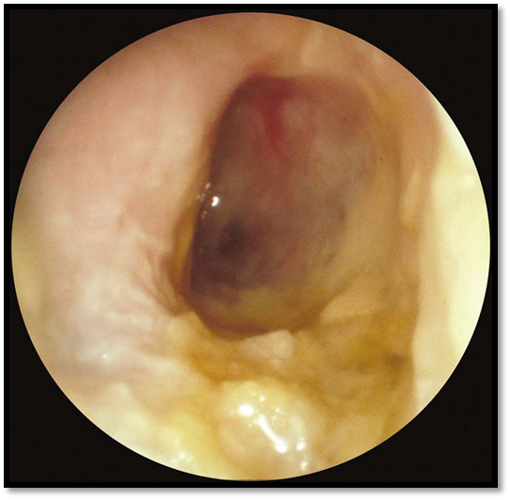
PE:
  Tenderness.
  Narrow EAC.
  Discharge.
  Debris.
  LN.

Slide 15
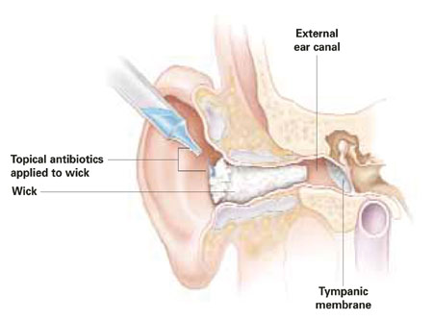
Management:
  Ear Cleaning (CS) and wicks.
  Antibiotic.(Topical+/-Oral).
  Analgesia.
  Instruction of the patient (Avoid
  instrumentation, Keep ear Dry).
  Local steroid
Complication:
  Necrotizing (malignant) otitis externa. (skull base osteomyelitis)

Slide 16
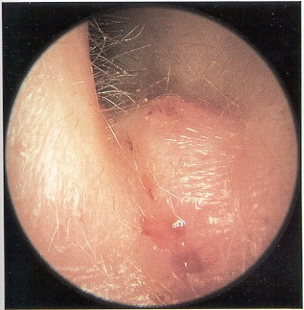
CLINICAL TYPES OF OTITIS EXTERNA
Localize O.E ( furuncle)

Slide 17
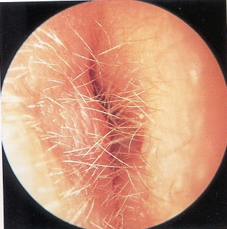
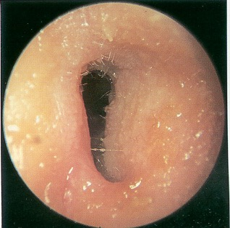
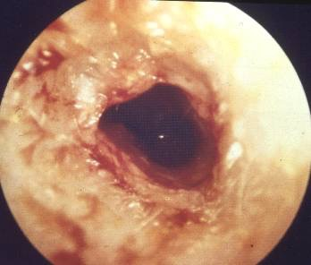
CLINICAL TYPES OF OTITIS EXTERNA
Localize O.E ( furuncle)
Diffuse infective O.E.

Slide 18
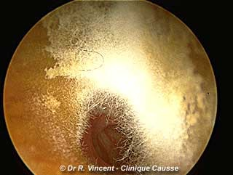
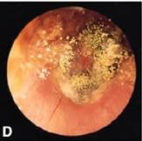
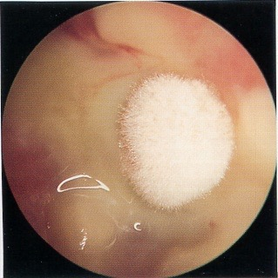
CLINICAL TYPES OF OTITIS EXTERNA
Localize O.E ( furuncle)
Diffuse infective O.E.
Otomycosis

Slide 19
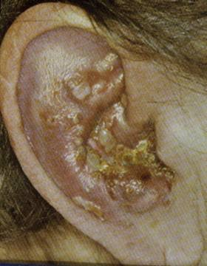
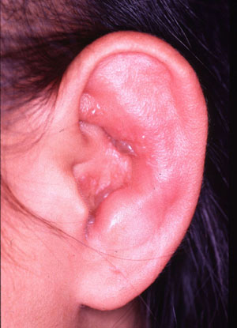
CLINICAL TYPES OF OTITIS EXTERNA
Localize O.E ( furuncle)
Diffuse infective O.E.
Otomycosis
Herpetic O.E.

Slide 20
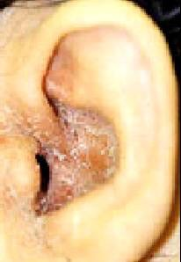
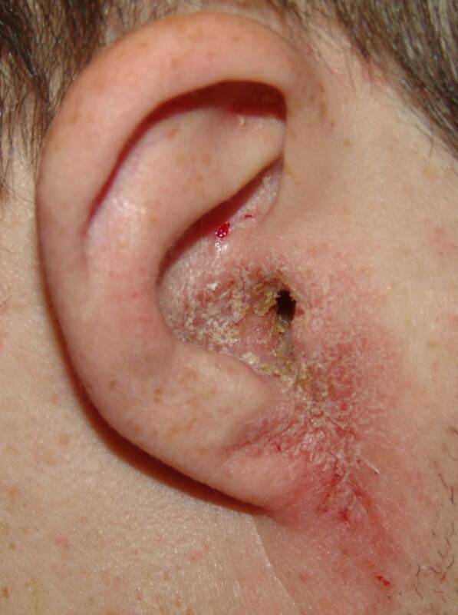
CLINICAL TYPES OF OTITIS EXTERNA
Localize O.E ( furuncle)
Diffuse infective O.E.
Otomycosis
Herpetic O.E
Eczematous and seborrheic O.E.

Slide 21
Malignant otitis externa:
Also termed necrotizing otitis externa/ skull base osteomyelitis
Is an invasive infection of the external auditory canal and skull base.
Gender: M<F.
Age: common in elderly >60 y.
DM is most important risk factor.
Pseudomonas aeruginosa (95%)

Slide 22
Four cardinal features of Necrotizing OE:
  Otalgia >1 month.
  Otorrhea/Granulation tissue.
  Advanced age, Diabetes or Immune suppression.
  Cranial neuropathy.
Three Cranial Nerves most often involved in Necrotizing OE
  Facial (75%).
  Vagus (70%).
  Accessory (56%).

Slide 23
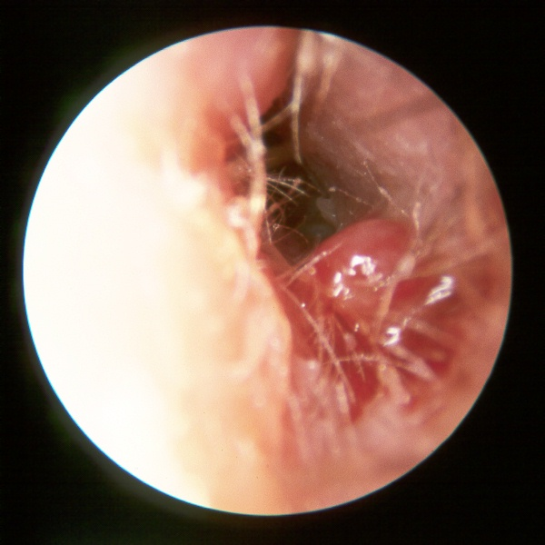

Slide 24
Work up:
Labs.
  ESR.
  CRP.
  Blood sugar
  C/S
Biopsy.
Imaging.
  CT scan.
  MRI.
  Technetium99 bone scan (Osteoblastic).
  Gallium scan (Leukocytes).

Slide 25
Management:
Aural toilet.
Analgesia.
Antibiotics. (Long term)
Control DM.
ID consultation.
Surgery.

Slide 26
Antibiotics.
  (systemic +local).
  6-8 weeks.
  Ciprofloxacin, Levofloxacin Piperacillin , Piperacillin-tazobactam, Ceftazidime ,Cefepime.

Slide 27
Otomycosis:
Is a fungal infection of the ear canal.
Causative organism:
  Aspergillus niger, A. fumigatus , Candida albicans.
RF:
  Hot and humid climate.
  Secondary fungal growth Using of topical antibiotics.

Slide 28
The clinical features:
  Intense itching.
  Discomfort or pain .
  Watery discharge with a bad odour.
  Ear blockage.
  Some time The fungal mass seen as white, brown or black.
On Examination:
  A. niger appears as blackheaded filamentous growth.
  A. fumigatus as pale blue or Green
  Candida as white or creamy deposit.
  Meatal skin appears sodden, red and oedematous.

Slide 29
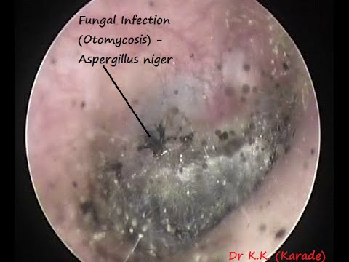
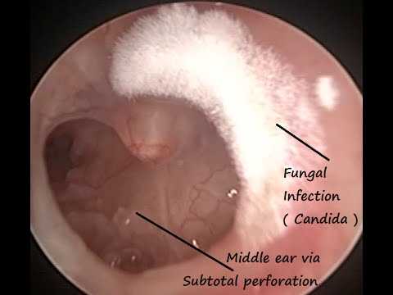

Slide 30
Treatment:
  Aural toilet.
  Antifungal agents. (Nystatin, clotrimazole).
  Optimize general conditions.

Slide 31
WAX
Mixture of ceruminous and sebaceous glands secretion
Normally is expelled from the canal aided by movements of the jaw
When accumulated it may cause deafness, earache or tinnitus

Slide 32
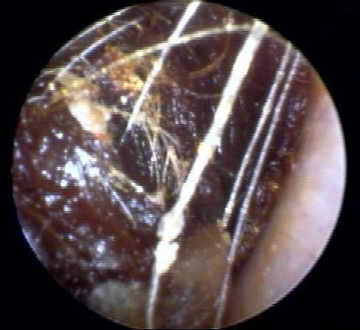
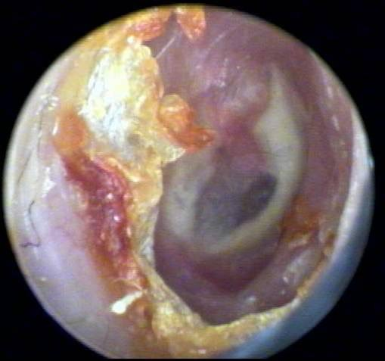
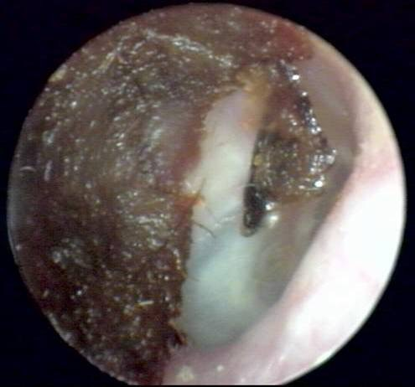
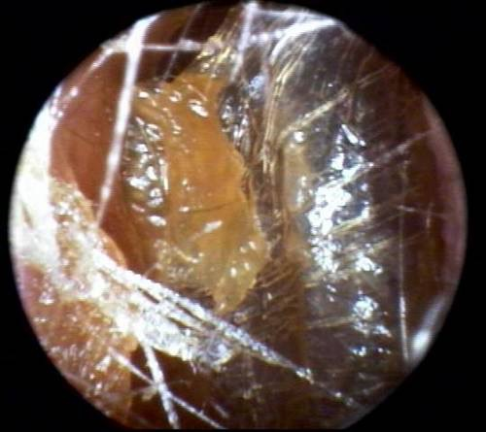

Slide 33
WAX
Treatment is by removal using syringing, suction or instrumentation

Slide 34
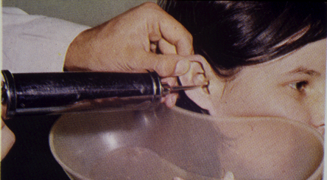
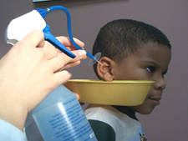
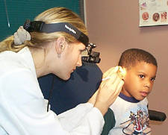

Slide 35
Thank you

