Slide 1
Hearing loss
Nader Aldajani
Otologist
KFMC

Slide 2
Objectives:
Types.
Degree.
Causes.
Approach.
Management.
Otosclerosis.
Sudden SNHL.

Slide 3
Deafness:
Is loss of auditory function.

Slide 4
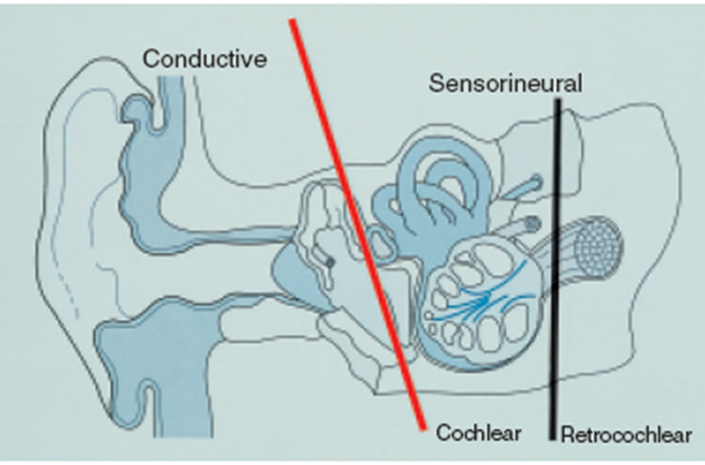
Types:

Slide 5
Conductive :
  External and middle ear diseases up to the footplate of the stapes.
Sensorineural :
  Diseases ahead of footplate of stapes up to auditory cortex.
Mixed:

Slide 6
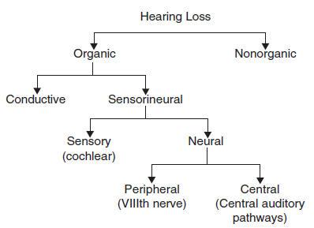

Slide 7
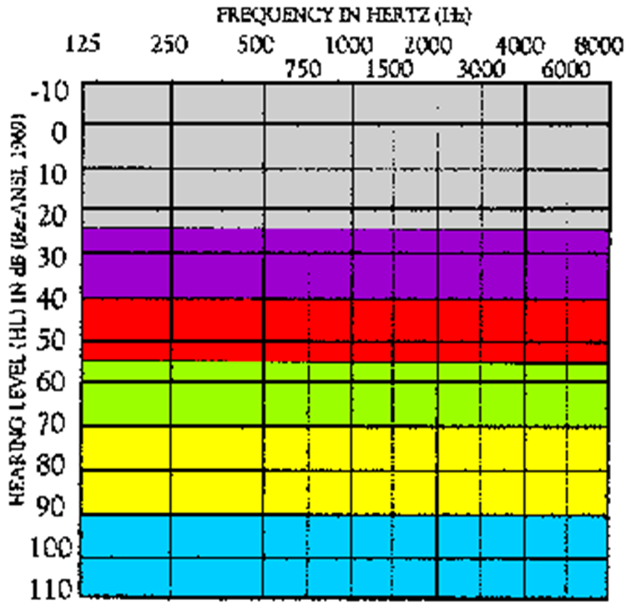
Degrees:
10 – 25 dB HL = Normal range
26 – 40 dB HL = Mild hearing loss
41 – 55 dB HL = Moderate
56 – 70 dB HL = Moderately Severe
71 – 90 dB HL= Severe
Greater than 90 dB HL = Profound

Slide 8
Approach:
History taking.
Complete ENT examination
Tuning fork tests
Audiology:
  PTA
  Speech audiometry
  Tympanometry
  OAE.
  ABR
Radiological investigations: CT and MRI
Labs:

Slide 9
Audiogram:
Hearing threshold.
Type of hearing loss.
Degree of hearing loss.
Configuration of hearing loss.

Slide 10
Conductive Hearing Loss (CHL):
  Air decreased-bone normal, there is AB gap.
Sensorineural Hearing Loss (SNHL):
  Both air & bone decreased-there is NO AB gap.
Mixed Hearing Loss (MHL):
  Both air & bone decreased-there is AB gap.

Slide 11
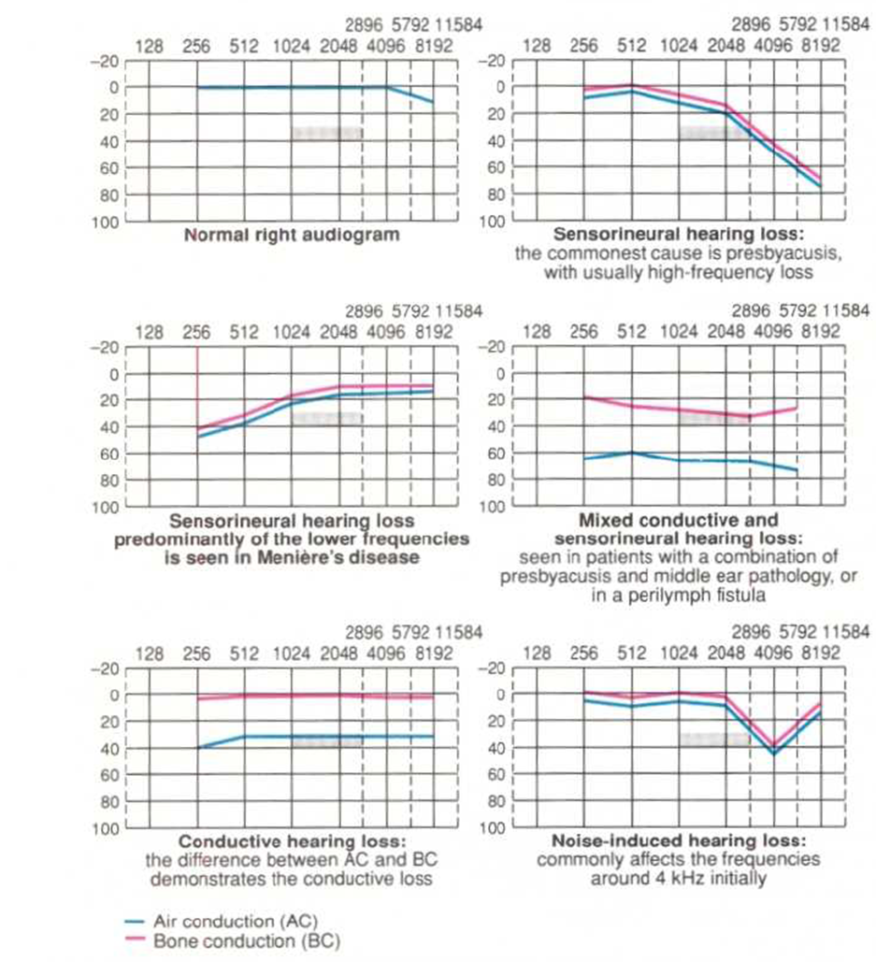

Slide 12
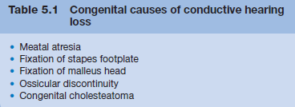
Causes of CHL:

Slide 13
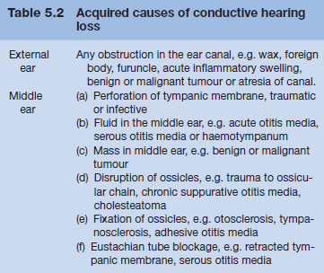
Causes of CHL:

Slide 14
Causes of SNHL:
congenital:
Acquired:
  Infections of labyrinth.
  Trauma to labyrinth or VIIIth nerve.
  Noise-induced hearing loss.
  Ototoxic drugs.
  Presbycusis.
  Ménière’s disease.
  Acoustic neuroma.
  Sudden hearing loss.
  Systemic disorders.

Slide 15
Management:
Depend on the cause.
Ear wash.
Antibiotics for otitis externa and media.
Antifungal drops For otomycosis
Hearing aid.
Surgery:
  Reconstruction of EAC
  Myringotomy & VT.
  Tympanoplasty.
  Ossiculoplasty.
  Stapedectomy.
  Cochlear implant.

Slide 16
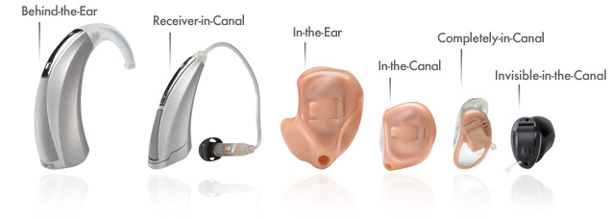
HEARING AIDS:

Slide 17
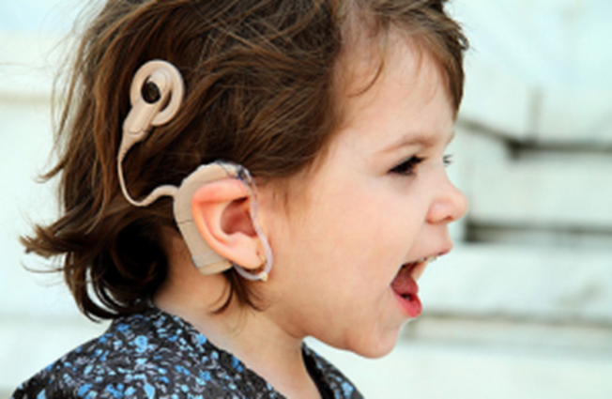
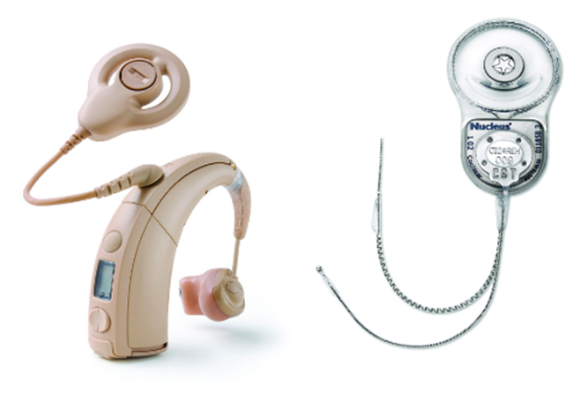
Cochlear implant

Slide 18
Indication of cochlear implant
contraindication
Bilateral severe-to-profound sensorineural hearing loss with PTA of 90 dB or greater in better ear
-No appreciable benefit with hearing aids
If there is absent cochlea
If there is absent vestibulocochlear nerve

Slide 19
Otosclerosis:
Definition:
  Primary metabolic bone disease of the otic capsule and ossicles, in which abnormal bone remodelling results in Fixation of the ossicles and Conductive Hearing Loss. (SNHL?)
Caucasians races.
Family history 60%.
Bilateral 80%.
F:M-2:1
Age (20-40) ys
Etiology:
  Autosomal Dominant with Incomplete Penetrance.
  Hormonal (pregnancy?).
  viral

Slide 20
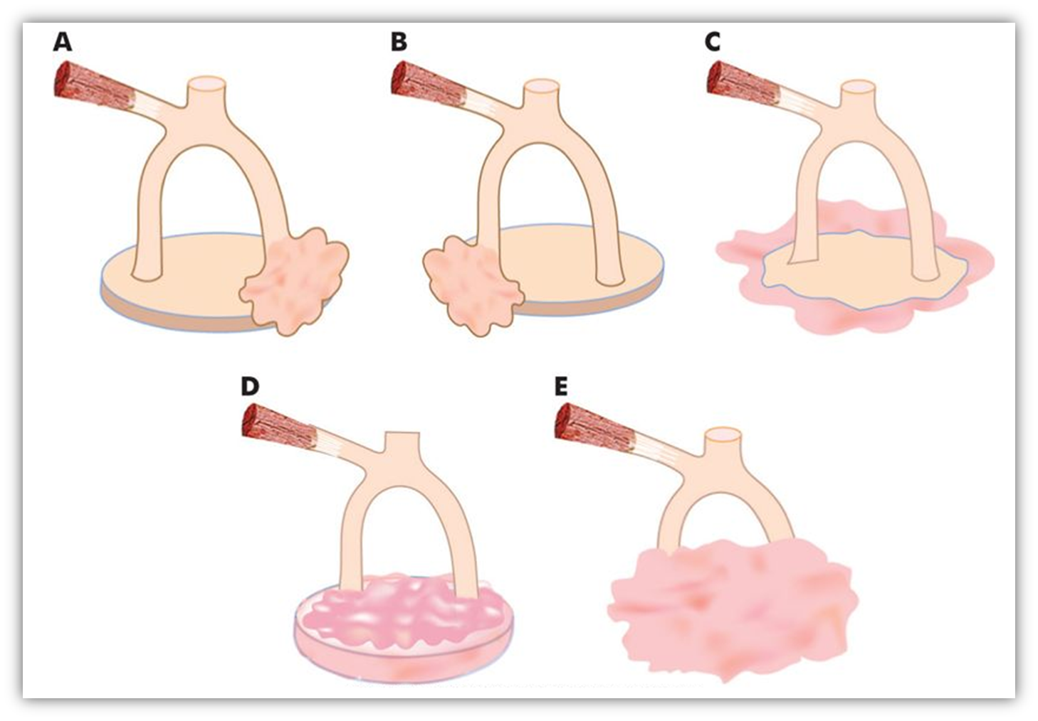

Slide 21
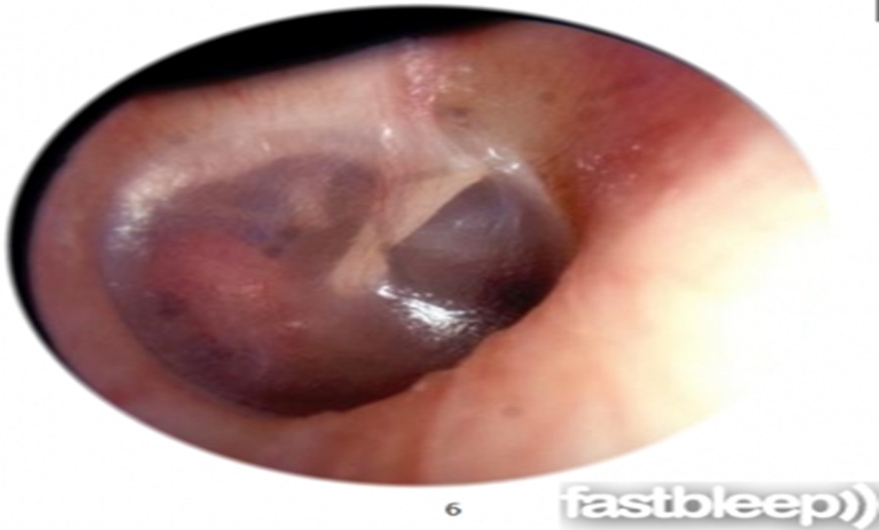
Presentation:
  Slowly progressive hearing loss.
  Tennitus.
OE:
  Schwartze sign.
Audiology:
  PTA ?.
  Tymoanometry ?

Slide 22
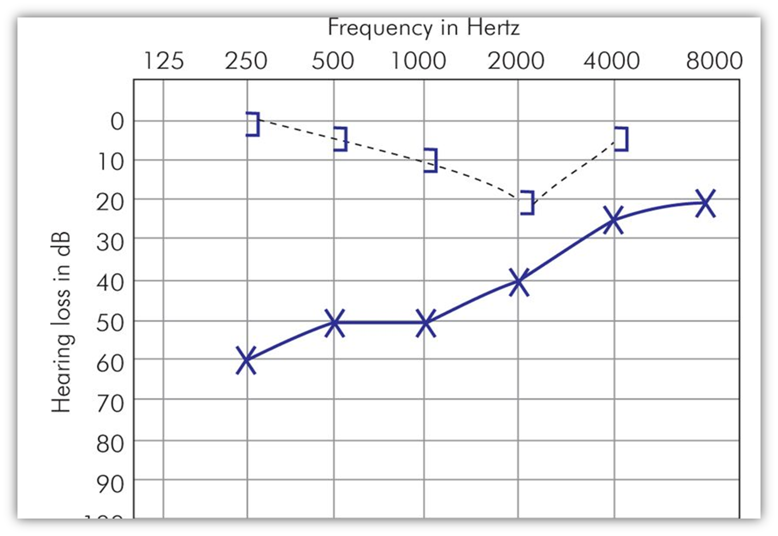
Carharts notch

Slide 23
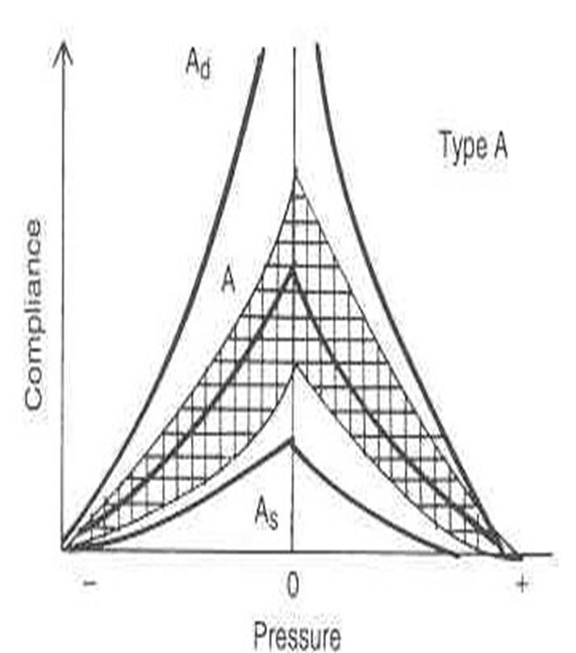

Slide 24
Management:
Observation
Trial of Amplification
Medical
Surgery:
  Stapedectomy.

Slide 25
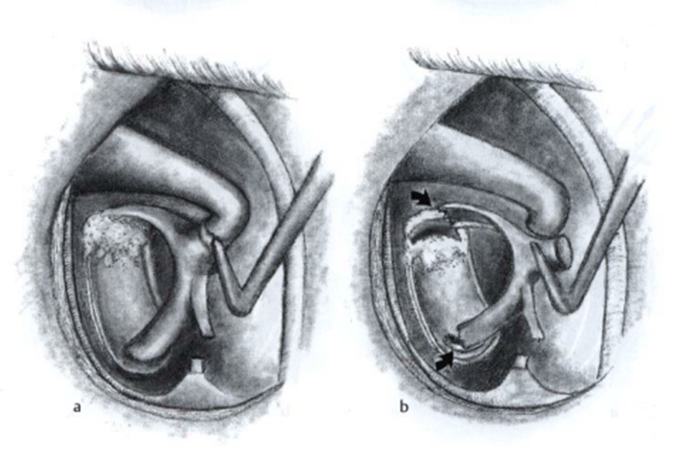
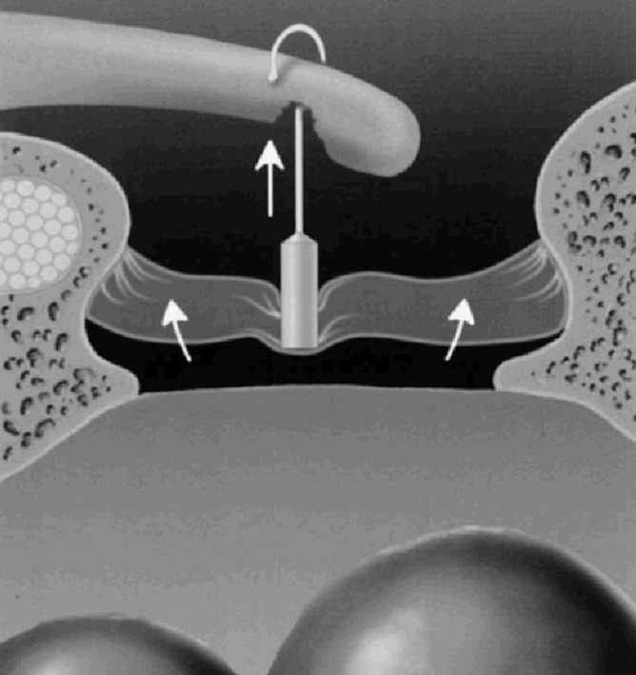
Stapedectomy operation:

Slide 26
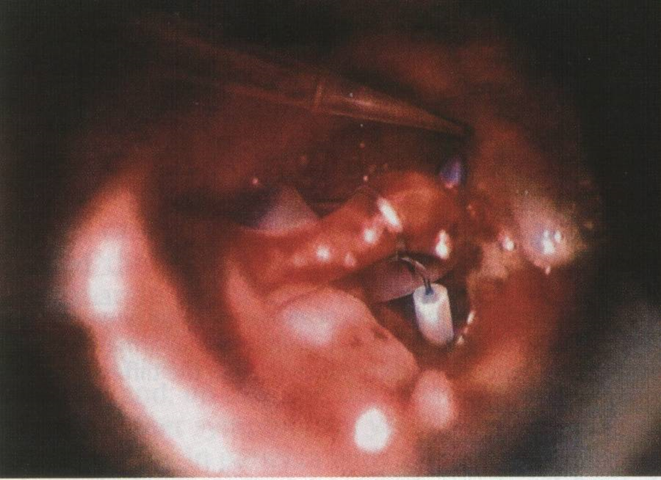

Slide 27
Sudden sensorineural hearing loss:
Hearing loss ≥30 dB in 3 Contiguous Frequencies in <3 days.

Slide 28
Etiology:
Infections.
Trauma.
Vascular.
Ear (otologic). Ménière’s disease, Cogan’s syndrome,
large vestibular aqueduct.
Toxic.
Neoplastic. Acoustic neuroma.
Other: Multiple sclerosis, hypothyroidism, sarcoidosis.
Psychogenic.
Non organic.

Slide 29
Screening tests:
Audiology.
Radiology: MRI.
Labs:
  CBC-ESR.
  Total Cholesterol .
  HIV – if high risk.
  ESR, ANA, RF.

Slide 30
Treatment:
Systemic Steroids +/- intratympanic injection fo steroid
Antivirals ?.
Vasodilators :Histamine

Slide 31
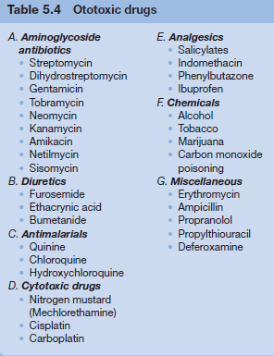
Ototoxic drugs:

Slide 32
Hearing loss in children-Etiology:
1/1000 in newborns
Etiology:
  Genetic: (50%)
    Syndromic VS Non-syndromic
  Environmental (20-25%) .
  Unknown etiology (20-25-%).

Slide 33
Tinnitus
Tinnitus is a sensation of noise in the ear or head. It may ring, hissing, or pulsating.
Causes:
Tinnitus may or may not be associated with Hearing loss .
1-Tinnitus with Hearing loss :
a) With CHL. : Noises are low pitched and intermittent.
b) With SNHL.: Noises are high pitched, continuous and persistent.

Slide 34
2-Tinnitus without Hearing loss :
TMJ disorder, cervical disc lesions, anemia, hypotension, hypertension and fevers
should all be considered as they all may cause tinnitus.
3-Objective tinnitus:
It is tinnitus heard by the patient and the examiner in cases of aneurysm of the internal carotid or intracranial vascular tumors.
Some cases of tinnitus remain for life and the patient should ignore it.

Slide 35
Thanks

