Slide 1
Neck swelling

Slide 2
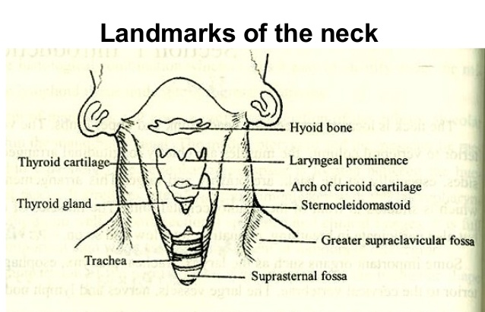
Landmarks of the neck
Hyoid bone
Thyroid cartilage
Cricoid cartilage
Trachea
Sternocleidomastoid muscles

Slide 3
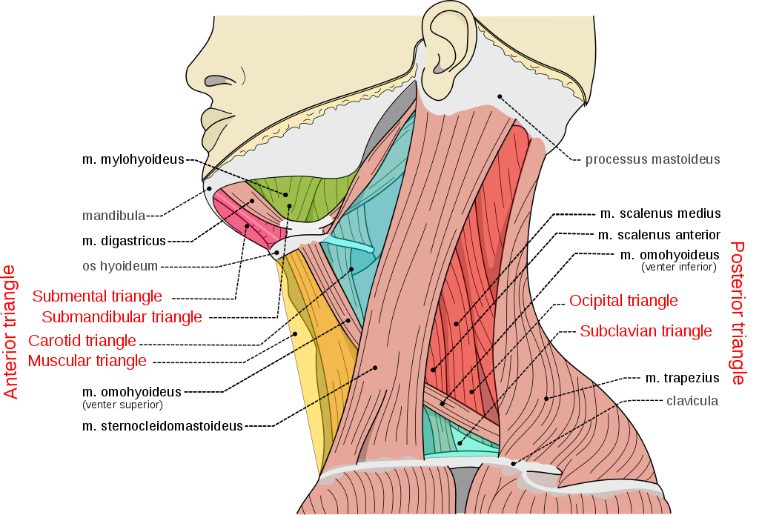
The sternocleidomastoid muscle divides each side of the neck into 2 major triangles:
• Anterior triangle
  Submandibular triangle
  Submental triangle
  Carotid triangle
  Muscular triangle
. Posterior triangle
  Occiptal triangle
  Supraclavicular triangle

Slide 4
Anterior triangle Borders:
Laterally: posterior border of the SCM
Medially: midline
Superiorly: lower border of the mandible
Posterior triangle Borders:
Anteriorly: posterior border of the SCM
Inferiorly: clavicle
Posteriorly: anterior border of trapezius muscle

Slide 6
DIFFERENTIAL DIAGNOSIS OF NECK SWELLING
Definition: any abnormal enlargement, swelling, or growth between clavicles & mandible.

Slide 7
Midline swelling

Slide 8
Midline swelling
A- Solid swellings:
Large submental LN.
Goiter of the thyroid isthmus & pyramidal lobe.
Peritrachreal & perilaryngeal LN.
Ectopic thyroid
B-Cystic swellings:
Thyroglossal cyst.
Dermoid cyst (submental or suprasternal).
Subhyoid bursitis.
Cysts in the thyroid gland.
Cold abscess, which is rare in the mid-line.

Slide 9
Thyroglossal duct cyst:
Symptoms:
Child 6-8 yrs presented by painless swelling Infront of the neck ,pain only if infected.
Signs:
Cystic mass in the mid-line of the neck
Moves with deglutition & protrusion of the tongue .
Investigation
US ͢ cyst

Slide 10
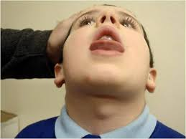
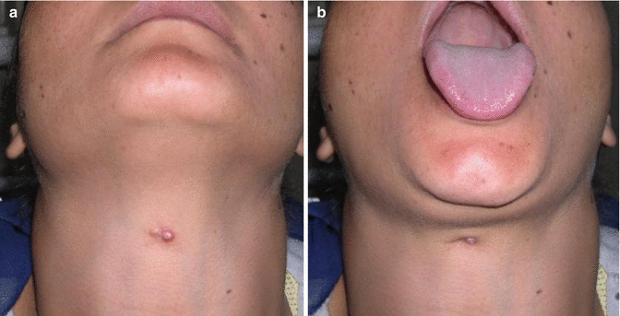
Thyroglossal cyst
Subhyoid bursitis

Slide 11
Dermoid cyst (Cystic teratoma)
Symptoms:
Child with slowly growing painless swelling in mid-line either sub-lingual or suprasternal.
Signs:
cystic swelling not attached to skin.
Contains mature skin with hair follicles and sweat gland.
sometimes clumps of hair, and often pockets of sebum, blood, fat.

Slide 12
Subhyoid bursitis.
Rare tender, oval swelling, which lies transversely below the hyoid bone.
It moves up and down with deglutition and with protrusion of the tongue.

Slide 13
Ectopic thyroid
Symptoms:
Painless swelling in middle of neck.
Signs:
Solid mass
Thyroid moves: with deglutition only
lf lingual : dyspnea ,dysphagia ,dysarthria .
lf retrosternal: pressure manifestation
Investigation:
U/S: solid
CT scan: to confirm whether its only thyroid tissue or not.

Slide 14
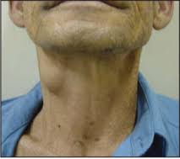
Laryngocele
Occurs in musicians playing with air-blown instruments.
The swelling is resonant, compressible and increases in size with coughing and blowing.

Slide 15
Lateral swellings:
A- swelling in the submandibular triangle
Enlarged submandibular LNs.
Enlarged submandibular salivary gland.

Slide 16
B-Swelling in carotid triangle
Solid swelling
Cystic swelling
  Enlarged upper deep cervical LNs.
  The upper part of an enlarged lateral lobe of the thyroid gland. It moves up with deglutition .
  Carotid body tumor. Rare, slowly growing, moves from side to side but not vertically, showing transmitted pulsations
Cold abscess:
  usually in children and young adult,
  it is cystic and fluctuant with dusky skin.
  lt is slightly warm and slightly tender.
  There may be manifestations of T.B in other parts of the body.
Branchial cyst:
  Remnants of embryonic development .
  Usually appears at the age of 20 years,
  deep to upper 1/3 of sternomastoid protruding beneath its anterior border,
Cystic swelling in the upper part of an enlarged lateral lobe of the thyroid gland.

Slide 17
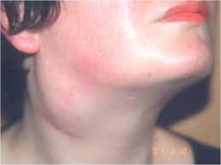
Branchial cyst

Slide 18
Submental & submandibular LN swellings
Acute lymphadenitis:
c/o: painful swelling of short duration.
Sign: Enlarged tender matted LNs. , usually apparent source of infection in the catchment's area, e.g. the tongue, lips or teeth... Latent abscess may form & the swelling becomes cystic.
B- TB lymphadenitis :
usually in children
c/o: slowly growing swelling
Sign:- Firm matted LNs.
- Later, a cold abscess may form --- finally ruptures leaving a TB sinus.

Slide 19
C. Lymphoma:
There is usually other LN swellings in the body.
Painless
The spleen may be palpable.
Investigation:
- Biopsy is essential to establish the diagnosis.
D. Metastatic carcinoma:
LNs are hard & painless.
- Mobile at first & later fixed.
The primary tumor is usually apparent e.g. in the tongue.
Investigadons
Directed to the primary lesion.

Slide 20
Submandibular salivary gland swelling
Submandibular salivary gland swelling is differentiated from submandibular LN swelling on bimanual palpation.
Salivary gland swelling is solitary & can't be rolled over the edge of the mandible.
-felt bulging into the floor of the mouth but LN swelling is not felt.

Slide 21
Submandibular sialoadenitis:
Presentation:
painfull swelling.
Occurs during meals & gradually subsides.
Sign:
Firm & tender swelling.
The orifice of the duct is reddish & pus discharged from it on pressing on the gland
A stone may be palpable in the floor of the mouth. .
X-ray
demonstrate size & position of the stone.

Slide 22
B-Submandibular salivary tumor:
Pleomorphic adenoma:
Symptoms:
painless swelling of the gland which does not increase with meals.
Signs:
well defined, lobulated, freely mobile, firm or cystic in consistency
Carcinoma
Symptoms.
rapidly growing swelling manifestation of lingual or hypoglossal N. paralysis
Signs
hard swelling (at 1st mobile + later fixed, infiltration of skin & Nerves )

Slide 23
Swellings in the posterior triangle

Slide 24
Swellings in the posterior triangle
*Solid swelling
* Cystic swelling
Enlarged LN.
Cervical rib
Neurofibroma arising from the brachial plexus
Cystic hygroma.
  An infant with a large swelling superficial to sternomastoid. lt is large, irregular, lax and translucent
Pharyngeal pouch.
  Usually an old man with dysphagia and regurgitation of undigested food on compression.

Slide 25
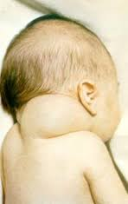
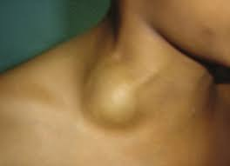
Cystic hygroma
Pharyngeal pouch

Slide 26
Cold abscess.
  Usually in children and young adults.
  It is soft and fluctuant with dusky skin.
  lt is slightly warm and slightly tender.
  There may be manifestations of T.B in other parts of the body.
Pneumatocele.
  Cystic swelling in the supraclavicular region which is resonant and compressible.

Slide 27
Other swelling that may arise anywhere
In addition, swellings of the skin and subcutaneous tissue are common in the neck and should be put in mind. They are added to any of the previous lists.
1- Lipomas.
2-Sebaceous cysts.
3-Haemangioma

Slide 28
The Differential Diagnosis of Neck Masses

Slide 29
HISTORY
• Symptoms (timing is everything)
– Onset , course ,Duration, recent changes, associated symptoms, sick contacts, recent travel, previous surgery
• Associated symptoms
– Fever, dysphagia, weight loss, otalgia, hearing loss, respiratory difficulty, night sweats
• Past medical/surgical history, allergies, medications, family history
• Social history – Alcohol, tobacco, drugs, occupation

Slide 30
PHYSICAL
• Full head and neck exam
– Skin
– Ears
– Mouth/oropharynx
Look at the tongue and tonsils
Nose and nasopharynx
– Neck
Characterize the mass!
Tender, mobile, firm, move with swallowing,
overlying skin changes, other lesions
– Neurologic
Full cranial nerve exam

Slide 31
Diagnostic imaging
• Ultrasound (US)
– Helpful with children because no sedation needed, inexpensive, avoid ionizing radiation, useful for soft tissue imaging, cystic vs solid, thyroid
– bad for invasion or bone
• Computed Tomography (CT)
– Soft tissue and bone
– iodinated IV contrast
– Ideal study for neck mass (CT neck with contrast) – CT without contrast almost useless

Slide 32
• Magnetic Resonance Imaging (MRI)
– Superior soft tissue
– less available, more expensive
– Often complementary with CT
• Radionuclide, angiography, plain radiography

Slide 33
Tissue Diagnosis
• Fine needle aspiration (FNA) biopsy
– Sens/spec 97%
Enhanced with ultrasound
– Always before an open procedure
– Cytology and culture
– If unsuccessful or inconclusive, repeat before an open procedure
– If failed again, core needle biopsy
– Open biopsy as last resort
Incisional or Excisional biopsy

Slide 34
Any Question

