Slide 1
Otitis media & cholesteatoma
Nader ALDAjani
Otologist
kfmc

Slide 2
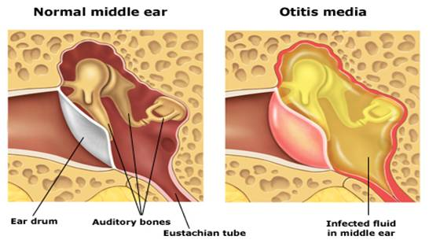

Slide 3
Classification Of otitis media:
Acute otitis media.
Serous Otitis Media.
Chronic suppurative otitis media (CSMO).

Slide 4
Acute otitis media:
Acute Suppurative Otitis Media
Definition:
acute infection (<3 weeks) of the middle ear space.
Pathophysiology: eustachian tube dysfunction.
Pathogens:
Streptococcus pneumoniae.
Haemophilus influenzae.
Moraxella catarrhalis.

Slide 5
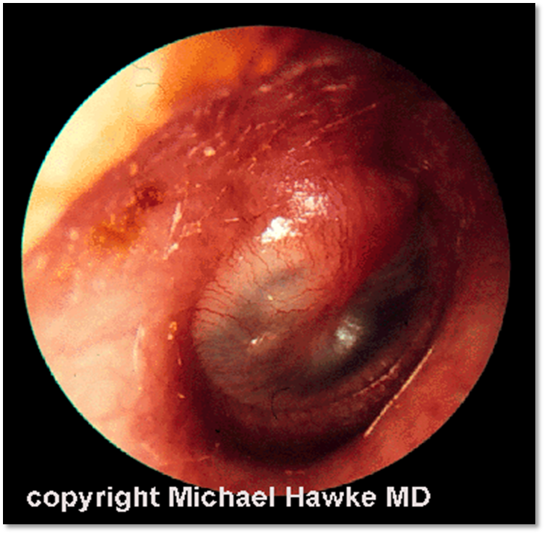
Presentation:
Fever.
Earache- ear fullness-hearing loss.
In children- ear itching and pulling.
OE:
Hyperemic TM
fluid in middle ear (bulging TM, air-fluid levels or bubbles).
Test: PTA-tympanometry

Slide 6
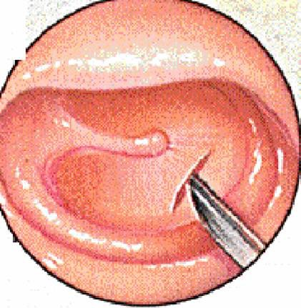
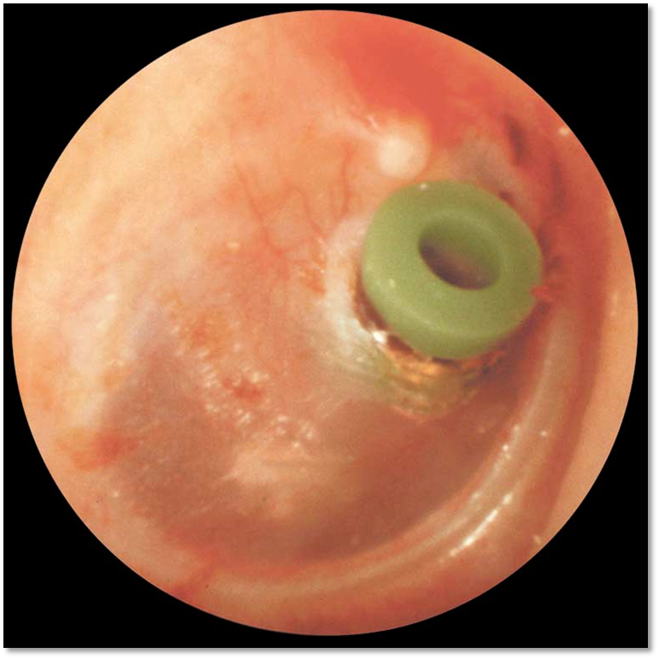
Management:
Antibiotics.
Analgesia.
Nasal Decongestant.
Surgery. Myringotomy +- ventilation tube insertion

Slide 7
Managemnt:
Age | Mild= fever<102, Pain <48 hrs | Severe= fever >102, pain >48hrs
< 6 mos | Antibiotics and analgesics | Antibiotics and analgesics
6-23 mos | Analgesia and Recheck 24-48hrs Unilateral | Antibiotics and analgesics Bilateral or Severe
> 2 yrs | Analgesia and Recheck 24-72hrs | Antibiotics and analgesics

Slide 8
Chronic otitis media

Slide 9
Classifications
Chronic Non Suppurative Otitis Media
– Otitis media with effusion “OME”
– Adhesive otitis media
Chronic Suppurative Otitis Media “CSOM”
– Tubotympanic (Safe)
– Atticoantral (Unsafe)

Slide 10
Serous Otitis Media: (otitis media with effusion)
Otitis Media with Effusion
Definition:
Persistence of fluid in the middle ear space without evidence of acute inflammation as in AOM.
Most common cause of pediatric hearing loss, associated with language delay and behavioral issues
Pathophysiology:
As consequence of acute otitis media.
Secondary to eustachian tube dysfunction.

Slide 11
Risk factors:
Age (<2 y).
Gender (Male).
Adenoids (reservoir of infection & mechanical ET obstruction)
ET dysfunction (short, horizontal, compliant)
Cleft palate, Craniofacial abnormality, Down’s
Immune deficiency
Atopy (disputed)
+ve family Hx
Daycare attendance.
Season (Fall/Winter).
URTIs.
Older siblings
Parental history of OM.
Passive smoking.
Low socioeconomic status.
Lack of breastfeeding.
bottle feeding (horizontal position).
Pacifier use.

Slide 12
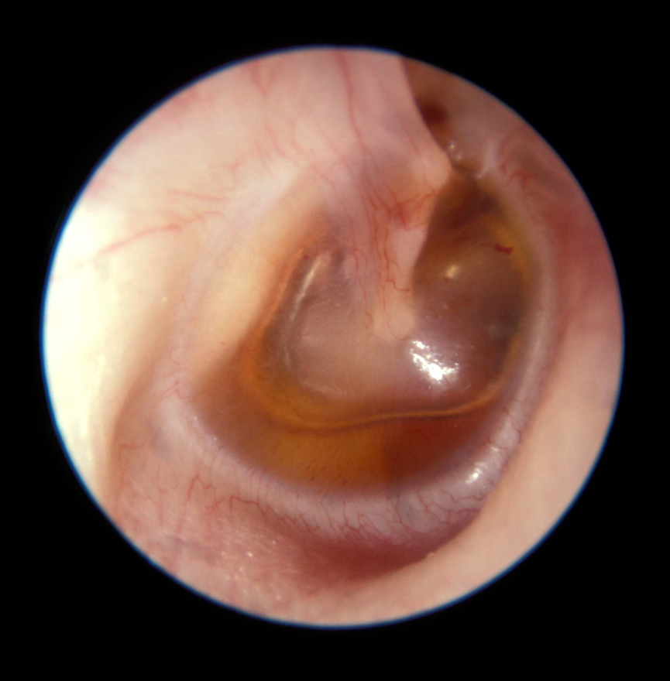
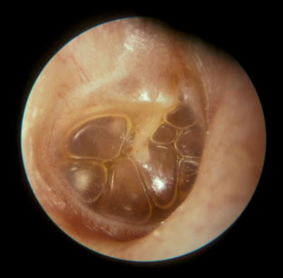
Presentation:
hearing loss- earache- ear fullness.
In children- ear itching and pulling.
OE:
fluid in middle ear (bulging TM, air-fluid levels or bubbles).loss of cone of light.
Test: PTA-tympanometry.

Slide 13
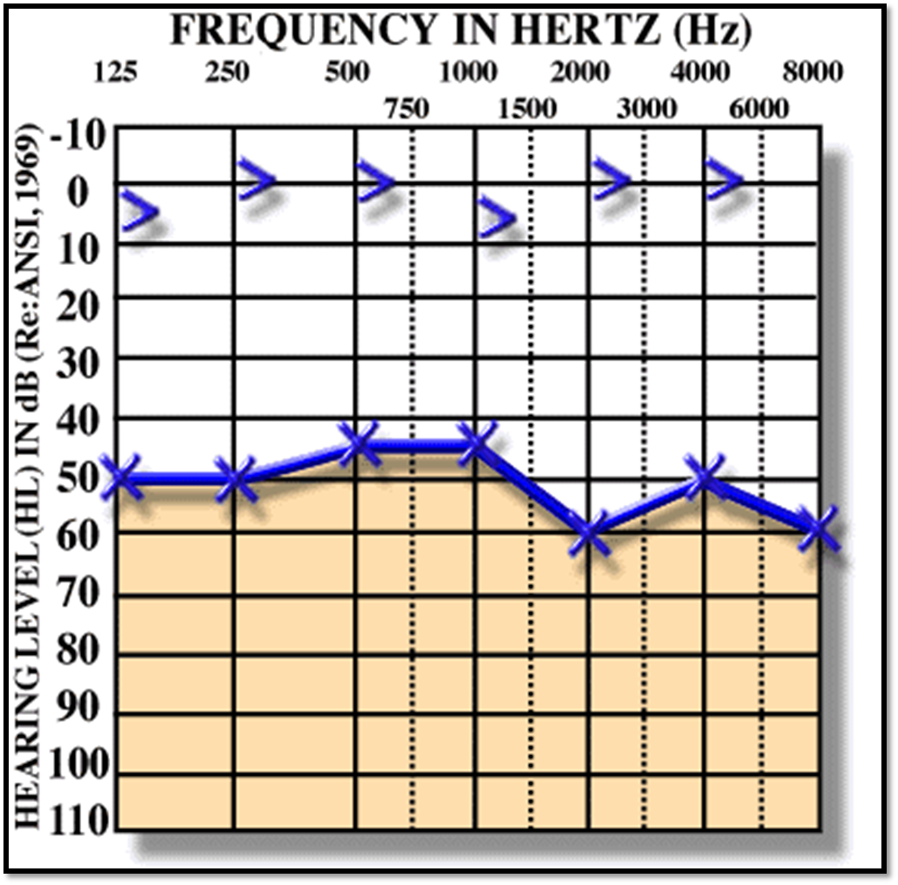
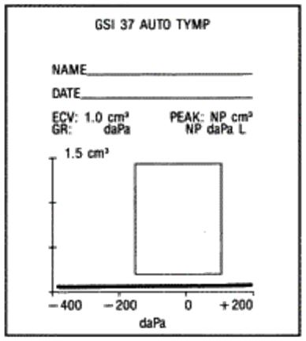

Slide 14
Management:
Observation for 3 months in non “at risk” patients,
management of risk factors (eg, allergic rhinitis, bottle feeding).
Consider myringotomy with VT tube, and/or adenoidectomy.
Antibiotics.
NOTE: any adult with unilateral, persistent middle ear
effusion should undergo inspection of the nasopharynx for nasopharyngeal tumor with biopsy of suspicious lesions.

Slide 15
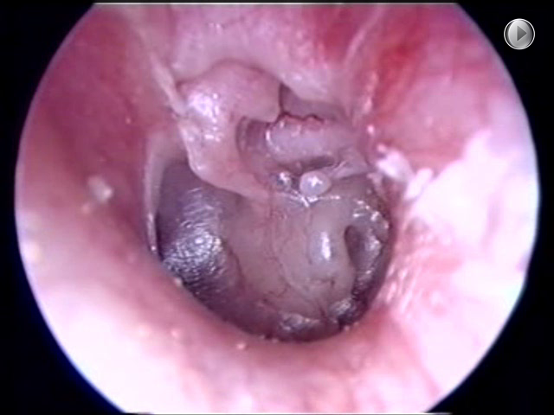
Adhesive otitis media
Lack of middle ear ventilation results in negative pressure within the tympanic cavity
The ear drum retracts onto structures within the middle ear
The result of long standing Eustachian tube dysfunction
The drum loses structural integrity and becomes flaccid
Contact between the drum and the incus or stapes can cause bone erosion at the IS joint
Can sometimes be treated with tympanostomy tubes

Slide 16
CHRONIC SUPPURATIVE OTITIS MEDIA (CSMO):
Definition:
Is defined as chronic otorrhea (lasting more than 3 months) through perforated TM.
Pathogens:
mixed infections; gram-negative bacilli (Pseudomonas, Klebsiella, Proteus, E. coli), Staphylococcus and anaerobes
Presentation:
Hearing loss, discharge,.

Slide 17
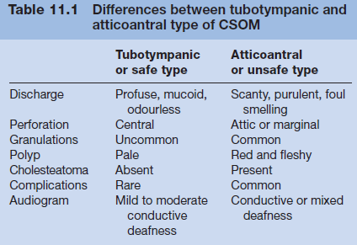
Types o CSOM:

Slide 18
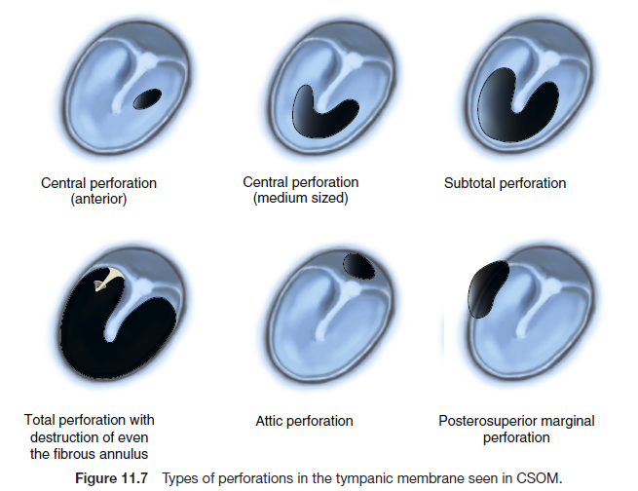

Slide 19
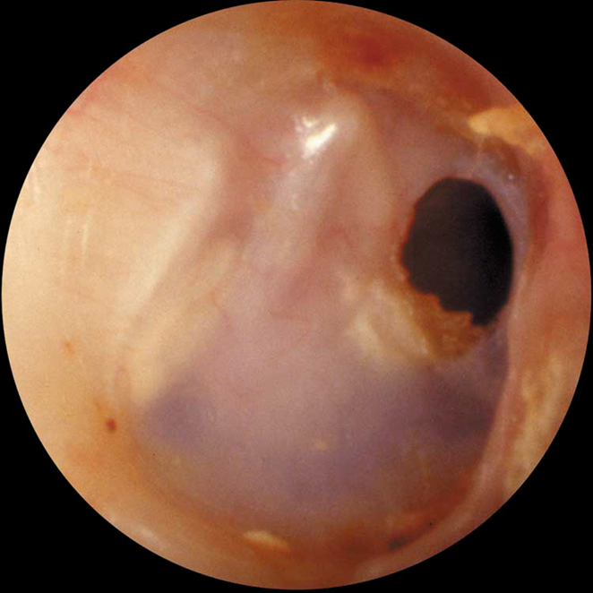
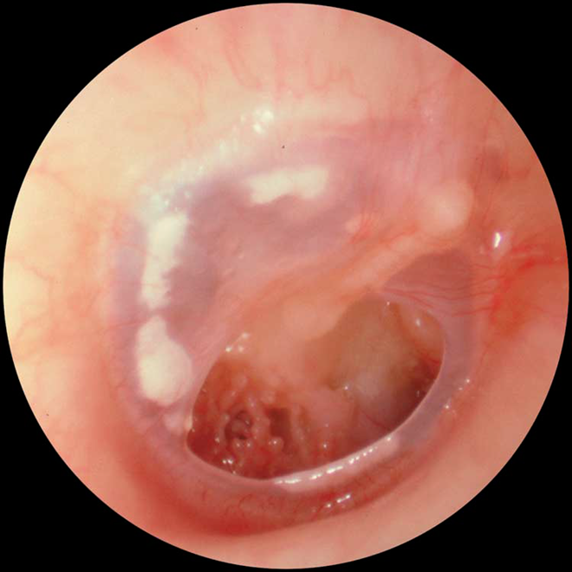

Slide 20
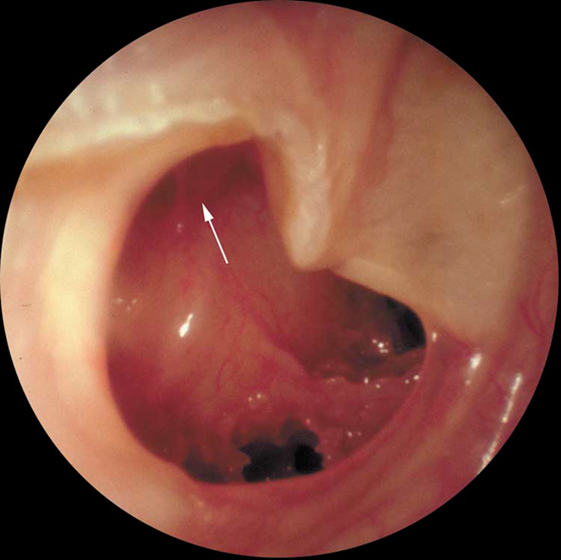
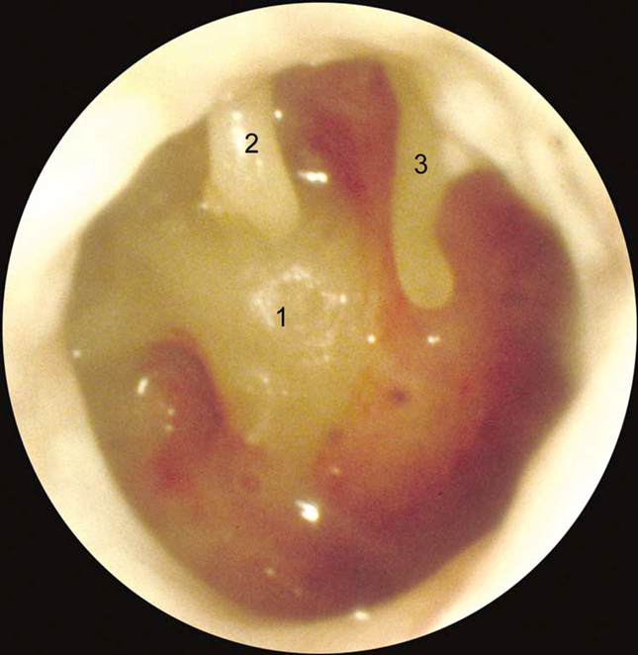

Slide 21
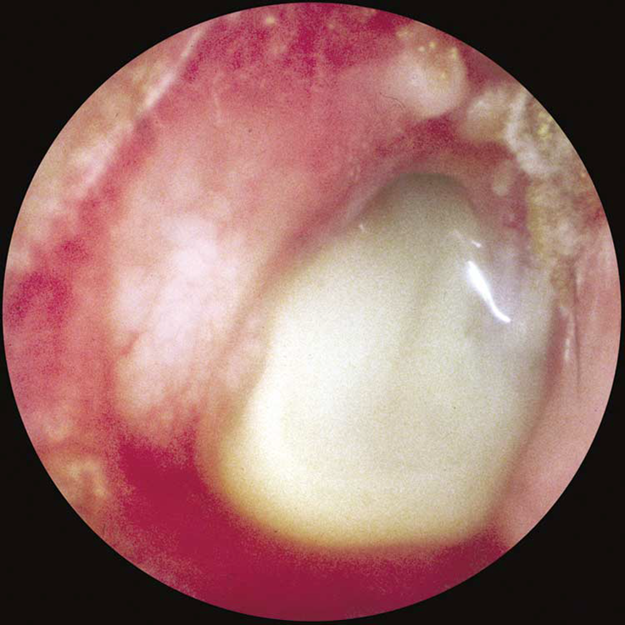
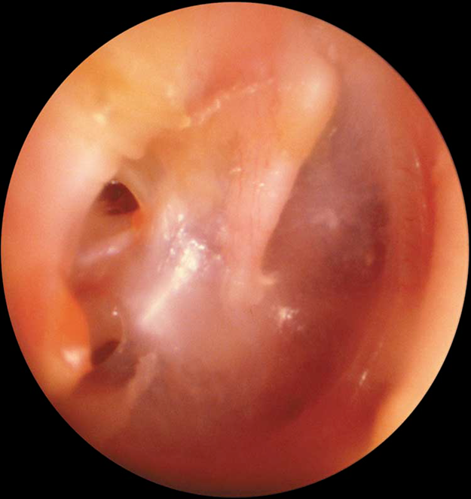

Slide 22
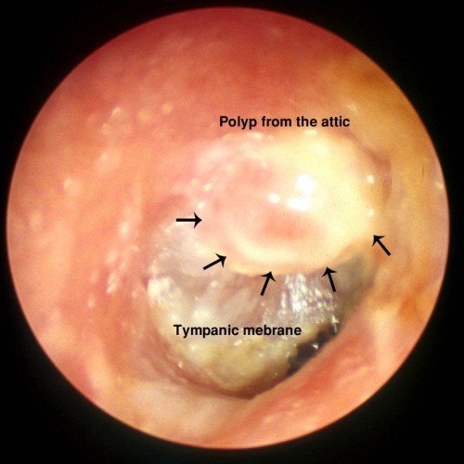
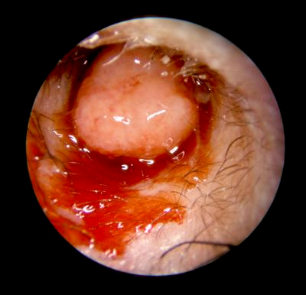

Slide 23
Approach:
History & Clinical examination.
Audiology.
CS.
Radiology (CT).

Slide 24
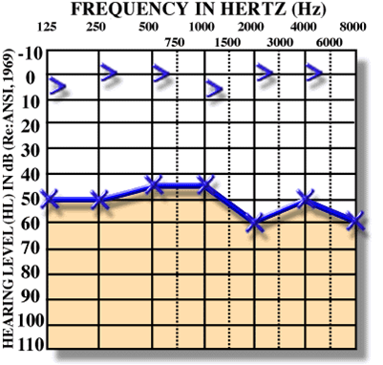
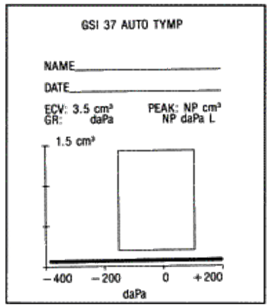
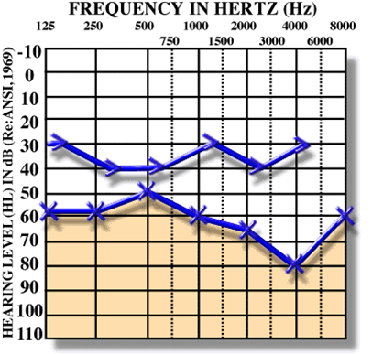

Slide 25
Management:
Water precaution.
Aural toilet.
Antibiotics.
Surgery.
Tympanoplasty.
Mastoidectomy.

Slide 26
Cholesteatoma:
Is a misnomer because it neither contains cholesterol crystals nor it is a tumour to merit the suffix (oma).
skin in the wrong place.
Pathophysilogy:
Squamous epithelium in the middle ear or mastoid.
Desquamation results in continued accumulation (growth) of keratin debris.
Associated with bone and soft tissue erosion and recurrent infections.

Slide 27
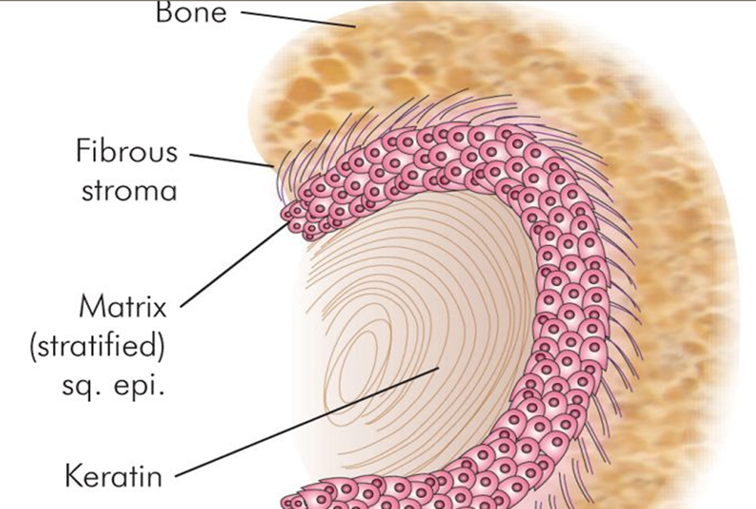

Slide 28
Types:
Acquired:
Primary:
Due to invagination of a retraction pocket, associated with negative ear pressure (eustachian tube dysfunction).
Secondary:
Ingrowth of keratinizing epithelium into the middle ear space through a pre-existing TM perforation
Congenital:
presents as a white mass generally in the anterosuperior middle ear with an intact TM.

Slide 29
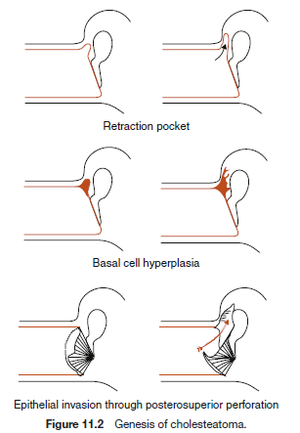

Slide 30
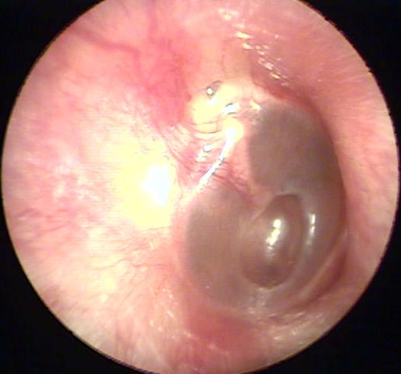
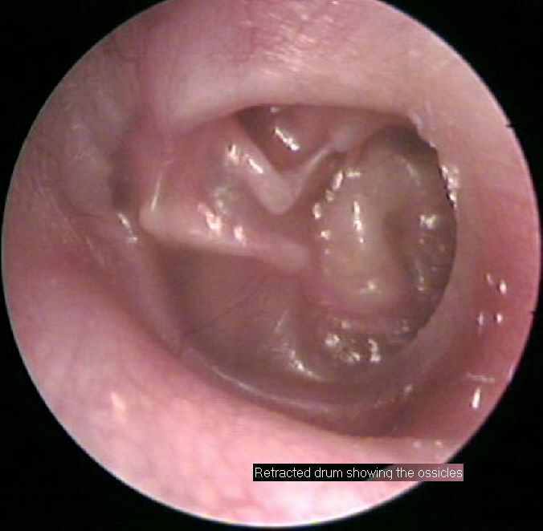

Slide 31
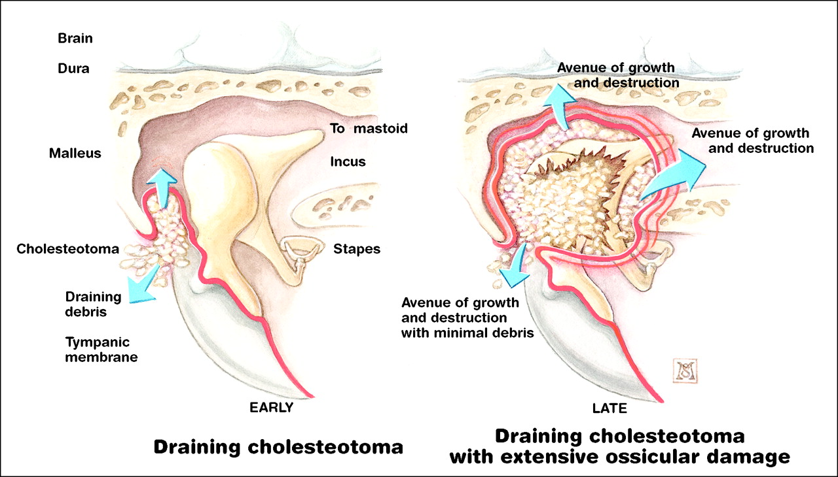

Slide 32
Presentation:
Progressive CHL,discharge
(cholesteatoma can act as a sound conductor).
OE:
White “pearly” mass within the middle ear.
Perforation, discharge, polyps.
Destruction of attic area.
Test:
CT.
PTA, tympanometry.

Slide 33
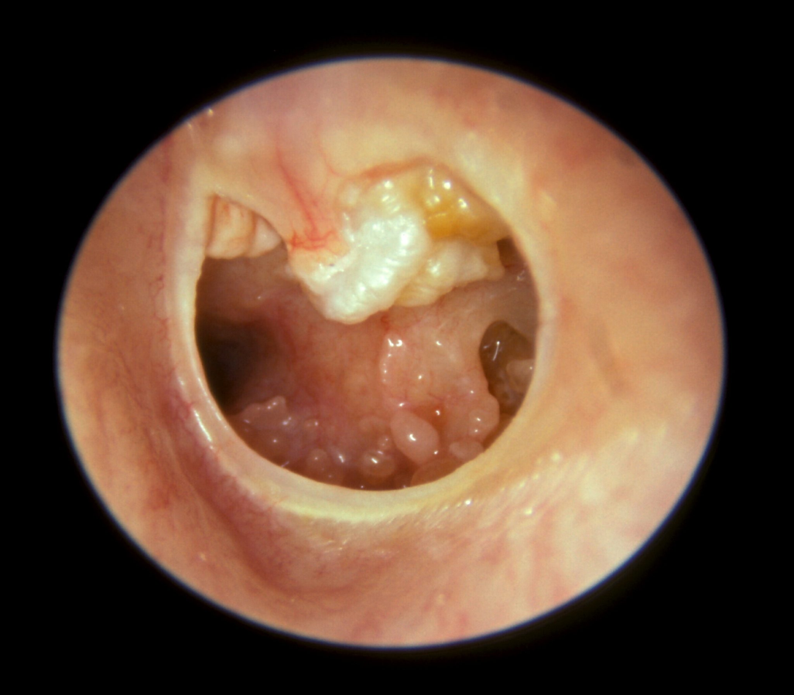
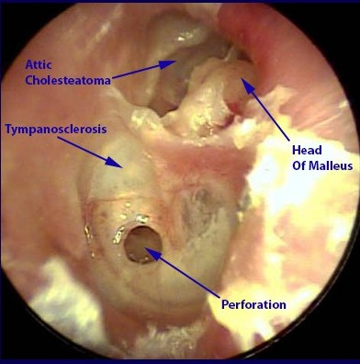

Slide 34
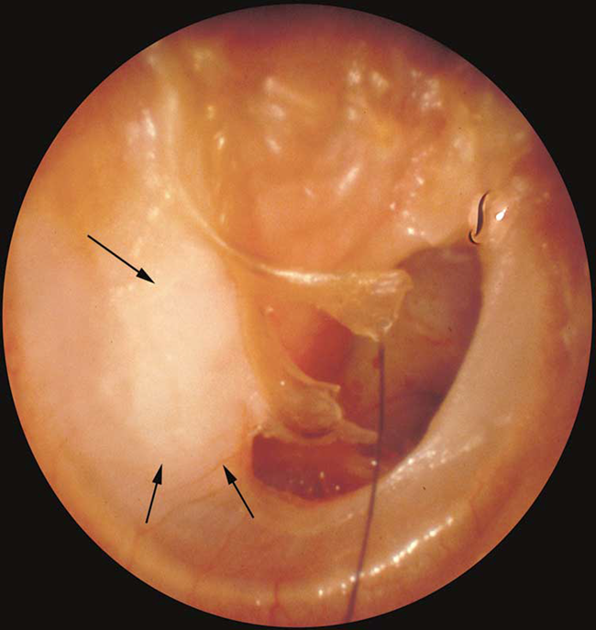
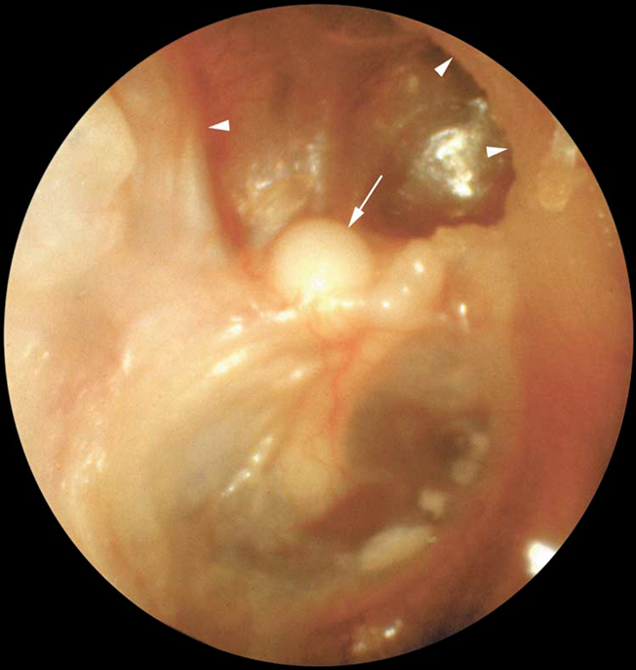

Slide 35
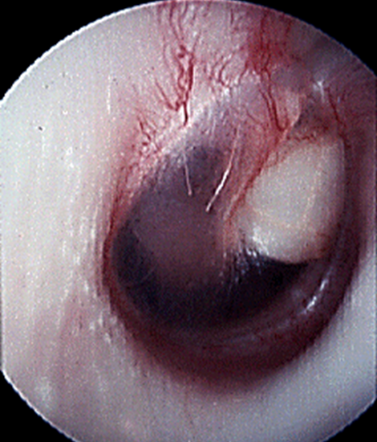
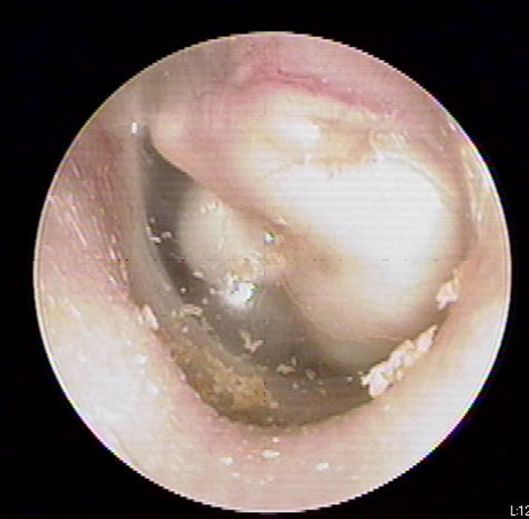

Slide 36
Complications:
Destruction of the ossicular chain.
Chronic otitis media.
Labyrinthine fistula.
Intracranial complications.
Facial nerve paralysis.

Slide 37
Management:
Antibiotics.
Surgery.
Aim: to remove the disease, restore the function.
Mastoidectomy.
Reconstructive surgery.

Slide 38
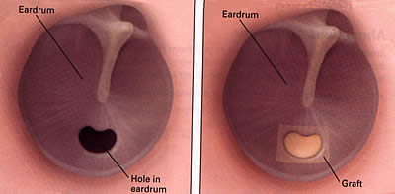
Tympanoplasty:

Slide 39
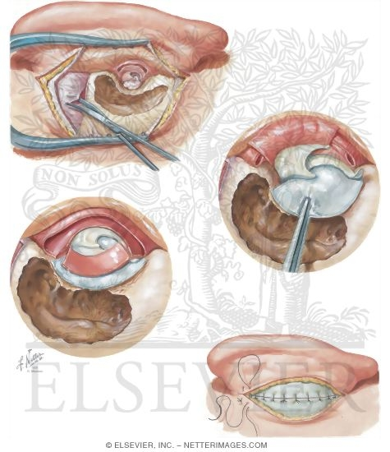
Mastoidectomy:

Slide 40
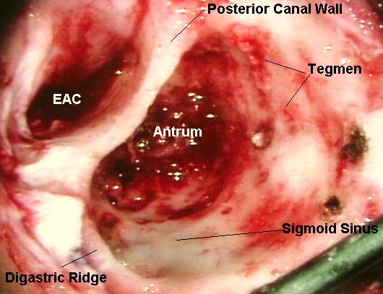
http://www.ghorayeb.com/mastoidectomy.html

Slide 41


