Slide 1
Nader ALDajani
Pharynx
I&II

Slide 2
pharynx
Funnel shaped
It extend from:
  the base of the skull to the level of 6th cervical vertebra at the lower border of cricoid cartilage.
10 cm length

Slide 3
Parts of the pharynx:
1-Nasopharynx:
2-Oropharynx
3- Hyoppharynx (Laryngopharynx)

Slide 4
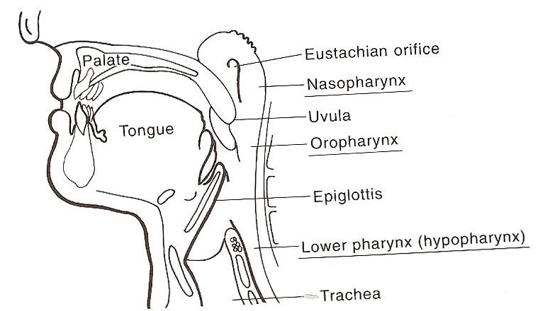
1-Nasopharynx
  Open ant to the nose ,
Above:
  the base of skull
below:
  soft palate
Laterally :
  opening of the eustachain tube
  Pharyngeal recess (fossa of rosenmuller)

Slide 5
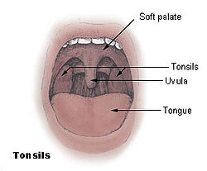
2-Oropharynx
Open ant to mouth.
Above:
  soft palate.
below :
  the upper border of epiglottis.
Contain
  Palatine tonsils between the ant pillars and post pillars.

Slide 6
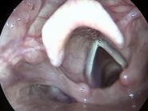
3- Hyoppharynx (Laryngopharynx)
Open ant to the larynx
Above :
  the upper border of the epiglottis
Below :
  lower border of cricoid cartilage
Contain:
  Pyriform fossa
  valleculae

Slide 7
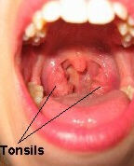
Palatine tonsils
Part of Oropharynx
Contain 12 to 15 crypts
The deep surface is separated from the constrictor muscles of the pharynx by connective tissue’ capsule’

Slide 8
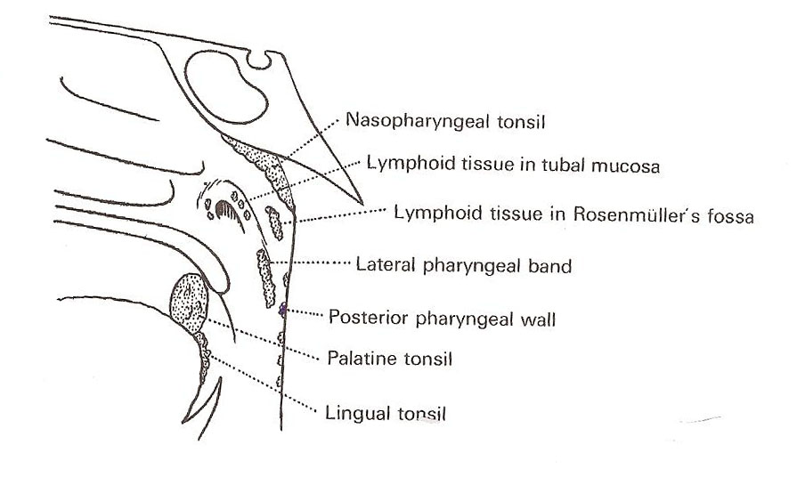
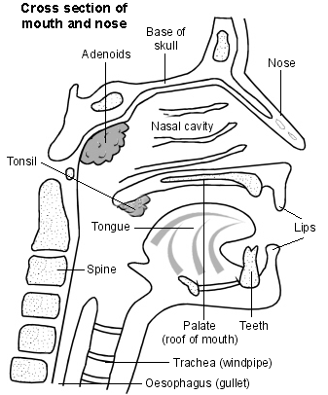
Other lymphoid tissue
Adenoid
  No capsule
Lingual tonsils
Tubal tonsils
Lateral pharyngeal bands
discrete nodules

Slide 9
physiology
Functions of the sub epithelial lymphoid tissue:
Protective functions
Formation of lymphocytes
Formation of antibodies
Acquisition of immunity
Localization of infection

Slide 10
Structure of the pharynx
Four layers:
  the mucous membrane
  Submucosa
  muscular layer (External and Internal)
  adventitia.
mucous membrane:
  Ciliated epithelium
  Stratified squamous epithelium
  Transitional epithelium
  Subepithelial lymphoid tissue of the pharynx( waldeyer’s ring)

Slide 11
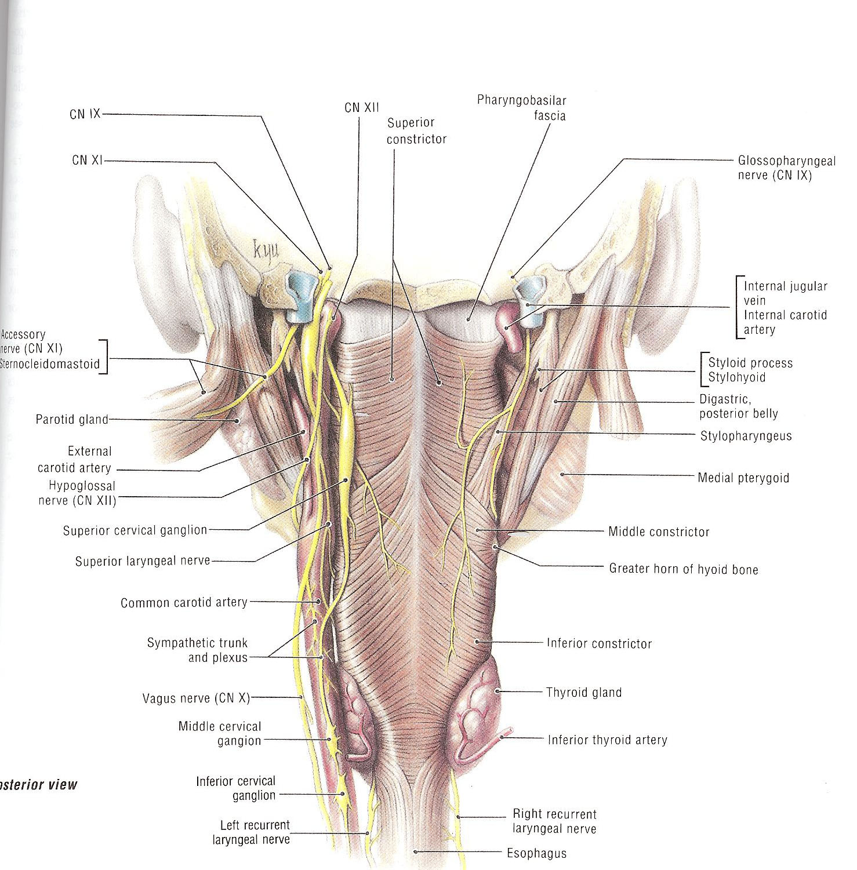

Slide 12
Muscular layer
External Muscles
internal Muscles

Slide 13
External Muscles :
Three constrictor muscles:
Superior constrictor
  arise from pterygoid , ptergomandibular ligament, post end of mylohyoid fibers
Middle constrictor:
  Arise from the hyoid bone and stylohyoid ligament
Inferior constrictor:
  Thyropharyngeus
  Cricopharyngus
Killian’s dehiscence
  Potential gap between the thyropharyngus and cricopharyngus

Slide 14
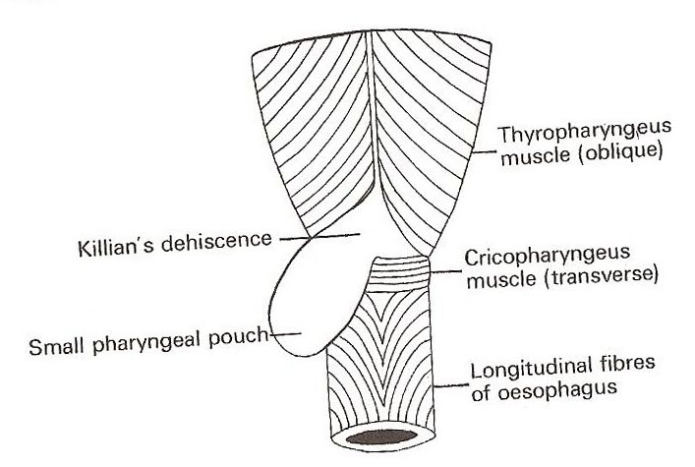

Slide 15
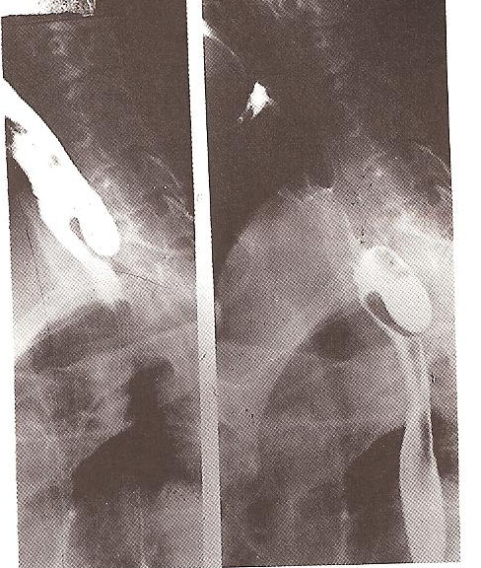

Slide 16
Internal layer:
Three muscles:
  Stylopharyngus
  Salpingopharyngus
  palatopharyngus

Slide 17
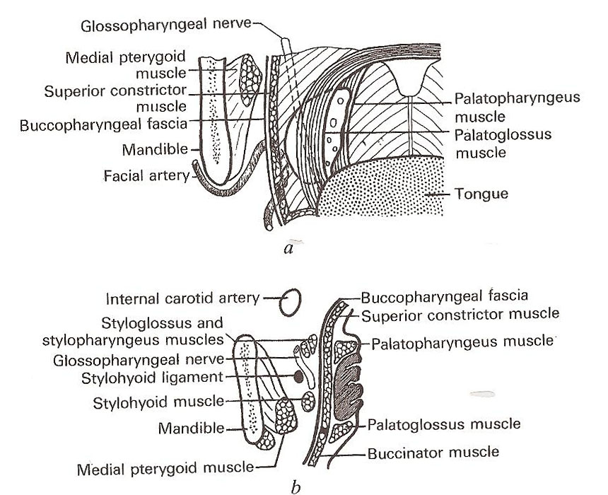
Relation of the pharynx
Posteriorly :
  Vertebral Colum, prevertebral muscle and fascia
Anteriorly:
  Nasal cavity
  Mouth
  Larynx
Superior:
  Sphenoid and base of skull
Inferior:
  Continuous with esophagus

Slide 18
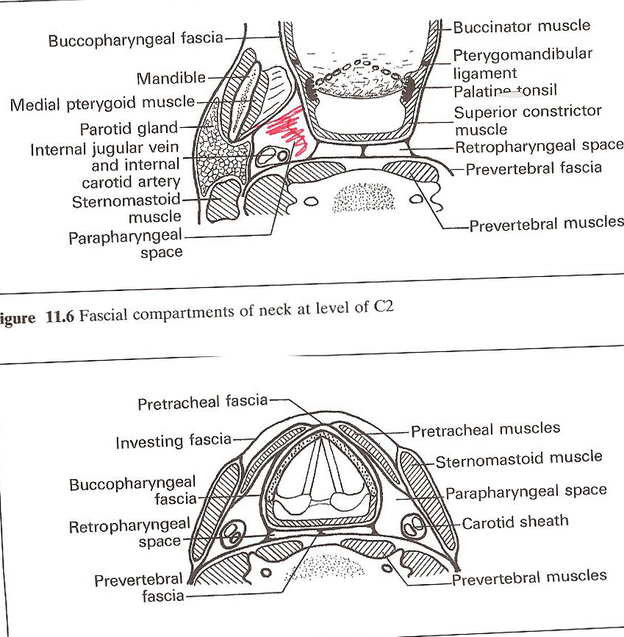
Parapharyngeal space
Potential space lies lateral to the pharynx
Triangular in cross section
it extend from the base of the skull above to the apex of hyoid bone
Anteromedial wall:
  buccopharyngeal fascia
Posteromedial wall :
  cervical vertebrae, prevertebral muscle and fascia
Lateral wall:
  (up) the mandible ,pterygoid muscle, parotid gland
  (Lower) sternomastoid muscle

Slide 19
Contenet of parapharyngeal space
  prestyloid:
    internal maxillary artery
    fat
    inferior alveolar ,lingual, and auricultemporal nerves.
  Poststyloid:
    neurovascular bundle (carotid artery,, internal jugular vein, sympathatic chain ,CN IX,X and,XI

Slide 20
Retropharyngeal space :
It extend from the base of skull to superior mediastinum
Lies behind the pharynx
Anterior:
  posterior pharyngeal wall and its covering buccopharyngeal fascia
Posterior:
  cervical vertebrae and muscles and fascia
Contents :
  Reteropharyngeal lymph nodes

Slide 21
Deglutition
Three stages
Oral stage:
  voluntary,
  closure of mouth,
  cessation of respiration
  raising of larynx
  sudden elevation of the tongue
  press the tongue against the palate,and pushes it backwards towards the oropharynx
Pharyngeal stage :
  Involuntary reflux
  contraction of nasopharynx sphincter,
  larynx rises more
  laryngeal inlet closure
  epiglottis diverts the food into cricopharyngeal sphincter
  contraction of constrictor muscles
  relaxed cricopharyngeal sphincter
Esophageal:

Slide 22
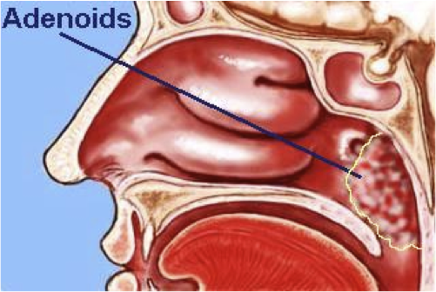
Adenoid
A hypertrophy of the nasopharyngeal tonsil to produce symptoms , most commonly between the age of 3---7 years
Clinical features:
  Mouth breathing
  Snoring
  hyopnasality
  adenoid face
  nasal discharge
  Eustchain tube obstruction
Diagnosis :
  x ray
  flexible fiberoptic nasopharyngeoscope
Treatment:
  conservative
  Surgical: adenoidectomy

Slide 23
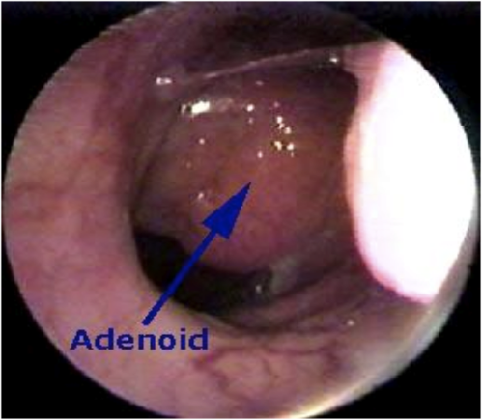
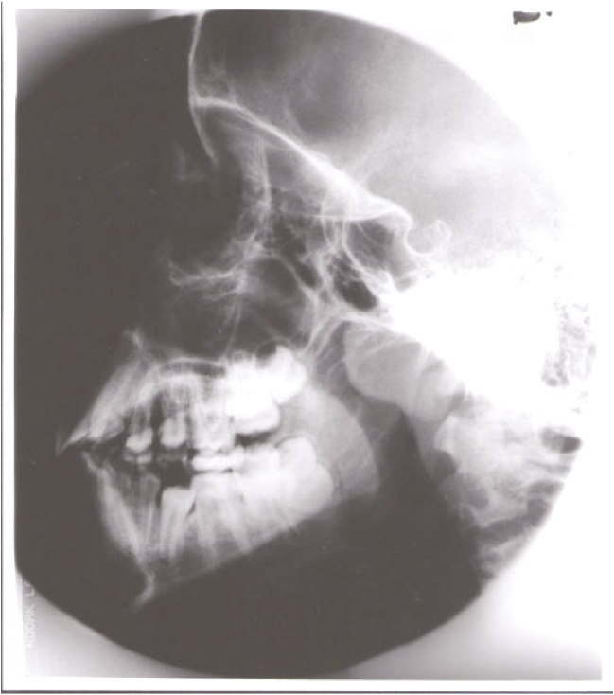
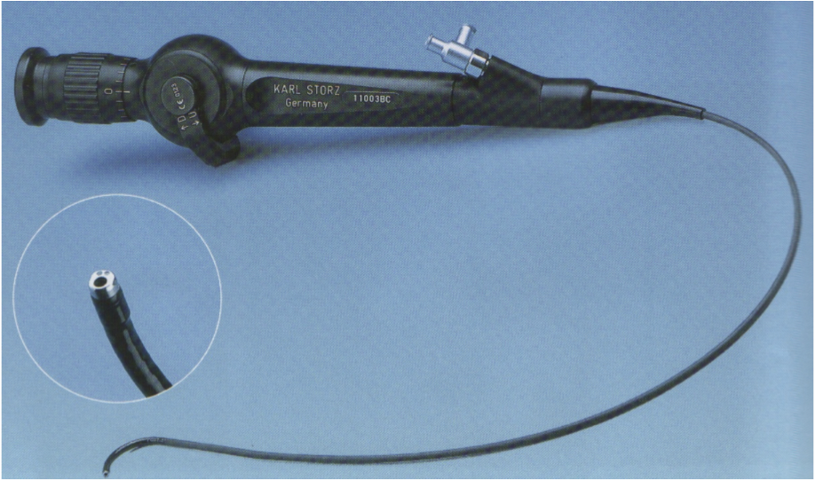

Slide 24
Sleep apnea and snoring
Snoring
  is a sign of partial obstruction of the upper airway during sleep
  Snoring is always present during type of sleep apnea
Sleep apnea:
  Cessation of airflow at the mouth and nostrils lasting 10 seconds for at least 30 apnoeioc episodes
Types :
  central sleep apnea:
    Failure of respiratory drive from the brain
  Obstructive sleep apnea (OSA)
    Due to anatomical narrowing of the upper airway
  Mixed

Slide 25
Investigation
Sleep study:
  EEG,EKG,EOG,pulse oximeter, respiration rate , nasal and oral air flow
Treatment:
  Nonsurgical :
    behavior modification :
    medical treatment
    CPAP (Continuous positive airway pressure)
  Surgical :
    UPPP (uvulopalatopharyngeoplasty)
    Mandibular advancment
    Tongue reduction
    Sleeve!

Slide 26
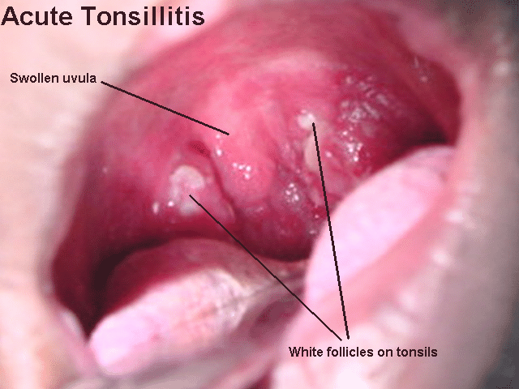
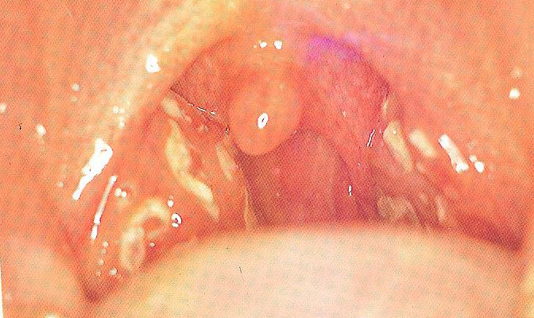
Acute infection of oropharynx
Acute tonsillitis:
Causes:
  viral followed by bacterial (group AB-hemolytic streptococcus , moraxella, H. influenza, bacteroides
SSX:
  Fever
  sore throat
  odynophagia
  Trismus
  halitosis
Complication:
  peritonsillar abscess
  parapharyngeal or retropharyngeal abscess
  rheumatic fever
  glomerulonephritis
Rx:
  ABX
  hydration
  analgesia

Slide 27
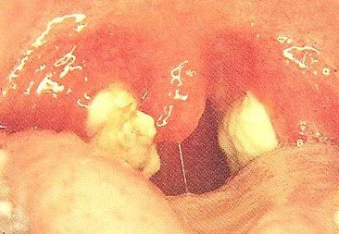
Infectious mononucleosis
Pathogen:
Epstein barr virus
SSX:
  fever
  lymphadenopathy malaise
  exudative tonsilitis,
  hepatosplenomegaly
DX:
  monosopt test ,paul bunnel test (heterophil antibodies in serum)
  80% mononuclear and 10% atypical lymphocytes on smear
Complication:
  cranial nerves involvement
  Meningitis
  autoimmune hemolytic anemia
  splenic rapture
RX:
  hydration,
  analgesia oral hygiene
  Avoid abdominal trauma

Slide 28
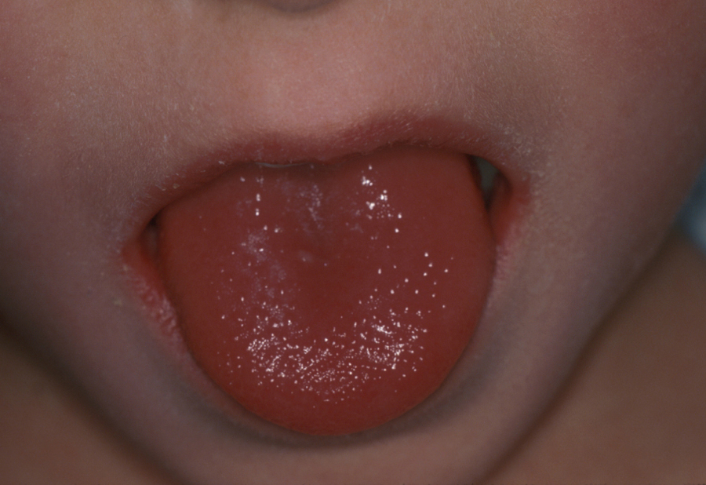

Scarlet fever
Endotoxin produced by by type A B-hemolytic streptococcus
SSX:
  red pharynx
  strawberry tongue
  perioral skin erythema and desquamation
  Dysphagaia
  Malaise
  sever cervical lymphodenopathy
DX
  Throat culture
RX:
  ABX

Slide 29
Diphtheria
Corynbeactrium diphtheria
SSX:
  sore throat
  Fever
  grayish green plaques friable membrane
  Swelling of the neck called ” Bull neck “
  Enlarged lymph nodes in the neck which are tender.
DX:
  culture
Complication:
  nephritis,
  airway obstruction
  death
RX:
  ABX
  Diptheria antitoxin

Slide 30
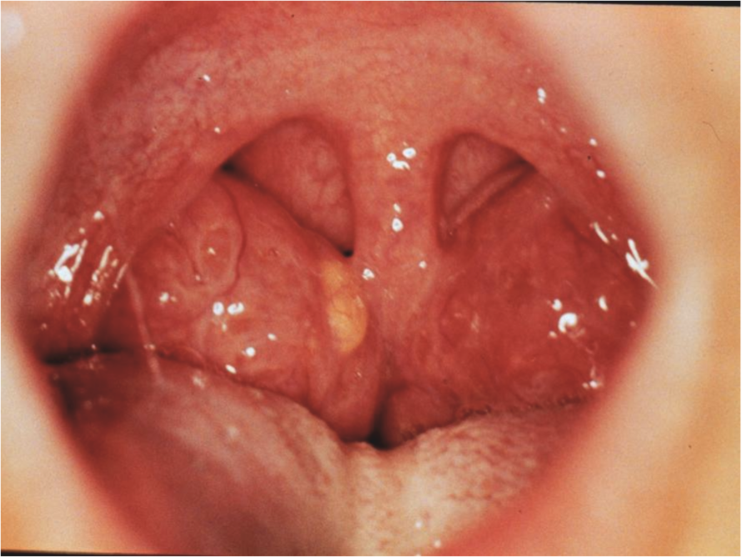
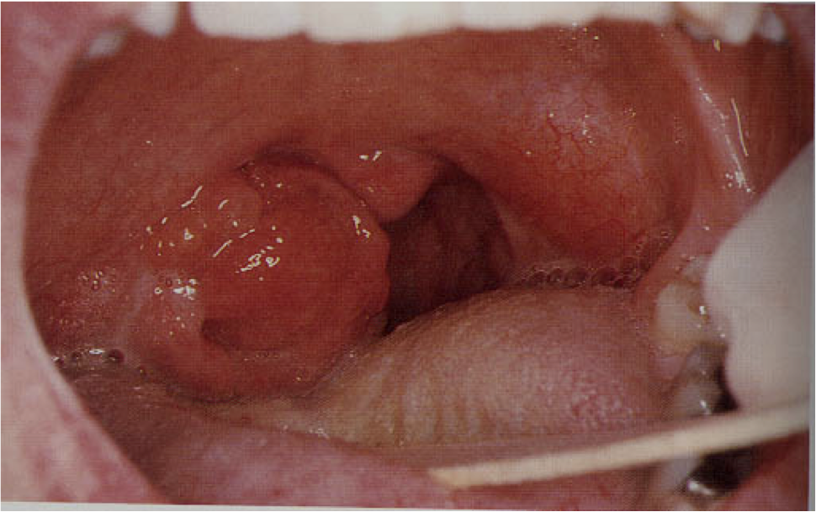

Slide 31
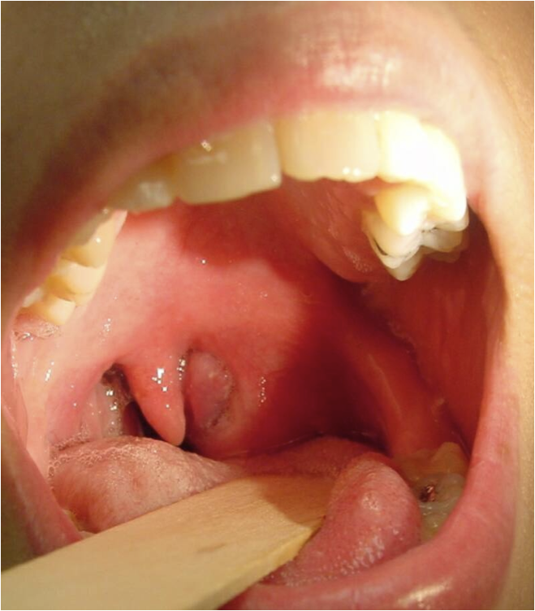

Slide 32
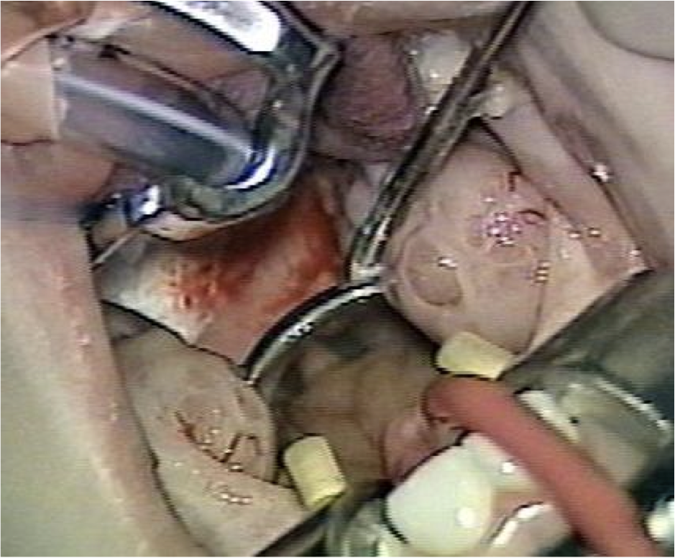
tonsillectomy

Slide 33
Complication of tonsilectomy surgery
Hemorrhage
Primary
Reactionary
Secondary
Respiratory obstruction
Injury to near-by structures

Slide 34
Primary hemorrhage
Bleeding occurring during the surgery
Causes
Bleeding tendency
Acute infections
Bad technique
Management
General supportive measures
Diathermy, ligature or stitches
Packing

Slide 35
Reactionary hemorrhage
Bleeding occurring within the first 24 hours postoperative period
Causes
Bleeding tendency
Slipped ligature
Diagnosis
Rising pulse & dropping blood pressure
Blood trickling from the mouth
Frequent swallowing
Examination

Slide 36
Treatment
  General supportive measures
  Take patient back to OR
  Control like primary hemorrhage

Slide 37
Secondary hemorrhage
Occur 5-10 days postoperatively
Secondary to infection
Treated by antibiotics
May need intraoperative control of persistent

Slide 38
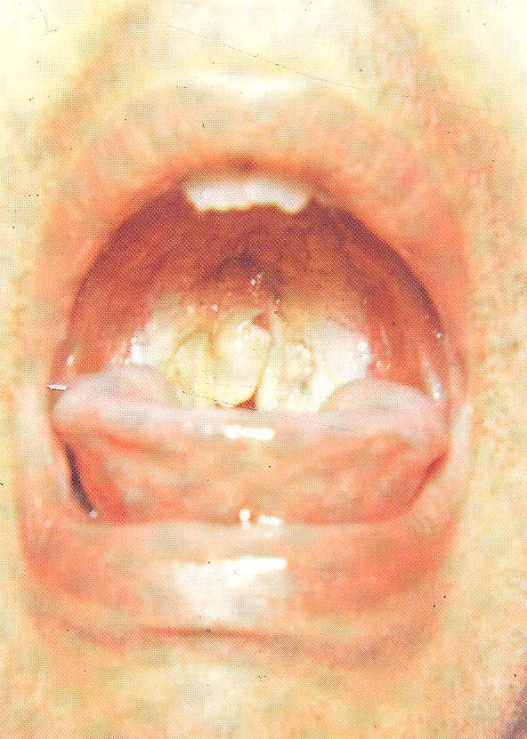

Slide 39
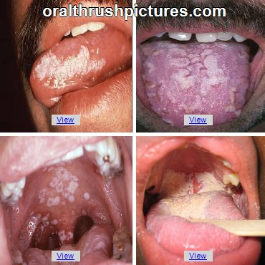
monoliasis
White patches caused by candida albicans fungus
RX:
nystatin

Slide 40
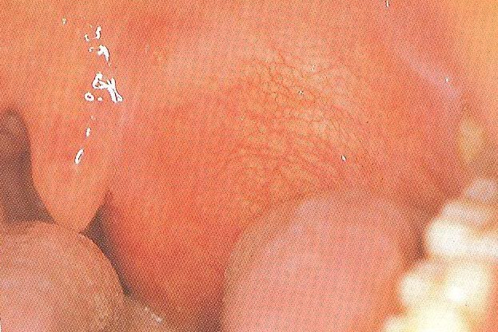
Peritonsillar abscess (quinsy):
An abscess between the tonsil capsule and the adjacent lateral pharyngeal wall
SSX:
  fever
  otalgeia
  odynophagia
  uvular deviation
  trismus
  drooling of saliva
Complication:
  Para and retrpharyngeal abscess,
  aspiration pneumonia
Rx:
  I&D
  aspiration
  Iv ABX

Slide 41
Parapharyngeal abscess
Source of the infection:
  odontogenic
  tonsils,
  parotid
SSX:
  Trismus
  Fever
  muffled voices
  intraoral bulge
Complication:
  Aspiration
  cranial nerve palsy
  airway compromise,
  septic thrombophlepitis,
  carotid blowout
  endocarditis
RX:
  Incision and drainage,
  iv ABX
  airway management

Slide 42
Retropharyngeal abscess
More common in children
SSX:
  Odynophagia
  hot potato voice
  Drooling
  stiff neck
  fever
  stridor
Complication
  mediastnitis
  respiratry distress
  rupture abscess
RX:
  Incision and drainge
  IV ABX

Slide 43
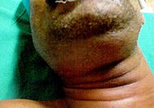
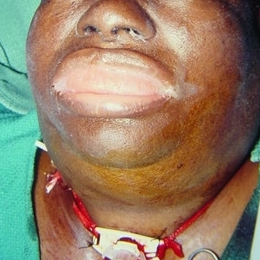
Ludwing’s angina
Bilateral cellulitis of submandibular and sublingual spaces
SSX:
  wooden floor of the mouth,
  neck swelling and indurations
  drooling
  respiratory distress
  swollen tongue
  dysphagia
  trismus ,
Complication:
  airway distress
  sepesis
RX:
  Tracheotomy
  incision and drainge
  IV antibiotic

Slide 44
Chronic pharyngitis
Pathogenesis :
  postnasal drip,
  irritant ( dust. Dry heat, smoking, alcohol)
  reflux esophagitis
  chronic mouth breathing
  allergy
  connective tissue disease
  malignancy
SSX:
  constant mouth clearing
  dry throat pharyngeal crusting
  thick granular wall
RX:
  address underlying etiology

Slide 45
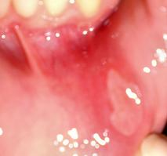
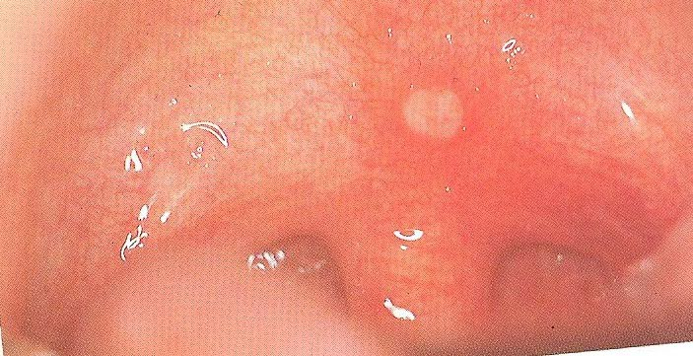
Aphthous ulcer
recurrent round or oval sore or ulcer
Causes:
  Emotional stress and lack of sleep
  Mechanical trauma, for example, self-inflicted bite
  Nutritional deficiency, particularly of vitamin B, iron, and folic acid
Treatment:
  Self limiting
  Symptomatic (analgesia, steroid ointment)

Slide 46
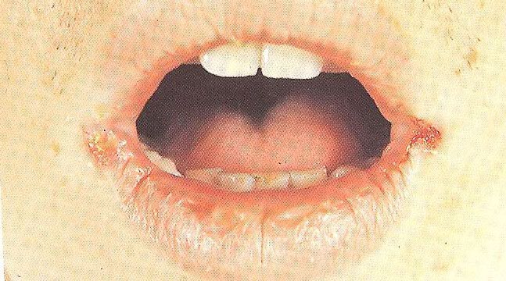
angular stomatitis
swollen red patches in the corners on the outside of lips
Symptoms:
  can vary from having only mild redness to having open, bleeding blisters
Causes:
  Yeast infection
  Anemia
Treatment:
  Antiseptic
  Steroid ointment
  Anemia correction

Slide 47
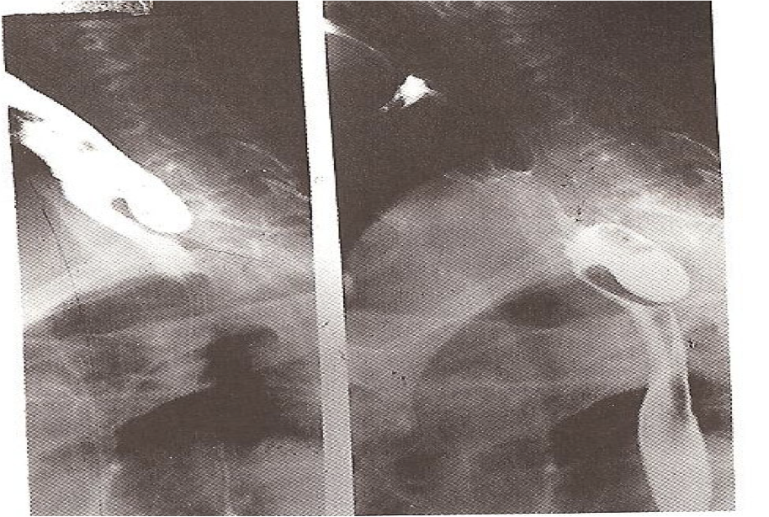
zenker’s diverticulum
Herniation of the mucosa at killian’s triangle due to increase intraluminal pressure
SSX:
dysphagia, regurgitation of undigested food aspiration
DX: barium swallow
RX:
Cricopharyngeal myotomy.
Diverticulectomy

Slide 48
THANK YOU

