Slide 1
Salivary glands

Slide 2
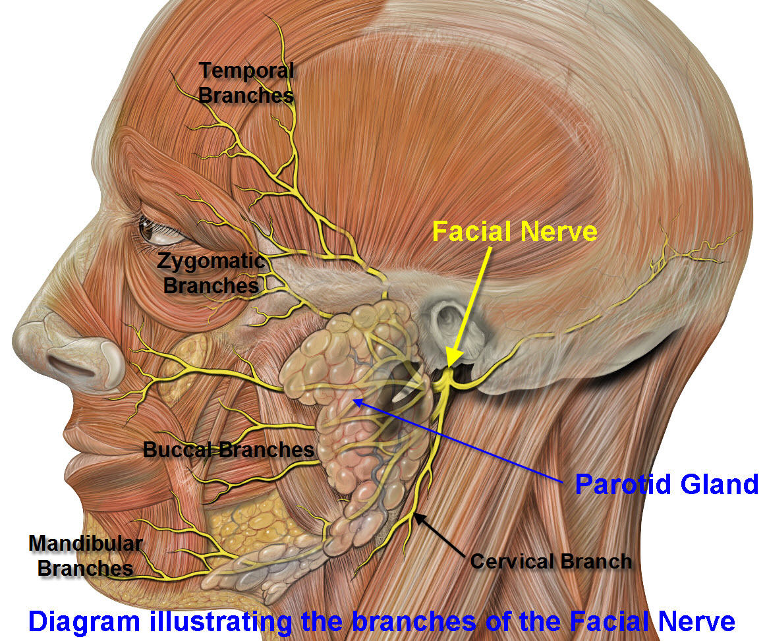
Surgical anatomy
There are 3 pairs of main salivary glands:
  parotid
  Submandibular
  sublingual glands
  + small innumerable glands scattered in mucous membrane of oral cavity.

Slide 3
Parotid gland
Serous cells only
On side of the face, deep to skin, subcutaneous tissue, superficial to the masseter muscle
Tail of parotid extends superficial to SCM.

Slide 4
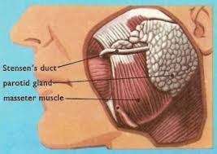
Parotid duct
Stensen’s duct begins at anterior border of the gland 1.5cm below the zygoma.
Traverses the masseter 5-6 cm, pierces the buccinator.
Opens in mouth lateral to 2nd upper molar.

Slide 5
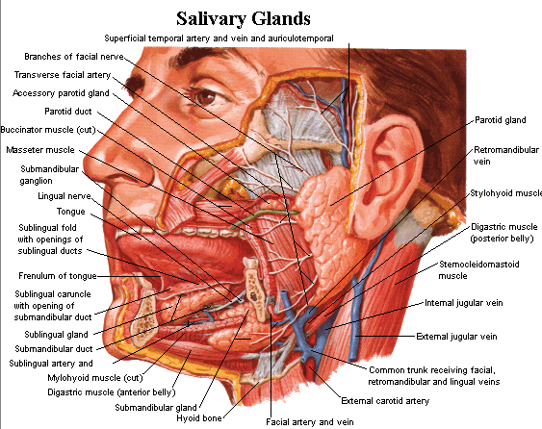
Submandibular gland
Mucous and serous cells.
Submandibular triangle: between anterior and posterior bellies of digastrics' and inferior margin of the mandible.
Medial and inferior to the mandible.

Slide 6
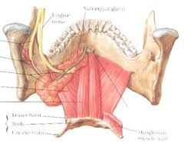
Wharton’s duct
Exits the gland from the medial surface
travels between the hyoglossus and mylohyoid muscles
enters the genioglossus muscle
opens into mouth just lateral to lingual frenulum.
CN XII is inferior to the duct and lingual nerve is superior to the duct.

Slide 7
Sublingual glands
Mucous secreting.
Just below the floor of mouth mucosa.
Bordered by genioglossus/hyoglosss medially
mandible laterally
mylohyoid inferiorly.
Wharton’s duct and lingual n. travel beween SL gland and genioglossus muscle.
No fascial capsule.

Slide 8
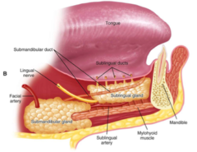
Ducts of Rivinus (~10) along the superior aspect of the gland
open into the mouth along sublingual fold in the floor of mouth.

Slide 9
Minor salivary glands
Either mucous/ serous or both
600-1000 /person
Each gland has it’s own duct
Found most commonly in buccal, labial, palatal, and lingual regions

Slide 10
Physiology
Role of saliva:
  Lubricates
  Moistens, help with mastication
  Cools hot food
  Buffers chemicals
  Cleans the mouth (lavage)
  Protects mucosa
  Prevent dental caries
  Antibacterial (lysozyme, IgA)
  Homeostasis

Slide 11
Disease of Salivary Glands
Non-neoplastic
Neoplastic
1- Congenital diseases.
2- Infections.
3- Salivary stones.
4- Salivary fistula.
5- Degenerative diseases.
6- Autoimmune salivary diseases.
7- Drug-induced endocrine and metabolic salivary gland enlargement.
1- Benign.
2- Malignant.

Slide 12
Infections (Sialoadenitis)
Acute
-Viral
-Bacterial
Chronic
-Specific (rare)
- TB.
- Sarcoidosis
-Non-specific (common)
- Recurrent subacute or chronic sialoadenitis
or chronic pyogenic sialoadenitis

Slide 13
Acute Bacterial Sialoadenitis
(acute suppurative sialoadenitis)
Definition
  acute suppurative inflammation of salivary glands.
Causative organism
  The commonest is staph. Aureus.
  Less commonly strept, pneumococci, etc....
Predisposing factors
  Poor oral hygiene
  common post-operative due to combination of dehydration and poor oral hygiene (due to fasting + anesthetic medication)

Slide 14
Precipitating factors
Obstruction of salivary duct by stone or food particles.
Route of entry
1- Direct: along the duct from the mouth.
2- Blood born

Slide 15
Symptoms
General: . Fever , anorexia, headache and malaise
Local
1- Pain:
ln the side of the face, marked as the gland lies within tough fascia increase with eating
2- Disturbance of function: pain increases with ingestion of lemon or acidic juice (lemon test)

Slide 16
Signs
Before suppuration:
General:
Mild toxemia (fever + tachycardia)
Local:
Gland: diffusely enlarged, firm, tender, raising lobule of the ear.
Skin: congested red, hot tender.
Duct: inflamed opening is red, raised, edematous and stone may be felt inside it by bimanual examination

Slide 17
Signs
After suppuration
General
Marked toxemia: marked fever + increase tachycardia
Local
Gland: fluctuation is very late (tough fascia)
Skin: Pitting edema + Marked tenderness
Duct: pus exudates from the duct orifice after pressure on the gland
stones may or may not felt on bimanual examination.

Slide 18
Complication
1- Chronicity.
2- Abscess.
3- Stone.
4- Fistula
5- Spread of infection (ear, mastoid region and retropharyngeal space)

Slide 19
Investigation
1- CBC show leucocytosis.
2- ESR, CRP increased
3- Culture and sensitivity of purulent discharge.
4- Radiology for stone.
Treatment
A. Prophylactic
Avoid predisposing factors.
B. Curative
- Initially antibiotics, analgesics, antipyretics) + hot fomentation.

Slide 20
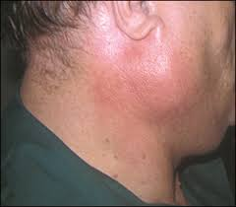
- Indications of surgery:
Failure to respond to conservative treatment within 48 hours.
- Evidence of abscess formation
acute suppurative sialoadenitis

Slide 21
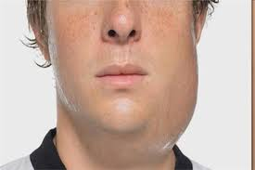
Acute viral Parotitis
(acute non-suppurative parotitis) (mumps)
Caused by mumps
presents in children
incubation period (15 days),
bilateral painful parotid gland swelling with fever and
it is self-limited.
Complications
  Pancreatitis, encephalitis, orchitis and oophoritis

Slide 22
Recurrent Subacute and Chronic Pyogenic Sialoadenitis
Submandibular > parotid gland. .
Predisposing factors:
1- Following acute due to persistence of the same predisposing factors or inadequate treatment.
2-Partial duct obstruction by stone , stricture or Sialectasis.
3-Autoimmune diseases of salivary gland.

Slide 23
Chronic sialoadenitis
mainly submandibular salivary gland
presents with swelling in digastric triangle characterized by:
1. History of pain and increase size of swelling during eating.
2. Swelling is solitary, can not be rolled over the edge of mandible.
3. Inspection of mouth floor may reveal redness of duct orifice
4. Bimanual palpation reveals that swelling is filling the floor of the mouth

Slide 24
Investigation
1- Plain X-ray show stone
2- Sialogram ͢ sialectasis (dilated duct).
Treatment
1- Treatment of predisposing factors + antibiotics + mouth wash.
2- Surgery for chronic submandibular sialoadenitis ͢ submandibular sialodentomy

Slide 25
Salivary Stone (sialolithiasis)
Incidence:
  Submandibular > parotid (50:1) due to:
    1- Gland secretions are more viscid with high calcium concentration.
    2- Duct ascends upwards ͢ inadequate drainage.
    3- Orifice lies in the floor of the mouth ͢ liable to be blocked by food particles.

Slide 26
Salivary Stone (sialolithiasis)
Predisposing factor:
  lnfection: (chronic sialoadenitis) due to change of pH of saliva + provide nidus for stone (pus cells)
  Stasis: causes stagnation and infection.

Slide 27
Salivary Stone (sialolithiasis)
Pathology
-Number: single or multiple.
-Site: inside gland or duct.
-Nature: Calcium + magnesium + phosphorus + carbonate
Complication
-Obstruction of duct ͢ sialectasis + sialadenitis.
-Salivarv fistula.

Slide 28
Salivary Stone (sialolithiasis)
Symptoms
Mainly asymptomatic or may present with:
As chronic sialadenitis (Episodes of pain followed by relief) especially after eating.
Signs
if acute on top of chronic sialoadentitis.

Slide 29
Investigation
Plain X-ray ͢ stone in submandibular gland is radio-opaque in 80% of cases due to high calcium concentration
Sialography : best in parotid stones as they are radiolucent. May be dilated ducts
Ultrasound :shows the stone

Slide 30
Treatment
  Surgical (according to the site of stone)
    Stone inside the gland substance
      Submandibular gland stone ͢ Submandibular sialadenectomy
      Parotid gland stone
        Superficial conservative parotidectomy
    Stone inside the duct
      Peeping stone from orifice ͢ meatotomy.
      Stone in duct ͢ removed through mouth under local anesthesia.
      Submandibular sialoadenectomy ͢ if recurrent.

Slide 31
Autoimmune Diseases
Mikulicz’s Disease
Enlargement of salivary and lacrimal glands due to lymphocyte infiltration +dryness of mouth.
Sjogren’s Disease(Keratoconjunctivitis sicca)
Common in female, may be due to CMV infection ͢ lymphocyte infiltration & duct obliteration.
Increase risk of lymphoma 44 times.
Types:
a- Primary: dry mouth + dry eye neither connective tissue not salivary involvement
b- Secondary: dry mouth + Rheumatoid arthritis

Slide 32
Frey’s syndrome (Gustatory sweating)
This condition follows surgery in the region of the parotid gland or tempromandibular joint
Clinical picture
Flushing and sweating of the skin innervated by auriculotemporal nerve when even the salivation is stimulated.

Slide 33
Salivary Gland Neoplasms
Relatively uncommon
  2% of head and neck neoplasms
Distribution
  95% in adult
  Parotid: 80% overall; 80% benign
  Submandibular: 15% overall; 50% benign
  Sublingual/Minor: 5% overall; 40% benign

Slide 34
Pleomorphic adenoma(Mixed tumor)
Incidence:
Commonest in the parotid, less in submandibular gland.
Pathology:
Benign tumor.
Site:
Usually from superficial part of parotid gland.

Slide 35
Pleomorphic adenoma(Mixed tumor)
Symptom:
Painless, slowly growing swelling in the side of the face.
Sign:
Well-defined swelling, lobulated, freely mobile (not attached to skin, muscles or bones)
variable in consistency (firm or cystic but never hard)
elevating lobule of ear
with no cervical LNs enlargement or facial nerve infiltration.

Slide 36
Pleomorphic adenoma(Mixed tumor)
Differential Diagnosis:
Non neoplastic lesions, LNs, sebaceous cyst and lipoma.
Complication:
1- Disfigurement.
2-Malignant transformation after > 10 years is rare (2-3%).

Slide 37
Pleomorphic adenoma(Mixed tumor)
Investigations:
1- CT scan for assessment of tumors arising from deep part of the parotid.
2- Tc99 scan: cold spot.
Treatment:
1-Tumor in parotid:
a- Conservative superficial parotedectomv: if the lesion is superficial.
Total conservative parotedectomy: if the lesion is deep.
2-Tumor in submandibular gland:
submandibular sialadenecomy.

Slide 38
Monomorphic Adenoma (Warthin’s tumor)
Incidence:
10% of parotid tumors and bilateral in 10% of cases especially in old age and smokers
Site:
Superficial part and lower lobe of parotid gland.

Slide 39
Symptom:
Elderly male > 50 years, presents with painless, slowly growing swelling in side of the face.
Sign:
Same as pleomorphic adenoma but always cystic or soft in consistency,
in front of tragus of ear
not elevating lobule of ear.
Investigation:
1-Tc99 scan: hot spot
2- CT scan
Treatment:
Conservative superficial parotidectomy

Slide 40
Carcinoma of salivary glands
Mucoepidermoid carcinoma:
The commonest type
Adenoid cystic carcinoma
Acinic cellcarcinoma
Adenocacrinoma:
Carcinoma ex pleomorphic adenoma
Undifferentiated

Slide 41
Spread:
1- Direct: to the surroundings.
2- Lymohatic: to cervical LNs.
3- Blood: rare & late.
Complication:
ulceration
Hemorrhage
lnfection
Nerve palsy.

Slide 42
Symptom:
Swelling: rapidly growing on the side of the face.
Pain: may radiate to the ear, increase by mastication.
Sign:
Swelling Usually warm
mildly tender,
hard in consistency,
ill-defined edge,
Nodular surface,
Rapid rate of growth,
Infiltration of skin ,muscles, vessels& nerves.
Cervical LNS:
enlarged, stony hard, mobile then fixed.

Slide 43
Investigation:
FNA
CT
Treatment:
According to site of tumor:
1- Cancer in parotid gland:
Total radical parotidectomy + total block dissection of the neck LNs + postoperative radiotherapy to decrease recurrence
2- Carcinoma in submandibular gland:
Complete excsion and total block dissection of the neck LNs + postoperative radiotherapy to decrease recurrence

Slide 44
Any Question

