Slide 1
Dizziness
Nader Aldajani
Otologist
KFMC

Slide 2
Objectives:
Identify the term.
Causes.
Difference between central & peripheral.
Approach.
BPPV.
Ménière’s Disease.

Slide 3
Dizziness: is a term used to describe any of a variety of sensations that produce spatial disorientation.
Vertigo: is defined as an illusion of rotational, linear or tilting movement of self or environment caused by asymmetric input to the vestibular system. Description includes(spinning, turning)
Disequilibrium: is sensation of instability of body positions, imbalance or off-balance.

Slide 4
Physiology:
Balance system include:
vestibular.
Visual.
somatosensory.

Slide 5
Causes:
Peripheral.
Central & systemic.

Slide 6
Peripheral causes:
BPPV (Benign Paroxysmal Positional Vertigo).
Menieres disease.
Vestibular neuronitis.
Labyrinthitis.
Perilymphatic fistula.
CPA tumor.
Otitis media.
Trauma.
Vestibulotoxic drug.
Infection, syphilis
Autoimmune.

Slide 7
Central causes:
Neurologic disorders.(migraine, seizure, stroke,MS).
Metabolic disorder.
Vascular headache.
Vascular causes.(vertebrobasilar insufficiency)
Medications & intoxication.
Infection.
Brain tumor.

Slide 8
Classes of Drugs causing Dizziness:
Antiepileptics:
Cerebellar Toxicity.
Antihypertensives:
Hypotension, Decreased CBF.
Anticoagulants:
Hemorrhage in Inner ear/Brain.
Aminoglycosides & Cisplatin:
Ototoxic.
Tranquilizers:
CNS Depression.

Slide 9
Central vs Peripheral

Slide 10
Central | Peripheral | Characteristics
mild | severe | intensity
severe | Mild-moderate | Imbalance
slow | rapid | Compensation
variable | severe | N & V
rare | common | Auditory symptoms
common | rare | Neurologic symptoms
better | Symptoms worse | Eye closure
Bidirectional Horizontal or vertical | Unidirectional,rotatory horizontal | Nystagmus
No effect,may enhance nystagmus | Suppress nystagmus,may not in acute phase | Ocular fixation

Slide 11
other | Aural fullness | tinnitus | Hearing loss | Duration
- | - | - | - | seconds | BPPV
- | Presure warmth | present | Uni-bilateral fluctuating | Minutes-hours | Menieres
- | - | - | no | hours-days | Vestibular neuronitis
Recent AOM or CSOM | - | whistling | yes | hours-days | labrynthitis
Ataxia 7th cn palsy | - | present | progressive | chronic | Acoustic neuroma

Slide 12
History:
Onset.
Duration.
Recurrence.
Precipitating factors.
Relieving factors:
Ear symptoms.
Nausea & vomiting.
Headaches.
Previous viral illness.
Ear diseases, trauma, or surgery.
Central symptoms.
Cardiovascular risk factors.
Endocrine system.
Medications.
Psychology.
Premenstrual syndrome.
Noise exposure, flying, diving, new eye glasses.
The impact on patient.
Family history.

Slide 13
Physical examination:
Vital signs, supine and standing blood-pressure measurements.
Nystagmus.
ENT.
Hearing test.
Vestibular testing.
Neurologic examination esp cerebellar.
Dynamic Visual Acuity.

Slide 14

Spontaneous Nystagmus:
It is defined as involuntary, rhythmical, oscillatory movement of eyes.
It may be horizontal, vertical or rotatory.
is an important sign in the evaluation of vestibular system.

Slide 15
Spontaneous nystagmus:
Examiner observe pt eyes in central position. Then in other different direction

Slide 16
Fukuda Stepping Test:
Originally described by Fukuda using 100 steps on a marked floor.
Patients are asked to step with eyes closed and hands out in front.
Rotation by more than 45 degrees is abnormal.
Rotation usually occurs to the side of the lesion.
Rotation often found in asymptomatic patients.

Slide 17
Orthostatic Hypotension:
Most often in patients on BP meds with “light headedness” on sitting to standing.
Defined as drop of SBP 20mm HG or DPB 10mm HG within 3 minutes of standing.

Slide 18
Tests:
CT scan.
Caloric testing.
Laboratory vestibular tests.

Slide 19
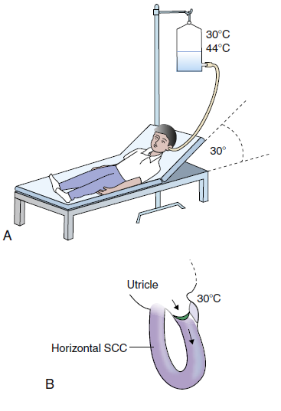
Caloric testing:
Is test that evaluates horizontal SCC function in each ear independently by thermal stimulation.
Technique:
in supine position, head is elevated (chin toward sternum) 30° to bring the horizontal canal into a vertical position, each ear is irrigated with cool and warm water (or air), nystagmus is recorded with eyes open and closed.
Observe the nystagmus response by using Frenzel goggles or an infrared video system.

Slide 20
Laboratory vestibular tests:
Electronystagmography (ENG).
Rotational Chair Testing.
Posturography.

Slide 21
Laboratory vestibular tests:
Indications:
Diagnosis unclear.
Prolonged symptoms unresponsive to conservative treatment.
Screen for central disorders.
Evaluate prior to surgical ablation procedures.
Documentation of vestibular deficits.

Slide 22
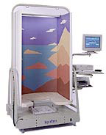
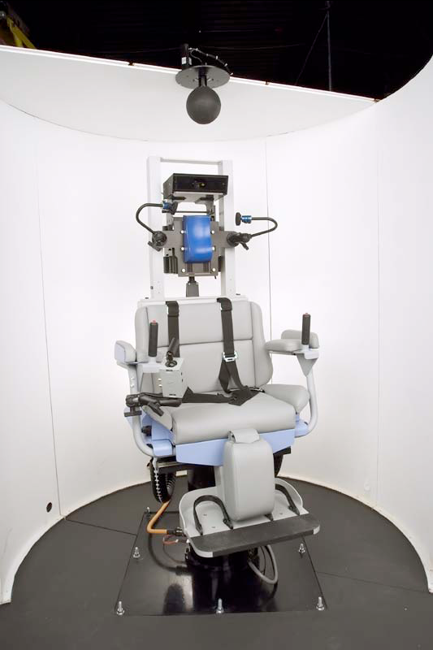

Slide 23
BPPV

Slide 24
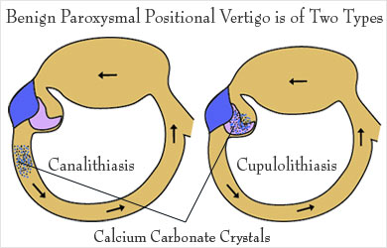
Benign Positional Paroxysmal Vertigo
onal vertigo develops when crystals of calcium carbonate moves free from Utricle's glycoprotein membrane and floats within the tube of the inner ear then deposits on post SCC's glycoprotin membrane.
(deposition over post SCC occur in 90% and rest of SCC 10%) This sends the brain confusing messages about your body's position.
Benign positional vertigo develops when crystals of calcium carbonate moves free from Utricle's glycoprotein membrane and floats within the tube of SCC's.

Slide 25
most common peripheral vestibular disorder.
Causes: spontaneous, posttraumatic, and post viral infection.
Affects posterior (90%), horizontal (10%), or superior (rare) semicircular canal.
Presentations:
Recurrent episodes of brief positional vertigo, nausea and prolonged lightheadedness.
No hearing loss.

Slide 26
Management:
Typically self-limiting, may have recurrent episodes.
Education, reassurance, and observation.
Repositioning Procedure (Epley Maneuver-Brandt-Daroff ).
Surgery.

Slide 27
Dix Hallpike maneuver:

Slide 28
Positive test creteria:
Torsional, Geotropic nystagmus: Direction does not change with repeated stimulation.
Latency : 5-15 sec.
Duration: <1 minute.
Fatigable.

Slide 29
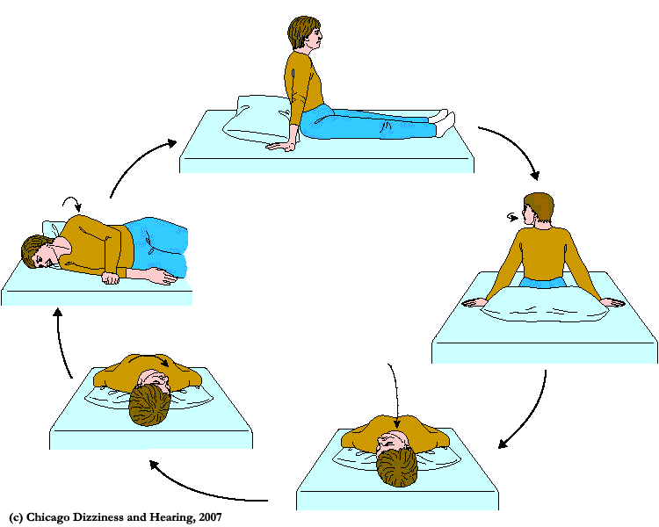
Epley's maneuver

Slide 30
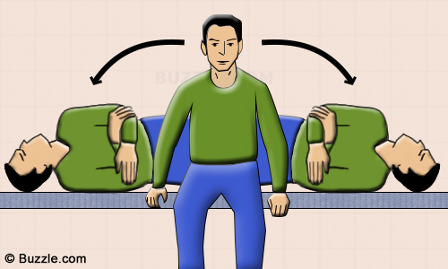
Brandt-daroff habituation exercise:

Slide 31
Vestibular neuritis
What is vestibular neuritis?
It is a disorder characterized by a sudden severe attack of vertigo caused by inflammation of the vestibular nerve.
Commonly preceded by attack of URTI .
Symptoms
Vestibular neuronitis may occur as a single, isolated attack of severe vertigo lasting 7 to 10 days, but many people have additional attacks of milder vertigo for several weeks thereafter.
The first attack of vertigo is usually the most severe.

Slide 32
The attack of vertigo is accompanied by nausea, vomiting, and nystagmus .
The vertigo is severe at first, and gradually subsides over the course of several days, with residual imbalance lasting up to several months.
People do not have tinnitus ,and hearing is usually not affected.
Although vestibular neuronitis and labyrinthitis may be closely related in some cases, vestibular neuronitis is generally distinguished from labyrinthitis by preserved auditory function.

Slide 33
Diagnosis
-Hearing tests
-Tests for nystagmus
-(MRI) of the head should be done to make sure the symptoms are not caused by another disorder, such as a stroke.
Treatment
-Drugs such as meclizine relieve vertigo
-Drugs such as prochlorperazine to relieve vomiting
-Sometimes corticosteroid drugs such as prednisone
-Intravenous fluids if vomiting persists
-Physical therapy

Slide 34
Ménière’s Disease

Slide 35
Also called (Endolymphatic Hydrops).
Symptomatic Triad.
1. episodic vertigo lasting minutes to hours.
2. episodic fluctuating SNHL.
3. tinnitus
4. ± aural fullness sensation

Slide 36
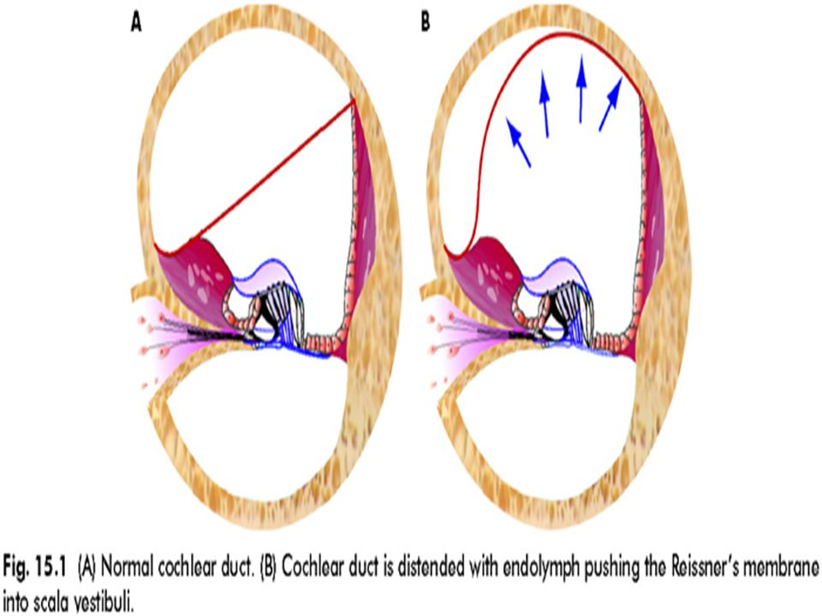

Slide 37
Management:
Dietary Restrictions.
Diuretics.
Vestibular Suppressants.
Transtympanic Corticosteroids injections
Transtympanic Aminoglycoside Injections.
Surgery.

Slide 38
Thank you

