Slide 1
Head &Neck Tumors
DR.Nader ALDajani

Slide 2
Oral Cavity tumor

Slide 3
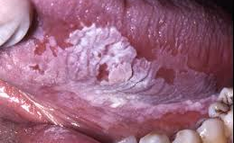
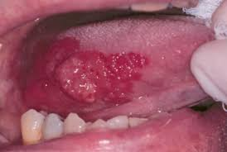
Oral Cavity tumor
Premalignant Lesions
  Leukoplakia, Hyperkeratosis, dysplasia and Erythroplasia
  Erythroplasia Greater risk of malignancy
Malignant transformation greater in smokers
Treatment :Surgical or laser excision
95% are squamous cell carcinoma

Slide 4
Risk factors
Smoking (depends on dosage and type)
Alcohol
Tobacco chewing
HPV (subtype 16)
mechanical irritation (dentures)

Slide 5
Tumor of the Pharynx

Slide 6
I-NASOPHARYNX

Slide 7
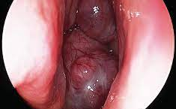
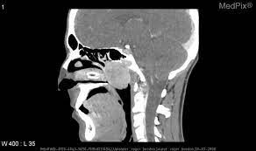
A-BENIGN
Nasopharyngeal Angiofibroma
Pathology:
A very vascular fibroma arising from the periosteum of the roof of nasopharynx.
It has tendency to bleed because there is no muscle coating its vessels.
It occurs in young males below the age of 18 years.
Occurs only in males in adolescent age.

Slide 8
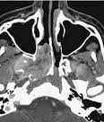
Behavior And Spread:
  Forward ͢ nasal cavity
  Laterally ͢ Pterygopalatine fossa
  Forward and laterally ͢ orbit through inferior orbital fissure
  Upward ͢ cranial cavity
  Downwards ͢ Oropharynx

Slide 9
Symptoms:
Signs:
1-Nasal:
  a. Nasal obstruction.
  b. Recurrent severe epistaxis.
2-Aural:
  Conductive deafness due to Eustachian obstruction.
1- A smooth, lobulated, firm, easily bleeding mass.
  a. Is seen in the nose.
  b. Depresses the palate and appears behind it.
2- Extension causes:
a. Widening of the nasal bones
b. Proptosis and frog-face deformity.
c. Swelling of the cheek and zygoma.

Slide 10
investigation
CT and MRI
Carotid angiography and MR angiography shows feeding vessel of the tumor and allow preoperative embolization of the tumor to minimize intraoperative bleeding
Biopsy not recommended except in operative room with facilities to control bleeding

Slide 11
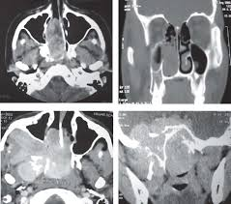
CT of Nasopharyngeal Angiofibroma

Slide 12
Treatment:
Pre-operative embolization to decrease operative bleeding .
Surgical removal through combined Moure’s lateral rhinotomy and trans palatal approach.

Slide 13
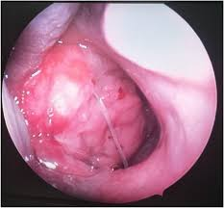
B. MALIGNANT
Squamous cell carcinoma, lymphoepithelioma and sarcoma (rare)
Usually in elderly males. Common in East country.

Slide 14
Symptoms:
Signs:
1-Nose:
a. Obstruction.
b. Nasal discharge.
c. Epistaxis.
2- Ear: Trotter’s triad:
a. Conductive hearing loss.
b. Earache.
c. Palatal paralysis.
Mass or ulcer seen by posterior rhinoscopy.
Neck mass
Serous otitis media

Slide 15
Investigation:
1-CTand MRI
2-Biobsy confirms diagnosis
3-Metastatic work up chest x ray brain CT bone scan and abdominal ultrasound.
Treatment:
radiation

Slide 16
II-Oropharynx

Slide 17
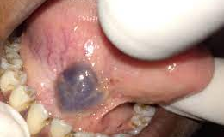
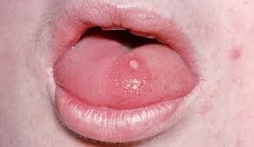
BENIGN TUMOURS
Papilloma:
  usually asymptomatic
  treatment :surgical excision
Haemangioma:
  may be capillary or cavernous.
  Treatment is diathermy coagulation or injection of sclerosing agents. Cryotherapy and laser coagulation is also effective

Slide 18
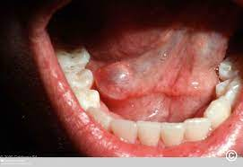
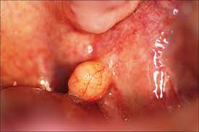
Pleomorphic adenoma: mostly seen submucosally on the hard or soft palate. It is potentially malignant and should be excised totally
Mucous cyst: usually seen in vallecula. Surgical excision is the treatment of choice in case of symptomatic cysts
Lipoma

Slide 19
MALIGNANT TUMOURS
Common sites of malignancy in oropharynx are:
  Base of tongue
  Tonsil and tonsillar fossa
  Faucial palatine arch (soft palate and anterior pillar)
  Posterior pharyngeal wall
Gross appearance:
  Superficially spreading
  Exophytic
  Ulcerative
  Infiltrative

Slide 20
Histological classification:
  Squamous cell carcinoma: may be well/moderately/poorly differentiated
  Lymphoepithelioma
  Adenocarcinoma
  Lymphomas: both Hodgkin and non- Hodgkin

Slide 21
TNM CLASSIFICATION
Primary tumor (T)
T0 No evidence of primary tumor
Tis Carcinoma in situ
T1 Tumor ≤2 cm in greatest dimension
T2 Tumor >2 cm but not more than 4cm in
greatest dimension
T3 Tumor >4 cm in greatest dimension or
extension to lingual surface of the epiglottis
T4a Moderately advanced, local disease
Tumor invades the larynx, deep/extrinsic muscle of the
tongue, medial pterygoid, hard palate, or mandible
T4b Very advanced, local disease
Tumor invades lateral pterygoid muscle, pterygoid plates,
lateral nasopharynx, or skull base or encases the carotid artery

Slide 22
Regional lymph nodes (N)
N0 No regional lymph node metastasis
N1 Metastasis in a single ipsilateral lymph node ≤3 cm in greatest
dimension
N2 Metastasis in a single ipsilateral lymph node >3 cm but not more than
6cm in greatest dimension; or in multiple ipsilateral lymph nodes, none
>6cm in greatest dimension; or in bilateral or contralateral lymph nodes,
none >6cm in greatest dimension
N2a Metastasis in a single ipsilateral lymph node >3 cm but not more than
6cm in greatest dimension
N2b Metastasis in multiple ipsilateral lymph nodes, none >6cm in greatest
dimension
N2c Metastasis in bilateral or contralateral lymph nodes, none >6 cm in
greatest dimension
N3 Metastasis in a lymph node >6cm in greatest dimension

Slide 23
Distant metastasis (M)
M0 No distant metastasis
M1 Distant metastasis
Histologic grade (G)
GX Grade cannot be assessed
G1 Well differentiated
G2 Moderately differentiated
G3 Poorly differentiated
G4 Undifferentiated

Slide 24
TREATMENT
Depends upon the site and extent of the disease,
patients general condition, experience of treating surgeon and facilities available.
Options of treatment are:
Surgery alone
Radiation alone
Surgery+radiotherapy
Chemotherapy+surgery+radiotherapy
Palliative therapy

Slide 25
Treatment
Team approach:
T1 and T2 –surgery or radiation
T3 and T4 –combined modality
surgeons and Radiation Oncologists SLP

Slide 26
III-Hypopharynx

Slide 27
1- Post-Cricoid Carcinoma
It is more prevalent in females over 40 years old
Symptoms:
1. Progressive dysphagia. 1st to solid then to fluids.
2. Hoarsness of voice and stridor due to invasion of larynx or recurrent laryngeal nerve.
3. Neck mass due to nodal metastasis.
4. Referred pain.
5. Loss of weight.

Slide 28
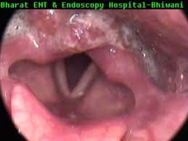
Signs:
1. Moure’s sign i.e. absence of laryngeal click.
2. Cervical lymph node usually enlarged unilateral hard fixed to deep structures
3. By indirect laryngoscopy, or rigid endoscope the tumour is seen behind the arytenoids
covered with froth. May be affection of vocal cord mobility.

Slide 29
Investigations:
1. Lateral X-ray shows widening of the tracheo-vertebral space
2. Barium swallow shows filling defect or obstruction
3. CT and MRI show extension, invasion and LN involvement.
4. Biopsy by hypopharyngoscopy.
5. Metastatic work up plain xray chest,CT brain and abdominal ultrasound.
Treatment:
- Layngo-pharyngectomy and block dissection.
Phx. is reconstructed by Myocutaneous flap,Colon

Slide 30
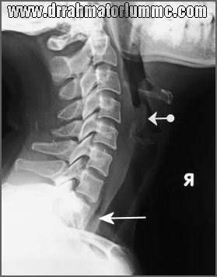
or Jujenuminterposition or Stomach pull up.
Irradiation

Slide 31
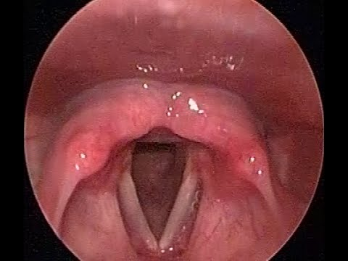
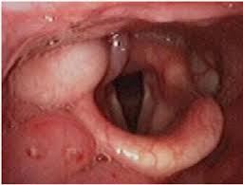
2-Cancer Pyriform Fossa
More common in elderly males 6th – 7th decade of life.
Symptoms:
Early ͢ vague throat discomfort or neck lump
Later ͢
- Progressive dysphagia to solids than to fluids (less than in PCC).
- Hoarseness of voice due to laryngeal invasion.
- Referred otalgia.

Slide 32
Signs:
1. Enlarged, hard cervical glands may be the earliest sign.
2. A pool of mucus in the pyriform fossa covering a mass or ulcer is seen by indirect laryngoscopy.
Investigation:
Same as Post Cricoid carcinoma.
Treatment:
▪ Laryngo-pharyngectomy (Glue’s operation) and block dissection.
▪ Irradiation before and after the operation.

Slide 33
Hypopharynx:
Primary tumor (T)
T0 No evidence of primary tumor
Tis Carcinoma in situ
T1 Tumor limited to 1 subsite of the hypopharynx and/or ≤2cm in greatest
dimension
T2 Tumor invades more than 1 subsite of the hypopharynx or an adjacent
site or measures >2 cm but not more than 4 cm in greatest dimension,
without fixation of the hemilarynx
T3 Tumor >4 cm in greatest dimension or with fixation of the hemilarynx or
extension to the esophagus
T4a Moderately advanced, local disease
Tumor invades thyroid/cricoid cartilage, hyoid bone, or
central compartment soft tissue (including prelaryngeal strap muscles
and subcutaneous fat)
T4b Very advanced, local disease
Tumor invades prevertebral fascia, encases carotid artery, or involves
mediastinal structures

Slide 34
Tumors Of The Larynx

Slide 35
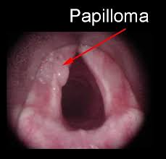
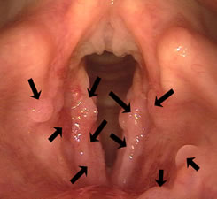
A.Benign
1-Epithelial:
Papilloma.
2-Connective Tissue:
Fibroma and angioma.
Squamous cell papilloma
It is single in adults and multiple in children.

Slide 36
In adults | In children
Single and true neoplasm. | Multiple, viral or hormonal.
Causes hoarseness, rarely obstruction. | Causes stridor and hoarseness.
Exclusively cordal in anterior 1/2. | Multiple, affecting any part of the larynx.
Removal by direct laryngoscopy and if big,through laryngofissure | Repeated removal by direct laryngoscopy,microsurgery and cryosurgery
No tracheostomy. | Tracheostomy, close it after removal each time (larynx grows normal)
No recurrence. | Recurs rapidly till puberty.
May turn malignant. | Does not -turn malignant.

Slide 37
B.Malignant Tumours
Usually squamous cell carcinoma.
Predisposing Factors:
1. Leucoplakia.
2. Papilloma in adults.
Age: Over 40.
Sex: Males are more affected than females by 10: 1.
Types:
1. Glottic (on the cords) 70%.
2. Supraglottic 20%.
3. Subglottic 10%.

Slide 38
Symptoms:
1. Hoarseness appears early in cordal carcinoma, late in other types.
2. Dyspnoea and stridor early in subglottic carcinoma
3. Discomfort in the throat early in supraglottic carcinoma
4. Late pain due to invasion and perichondritis
5. Dysphagia indicates infiltration of pharynx
6. Haemoptysis. Weight loss and neck swelling as late symptoms
7. Referred pain to the ear.

Slide 39
Sign:
1-laryngeal examination may shoes
a) Bilateral fungating mass in supraglottic tumors.
b) Unilateral thickening or roughness of vocal cords later on cauliflower mass in glottic tumor.
c) Bilateral ulcerofungating mass in subglottic tumor.
d) Fixation of vocal cords and tenderness of larynx due to perichondritis or its invasion.
2-Enlarged cervical glands and broadening of larynx

Slide 40
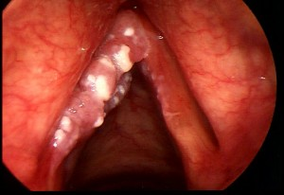
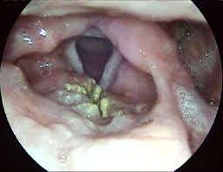
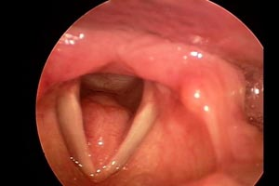
glottic carcinoma
supraglottic carcinoma
subglottic carcinoma

Slide 41
Investigations:
1-CT or MRI evaluate
a- Tumor limits
b- Cartilage invasion
c- extralaryngeal spread
d- LN involvement
2-Direct Laryngoscopy under general anesthesia to map tumor and get biopsy
3-laboratory
a) Test to exclude syphilis and sputum to exclude TB
b) C.B.C, renal and liver functions as preoperative investigations

Slide 42
Classification and Staging:
Primary Tumor:
Lymph nodes (N):
T1 | Tumor limited to one site with normal vocal cord mobility.
T2 | Tumor extending to more than one site with normal vocal cord mobility.
T3 | Tumor limited to larynx with vocal cord fixation.
T4 | Tumor extending beyond the larynx.
N0 | No clinically positive nodes.
N1 | Single clinically positive ipsilateral node 3 cm or less in diameter.
N2 | Single clinically posi􀀤ve node more than 3 cm but less than 6 cm in diameter.
N3 | Massive ipsilateral nodes (>6cm), bilateral or contralateral nodes.

Slide 43
Distant metastasis (M):
Treatment:
1- Limited excision with a safety margin through laryngofissure. (In T1 and T2)
2-Total laryngectomy: T3 and T4
If the cords fixed or if there is extension outside the cord to:
I. Anteror commissure
II. Atytenoids
III. Subglottic
IV. Supraglottic
M0 | No evidence of distant metastasis.
M1 | Tumour with distant metastasis.

Slide 44
3- Total excision and block dissection of the cervical lymph glands:
If the cervical lymph glands are palpable.
4- Radiotherapy (5500 rads):T1 and T2
In early cordal cancer and in late cases.
5- Inoperable Cases:
Extensive infiltration or distant metastasis.
a. Radiotherapy.
b. Cytotoxic drugs.
c. Sedatives as morphine.
d. Tracheostomy when indicated.
e. Gastrostomy for dysphagia.

