Slide 1

Antenatal & Postnatal Depression & Anxiety
Dr Mona Ahmed
Assistant professor OBG
SMSB

Slide 2

Depression
Definition:
Persistent low mood or loss of interest ≥2 weeks.
Risk Factors:
Past psychiatric illness
Lack of social support
Marital/family conflict
Unplanned/unwanted pregnancy
Medical complications

Slide 3
Anxiety
Definition:
Excessive worry, fear, or nervousness interfering with daily life.
Types:
GAD, panic disorder, phobias, OCD.
Risk Factors:
Previous anxiety disorder
Stressful life events
Family history
Lack of support

Slide 4
Screening Tools
Depression: EPDS, PHQ-9
Anxiety: GAD-2 → if ≥3 → GAD-7
Screen at every antenatal
& postnatal visit

Slide 5
Management – General Principles
Non-pharmacological:
Psychoeducation & counseling
CBT, interpersonal therapy
Support groups
Pharmacological (if severe):
Antidepressants (SSRIs)
Anxiolytics (avoid benzodiazepines in pregnancy)

Slide 6
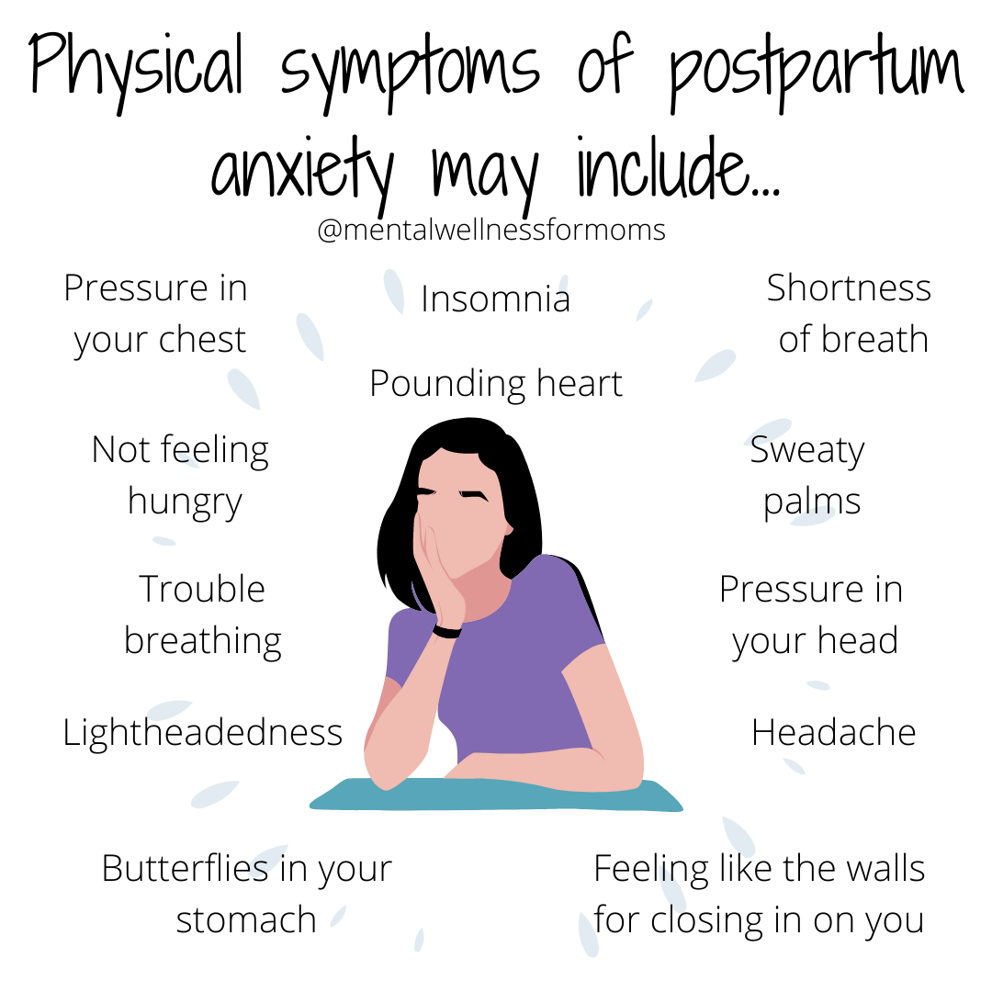

Slide 7
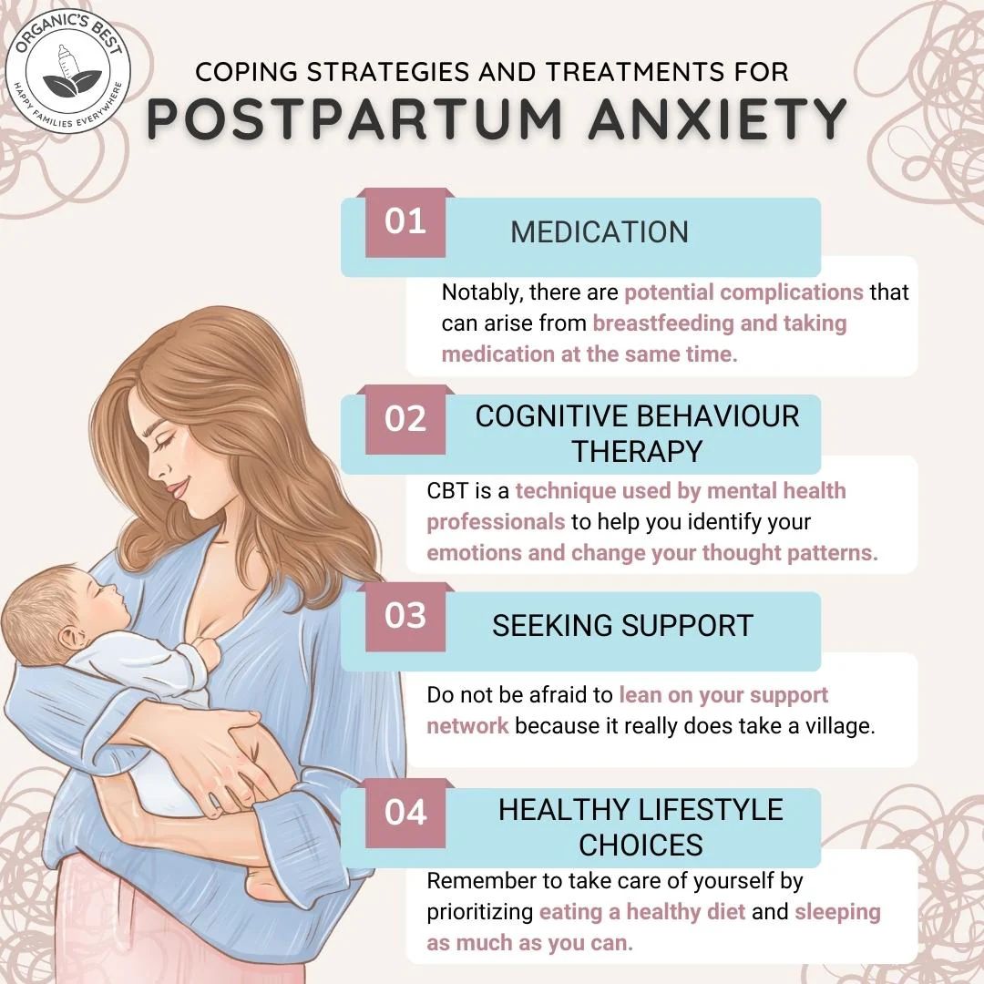

Slide 8
Key Takeaways
Depression & anxiety are common in perinatal period
Early screening is essential
Use stepwise care (mild → severe)

Slide 9


