Slide 1


Breast changes & Lactation
Dr. Rayan Albarakati MBBs, SB-OB
Majmaah University
Assistant professor

Slide 2
Objectives
Identify the normal physiologic & anatomic changes of breasts during
pregnancy and postpartum.
Define colostrum
Describe the differences between colostrum and human breast milk
Describe how to treat common postpartum abnormalities of the breast
Identify the advantages of breast-feeding.
Describe common challenges in the initiation and maintenance of lactation.

Slide 3
physiologic & anatomic changes of breast
The breasts gland, tissue and nipples increase in size, areola color darkens and some veins under skin might become visible
Estrogen, progesterone, human chorionic gonadotropin, cortisol, insulin, prolactin, and placental lactogen, all play an important role in preparing the breasts for lactation.

Slide 4
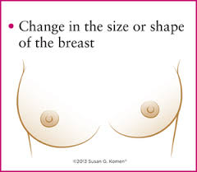
Anatomical changes
BREAST
NIPPLES
Hypertrophy(asymmetrical)
Stretch marks
Sore or tender
Visible veins
Lumps & bumps
Points downwards
Darkens
widens
Montgomery tubercles hypertrophy
Pronounced & elongated
Leaks

Slide 5
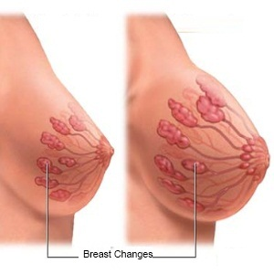
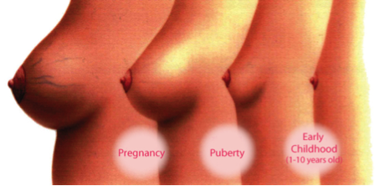
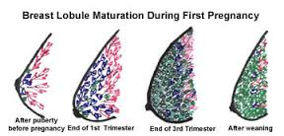
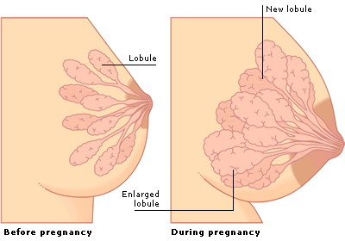

Slide 6
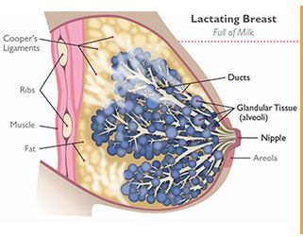
Physiologic changes
Estrogen and progesterone prepare breasts to make milk. *released by the placenta during pregnancy.
They have two major roles:
1. They increase the size and number of milk ducts
2.They suppress the body from making large amounts of breast milk until after baby is born.
*Once baby is born and the placenta is delivered, these hormones decrease.
**This decrease signals body that it is time to make milk

Slide 7
Prolactin helps breasts make milk.
After the birth, prolactin levels increase.
With suckling prolactin is released .
With each release, the body produce and stores more milk in the breast alveoli.
If the level of this hormone gets too low, milk supply will decrease.
*This is why it is important to breastfeed or pump right after delivery and then at regular time frames.

Slide 8
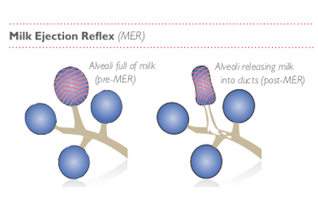
Oxytocin
releases milk from breasts.
Suckling releases this hormone. This release causes milk to be squeezed out of the alveoli, into the ducts and out
This process is called Milk Ejection Reflex (MER).

Slide 9
At delivery, two events are essential in initiating lactation:
1. A drop in placental hormones, particularly estrogen.
2. Suckling stimulates the release of prolactin and oxytocin.
* Oxytocin causes contraction of the myoepithelial cells in the alveoli and milk ducts(ejection).
** Prolactin promotes the production of milk in breast alveoli

Slide 10
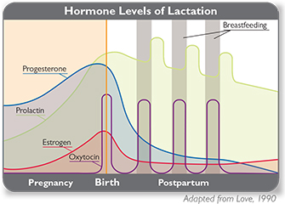

Slide 11
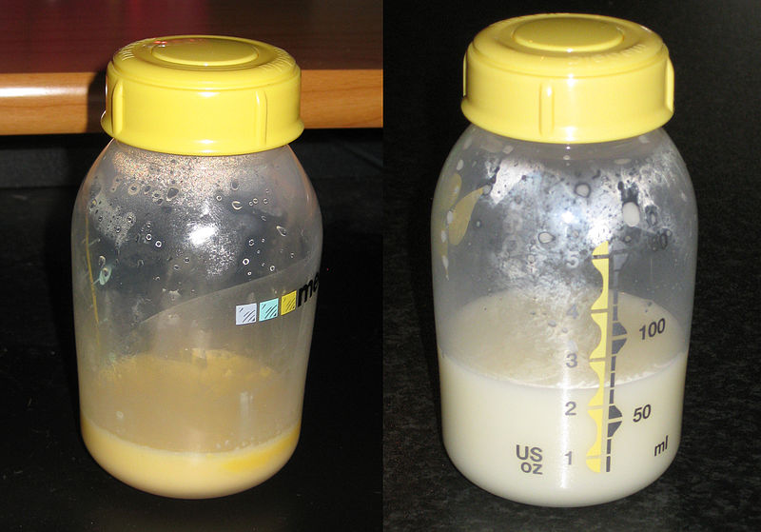
Colostrum definition
A form of milk which is the first secretion from the mammary glands after giving birth, rich in antibodies, and yellowish in color

Slide 12
Colostrum & Breast milk
Colostrum is secreted 2nd day after delivery for 3 -6 days
It is the colostrum that contains secretory IgA.
The major components of breast milk are proteins, lactose, water, minerals and fat.
The major proteins synthesized exclusively in human breast milk, are casein, lactalbumin, and ß-lactoglobulin

Slide 13
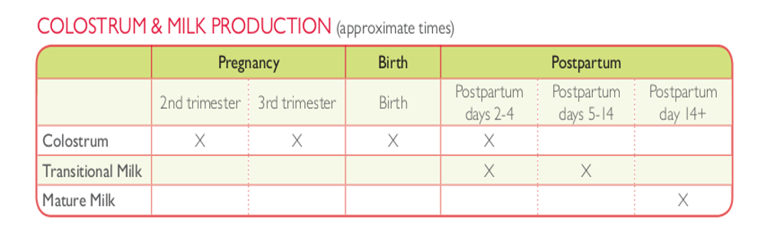

Slide 14
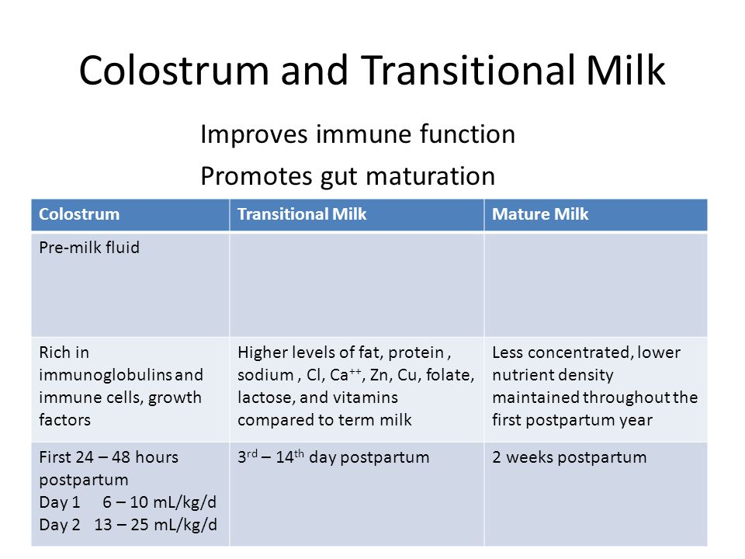

Slide 15
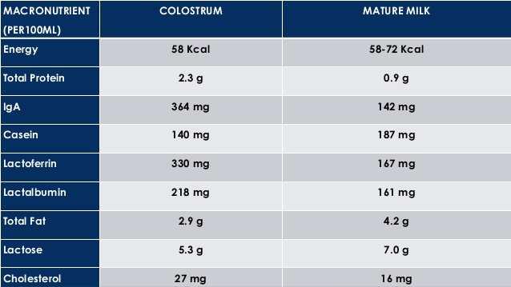
Comparison of Breast Milk contents

Slide 16
Advantages of Breastfeeding
There are many advantages to breastfeeding:
1. Breast milk is the ideal food for the newborn, is inexpensive, and is usually in good supply.
2.It provides the newborn with passive immunity (secretory immunoglobulin A and maternal lymphocytes)
3. It accelerates the involution of the uterus because suckling stimulates the release of oxytocin
4. Emotional Bonding between the mom and the new born

Slide 17
Challenges of initiation and maintaining breast feeding :
No Milk is coming
Baby in NICU
Mother uses certain medications
Mother is working and not with the baby all the time
breast pain
cosmetic reasons

Slide 18
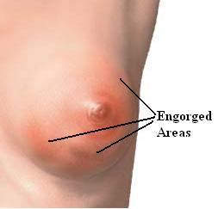
Common post partum breast complications & management:
Engorgement & Pain (most common)
Cracked nipples
Mastitis
Galactocele or Plugged ducts
Breast abscess (0.5%)

Slide 19
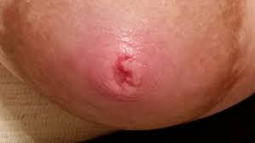
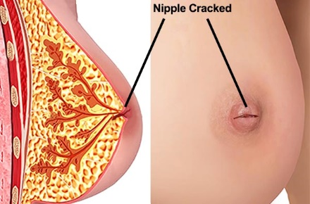
Cracked Nipple

Slide 20
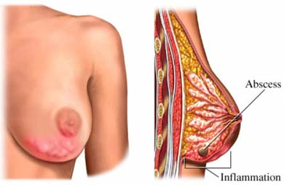
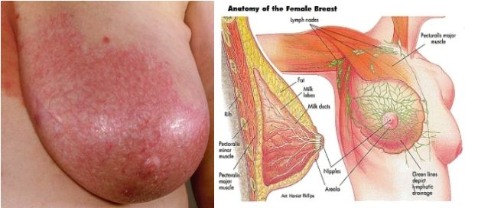

Slide 21
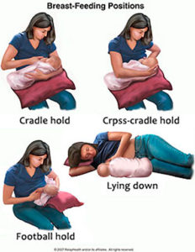
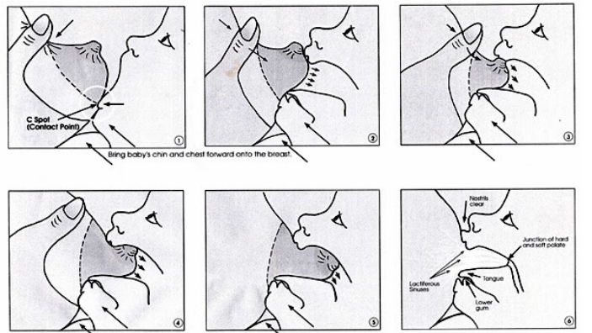
The Right technique for breast feeding

Slide 22
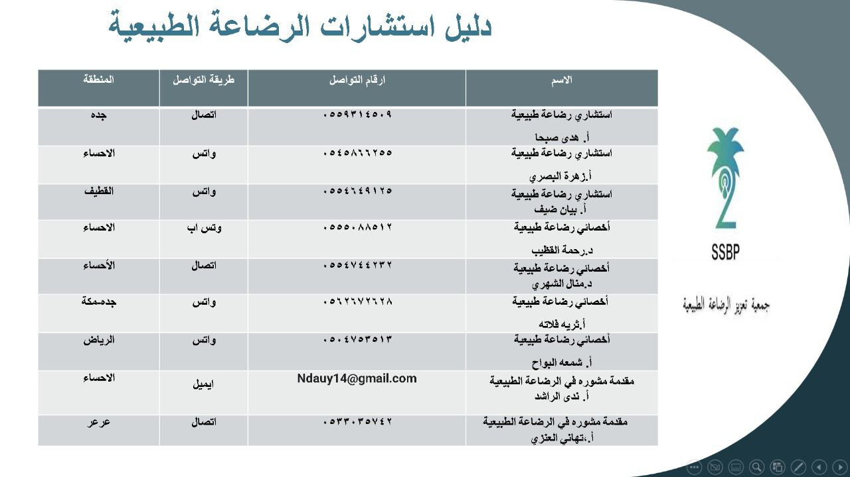
Directory for societies and agencies supporting breast feeding
Link to electronic form requesting virtual clinic appointment for breast feeding support
https://forms.gle/3PVditEDFv9uYMgD7

Slide 23
THANK YOU

