Slide 1
CESAREAN SECTION

Slide 2
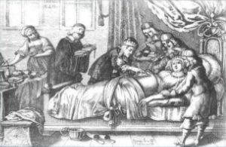
History
According to legend, Julius Caesar was born by this operation and hence the origin of the term caesarean. ???
Most important modification was the lower segment transverse incision. First done by kehrer and popularized by Munro Kerr

Slide 3
DEFINITIONS
Cesarean delivery is defined as the delivery of a fetus through surgical incisions made through the abdominal wall (laparotomy) and the uterine wall
Hysterotomy, the surgical removal of the uterine contents (either viable or non viable fetus), may be used during the second trimester or later ( lower uterine segment not well formed ) .It can be performed for various reasons including preterm caesarian section, foetal surgery, delayed abortion.

Slide 4
Indications:
Fetal indications :
Nonreassuring FHT
(malpresentation/malposition)
Fetal anomalies, such as hydrocephalus, that would make successful vaginal delivery unlikely
Umbilical cord prolapse
Conjoined twins
Maternal indications :
Obstruction of the lower genital tract (e.g., large condyloma)
Previous cesarean section (if vaginal birth after cesarean [VBAC] is declined by patient or not appropriate)
Previous uterine surgery involving the contractile portion of the uterus (i.e., classical cesarean, transmural myomectomy)
failed forceps or vacuum/ failed induction .
History of severe pelvic floor injury from a prior vaginal delivery
Abdominal cerclage
Medical disorders e.g.-preeclampsia and eclampsia .coarctation of aorta

Slide 5
Indications :
Maternal and fetal indications:
Abruptio placentae
Active maternal herpes simplex virus infection
Labor dystocia (slow or Faliure to progress) or cephalopelvic disproportion
Placenta previa or known vasa previa (absolute indication)

Slide 6
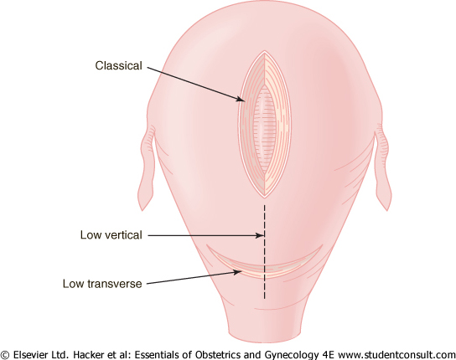
CAESARAEAN SECTION -TYPES
Lower Segment Caeserean Section(LSCS):
Most commonly type
Lower segment vertical incision
Classical CS
Caeserean hysterectomy

Slide 7
Classical Caesarean section
Classical Caesarean section :Uterine incision –on the anterior uterine wall in the upper segment.
Indications : rarely performed :
• Lower segment is unapproachable due to severe adhesions or myomas
• Ca cervix
• Some cases of anterior placenta praevia with a previous caeserean
• Some cases of transverse lie (back down )
• Conjoined twins
Post-mortem C-Section
Poorly developed lower uterine segment (eg, extremely preterm breech presentation)
Disadvantages
• Chance of scar rupture more
• General peritonitis ,if infection occurs

Slide 8
Caesarean Hysterectomy
Life saving measure
Indications :
• Severe atonic PPH
• Placenta accreta , increta, percreta
• Severe sepsis
• Multiple large myomas
• Carcinoma in situ of the cervix

Slide 9
Anesthesia in C-SECTION
Anesthesia for c-section
G.A
Spinal
Epidural
Antibiotic prophylaxis : should be given 1 hour before skin incision ( single dose of cefazoline)

Slide 10
Complications of C.Section
Complications of anesthesia
Complications of operation-
1-Maternal
Intra operative
hemorrhage, visceral injuries and infection
Immediate post operative
chest infection. Urinary retention, UTI. wound infection
Remote
Rupture of scar in next pregnancy, adhesions ,Gut obstruction from adhesion formation (specially repeated),Incisional hernia
2-Fetal :Risks of anesthesia /Iatrogenic prematurity of baby

Slide 11
How to reduce c.section rate
External cephalic version (ECV) SUCCESS RATE 60 %
Vaginal birth after c-section (VBAC ) SUCCESS RATE 70 %

Slide 12
VAGINAL BIRTH AFTER CESAREAN SECTION (VBAC)
Provided there are no contraindications to vaginal delivery, a patient may be counseled and offered a trial of labor after previous cesarean delivery (TOLAC).
Success rates of VBAC are higher for patients with nonrecurring conditions, such as malpresentation or fetal distress in labor (60% to 85%), than for those with a prior diagnosis of dystocia (15% to 30%).
Patients should be counseled regarding the risk of uterine rupture (0.9% to 3.7%), failed trial of labor, and need for cesarean delivery.
Contraindications include
previous classical or inverted T-shaped uterine incision
transfundal uterine surgery
history of uterine rupture, contracted pelvis
medical or obstetric contraindications to vaginal delivery (e.g transverse lie , PP).

Slide 13
VAGINAL BIRTH AFTER CESAREAN SECTION (VBAC)
Induction of labor in not contraindicated .
A clear recommendation for or against prostaglandin E2 for labor induction is difficult to make because of limited data (to use it or not depend on your hospital policy) .
Someone with a history of two prior C-sections may consider a TOLAC, depending on prior indications, although some providers may choose not to offer it.
Macrosomia should not be considered a contraindication to TOLAC.
Patients with twin gestations and one previous cesarean delivery are candidates for TOLAC.

Slide 14
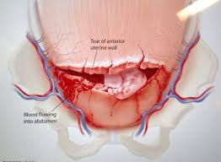
UTERINE DEHISCENCE OR RUPTURE
Dehiscence is defined as lower uterine scar separation that does not breach the serosa; it rarely causes significant bleeding.
Rupture is defined as complete separation of the uterine wall and may lead to fetal distress and significant maternal hemorrhage.
Incidence:
0.2% to 1.8% of patients with one or more previous low-segment transverse cesarean sections
4% to 9% of patients with a prior uterine active segment incision (classical cesarean or T-incision).

Slide 15
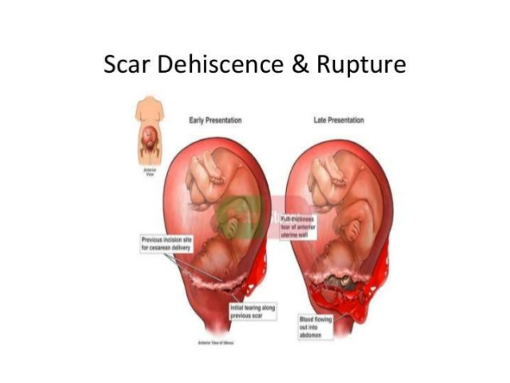

Slide 16
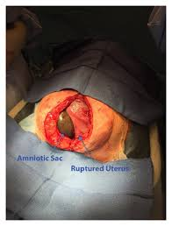
Diagnosis
Fetal bradycardia is clinically manifested in 33% to 70% of cases. Fetal distress may be the initial and common presentation in uterine rupture.
In more subtle cases, the initial presentation may be a simple rise in fetal station .
Maternal signs and symptoms include hypotension, tachycardia vaginal bleeding , uterine tenderness, a change in uterine shape, or constant abdominal pain
Management
When uterine rupture is suspected, it is important to proceed emergently to laparotomy with delivery of the infant and repair of the uterine rupture.
Rates of recurrent rupture in subsequent pregnancies carried to term approach 22%. Recommendations are for early delivery via cesarean section by 36 weeks.

Slide 17


Slide 18
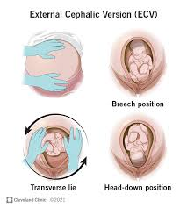
ECV
At 36 -37 weeks.
Make sure that
there is no fetal anomaly
and the placenta is not low lying
and liquor is adequate.
By doing US (or revising anomaly scan)
Then do the procedure
under ultrasound guidance
and after giving tocolytics (to relax the uterus).
Hold the head by one hand and buttocks by other hand
then turn the baby gently
procedure can be done with or without assistant

