Slide 1
‪CTG Interpretation
Dr.Bodoor Alshareef

Slide 2
DR C BRAVADO
Determine Risk
Contraction
Baseline Rate
Variability
Acceleration
Deceleration
Overall assessment

Slide 3
Uterine contractions
Uterine contractions are quantified as the number of contractions present in a 10-minute window, averaged over a 30-minute period.
Normal: five contractions or less in 10 minutes, averaged over a 30-minute window
Tachysystole: more than five contractions in 10 minutes, averaged over a 30-minute window

Slide 4
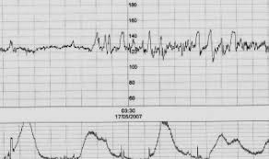

Slide 5
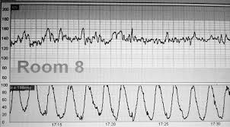
Tachysystole

Slide 6
Electronic Fetal Monitoring Definitions
Baseline
• Normal FHR baseline: 110–160 beats per minute
• Tachycardia: FHR baseline is greater than 160 beats per minute for >10 min
• Bradycardia: FHR baseline is less than 110 beats per minute for >10 minute

Slide 7
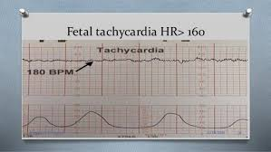

Slide 8
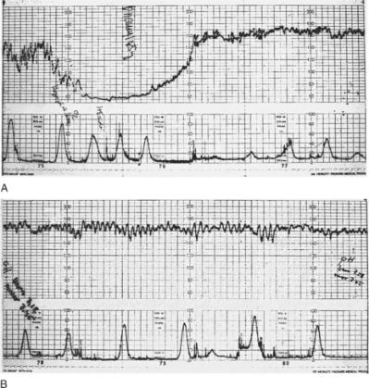
Bradycardia

Slide 9
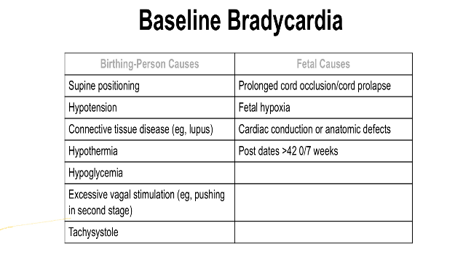

Slide 10
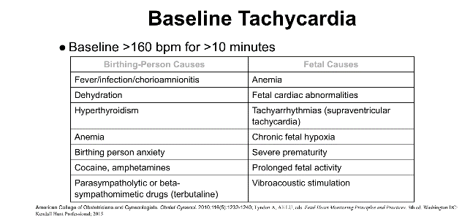

Slide 11
Baseline variability
Minor Fluctuations in the baseline FHR that are irregular in amplitude and frequency
It is assessed by by estimating the difference in bpm between the highest peak and lowest trough of fluctuation in one minute segment of trace .
Moderate variability amplitude range 5–25 beats per minute .
Minimal variability less than 5bpm.
Marked variability more than 25bpm.
Absent .

Slide 12
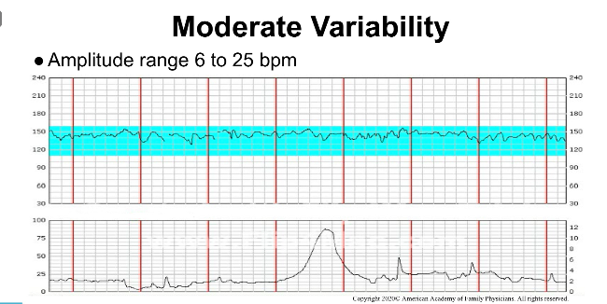

Slide 13
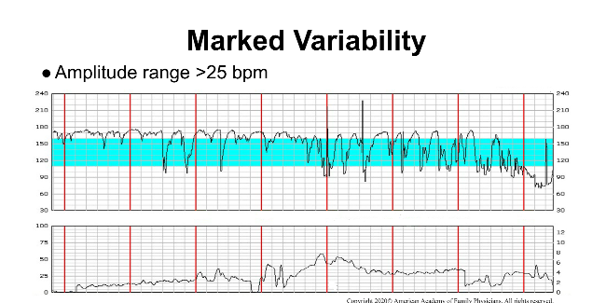

Slide 14
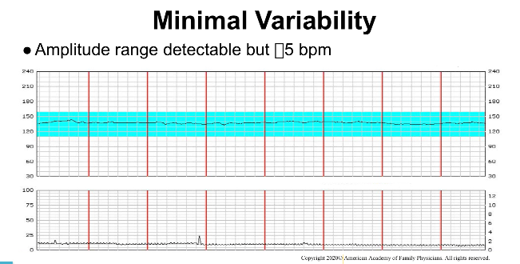

Slide 15
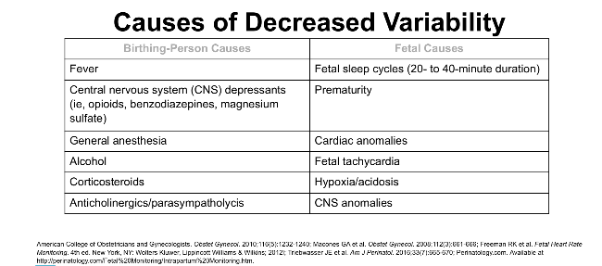

Slide 16
Acceleration
Abrupt increase in the FHR
At 32 weeks of gestation and beyond, an acceleration has a peak of 15 beats per minute or more above baseline, with a duration of 15 seconds or more.

Slide 17
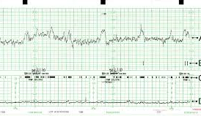

Slide 18
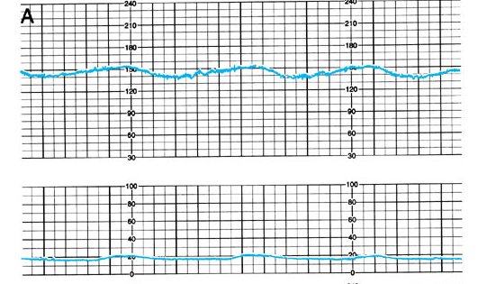
Non-Reactive NST

Slide 19
Decelerations
transient slowing of FHR below the baseline level of more than 15 bpm and lasting for 15 sec Or more.

Slide 20
Early deceleration
(head compression)
• Visually apparent usually symmetrical gradual decrease and return of the FHR associated with a uterine contraction .
• A gradual FHR decrease is defined as from the onset to the FHR nadir of 30 seconds or more.

Slide 21
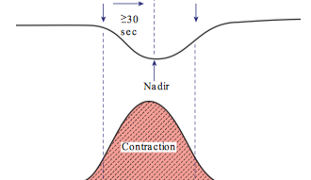
Early deceleration

Slide 22
Late deceleration
Visually apparent usually symmetrical gradual decrease with return to baseline
Onset to nadir >30 second
The onset, nadir, and recovery of the deceleration occur after the beginning, peak, and ending of the contraction, respectively.

Slide 23
Late Decelerations
  Due to uteroplacental insufficiency
  Common in patients with PIH, DM, IUGR or other form of placental insufficiency.
  Reduces Baseline variability together with Late Decelerations or Variable Decelerations is associated with increased risk of CP.

Slide 24
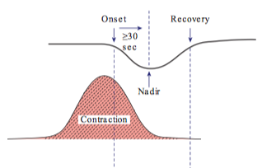
Late deceleration

Slide 25
Variable deceleration
Vary in duration , intensity and relation to uterine contractions,
Visually apparent abrupt decrease in FHR
Onset to nadir <30 second
Decrease in FHR is 15 bpm or more lasting for 15 second but less than 2 minute .
Caused by cord compression

Slide 26
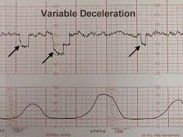

Slide 27
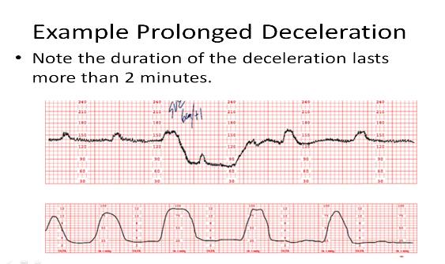
Prolonged deceleration
Any deceleration 15 bpm or more below the baseline that last 2 minute or more but less than 10 minute

Slide 28
Sinusoidal Pattern
Visually apparent, smooth, wave-like above and below FHR baseline with a cycle frequency of 3–5 per minute
when persists for 20 minutes or more. (Role out narcotic induced)
Causes: fetal anaemia ( Rh isoimmunisation, fetal haemorrhage)

Slide 29
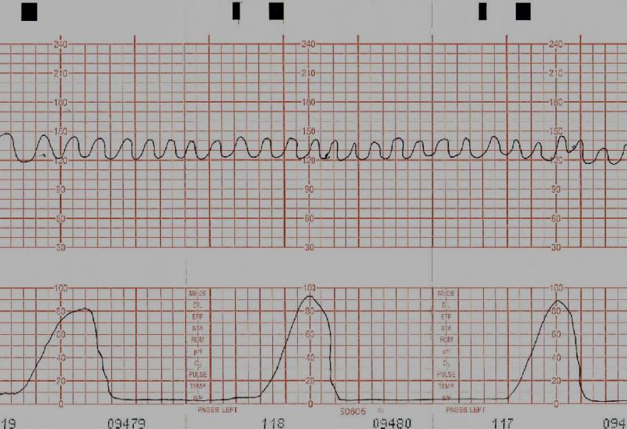

Slide 30
O-overall assessment
Category 1 – no risk
Category II – intermediate risk
Category III – HIGH RISK

Slide 31
Category I
Include all of the following:
-Baseline rate:110–160 beats/minute
-Baseline FHR variability: moderate
-Late or variable decelerations: absent
-Early decelerations: present or absent
- Accelerations: present or absent

Slide 33
Category II
FHR tracings include any of the following: Tachycardia
Baseline FHR with Absent or minimal or marked variability.
Absence induced Accelerations after fetal stimulation
Recurrent (late or variable) decelerations with moderate variability

Slide 34
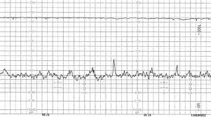
Category II

Slide 35
Category III
Category III FHR tracings include either
  Absent baseline FHR variability and any of the following:
  Recurrent late decelerations
  Recurrent variable decelerations
  Bradycardia
  Sinusoidal pattern

Slide 36
Management
CTG is normal/ reassuring/category 1
- Healthy fetus
--- Continue CTG and normal care.

Slide 37
non- reassuring/category 2
Think about possible underlying causes.
If the baseline fetal heart rate is over 160 beats/minute, check the woman’s temperature and pulse. If either are raised, offer fluids and paracetamol.
Noninvasive Management
a left-lateral position, rule out cord prolapse
Give O2 to mother
offer oral or intravenous fluids
Discontinue oxytocin until the FHR and uterine activity become normal.
Vibroacoustic stimulation (VAS) or fetal scalp stimulation (if reduce variability and or no acceleration)
Tocolytic agents: Beta-adrenergic agonists (e.g., terbutaline, subcutaneously can be administered g to decrease uterine activity in the presence of uterine tachysystole.
Inform coordinating midwife and obstetrician.

Slide 38
non- reassuring/category 2
Invasive Management
Amniotomy: If the FHR cannot be monitored adequately externally, an amniotomy should be performed to place internal monitors.
Fetal scalp electrode (FSE).
(contraindicated in cases of fetal coagulopathy or maternal infections such as HIV, active herpes simplex virus, and hepatitis B or C).

Slide 39
Fetal scalp blood pH: Determination of fetal scalp blood pH can clarify the acid-base state of the fetus.
-A pH value of 7.25 or higher is normal.
-A pH range of 7.20 to 7.24 is a borderline repeat in 30 minute .
-A pH of <7.20 on two measurements 5 to 10 minutes apart may indicate sufficient fetal acidosis to warrant immediate delivery

Slide 40
category 3 is abnormal indicates need for urgent intervention

Slide 41
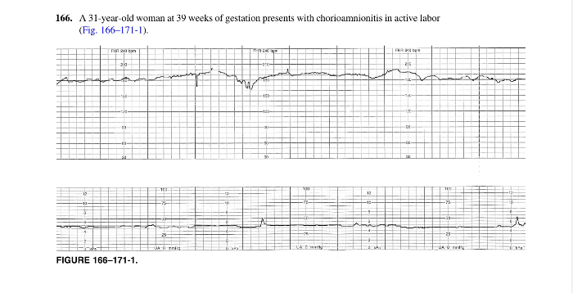

Slide 42
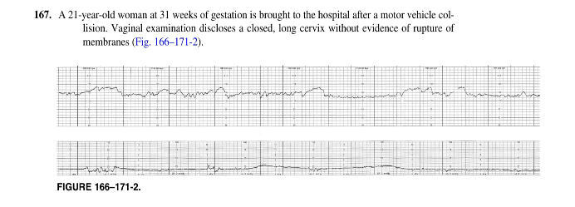

Slide 43
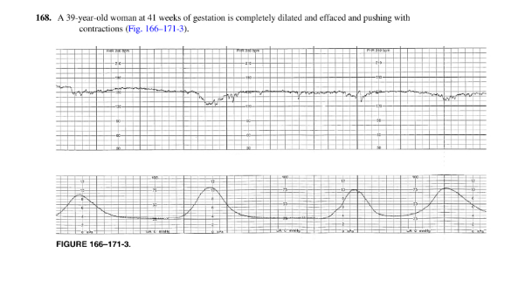

Slide 44
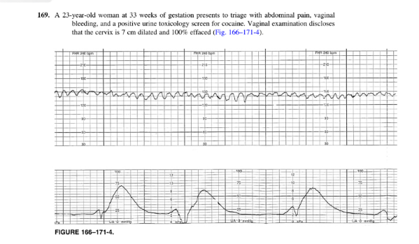

Slide 45
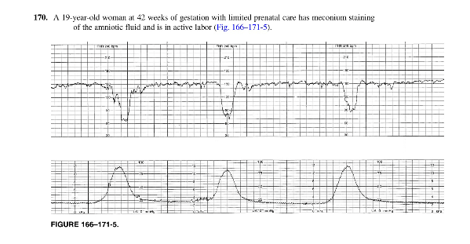

Slide 46
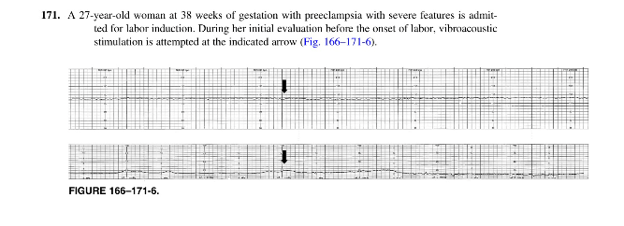

Slide 47
Thank you

