Slide 1

Gynaecologic cancers
Presented by
Dr Mona Ahmed
Associated Professor
SMSB

Slide 2
Outline
• Ovarian cancer
• Uterine (endometrial) cancer
• Cervical cancer
• Vulvar cancer
• Vaginal cancer

Slide 3



Ovarian cancer
Ovarian cancer is
cancer that forms in the tissue of the ovary and it Called
“the overlooked disease” or “the silent killer”

Slide 4
Epidemiology
Ovarian cancer is the second most common gynaecological cancer after uterine cancer.
It causes more deaths than any other gynaecological cancer.
Older women are at highest risk (frequently in women between 55 and 75 years of age).
•75%will survive one year and about 25% will survive 5 years after treatment.

Slide 5
Pathophysiology
Ovarian cancer, the cause of which is unknown, can originate from different cell types.
Most ovarian cancers originate in the ovarian epithelium.
They usually present as solid masses that have spread beyond the ovary.

Slide 6
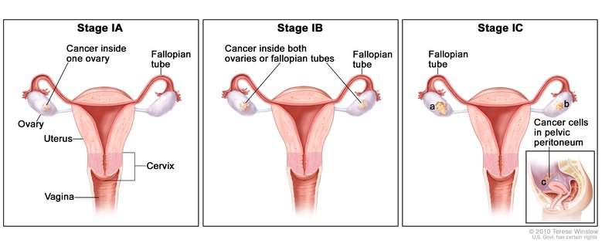
Stages :
In stage 1 the cancer is limited to the ovaries.
In stage 2 the growth involves one or both
ovaries, with pelvic extension.
Stage 3 cancer has spread to the lymph nodes and other organs or structures inside the abdominal cavity.
In stage 4, the cancer has metastasized to distant sites

Slide 7
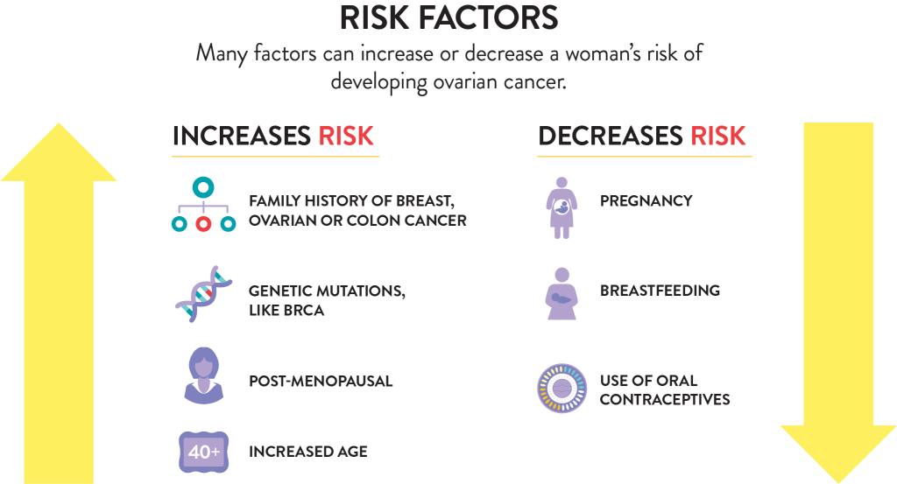
Risk factors
Nulliparity
Early menarche (before 12 years old)
Late menopause (after 55 years old)
Increasing age (over 50 years of age)
High-fat diet
Obesity
Persistent ovulation over time
First-degree relative with ovarian cancer

Slide 8
Inherited.
Older than 30 years at first pregnancy.
Positive BRCA-1 and BRCA-2 mutations.
Personal history of breast, bladder, or colon cancer.
Hormone replacement therapy for more than 10 years.
Infertility.

Slide 9

Clinical manifestation
Pelvic discomfort or pain
Persistent indigestion, gas, or nausea
Abdominal pressure, swelling, or bloating
Urinary urgency or burning with no infection
Changes in menstruation.
fatigue
Vague abdominal pain
diarrhoea or constipation
unexplained weight loss or gain
ascites
a palpable abdominal mass
back pain

Slide 10
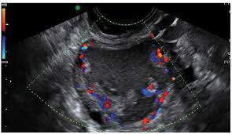

Assessment
History
Physical examination
Investigation:-
Ultrasound: Low positive predictive value for cancer
Tumour markers

Slide 11
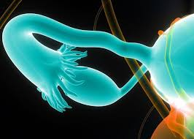

Treatment
There are many different kinds of treatments available, depends on certain factors, like:
The stage and size of the tumours
Age
General health
Desire to have kids
Surgery
Chemotherapy
Radiation Therapy: The main goal is to reduce pain symptoms
Biotherapy/Immunotherapy

Slide 12

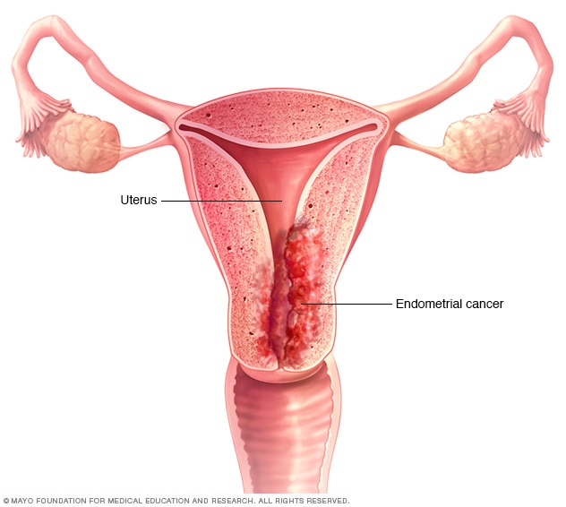

Endometrial cancer
Endometrial cancer also known as (uterine cancer) is malignant neoplastic growth of the uterine lining.

Slide 13
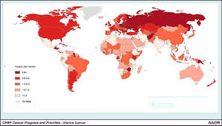


Epidemiology
Approximately 95% of these malignancies
are carcinomas of the endometrium.
Most common in women > age 50 years.
75% of uterine cancers occur in postmenopausal women.
Incidence is highly dependent on age.

Slide 14
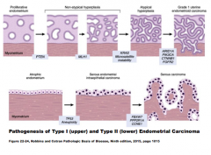
Pathophysiology
Endometrial cancer may originate in a polyp or in a diffuse multifocal pattern.
The pattern of spread partially depends on the degree of cellular differentiation.
Early tumour growth is characterized by friable and spontaneous bleeding.
Later tumour growth is characterized by growth toward the cervix

Slide 15
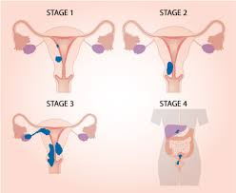
Stages
In stage 1, it has spread to the muscle wall of the uterus.
In stage 2, it has spread to the cervix.
In stage 3, it has spread to the bowel or vagina, with metastases to pelvic lymph nodes.
In stage 4, it has invaded the bladder mucosa with distant metastases to the lungs , inguinal, supraclavicular nodes, liver, and bone

Slide 16
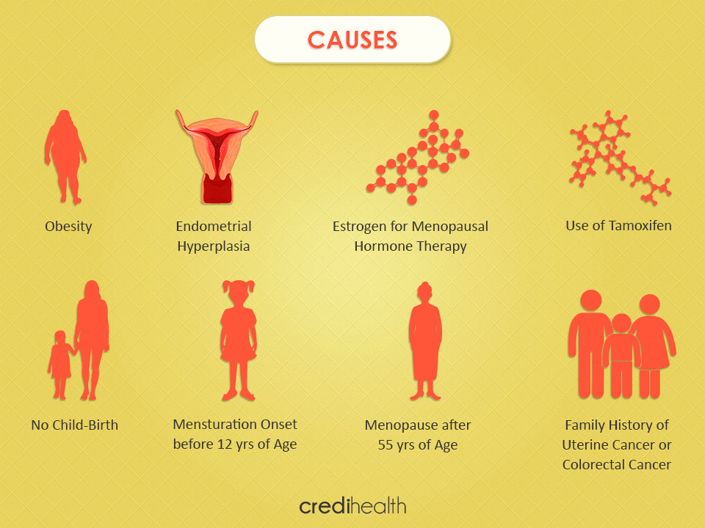
Causes &risk factor
Early Menarche less than 12 year
Late Menopause more than 52
Infertility
Obesity
Treatment with tamoxifen for breast cancer
Oestrogen replacement therapy ( ERT ) after menopause
Diet high in animal fat
DM
Age greater than 40
Family history of endometrial cancer or hereditary nonpolyposis colon cancer ( HNPCC)
Personal history of breast cancer
Prior radiation therapy for pelvic cancer

Slide 17
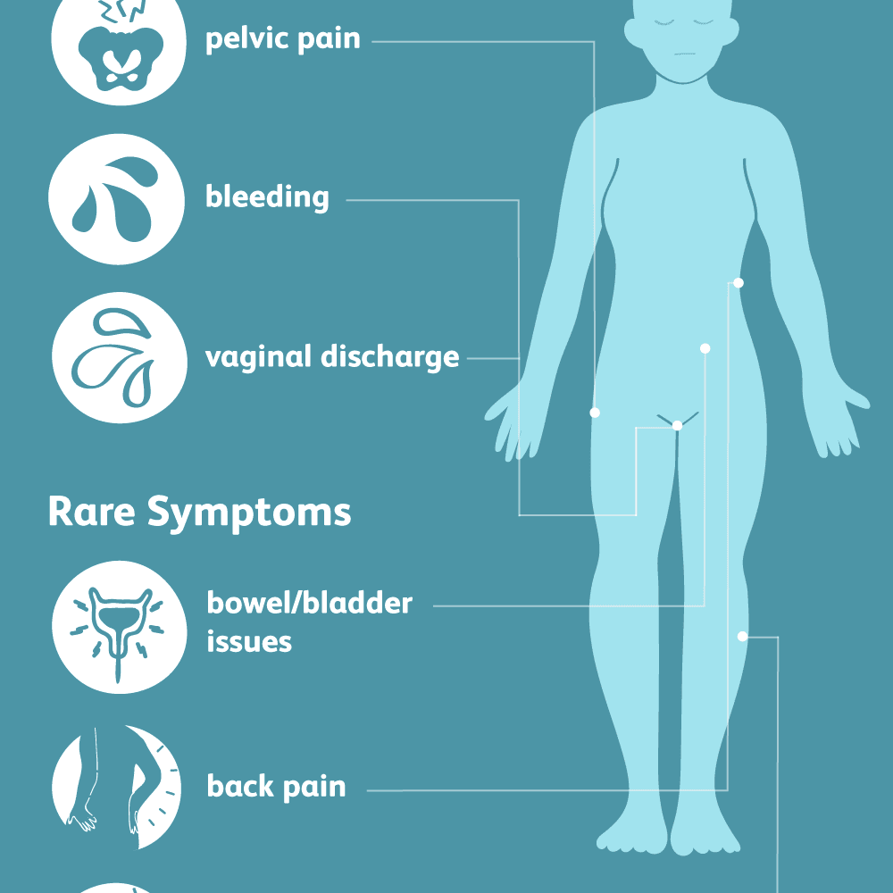
Clinical manifestation
Dyspareunia
Low back pain
Purulent genital discharge
Dysuria
Pelvic pain
Weight loss
A change in bladder and bowel habits

Slide 18
Assessment
History .
Physical examination
Investigation:
A pelvic examination is frequently normal in the early stages of the disease.
Changes in the size, shape, or consistency of the uterus or its surrounding support structures may exist when the disease is more advanced

Slide 19
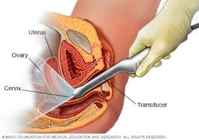
investigation:
Pap Smear
Only 30-50% patients with cancer will have an abnormal result
Endometrial Biopsy
Transvaginal Ultrasound
Fractional Dilation and Curettage
Use in cases of cervical stenosis, patient
intolerance to exam, recurrent bleeding after negative biopsy

Slide 20



Endometrial Carcinoma Treatment
Surgery is the mainstay of treatment followed by
Adjuvant radiation and/or chemotherapy based on stage of disease.
Primary radiotherapy or hormonal therapy may be employed in patients who have contraindications to surgery.

Slide 21


Cervical cancer
Cervical cancer is cancer of the uterine cervix.

Slide 22
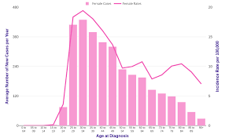

Epidemiology
Cervical cancer is the fourth most common cancer in women.
In 2018, an estimated 570 000 women were diagnosed with cervical cancer worldwide
about 311 000 women died from the disease.
Effective primary (HPV vaccination) and secondary prevention approaches (screening for, and treating precancerous lesions) will prevent most cervical cancer cases.

Slide 23
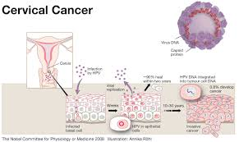
Pathophysiology
Cervical cancer starts with abnormal changes in the cellular lining of the cervix.
Typically these changes occur in the squamous–columnar junction of the cervix.
Here, columnar epithelial cells meet the protective flat squamous epithelial cells from the outer cervix and vagina in what is termed the transformation zone.
The continuous replacement of columnar epithelial cells by squamous epithelial cells in this area makes these cells vulnerable to take up foreign or abnormal genetic material

Slide 24
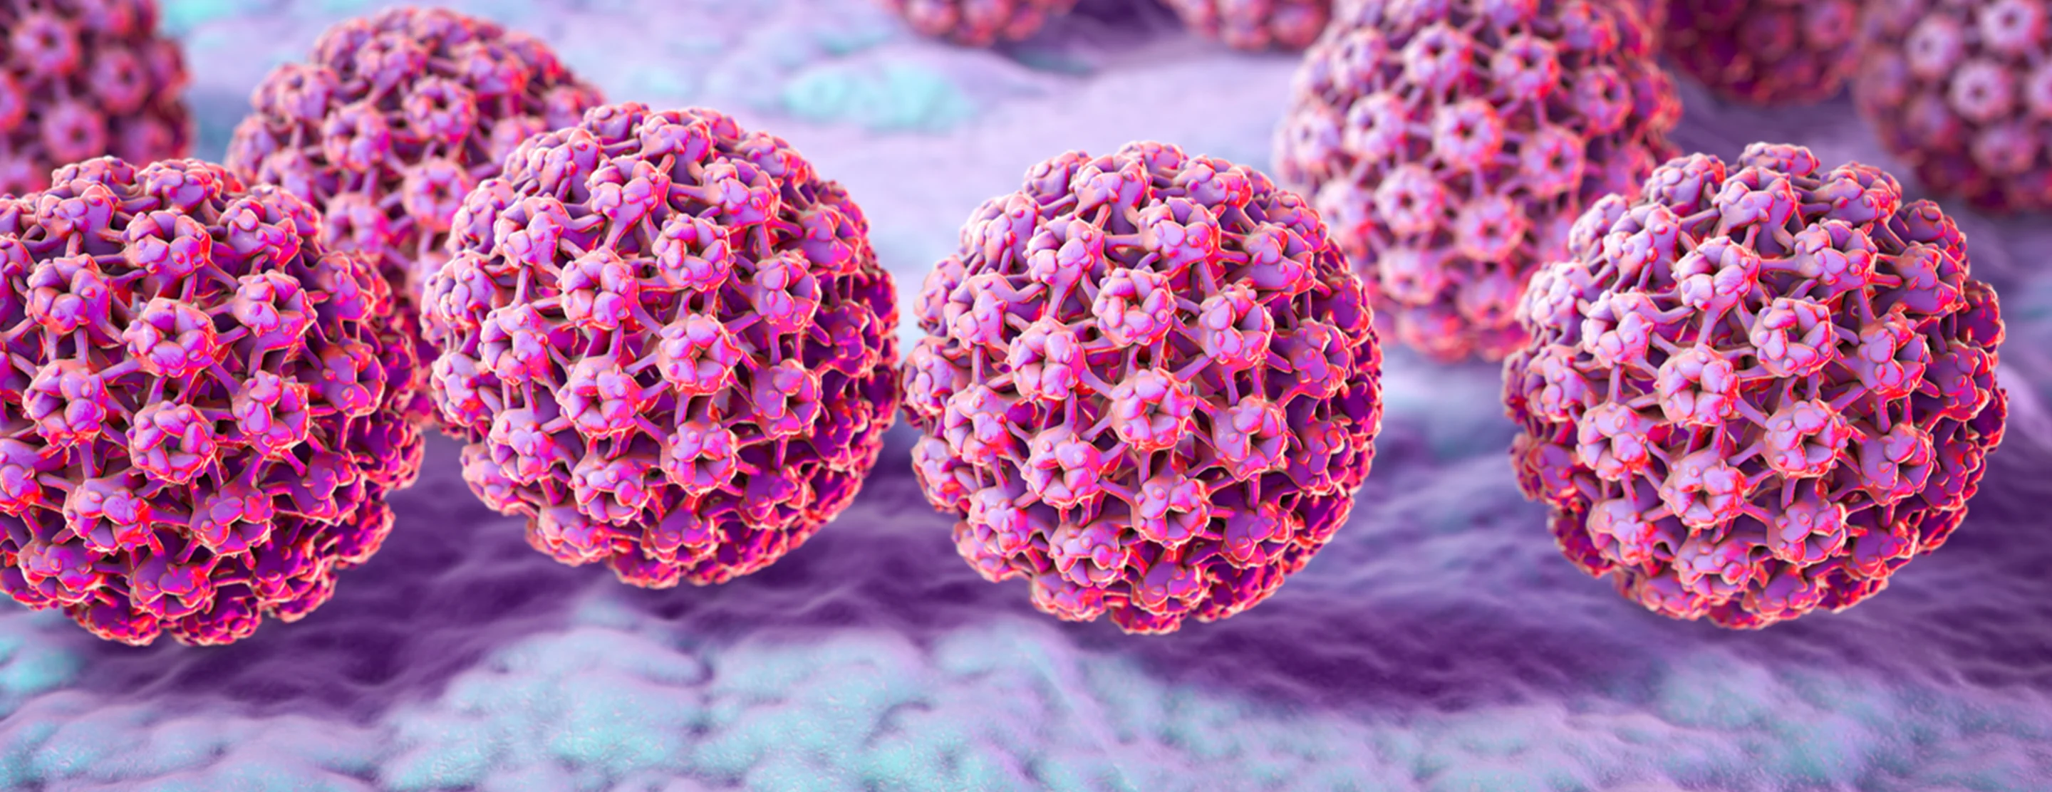
Cervical Cancer Aetiology
Cervical cancer is a sexually transmitted disease.
HPV is the primary cause of cervical cancer.
Some strains of HPV have a predilection to the genital tract and transmission is usually through sexual contact

Slide 25
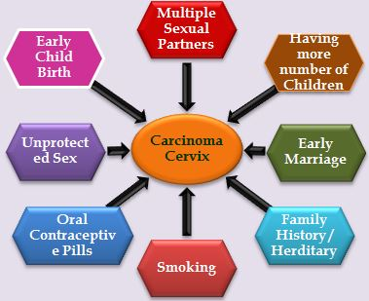
Cervical Cancer Risk Factors
Smoking
Giving birth to more than 7 children
having first child before 17yrs
Number of sexual partners
Early age of intercourse
weak immune system

Slide 26
The stages of cancer progression
The pre-cancerous stage before the cells turn cancerous is called Cervical Intraepithelial Neoplasia (CIN)

Slide 28
Clinical Manifestations
May be silent until advanced disease develops
Symptoms of Invasion :
Post-coital bleeding
Foul vaginal discharge
Abnormal bleeding
Unilateral leg swelling or pain
Pelvic mass
Pelvic pain
Gross cervical lesion

Slide 29
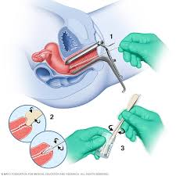
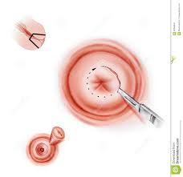
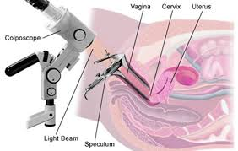
Assessment
History
Physical examination
Investigation:
Pap smear test :To Obtain Cells From the Cervix for Cervical Cytology Screening
Cold cone biopsy
MRI, a CT, blood tests or a X-ray
Colposcopy,

Slide 30
Treatment
Five types of standard treatment are used:
Surgery
Radiation therapy
Chemotherapy
Targeted therapy
Immunotherapy
Treatment of Early Disease
simple hysterectomy
microinvasive cancer Radical hysterectomy –removal of the uterus with its associated connective tissues, the upper vagina, and pelvic lymph nodes..
Chemoradiation therapy
Advanced Staging:
Chemoradiation

Slide 31
Radical hysterectomy -removal of the uterus

Slide 32


Vaginal caner
Vaginal cancer is malignant tissue growth arising in the vagina.

Slide 33
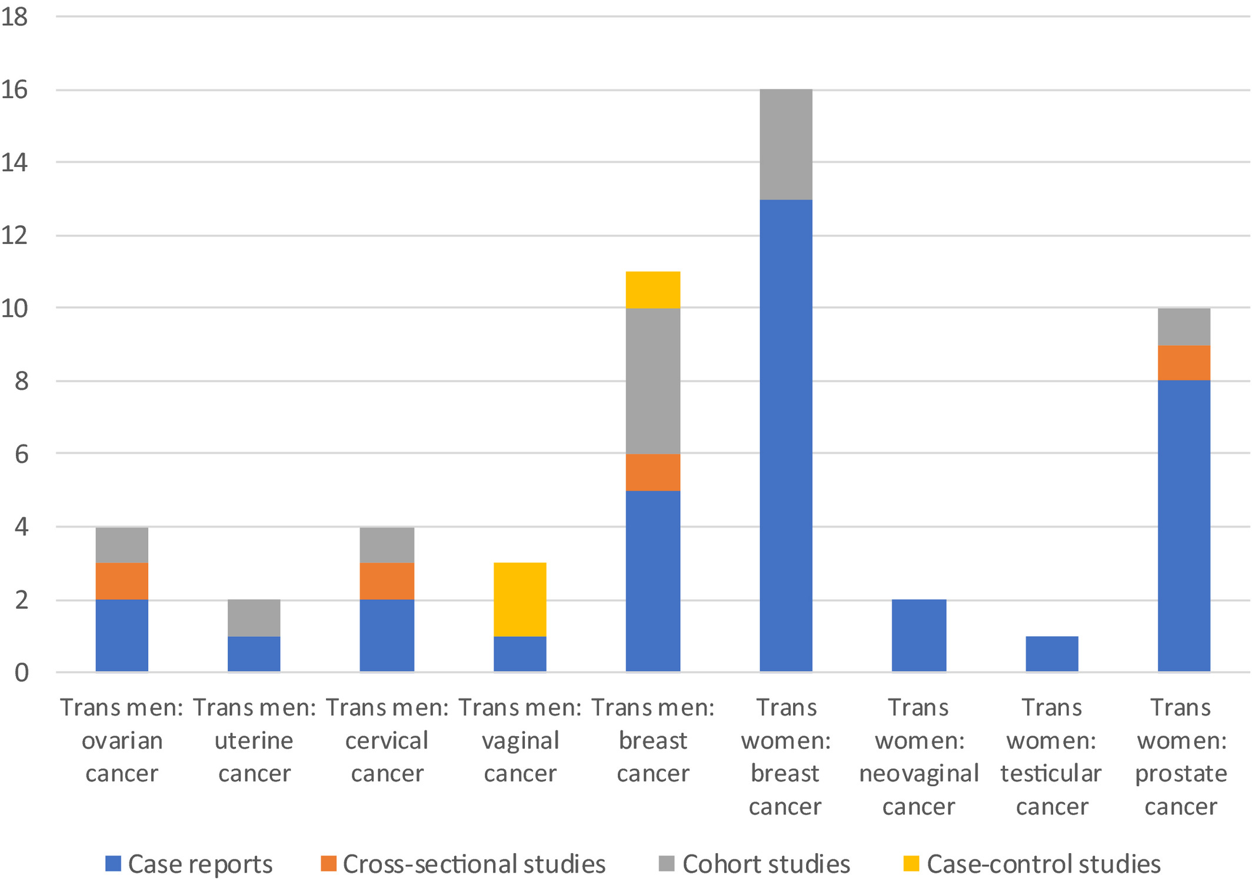

Epidemiology
It is rare, representing less than 3% of all genital cancers.
This type of cancer usually occurs in women over age 50.
Vaginal cancer can be effectively treated, and when found early it is often curable.
The aetiology of vaginal cancer has not been identified.

Slide 34
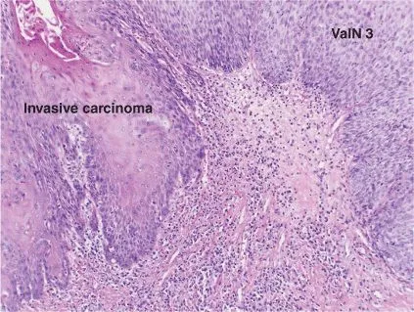
Pathophysiology
Malignant diseases of the vagina are either primary vaginal cancers or metastatic forms from adjacent or distant organs.
About 80% of vaginal cancers are metastatic, primarily from the cervix and endometrium.
Cancers from distant sites that metastasize to the vagina through the blood or lymphatic system are typically from the colon, kidneys, skin (melanoma), or breast.
Tumours in the vagina commonly occur on the posterior wall and spread to the cervix or vulva
Squamous cell carcinomas that begin in the epithelial lining of the vagina account for about 85% of vaginal cancers occur in women( 50 yrs and up).
The remaining 15% are adenocarcinomas, occur in teenagers and young women[14 –20 yrs. ]
Vagina cancer develop slowly over a period of years, commonly in the upper third of the vagina.

Slide 35
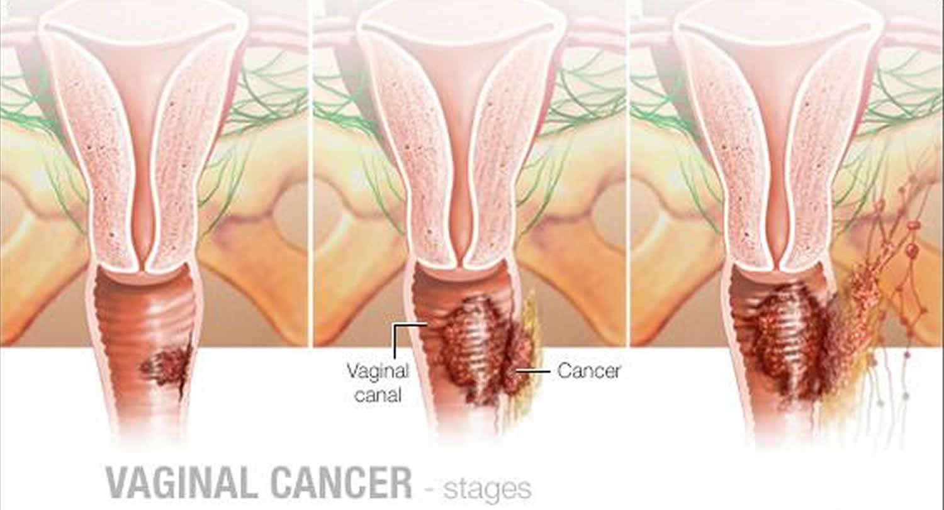
Vagina cancer Staging
Stage 1: Confined to Vaginal Wall
Stage 2: Sub vaginal tissue but not to pelvic sidewall
Stage 3: Extended to pelvic sidewall
Stage 4: Bowel or Bladder
Stage 5: Distant metastasis

Slide 36

Causes &Risk factors
Cause is unknown
Advancing age (over 50 years old)
Previous pelvic radiation
Vaginal trauma
History of genital warts (HPV infection)
HIV infection
Cervical cancer
Chronic vaginal discharge
Smoking

Slide 37

Symptoms
Painless vaginal bleeding.
Abnormal vaginal discharge
Dyspareunia
Dysuria
Swelling in the legs (oedema)
Constipation
pelvic pain

Slide 38
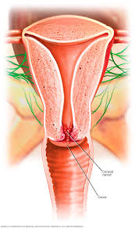
Assessment
History.
Physical examination.
Investigation:
Biopsy to look for either precancerous or cancerous cells.
Scans and x-rays to see if the cancer has spread to other parts of your body.

Slide 39
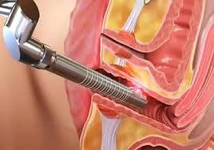
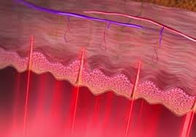
Treatment
Treatment of vaginal cancer depends on the type of cells involved and the stage of the disease.
If the cancer is localized, radiation, laser surgery, or both may be used.
If the cancer has spread, radical surgery might be needed, such as a hysterectomy, or removal of the upper vagina with dissection of the pelvic nodes in addition to radiation therapy.

Slide 40


Vulvar cancer
Vulvar cancer is an abnormal neoplastic growth on the external female genitalia

Slide 41

Vulvar cancer epidemiology
It is responsible for 0.6% of all malignancies in women and 4% of all female genital cancers.
It is the fourth most common gynaecological cancer, after endometrial, ovarian, and cervical cancers
It typically occurs in women between 30 and 40 years old.

Slide 42
Pathophysiology
Approximately 90% of vulvar tumors are
squamous cell carcinomas.
• This type of cancer forms slowly over several
years and is usually preceded by precancerous
changes.
• These precancerous changes are termed
vulvar intraepithelial neoplasia (VIN).

Slide 43
• The two major types of VIN are classic
(undifferentiated) and simplex
(differentiated).
• Classic VIN, the more common one, is
associated with HPV infection
• In contrast to classic VIN, simplex VIN
usually occurs in postmenopausal women
and is not associated with HPV

Slide 44

Causes & Risk Factor
History of breast cancer
Multiple sex partners
Previous hx of cervical cancer
Previous hx of HPV
Obesity
Cigarette smoking
Human Papilloma Virus (HPV)
infection
Immunosuppression
Chronic vulvar conditions such as lichen sclerosis

Slide 45
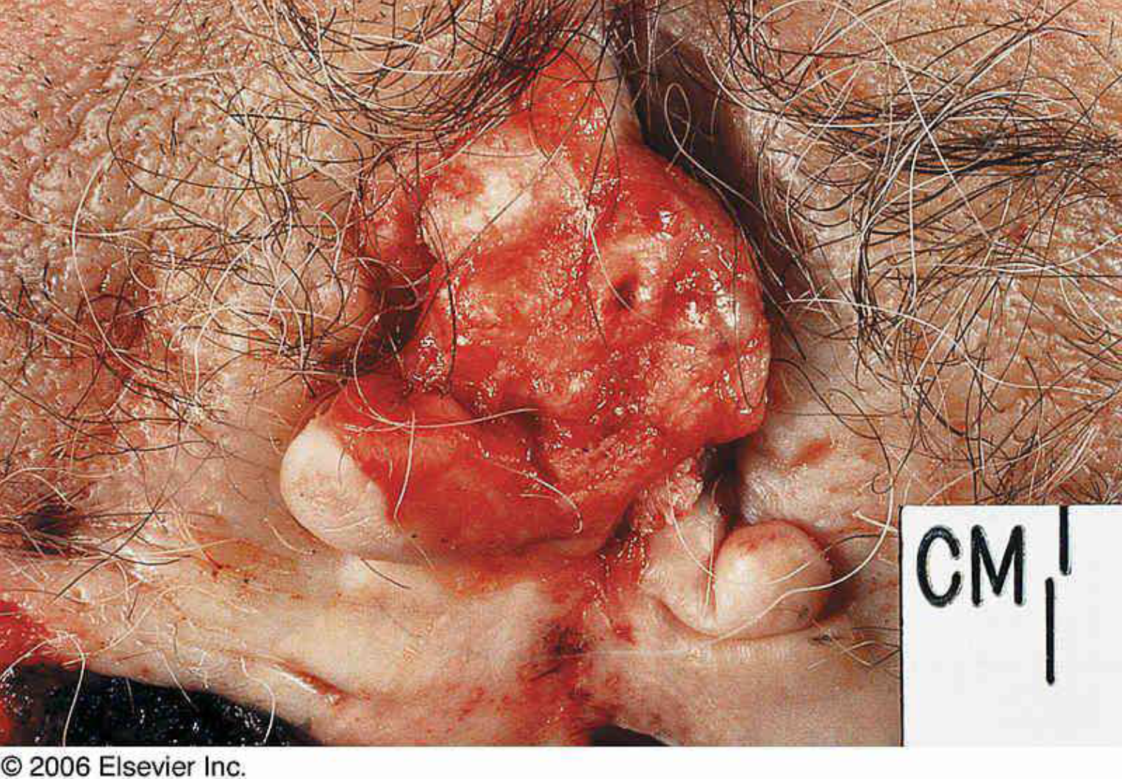
Clinical Manifestations
Ulcer or mass
Pruritus is the most common presenting
symptom especially if associated with vulvar dystrophy
Vulvar bleeding or discharge
Dysuria
Enlarged groin lymph node

Slide 46
Assessment
History
Physical examinations
Investigations:
Biopsy of gross lesions
If no gross lesion present but high clinical suspicion, perform colposcopy

Slide 47

Therapeutic Management
Chemotherapy
Radiotherapy.
Surgery

Slide 48

Pregnancy & Cancer
Cancer during pregnancy is uncommon
•Most importantly, a pregnant woman with cancer is capable of giving birth to a healthy baby because cancer rarely affects the fetus directly.
Although some cancers may spread to the placenta, most cancers cannot spread to the baby.
However, being pregnant with cancer is extremely complicated for both the mother and the health care team.

Slide 49
Treatment of pregnant women
Some cancer treatments may be used during pregnancy but only after careful consideration and treatment
planning to optimize the safety of both the mother and the unborn baby.
These include: surgery, chemotherapy, and rarely, radiation therapy.
Surgery:
Surgery is the removal of the tumour and surrounding tissue during an operation.
There is little risk to the developing baby
In some cases, more extensive surgery can be done to avoid having to use chemotherapy or radiation therapy.

Slide 50
Chemotherapy.
Chemotherapy can harm the fetus, particularly if it is given during • The first trimester of pregnancy when the fetus' organs are still developing
may cause birth defects or even the loss of the pregnancy (miscarriage).
• During the second and third trimesters, some types of chemotherapy may be given without necessarily harming the fetus. The placenta acts as a barrier between the mother and the baby
The later stages of pregnancy may not directly harm the developing baby, it may cause side effects like malnutrition and anaemia in the mother that may cause indirect harm.
May cause early labor and low birth weight,
No breast feeding?

Slide 51

Radiation therapy
Radiation therapy can harm the fetus, particularly during the first trimester, doctors generally avoid using this treatment.
Even in the second and third trimesters, the use of radiation therapy is uncommon.
The risks to the developing baby depend on:
the dose of radiation
And the area .

Slide 52



