Slide 1
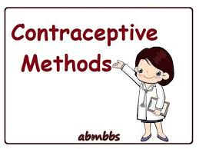









Slide 2

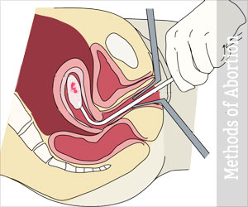

Correct use of effective methods of contraception
can prevent most unintended pregnancies.
Unintended pregnancies lead to
delayed or no antenatal care
Abortion attempt.

Slide 3

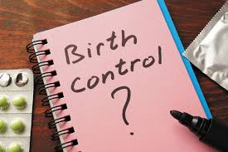


Over 200 million women worldwide would like to
avoid a pregnancy, but are not using an effective
method of contraception.
This is due to :
a lack of supplies.
cultural .
political barriers.
poor quality of services.

Slide 4
Contraceptive targets in female reproductive tract
No methods are 100% effective at preventing pregnancy.
The effectiveness of a method depends on
mechanism of action .
correct and consistent use.
Compliance depends on:
acceptability of the method.
and tolerability (S/E) .

Slide 5
Ideal contraceptive
Safe
Effective
acceptable
reversable
inexpensive
long lasting
require no or little medical supervision

Slide 6

A woman’s choice of contraception is just as likely to be based upon information from:
media.
friends.
family,
Health care professional.
major factors that limit their uptake.
Myths
misconceptions :
among women and health providers.

Slide 7
Characteristics of the user that determine risk of pregnancy include :
Compliance.
age (reducing fertility in late 30s).
and frequency of intercourse.

Slide 8
Determinants of contraceptive method acceptability
• Personal characteristics (e.g. age).
• Fertility intentions.
• Perceptions of effectiveness.
• Perceptions of safety.
• Fear of side-effects.
• Familiarity.
• Experience of others.
• Ease of use and of access.
• Need to see a health professional.
• Intrusiveness.
• Non-contraceptive benefits.

Slide 9
Practical prescribing
Women considering using a particular method of contraception require clear, accurate information
What a woman needs to know before starting a method of contraception
• How to use the method (pill, patch or ring) and what to do when misused (e.g. missed pill)
• Typical failure rates
• Common side-effects
• Health benefits
• Fertility return on stopping
• When she requires review

Slide 10
Percentage of women experiencing an unintended pregnancy within the first year of use
Method | Typical use % | Perfect use %
No method | 85 | 85
Fertility awareness-based method | 24 | 0.4-0.5
Male condom | 18 | 2
Female diaphragm | 12 | 6
Progesterone-only pills | 9 | 0.3
Combined hormonal contraceptive | 9 | 0.3
Progesterone-only injectable | 6 | 0.2
Cu-IUD | 0.8 | 0.6
LNG-IUS | 0.2 | 0.2
Progesterone-only implant | 0.05 | 0.05
Female sterilization | 0.5 | 0.5
Vasectomy | 0.15 | 0.1

Slide 11
Mechanism of action
The efficacy of a method depends on its mechanism of action
1) Prevent ovulation:
Combined hormonal methods (pill, patch and vaginal ring).
Progestogen-only injectables.
Progestogen-only implant (Nexplanon®).
Oral emergency contraception.
Lactational amenorrhoea.
2) Prevent sperm reaching the oocyte:
Female sterilization.
Male sterilization (vasectomy).

Slide 12
3) Prevent an embryo implanting in the uterus:
Cu-IUD (Intra Uterine Copper Device).
LNG-IUS. (Mirena).
4) Allow sperm into the vagina but poison them: spermicides.
5) Allow sperm into the vagina but block further passage:
Cervical diaphragm & cervical cap.
One of the mechanisms of action of progestogens.
6)Prevent sperm entering the vagina:
• male and female condoms;
7) avoid sex during the fertile time of the cycle:

Slide 13
Route of administration of contraceptive & duration
Rout of currently available contraceptive | Duration
Oral CHC and progesterone | 24 hours
Transdermal CHC | 7 days
Vaginal ring CHC | 21 days
Progesterone-only injectable | 14 days
Progesterone-only implant(sub cutaneious ) | 3 years
Cu-IUD( intrauterine). | 3 years , 5 years , 10 years or more .
LNG-IUD( intrauterine). | 3 years , 5 years or more

Slide 14
Non-contraceptive health benefits of contraceptives
Method | Benefit against
Barrier methods (condoms) | protect against sexually transmitted infections
LNG-IUS (52 mg) | Heavy menstrual bleeding Endometriosis Adenomyosis Dysmenorrhoea Endometrial protection Simple hyperplasia
Combined hormonal contraception | Heavy menstrual bleeding Irregular menses Hirsutism Acne Premenstrual syndrome Reduces risk of ovarian cancer Reduces risk of endometrial cancer
Progestogen-only injectable (depot medroxyprogesterone acetate) | Heavy menstrual bleeding Endometriosis Dysmenorrhoea

Slide 15
METHODS OF CONTRACEPTION:
Natural methods.
Barrier methods
Long acting reversable contraceptives :
Implant
Intra uterine device (IUD)
Hormonal contraceptives :
Pill
Depo Provera injection
Barrier methods : such as condoms
Permanent contraceptives :
Vasectomy
Tubal ligation.

Slide 16
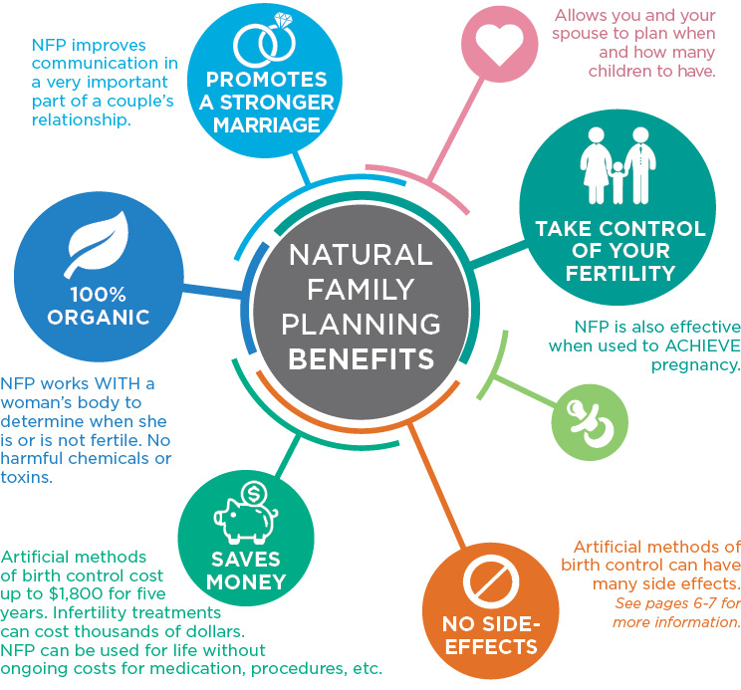
Natural family planning:
Calendar or rhythm method or safe period .
Cervical mucus method
Basal body temperature method.
Breastfeeding is an effective (98%) temporary
method of contraception only if :
Lactational amenorrhoea
& exclusive breastfeeding
& infant is under 6 months old.

Slide 17
Barrier methods
WHAT ARE BARRIER METHODS?
Barrier methods prevent sperm from fertilizing ovum.
Types of barrier methods:
Male condom.
Female condom.
diaphragm .
spermicidal .

Slide 18
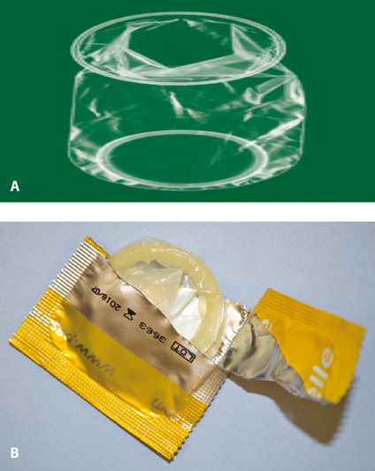
Male condom:
Cheap and widely available.
They made of latex.
They protect against STIs including HIV.
They are the only reversible male method.
Used before sex.
The female condom
Is a lubricated polyurethane condom
Inserted into the vagina.
It protects against STIs

Slide 19
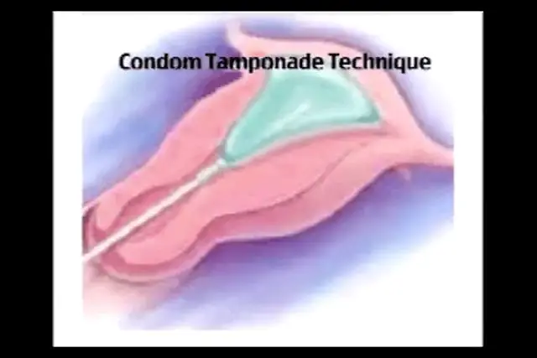
Non contraceptives uses of Condoms:
Condom catheter.
In post partum haemorrhage as condom tamponade.

Slide 20
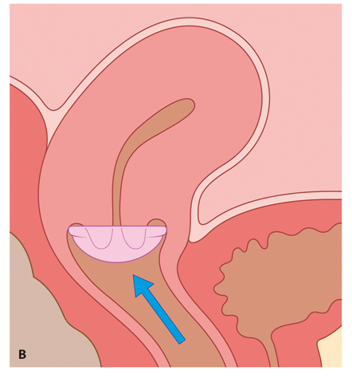
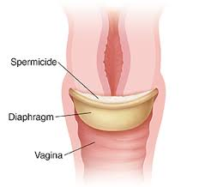
Diaphragm and cap
These are latex or non-latex devices that are
inserted into the vagina to prevent passage of
sperm to the cervix .
Caps fit over the cervix.
They are often used in with a spermicide.
Disadvantages
women need to be taught how to insert and remove. device
High failure rate.
May be associated with increased vaginal discharge
Associated urinary tract infections.

Slide 21
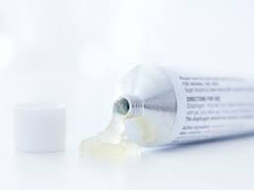
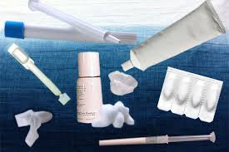
Spermicides :
Spermicide alone is not recommended for prevention of pregnancy as it is of low effectiveness.
Nonoxynol 9 (N-9) is a spermicidal product sold as:
a gel
cream
Foam
sponge
or pessary for use with diaphragms or caps.

Slide 22
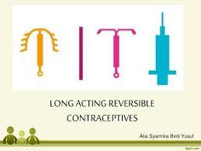
LARC
Types:
injectable
Implant
intrauterine device (IUD).
LARC methods are the most effective
once inserted do not require any action by the user
until they need to be renewed.

Slide 23

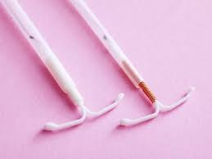
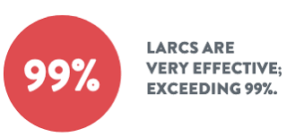
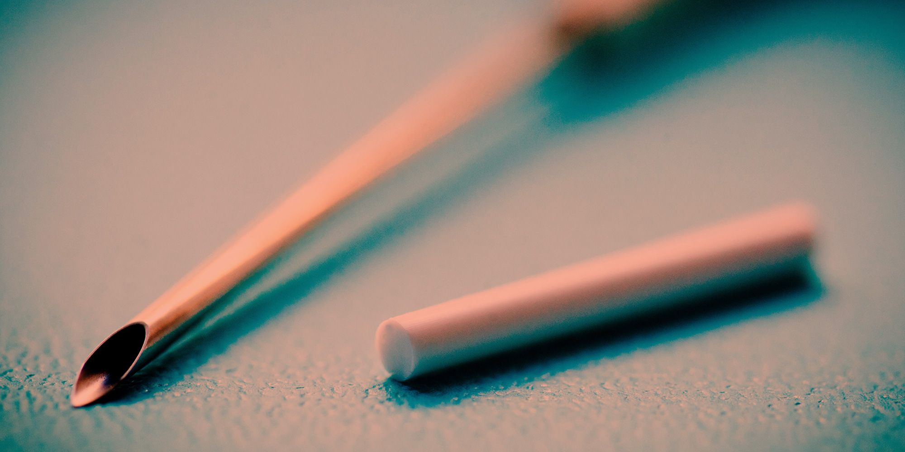
Long-acting reversible contraception (LARC) is a contraceptive that lasts for a long time.
Types of LARC :
Intrauterine devices: (IUCD Mirena) which lasts for
three, five or ten years
Implants: which lasts for five years.
LARCs are the most effective types of contraception.

Slide 24
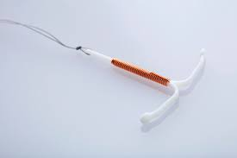
IUCD
Life span 10 years
Contraindications :
Pregnancy .
DUB .
PID.
cervical cancer.
endometrial cancer.
Time of insertion :
at menstruation time(within 10 days).
post partum(within 48 hs) .
after puerperium (6 weeks after delivery)

Slide 25
IUCD
Side effects:
Pregnancy(failure)
Pain .
Bleeding.
PID.(increase vaginal discharge).
Perforation .
Ectopic pregnancy.
Expulsion.
Difficult removal.
Actinomyces-like organisms (ALOs)
‘Missing’ threads may indicate
Pregnancy
expulsion
or perforation.

Slide 26
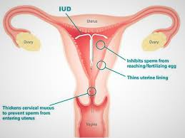
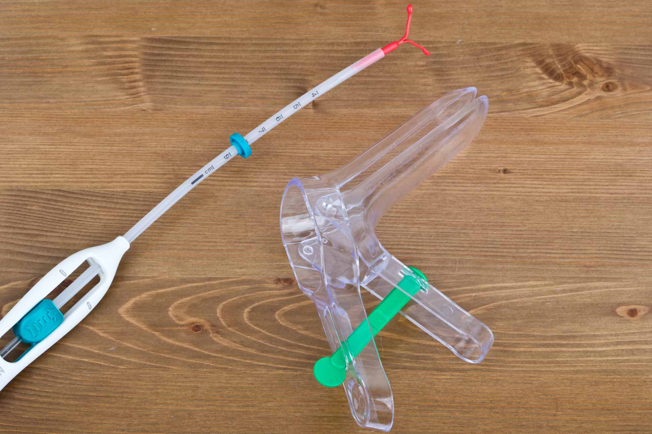
Progestogen-releasing intrauterine system
Contain 52 mg of progesterone.
Release 20 ug /day.
Life span 5 years.
(Mirena®) is licensed for 5 years for contraceptive use (but if inserted in women 45 years or older, may be used for contraception until the menopause) The LNG-IUS does not prevent ovulation.
women experience unpredictable bleeding.
side-effects of the LNG-IUS include
acne.
tenderness.
mood disturbance.
and headaches.

Slide 27
The non-contraceptive benefits:
reducing HMB (reduced by 90% at 12 months).
It is also effective for treating dysmenorrhoea,
pain associated with endometriosis
Adenomyosis pain
and protecting the endometrium against hyperplasia

Slide 28
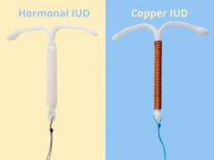
Mode of action
IUDs stimulate an inflammatory reaction in the uterus.
It is thought that these effects are toxic to both sperm and egg and interfere with sperm transport.
If a healthy fertilized egg reaches the uterine cavity, implantation is inhibited.

Slide 29
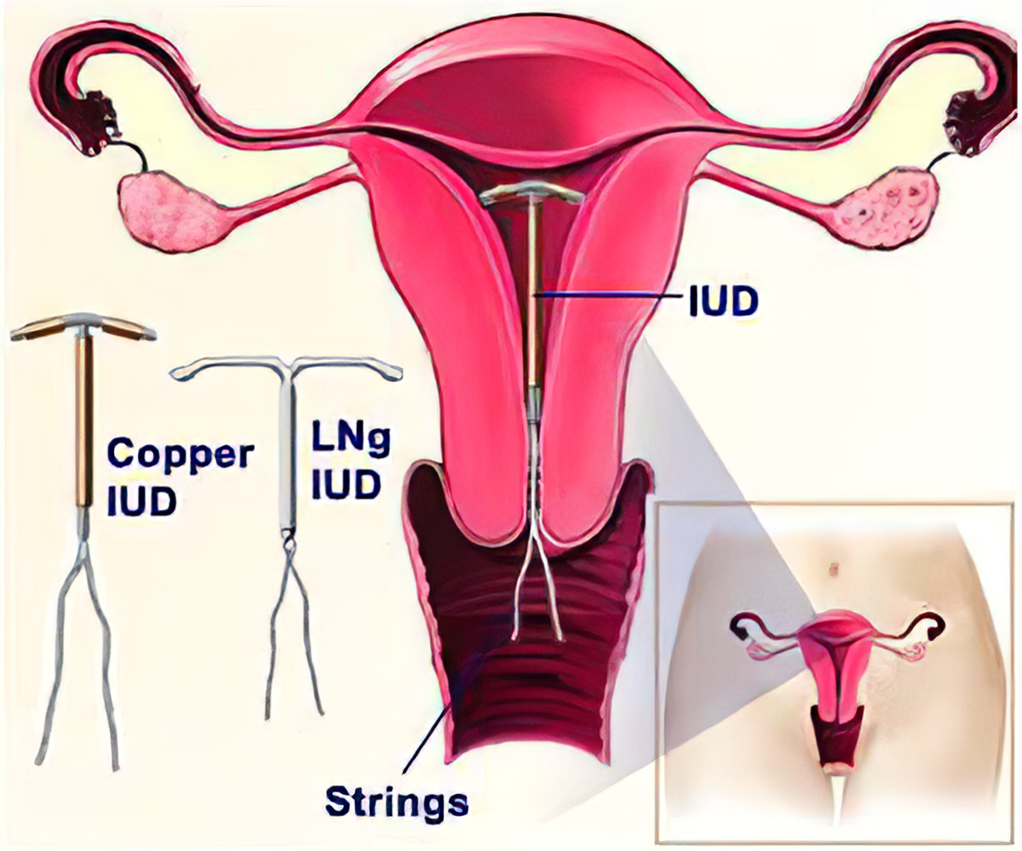

Slide 30
WHAT ARE HORMONAL CONTRACEPTIVES?
Hormonal contraceptives include the
Pills
Depo Provera injection.
There are two types of pill:
combined oral contraceptive pill
progestogen-only contraceptive pill
The pill is more than 99% effective.
Daily taking.
The Depo Provera injection is another type of hormonal contraception.
An injection every three months.
Its is more than 99% effective .

Slide 31
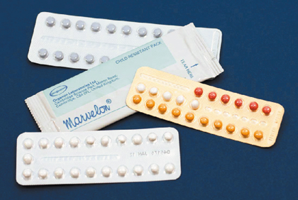
Combined hormonal contraception :
COCP methods contain two hormones: an oestrogen and a progestogen.
They are available as
oral pills
a transdermal patch
vaginal ring.
They are similar in terms of
effectiveness, safety and side-effects.
These methods all work by inhibition of ovulation .
One tablet every day at the same time, without interruption.

Slide 32
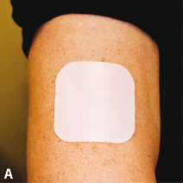
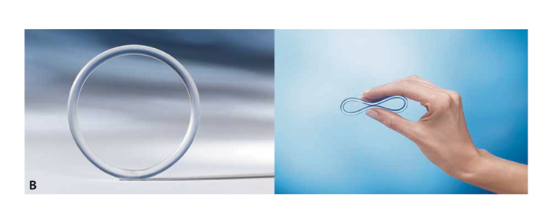

Slide 33
Side-effects
unexpected bleeding,.
weight gain.
Headaches.
mood swings.
loss of libido.

Slide 34
Examples of WHO medical eligibility criteria category 4 conditions and use of combined hormonal contraception
Age >35 and smoking.
Blood pressure >160/100mmHg
Hypertension with vascular disseises.
Deep vein thrombosis, current or past.
Myocardial infarction current or past.
Cerebrovascular accident , current or past.
Multiple serious risk factors for cardiovascular disease.
Known thrombogenic mutation.
Current breast cancer.

Slide 35
Safety of CHC
Cancer
Cancer risks among users of COCPs
• A 12% reduction in the risk of any cancer.
• Reduced risk of colorectal cancer.
• Reduced risk of endometrial cancer.
• Reduced risk of ovarian cancer.
• Increased risk of breast cancer during use (decreases on stopping and similar risk to never used by 10 years after stopping).
• Increased risk of cervical cancer (but early changes detected by
cervical cytology and human papillomavirus [HPV] vaccination).

Slide 36
Drugs decrease efficacy of hormonal contraception
Type of drug | Liver enzyme induction
Anticonvulsant | Carbamazepine Eslicarbazepine Oxcarbazepine Phenobarbital Phenytoin Primidone Topiramate
Antibiotic | Rifampicin Rifabutin
Antifungal | Griseofulvin
 | Protease inhibitors Amprenavir Atazanavir Nelfinavir Lopinavir
Antiretroviral | Saquinavir Ritonavir Non-nucleoside reverse transcriptase inhibitors Efavirenz Nevirapine

Slide 37
3 Missed pill guideline
If one pill has been missed >24 hs and <48hs
If one pill has been missed >48 hs
Continue contraceptive cover
Missed pill should be taken as soon as possible
Then continue pills as usual
Minimizing risk of pregnancy
Continue contraceptive cover
Missed pill should be taken as soon as possible
Remaining should continue at usual time
Pack up for 7 pills
Minimizing risk of pregnancy
EC if missed pill in the early packet or last week of previous packet
If missed pill in the 1st week EC
If pill missed in the 2nd week (8-14 d)
If missed pill in the 3rd week (15-21 d) omit the pill free period

Slide 38
Progestogen-only contraceptive methods
Progestogen-only methods are available as
Oral
Injectable
Implant
and intrauterine system.
The mechanism of action
All progestogen-only contraceptive methods by thicken cervical mucus so reducing sperm penetrability and transport.
The progestogens that are used are referred to
as second-generation (levonorgestrel, norethisterone)

Slide 39
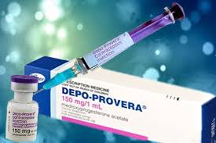
Progestogen-only injectable:
One injection every 13 weeks.
There are 2 forms:
DMPA-IM administered by IM . Depo-Provera® (150 mg)
DMPA-SC by SC route. Sayana press® (104 mg)
Protection: 3 months.
Advantages & disadvantages:
no daily administration.
self-administration possible.
long delay in return to fertility ..on average 5 months after stopping injections, sometimes up to 1 year
bleeding may occur at any time (irregular) or there may be no monthly bleeding (amenorrhoea).

Slide 40
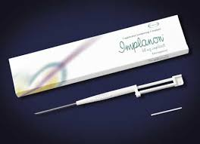
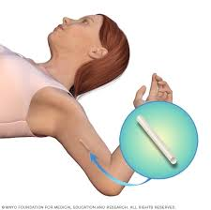
Implant
containing the progestogen etonorgestrel
(implanon & Nexplanon) 68 mg
providing contraception for 3 years.
One (or two) rods inserted under the skin
of the upper arm, under local anaesthesia. – Protection: 3 years.
PRO & CON
effectiveness does not depend on compliance.
bleeding may occur at any time (irregular)
there may be no monthly bleeding (amenorrhoea).
the implant is discreet but palpable under the skin.

Slide 41
Side effects: cause weight gain in a minority of women
loss of bone mineral density (BMD)
Other progesterone S/E.
Irregularity of cycle
Difficulties in resuming fertility after stopping.

Slide 42
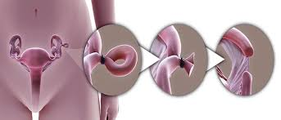
Female sterilization
This is a permanent method of contraception that prevents sperm reaching the oocyte in the Fallopian tube.
Tubal ligation.
Effectiveness 99%.
It can be performed by
(1) laparoscopy
(2) hysteroscopy or
(3) laparotomy (e.g. at caesarean section).

Slide 43
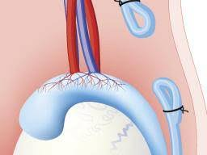
Vasectomy
This is the technique of interrupting the vas deferens to provide permanent occlusion.
There is a small risk of a scrotal haematoma and infection with the procedure.
Post vasectomy semen analysis should be
conducted at 12 weeks to confirm the absence
of spermatozoa.
Alternative contraception should be
used until azoospermia is confirmed.

Slide 44
Emergency contraception
• The most effective method of EC is an IUD (about 99% effective).
• An IUD can be inserted up to 5 days after ovulation for EC.
• Ulipristal acetate (UPA) or levonorgestrel (LNG) are available as oral methods of EC.
• UPA can be given within 120 hours of unprotected intercourse.
• LNG can be used within 96 hours of unprotected intercourse.
• Effective ongoing contraception should be started after EC.

Slide 45




