Slide 1


Diabetes & Pregnancy
DR Rayan Albarakati
Assistant prof
OBSTETRICS/GYN

Slide 2
Introduction
Varieties:
Preexisting DM
GDM ( A1 & A2)
GDM Definition:
Glucose intolerance with onset first recognition during pregnancy

Slide 3
Prevalence :
Most common medical complication of Pregnancy
3-8 % of pregnancies
GDM 90%
Preexisting DM 10%

Slide 4
Physiological changes during pregnancy
Pregnancy is a state of insulin resistance & relative glucose intolerance
This is due to placental production of anti-insulin hormones : hPL, cortisol, and glucagon
FBS might be low (increased insulin sensitivity in 1st trimister) and increased glucose uptake)
Postprandial glucose increased
Insulin increases by 2 folds in N women
Insulin requirements increased(fetal growth)
↓ Renal threshold for glucose glycosuria( Increased GFR, tubular reabsorption is less efficient)

Slide 5

EFFECT OF PREGNANCY ON pt with DM
Insulin requirement increased reaching a max at term & being about 2 X the pre-pregnancy requirement
Pt with diabetic nephropathy:
Deterioration in renal function
Proteinuria.
Usually reversed after delivery

Slide 6
EFFECT OF PREGNANCY ON DM
2 X increase in retinopathy
Hypoglycemia (with tight control of BG level)
Ketoacidosis: rare unless associated with hyperemesis, infections, tocolytics & corticosteroid Rx
Increased risk of PIH especially in pt. with pre-existing hypertension & nephropathy
Post partum hemorrhage … why ? *
*(placentomegally – polyhydramnios- macrosomic baby)

Slide 7
EFFECTS OF DM ON PREGNANCY
Increased risk of abortions
increased incidence of congenital abnormalities
5% with Hb A1c > 8
25% with Hb A1c > 10
Sacral agenesis, congenital heart defects, skeletal abnormalities & neural tube defects
Perinatal & neonatal mortality increased 2-4 X
Unexplained IUFD at term (more in macrocosmic babies)

Slide 8
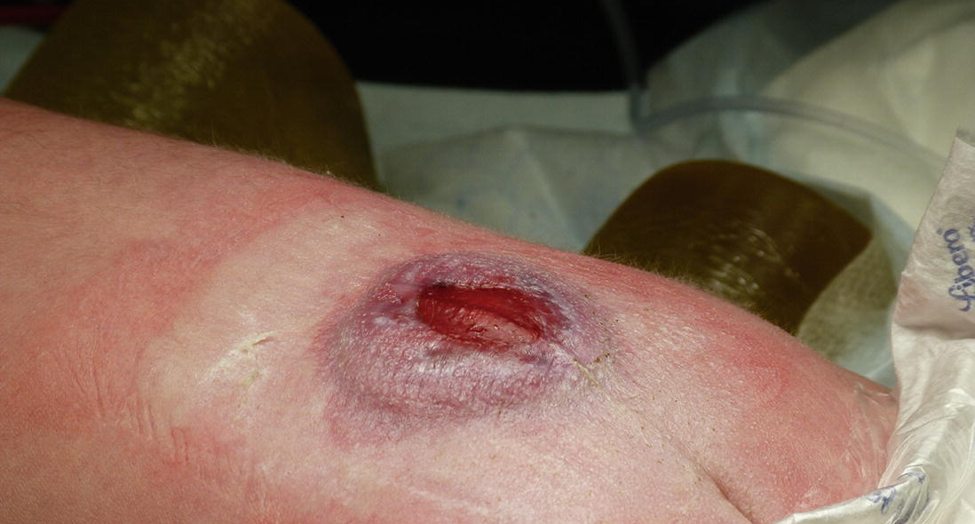
NTD: Spina Bifida

Slide 9
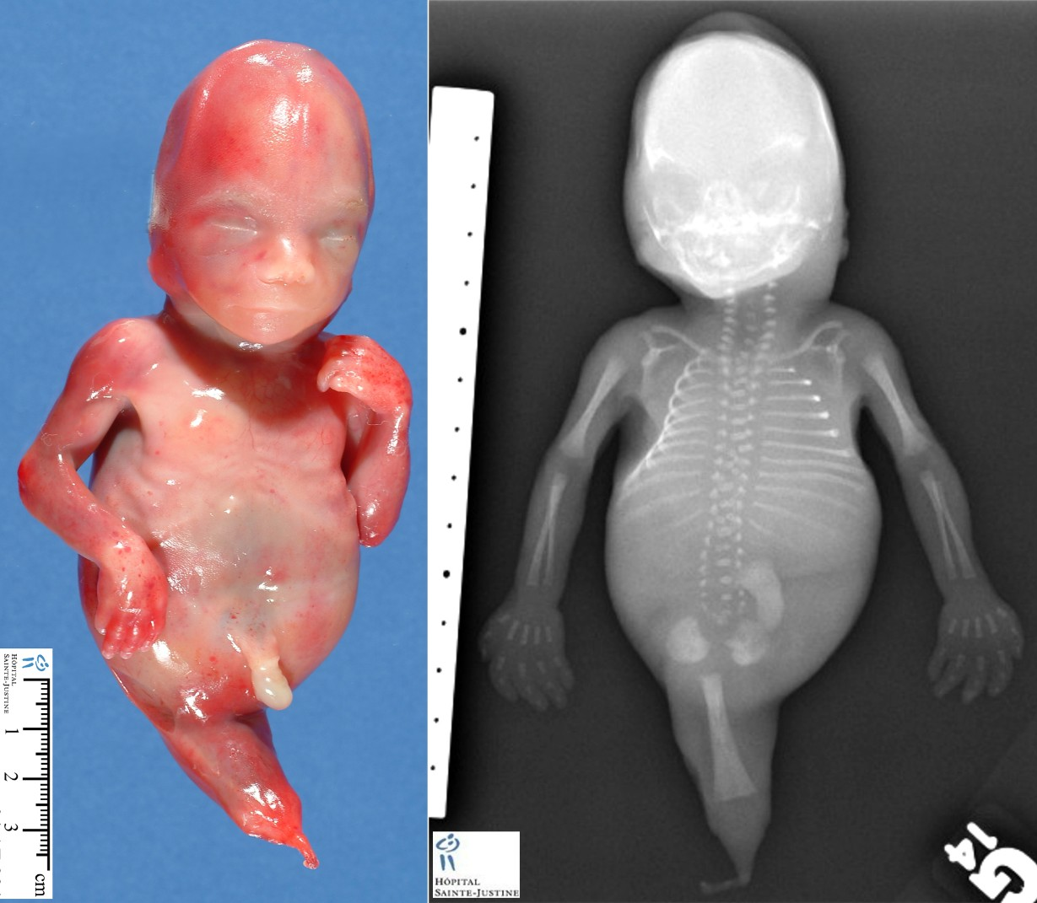
Caudal regression
AKA sacral agenesis

Slide 10
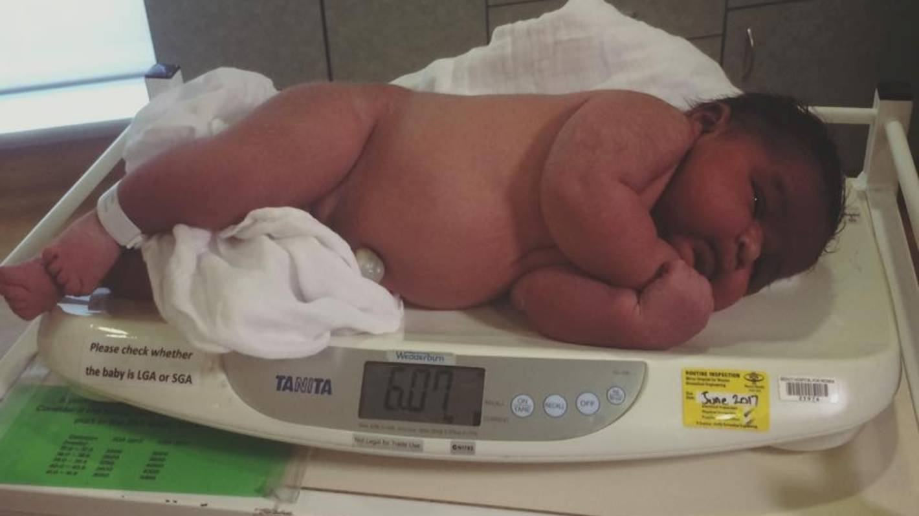
EFFECTS OF DM ON PREGNANCY
Macrosomia
Risk increased with poor diabetic control
Not eliminated by tight control
Increased risk of operative delivery, birth trauma, & shoulder dystocia
Hyperglycemia: fetal polyuria – polyhydramnios –PROM - PTD
Delayed lung maturity
Prematurity

Slide 11
EFFECTS OF DM ON PREGNANCY- Postnataly
infant is at risk of:
Hypoglycemia
hypotension ( low glucose and low Ca & Mg)
Electrolytes imbalance ( ↓ Ca++ , ↓Mg++)
Polycythemia causing hyper viscosity & jaundice -- why ? hypoxia

Slide 12
Preexisting Diabetes:
Preconception Counselling
risk of NTD ~1-2% (
Folic Acid 1-4 mg /day
BG 3.5-5.3 prior to meals
switch /adjust insulin +/- OHA

Slide 13
GDM High Risk Factors
Maternal age >25
Family history
Glucosuria
Prior macrosomia
Previous unexplained stillbirth
PCOS
ethnic group: Hispanic, Asians, Black

Slide 14
Screening
24-28 weeks routine
screen at 1st prenatal visit if high risk
50 g GCT at 1 hour (don’t need to fast prior to test)
≥ 130 mg/dl → OGTT
≥ 200mg/dl → No further tests & start ttt.
Diagnostic test → 3-hour 100g OGTT

Slide 15
Values on 100g OGTT
Three-hour OGTT
# | Timing | Max Normal Blood Glucose level (mg/dL)
0 | Fasting | 95
1 | 1 hr | 180
2 | 2 hr | 155
3 | 3 hr | 140
* 2 or more abnormal readings is diagnostic for GDM

Slide 16
Maternal Risks
Increased birth trauma
Operative delivery *
50% lifetime risk in developing Type II DM
recurrence risk of GDM is 30-50%
* Cesarean section if baby wt. ≥ 4250-4500 g

Slide 17
Fetal Risks
Increase in congenital anomalies
increased risk of stillbirth
Macrosomia
Birth trauma (shoulder dystocia)

Slide 18
Management
Goal is to optimize BG levels
Minimize risk of adverse perinatal outcomes
diet +/- OHA
exercise
insulin therapy

Slide 19
Diet : general principles
Composition:
50% CHO
20% Protein
20% fat
Total calories to be divided :
25% breakfast
30% Lunch
30% Dinner
15% at bedtime snack
Calories intake
BMI>27 →25 kcal/kg/ideal body weight/d
BMI 20-26 → 30 kcal/kg/ideal body weight/d
BMI<20 → 38 kcal/kg/ideal body weight/d
Normal weight gain 10-12 kg
Exercise : Walking 30 min after meals

Slide 20
Insulin
Types:
Rapid (Lantos) 30-90 min
short acting(regular) 2-3 hours
Long acting (NPH) 6-10 hours
Dosage calculation & timings:
depends on: ( Body weight , Trimester )
Divided doses ( AM – PM)
How & what insulin to mix ?

Slide 21
OHA
Types :
Glyburide
Metformin
Both safe in pregnancy
Both to be used prior to meals(30-60 min)
Both cross the placenta
Both can be used with diet alone or combined with insulin
Effects:
Lower mean birth Wt.
Less macrosomia
Less Gestational Wt. gain
Treatment failure between 15 -30%

Slide 22
Glyburide
Starting dose of 2.5 to 5 mg once daily
Increased as needed up to 20 mg/Day in divided doses
Higher risk of hypoglycemia than insulin

Slide 23
Metformin
Starting dose 500mg with dinner
can be increased to 1000 mg with dinner or 500 mg with dinner and breakfast
Usual effective dose 1500-2000 mg daily divided into two doses
Maximum daily dose is 2500 mg.
Extended Release(XR) form is preferred over the regular type
Not recommended to be used in patients with Htn., PET, or at risk of IUGR or pt. with Renal disease

Slide 24
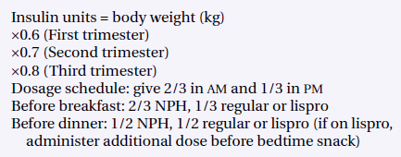
Insulin Dosage calculation
Current body weight

Slide 25
Insulin Total dose Calculation
Trimester
1st → 0.6
2nd → 0.7
3rd → 0.8
Total Insulin units
Body Wt. (Kg)
AM
2/3rd
PM
1/3rd

Slide 26
What & how to mix INSULIN?
AM dose: 2/3rd NPH and 1/3rd Lispro or Regular
Pm dose: ½ NPH and ½ Lispro or regular

Slide 27
Insulin Type & Total dose distribution
Total Insulin units
AM
2/3rd
(2/3rd NPH and 1/3rd Lispro or Regular Ins)
PM
1/3rd
(½ NPH and ½ Lispro or regular)

Slide 28
Insulin Type, Total dose Calculation & Distribution
Trimester
1st → 0.6
2nd → 0.7
3rd → 0.8
Total Insulin units
Body Wt. (Kg)
AM
2/3rd
(2/3rd NPH and 1/3rd Lispro or Regular Ins)
PM
1/3rd
(½ NPH and ½ Lispro or regular)

Slide 29

Timing of Delivery
GDM Diet controlled
Same as nondiabetic
IOL at 40 - 41 weeks if undelivered
GDM on Insulin/Type II/Type I
Well controlled → Deliver by 38+ to 39 weeks
Suboptimal control →deliver following confirmation of lung maturity

Slide 30
Mode of Delivery :
Vaginal delivery is recommended
c/s for maternal or fetal indications
Ultrasound estimates of fetal weight become significantly inaccurate after 4kg
High risk for shoulder dystocia
C/S delivery if EFW is >4250g

Slide 31
Peripartum/Intrapartum Management
Withhold subcutaneous insulin from onset of labor or induction
IV D10 @50cc/h
insulin in NS usually starting at 0.5-1u/h insulin rate usually based on BG and pre-delivery insulin requirement
BG hourly
target: 4-6mmol/L

Slide 32
Postpartum
GDM:
D/C insulin
6 – 12 weeks post partum 75g OGTT
Yearly fasting BG
Advise for weight control & exercise
With breast feeding mothers add 500 kcal/day for the pregnancy diet
Life risk of developing DM-II is 50%

Slide 33
Post-partum management
Pre-pregnancy DM: stop insulin infusion
Begin sub cutaneous insulin
Resume previous schedule at 1/2 -2/3 the pre pregnancy dose
Maintain IV D5W @50cc/h until oral feeds tolerated
Referee to MD outpatient for follow up.

Slide 34

THANK YOU

