Slide 1
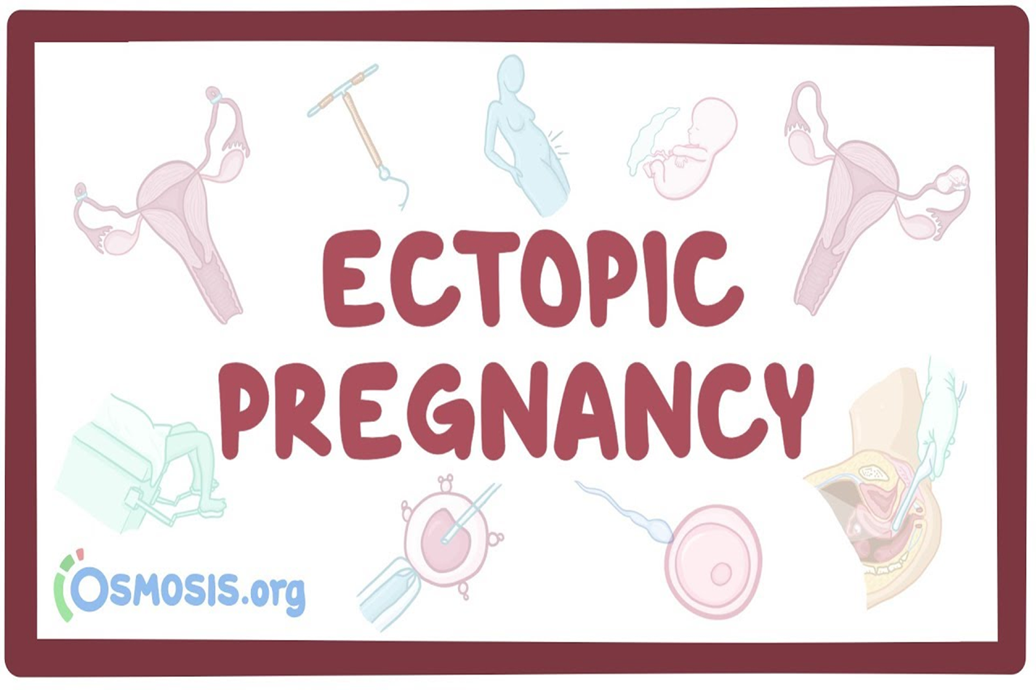
BY DR Mona Ahmed Assisted professor Elmareefa university SMSB

Slide 2
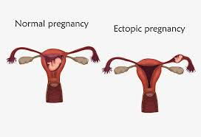
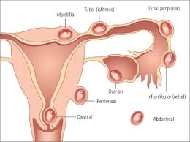
Ectopic pregnancy
Ectopic pregnancy
is implantation of a pregnancy
outside the normal uterine cavity.
Sites:
Over 98% implant in the Fallopian tube .
Rarely:
in the interstitium of the tube.
Ovary.
Cervix.
abdominal cavity.
or in caesarean section scars.

Slide 3
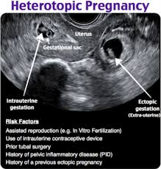
A heterotopic pregnancy
is the simultaneous development of two
pregnancies: one within and one outside
the uterine cavity.
Incidence :
One in 80 pregnancies are ectopic.

Slide 4

Aetiological factors for ectopic pregnancy:
• Damage of Fallopian tube due to :
pelvic infection (e.g. Chlamydia/Gonorrhoea)
previous ectopic pregnancy.
• Functional alterations in Fallopian tube due to
smoking and increased maternal age.
Additional risk factors include :
previous abdominal surgery
(e.g. appendicectomy, caesarean section).
Subfertility.
IVF.
Intrauterine contraceptive devices.
Endometriosis
Conception on oral contraceptive/morning after pill.

Slide 5
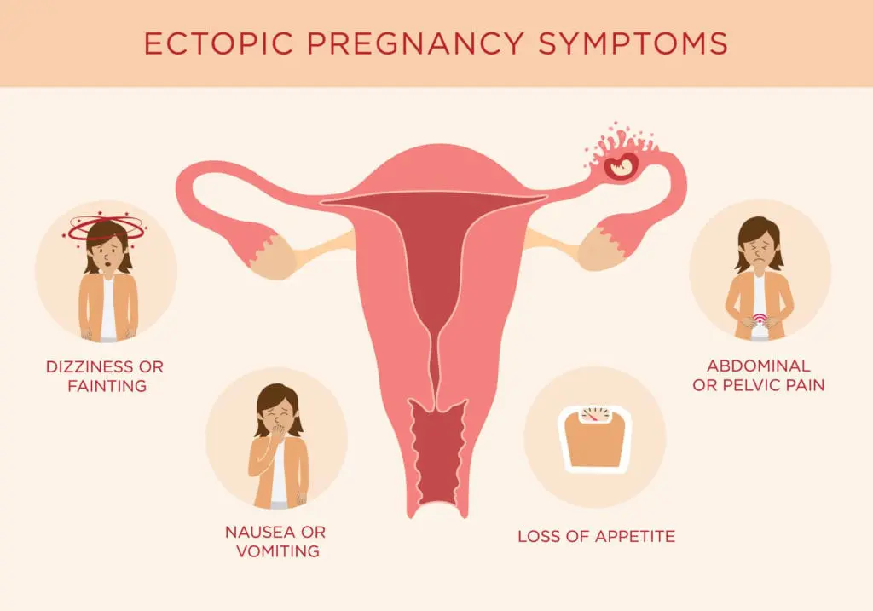
Clinical presentation:
Symptoms of pregnancy.
Abdominal pain .
and/or vaginal bleeding in early pregnancy.
*very acutely with rupture of the EP and
massive intraperitoneal bleeding).
The free blood in the peritoneal cavity can
cause diaphragmatic irritation
and shoulder tip pain.

Slide 6
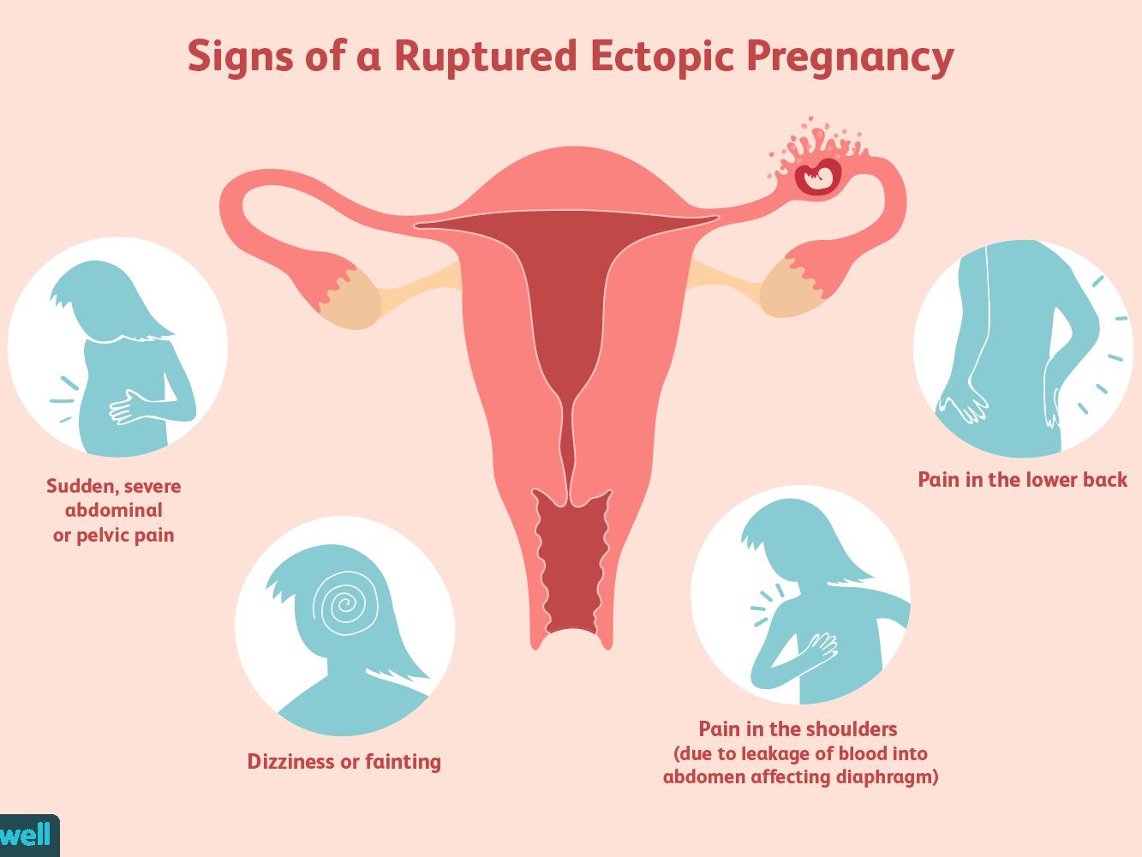
Diagnosis of ruptured EP:
Acute abdomen .
hypovolaemic shock with positive PT.
Bleeding.
Abdominal pain.
Without viable intrauterine pregnancy.(US)

Slide 7
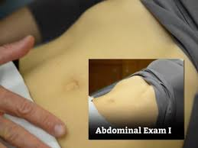
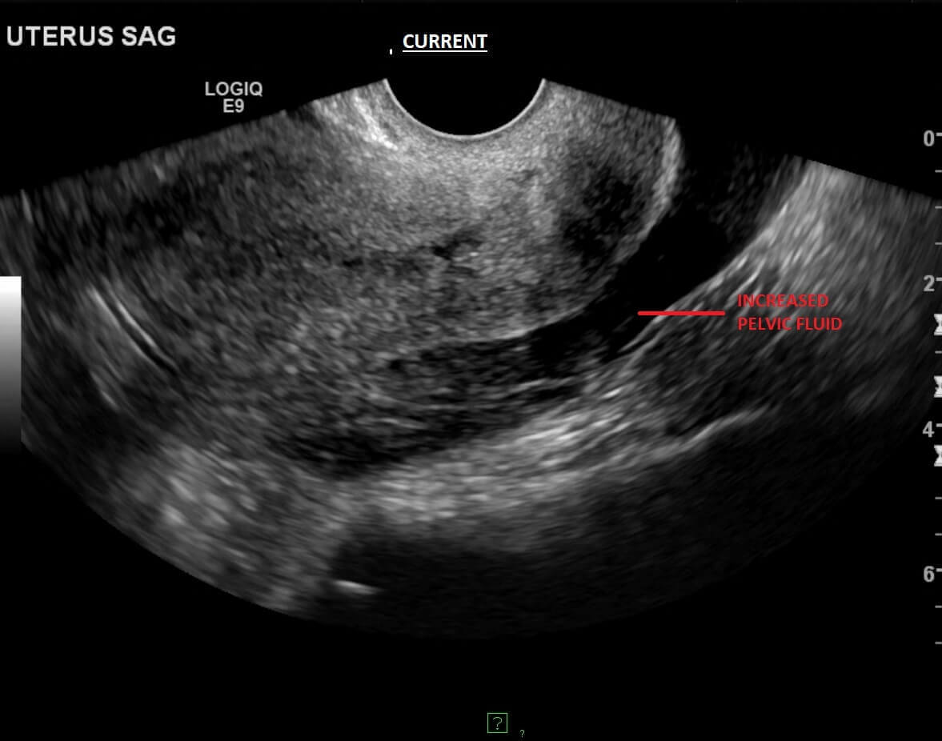
Investigations
important to assess clinically :
(‘abdominopelvic examination) .
TVUSS:
A TVUSS showing :
Empty uterus.
Adnexal mass .
Moderate to significant
free fluid during TVUSS is suggestive
Of a ruptured EP.

Slide 8
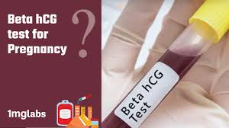

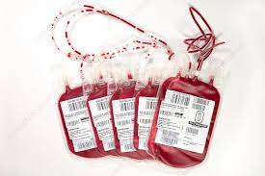
Serum hCG:
the serum hCG level in EP
the rise of hCG is often suboptimal.
Haemoglobin and ‘Group and Save’
(or cross-match if pt is severely compromised)
measure to assess degree of intra-abdominal
bleeding and rhesus status.

Slide 9
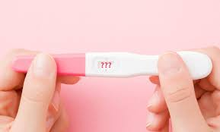
Pregnancy of unknown location
In up to 40% of women with an EP.
Diagnosis is not made on first attendance
and they are labelled as having a ‘pregnancy
of unknown location’ (PUL).
Diagnosis :
Empty uterus + adnexal mass on TVUSS(+positive pregnancy test)
The mainstay of investigation is consecutive measurement of serum hCG concentrations.
Endometrial biopsy (occasionally when hCG levels are static).
All PUL must be investigated to determine the location of the pregnancy.

Slide 10

Management
can be managed using (expectant, medical or a surgical )
……depending on clinical presentation and patient choice.
Expectant management
is suitable for patients who are …. haemodynamically stable.
….. and asymptomatic .
The patient requires serial hCG measurements until levels are undetectable

Slide 11
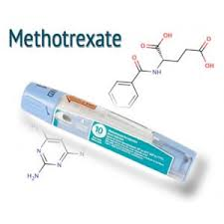
Medical management
Intramuscular methotrexate
is a treatment option for patients with
minimal symptoms.
adnexal mass <40 mm in diameter.
serum hCG concentration under 3,000 IU/l.
Methotrexate is a folic acid antagonist that
inhibits trophoblastic cells.

Slide 12

The dose is calculated based on the patient’s body surface area and
is 50 mg/m2
After methotrexate treatment serum hCG is usually routinely measured on days 4, 7 and 11.
then weekly thereafter until undetectable .
Medical treatment should therefore only be offered if facilities are present for regular follow-up visits

Slide 13
Contraindications to medical treatment include:
(1) chronic liver, renal or haematological disorder.
(2) active infection.
(3) immunodeficiency.
(4) breastfeeding.
side-effects stomatitis, conjunctivitis, gastrointestinal upset and photosensitive skin reaction, and causing abdominal pain.
It is important to avoid
conceiving for 3 months after, coz of teratogenicity risk .
Alcohol
prolonged exposure to sunlight during treatment

Slide 14
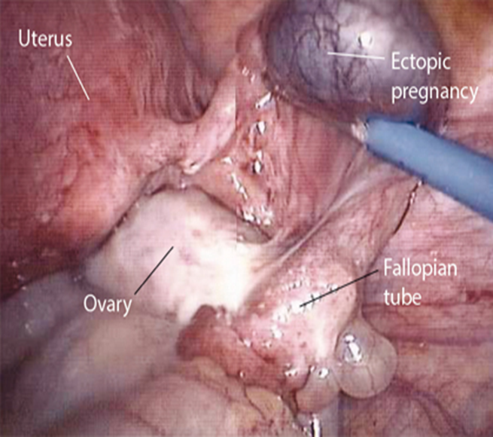
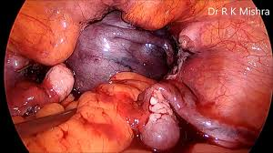
Surgical management
The standard surgical treatment approach is
laparoscopy
(for stable patient).
or
Laparotomy
( for severely compromised patients
or where there are no endoscopic facilities).

Slide 15
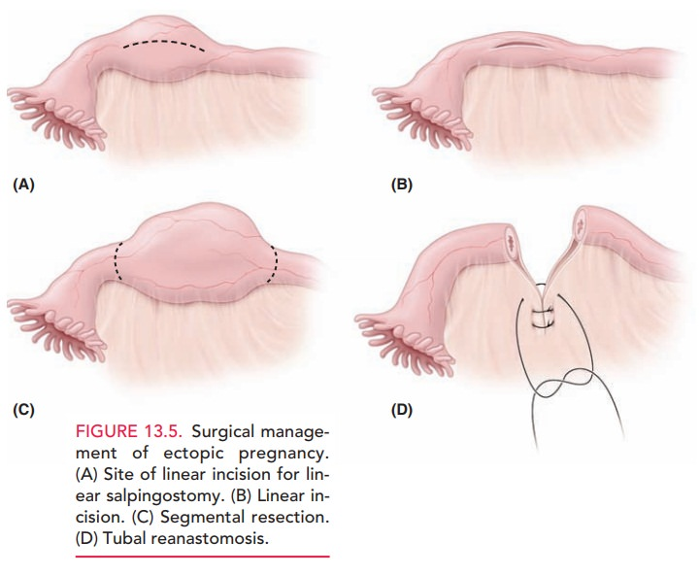
The operation of choice is:
salpingectomy
or
salpingostomy.
Salpingostomy
Recommended only if the contralateral
tube is absent or damaged.
It is associated with a higher rate of
subsequent EP.
Pregnancy rates subsequently remain high if the contralateral tube is normal

Slide 16
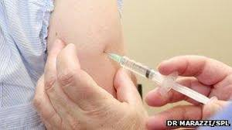
Anti-D administration
All rhesus-negative women who have a surgical procedure to manage an EP or miscarriage should be offered anti-D immunoglobulin.
Anti-D is not required for:
Threatened miscarriage.
Incomplete miscarriage.
complete miscarriage.
medical management of miscarriage or EP but guidelines differ, and prophylaxis is often given

Slide 17
Summary of other early pregnancy disorders
Disorder | Definition | Risk factors | Clinical presentation
Gestational trophoblastic disease (GTD) (abnormal trophoblast proliferation) | Spectrum of conditions that includes complete and partial hydatidiform mole, invasive mole and choriocarcinoma | Previous molar pregnancy High or low maternal age Asian origin | Ultrasound features of intrauterine vesicles (‘cluster of grapes’) Persistently raised hCG levels after miscarriage | Registration Uterine evacuation by suction curettage (without misoprostol) Serial hCG measurements Avoid oestrogens
Hyperemesis gravidarum |  | Multiple pregnancies GTD | Excessive nausea and vomiting, often accompanied by dehydration | Antiemetics Fluid and electrolyte replacement Multivitamins Thromboprophylaxis

Slide 18
CASE HISTORY
Mrs Maysa is a 32-year-old woman who presents after 6 weeks of amenorrhoea with abdominal pain and dizziness. Her observations on admission are blood pressure 90/50 mmHg, pulse 115/min,
temperature 36.9ºC. She has a positive urinary pregnancy test.
A What is your differential diagnosis?
B What are the key points in her history, examination and investigation?
C Discuss her management.

Slide 19
Mrs Maysa is a 32-year-old woman who presents after 6 weeks of amenorrhoea with abdominal pain and dizziness. Her observations on admission are blood pressure 90/50 mmHg, pulse 115/min,
temperature 36.9ºC. She has a positive urinary pregnancy test.
A What is your differential diagnosis?
A EP. The findings of cardiovascular instability, in the presence of pregnancy, are an ectopic until
proven otherwise.
B What are the key points in her history, examination and investigation?
B An EP should be suspected in any woman of reproductive age who presents with symptoms. This
patient has classical symptoms of ectopic pregnancy: pain and dizziness. She also has signs of
hypovolaemic shock. She has a positive urinary pregnancy test.

Slide 20
Mrs Maysa is a 32-year-old woman who presents after 6 weeks of amenorrhoea with abdominal pain and
dizziness. Her observations on admission are blood pressure 90/50 mmHg, pulse 115/min,
temperature 36.9ºC. She has a positive urinary pregnancy test
C Discuss her management.
C ‘ABC’. The patient should have a large bore cannula inserted and be given IV fluids. Bloods
should be taken for full blood count (FBC) and ‘Group and Save’. She should remain nil by mouth.
She requires an abdominopelvic examination. A senior colleague should be informed about her
admission and the possibility of her requiring an urgent laparoscopy.
The patient had a laparoscopy and was discovered to have a large right ruptured EP in her
Fallopian tube with 1.5 litres of blood in her pelvis. She had a salpingectomy and subsequently recovered well

Slide 21
Pregnant in first trimester develop vaginal bleeding and lower quadrant pain, she denied
any passage of tissue. U/S shows: No sac either intrauterine or extrauterine, what is the
most likely diagnosis?
A. Ovarian ectopic
B. Complete abortion
C. Missed abortion
D. Pregnancy of unknown location

Slide 22
Pregnant in first trimester develop vaginal bleeding and lower quadrant pain, she denied
any passage of tissue. U/S shows: No sac either intrauterine or extrauterine, what is the
most likely diagnosis?
A. Ovarian ectopic
B. Complete abortion
C. Missed abortion
D. Pregnancy of unknown location T

Slide 23
Pregnant at 8 weeks with inevitable abortion, they let her decide what she want, after 15
min severe gush of blood coming out, what to do?
A. Observe
B. Mifepristone
C. D&C
D. Expectant management

Slide 24
Pregnant at 8 weeks with inevitable abortion, they let her decide what she want, after 15
min severe gush of blood coming out, what to do?
A. Observe
B. Mifepristone
C. D&C T
D. Expectant management

Slide 25
Female with missed abortion, what to do?
A. Misoprostol
B. Hypertonic saline
C. Myotomy
D. Oxytocin

Slide 26
Female with missed abortion, what to do?
A. Misoprostol T
B. Hypertonic saline
C. Myotomy
D. Oxytocin

Slide 27
Pregnant at 8 weeks of gestation with vaginal spotting and everything else is normal, upon
examination cervix is closed. On US normal gestational sac seen, what is the most
appropriate management?
A. Reassurance
B. Evacuate
C. Misoprostol
D.Repeat US

Slide 28
Pregnant at 8 weeks of gestation with vaginal spotting and everything else is normal, upon
examination cervix is closed. On US normal gestational sac seen, what is the most
appropriate management?
A. Reassurance T
B. Evacuate
C. Misoprostol
D.Repeat US

Slide 29



