Slide 1
Female Urinary Incontinence
Dr Mona Ahmed
Associated Professor
Elmareefa University
SMSB

Slide 2
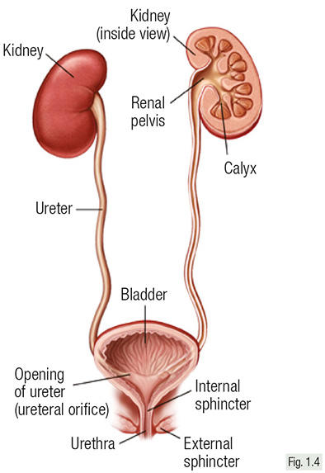
Functions of urinary system
Urine
  – Formation
  – Transport
  – Micturition cycle
• Storage phase
• Voiding phase
↓↓↓Any defect↓↓↓
Urinary Incontinence

Slide 3
Normal Micturition Cycle

Slide 4
Urinary incontinence
demonstrable and is a social or hygienic problem.
• Types
– Continuous:
• Total
• Partial
– Intermittent:
– Stress (1st )
– Urge (2nd)
– Mixed (3rd)
– Reflex
– Overflow
– Nocturnal enuresis
– Functional
– Vaginal ??

Slide 5
Continuous incontinence (patient is always wet)
Type | Total | Partial
Cause | Vesicovaginal fistula Bilateral ureterovaginal F | •Unilateral Uterovaginal F •Small , valvular or very high VVF
Micturition desire | Absent | Present but less than normal
Bladder distention | Absent | May be distended

Slide 6
Intermittent incontinence
(Urine passes intermittently and patient is dry in between)
Involuntary loss of urine:
• Stress : when IVP exceeds IUP due to ↑IAP by stress.
• Urge: associated with strong desire to void due to detrusor instability.
• Reflex: due to abnormal reflex activity in spinal cord ( due to brain tumor & spinal cord injury) usually associated with strong desire to void.

Slide 7
Overflow : when IVP exceeds IUP due to excessive
bladder distension .
• Nocturnal enuresis : during sleep e.g. spina bifida,
small bladder capacity, psychosomatic, & children.
• Functional : due to immobility or cognitive impairment
hinder to get to toilet.
• Mixed

Slide 8
Genuine stress incontinence
Def: Involuntary loss of a spurt of urine simultaneously with manoeuvres that increase IAP which ends abruptly with end of act
Degree of stress incontinence :
Grade I: incontinence occur only with severe stress such as coughing , sneezing . Etc
Grade II : incontinence with moderate stress such as rapid movement or walking up and down stairs
Grade III : incontinence with Mild stress , such as standing . The patient is continent in the supine position

Slide 9
Pathophysiology
An interaction between bladder and sphincter
Bladder abnormalities :
  -Detrussor overactivity ( idiopathic , Neurogenic )
  -Low bladder compliance
  SCI, interstitial cystitis , Radiation cystitis , hysterectomy
Sphincter abnormalities
  Extrinsic : urethral hypermobility
  Weakness of pelvic floor muscle ( urethral support )
  Intrinsic : intrinsic sphincter deficiency ( ISD )
  Urethral musculature . Blood flow , innervation

Slide 10
Aetiology of GSI
• Congenital
• Traumatic:
  – Obstetrics
  – Iatrogenic (operations) causing scarring at bladder neck.
• 3P
  – Pregnancy
  – Prolapse
  – Postmenopausal
• Short urethra
• Obesity

Slide 11
Clinical evaluation
General examination :
• Abdominal examination: Distended bladder,
abdominal mass/obesity.
• Chest examination: For chronic cough.
• Pelvic Examination:
– Inspection:
Atrophic
vaginitis/ urethritis.
-Pelvic organ
prolapse.
-Genitourinary

Slide 12
Examination
• Rectal examination : skin irritation, anal
sphincter control, faecal impaction
• Neurologic examination:
-Mental status.
-Perineal sensation (S2, 3, 4)
-Sacral reflexes assess (S2, 3, 4)
Controlling micturition.
a} Anal reflex → scratch
perineum with a pin.

Slide 13
Special tests
Signs: special tests (Aim, technique, results)
1. Stress test
2. Perineal pad test
3. Q tip test
4.Water bridge test
5. Bladder neck elevation test

Slide 15
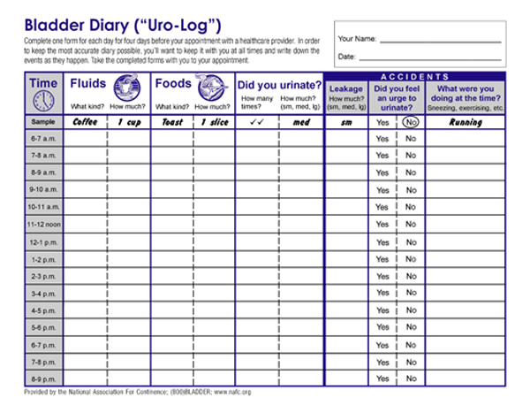

Slide 16
Investigations
Urine analysis
• Kidney function tests
• US for:
– Residual urine
– Renal size
– Bladder mass , neck and urethral anatomy.
• Cystoscopy
• Voiding cystourethrography
• Urodynamic study

Slide 17
Cytometry

Slide 20
Treatment
Prophylactic:
1. Treatment of predisposing factors.
2. Good obstetric care
3. Postnatal pelvic exercises
4. HRT in postmenopausal women
5. Proper surgical technique to avoid scaring at bladder neck.

Slide 21
Conservative Treatment
Life style:
• Weight loss
• Stop caffeine & smoking
• Fluid management
Medical:
– Estrogen either systemic or local in postmenopausal women.
– Alpha-adrenergic stimulants
– Anticholinergics
•Physiotherapy:
– Pelvic floor exercises
– Faradic current stimulation
• Mechanical devices: e.g. pessary, weighted cones
used preoperative or when patient is unfit for surgery
• Others:
– implanted artificial sphincter
– Paraurethral bulking agents : collagen, fat

Slide 22
Surgical Treatment
A} Vaginal Urethroplasty :
Paraurethral fascia on either side of bladder neck by 2-3 sutures.
B} Abdominal Urethrocystopexy:
suture the front of urinary bladder to the back of symphysis pubis.
C} Urethral sling procedures
D} Minimal invasive sling like procedures:
• Tension Free Vaginal Tape {TVT}
• Transobturator Tape {TOT}

Slide 23
Treatment of urge incontinence

Slide 24



