Slide 1
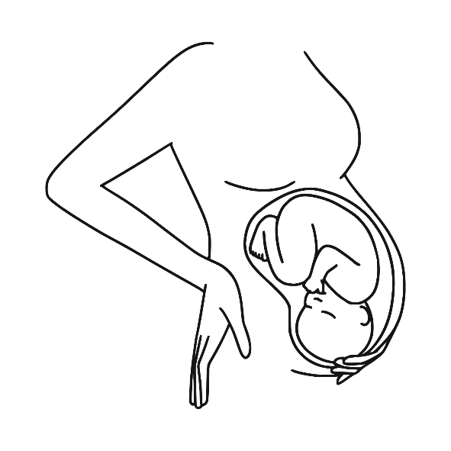

Fetal Growth Restriction
Dr.Bodoor Alshareef

Slide 2
IUGR : when the birth weight of a newborn infant is below the 10th percentile for a given gestational age. low birthweight (<2500 grams)
SGA indicates that a fetus or neonate is below a defined reference range of weight for a gestational age.

Slide 3
Etiology of IUGR:
Maternal :
Behavioral: poor nutritional intake,cigarette smoking, drug abuse.
Medical : early cardiovasculardisease, hypertension, diabetes, obesity (associated with leptin resistance), alcoholism, cyanotic heart disease, and pulmonary insufficiency , antiphospholipid syndrome and hereditary thrombophilia.

Slide 4
Teratogen exposure.
Extreme of maternal age .
Fetal factor : intrauterine infection listeriosis and TORCH and congenital anomalies.
Placental factor : poor implantation , placenta Previa , umbilical cord abnormality.

Slide 5
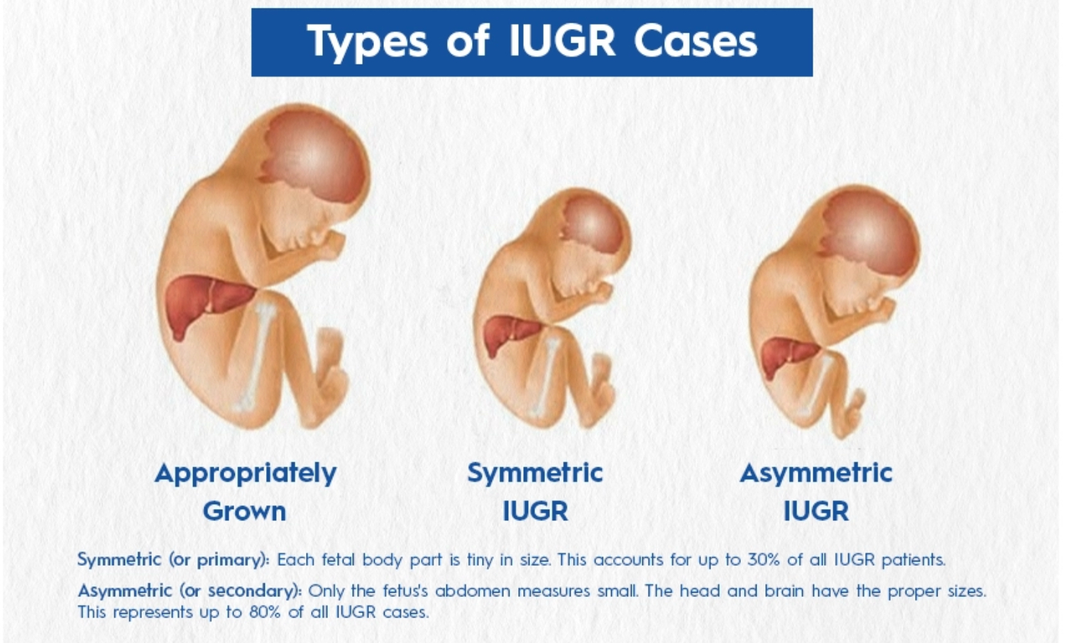
Type: symmetric and asymmetric.

Slide 6
Early FGR <32 week
Late-onset (diagnosed ≥ 32 weeks).

Slide 7
Diagnosis
Serial uterine fundal height measurements. the fundal height lags more than 3 cm behind expectations
Ultrasound
Fetal biometry: biparietal diameter (BPD), head circumference, abdominal cir- cumference, femoral length, calculated fetal weight. amniotic fluid volume. umbilical artery Doppler: low, absent, or reversal of diastolic flow

Slide 8
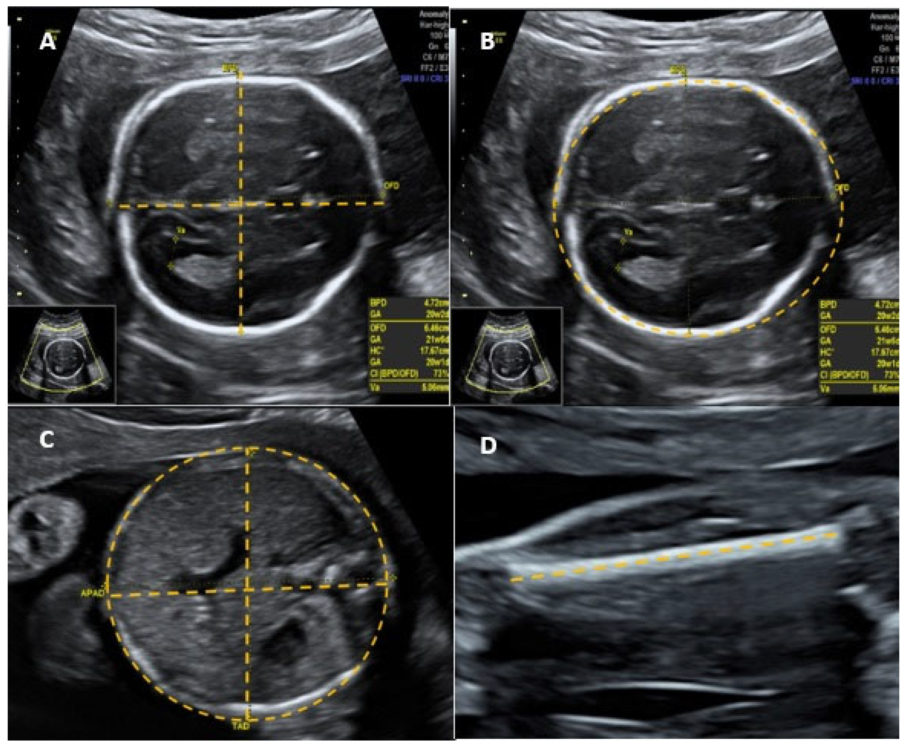

Slide 9
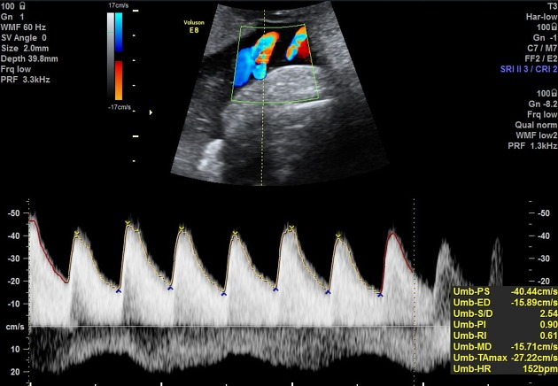

Slide 10
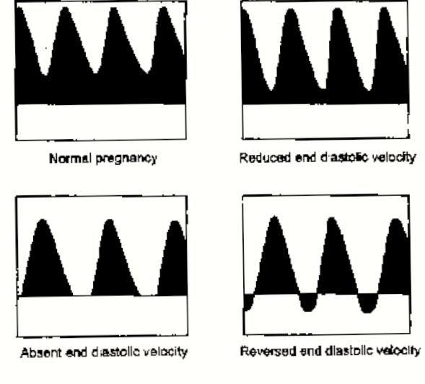

Slide 11
Abdominal circumference is the single most effective parameter for predicting fetal weight because it is reduced in both symmetric and asymmetric IUGR
Maternal lab :serology, amniocentesis

Slide 12
Management

Slide 13
Pre pregnancy: stop smoking and alcohol improve nutrition
Aspirin 81mg/day
Antepartum :
Stop smoking
Improve nutrition work leave teach the patient about fetal kick count .
Hospitalization

Slide 14
twice-weekly nonstress test (NST) and biophysical profile.
Most institutions use a modified biophysical(NST and AFI)
Umbilical artery Doppler weekly.

Slide 15
Labor and delivery :
Treatment of the fetus with suspected IUGR will depend upon the clinical circumstances, particularly the gestational age.
In general, pregnancies of < 34 weeks’
GA should receive a course of antenatal corticosteroids to enhance lung maturation.

Slide 16
IUGR is not a contraindication to induction of labor but low threshold to perform a cesarean section.

Slide 17
Complication
Treatment :
Admission
Hydration

Slide 18
Increased chance of C-section and early birth.
Breathing and feeding issues during birth.
Hypoxia.
Hypoglycemia.
Having trouble regulating body temperature.
Meconium aspiration .
Polycythemia .
Infection.
NICU admission .

Slide 19
A 21-year-old G1P0 woman is seen for her first prenatal visit at the obstetrician’s office. Based on the LMP, the patient is 36 weeks’ gestation. On ultrasound, the measurements indicate 32 weeks for all parameters including the H C, AC, and FL. Which of the following is the best management for this patient?
A. Antenatal steroids for probably IUGR
B. Recommend amniocentesis for karyotype
C. Delivery in 1 week (at term)
D. Continued monitoring and repeat ultrasound
Treatment :
Admission
Hydration

Slide 20
A 21-year-old G1P0 woman is seen for her first prenatal visit at the obstetrician’s office. Based on the LMP, the patient is 36 weeks’ gestation. On ultrasound, the measurements indicate 32 weeks for all parameters including the H C, AC, and FL. Which of the following is the best management for this patient?
A. Antenatal steroids for probably IUGR
B. Recommend amniocentesis for karyotype
C. Delivery in 1 week (at term)
D. Continued monitoring and repeat ultrasound
Treatment :
Admission
Hydration

Slide 21
An 18-year-old G1P0 woman at 38 weeks’ gestation confirmed by a 12-week ultrasound has a fundal height of 34 cm. The patient has gained 20 lbs during the pregnancy. She denies smoking or alcohol or illicit substance use. Her BP is 110/ 70 mm H g. Which of the following is the best management of this patient?
A. Perform a basic ultrasound study
B. Schedule for delivery since the patient has reached a term gestational age
C. Schedule biophysical profile and Doppler studies for this patient
D. Send her urine for a drug screen and consider ordering serum TORCH titers
Treatment :
Admission
Hydration

