Slide 1

By dr. Mona Ahmed Elmareefa university SMSB

Slide 2
Definitions
HMB:
excessive menstrual blood loss
IMB:
bleeding between periods
PCB:
bleeding after intercourse.
PMB:
bleeding more than 1 year after cessation of periods.

Slide 3
HMB
Heavy menstrual bleeding (HMB) is now replaces the older term ‘menorrhagia.
HMB :
is defined as a blood loss of greater than 80 mL per period.
Methods to quantify menstrual blood loss are both inaccurate and impractical
Clinical diagnosis based on ….the patient’s own perception of blood loss .
The presentation of HMB is common because women are having fewer children and consequently more menstrual cycles.

Slide 4
Symptoms which can be associated with HMB and related pathologies
Associated symptoms | Suggestive of
Irregular bleeding Intermenstrual bleeding Postcoital bleeding | Endometrial or cervical polyp
Excessive bruising/bleeding from other sites History of postpartum haemorrhage (PPH) Excessive postoperative bleeding Excessive bleeding with dental extractions Family history of bleeding problems | Coagulation disorder ( will be present in 20% of those presenting with ‘unexplained’ heavy menstrual bleeding.)
Unusual vaginal discharge | Pelvic inflammatory disease
Urinary symptoms | Pressure from fibroids
Weight change skin changes fatigue | Thyroid disease

Slide 5

Aetiology
Hormonal.
structural, with common causes :
Fibroids
Adenomyosis.
Endometrial polyps.
Coagulation disorders(e.g VonWillebrand disease).
Pelvic inflammatory disease (PID).
Thyroid disease.
Drug therapy (e.g. warfarin).
Intrauterine devices (IUDs).
Endometrial/cervical carcinoma.
Often no pathology can be identified. DUB is the diagnosis of
exclusion.

Slide 6
History and examination
Patients will have different ideas as to what constitutes a ‘heavy period’,
Useful questions include:
How often sanitary wear need to be used?
Is there presence of clots?
Is the bleeding so heavy (flooding)?
Have you had to take any time off work due to this bleeding?
Is it causing symptoms & signs of anaemia?
Examining:
signs of anaemia.
Abdominal and pelvic examination for (masses ).
Cervical visualization for( polyps/carcinoma)
Take swabs if pelvic infection is suspected.
Cervical smear to be taken if one is due.

Slide 7
Investigations
Hormonal profile.
Full blood count:
Anaemia.
Coagulation screen.
Pelvic ultrasound scan:
when a pelvic mass is palpated on examination(fibroids).
when symptoms suggest an endometrial polyp( e.g. irregular or intermenstrual bleeding).
when drug therapy for HMB is unsuccessful.
High vaginal and endocervical swabs:
when unusual vaginal discharge.
where there are risk factors for PID.
Endometrial biopsy.
Thyroid function tests.
hysteroscopy with guided biopsy may be indicated.

Slide 8
Management
Reassure For some women, the demonstration that their blood loss is in fact ‘normal’.
Medical treatments (temporary).
Surgical treatments ( incompatible with desired fertility).
When selecting management it is important to consider and discuss:
• the patient’s preference of treatment;
• risks/benefits of each option;
• contraceptive requirements:
• family complete?
• current contraception?
• past medical history:
• any contraindications to medical therapies for HMB?
• suitability for an anaesthetic. Previous surgical history?

Slide 9
Medical treatments
Mefenamic acid:
Reduction in menstrual blood loss of 20–25 percent.
Benefits:
Effective analgesia( useful if any dysmenorrhoea).
• Disadvantages:
Contraindicated with a history of duodenal ulcer or severe asthma.
long-term usage may cause difficulties in conceiving
• Recommended dose: 500 mg p.o. tds.
Tranexamic acid:
Reduction in menstrual blood loss (MBL) 50 per cent.
• Recommended dose: 1 g p.o. qds to be taken when menstruating heavily

Slide 10
Combined oral contraceptive pill:
• Benefits: Doubles up as a very effective
contraceptive when taken properly.
• Disadvantages:
(1) It is contraindicated for patients who have risk factors for thromboembolism.
(2) It is unsuitable for patients over 35 years old who smoke.
(3) It is unsuitable if there is a personal or family history of breast cancer.
(4) It is unsuitable for patients who are grossly overweigh.
Norethisterone
(progestogen) taken in a cyclical pattern .
• Benefits:
It is a safe.
and effective oral preparation,.
• Disadvantages:
It is not a contraceptive.
can cause irregular bleeding

Slide 11
GnRH agonists:
Act on the pituitary to stop the production of oestrogen( results in amenorrhoea).
Only used in the short term due to the resulting hypoestrogenic state( osteoporosis).
Benefits:
They are effective for associated dysmenorrhoea.
Disadvantages:
They can cause irregular bleeding
They can be associated with flushing and sweating.
Levonorgestrel intrauterine system
Alternative to surgical treatment.
Reductions 95 per cent by one year after insertion .
Benefits:
Its contraceptive.
Effective for associated dysmenorrhoea.
30 per cent of women are amenorrhoeic by one year .
Disadvantages:
Irregular menses for the first three to nine months after insertion

Slide 12
Surgical treatments
When?
If medical treatments have failed.
Women who completed their families.
1. Endometrial ablation
Endometrial lining destructive procedures .
Reduction in blood loss around 90 per cent.
They are two types:
First-generation techniques, include:
Electrical diathermy ablation,
Second-generation techniques include:
• Controlled endometrial ablation.
• Thermal uterine balloon.
• Microwave ablation .

Slide 13
2.Umbilical artery embolization UAE:
3.Hysterectomy
A hysterectomy may be achieved using three approaches:
Abdominal.
Vaginal.
Laparoscopic.

Slide 14
IMB
IMB:
bleeding between periods, often seen with
Causes :
Endometrial polyp.
cervical polyps.
Endometriosis

Slide 15
PCB
PCB:
bleeding after sex.
Causes:
associated with cervical abnormalities
Infection
malgnancy

Slide 16
Post-menopausal bleeding
PMB:
is defined as vaginal bleeding after the menopause.
This is abnormal and should
always be investigated
Aetiology
atrophic vaginitis,
endometrial polyps.
endometrial hyperplasia.
endometrial carcinoma.
cervical carcinoma.
Majority of women with PMB have atrophic vaginitis.

Slide 17
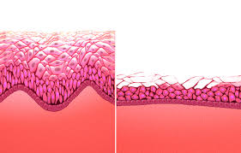
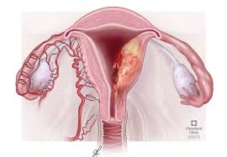
What is atrophic vaginitis?
Vaginal epithelium thins and breaks down
in response to low oestrogen levels.
This is a benign condition.
Easily treated with topical oestrogens.
10 per cent of patients with PMB will have
endometrial cancer.
The risk of endometrial cancer progressively
increases with age.

Slide 18
History and examination
History:
• When was your last period? (i.e. confirm menopausal)
• Was the bleeding post-coital? (i.e. think cervical polyp/cervical malignancy)
• When was your last smear done? Have they always been normal? (i.e. think cervical malignancy).
Examination :
Abdominal examination.
Vaginal examination to detect any pelvic masses.
Speculum to visualize:
vagina for atrophy
cervix for polyps or potential carcinoma.
Asmear should be taken if due.

Slide 19
Investigations
Ultrasound scan:
To assess endometrial thickness.
If thickness is 3 mm or less:
Reassurance.
No further investigation is required.
If thickness > 3 mm:
Endometrial biopsy.
Hysteroscopy.
MRI.
Other investigations(CBC..CXR..ECG..RFT..LFT)

Slide 20
Endometrial cancer is most prevalent in the postmenopausal age group.
Risk factors :
Nulliparity.
Obesity.
Early menarche & late menopause.
Tamoxifen exposure.
Diagnosis:
is by Endometrial biopsy.
Treatment:
Total abdominal hysterectomy + washings+ bilateral salpingo-oophorectomy and lymph node evaluation.(then staging)
Postoperative radiotherapy.
Or chemotherapy.
Prognosis:
Good if detected early

Slide 21
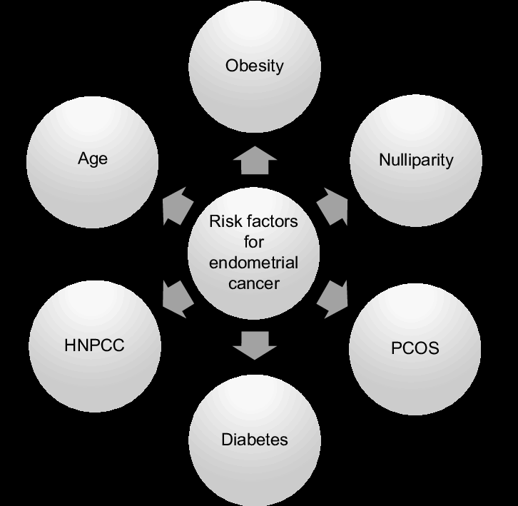

Slide 22
Information required | Relevant factors | Possible diagnoses
Developmental history including menarche | Delayed/incomplete | Congenital malformation or chromosomal abnormality
Menstrual history | Oligomenorrhoea Secondary amenorrhoea | PCOS POF
Reproductive history | Infertility | PCOS
Cyclical symptom | Cyclical pain without menstruation | Congenital malformation Imperforate hymen
Hair growth | Hirsutism | PCOS
Weight | Dramatic weight loss Difficulty losing weigh | Hypothalamic malfunction PCOS
Lifestyle | Exercise, stress | Hypothalamic malfunction
Past medical history | Systemic diseases, e.g. sarcoidosis | Hypothalamic malfunction
Past surgical history | Evacuation of uterus | Asherman’s
Visual disturbance |  | Pituitary adenoma
Drug history | Dopamine agonists, HRT | Hypothalamic malfunction
Headache |  | Pituitary adenoma
Galactorrhoea |  | Prolactinoma

Slide 23



