Slide 1
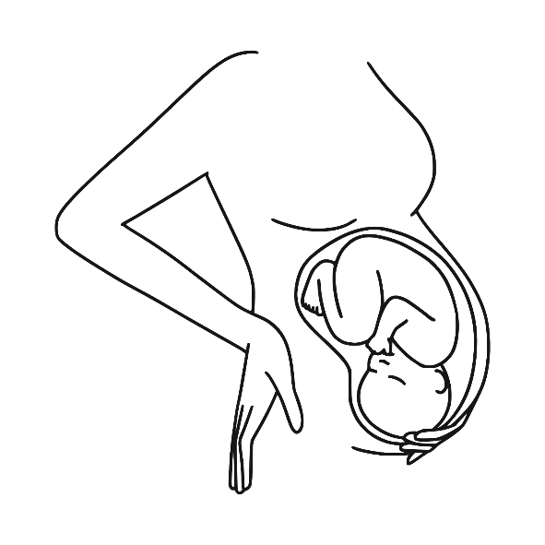

Hypertensive Disorder of Pregnancy
Dr.Bodoor Alshareef

Slide 2
Incidence :
World wide incidence of hypertensive disorder in pregnancy is 10%
One of the leading cause of maternal mortality due to CNS haemorrhage

Slide 3
Classification:
Gestational HTN
Chronic HTN pre eclampsia with or without sever feature
Chronic HTN with superimposed Preeclapsia
Eclampsia

Slide 4
The diagnosis of hypertension should be reserved for pregnant women with a systolic blood pressure
≥140 mm Hg and/or a diastolic blood pressure ≥90 mm Hg.

Slide 5
Gestational HTN
The diagnosis of gestational hypertension is made if hypertension without proteinuria or other signs of organ dysfunction first appears after 20 weeks’ gesta- tion or within 48 to 72 hours of delivery and resolves by 12 weeks postpartum.
Formerly called PIH (pregnancy induced HTN).

Slide 6
CHRONIC HYPERTENSION:
The diagnosis of chronic hypertension requires at least one of the following: known hypertension before pregnancy or the development of hypertension before
20 weeks’ gestation.

Slide 7
Preeclampsia:
New-onset hypertension is defined as the development of hypertension (systolic blood pressure ≥140 mm Hg or diastolic blood pressure ≥90 mm Hg on two occasions 4 hours apart) in a woman whose blood pressure readings were previously normal, after the 20th week of pregnancy.
New-onset proteinuria is defined as ≥0.3 g of protein in a timed 24-hour urine collection or a protein/creatinine ratio ≥0.3 after the
20th week of gestation

Slide 8
Urine dipstick readings are not preferred, but if no other method is available, +1 or greater indicates proteinuria
Protein levels are not predictive of how the disease will progress
Edema is no longer considered diagnostic criterion

Slide 9
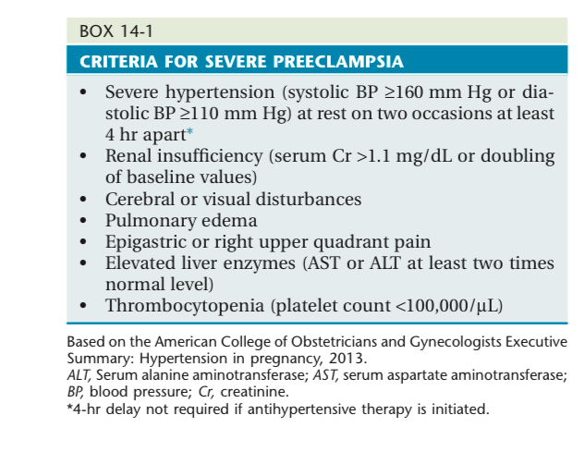

Slide 10
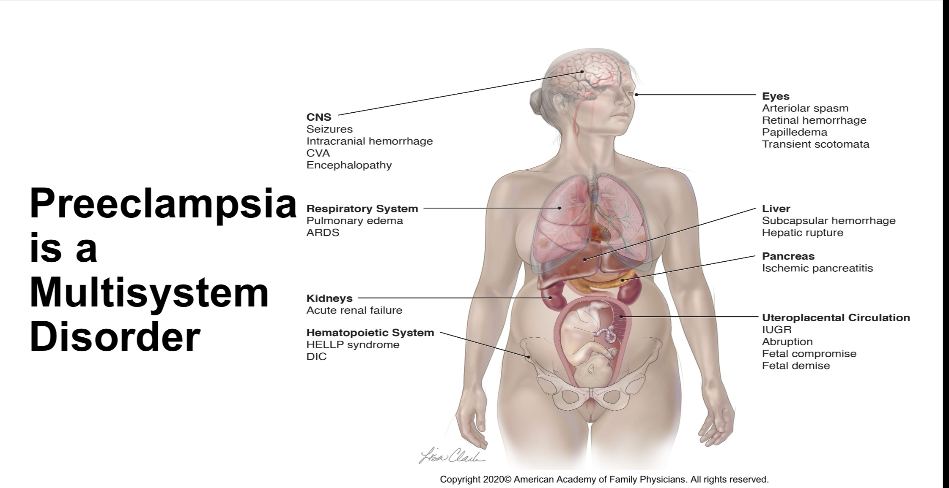

Slide 11
ECLAMPSIA
Eclampsia is the presence of new-onset grand mal seizures in a woman with preeclampsia that cannot be attributed to other causes.

Slide 12
HELLP syndrome :
Haemolysis elevated liver enzymes
Low platelets
Need all three to diagnose HELLP syndrome; however, any one of them is diagnostic of preeclampsia with severe features when elevated BP is present

Slide 13
Chronic HTN with superimposed preeclampsia :
Women with chronic hypertension who develop new-onset proteinuria (≥0.3 g in a 24-hour collection) after the 20th week of gestation.
In pregnant women with preexisting hypertension and proteinuria, the diagnosis of superimposed preeclampsia should be considered if they experience sudden significant increases in blood pressure or proteinuria or the new onset of any of the other signs and symptoms of severe preeclampsia

Slide 14
Pathogenesis of preeclampsia: it is multi system disorder.
Inadequate uteroplacental perfusion leading to placental ischemia,which lead to oxidative and inflammatory stress, with the involvement of secondary mediators leading to endothelial dysfunction, vasospasm, and activation of the coagulation system.
Treatment :
Admission
Hydration

Slide 15
When preeclampsia arises in the early second trimester (14 to 20 weeks), a hydatidiform mole or choriocarcinoma should be considered.
Treatment :
Admission
Hydration

Slide 16
Risk Factors for Preeclampsia
● Nulliparity
● First-degree relative with history of preeclampsia
● Previous preeclamptic pregnancy
● Chronic HTN
● Obesity
● Chronic renal disease
● Multiple-gestation pregnancy
● Diabetes
● Systemic lupus erythematosus
● Maternal age >40 years
Treatment :
Admission
Hydration

Slide 17
The evaluation should focus on whether there is any past history of elevated blood pressure or renal disease, either before pregnancy or during previous pregnancies. The patient should be questioned carefully regarding symptoms of severe preeclampsia or its complications, ICU admission.
Outcome of her pregnancy and NICU admission .
Mode of delivery and at which GA
Follow up after delivery.
Treatment :
Admission
Hydration

Slide 18
The physical examination should be focused on the assessment of blood pressure, weight gain, edema, fundal height, and reflexes, as well as on a qualitative assessment of urinary protein excretion with a dipstick.
In addition, findings consistent with severe preeclamp- sia, such as epigastric or right upper quadrant tender- ness, uterine tenderness, and signs of pulmonary edema, should be sought.
If there is severe headache or visual symptoms, an ophthalmic examination may be indicated.
Treatment :
Admission
Hydration

Slide 19
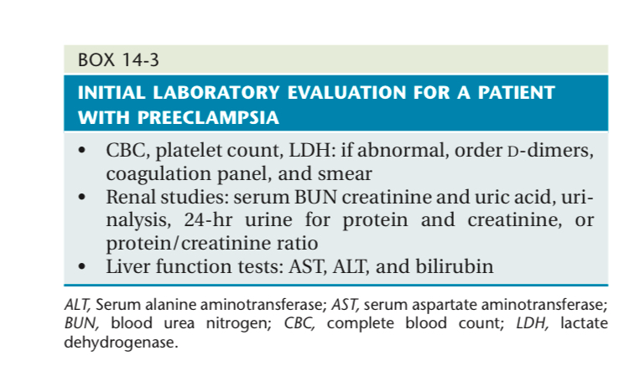
Treatment :
Admission
Hydration

Slide 20
Fetal ultrasound should be performed to evaluate fetal growth, amniotic fluid index, and the umbilical artery Doppler resistance index or systolic/ diastolic ratio.
A nonstress test (NST) should also be done to determine if there evidence of acute fetal compromise
Treatment :
Admission
Hydration

Slide 21
Management
Treatment :
Admission
Hydration

Slide 22
Delivery is the only definitive cure for preeclampsia.
Treatment :
Admission
Hydration

Slide 23
Manegement of chroic HTN :
The primary goals of management of chronic hypertension are to control hypertension and detect the development of superimposed preeclampsia in the mother and IUGR in the fetus.
As a general rule, the safest antihypertensive medication should be used at the lowest possible dose needed to keep blood pressure at about 130/80 mm Hg to 140/90 mm Hg.
Treatment :
Admission
Hydration

Slide 24
Methyldopa is considered to be the safest antihypertensive medication in pregnancy, but calcium channel blockers and labetalol are also considered to be safe.
Angiotensin-converting enzyme inhibitors, angiotensin II receptor blockers, renin inhibitors, and mineralocorticoid blockers should be avoided at all stages of pregnancy because of potential fetal toxicity.
Beta blockers should be used with caution because they may cause fetal growth restriction and may affect the interpretation of the NST .
Treatment :
Admission
Hydration

Slide 25
The timing of delivery in the patient with chronic hypertension depends on the clinical circumstances.
For patients without evidence of fetal growth restriction or superimposed preeclampsia, in whom blood pressure is well controlled and who have no other indications for delivery, pregnancy may be allowed to progress until at least 38 weeks’ gestation.
The route of delivery should be vaginal in the absence of other obstetric reasons for cesarean delivery.
Treatment :
Admission
Hydration

Slide 26
Mangment of gestaional HTN :
No hospitalization
Delivery at 37 week
Monitor for preeclmpsia or complication.
The route of delivery should be vaginal in the absence of other obstetric reasons for cesarean delivery

Slide 27
Mangment of preeclmpsia : should be delivered by the time she reaches 37 weeks,or earlier if she develops signs or symptoms of worsening disease or if there is evidence of fetal compromise.

Slide 28
If the initial evaluation is consistent with the diagnosis of severe preeclampsia, the patient should remain hospitalized for the remainder of the pregnancy.
Treatment :
Admission
Hydration

Slide 29
After 34 weeks’ gestation, stabilization and delivery are appropriate for most patients.
For those patients at less than 34 weeks’ gestation who have severe preeclampsia the decision regarding delivery needs to be individualized after carefully considering the risks to the neonate of prematurity versus the potential maternal and fetal risks of continuing the pregnancy.

Slide 30
Both the mother and fetus require very close monitoring with maternal laboratory parameters and fetal assessment testing repeated daily or more often if necessary. stabilization of the patient with severe preeclampsia with magnesium sulfate for seizure prophylaxis, along with medical control of severe hypertension and corticosteroids for fetal lung maturity
Treatment :
Admission
Hydration

Slide 31
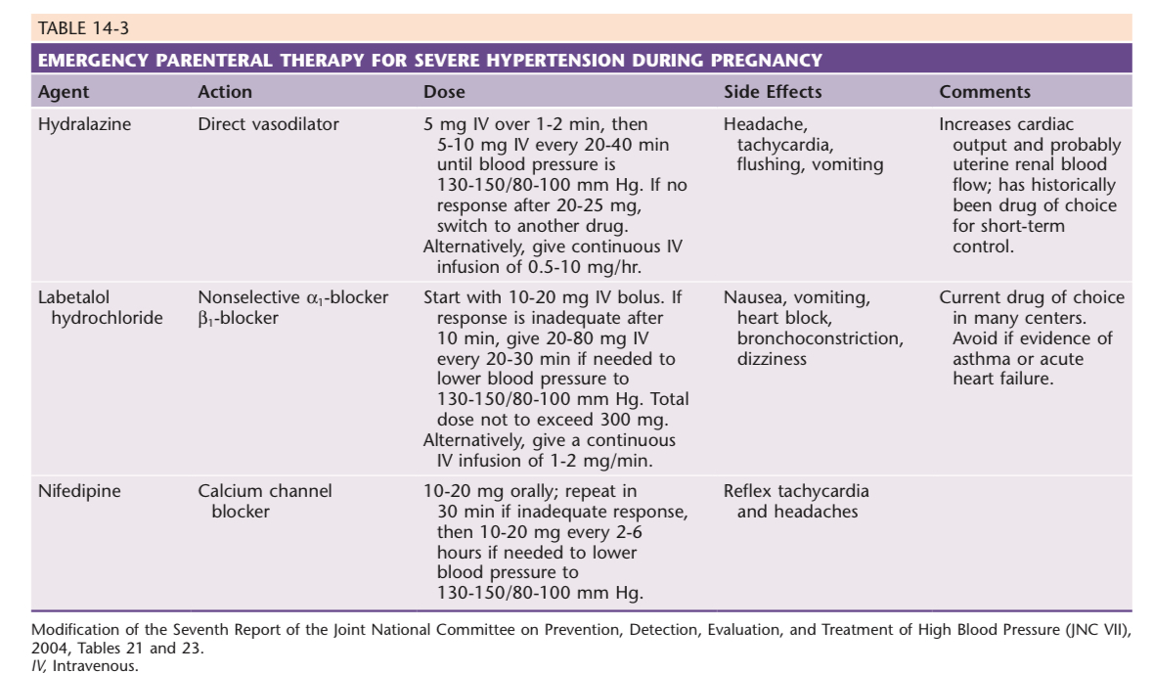
Treatment :
Admission
Hydration

Slide 32
Intrapartum Manegement of Preeclampsia
Treatment :
Admission
Hydration

Slide 33
SEIZURE PROPHYLAXIS
magnesium sulphate
4-6 g IV loading dose over 20-30 minutes, followed by
continuous infusion of 1-2 g/hour
Serial assessments of urine output, deep tendon reflexes, and respirations are important for detecting signs of magnesium toxicity.

Slide 34
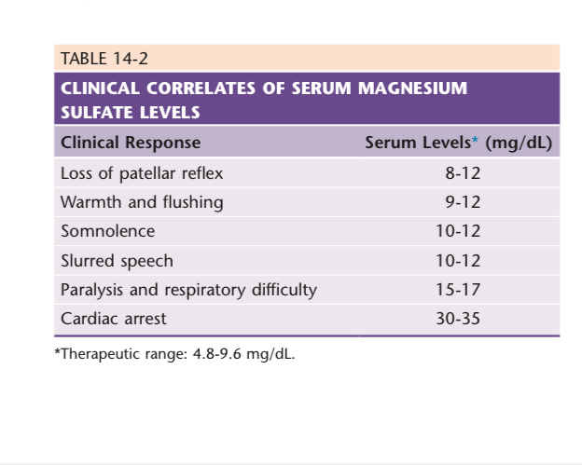

Slide 35
Magnesium toxicity is treated by stopping the infusion and
administering IV calcium gluconate along with resuscitative measures if necessary.

Slide 36
ANTIHYPERTENSIVE THERAPY
  caution not to lower the arterial pressure too much or too rapidly, for either may result in a decreased uteroplacental blood flow and fetal distress, which may necessitate an emergency cesarean delivery in an unstable mother.

Slide 38
Management of Eclampsia:
Do not attempt to shorten or stop initial seizure with
anticonvulsants
(ABC) Protect airway and administer oxygen
Roll to left side and provide suction to minimize aspiration
Prevent injury by padding side rails
Administer MgSO4 to prevent further seizures
When stable, plan for mode of delivery

Slide 39
Eclamptic seizures often induce a fetal bradycardia that usually resolves after maternal stabilization and correction of hypoxia, unless there is a placental abruption.

Slide 40
SEIZURE PROPHYLAXIS
magnesium sulphate
4-6 g IV loading dose over 20-30 minutes, followed by
continuous infusion of 1-2 g/hour
Serial assessments of urine output, deep tendon reflexes, and respirations are important for detecting signs of magnesium toxicity.

Slide 41
How to prevent Preeclampsia ??

Slide 42
Aspirin
81 mg/day for 12-28 weeks starting at 12
weeks

