Slide 1

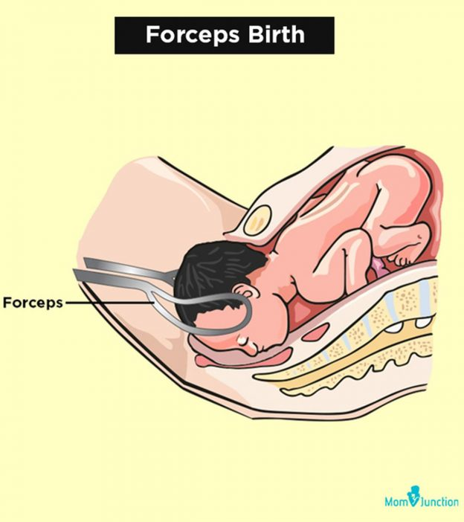
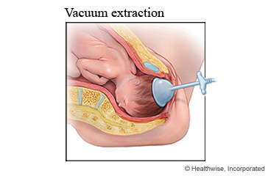

By dr.Mona Ahmed
Assisted Professor SMSB
Almareefa University
SMSB

Slide 2

Learning outcomes
When you have completed this tutorial you will be able to:
decide when an instrumental delivery is needed
decide which instrument is appropriate
appreciate the techniques required for vacuum and forceps delivery
recognise the complications associated with instrumental delivery
know when to abandon the procedure.

Slide 3
Learning outcomes
KEY LEARNING POINTS
OVD should be classified according to the position and station of the presenting part.
Clinical assessment and confirmation that the safety criteria have been met are prerequisites for OVD.
Vacuum or forceps may be suitable depending on the clinical circumstances and operator’s preference.
OVDs with a higher chance of failure should be conducted in an operating theatre.
Contingency planning is an essential part of any OVD.
Anticipation and early management of maternal and neonatal complications is essential.
Caesarean

Slide 4
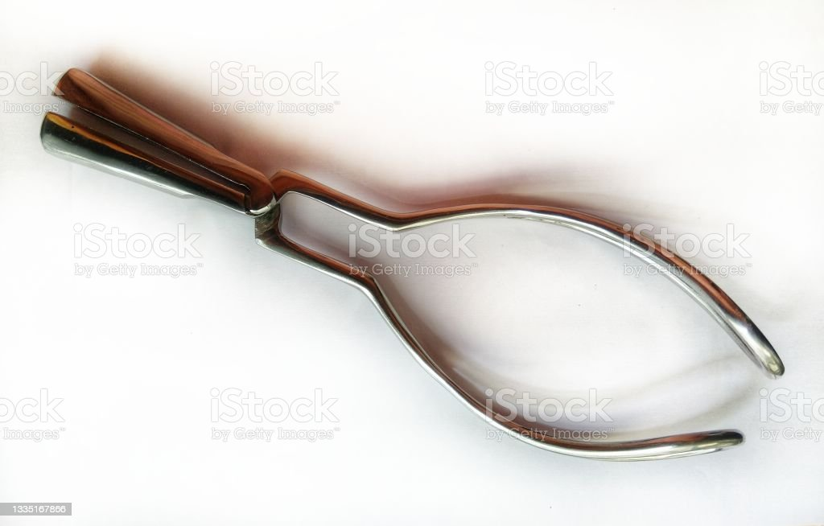
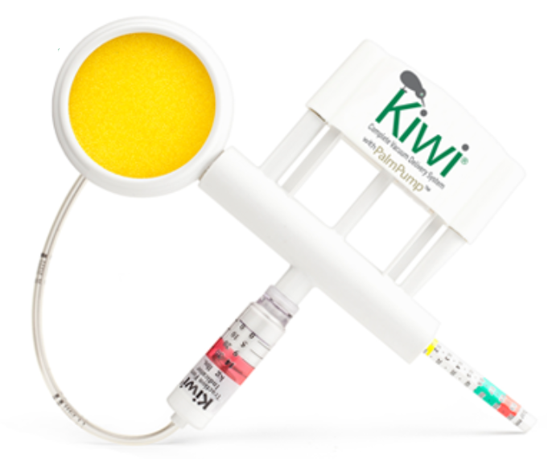
Obstetric instruments
Obstetric forceps.
Obstetric vacuum.

Slide 5
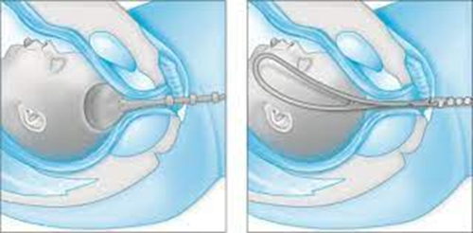
Choice of instruments
Conditions where ventouse would be preferred over forceps
Urgent low lift-out delivery.
Rotational delivery.
Operator or maternal preference.
Conditions where forceps would be preferred to ventouse
Poor maternal effort.
Operator or maternal preference.
Large caput.
Gestation of less than 34 weeks (at 34–36 weeks of gestation, ventouse is relatively contraindicated).
After-coming head of the breech

Slide 6
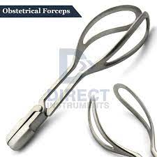
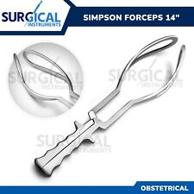
1.Obstetric forceps
Definition:
-An instruments to offer traction and / or rotation
of the Fetal head When the mothers expulsive forces
are not sufficient to accomplish a safe delivery of the fetus

Slide 7
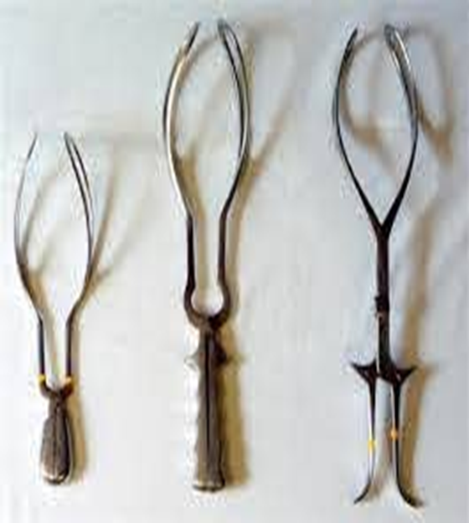
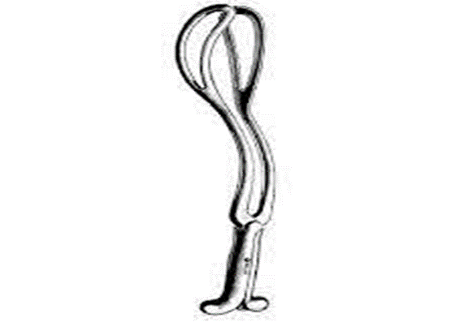
Types:
1. Short curved or Wrigley's forceps…… Outlet forceps
2. Long curved or Simpsons forceps……..midway forceps
( For traction only) in breech vaginal delivery & in CS
3. Long straight or kiellands forceps. For rotation and
raction when head above 0 station.
4. Piper : after the coming of the head in a vaginal
breech baby

Slide 8
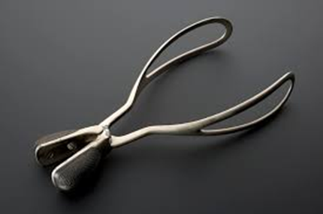
Indications for forceps delivery
1. Maternal:
Dangers for the mother (eg.prophylactic forceps(heart diseases):
Toxaemia of pregnancy (pre-eclampsia & eclampsia).
Weakness in the abdominal wall (eg.hernias ).
Maternal distress.

Slide 9

2. Fetal:
prophylactic forceps(Dangers for the fetus)…….as in the case of Cord prolapse.
Abnormal presentations &position:
occipito-posterior ,deep transverse arrest, face presentation & after-coming head.
Fetal distress .
3- Prolonged 2nd stage of labor:
Over 2 hrs in multipara or 3 hrs in primigravidae.
we can use it in C-section, to pick the head up

Slide 10
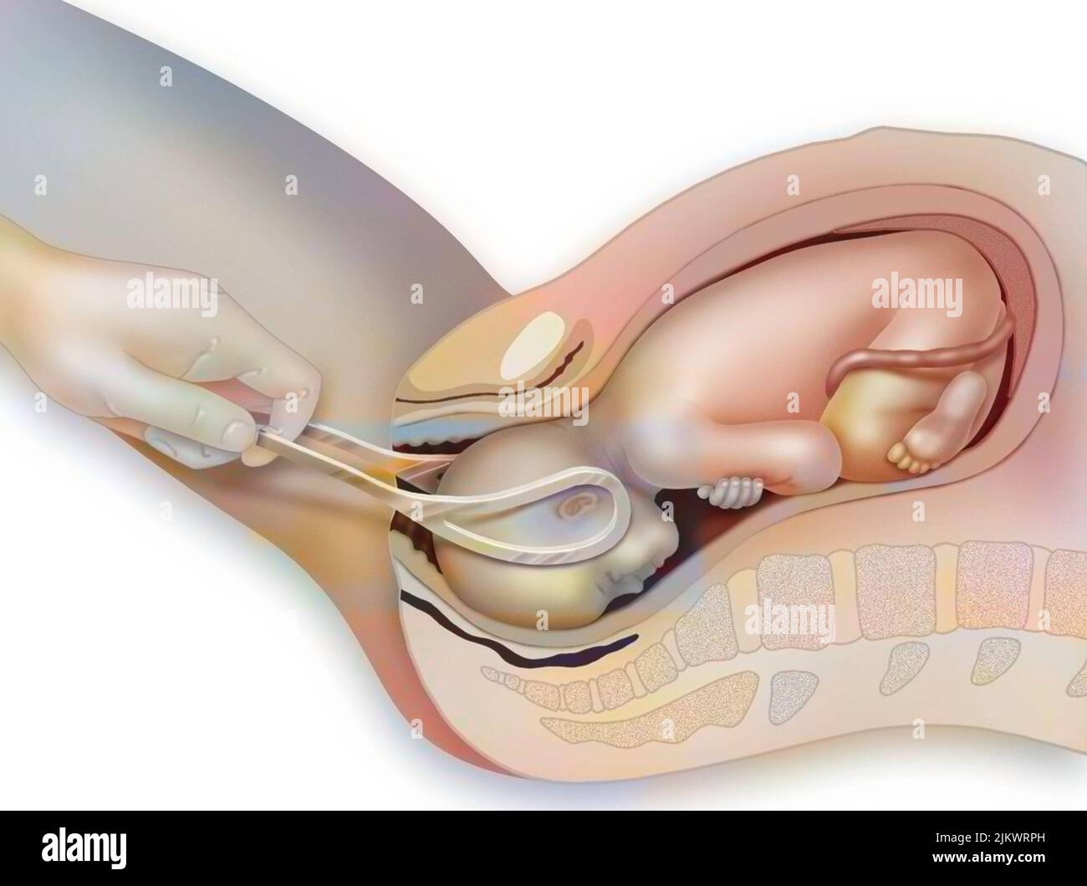
Pre-requests:
Cephalic presentation(piper forceps in breech).
Head is engaged .
A fully dilated cervix.
Ruptured membranes.
Empty bladder & rectum.
Adequate Anaesthesia.
Adequate pelvis.
Episiotomy.
Make sure you lock the device before using it.
Experienced operator

Slide 11
Complications:
A. Maternal:
Traumatic lesions of the lower uterine segment, cervix, vagina& perineum.
Sepsis.
Obstetric shock.
Bone injuries: Separation of the symphysis .
Dislocation of the Sacro-iliac joint .
fracture of the coccyx or its dislocation.
Post partum haemorrhage (traumatic or atonic).
Vesico-vaginal fistula & stress incontinence.

Slide 12
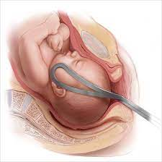
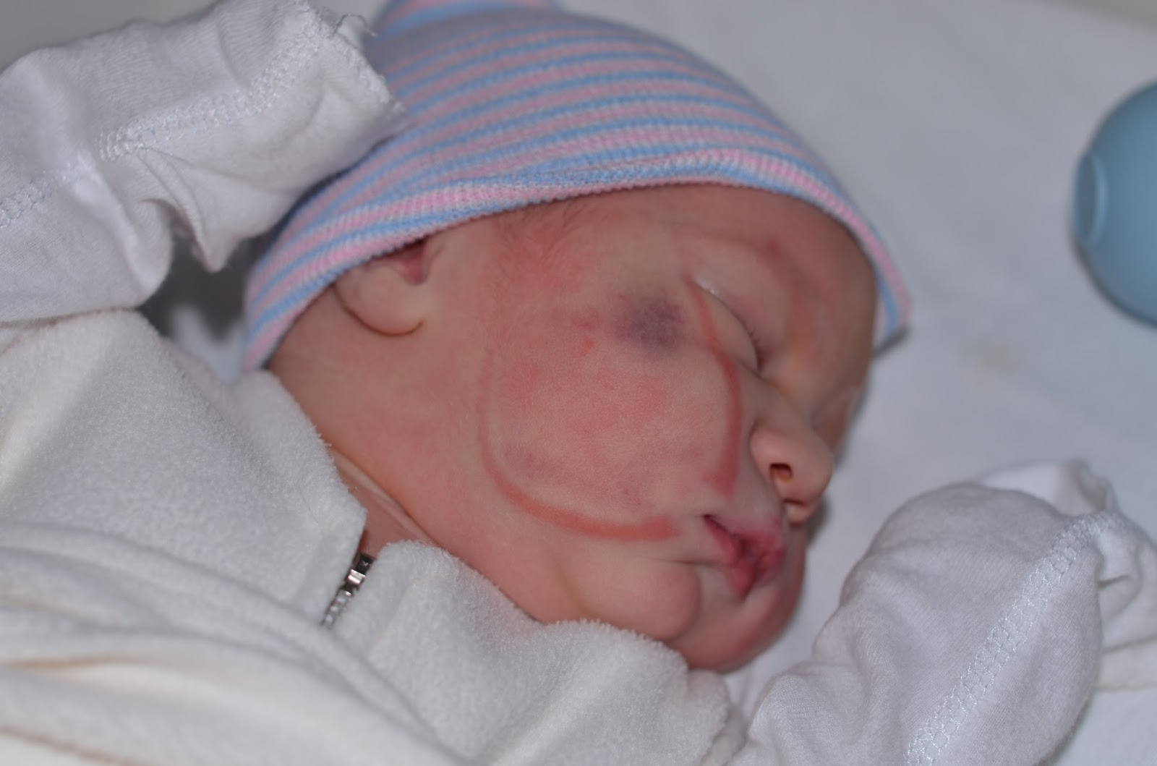
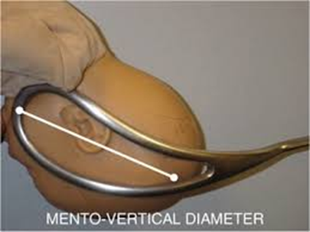
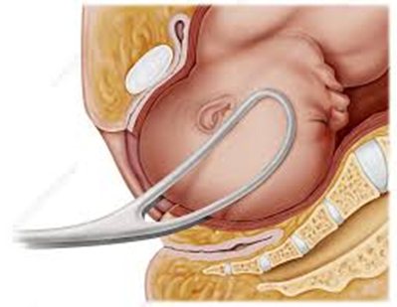
B-Fetal:
soft tissue compression
cranial injury due to incorrectly placed forceps blade.
Contraindication:
Hx. Of cephalo-pelvic disproportion.

Slide 13
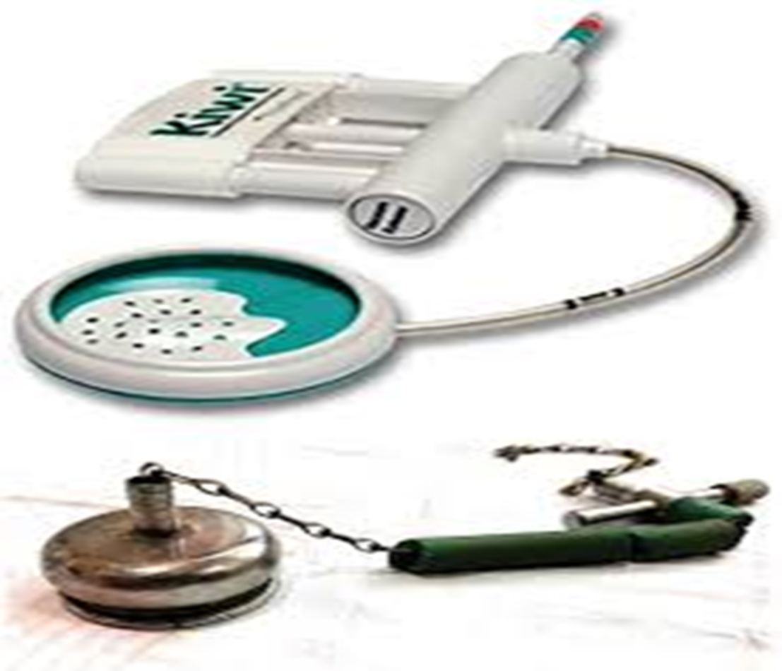

The vacuum extractor or ventose:
Definition:
A cup like instrument held against the Fetal head for
suction under the aid of the mothers pushing
Types:
Two types:
Metal cup ventose
plastic cup ventose.
write the type of the ventose in the exam.

Slide 14
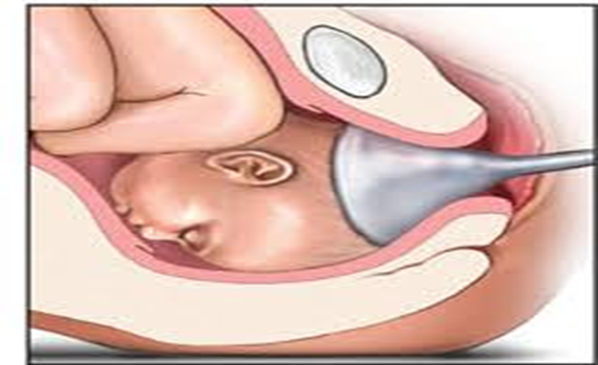

Prerequisites :
Clinically adequate pelvic dimension
Experienced operator
Cervix fully dilated
Engaged Fetal head
Gestational age greater than 34 w
Fetal head direction not important.

Slide 15
Indications:
All the indications of forceps delivery EXCEPT:
face presentation
after- coming head in breech.
It can be utilized to remove the head out of a lower uterine segment C-section.

Slide 16
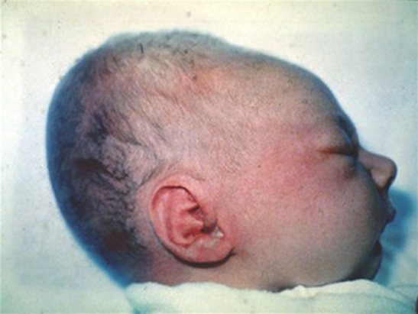
Contraindications:
Face, breech & transverse presentation of the after coming head.
Premature babies.
Moderate or severe cephalo-pelvic disproportion.
Fetal & maternal distress that requires a rapid delivery.
Complications:
Increase the risk of cervical incompetence.
Vaginal laceration .
Fetal skull injuries: Cephalohematoma,
Intracranial haemorrhage
scalp lacerations, necrosis & alopecia.

Slide 17


Slide 18



