Slide 1
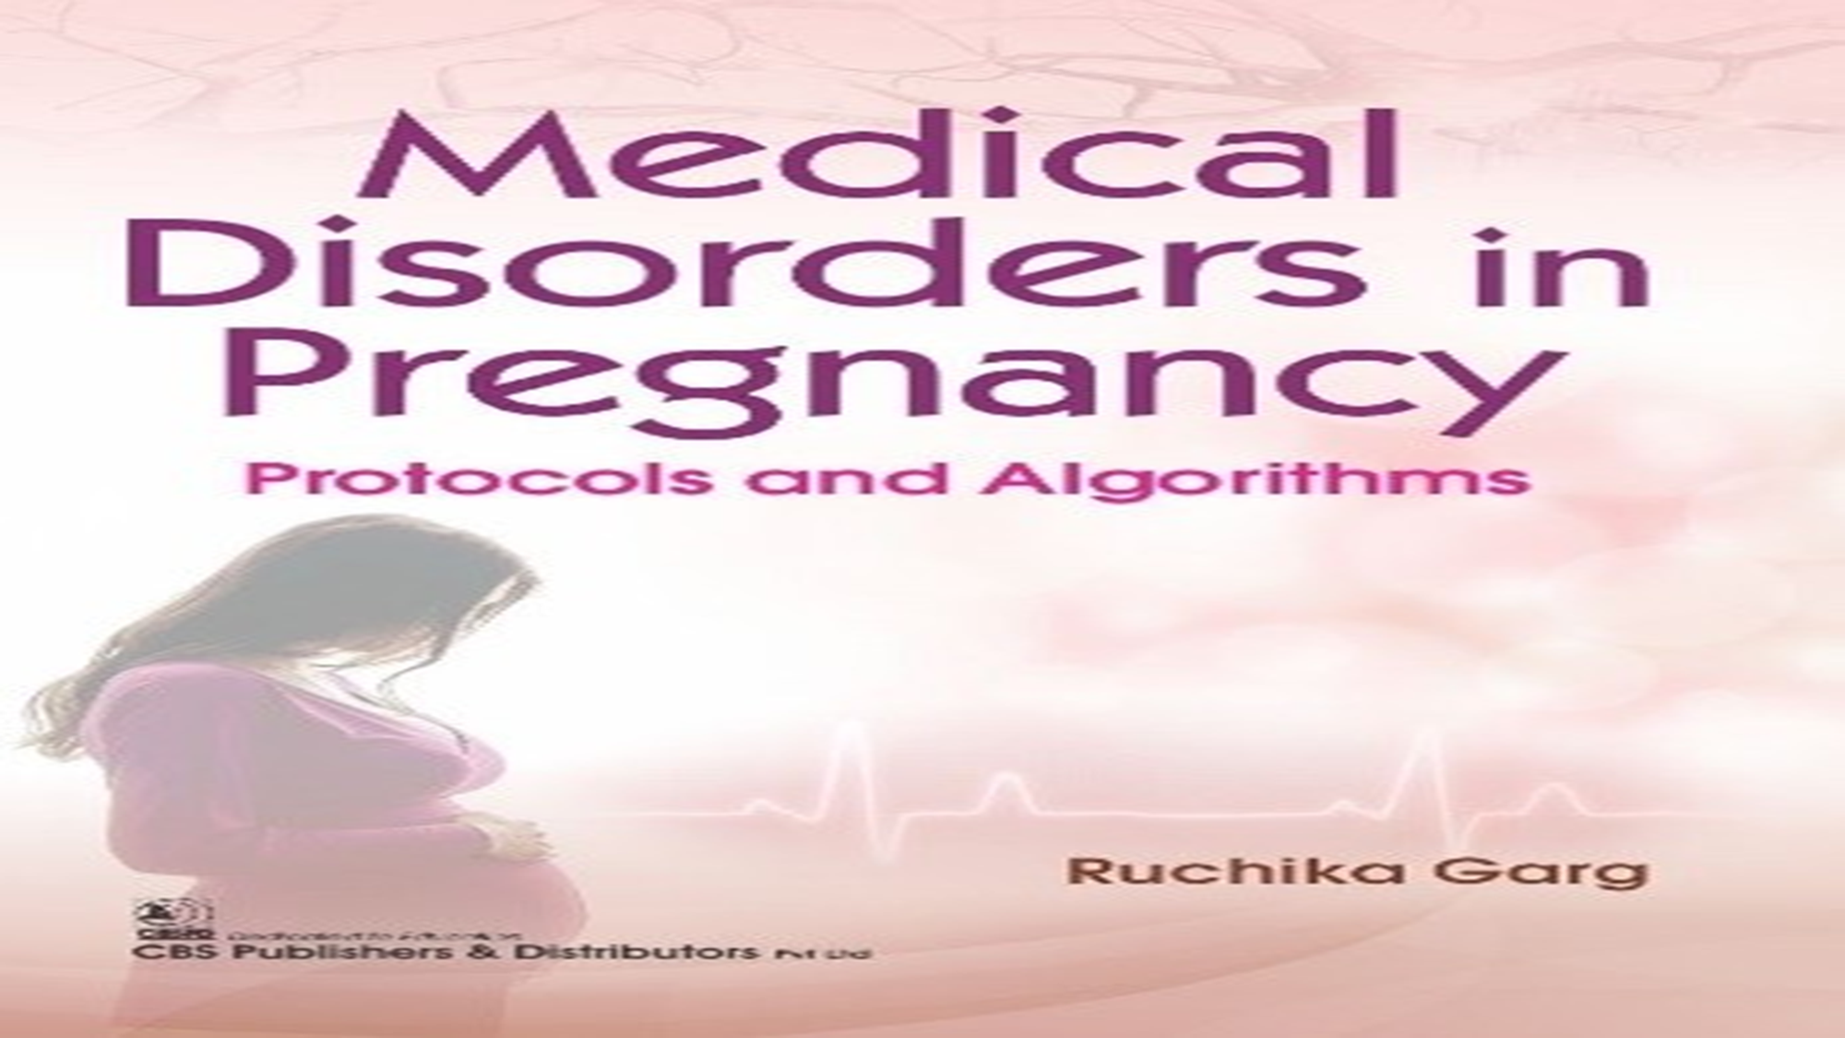

Mona
Ahmed
SMSB

Slide 2

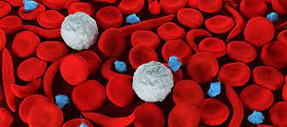

Slide 3
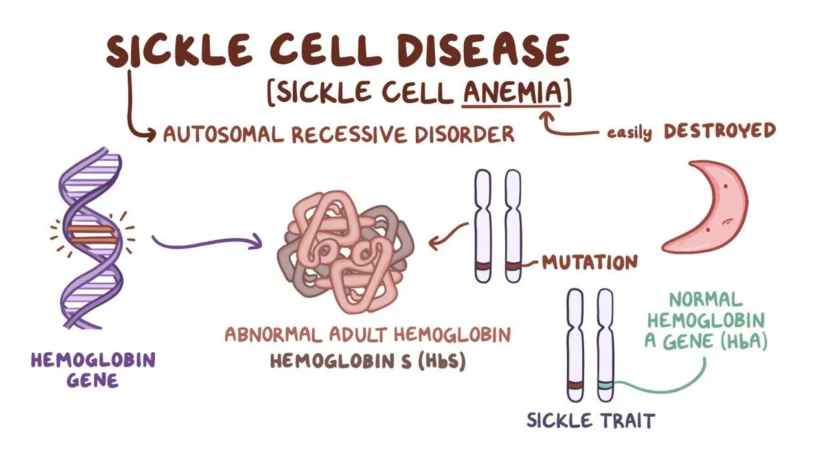

Slide 4


Prepregnancy counselling
Multidisciplinary team (obstetrician and haematologist).
screening of the partner (if the partner is a carrier, consider prenatal diagnosis).
Stop iron-chelating agents before pregnancy.
If there is a history of iron overload, arrange a maternal echo.
Give folic acid 5mg/day and penicillin prophylaxis for Hyposplenism.
Monitor Hb and HbS percentage and arrange transfusion if necessary (may have red cell antibodies from multiple transfusions).
Screen for urine infection .

Slide 5

Clinical features of sickle cell disease
Haemolytic anaemia.
Painful crises.
Hyposplenism (chronic damage to the spleen results in atrophy).
Increased risk of infection (UTI, pyelonephritis, pneumonia, puerperal sepsis).
Avascular necrosis of bone.
Increased risk of thromboembolic disease ( pulmonary embolism ( PE), stroke).
Acute chest syndrome (fever, chest pain, tachypnoea, increase ).
WCC, pulmonary infiltrates).
Iron overload: leads to cardiomyopathy.

Slide 6
ANC
Screen for urine infection each visit.
Treatment of a crisis (analgesia, oxygen, rehydration, and antibiotics if infection suspected).
Regular assessment of fetal growth (ultrasound, including Doppler).
Aim for vaginal delivery :
*adequate hydration *avoiding hypoxia. *continuous fetal monitoring .
Consider antenatal and postnatal thromboprophylaxis.
The use of prophylactic antibiotics .
Fetal risks in sickle cell disease
Miscarriage.
IUGR.
Prematurity.
Stillbirth.

Slide 7
Fetal complications
Miscarriage.
Congenital abnormalities.
neural tube defects :microcephaly .
cardiac abnormalities.
sacral agenesis .
renal abnormalities.
Preterm labour.
Polyhydramnios (25%).
Macrosomia (25–40%).
IUGR.
Unexplained IUD.

Slide 8


Slide 9
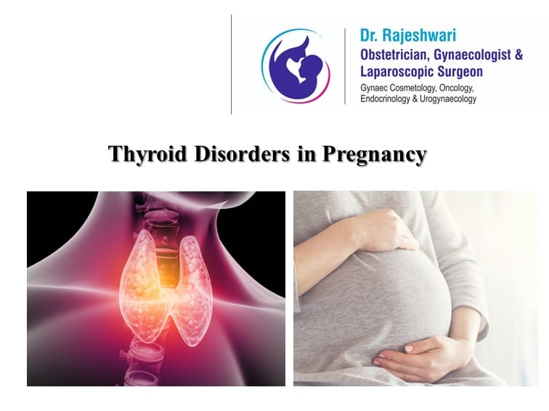
Thyroid diseases
Thyrotoxicosis:
95% of women have graves disease.
For first time in pregnancy occur in the late first or early second trimester.
Clinical features:
Palpitation.
Vomiting.
Goitre.
Palmer erythema.
Emotional liabilities.
Tremors.
Lid lag.
Lid retraction.
Diagnosis:
TFT

Slide 10

Complications
Maternal complications:
Maternal hypertension.
Preeclampsia
Heart failure.
Fetal risks:
Miscarriage.
IUGR.
Preterm birth.
Fetal hypothyroidism(drug induced).
Thyrotoxicosis(in autoimmune cases due to transplacental TSI)
IUFD.

Slide 11

Propylthiouracil is better than carbimazole (less teratogenisity).
Do serial US to monitor the baby.
Do TFT in each semester.
Close monitoring during labour”+ continuous CTG”.
Do cord blood sampling for TFT.
Delivery is by
VD unless CS is indicated

Slide 12
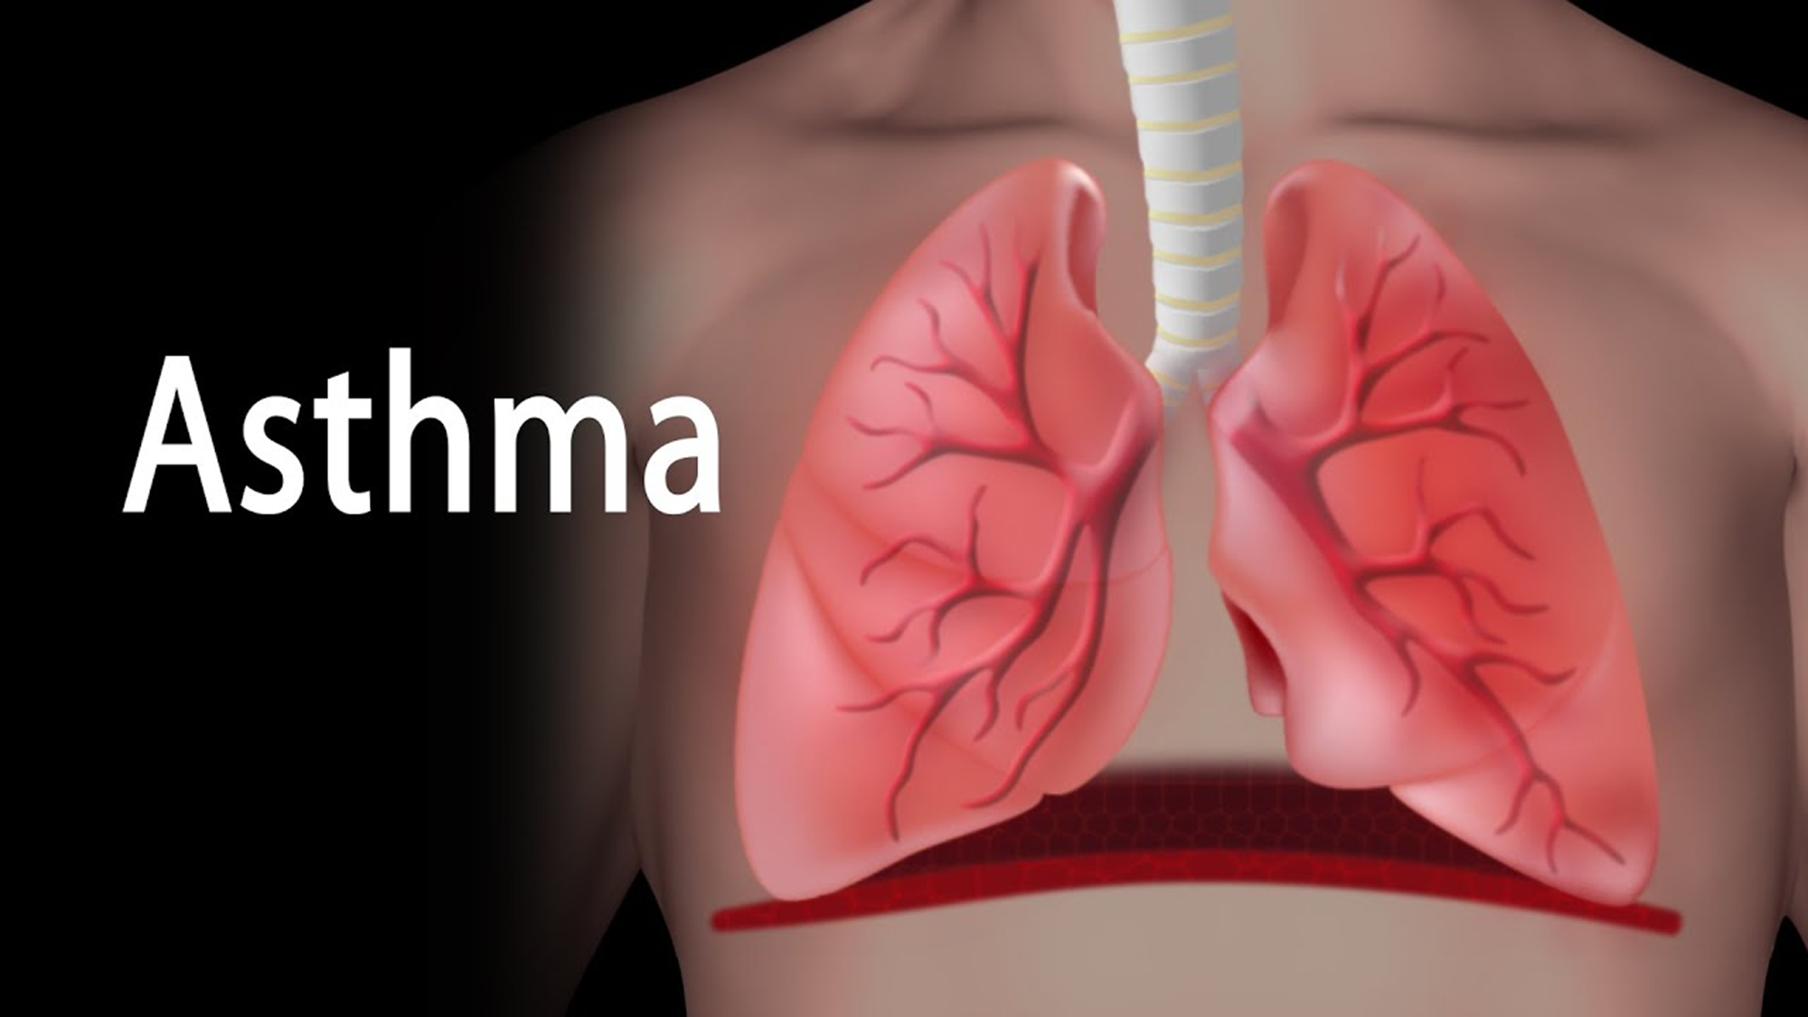
In Pregnancy

Slide 13


Slide 14

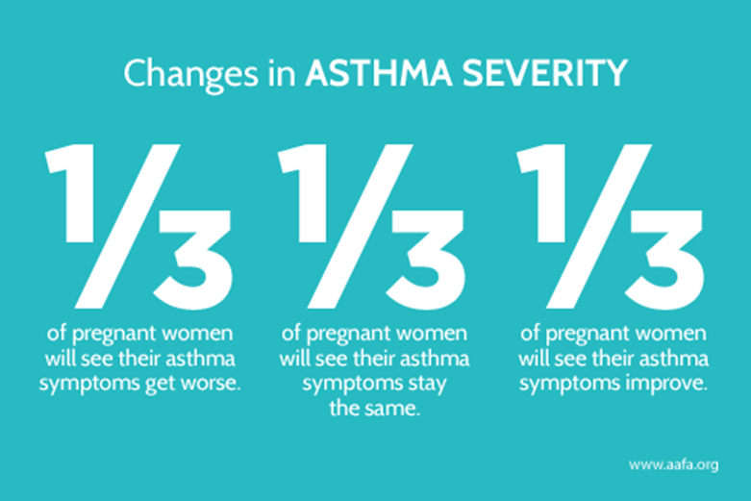
Asthma
Course of disease:
1/3 of pts become worse during pregnancy;
1/3 become better.
1/3 unchanged(pregnancy not affecting them).
Most exacerbations occur in the third trimester.
Most pregnancies pass uneventfully

Slide 15

Symptoms:
Cough.
Wheeze.
Dyspnoea.
Chest tightness.
Trigger factors should be avoided
What are the trigger factors?
Pollen.
Animal dander.
Dust .
Emotions.
Chest infection.
Cold weather.

Slide 16
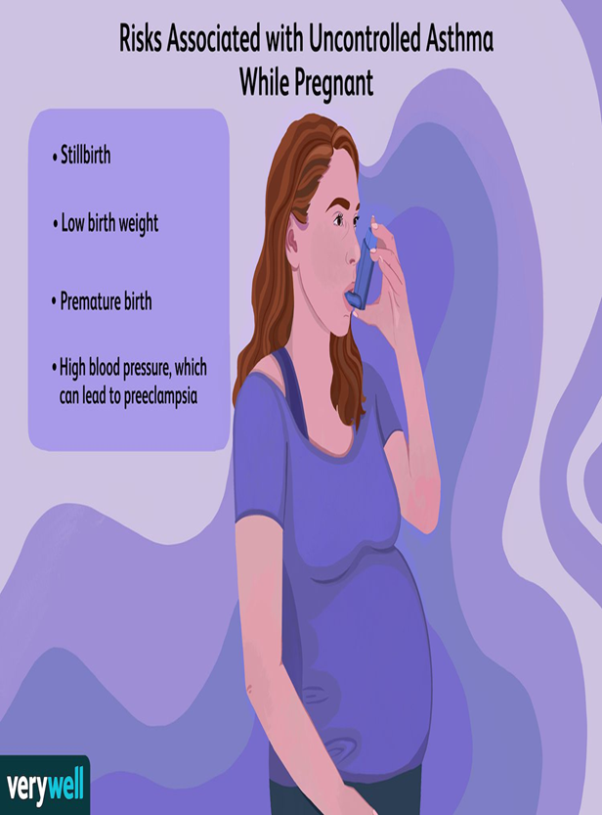
Signs:
tachycardia .
Increase respiratory rate.
Wheeze .
Use of accessory respiratory muscles.
Maternal risks:
Increase risk of preeclampsia.
Increase maternal mortality.
Increase need for hospitalization
Risks to baby:
Low birth weight.
Preterm baby.
Neonatal asphyxia

Slide 17
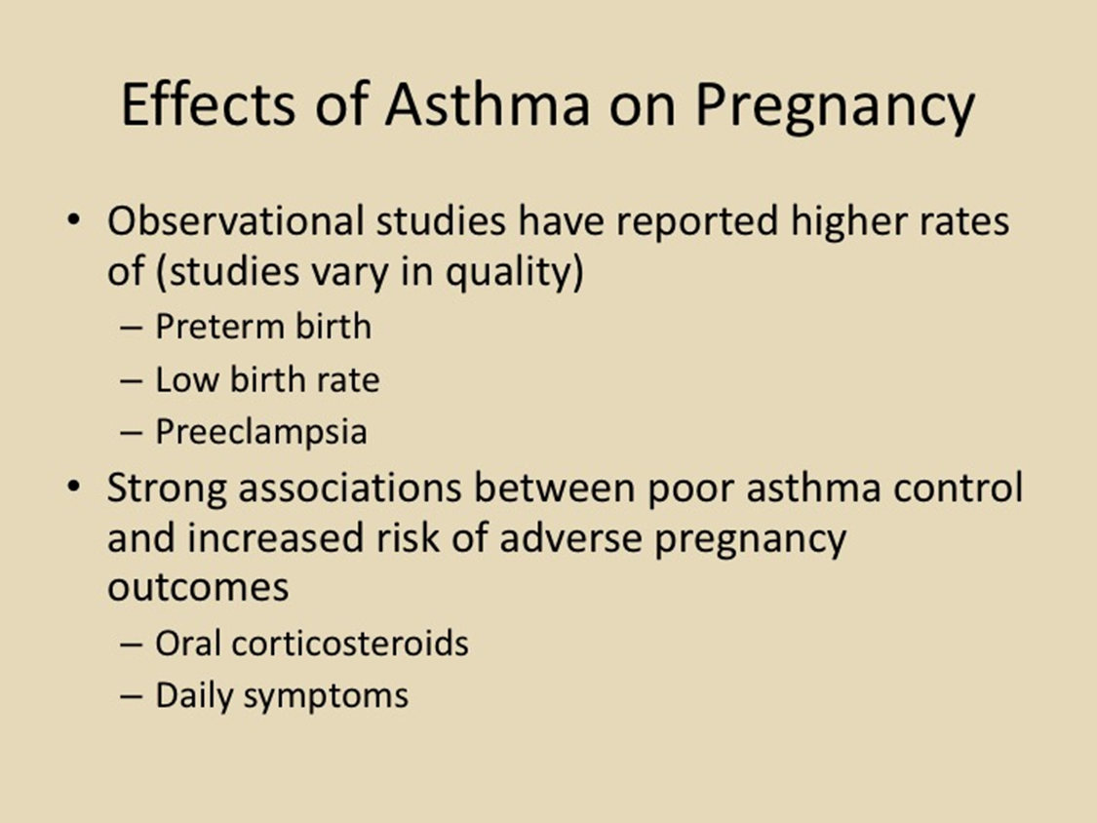


Slide 18

Management of asthmatic attack
O2.
Bronchodilator(Salbutamol).(inhaler or oral ).
Steroids.(oral , inhaler).
Antibiotics if there is infection.
Avoid PGs in induction(exacerbate asthma).
Delivery
VD Unless C/S is indicated.

Slide 19
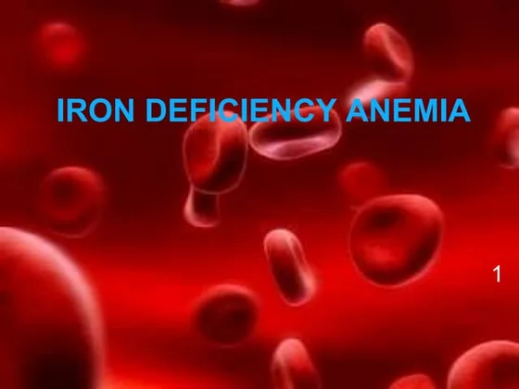

Slide 20

Anaemia in Pregnancy
1. Definition
Haemoglobin or haematocrit below trimester-specific cut-offs.
1st trimester: Hb < 11 g/dL, Hct < 33%
2nd trimester: Hb < 10.5 g/dL, Hct < 32%
3rd trimester: Hb < 11 g/dL, Hct < 33%
Classification By Size (MCV):Microcytic (<80 fL): Iron deficiency,
Thalassemia Normocytic (80–100 fL):
Anemia of chronic disease, hemorrhage
Macrocytic (>100 fL): Folate or Vitamin B12 deficiency
Anaemia in pregnancy
By Mechanism:↓ Production (iron, folate, B12 deficiency, marrow disease)↑ Destruction (hemolysis, sickle cell, thalassemia)Blood loss (acute or chronic)Anaemia in pregnancy

Slide 21
Risk Factors
Poor diet (low iron/protein/folate foods)
Short interpregnancy interval
Heavy menses / delivery blood loss
GI malabsorption / chronic illness
Teenage pregnancy
Multiparity
Diagnosis
CBC + indices (Hb, Hct, MCV)Ferritin (<30 µg/L confirms iron deficiency)
Peripheral smear
Hemoglobin electrophoresis if hemoglobinopathy suspected

Slide 22

Management
Lifestyle/Nutrition: Iron-rich foods: meat, leafy vegetables
Vitamin C ↑ absorption.
Avoid tea/coffee with meals
Pharmacological: Routine supplementation: 27 mg/day elemental iron in pregnancy
Treatment doses: Ferrous sulfate/fumarate/gluconateParenteral iron: If severe, intolerant, or poor response to oral
Transfusion: Only in severe cases (Hb < 6 g/dL with fetal compromise)
Elemental Iron Content per Tablet
Ferrous fumarate → ~106 mg elemental iron (per 325 mg tablet)Ferrous sate → ~65 mg elemental iron (per 325 mg tablet)Ferrous gluconate → ~34 mg elemental iron (per 300 mg tablet)
Clinical Consideration: Ferrous fumarate: Highest elemental iron → fewer tablets needed, but may cause more GI side effects (nausea, constipation).
Ferrous sulfate: Most widely used, affordable, and effective. Standard choice in pregnancy.
Ferrous gluconate: Lowest iron content per tablet → often better tolerated (less nausea, less constipation), but requires more tablets to achieve the same dose.

Slide 23
Ferrous sulfate is usually the first-line standard (effective + widely available).
If not tolerated → switch to ferrous gluconate (gentler, but more pills).
Ferrous fumarate can be used when higher doses are needed with fewer tablets, if tolerated.
Prevention
Universal low-dose iron supplementation from 1st trimester
Prenatal vitamins with folate
Early screening: CBC at booking & at 24–28 weeks

Slide 24
Maternal Complications of Anemia in Pregnancy
General effects of iron deficiency anaemia
Fatigue, weakness, poor work capacity
Anaemia in pregnancy
Increased risk of infections
Higher chance of requiring blood transfusion (especially in obstetric haemorrhage: atony, previa, abruption, etc.)
More severe Anemia (Hb <6 g/dL) → associated with:
Abnormal fetal oxygenation
Non-reassuring fetal heart patterns
Fetal cerebral vasodilatation
Fetal death
Hence, maternal transfusion may be required for fetal indications

Slide 25
Maternal Complications of Anemia in Pregnancy
Postpartum complications
Postpartum depression (linked with maternal iron deficiency anaemia)
Poor maternal-infant interaction, affecting infant development

Slide 26
UTI
Asymptomatic bacteriuria : 4-8 % and 40 % will develop symptomatic infection if untreated
Acute cystitis 1%
Acute pyelonephritis 1-2%
Risks factors :
more in women with DM.
Sickle cell trait and disease.
Immunosuppressed .
Urinary tract stones.
Polycystic kidney.
Renal congenital anomalies

Slide 27
Symptoms of pyelonephritis includes: nausea, vomiting , loin pain , fever
Symptoms of cystitis includes suprapubic pain and dysuria
Positive dipsticks should always be followed by MSU culture
All bacteriuria should be treated to prevent pyelonephritis and preterm labor with 3-7 days of broad spectrum antibiotic
Acute cystitis should be treated with 7 days antibiotic
Pyelonephritis is treated with 10-14 days of antibiotics

Slide 28


Causes of seizures in pregnancy
Epilepsy.
Eclampsia.
Encephalitis or meningitis.
Space-occupying lesions (e.g. tumour, tuberculoma).
Cerebral vascular accident.
Cerebral malaria or toxoplasmosis.
Thrombotic thrombocytopenic purpura.
Drug and alcohol withdrawal.
Toxic overdose.
Metabolic abnormalities (e.g. hypoglycaemia)

Slide 29
Most mothers have normal healthy babies.
Risk of congenital abnormalities is dependent
on the
Type.
Number.
Dose of AEDs.
Sodium Valproate should be avoided in pregnancy
Why?
duo possible adverse impact on the embryo &neonate.

Slide 30
1. Definition & Diagnosis
Definition: Epilepsy = recurrent unprovoked seizures, diagnosed by a neurologist
Types:
Tonic–clonic.
Absence.
Focal.
Pregnancy differential:
Eclampsia.
Metabolic causes.
Cardiac syncope.
psychogenic non-epileptic seizures
Epilepsy.

Slide 31
Pre-pregnancy Counselling
Folic acid: 5 mg/day before conception → ↓ risk of neural tube defectsgtg68_epilepsy.
AED choice: Use lowest effective dose; avoid valproate/polytherapy if possible.
Risks explained:
Congenital malformations, long-term neurodevelopmental effects (esp. with valproate).Seizure control: Women seizure-free ≥1 year have best prognosis.

Slide 32
Antenatal Management
Antenatal care: Joint obstetrics–neurology clinic recommendedgtg68_epilepsy.
Screening: Detailed anomaly scan at 18–20 weeks; serial growth scans if on AEDsgtg68_epilepsy.
AED monitoring: Routine serum levels not required (except lamotrigine in select cases).
Obstetric risks: ↑ miscarriage, hypertensive disorders, haemorrhage, preterm birthgtg68_epilepsy.Maternal monitoring: Look for depression, anxiety, cognitive effects.

Slide 33
Intrapartum Care
Seizure risk in labour: Low (1–2%).Continue AEDs (oral/parenteral if needed).
Seizure management: Benzodiazepines are first-line; avoid delays.
Analgesia: Epidural, Entonox, TENS safe. Avoid pethidine (epileptogenic).gtg68_epilepsy
Delivery: Epilepsy is not an indication for C-section unless poor seizure control.
Monitoring: Continuous fetal monitoring if seizures occur.

Slide 34
Postpartum Management
Seizure risk ↑ in first 3 days postpartum (stress, sleep deprivation, missed AEDs)gtg68_epilepsy.
AEDs: Review dose within 10 days (to avoid toxicity).
Breastfeeding: Encouraged — AED exposure via milk usually safe; lamotrigine & levetiracetam transfer more, but no adverse outcomes proven.
Safety advice:
Baby baths on floor, avoid bathing alone, seizure safety precautionsgtg68_epilepsy.
Postpartum depression: More common in WWE (29% vs 11%); screen allgtg68_epilepsy.

Slide 35
Contraception & Future Pregnancy
Safe options (enzyme-inducing AEDs): Copper IUD, LNG-IUS, Depo injectiongtg68_epilepsy.Enzyme-inducing AEDs reduce efficacy of pills, patches, rings, implants.
Lamotrigine + estrogen contraceptives → risk of increased seizures.
Emergency contraception: Copper IUD preferred.

Slide 36
Antenatal management
Manage pregnant women with significant heart disease in a joint obstetric/cardiac clinic.
Continuity of care makes the detection of subtle changes in maternal wellbeing more likely.
Routine physical examination should include:
pulse rate.
blood pressure.
jugular venous pressure.
heart sounds.
ankle and sacral oedema
and presence of basal crepitations.

Slide 37
Most women will remain well during the antenatal period.
Echocardiography is useful in assess function and valves,
and an echocardiogram at the booking visit and at around 28
weeks’ gestation is usual.
Any signs of deteriorating cardiac status should be carefully investigated and treated.
Anticoagulation is essential in patients with:
congenital heart disease with pulmonary hypertension (PH).
or artificial valve replacements.
and in those at risk of atrial fibrillation.
Low molecular-weight heparin is often used as an alternative to
warfarin, especially in the first and third trimester.

Slide 38
Management of labour and delivery
In most cases the aim of management is to await the onset of spontaneous labour.
Anaesthesia is often recommended to reduces the pain related stress.
Prophylactic antibiotics should be given to any woman with a structural
heart defect to reduce the risk of bacterial endocarditis.
VD is the mode of delivery unless C-section is indicated.
Caesarean delivery is associated with:
Risk of haemorrhage, thrombosis and infection, conditions that are likely to be much less
well tolerated in women with cardiac disease

Slide 39
the maternal condition is considered too unstable to tolerate the physiological
demands of labour.. Postpartum haemorrhage in
particular can lead to major cardiovascular instability. Ergometrine may be
associated with intense vasoconstriction, hypertension and heart failure, and
therefore active management of the third stage is usually with Syntocinon™
(synthetic oxytocin) alone. Syntocinon is a vasodilator and therefore should be
given slowly to patients with significant heart disease, with low-dose infusions
preferable. High-level maternal surveillance is required until the main
haemodynamic changes following delivery have passed

Slide 40
Prepregnancy counselling
Women with heart disease: will be aware of their condition prior pregnancy
They should be fully assessed by an obstetrician and cardiologist.
fetal risks carefully explained.
A plan to optimize medication & health state.
Issues in pre-pregnancy counselling of women with heart disease
Risk of maternal death.
Possible reduction of maternal life expectancy.
Effects of pregnancy on cardiac disease.
Mortality associated with high-risk conditions.
Risk of fetus developing congenital heart disease.
Risk of preterm labour and FGR.
Need for frequent hospital attendance and possible admission.
Intensive maternal and fetal monitoring during labour.
Other options – contraception, adoption, surrogacy.
Timing of pregnancy

Slide 41
Fetal risks of maternal cardiac disease
Recurrence (congenital heart disease).
Maternal cyanosis (fetal hypoxia).
Iatrogenic prematurity.
FGR.
Effects of maternal drugs (teratogenesis, growth restriction, fetal loss).

Slide 42
Risk factors for the development of heart failure in pregnancy
Respiratory or urinary infections.
Anaemia.
Obesity.
Corticosteroids.
Tocolytics.
Multiple gestation.
Hypertension.
Arrhythmias.
Pain-related stress.
Fluid overload

Slide 43
Management of labour in women with heart disease
Avoid induction of labour if possible.
Use prophylactic antibiotics.
Ensure fluid balance.
Avoid the supine position.
Discuss regional/epidural anaesthesia/analgesia with senior anaesthetist.
Keep the second stage short.
Use Syntocinon judiciously.

Slide 47




