Slide 1

By dr MONA AHMED Assisted PROFESSOR ELMAREFA UNIVERSITY SMSB

Slide 2
GTD
Gestational Trophoblastic Diseases
Proliferative disorder of trophoblastic cells
It could begnin premalignant malignant
Unique tumours that developed from abnormality at fertilization and entirely are Fetal in origin .
They consist of syncytotrophoplast and cytotrophoblast and express bHCG as tumour marker
They are highly sensitive to chemotherapy
More in Asian women and in those who are from far east

Slide 3
Classification of GTD(WHO)
Premalignant:
Partial hyditiform mole.
Complete hyditiform mole.
Malignant:
Invasive mole.
Choriocarcinoma.
Placenta site trophoblastic diseases.

Slide 4
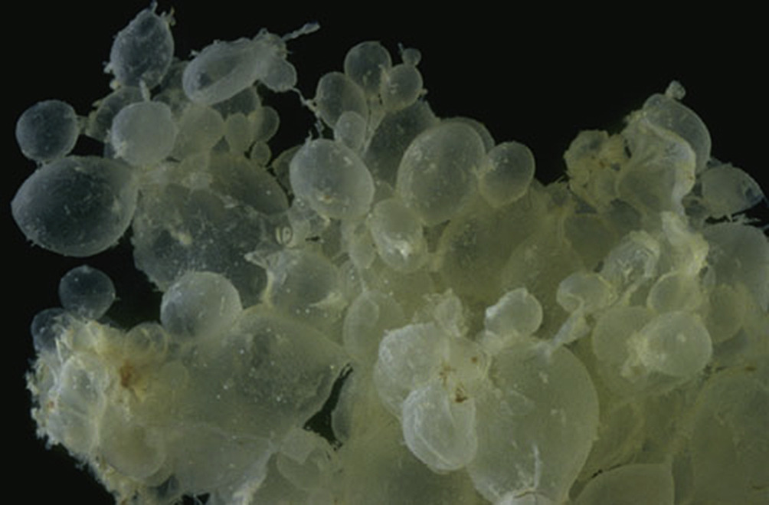
Molar pregnancy(hyditiform mole)
Definition
Hydatid means…. drop of water
mole…..spot
Abnormal form of pregnancy where
a non viable fertilized egg implants
in the uterus and convert pregnancy
process to pathological one

Slide 5
Risk factors
1.Erxreme of reproductive age
(20 folds<15 years and 10 folds>40 years).
2. Previous molar pregnancy.
3.Women of blood group A with partner.
with group O(increase 10 folds).
4.High parity.
5.Diet deficiency of protein or vit A deficiency.
6.Smoking.
7.Increase paternal age.

Slide 6
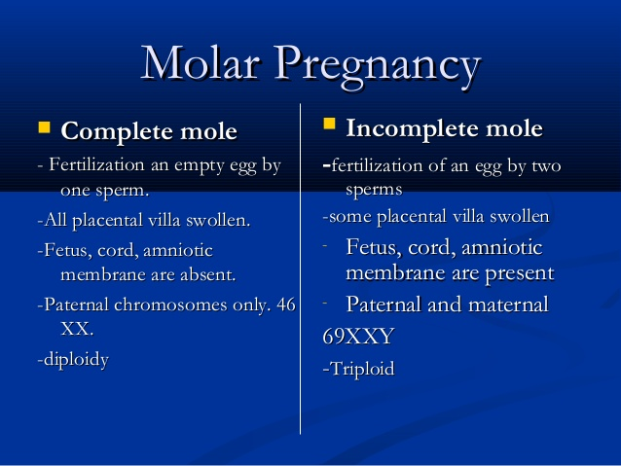

Slide 7
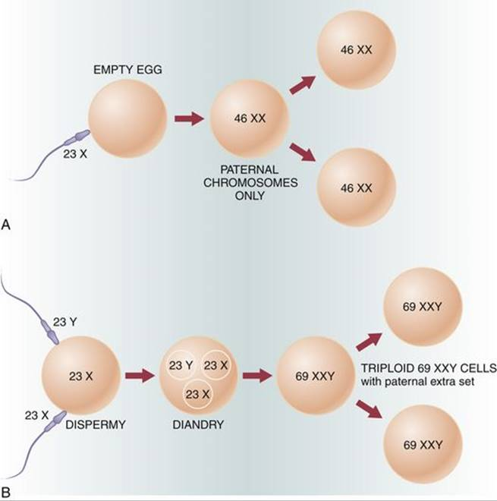

Slide 8


Slide 9
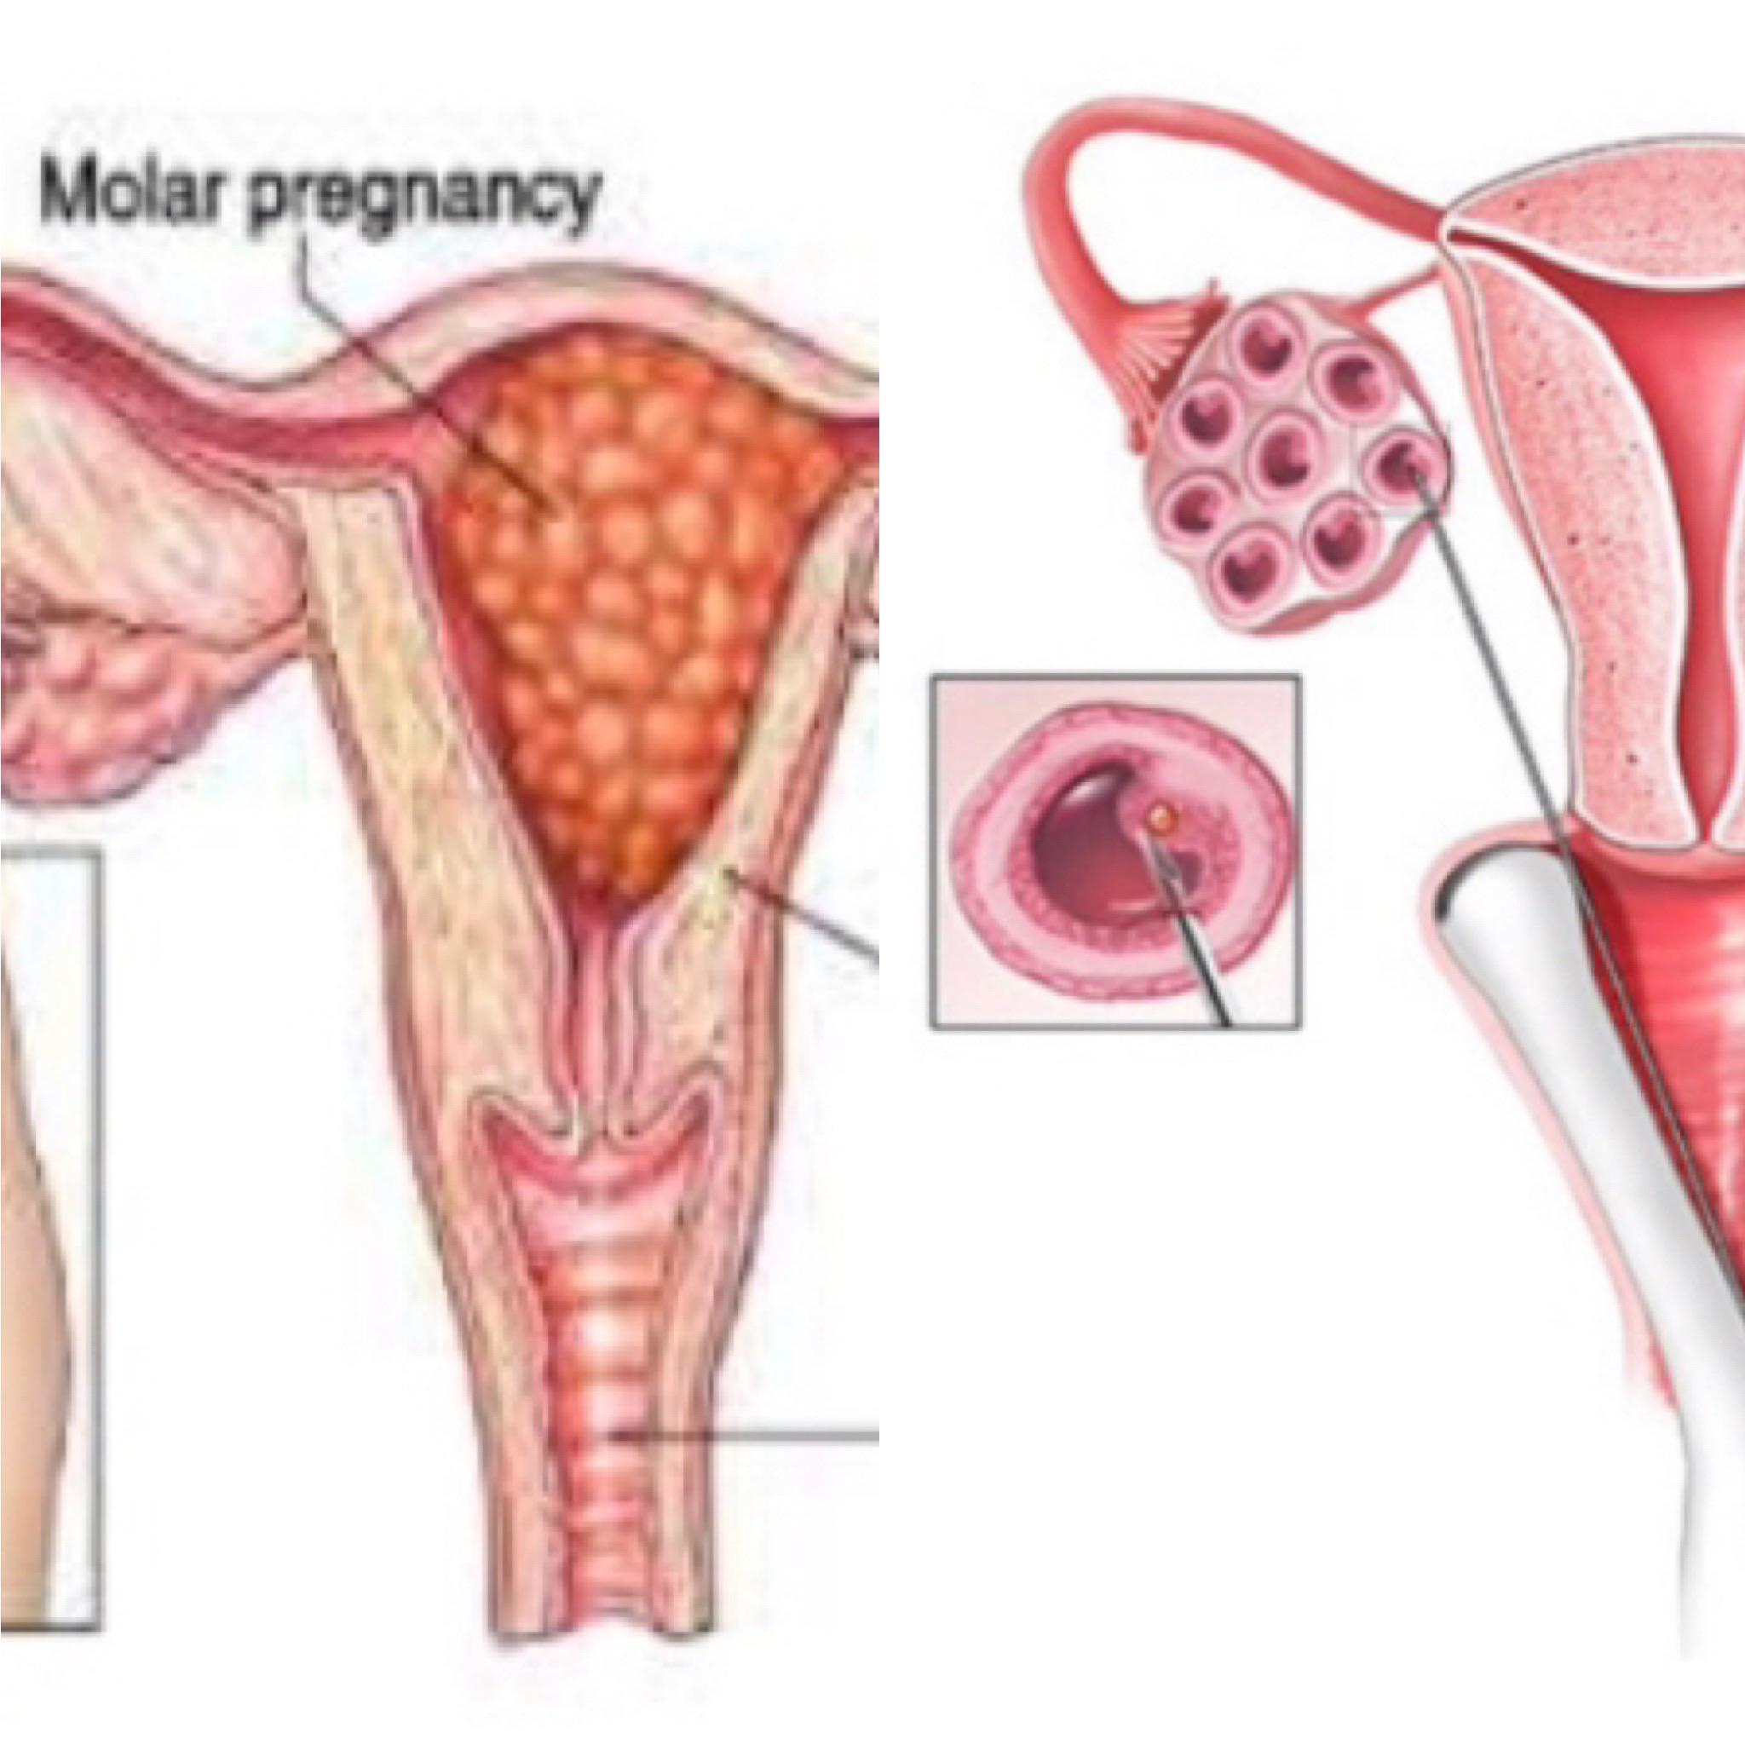
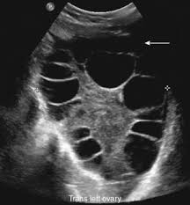
Symptoms and signs
amenorrhoea
Irregular vaginal bleeding
abdominal pain
Hyperemesis gravidarum.
breathlessness
Expulsion of grape like vesicles
Large for date uterus.
firm elastic uterus(doughy)
Lutein cyst
Features of hyperthyroidism
Early preeclampsia (1st trimester or early 2nd trimester).

Slide 10

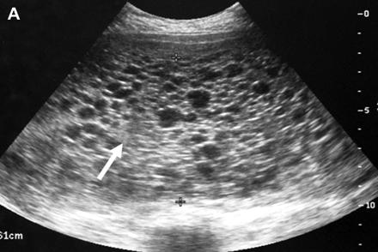
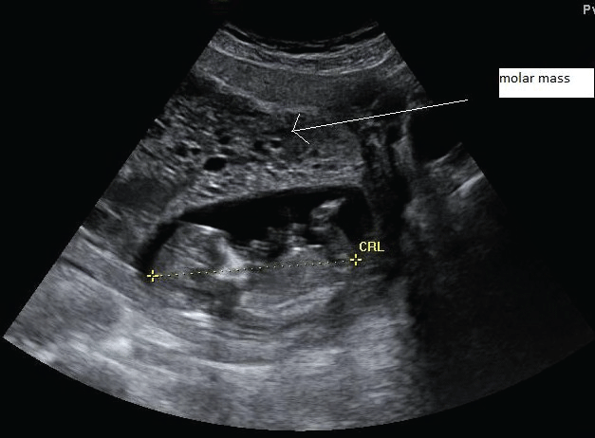
Investigations
1.US
Complete male
Hyper echoic multiple cysts filled the uterus.(snow storm appearance).
Partial mole
appear as missed miscarriage with cystic lesions in the placenta (some times)but definitive diagnosis when send POC to chromosomal analysis.

Slide 11
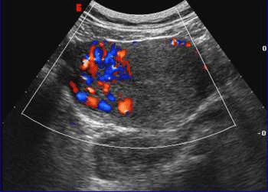
Choriocarcinoma
Enlarged uterus .
with highly vascular mass w’ invade the endometrium.
and some times with areas of necrosis & cystic lesions.

Slide 12

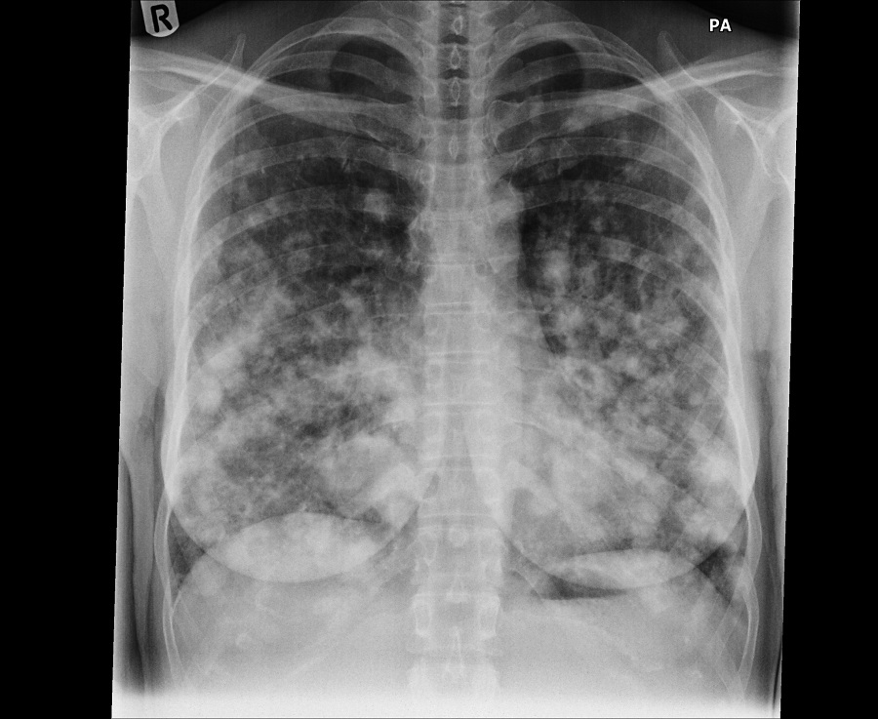
2. blood tests
Serum bHCG.
FBC.
RFT & electrolytes.
LFT.
TFT.
3.CXRAY .
4.Group & Saving.

Slide 13
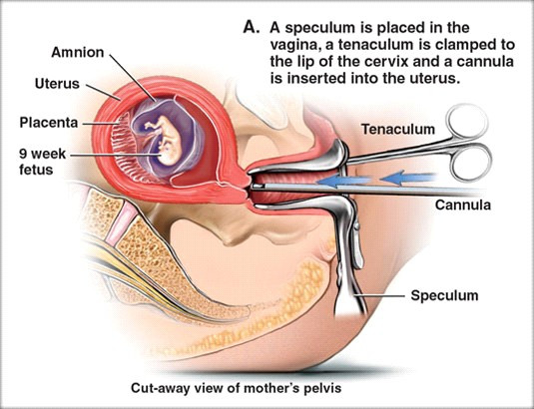

Management
Surgical evacuation
Suction evacuation by expertise hands
Do serial bHCG until it become –ve
Avoid pregnancy at least 6 months
After the last –ve bHCG.
Give her contraceptives avoid COCP
& IUCD.

Slide 14
Complications
Excessive intraoperative bleeding. Perforation or atony(possible hysterectomy).
Persistent trophoblastic disease.
Pulmonary oedema 2ry to heart failure due to :
preeclampsia .
Hyperthyroidism.
anaemia.
or excessive fluid overload.
Trophoblastic embolus *DIC *ARDS.

Slide 15


Follow up
Serial bHCG for at least 6 months after evacuation.
Pregnancy at least 6 months after last unpredictable b HCG.
Contraceptive avoid COCP.
After any pregnancy follow up with bHCG.

Slide 16



Slide 17


